Slide 1
PROJECT REPORT
Retail Transaction Data:
Exploratory Data Analysis
100,000 transactions • 18 variables • Data-driven business insights
PRESENTED BY
Farin Shaha
Nexthike IT Solution • Data Analytics Program

Slide 2
AGENDA
What we'll cover
01
Business Objective
05
Bivariate & Correlation
Why this analysis matters
Relationships between key variables
02
Dataset Overview
06
Outlier Detection
Scale, structure and quality
Data quality checks (IQR & Z-score)
03
Methodology
07
Revenue & Returns
Our analytical approach
Segment, category & logistics performance
04
Univariate Analysis
08
Business Recommendations
Customers, pricing & purchase behavior
Where to focus for growth
Nexthike IT Solution
02 / 16

Slide 3
OBJECTIVE
Why we ran this analysis
Retail businesses generate large volumes of transaction data every day, but raw data alone doesn't drive decisions. This project explores 100,000 retail transactions to uncover patterns in customer behavior, pricing, and returns — turning raw records into clear, actionable business insights.
Understand who the customers are and how they shop
Identify what drives final transaction value
Detect and explain unusual/outlier transactions
Uncover where returns and inefficiencies occur
Translate findings into growth recommendations
Nexthike IT Solution
03 / 16

Slide 4
DATASET
A large, clean transactional dataset
100,000
18
0
DATA QUALITY
100% complete — every one of the 18 columns has 100,000 non-null entries. No imputation or null-handling required before analysis.
Order dates span 2023–2025.
Transaction records
Variables tracked
Missing values
Column groups
Customer:
customer_id, age, gender, city, state, segment
Order:
order_id, order_date, payment_method
Product:
category, subcategory, price, quantity, discount
Fulfillment:
final_price, shipping_type, delivery_days, return_status
Nexthike IT Solution
04 / 16

Slide 5
APPROACH
Our analytical methodology
1
2
3
4
5
Univariate
Bivariate
Correlation
Outlier Detection
Multivariate
Distribution of each variable
Relationships between pairs
Strength of numeric relationships
IQR & Z-score screening
Combined segment patterns
Tools used: Python • Pandas • NumPy • Seaborn / Matplotlib • SciPy (statistical testing)
Nexthike IT Solution
05 / 16

Slide 6
UNIVARIATE
Who are the customers?
AGE RANGE
18 – 65 years
Uniformly distributed — no single age group dominates (skewness ≈ 0)
CUSTOMER SEGMENTS
New • Premium • Regular
Fairly evenly represented across the customer base
Insight:
The customer base is broad and balanced — near 50/50 by gender, evenly spread across ages, and not concentrated in any single segment. This gives a level playing field for testing targeted campaigns.
Nexthike IT Solution
06 / 16

Slide 7
UNIVARIATE
Pricing & purchase behavior
MEAN vs MEDIAN
₹64,166 vs ₹49,752
Mean pulled higher by a smaller number of high-value orders
SKEWNESS
+0.93 (right-skewed)
Most orders are lower value, with a long tail of high-value transactions
PRICE & QUANTITY
Uniform spread
product_price (₹500–60k) and quantity (1–4 units) both spread evenly — no bias toward budget or bulk buying
Nexthike IT Solution
07 / 16

Slide 8
DATA QUALITY
Outlier detection (IQR & Z-score)
Variable
IQR Outliers
Z-score Outliers
Status
product_price
0
0
Clean
quantity
0
0
Clean
delivery_days
0
0
Clean
final_price
1,335
503
Flagged
Key finding:
final_price is the only variable with meaningful outliers (~1.3% of transactions by IQR). These align with the right-skew seen earlier and represent a genuine population of high-value orders — not data-entry errors — so they were retained rather than removed.
Nexthike IT Solution
08 / 16

Slide 9
BIVARIATE
What drives the final price?
STRONG DRIVERS
Product Price (0.73)
Quantity (0.58)
Together these explain most of the variation in final_price
WEAK / NO EFFECT
Discount % (-0.14), Age (0.00), Delivery Days (0.00)
Discounting only mildly lowers final price and does not meaningfully lift order value — age and delivery time play no real role
Nexthike IT Solution
09 / 16

Slide 10
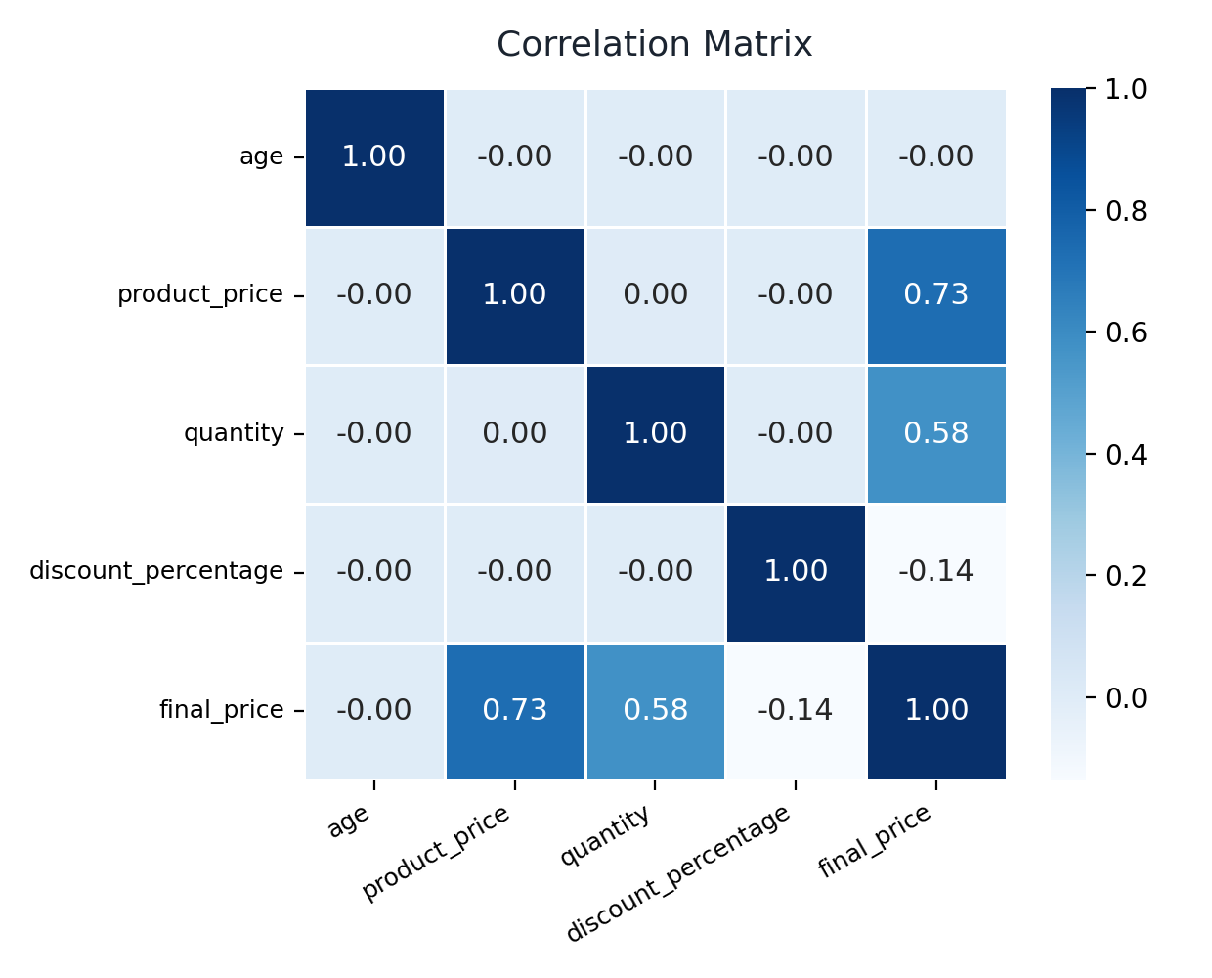
CORRELATION
Full correlation matrix
0.73
product_price ↔ final_price — strongest relationship in the dataset
0.58
quantity ↔ final_price — more units reliably means higher spend
-0.14
discount % ↔ final_price — weak, as expected
≈0.00
age & delivery_days — essentially unrelated to spend
Nexthike IT Solution
10 / 16

Slide 11
MULTIVARIATE
Customer segment spending
OPPORTUNITY
Loyalty isn't paying off yet
Premium customers spend only ₹663 more on average than New customers — less than 1% difference. The segment tiers currently show almost no differentiation in spending behavior.
This suggests the Premium tier's perks aren't currently incentivizing higher spend — a clear lever for improvement (see recommendations).
Nexthike IT Solution
11 / 16

Slide 12
MULTIVARIATE
Product category performance
Revenue is evenly diversified across categories, but Fashion combines average revenue with the highest return rate — a likely sizing/fit issue worth investigating.
Nexthike IT Solution
12 / 16

Slide 13
RETURNS
Returns are consistent, not logistics-driven
14.8%
0.144–0.153
p = 0.82
Overall return rate
Range across shipping type & delivery time
Chi-square test: not statistically significant
Finding:
Return rate stays within a tight 14.4%–15.3% band across every shipping type and delivery-day bucket, and a Chi-square test of independence confirms this: with a p-value of 0.82 (well above 0.05), there is no statistically significant relationship between shipping type, delivery speed, and returns.
This is good operational news — logistics is not the cause of returns. It also means fixing delivery speed alone will not reduce the return rate; the root cause more likely lies in product fit, quality, or expectation-setting (as suggested by Fashion's elevated rate on the previous slide).
Nexthike IT Solution
13 / 16

Slide 14
INSIGHT
What's working well
✓
Clean, reliable data
✓
Diversified revenue
100% complete records across all 18 columns — analysis and future reporting can be trusted without heavy cleanup.
No single category or city contributes more than ~1% above the average — the business isn't overexposed to any one segment.
✓
Predictable pricing logic
✓
Stable operations
final_price is strongly explained by product_price and quantity (r = 0.73 and 0.58) — pricing behaves rationally and predictably.
Return rates are consistent across shipping types and delivery windows — logistics execution is not creating quality problems.
Nexthike IT Solution
14 / 16

Slide 15
RECOMMENDATIONS
Where to focus for growth
1
Investigate the ~15% return rate
2
Strengthen the Premium tier
Since logistics isn't the cause, run root-cause analysis on product fit/quality — starting with Fashion, which has the highest return rate.
Premium customers spend almost the same as New customers. Redesign loyalty perks (early access, bundles, free shipping) to justify and grow the tier.
3
Rethink blanket discounting
4
Expand data collection
Discount % barely affects final price (r = -0.14) and doesn't lift quantity. Shift broad discounts toward targeted clearance or bundle offers instead.
Add product reviews, size/fit feedback and satisfaction scores — current fields explain returns poorly, so richer data is needed for deeper root-cause work.
Nexthike IT Solution
15 / 16

Slide 16
THANK YOU
Retail Transaction Data — Exploratory Data Analysis
1
2
3
4
Explore
Analyze
Correlate
Recommend
Presented by • Farin Shaha
Nexthike IT Solution
Python • Pandas • Seaborn • SciPy • Data Analytics

