Slide 1


GROUP 4
Manufacturing Production & Rejection Analysis
Group members :
Sonal ,Hemateja ,Faris ,Siddesh ,Vinayak ,Swapnil ,
Saikrishna
Tools used :
excel ,powerbi ,sql ,tableau

Slide 2
Introduction
Domain: Manufacturing
Business Problem: Employees and Machines have a lot of rejected quantities
Gold: improved quality control, reduced rejection rates, and enhanced production efficiency

Slide 3
Data overview
File: PROD DATA. TXT
Size: 10335 Rows and 68 Columns
Key Columns: Emp Name, Machine Name, Department Name, Manufactured Qty and Rejected Qty
Aggregation: Manufactured Qty 83.71 M, Rejected Qty 523.71K and Process Qty 83.19M

Slide 4
Objective
Employee Wise Rejected Qty
Machine Wise Rejected Qty
Production Comparison trend
Manufacture Vs Rejected
Department Wise Manufacture Vs Rejected

Slide 5

Process
Data Collection :
Gathered raw manufacturing data from production logs, employee sheets, and machine reports.
Data Cleaning
Removed duplicates, fixed inconsistent entries, handled missing values, standardized formatting.
Data Transformation
Added calculated fields (Rejection %, Monthly Summary).
Combined related tables using IDs.
. Exploratory Data Analysis (EDA)
Identified trends, outliers, top contributing factors.
Summarized data using pivot tables and descriptive statistics.
Data Visualization
Built dashboards in Excel, Tableau, and Power BI to represent trends, comparisons, and KPIs.
Insights & Reporting
Extracted actionable insights and prepared final visual summaries and SQL outputs

Slide 6
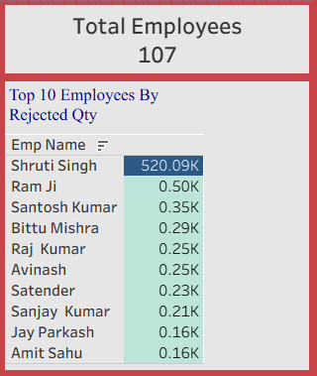
Employee Wise Rejected Qty
The Top 10 Employees by Rejected Quantity out of 107 employees.
One employee has a very high rejected quantity compared to others.
This needs investigation because the number is extremely high and not in line with other employees.
This value is over 1,000× higher than everyone else in the Top 10.

Slide 7
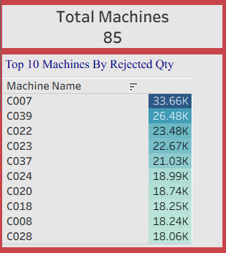
Machine-Wise Rejected Qty
The Top 10 Machines by Rejected Quantity out of 85 Machines.
A few machines—especially Machine C007—have very high rejection values.
This shows it needs maintenance, calibration, or operator support for these machines

Slide 8
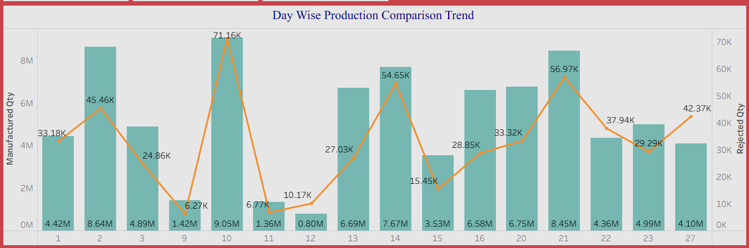
Production Comparison Trend
Shows daily production patterns vs rejection.
some days show sudden jumps in rejection even when production was steady.
These spikes help us identify days where machines or processes may have faced issues

Slide 9
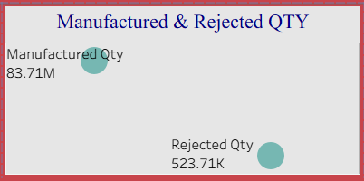
Manufacture vs Rejected
Direct comparison between production volume and rejection.
Highlights imbalance or inefficiencies in production.
Supports monitoring of wastage control efforts

Slide 10
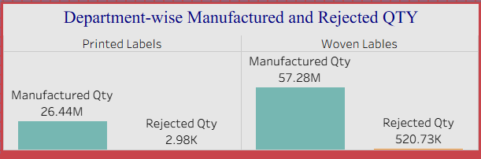
Department-wise Manufacture vs Rejected
Printed Labels manufactured around 26.44M units, with very low rejection.
Woven Labels manufactured about 57.28M units, but the rejection is extremely high—over 520K units.
This shows that most quality issues come from the Woven Labels department

Slide 11
Recommendations & Insights
Insights
Certain machines and employees had consistently higher rejection rates.
A few departments showed poor rejection-to-production ratios.
Monthly trends revealed spikes in rejection during specific periods.
Reducing high-rejection zones can improve total output efficiency.
Processed Qty vs Wastage Qty showed waste patterns across shifts.
Recommendations
Process improvements in the Woven department.
Investigate why that one employee has an extremely high rejected quantity.

Slide 12

Conclusion
The project successfully analyzed multiple aspects of manufacturing operational data.
Clear patterns were identified in rejection, wastage, and production quantities.
Dashboards enabled quick insight into employee performance, machine efficiency, and department trends.
The multi-tool approach helped create reliable and validated results.

Slide 13
Key Learnings
Importance of data cleaning before analysis
Usefulness of multiple visualisation tools
Power of SQL for structured data processing
Understanding manufacturing KPIs deeply improves decision-making
Dashboards help transform raw data into actionable insights

Slide 14
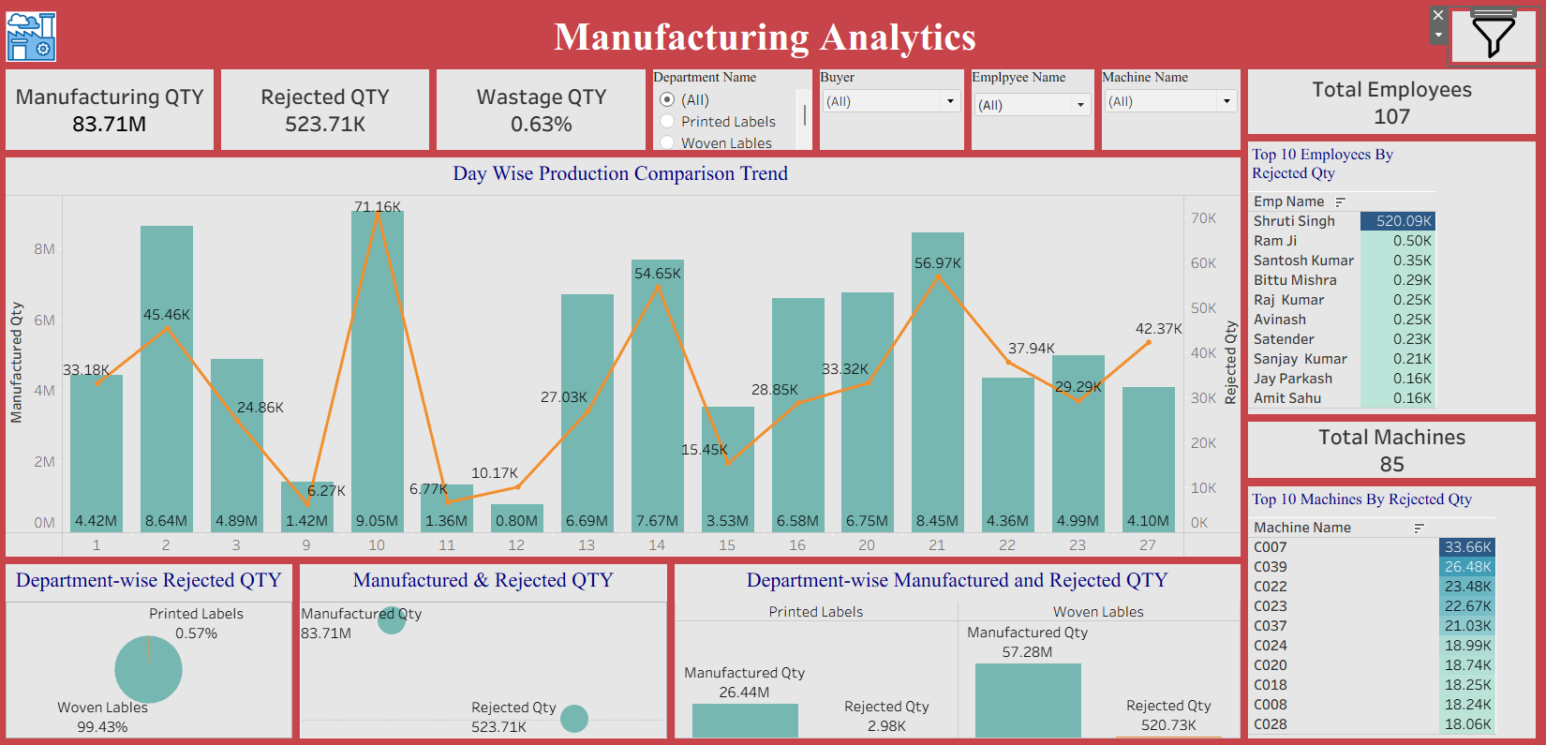
Dashboard

Slide 15
Thank you very much!

