Slide 1
Language Models & Their Applications
By: Faris Abdullah Alasmary

Slide 2
What is Language Modeling?
Language modeling (LM) is the use of various statistical and probabilistic techniques to determine the probability of a given sequence of words occurring in a sentence.
Source: https://www.techtarget.com/searchenterpriseai/definition/language-modeling

Slide 3
Motivation
We want to give a high probability score for sensible sentences and a low probability to sentences that are not reasonable.
P(“بسم الله الرحمن الرحيم”) >> P(“الرحيم بسم الرحمن الله”)

Slide 4
Motivation
The probability of a sentence is the joint probability of its words, i.e., P(w₁, w₂, w₃,…,w_{n})
P(“بسم الله الرحمن الرحيم”)
= P(“بسم”, “االله”, “الرحمن”, “الرحيم”)

Slide 5
Example #1
P(“بسم الله الرحمن الرحيم”) = 5.11e-05
P(“الرحيم بسم الرحمن الله”) = 2.01e-18
P(“بسم الله الرحمن الرحيم”) = 0.0000511
P(“الرحيم بسم الرحمن الله”) = 0.00000000000000000201

Slide 6
Example #2
P(“السلام عليكم ورحمة الله وبركاته”) = 6.33e-05
P(“السلام ورحمة عليكم وبركاته الله”) = 5.79e-25
P(“السلام عليكم ورحمة الله وبركاته”) = 0.0000633
P(“السلام ورحمة عليكم وبركاته الله”) = 0.000000000000000000000000579

Slide 7

BUT, how to Calculate the Joint Probability?

Slide 8
Probability Chain Rule
The probability of a sentence is the joint probability of its words, i.e., P(w₁, w₂, w₃,…,w_{n})
P(w₁, w₂, w₃,…,w_{n})
= P(w_{n}|w₁, w₂,…,w_{n-1}) x P(w_{n-1}|w₁, w₂,…,w_{n-2}) x … x P(w₁)

Slide 9
Example
P(“بسم”, “االله”, “الرحمن”, “الرحيم”)
= P(“الرحيم” | “بسم”, “االله”, “الرحمن”) x P(“الرحمن” | “بسم”, “االله”) x P(“االله” | “بسم”) x P( “بسم”)

Slide 10
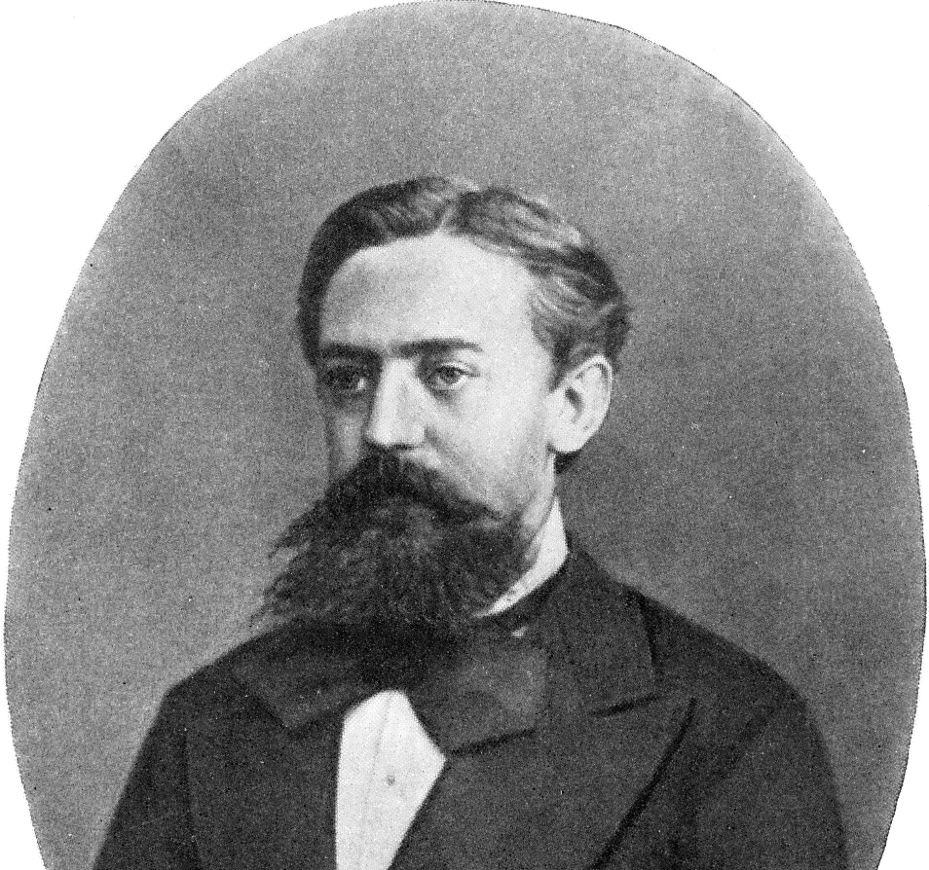
Markov Assumption
Unigram (1-gram): P( “بسم”)
Bigram (2-gram): P(“االله” | “بسم”)
Trigram (3-gram): P(“الرحمن” | “بسم”, “االله”)
Quadgram (4-gram): P(“الرحيم” | “بسم”, “االله”, “الرحمن”)
Andrey Andreyevich Markov (14 June 1856 – 20 July 1922)

Slide 11
N-gram language model
One way to estimate this probability is from relative frequency counts: take a very large corpus, count the number of times we see “بسم الله الرحمن”, and count the number of times this is followed by “الرحيم”.
Source: https://web.stanford.edu/~jurafsky/slp3/3.pdf

Slide 12
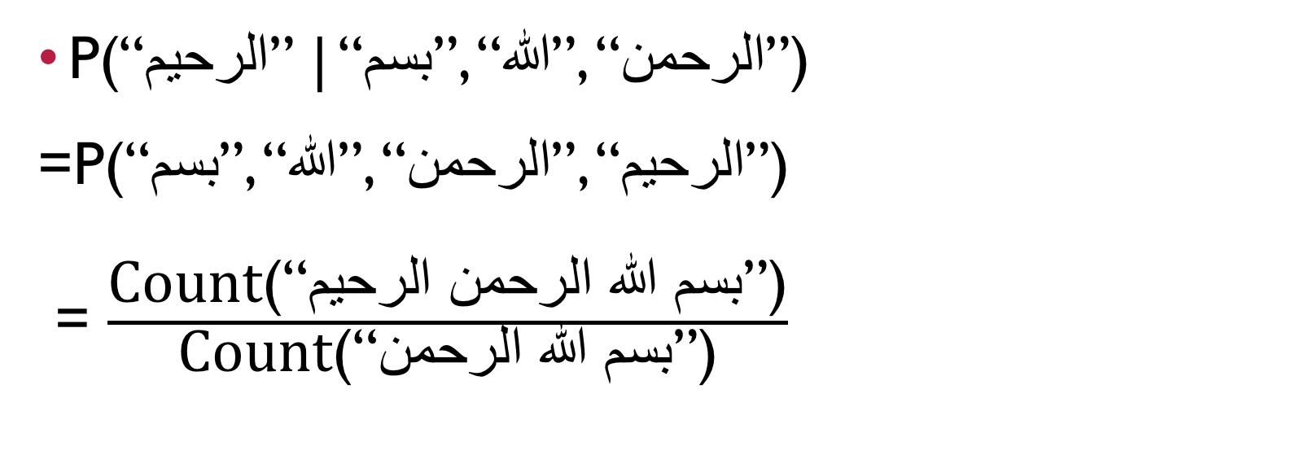
Estimating the Probability of a 4-gram
P(“الرحيم” | “بسم”, “االله”, “الرحمن”)
=P(“بسم”, “االله”, “الرحمن”, “الرحيم”)
= $\frac{\text{Count}\text{(“}\text{بسم الله الرحمن الرحيم}\text{”)}}{\text{Count}\text{(“}\text{بسم الله الرحمن}\text{”)}}$
Source: https://web.stanford.edu/~jurafsky/slp3/3.pdf

Slide 13
Special Symbols
Symbol: <S> OR <BOS>
Symbol: </S> OR <EOS>
Symbol: <UNK>

Slide 14
Enough of the Theory Part! Let’s Jump!!!

