Slide 1


Social Buzz Analysis:
Insights into Content Performance and User Activity

Slide 2


Today's agenda
Project recap
Problem
The Analytics team
Process
Insights
Summary

Slide 3

Objective : Analyze Top popularity content categories, user engagement, sentiment distributions, and active user trends on Social Buzz.
Project Recap
Findings :
Identified top-performing content categories
Content Strategy Optimization through Sentiment Analysis
Uncovered users activity patterns throughout the observations period
Achievements :
Established a baseline for high-engagement content strategies.
Tracked and visualized significant trends in user activity.

Slide 4

Problem
Identifying 5 most popular content categories by aggregating their reaction scores
Identifying Sentiment Trends and User Activity Patterns During the Observation Period

Slide 5



Andrew Fleming
Chief Technical Architect
The Analytics team
Marcus Rompton
Senior Principle
Faris Arief M.
Data Analyst

Slide 6
Process
1
Data Collection and Preparations
2
Data Cleaning
Top 5 categories identifications and analysis
3
Sentiment Distribution Analysis of Contents in Social Buzz
Exploratory Data Analysis
Active Users Analysis
4
Conclusions and Recommendations

Slide 7

Insights

Slide 8
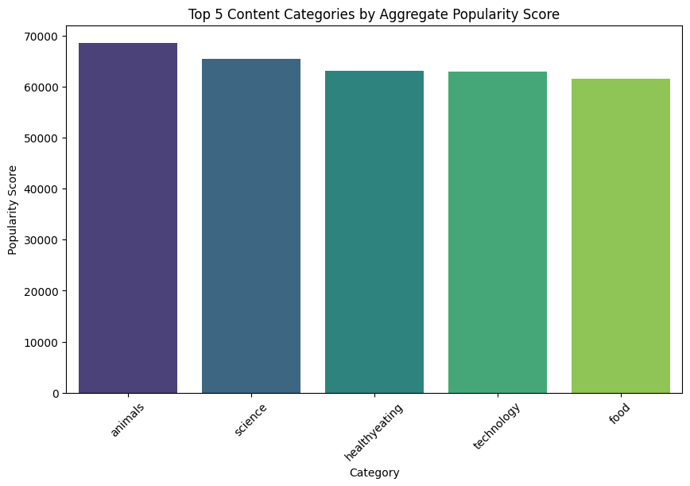
Top 5 Content Categories
Animals, Science, Healthy Eating, Tech, and Foods lead in popularity score.
Scores reflect popularity score based on users interactions and reactions across various content categories during observation period.
Specific Trends :
Dominance of "Animals" Category
Strong Interests in educational and health-related contents
Technology's Prominence Reflects Modern Trends
Good strength of universal appeal of foods-related contents.

Slide 9
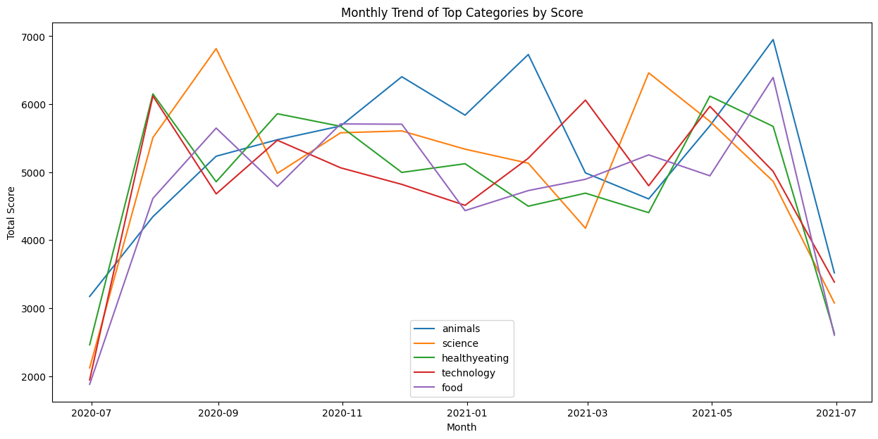
Monthly Trend of Top 5 Categories
1. Fluctuating Popularity: Fluctuations in popularity over time -> could be influenced by various factors such as seasonal interests, events, or changes in user demographics.
2. Initial Growth: Initial increase in scores for all categories found in period of July to August 2020, which suggests growing engagement
3. Mid-Term Declines and Peaks: There are declines and peaks -> Possible cyclic trends or responses to specific events or campaigns. For example, the 'science' category shows a significant peak around September 2020, which could be associated with a specific event or content release that garnered a lot of user interaction.
4. Convergence and Divergence: The categories tend to converge around certain points (e.g., October 2020 and May 2021), suggesting a relatively similar levels of engagement across different types of content. Conversely, there are periods where the categories diverge significantly, indicating varying levels of user engagement.
5. Downward Trend Towards the End: There is a noticeable downward trend in total scores for all categories towards the end of the timeframe (around July 2021). This could be due to a seasonal dip, a change in platform dynamics, or external factors affecting user interaction.

Slide 10
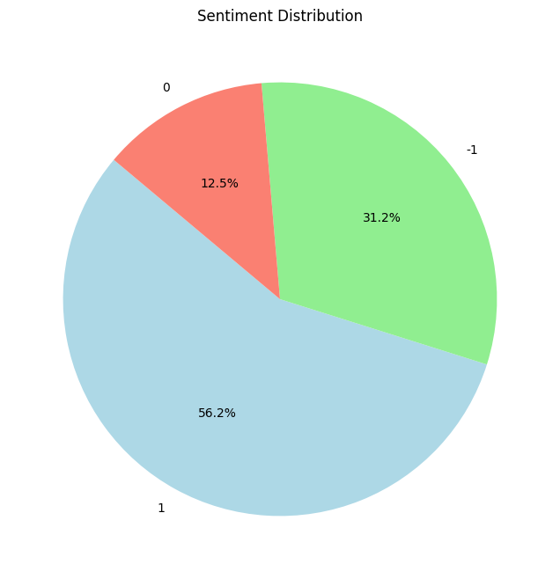
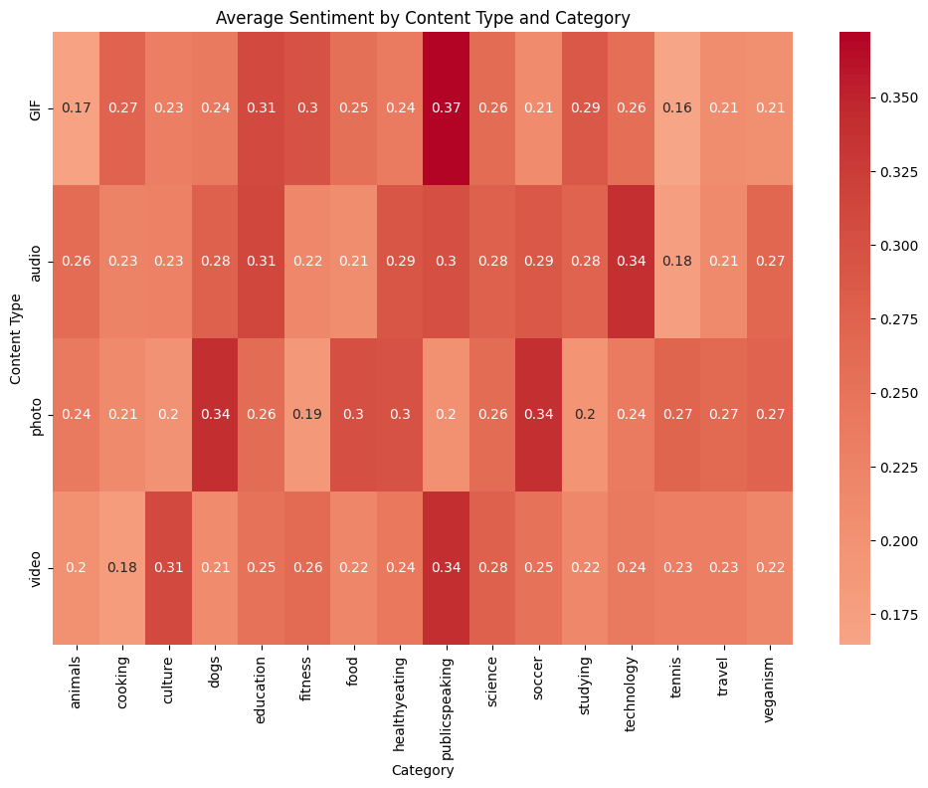
Sentiment Distribution Analysis
-1 = Negative Sentiments ;
0 = Neutral Sentiments ;
1 = Positive Sentiments
Predominance of Positive Sentiment : The majority of users reactions towards various content types and categories are positive (56.2%)
The sentiment is generally positive across most categories and content types, with no categories having an average sentiment value below 0.15.
High Performing Categories : education, healthy eating, science, and technology perform well across multiple content types, suggesting these categories resonate well with the audience.
Content Strategy Optimizations : Information in sentiment across categories and content types can help enhancing content strategy. For instance, focusing on audio or videos for science-related contents could be a good strategy as they have higher values.
Potential for Engagement Improvement : Categories with lower sentiment values, especially for specific content types, represent areas where there may be room for engagement improvement. For instance, tennis and travel could benefit from a strategic review to understand why these categories underperform in sentiment compared to others.

Slide 11
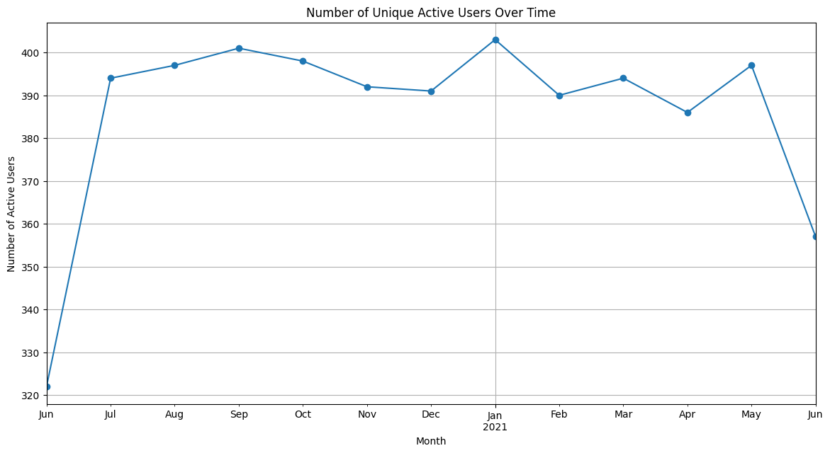
Active Users Analysis Over Time
Initial User Growth : There is a sharp increase from June to September 2020, which suggests a successful user acquisition phase or an event that significantly boosted active users engagement.
Stability in User Base : From July to the following January, there is relative stability in the number of active users, with minor fluctuations. This could indicate a consistent user engagement strategy that maintains user interest.
Seasonal Variations : The small dips and rises could be indicative of seasonal trends or periodic events that affect user activity. For instance, a dip in October might correspond to a holiday period or a seasonal event.
Sudden Decline : There's a notable drop in active users in the final month (June). This could be due to several factors, such as changes in the platform, a lapse in user retention efforts, or external factors that might have influenced user activity negatively
Peak Users Activity : The peaks in user activity, especially those in September and January, could correlate with specific campaigns or content that was particularly engaging. These periods would be worth investigating to replicate successful strategies.

Slide 12

Conclusions :
- Animals, science, healthy eating, technology, and food are the top 5 content categories in terms of user engagement on Social Buzz
- Certain content categories consistently engage users more positively than others.
- Information of users reactions/sentiments across categories and content types can help enhancing content strategy.
- The number of unique active users shows both stability and variability, indicating both successful user retention strategies and areas needing attention.
- Seasonal trends and specific events seem to have a noticeable impact on user engagement.
Summary
Recommendations :
- Increase the creation and promotion of contents in high-engagement categories using contents with higher sentiment values.
- Investigate the cause of the recent drop in active users and develop targeted re-engagement campaigns.
- Plan for seasonal content and marketing strategies in anticipation of engagement fluctuations throughout the year.

Slide 13

Thank you!
ANY QUESTIONS?

