Slide 1
Hate Speech Detection
Faris Chaudhry

Slide 2
Problem Statement
Hate Speech Detection is a task of sentiment classification.
Censor hate speech posts.
These aren’t in line with platform policy.
Defined as discriminatory messages based on identity.
Earn user’s trust as safe and accessible platform.
Raise advertiser confidence in brand image and platform.
Increase ad revenue.
Question: censor all posts on hateful/controversial topics?

Slide 3
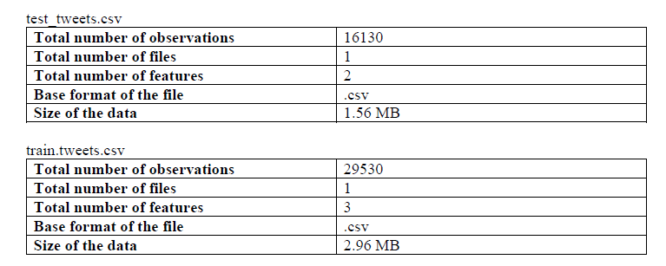
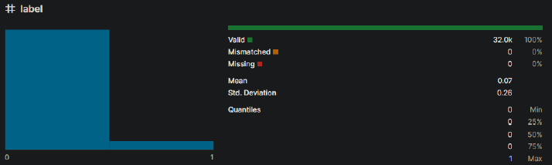
Dataset and Assumptions
The data is derived from real tweets.
The training data is labelled correctly.
The training and test data are from the same domain.
The amount of hate speech compared to non-hate speech reflects the proportion on the platform (see below)..
Dataset split into training and testing data.

Slide 4
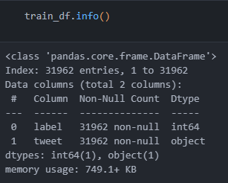
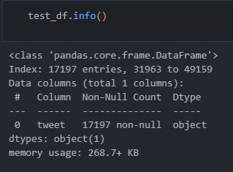

Data Pre-processing
Column Validation
Standardise Column Names
Replace spaces with underscores
Remove duplicate tweets
Remove null tweets
Remove unlabelled training data
Remove null and duplicate indexes
Upsampling
Make number of samples labelled ‘0’ and ‘1’ same.
Reduces bias towards randomly guessing ‘0’.
Lowers false negatives.

Slide 5
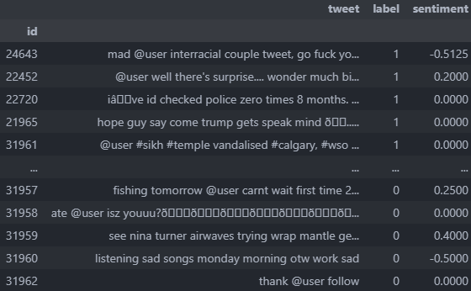
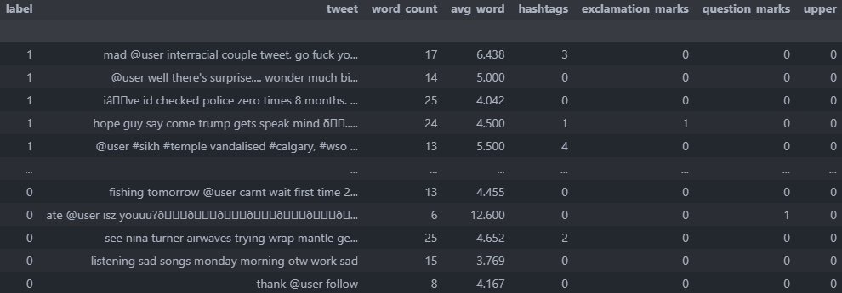
Basic Training Features
What factors are indicators of hate speech?
Word count and avg. length
Hashtags
Exclamation marks:
Question marks
Uppercase usage (percentage)
Sentiment

Slide 6
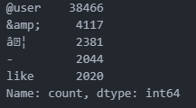
Dimensionality Reduction
Data Cleaning (remove extra noise)
Remove punctuation
Remove stop words (e.g., ‘the’, ‘and’, ‘a’, ‘I’)
Make tweets lowercase
Remove common and rare words and symbols.
Common words show up too often.
Rare words don’t have great enough sample size.
Around 200 tokens which only show up once in dataset (in practice could be far greater).
Note: important to replace usernames with ‘@user’ to prevent the model from being biased towards certain users.

Slide 7
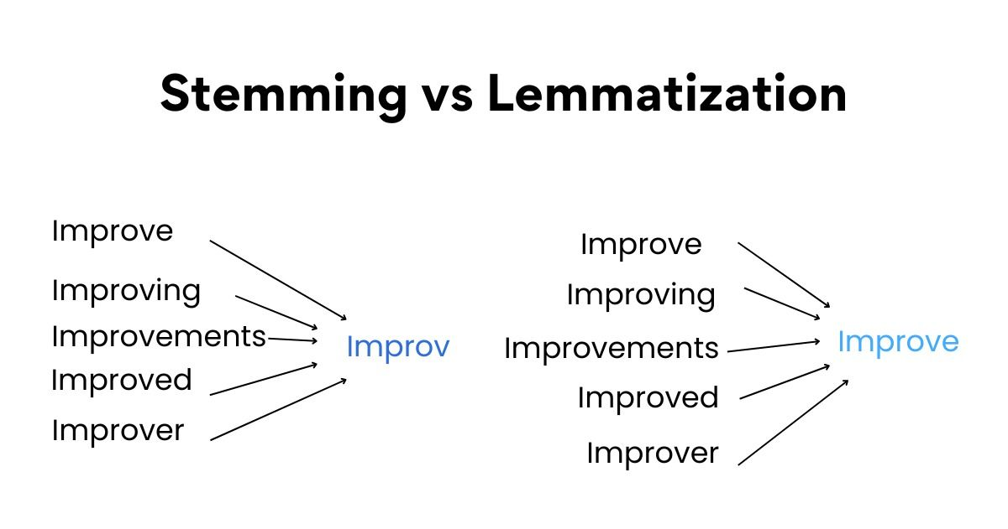
Dimensionality Reduction cont.
Spelling Correction
Reduces lexicon of words which must be identified.
Words may be corrected to the wrong word e.g., abbreviations.
Slang and language change quickly.
Suffix and Prefix Removal/Stemming (or) Lemmatization
Reduces words to their root form.
Reduces lexicon of words which must be identified.

Slide 8
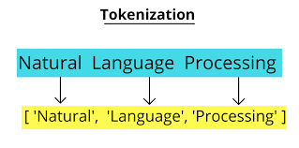

Features for Context-Free Evaluation
Tokenization
Tweets can be analysed by which their contained words (set of lexicon).
Loss: repetition of words and phrases is not considered.
Vectorisation
Each words gets its own vector.
A tweet is identified by adding together the vectors of its words.
Loss: doesn’t work if word is not found in model (default value of 0 given).
Question: LLM (e.g., GPT) vs RNN vs ML model?

Slide 9
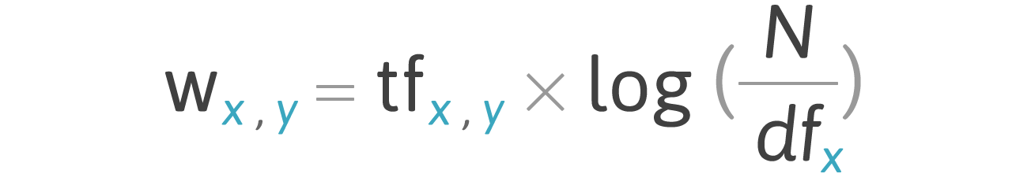
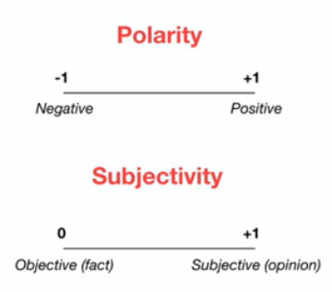
Sentiment Assignment
TF-IDF (term frequency, inverse document frequency)
A word with occurrences in multiple tweets should have more significance. (TF)
Word appearing too often isn't of much use because it only adds statistical noise. (IDF)
Textblob sentiment
Library to classify sentiment of words.
Not perfect because it’s generic and not for hate speech.

Slide 10
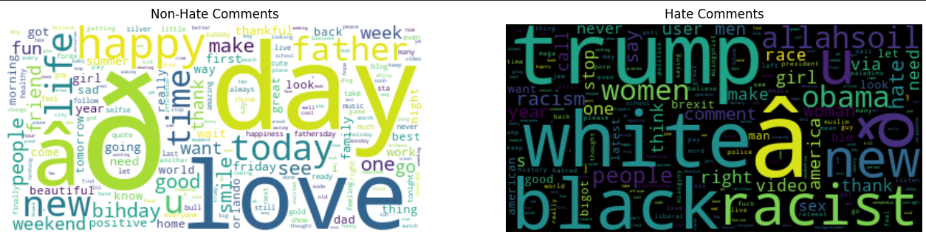
Textcloud of Common Words

Slide 11
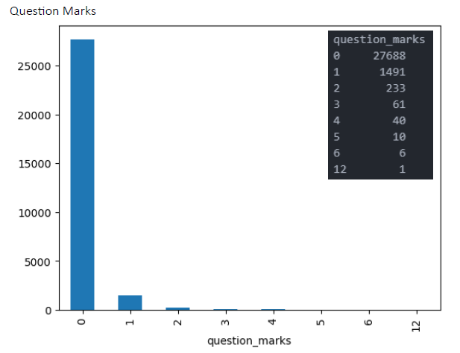
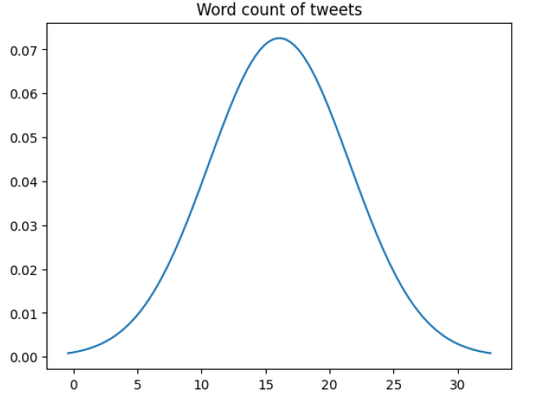
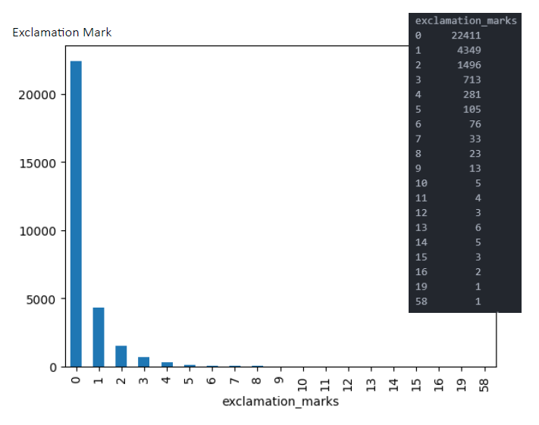
Extra Training Features

Slide 12
Models Foreword
We must choose whether we wish to minimizes false negatives (stricter model) or false positives more (more lenient model).
Users don’t want their content to be flagged when it’s not hate speech.
Advertisers don’t want hate speech at all; if we miss it then this erodes their confidence in the platform.
Users can flag missed hate speech and it can be manually reviewed
This must be decided by stakeholders, so we primarily use F1-score, precision, and recall.

Slide 13
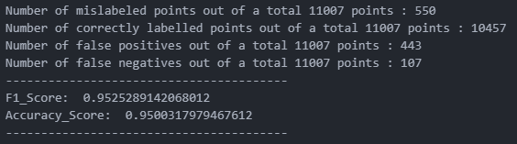
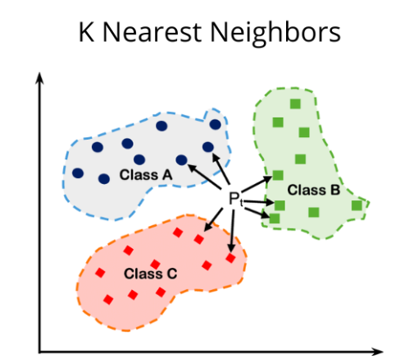
K-Nearest Neighbor (KNN)
Hyperparameters
weights=‘distance’: can be uniform or distance. Using distance makes weights inversely proportional to the distance.
p=1: uses l1 norm (max) for distance rather than Euclidian distance.
Model can’t be graphed since it uses 7 features plus the TF-IDF transformer.

Slide 14
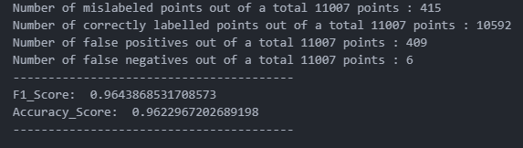
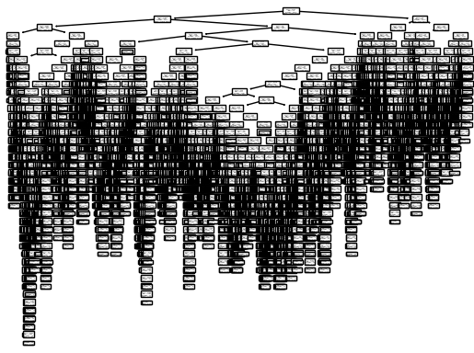
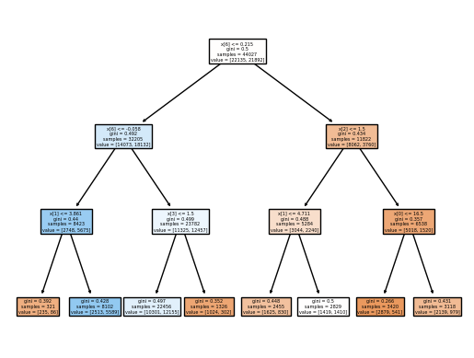
Decision Tree
Best model by every metric.
Especially high recall.
Low number of false negatives.
Stricter model
No max depth specified so the tree is quite complex.

Slide 15
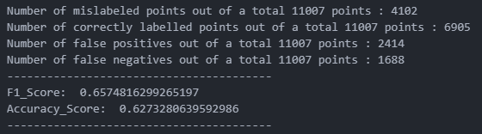
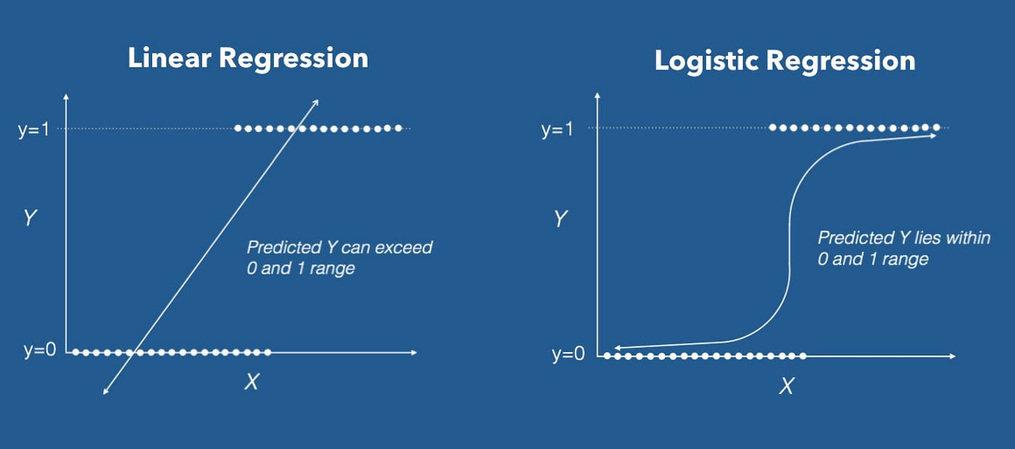
Logistic Regression
Bad model overall.
Could have benefitted from better hyper tuning of parameters.
Greater regularization.
Change in intercept bias.
Balanced class weights originally were used because the minority class wasn’t up sampled.
After up sampling, this makes very little difference.
Random sampling for all models can cause a bit of imbalance between the two classes (negligible if randomly selected).

Slide 16
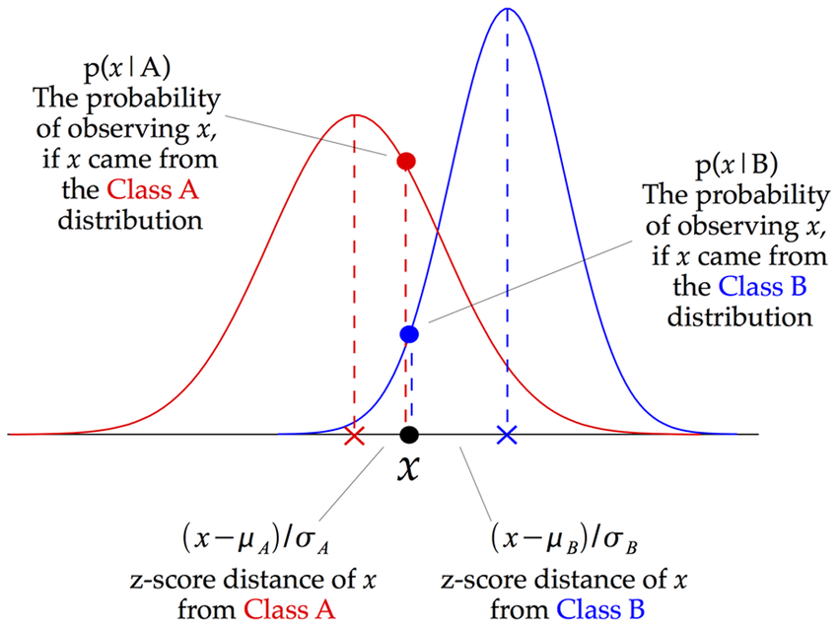
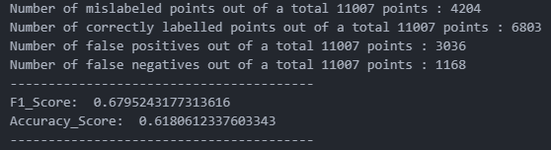
Gaussian Naïve Bayes
Bad model overall.
TF-IDF transformation couldn’t be used because it outputs a sparse matrix and GNB needs a dense one.
Could be fixed if pipeline not used.
Could be improved using CountVector transformation if data pre-processing style is changed.

Slide 17
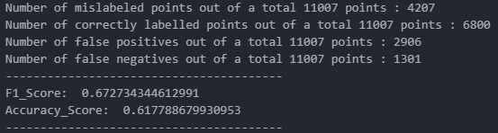
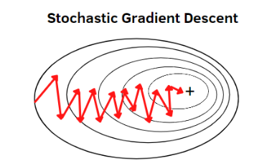
Stochastic Gradient Descent (SGD)
Bad model overall.
Could be improved using CountVector transformation if data pre-processing style is changed.
An accelerated gradient descent might be beneficial.
Changing the loss function using might be beneficial.

Slide 18
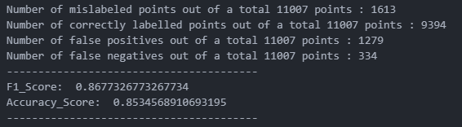
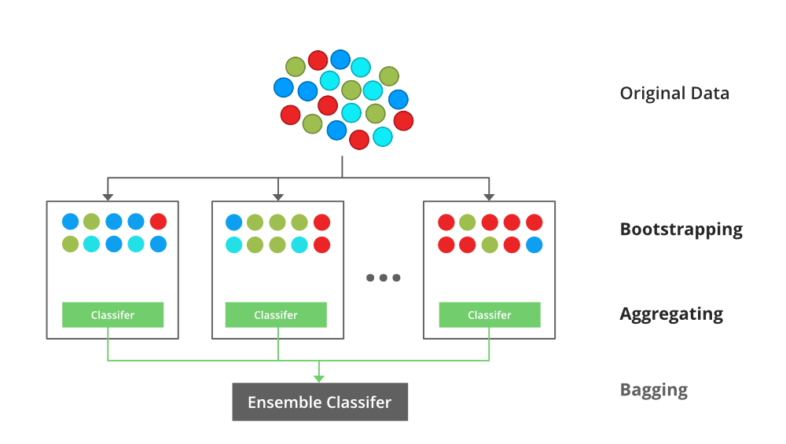
XGB Classifier
Worked moderately well
Ensemble classifier
Would likely benefit from more features for training.
A list of commonly used words in hate speech could be used.
List would have to be updated regularly since language changes quickly on social media.
Could introduce political bias.

Slide 19
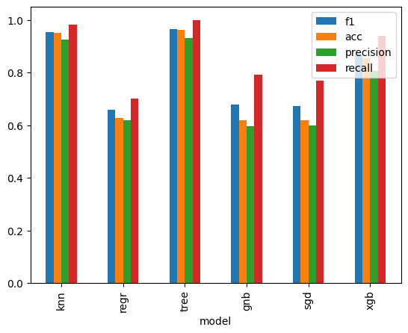
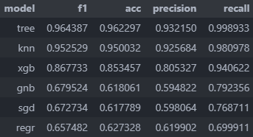
Results
Decision tree performed the best in every category. It was exceptional at recall (i.e., not mistakenly flagging messages).
Why black box models are suitable:
Don’t want political views to affect what is viewed as hate speech (biased censorship).
Better than individuals reviewing hate speech since model is consistent.
Bias can exist from chosen data and how it is labelled, but not after the model is trained.
However, model will have to be retrained to keep up with changing language.

Slide 20
Thank You

