Slide 1

Hate Speech Detection
Final Report
Faris Chaudhry
09/06/23

Slide 2

Contents
Problem Statement
Assumptions
Data Cleaning and Pre-processing
EDA and Featurization
Models

Slide 3
Business Understanding
Hate Speech Detection is a task of sentiment classification.
Censor hate speech posts.
These aren’t in line with our policy.
Defined as discriminatory messages based on identity.
Earn user’s trust as safe and accessible platform.
Raise advertiser confidence in brand image and platform.
Increase ad revenue.

Slide 4
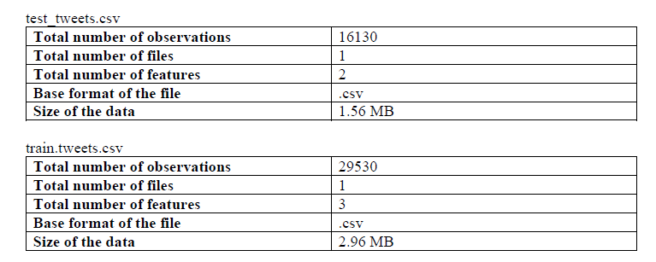
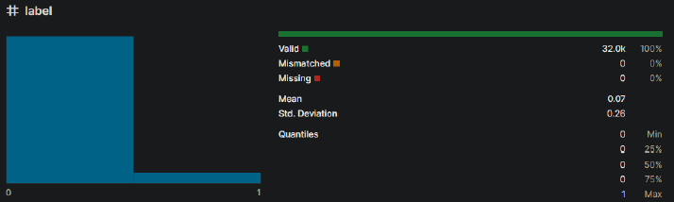
Dataset and Assumptions
The data is derived from real tweets.
The training data is labelled correctly.
The training and test data are from the same domain.
The amount of hate speech compared to non-hate speech reflects the proportion on the platform (see below)..
Tweets are below the limit of 200 characters and are formatted in the same way.
Dataset split into training and testing data.

Slide 5
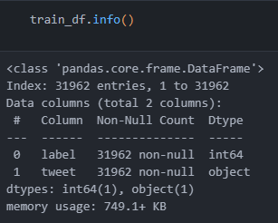
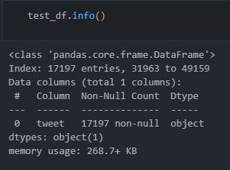

Data Pre-processing
Column Validation
Standardise Column Names
Lowercase
Replace spaces with underscores
Remove duplicate tweets
Remove null tweets
Remove unlabelled training data
Remove null and duplicate indexes
Up sampling
Make number of samples labelled ‘0’ and ‘1’ same.
Reduces bias towards randomly guessing ‘0’.
Lowers false negatives.

Slide 6
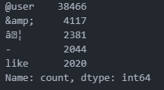
Data Cleaning
Data Cleaning (remove extra noise)
Make all tweet words lowercase
Remove punctuation
Remove stop words (common words that add no information e.g., ‘the’, ‘and’, ‘a’, ‘I’)
Remove common and rare words and symbols.
Common words show up too often.
Add extra dimensionality.
Don’t contain any information used for classification
Rare words don’t have great enough sample size.
Overfitting to model
Add extra dimensionality
Around 200 tokens which only show up once in dataset.

Slide 7
Optional Data Cleaning
Spelling Correction
Reduces lexicon of words which must be identified.
Words may be corrected to the wrong word.
Slang and language changed too quickly.
Suffix and Prefix Removal (or)
Lemmatization
Reduces words to their root form.
Reduces lexicon of words which must be identified.
Tokenization
Tweets can be analysed by which their contained words.
Loss: repetition of words and phrases is not considered.
Vectorisation
Each words gets its own vector.
A tweet is identified by adding together the vectors of its words.
Loss: adds extra noise and unnecessary dimensionality.
Loss: doesn’t work if word is not found in model.

Slide 8
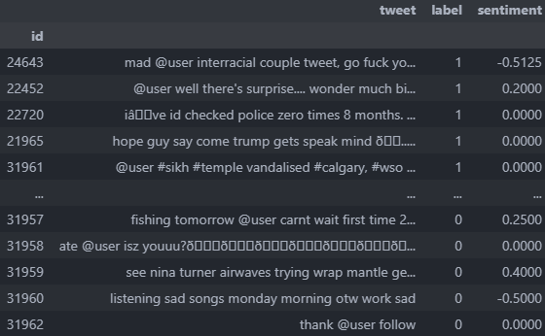
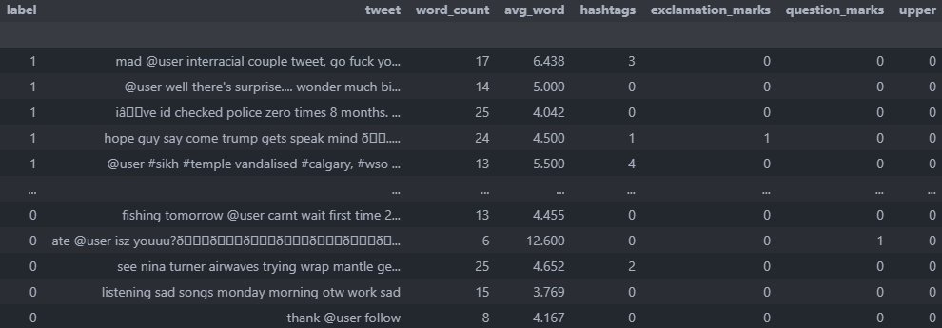
Extra Training Features
What factors are indicators of hate speech?
Word count and avg. length:
some speech patterns are indicative of anger.
Hashtags:
hashtags might be associated with hate speech.
Exclamation marks:
can be an indicator of rage.
Question marks:
people often use rhetorical questions to show anger.
Uppercase usage:
can be an indicator of anger.
Sentiment:
there might be a link between use of negative words and hate speech.

Slide 9
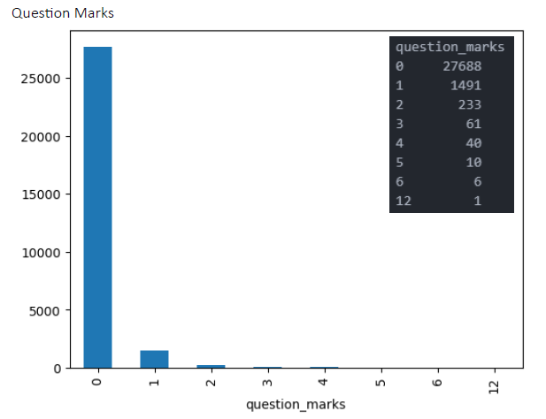
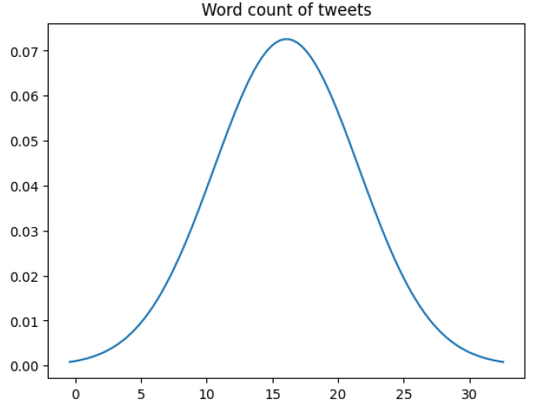
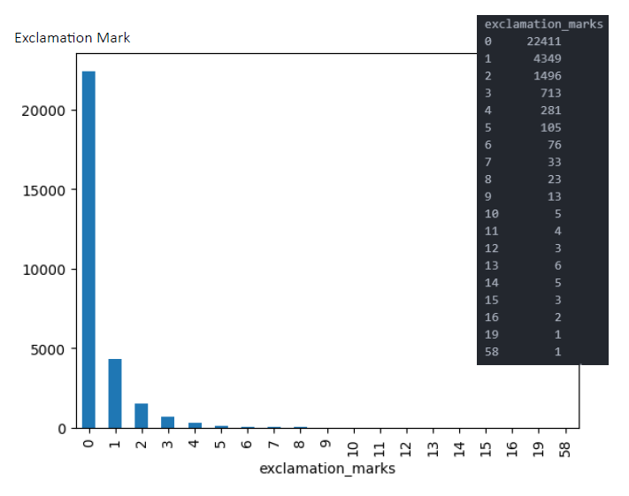
Extra Training Features

Slide 10
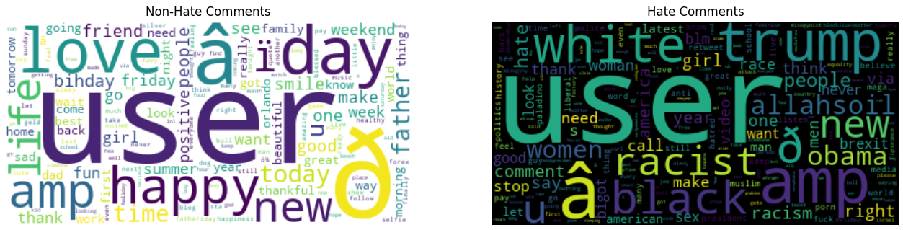
Textcloud of Common Words

Slide 11
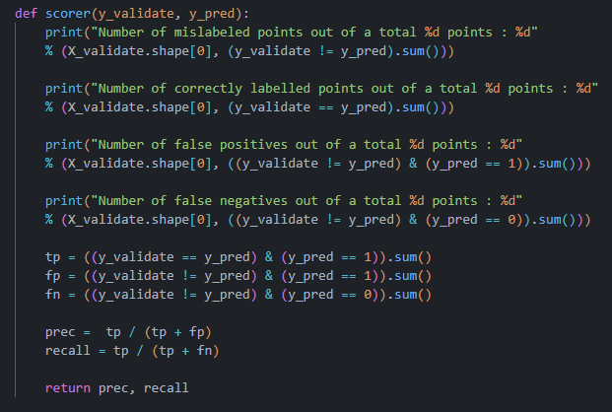
Models Foreword
We must choose whether we wish to minimizes false negatives (stricter model) or false positives more (more lenient model).
Users don’t want their content to be flagged when it’s not hate speech.
Advertisers don’t want hate speech at all; if we miss it then this erodes their confidence in us.
Users can flag missed hate speech and it can be manually reviewed
This must be decided by stakeholders, so we primarily use F1-score, precision, and recall.

Slide 12
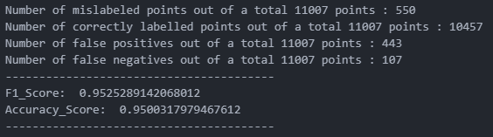
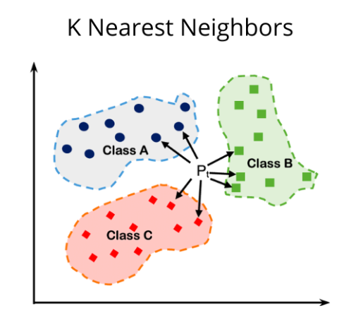
K-Nearest Neighbor (KNN)
Hyperparameters
n_neighbours=1: any higher n was reducing the F-1 score.
weights=‘distance’: can be uniform or distance. Using distance makes weights inversely proportional to the distance.
leaf_size=30: default
p=1: uses l1 norm (max) for distance rather than Euclidian distance.
Model can’t be graphed since it uses 7 features plus the TF-IDF transformer.

Slide 13
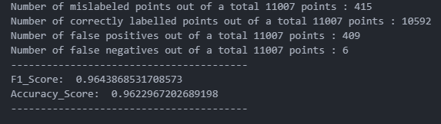
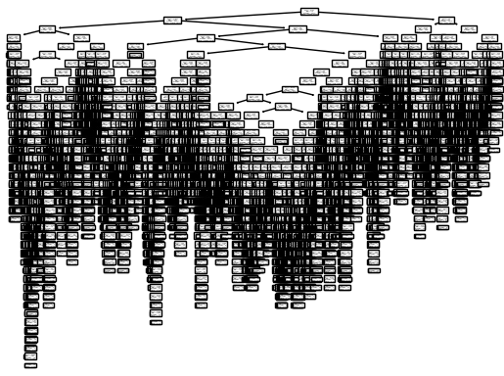
Decision Tree
Best model by every metric.
Especially high recall.
Low number of false negatives.
Stricter model
No max depth specified so the tree is quite complex.
gini was the best criterion.
log_loss and entropy were also tried.

Slide 14
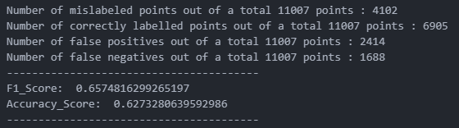
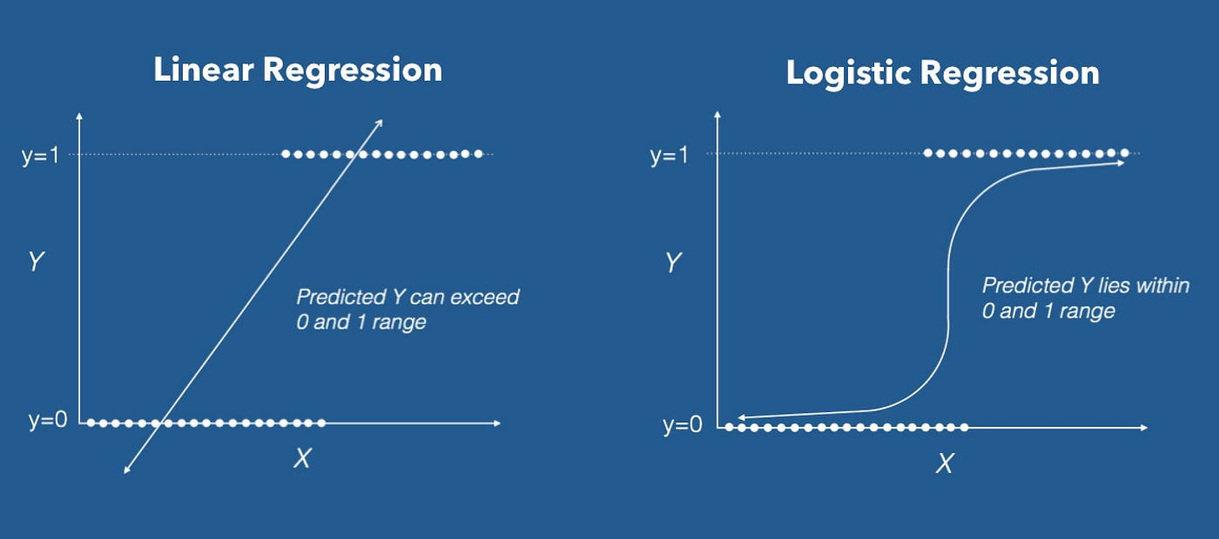
Logistic Regression
Bad model overall.
Could have benefitted from better hyper tuning of parameters.
Greater regularization.
Change in intercept bias.
Balanced class weights originally were used because the minority class wasn’t up sampled.
After up sampling, this makes very little difference.
Random sampling for all models can cause a bit of imbalance between the two classes (negligible if randomly selected).

Slide 15
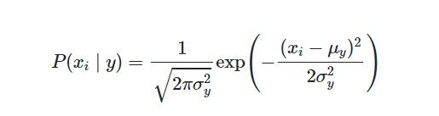
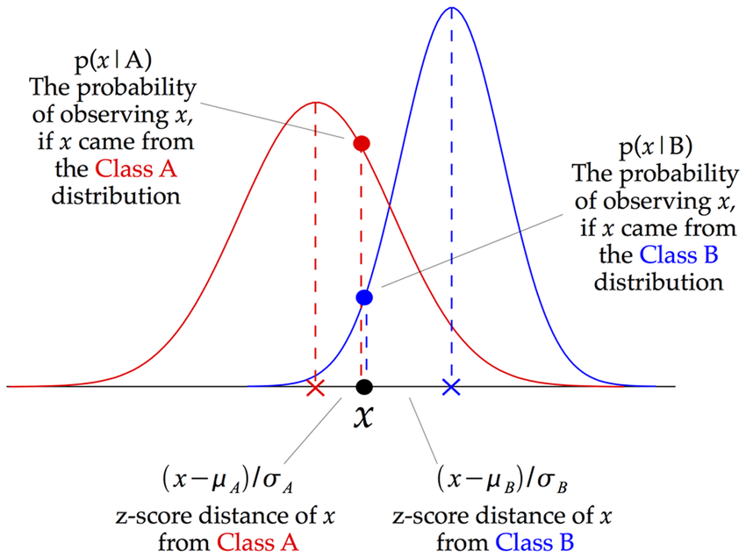
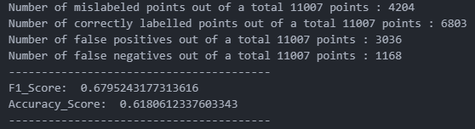
Gaussian Naïve Bayes
Bad model overall.
TF-IDF transformation couldn’t be used because it outputs a sparse matrix and GNB needs a dense one.
Could be fixed if pipeline not used.
Could be improved using CountVector transformation if data pre-processing style is changed.

Slide 16
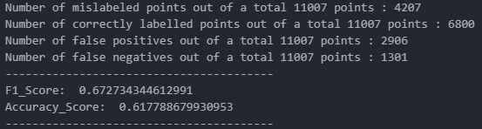
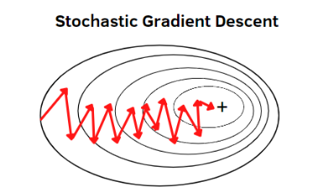
Stochastic Gradient Descent (SGD)
Bad model overall.
Could be improved using CountVector transformation if data pre-processing style is changed.
An accelerated gradient descent might be beneficial.
Changing the loss function using might be beneficial.

Slide 17
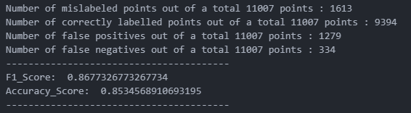
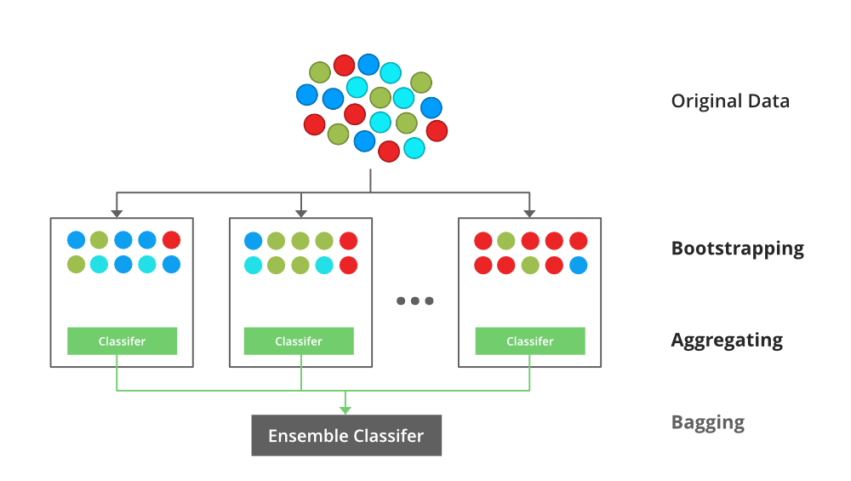
XGB Classifier
Worked moderately well
Ensemble classifier
Would likely benefit from more features for training.
A list of commonly used words in hate speech could be used.
List would have to be updated regularly since language changes quickly on social media.
Could introduce political bias.

Slide 18
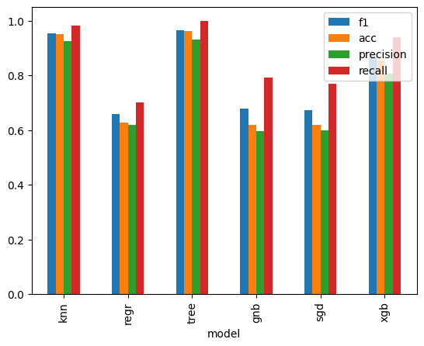
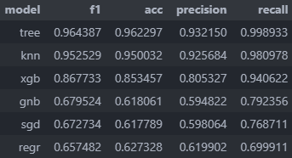
Results
Decision tree performed the best in every category. It was exceptional at recall (i.e., minimizing false negatives).
Why black box models are suitable:
Don’t want political views to affect what is viewed as hate speech (greater censorship).
Better than individuals reviewing hate speech since model is consistent.
Bias can exist from chosen data and how it is labelled, but not after the model is trained.
However, model will have to be retrained to keep up with changing language.

Slide 19
Thank You

