Slide 1
Principles of Autonomy and Decision Making
(AI_PrincAutonomy_2808)
Team:
Prof. Dr. rer. nat. Lenz Belzner
Chidvilas Karpenahalli Ramakrishna, M.Eng.
Adithya Mohan, M.Eng.
Zahra Zeinaly, Ph.D.
Week 3: Uninformed and Informed Search
Ref: Adapted from UC Berkeley CS 188 Fall 2023

Slide 2
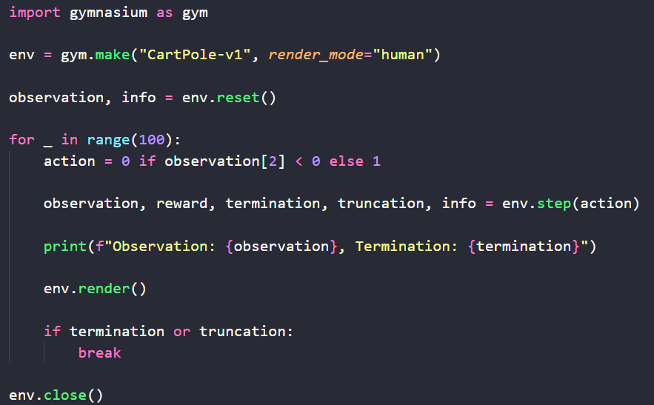
Reflex Agent (Recap)
Week 3: Uninformed and Informed Search
What is a reflex agent?
Chooses actions based on the current percept
Works based on condition-action rule
No consideration of the consequences of the action
No planning involved
Question: Is a Reflex agent optimal?
Fig 1. Reflex agent (CartPole)

Slide 3
Planning Agent
Week 3: Uninformed and Informed Search
What is a planning agent?
Reasons
Considers the consequences of its actions
Model of the world
To evaluate how the world evolves based on the chosen action
Goal condition
Fig 1. Planning agent in action

Slide 4
Search Problem
Week 3: Uninformed and Informed Search
Search problem:
Involves finding a sequence of actions that leads from an initial state to a goal state.
Search problems are models
Components of a search problem
State space
Successor function
Actions
Costs
Start state and goal state
A search problem can be
Uninformed (blind)
Informed (heuristic)
Discussion: Can you define the above terms for a FrozenLake environment?
Fig 1. Search problem in frozen lake

Slide 5
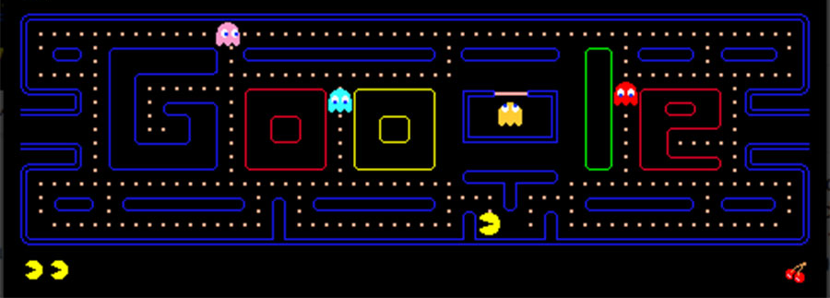
State Space
Week 3: Uninformed and Informed Search
World state:
Includes every detail of the environmnet
Search state:
Includes information relevant to the problem
Problem 1: Path problem
States: (x, y)
Successor: {U, D, L, R}, update (x,y)
Goal test: (x,y)_{pacman} == (x,y)_{goal}
Problem 2: Eating problem
States: {(x, y), dot booleans}
Successor: {U, D, L, R}, update (x,y), update dot booleans
Goal test: No dots left
Fig 1. Pacman environment

Slide 6
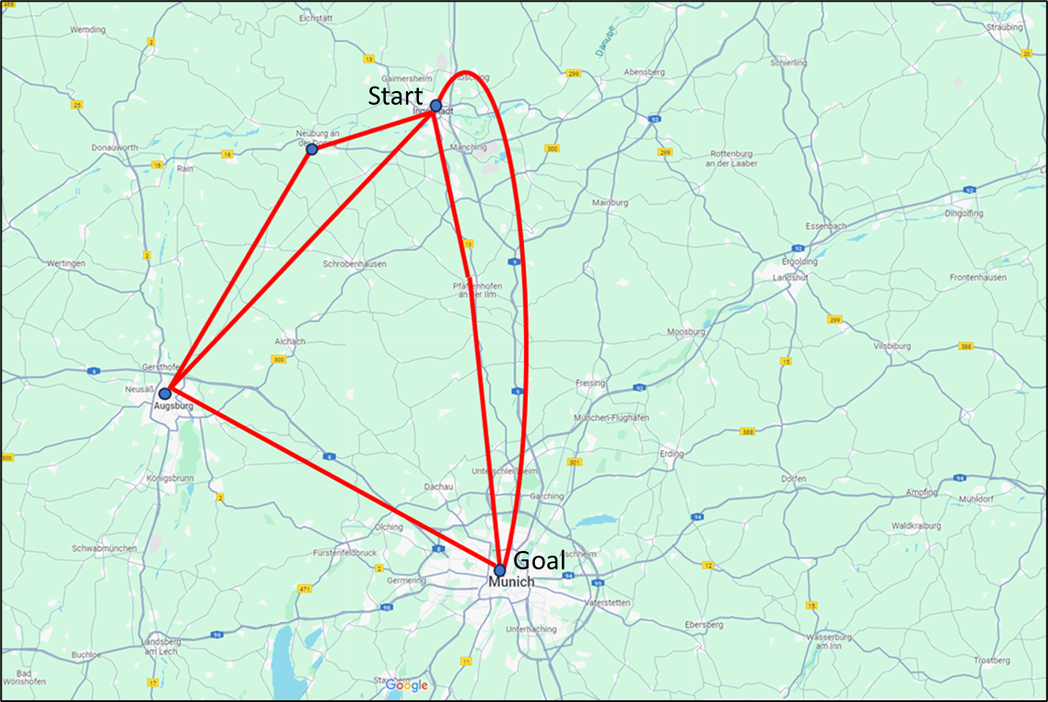
State Space Graph
Week 3: Uninformed and Informed Search
Problem:
Travel from Ingolstadt to Munich
State Space Graph
A mathematical formulation of the search problem
Nodes are states
Edges are successors
Goal state may be one or many
Goal state may also be
Optimal
Sub-optimal
Each state only occurs once (unique)
Formulate problem as a graph
Which path would you take based on distance?
Which path would you take considering cost?
Which path would you take considering time?
Fig 1. Path problem – Ingolstadt to Munich
I
N
60€
200 min
P
150€
A
50 min
120€
65 min
80€
150 min
M
Fig 2. State Space Graph

Slide 7
Search Tree
Week 3: Uninformed and Informed Search
Search tree:
A tree depicting plans and outcomes
Root node: Start state
Intermediate node: Intermediate states/ successors
Goal node: Goal state
Fig 1. Path problem – Ingolstadt to Munich
I
N
I
60€
N
200 min
A
P
M
P
150€
A
50 min
A
M
M
120€
65 min
M
80€
150 min
M
Fig 3. Search Tree
Fig 2. State Space Graph

Slide 8

Quiz: Design the search tree?
Week 3: Uninformed and Informed Search
State Space Graph
Search Tree
A
S
G
B
Fig 1. Sample state space graph

Slide 9
State Space Graph and Search Tree
Week 3: Uninformed and Informed Search
S
p
d
a
e
c
b
c
q
b
e
a
h
r
d
G
a
e
f
S
h
r
q
p
f
h
r
p
q
c
G
q
q
p
f
a
q
c
G
Fig 1. State Space Graph
a
Fig 2. Search Tree
Ref: UC Berkeley CS 188 Fall 2023

Slide 10
Uninformed: Depth-First Search (DFS)
Week 3: Uninformed and Informed Search
S
1
Definition:
„An algorithm for traversing or searching tree or graph data structures. It starts at the root and explores as far as possible along each branch before backtracking.“
Completeness:
Not complete, as it can get trapped exploring down an infinite branch and never find the goal node.
Optimality:
Not optimal. DFS may find a solution that is not the shortest path in terms of edge count or path cost.
p
2
d
c
e
q
b
e
7
3
a
h
r
5
8
a
9
h
r
q
p
f
11
4
q
c
G
q
p
f
10
6
a
q
c
G
a
Fig 1. DFS algorithm
Ref: UC Berkeley CS 188 Fall 2023

Slide 11
Uninformed: Depth-First Search (DFS)
Week 3: Uninformed and Informed Search
Grid world environment
„X“ marks states that cannot be visited by the agent
Action: {Up, Down, Left, Right}
Start state: Top left (0, 0)
Goal stae: Top right (0, 4)
Fig 1. shows the agent exploring each branch till it reaches the depth
Hence the name „Depth-first search“
Goal
Fig 1. DFS algorithm demo

Slide 12
Uninformed: Breadth-First Search (BFS)
Week 3: Uninformed and Informed Search
S
Definition:
“BFS is an algorithm for searching a tree or graph data structure. It starts at the tree root and explores the neighbour nodes at the present depth prior to moving on to the nodes at the next depth level.”
Completeness:
Is complete, meaning it will always find a solution if one exists as it explores all possible nodes.
Optimality:
Is optimal if the path cost is a non-decreasing function of the depth of the node. It guarantees the shortest path on a graph with uniform edge costs.
p
d
e
q
b
e
c
h
r
a
h
r
a
q
p
f
q
p
f
q
c
G
q
c
G
a
a
Ref: UC Berkeley CS 188 Fall 2023
Fig 1. BFS algorithm

Slide 13
Uninformed: Breadth-First Search (BFS)
Week 3: Uninformed and Informed Search
Grid world environment
„X“ marks states that cannot be visited by the agent
Action: {Up, Down, Left, Right}
Start state: Top left (0, 0)
Goal stae: Top right (0, 4)
Fig 1. shows the agent exploring each level one by one till it reaches the goal
Hence the name „Breadth-first search“
Goal
Fig 1. BFS algorithm demo

Slide 14
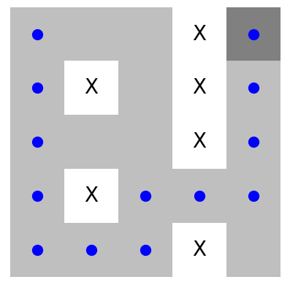
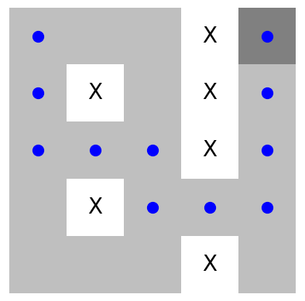
Optimality of DFS and BFS
Week 3: Uninformed and Informed Search
Fig 1. DFS algorithm final path
No. Step = 12
Is it optimal?
Ans: No
Fig 2. BFS algorithm final path
No. Step = 10
Is it optimal?
Ans: Yes

Slide 15

Quiz: DFS vs. BFS
Week 3: Uninformed and Informed Search
When would you use DFS over BFS?
When would you use BFS over DFS?
Hints:
Shallow vs. Deep
Time requirements
Memory requirements
Computational resources
Think!

Slide 16
Cost
Week 3: Uninformed and Informed Search
S
1
3
d
a
p
e
9
2
3
11
c
b
c
16
4
b
5
e
h
r
11
8
4
q
17
1
14
2
a
d
G
6
a
3
9
e
2
f
2
28
q
p
24
f
12
S
1
13
h
r
7
7
h
8
r
1
39
q
16
c
G
14
p
11
15
q
24
q
p
20
f
8
19
a
35
q
12
c
G
10
Fig 1. State Space Graph
15
a
Fig 2. Search Tree
Ref: UC Berkeley CS 188 Fall 2023

Slide 17
Uninformed: Uniform Cost Search (UCS)
Week 3: Uninformed and Informed Search
Definition:
“UCS is a search algorithm that moves ahead to the lowest cumulative cost path. It expands the least cost node first and ensures that the path to every node is the shortest.”
Completeness:
Complete as long as the cost of each step exceeds some small positive constant.
Optimality:
Optimal. UCS always selects the path that leads to the least cost.
Exercise:
Find the path based on cost considerations
S
1
3
d
p
e
9
11
c
16
4
b
5
e
h
r
11
q
17
a
14
6
a
28
q
p
24
f
12
13
h
r
7
39
q
16
c
G
14
24
q
p
20
f
8
19
a
35
q
12
c
G
10
Ref: UC Berkeley CS 188 Fall 2023
15
a
Fig 2. Search Tree

Slide 18
Uninformed: Uniform Cost Search (UCS)
Week 3: Uninformed and Informed Search
Grid world environment
States now also have a cost associated with them
„X“ marks states that cannot be visited by the agent
Action: {Up, Down, Left, Right}
Start state: Top left (0, 0)
Goal stae: Top right (0, 4)
Fig 1. shows the agent exploring each level by taking cost into consideration, till it reaches the goal
Hence the name „Uniform cost search“
Drawback:
Explores in all directions
No heuristics are considered here
Goal
Fig 1. UCS algorithm demo

Slide 19
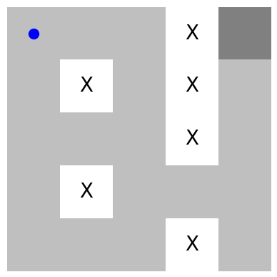
Informed: Heuristic function
Week 3: Uninformed and Informed Search
Informed search:
Presence of problem-specific knowledge beyond the definition of the problem
Heuristic function:
A function that estimates how close a state is to the goal
Specific to a problem
Discussion: How to choose a heuristic function?
Goal
Fig 1. Which heuristic fuction would you use?

Slide 20
Greedy Search
Week 3: Uninformed and Informed Search
Greedy search:
Define a heuristic function
Expand the node that gets you closer to the goal
In Fig 1. we use „Manhattan distance“ as the heuristic function
Discussion: What can go wrong?
The agent is on the right track to reach the goal. However, it has to first go down and then go up to reach the goal. Going down increased the Manhattan distance and hence, the agent starts exploring in other directions.
Cost is not considered
Fig 1. Greedy search demo

Slide 21
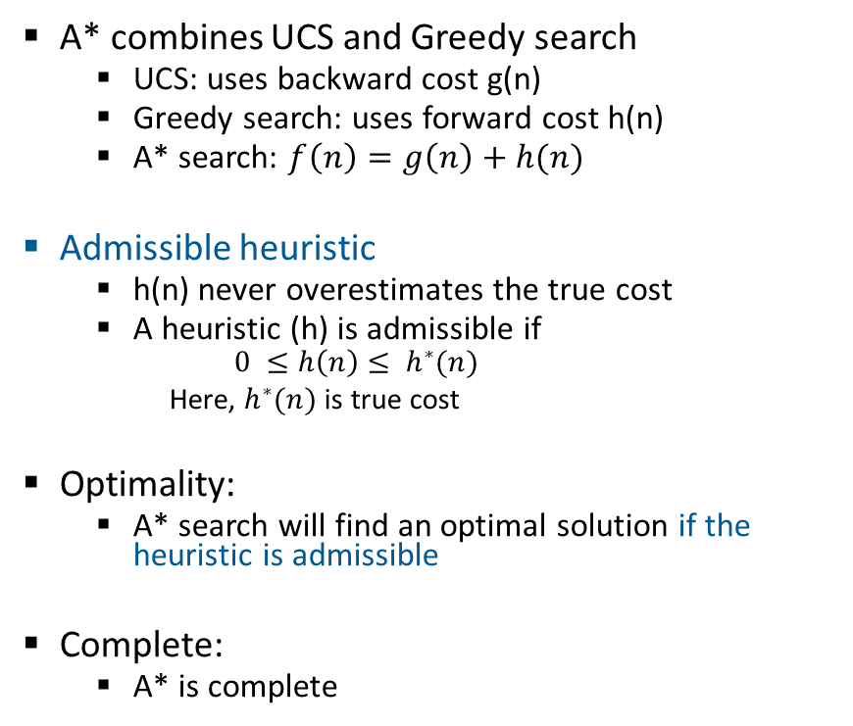
A* Search Algorithm
Week 3: Uninformed and Informed Search
A* combines UCS and Greedy search
UCS: uses backward cost g(n)
Greedy search: uses forward cost h(n)
A* search: $f\left(n\right)=g\left(n\right)+h(n)$
Admissible heuristic
h(n) never overestimates the true cost
A heuristic (h) is admissible if
$$0 ≤h\left(n\right)≤ h^{∗}(n)$$
Here, $h^{∗}(n)$ is true cost
Optimality:
A* search will find an optimal solution if the heuristic is admissible
Complete:
A* is complete
g=0
h=6
S
g=1
h=5
a
g=2
h=6
b
g=4
h=2
d
e
g=9
h=1
g=3
h=7
c
g=6
h=0
G
d
g=10
h=2
G
g=12
h=0
Fig 1. How would you solve this search tree?
Ref: UC Berkeley CS 188 Fall 2023

Slide 22
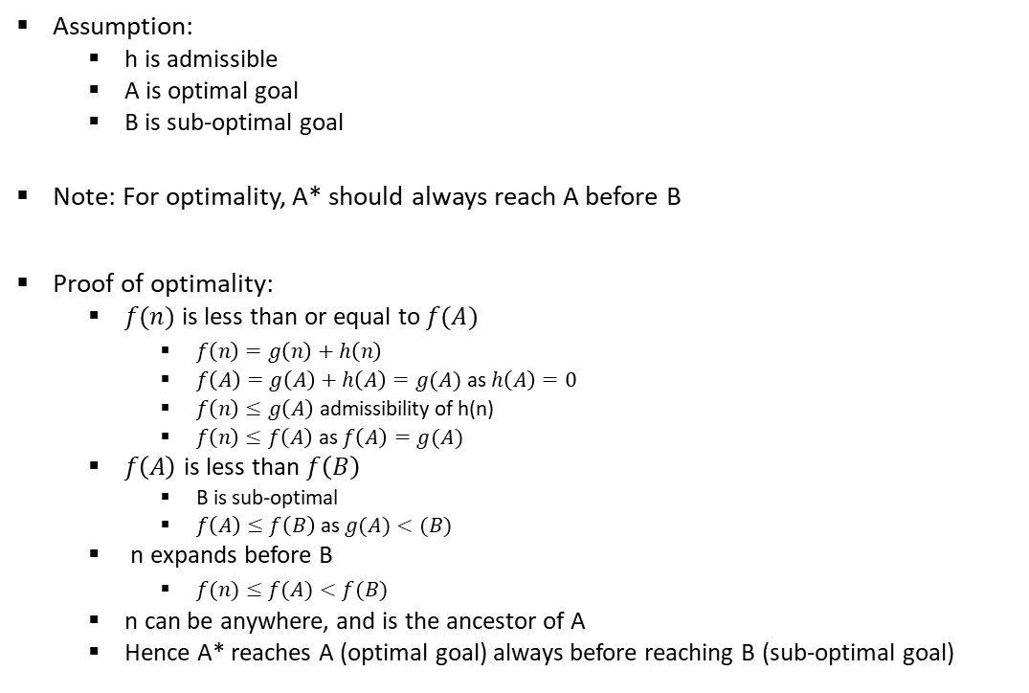
Optimality of A* Search
Week 3: Uninformed and Informed Search
Assumption:
h is admissible
A is optimal goal
B is sub-optimal goal
Note: For optimality, A* should always reach A before B
Proof of optimality:
$f(n)$ is less than or equal to $f(A)$
$f\left(n\right)=g\left(n\right)+h\left(n\right)$
$f\left(A\right)=g\left(A\right)+h\left(A\right)=g(A)$ as $h\left(A\right)=0$
$f\left(n\right)≤g\left(A\right)$ admissibility of h(n)
$f\left(n\right)≤f\left(A\right)$ as $f\left(A\right)=g(A)$
$f\left(A\right)$ is less than $f\left(B\right)$
B is sub-optimal
$f\left(A\right)≤f\left(B\right)$ as $g(A)<(B)$
n expands before B
$f(n)≤f(A)<f(B)$
n can be anywhere, and is the ancestor of A
Hence A* reaches A (optimal goal) always before reaching B (sub-optimal goal)
n
A
B
Fig 1. A* tree search
Ref: UC Berkeley CS 188 Fall 2023

Slide 23
DFS vs. BFS vs. UCS vs. Greedy vs. A*
Week 3: Uninformed and Informed Search
Fig 1. DFS algorithm
Fig 2. BFS algorithm
Fig 3. UCS algorithm
Fig 4. Greedy search
Fig 5. A* algorithm

