Slide 1

CHECKERS

Slide 2
Application Overview
The Checkers application is a desktop program that implements the game of checkers. It is developed using C++ and the NetID GUI framework.
The game follows official checkers rules and is played on an 8x8 board. The application separates the game engine, graphics, and controls.
This modular structure makes the program maintainable, scalable, and easier to manage.

Slide 3
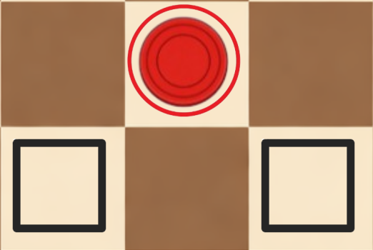
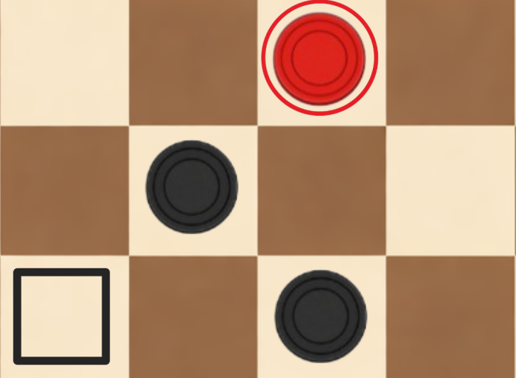
Movement and Capture Mechanics
Piece movement follows official checkers rules with enforced diagonal motion. The engine validates all legal moves before execution. Mandatory captures are implemented, and recursive search enables multi‑jump capture sequences.
Captured pieces are removed during animated transitions to synchronize logic and visuals.

Slide 4
Artificial Intelligence System
The AI opponent uses the Minimax algorithm with Alpha-Beta pruning to decide its moves. It simulates possible future moves and evaluates board states to choose the most optimal action.
The algorithm assumes the opponent also plays optimally, so it maximizes its own advantage while minimizing the opponent’s gain. Board positions are evaluated using a heuristic function. The heuristic considers factors such as the number of pieces, the higher value of king pieces, piece mobility, and positional advantages.
Alpha-Beta pruning increases efficiency by cutting off branches that do not affect the final decision. This reduces unnecessary computations while maintaining strong decision quality.

Slide 5
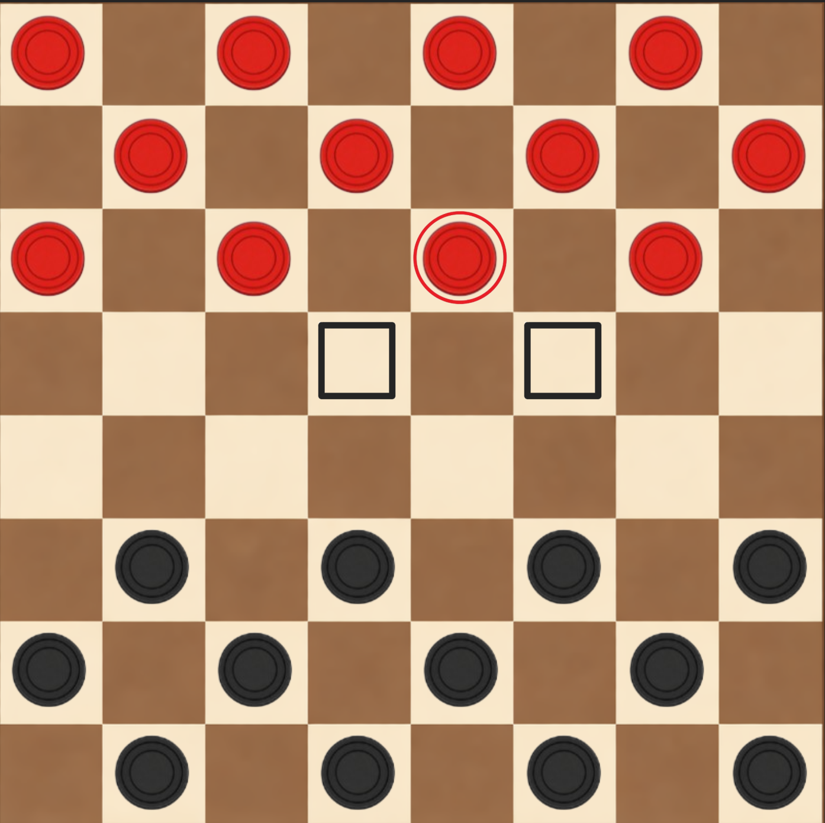
Game Board and Rendering
The board is rendered dynamically using the GUI Canvas system. It automatically scales with window resizing while maintaining correct proportions.
Sprites are used for pieces, highlights, and overlays, allowing visual feedback for selected pieces and legal moves. The rendering loop continuously updates animations and board states.

Slide 6
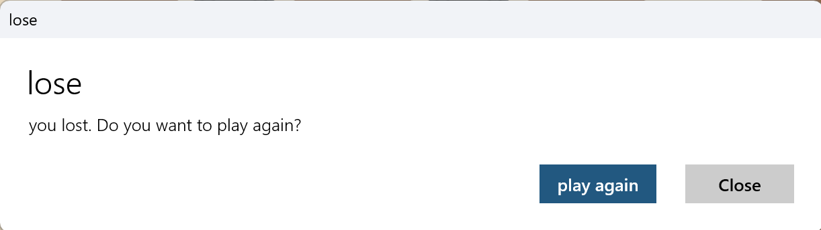
Game End Detection and Dialogs
The engine continuously monitors the game state in real time. It detects win, loss, and draw conditions automatically.
A player loses when they have no legal moves remaining. Draws are determined using the no-capture move limit rule to prevent endless play.
When the game ends, a dialog window displays the result. The dialog also offers options to restart the game or close the session.

Slide 7
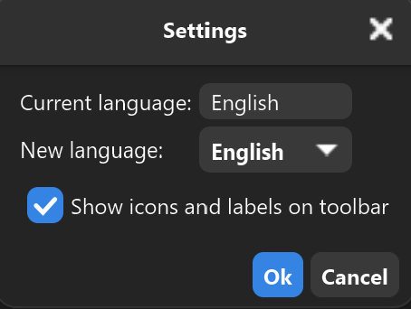

User Interface and Settings
The interface includes a menu bar, toolbar, and settings dialog. Players can start or reset matches, adjust toolbar display, and change language settings.
Localization is handled through XML translation resources, and restart prompts ensure language changes apply correctly across the application.

Slide 8

THE END

