Slide 1
EEE 312 | Project Report
YOLO Based Traffic Speed Detection System
L-3, T-1
Section: A2
Group No: 03
Submission Date: 25th July, 2021

Slide 2
Objectives:
1. To build a model and train it using a dataset that consists of almost 2400 images of cars in roads.
2. To detect our desired object, a car, from a video feed collected from a traffic signal CCTV footage. And then, to calculate the accuracy of the vehicle detection.
3. Measure speed from the movement of our detected object in the video feed as frames change.
4. Compare our measured speed with actual speed of the vehicles in the traffic signal and calculate the error.
5. Analyze the error and search for room for improvements in future work

Slide 3
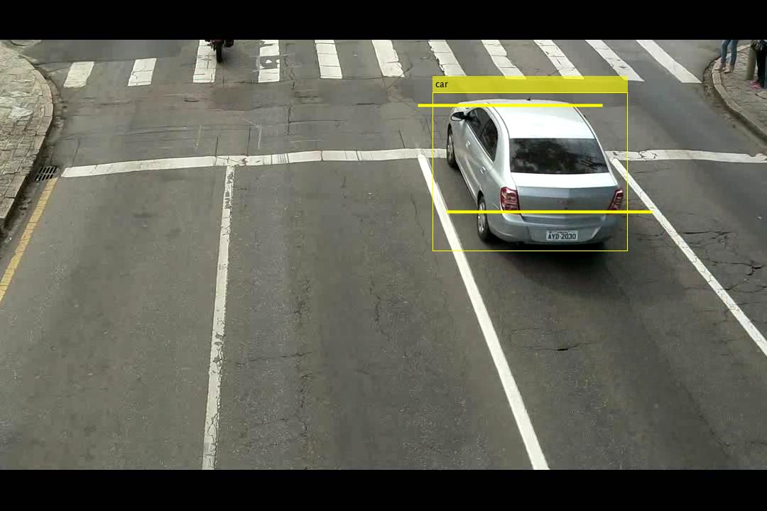
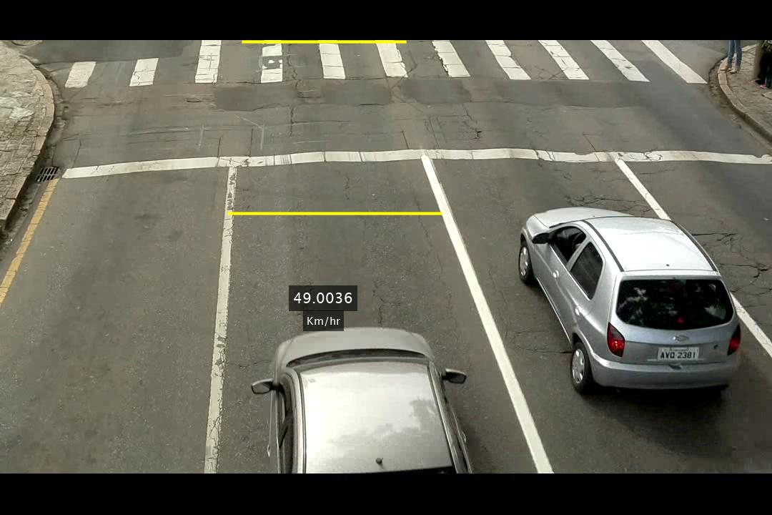
Methodology
Vehicle Detection
Speed Measurement

Slide 4
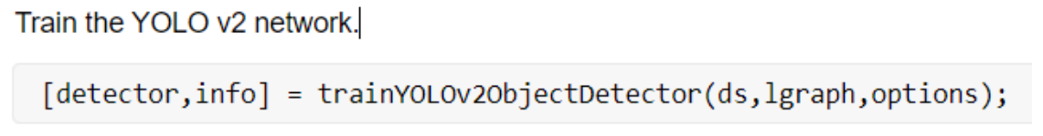
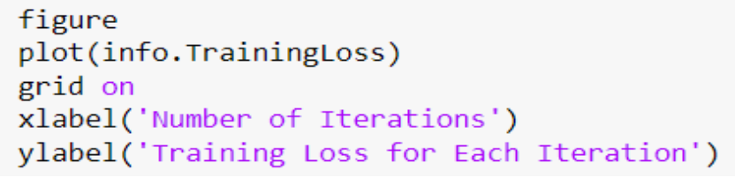
Methodology
Training the Dataset Using YOLO v2 Algorithm
Training the Dataset Using YOLO v2 Algorithm
Car Detection
Lane Selection
Speed Measurement
Position Mapping

Slide 5
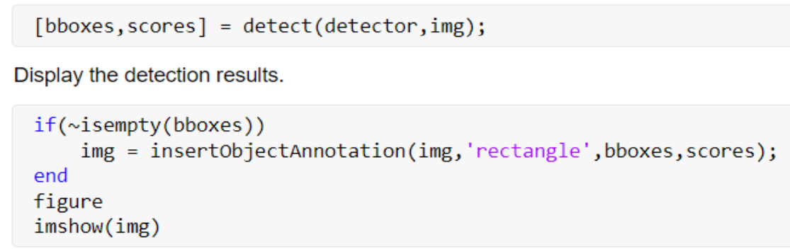
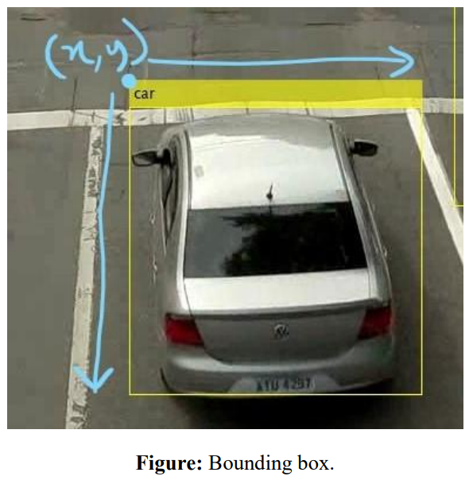
Methodology
Training the Dataset Using YOLO v2 Algorithm
Car Detection
Car Detection
Lane Selection
Speed Measurement
Position Mapping

Slide 6
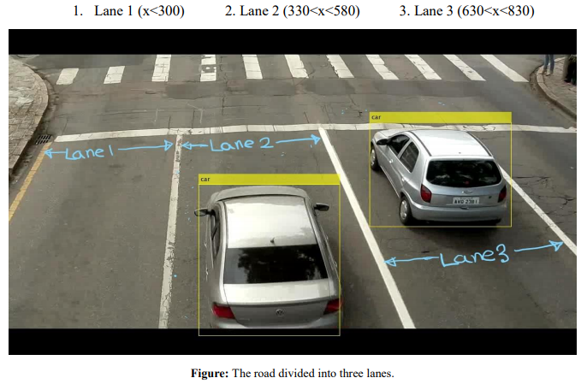
Methodology
Training the Dataset Using YOLO v2 Algorithm
Car Detection
Lane Selection
Speed Measurement
Position Mapping

Slide 7
Methodology
Training the Dataset Using YOLO v2 Algorithm
Car Detection
Lane Selection
Speed Measurement
Position Mapping

Slide 8
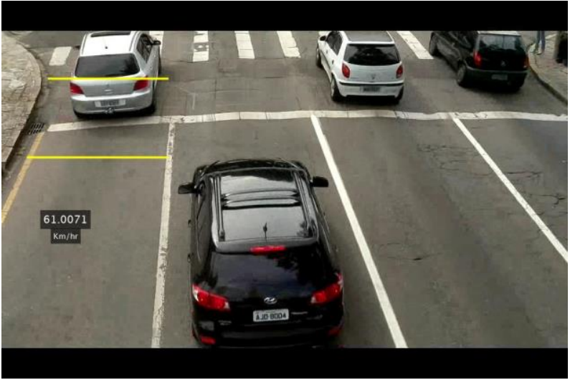
Methodology
Training the Dataset Using YOLO v2 Algorithm
Car Detection
Lane Selection
Speed Measurement
Position Mapping

Slide 9
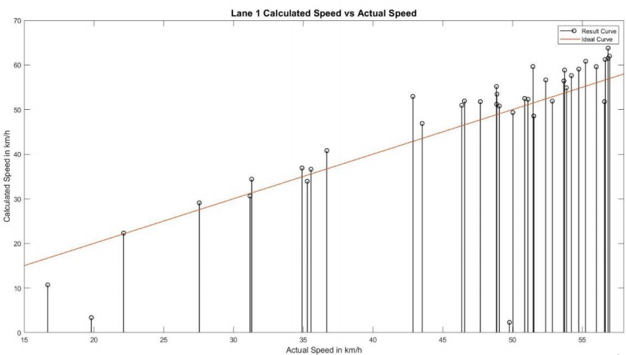
Analysis
The error was almost 11%(max). It’s not perfect but it’s an exciting start for us!

Slide 10
We’ll proceed for further improvement-
Decrease the error to 5%
Train our program for more types of vehicle
Modify the program to work for multiple lanes

Slide 11


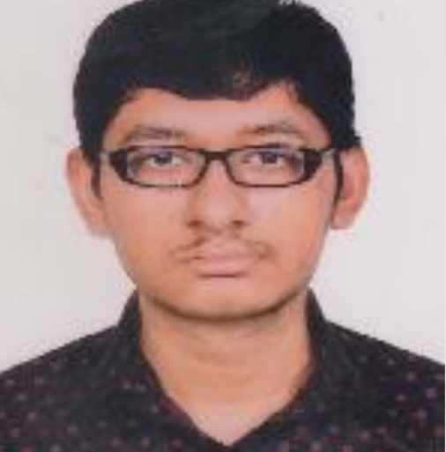

Presented by
Monirul Islam
1706042
Fariza Siddiqua
1706043
Shuvro Chowdhury
1706044
A.F.M. Mahfuzul Kabir Sourav
1706045

