Slide 1
Fraud Detection in Banking Data by Machine Learning Techniques
PROJECT GUIDE – PROF Dr.S.RATHI ME.,Ph.D
PRESENTED BY,
2018102 - AJMAL FARIZ M
2018113 - GOKUL R
2018L05 - ARAVIND M 2018L12 - KIRAN R V

Slide 2
Objective
To Develop and implement an efficient machine learning-based fraud detection system for Credit card banking data to:
Identify fraudulent transactions.
Minimize false positives.
Ensure adaptability and scalability.
Enhance customer trust.
Maintain compliance with regulations.
Continuously enhance fraud detection capabilities.
Prioritize data security and efficiency.

Slide 3
Existing Method
To classify fraudulent transactions from legitimate ones, the Information Gain method was employed for the selection of important features from the dataset.And various algorithms, including Logistic Regression, LightGBM, XGBoost, and CatBoost, were implemented and evaluated.
In order to enhance the model's efficiency, the Majority Voting ensemble learning method was applied to merge two or more distinct models, such as Vot_Lg, Xg, Ca, as well as Vot_Lg, Xg, Vot_Xg, Ca, and Vot_Lg, Ca. The effectiveness of these combinations was also assessed.
Bayesian optimization and class weight tuning were performed for each model.
The model was trained and tested using a 5-fold cross-validation technique.
The model's performance was assessed using the following metrics: Accuracy, ROC-AUC(Receiver Operating Characteristic - Area Under the Curve), Recall, Precision, F1-score, and MCC (Matthews Correlation Coefficient).

Slide 4
Disadvantages(Issue in Existing Method)
Addressing data imbalance through specific techniques.
Feature engineering possibilities are constrained.
Sole reliance on a single feature selection method.
Occurrence of false positives.
Occurrence of false negatives.

Slide 5
Proposed Method
The implementation of a multilayer Artificial Neural Network (ANN) with Bayesian optimization and fine-tuning of class weights to address the issue of unbalanced data.
Enhancing the existing majority voting method of LightGBM and Extreme Boosting by employing diverse feature selection techniques, such as Correlation Analysis and Recursive Feature Addition.
Choosing the most effective approach between SMOTE (Synthetic Minority Over-sampling Technique) and class weight tuning to rectify the imbalanced data problem.
Deployment of the model and conducting testing using a real time bank customer CSV file, followed by the presentation of the counts of fraudulent and legitimate transactions.

Slide 6
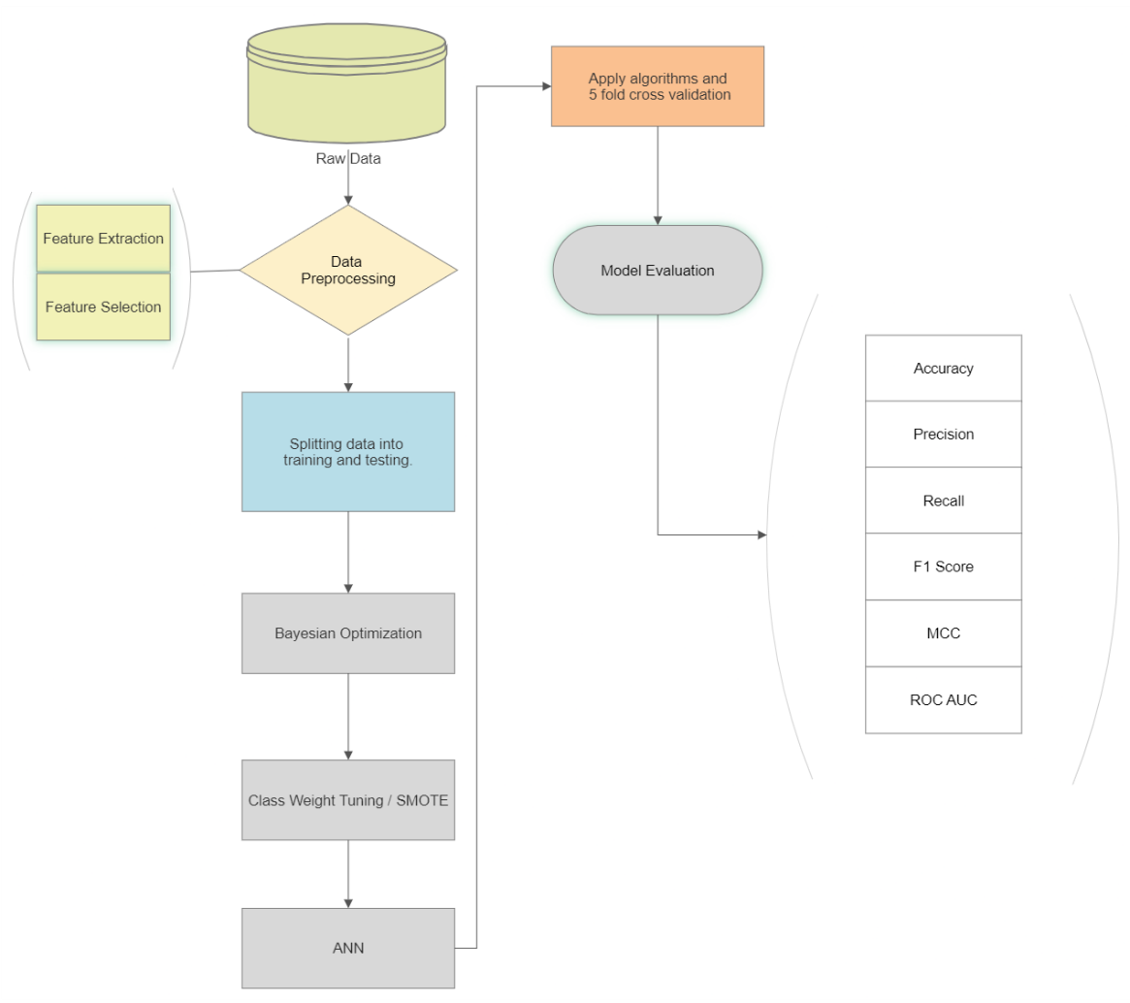
System functions

Slide 7
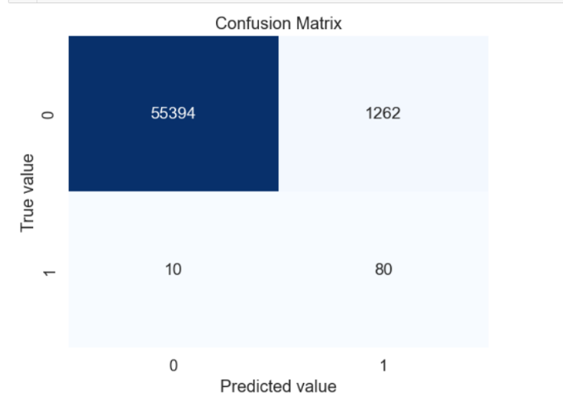
Evaluation metrics
Accuracy = (TP + TN) / (TP + TN + FP + FN)
Recall = TP / (TP + FN)
Precision = TP / (TP + FP)
2 * (precision * recall)
F1_score =
(precision + recall)
(TP * TN - FP * FN)
MCC =
√(TP+FP)(TP+FN)(TN+FP)(TN+FN)

Slide 8
Hardware/Software Requirement
Hardware
A computer with sufficient processing power, preferably with GPU support.
RAM Memory of minimum 8GB needed.
Software
Python,
Machine Learning Libraries,
IDE,
Data Visualization Tools.

Slide 9
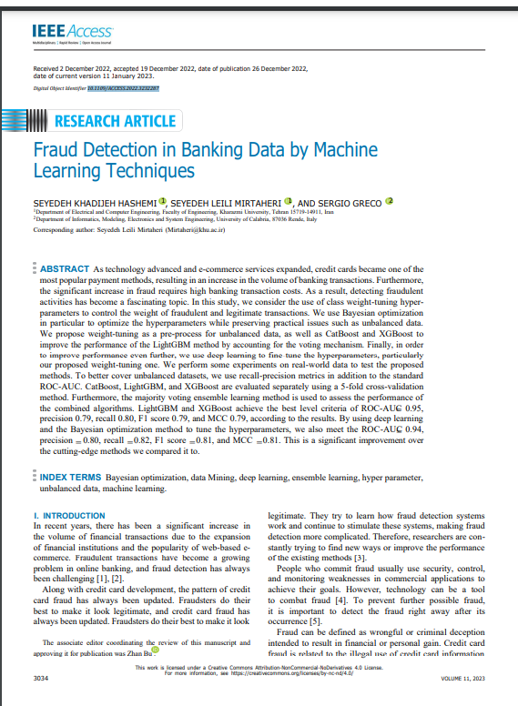
Base paper
DOI : 10.1109/ACCESS.2022.3232287
Drive Link:
https://drive.google.com/file/d/1B4t79wdCkub8B6bF04QYU0e54PismtJ2/view?usp=sharing

