Slide 1
Fraud Detection in Banking Data by Machine Learning Techniques
Review - 1
PROJECT GUIDE – PROF Dr.S.RATHI ME.,Ph.D
PRESENTED BY,
2018102 - AJMAL FARIZ M
2018113 - GOKUL R
2018L05 - ARAVIND M 2018L12 - KIRAN R V

Slide 2
Problem Identification
To Develop and implement an efficient machine learning-based fraud detection system for Credit card banking data to:
Identify fraudulent transactions.
Minimize false positives.
Ensure adaptability and scalability.
Enhance customer trust.
Maintain compliance with regulations.
Continuously enhance fraud detection capabilities.
Prioritize data security and efficiency.

Slide 3
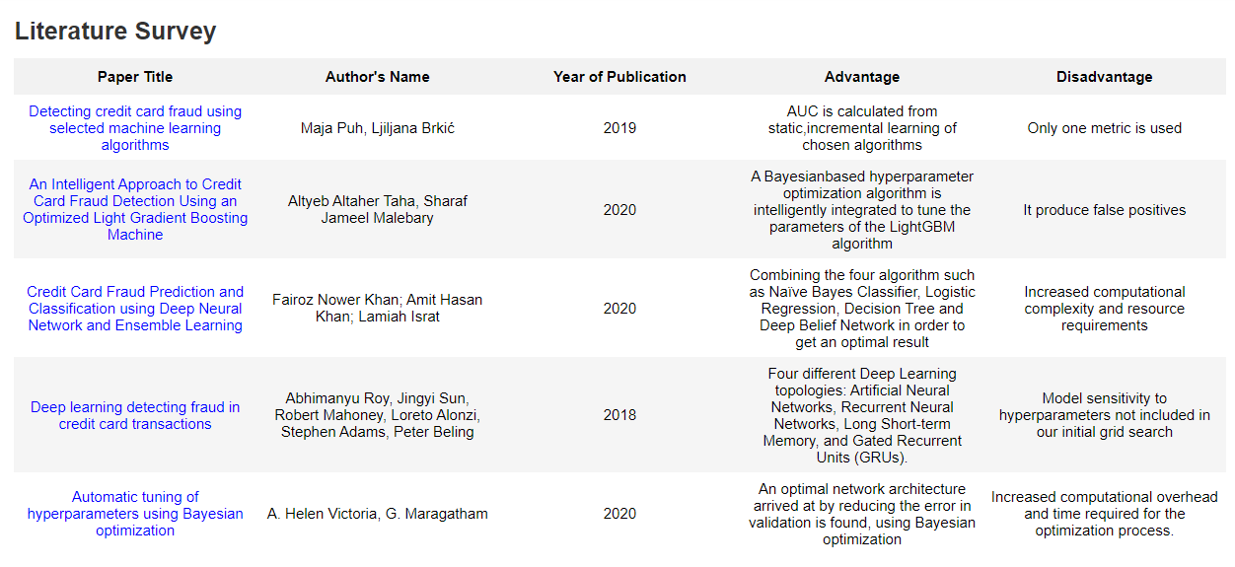

Slide 4
Implementation in the Base Paper
To classify fraudulent transactions from legitimate ones, the Information Gain method was employed for the feature selection.And algorithms such as Logistic Regression, LightGBM, XGBoost, and CatBoost, were implemented and evaluated.
In order to enhance the model's efficiency, the Majority Voting ensemble learning method was applied to merge two or more distinct models, such as Vot_Lg, Xg, Ca, as well as Vot_Lg, Xg, Vot_Xg, Ca, and Vot_Lg, Ca. The effectiveness of these combinations was also assessed.
The implementation of a multilayer Artificial Neural Network (ANN) model.
Bayesian optimization and class weight tuning were performed for each model.
The model was trained and tested using a 5-fold cross-validation technique.
The model's performance was assessed using the following metrics: Accuracy, ROC-AUC(Receiver Operating Characteristic - Area Under the Curve), Recall, Precision, F1-score, and MCC (Matthews Correlation Coefficient).

Slide 5
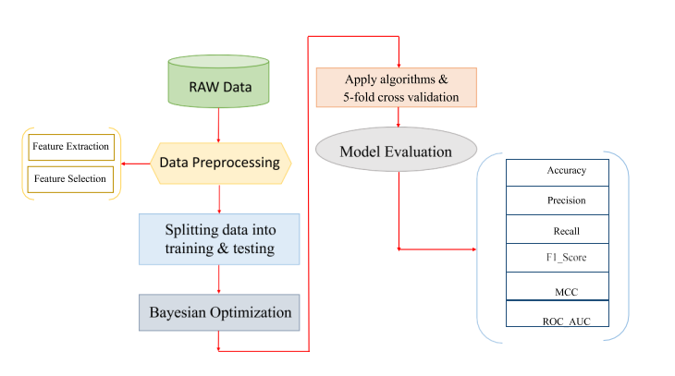
System functions

Slide 6
Modules
Process 1 : Gather Sense of Our Data
Process 2: Data Preprocessing Process 2(a): Feature Extraction Process 2(b): Feature Selection
Process 3: Bayesian Optimization
Process 4: Classifier Models
Process 5: Five Fold Cross Validation
Process 6: Model Evaluation

Slide 7
Process 1 : Gather Sense of Our Data
Link:https://www.kaggle.com/datasets/mlg-ulb/creditcardfraud
The dataset contains transactions made by credit cards in September 2013 by European cardholders. This dataset presents transactions that occurred in two days, where we have 492 frauds out of 284,807 transactions. The dataset is highly unbalanced, the positive class (frauds) account for 0.172% of all transactions.
It contains only numerical input variables which are the result of a PCA transformation. Features V1, V2, … V28 are the principal components obtained with PCA, the only features which have not been transformed with PCA are 'Time' and 'Amount'. Feature 'Time' contains the seconds elapsed between each transaction and the first transaction in the dataset. The feature 'Amount' is the transaction Amount,Feature 'Class' is the response variable and it takes value 1 in case of fraud and 0 otherwise.

Slide 8
Process 2: Data Preprocessing
Remove Null values
Remove Duplicate rows from the dataset
Process 2(a): Feature Extraction
The feature extraction process involves expanding the "time" feature to extract additional temporal information. Specifically, we derive two new features: "hour" and "second". This extraction allows us to gain more detailed insights into the timing of transactions.

Slide 9
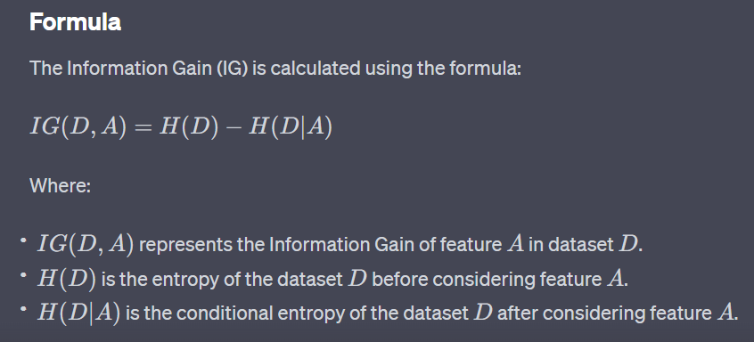
Process 2(b): Feature Selection
The Information Gain method is a commonly used technique in the field of machine learning and decision tree-based algorithms. It is employed to determine the relevance of a feature in a dataset when constructing decision trees or making decisions based on data.

Slide 10
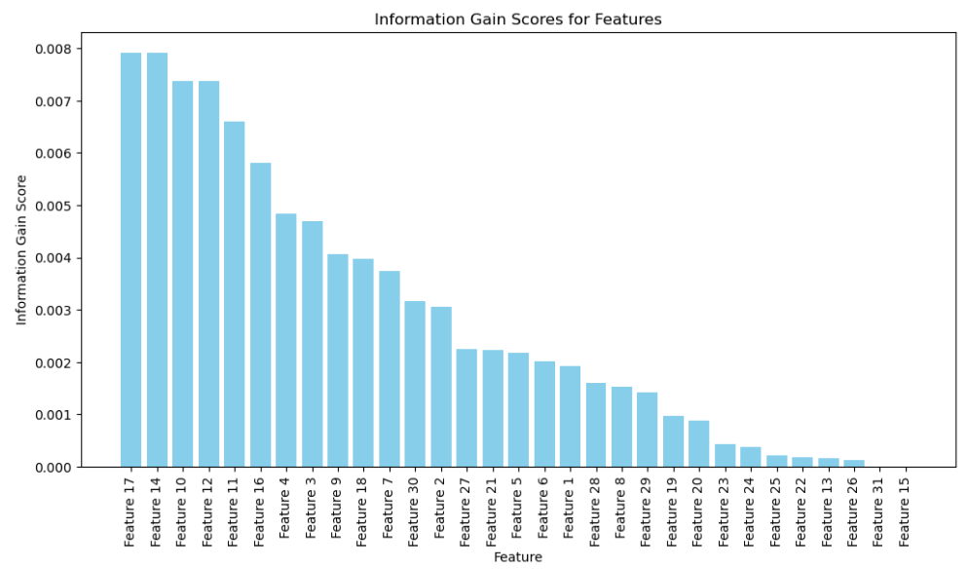

Slide 11
Process 3: Bayesian Optimization
Bayesian optimization is a powerful technique used primarily in the field of machine learning and optimization for finding the optimal set of hyperparameters for complex, computationally expensive functions. It is particularly useful in scenarios where the objective function is costly to evaluate, as it aims to minimize the number of function evaluations required to find the best parameter configuration

Slide 12
Process 4: Classifier Models
Model 1: Logistic Regression
Activation Function - Sigmoid
Gradient Descent Algorithm
Cost Function

Slide 13
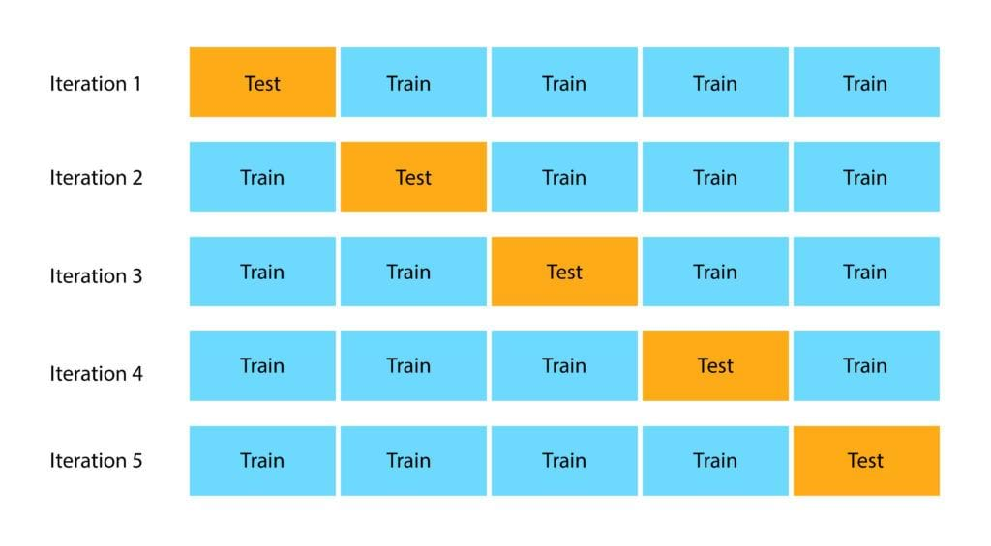
Process 5: Five Fold Cross Validation

Slide 14
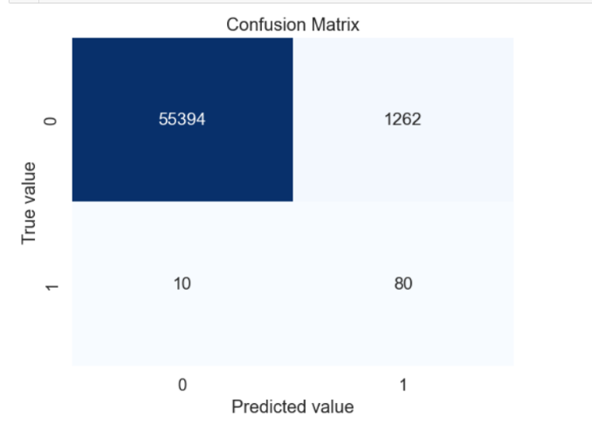
Process 6: Model Evaluation
Accuracy = (TP + TN) / (TP + TN + FP + FN)
Recall = TP / (TP + FN)
Precision = TP / (TP + FP)
2 * (precision * recall)
F1_score =
(precision + recall)
(TP * TN - FP * FN)
MCC =
√(TP+FP)(TP+FN)(TN+FP)(TN+FN)

