Slide 1

EDGE ICT
Python Django-Machine Learning Project
Farjana Jabin Ava
Email: it19009@mbstu.ac.bd
Dept. of ICT, MBSTU, Tangail-1902
29 Jan 2025, MBSTU, Tangail

Slide 2
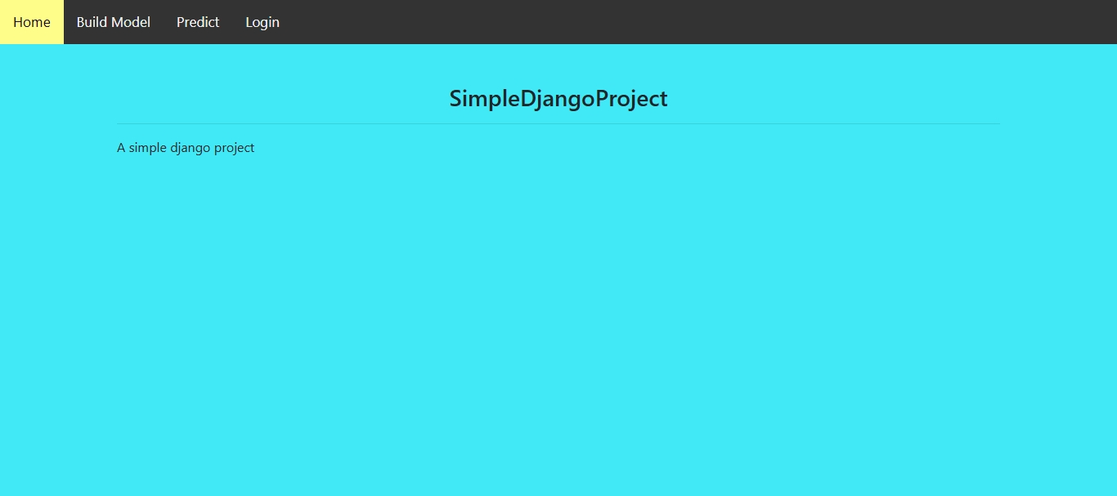
HOME PAGE

Slide 3
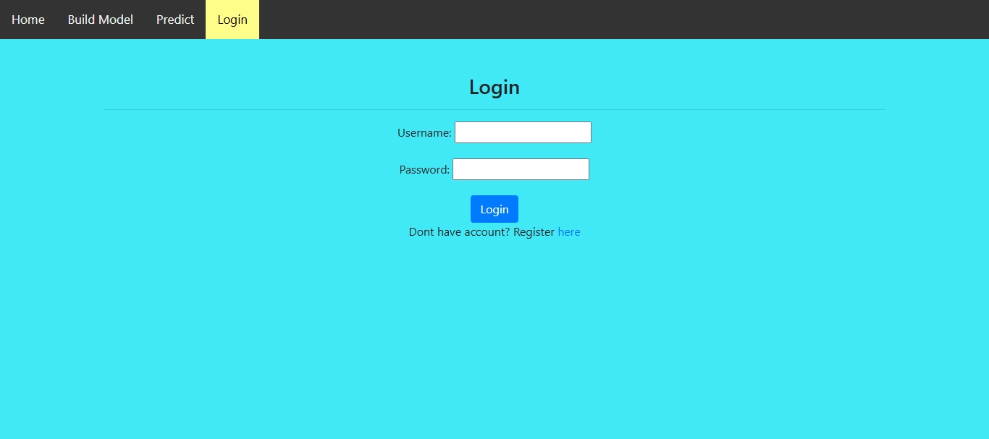
LOGIN PAGE

Slide 4
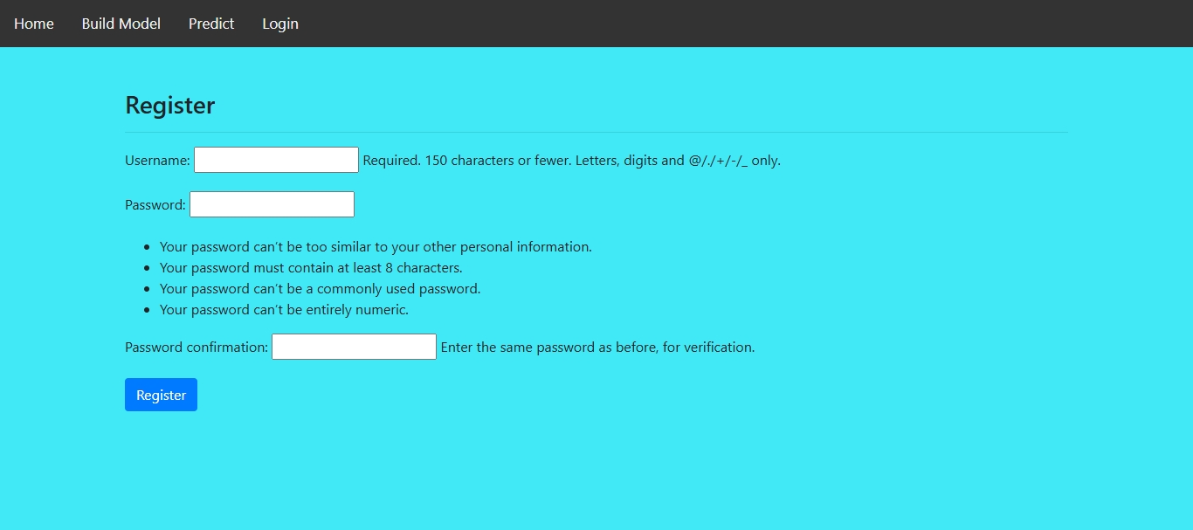
REGISTRATION PAGE

Slide 5
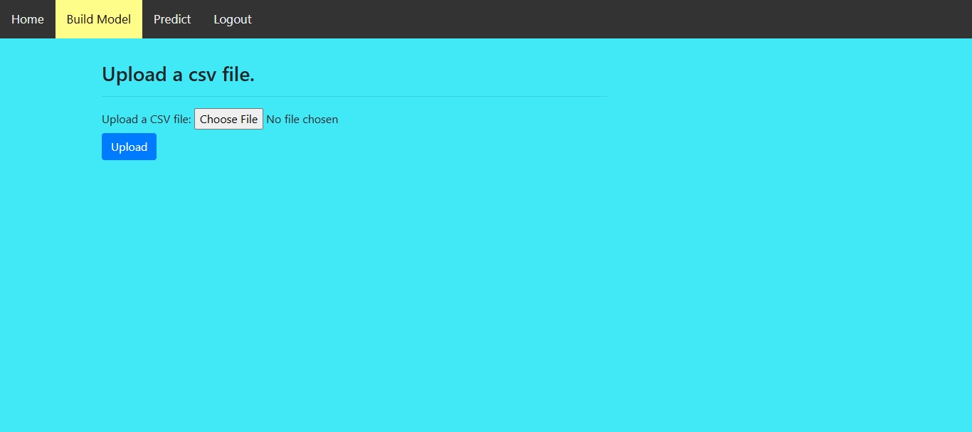
Building Machine Learning Model

Slide 6
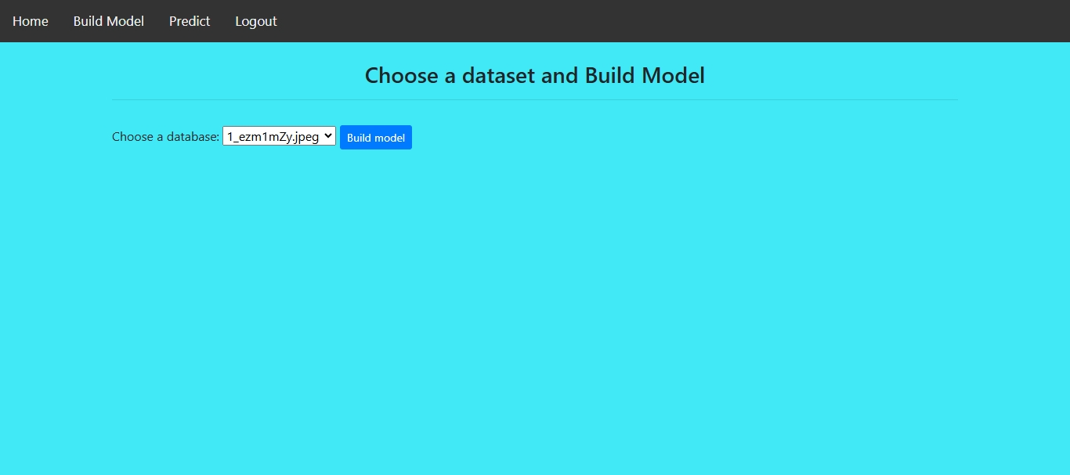
Upload DATASET

Slide 7
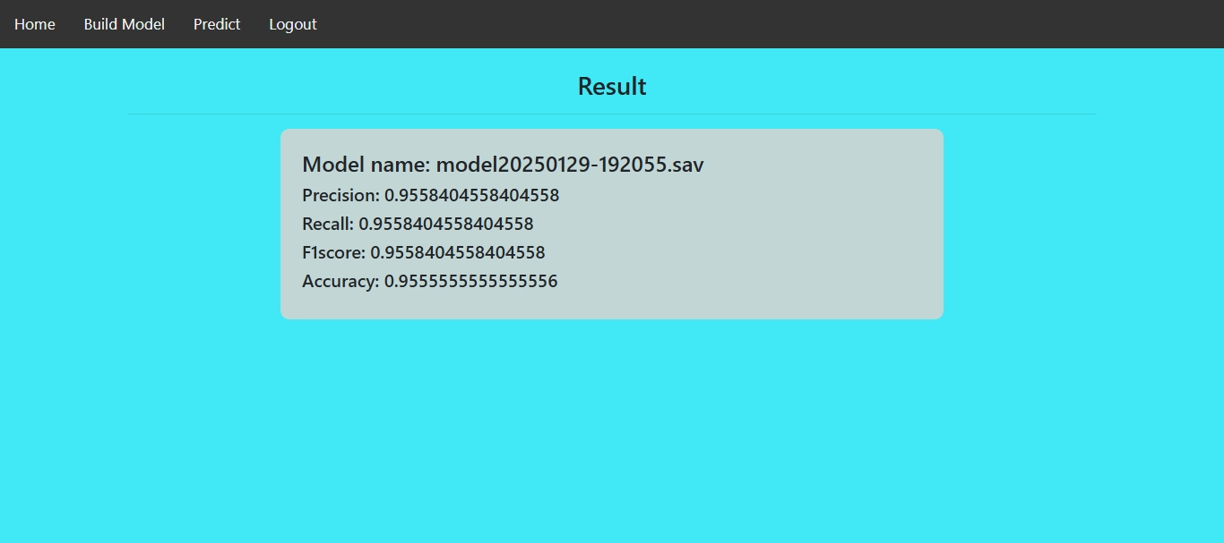
MODEL PERFORMANCE

Slide 8
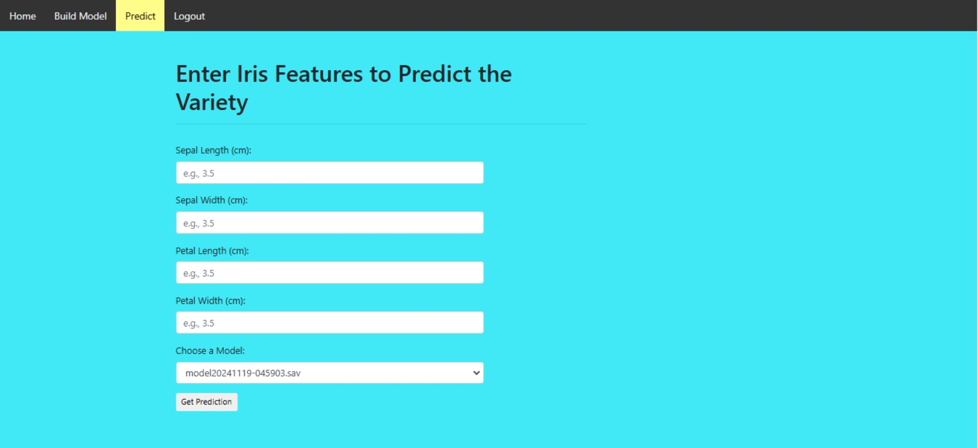
PREDICTION

Slide 9
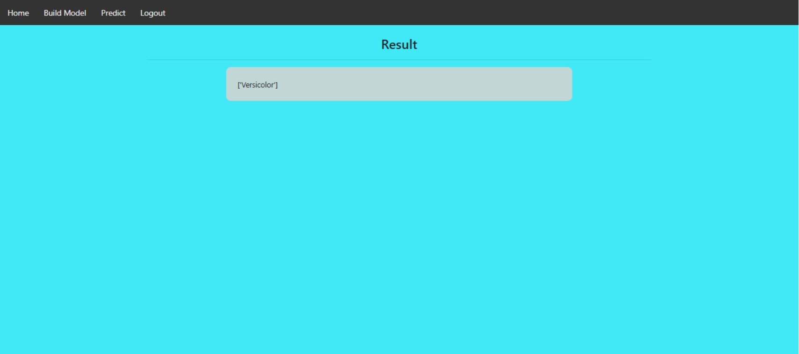
RESULT

Slide 10
Thanks

