Slide 1
Solution of Equations
Using Cramar’s Rule
1

Slide 2
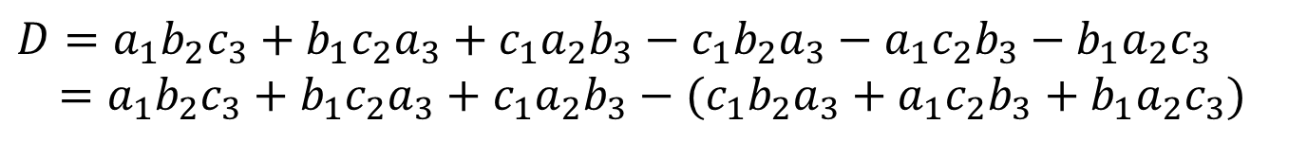
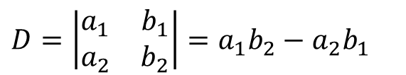
Calculation of Determinant
$D=\left|\begin{matrix}a_{1} & b_{1} \\ a_{2} & b_{2}\end{matrix}\right|=a_{1}b_{2}−a_{2}b_{1}$
(+)
(+)
(+)
(−)
(−)
(−)
c₁b₂a₃
a₁c₂b₃
b₁a₂c₃
a₁b₂c₃
b₁c₂a₃
c₁a₂b₃
$$D=a_{1}b_{2}c_{3}+b_{1}c_{2}a_{3}+c_{1}a_{2}b_{3}−c_{1}b_{2}a_{3}−a_{1}c_{2}b_{3}−b_{1}a_{2}c_{3} \\ =a_{1}b_{2}c_{3}+b_{1}c_{2}a_{3}+c_{1}a_{2}b_{3}−(c_{1}b_{2}a_{3}+a_{1}c_{2}b_{3}+b_{1}a_{2}c_{3})$$
$$D=a_{1}b_{2}c_{3}+a_{2}b_{3}c_{1}+a_{3}b_{1}c_{2}−(a_{3}b_{2}c_{1}+a_{1}b_{3}c_{2}+a_{2}b_{1}c_{3})$$
2

Slide 3
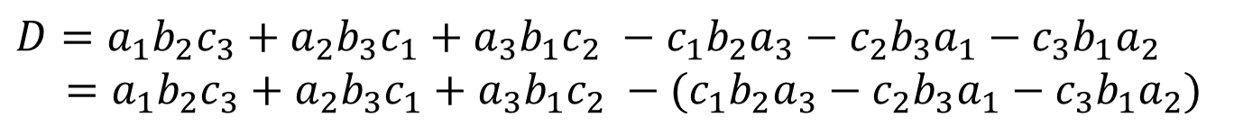
c₁b₂a₃
(−)
(+)
a₁b₂c₃
c₂b₃a₁
(−)
(+)
a₂b₃c₁
c₃b₁a₂
(−)
(+)
a₃b₁c₂
$$D=a_{1}b_{2}c_{3}+a_{2}b_{3}c_{1}+a_{3}b_{1}c_{2} −c_{1}b_{2}a_{3}−c_{2}b_{3}a_{1}−c_{3}b_{1}a_{2} \\ =a_{1}b_{2}c_{3}+a_{2}b_{3}c_{1}+a_{3}b_{1}c_{2} −(c_{1}b_{2}a_{3}−c_{2}b_{3}a_{1}−c_{3}b_{1}a_{2})$$
$$D=a_{1}b_{2}c_{3}+a_{2}b_{3}c_{1}+a_{3}b_{1}c_{2}−(a_{3}b_{2}c_{1}+a_{1}b_{3}c_{2}+a_{2}b_{1}c_{3})$$

Slide 4
Equation Solution with Two variables x and y
Calculate the Determinants (which is used to calculate the value of y) x column and replacing y column by constant column:
c₁
c₂
= a₂c₂ − a₂c₁
Calculate the Determinants using x and y columns:
Now, x and y can be calculated as follows:
Calculate the Determinants (which is used to calculate the value of x) replacing x column by constant column and y columns:
c₁b₂ − c₂b₁
c₁
c₂
a₂c₂ − a₂c₁
= c₁b₂ − c₂b₁
4

Slide 5
Equation Solution with Three Variables x, y, and z
Calculate the Determinants (which is used to calculate the value of y) x column, replacing y column by constant column: and z columns :
d₁
d₂
d₃
Calculate the Determinants using x, y and z columns:
Calculate the Determinants (which is used to calculate the value of z) x column, y column and replacing z column by constant column:
Calculate the Determinants (which is used to calculate the value of x) replacing x column by constant column, y and z columns:
d₁
d₂
d₃
d₁
d₂
d₃
Now, x, and y and z can be calculated as follows:
5

Slide 6
Chapter 8 (DC) 17 (AC)
Methods of Analysis
And Selected Topics
6

Slide 7

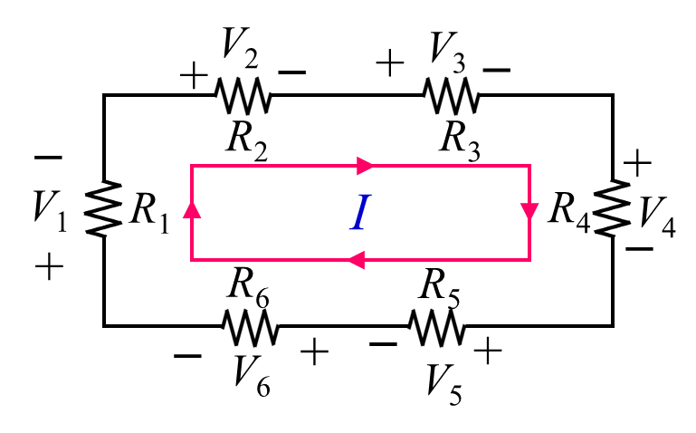
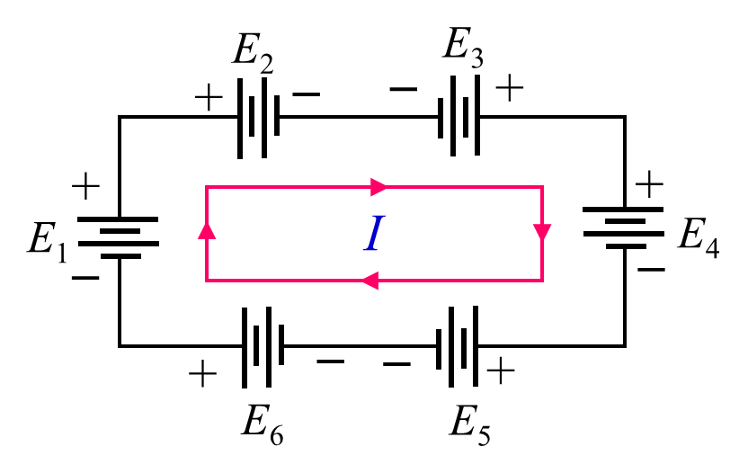
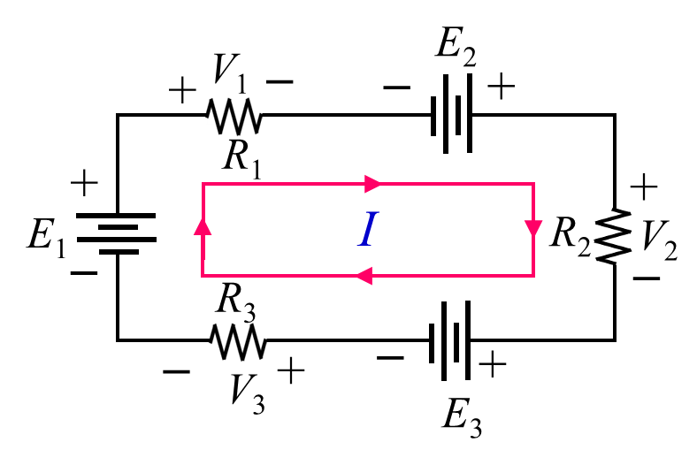
Kirchhoff’s Voltage Law [KVL]
In closed path, according to KVL: Summation of Voltage Drop = Summation of Voltage Rise
Positive if current entering through positive terminal.
Negative if current entering through negative terminal.
Positive if current entering through negative terminal.
Negative if current entering through positive terminal.
7

Slide 8
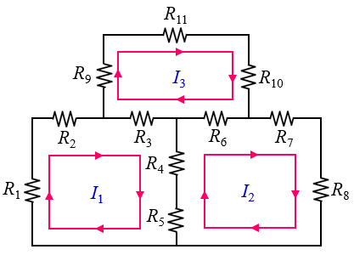
If a resistor has two or more assumed currents through it, the total current through the resistor is the assumed current of the loop in which Kirchhoff’s voltage law is being applied, plus the assumed currents of the other loops passing through in the same direction, minus the assumed currents through in the opposite direction.
Example: Write the loop equations for the following circuit.
Loop 1:
8

Slide 9
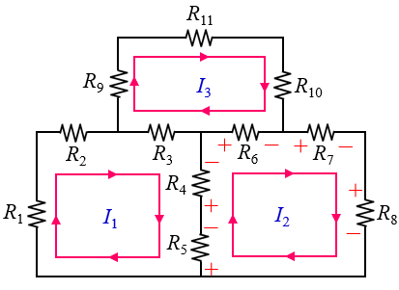
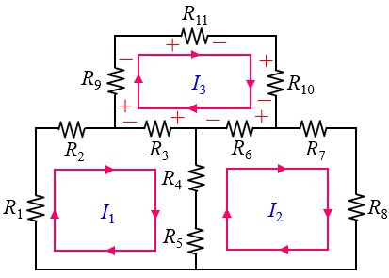
Loop 2:
Loop 3:
9

Slide 10
Three the loop equations for the following circuit.
Loop 1:
Loop 2:
Loop 3:
10

Slide 11
8.7 MESH ANALYSIS
11

Slide 12
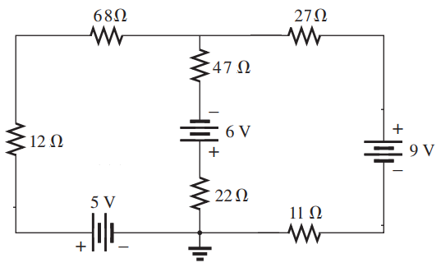
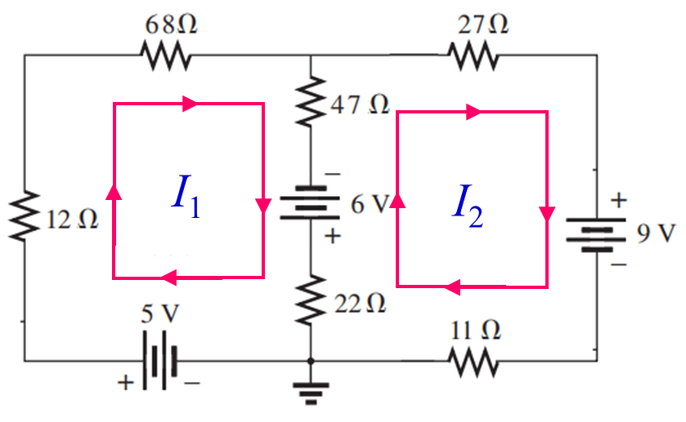
8.7 MESH ANALYSIS
Step 1: Assign a distinct current in the clockwise direction to each independent, closed loop of the network. It is not absolutely necessary to choose the clockwise direction for each loop current.
Step 2: 2. Indicate the polarities within each loop for each resistor as determined by the assumed direction of loop current for that loop.
+
−
+
−
+
−
−
+
−
I₁
I₂
+
+
−
−
+
−
+
12

Slide 13
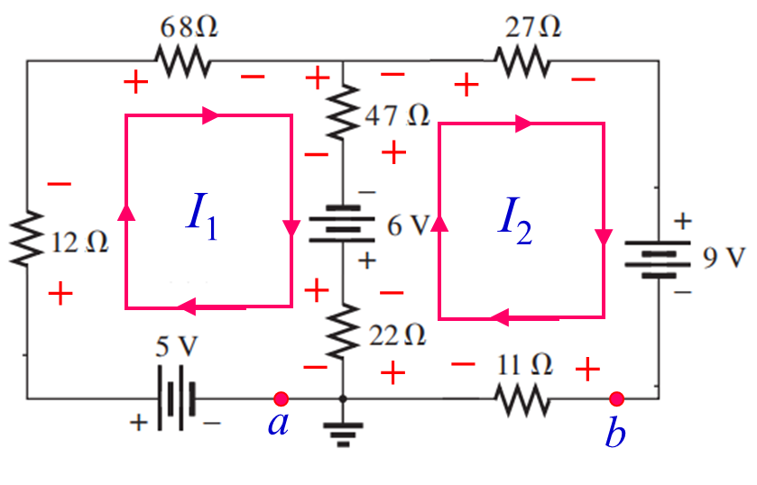
Step 3: Apply Kirchhoff’s voltage law around each closed loop in the clockwise direction. [Consider voltage is positive if current entering through negative terminal of an elements and voltage is negative if current entering through positive terminal of an elements]
a. If a resistor has two or more assumed currents through it, the total current through the resistor is the assumed current of the loop in which Kirchhoff’s voltage law is being applied, plus the assumed currents of the other loops passing through in the same direction, minus the assumed currents through in the opposite direction.
b. The polarity of a voltage source is unaffected by the direction of the assigned loop currents.
Loop 1: From a terminal
Loop 2: From b terminal
13

Slide 14
Step 4: Solve the resulting simultaneous linear equations for the assumed loop currents.
11V
−15V
11V
−15V
14

Slide 15
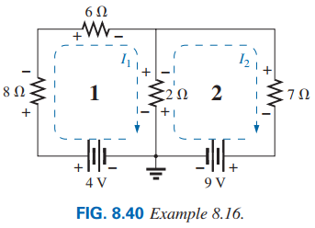
EXAMPLE 8.16 Write the mesh equations for the network in Fig. 8.40, and find the current through the 8 Ω and 7 Ω resistors.
15

Slide 16
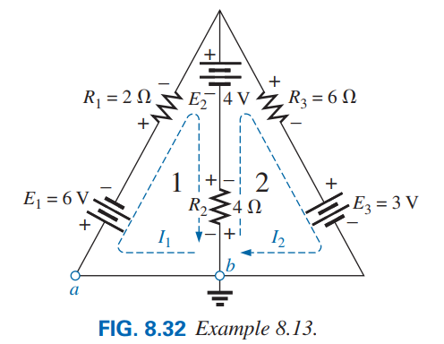
EXAMPLE 8.13 Write the mesh equations for the network in Fig. 8.32, and find the branch currents.
16

Slide 17
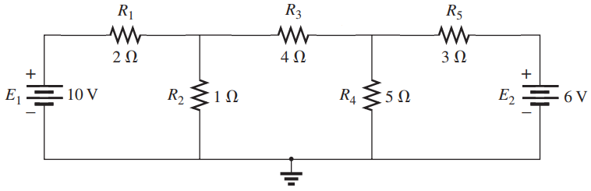

EXAMPLE 8.7.1 (a) Write the mesh equations for each loop of the networks. (b) Using determinants, solve for the loop currents. (b) Find the current of each branch.
−
+
−
+
−
+
+
−
+
−
I₁
I₂
−
+
I₃
−
+
a
b
c
Loop 1: Start from point a
Loop 3: Start from point c
Putting the values of resistances and voltages:
Loop 2: Start from point b
17

Slide 18
10V
0V
−6V
10V
0V
−6V
10V
0V
−6V
18

Slide 19
10V
0V
−6V
Check or Justification of Results:
19

Slide 20
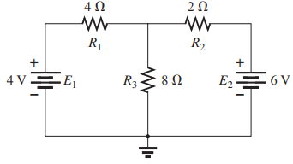
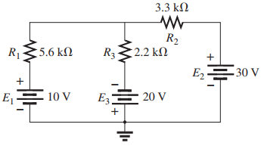
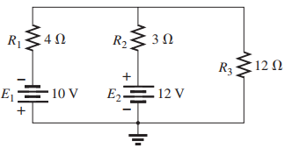
Write the mesh/loop equations for the following networks.
I₁
I₂
I₁
I₂
I₁
I₂
20

Slide 21
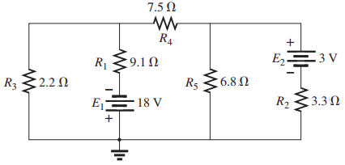
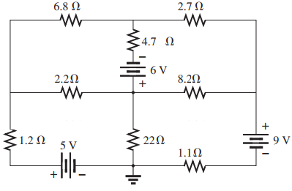
Write the mesh/loop equations for the following networks.
I₃
I₄
I₁
I₂
I₃
I₁
I₂
Practice Book [Ch 8] Problem: 28 ~ 34
21

Slide 22
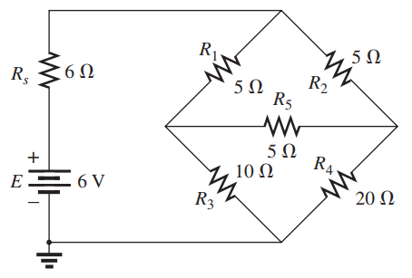
Write the mesh/loop equations for the following networks.
I₂
I₁
I₃
22

Slide 23
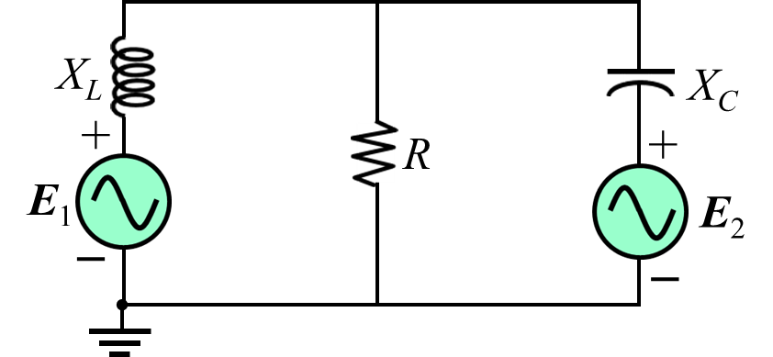
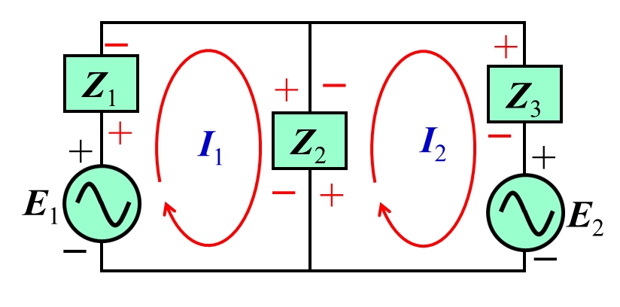
EXAMPLE 17.5: For the following circuit having E₁ = 2V∠0º, E₂ = 6V∠0º, R = 4 Ω, X_{L} = 2 Ω and X_{C} = 1 Ω:
(a) Write the mesh equations for each loop of the networks. (b) Using determinants, solve for the loop currents. (c) Find the current of each branch.
Loop 1:
Loop 2:
Loop equations in matrix form as follows:
Solution: The network is redrawn in Fig. (a) with subscripted impedances:
23

Slide 24
I_{L}
I_{R}
I_{C}
I₁
I₂
Since I₂ greater than I₁, the current pass through the R in upward direction is as follows:
24

Slide 25
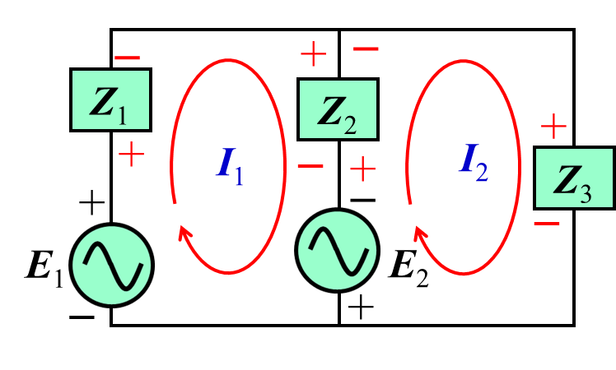
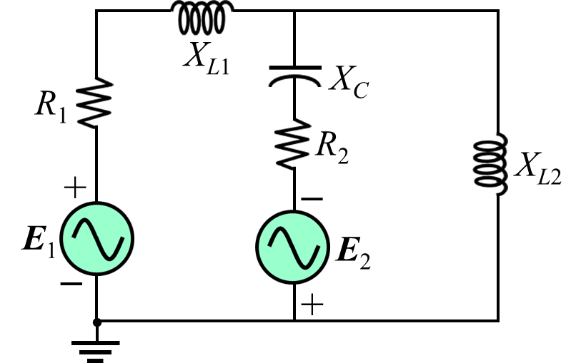
EXAMPLE 17.5: For the following circuit having
E₁ = 8V∠20º, E₂ = 10V∠0º, R₁ = 1 Ω, X_{L1} = 2 Ω ,
R₂ = 4 Ω, X_{C} = 8 Ω and X_{L2} = 6 Ω:
(a) Write the mesh equations for each loop of the networks.
(b) Using determinants, solve for the loop currents.
(c) Find the current of each branch.
Loop 1:
Loop 2:
Loop equations in matrix form as follows:
Here,
Solution: The network is redrawn in Fig. (a) with subscripted impedances:
25

Slide 26
I_{Z2}
I_{Z3}
I_{Z1}
I₁
I₂
Since I₂ greater than I₁, the current pass through the Z₂ in upward direction is as follows:
26

Slide 27
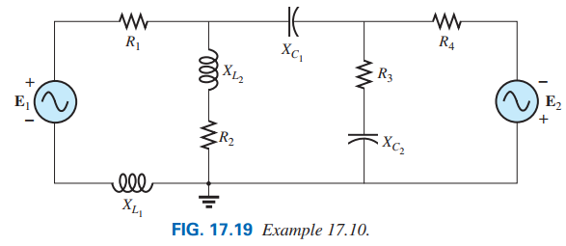
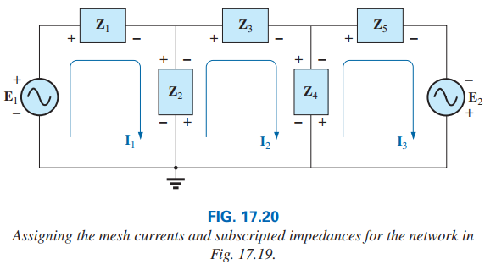

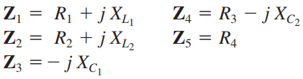

EXAMPLE 17.10: For the following circuit Write the mesh equations for each loop of the networks.
Solution: The network is redrawn in Fig. 17.20 with subscripted impedances:
Loop 1:
Loop 2:
Loop 3:
27

Slide 28
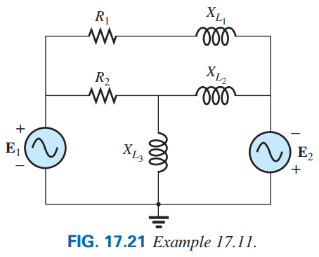
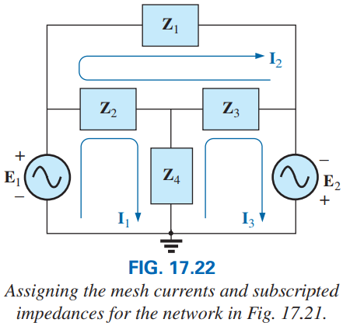

EXAMPLE 17.11: For the following circuit Write the mesh equations for each loop of the networks.
Solution: The network is redrawn in Fig. 17.22 with subscripted impedances:
Loop 1:
Loop 2:
Practice Book [Ch 17] Problem: 5 ~ 8
Loop 3:
28

