Slide 1
Chapter 8 (DC) 17 (AC)
Methods of Analysis
And Selected Topics
1

Slide 2
8.9 NODAL ANALYSIS
Steps of Nodal Analysis:
Convert voltage sources to current sources.
Determine the number of nodes within the network.
2. Pick a reference node, and label each remaining node with a subscripted value
of voltage: V₁, V₂, and so on.
3. Apply Kirchhoff’s current law (KCL) at each node except the reference. Assume that:
(a) all unknown currents leave the node for each application of Kirchhoff’s
current law (KCL).
(b) Each node is to be treated as a separate entity, independent of the
application of KCL to the other nodes.
4. Solve the resulting equations for the nodal voltages.
2

Slide 3
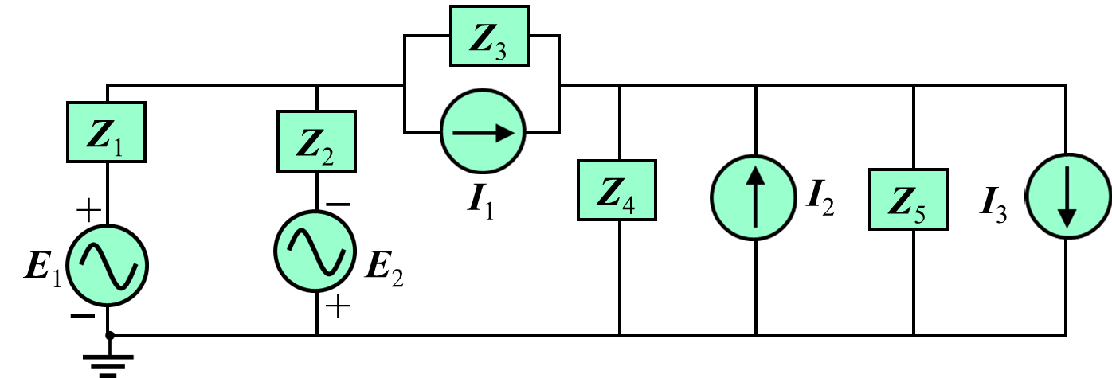
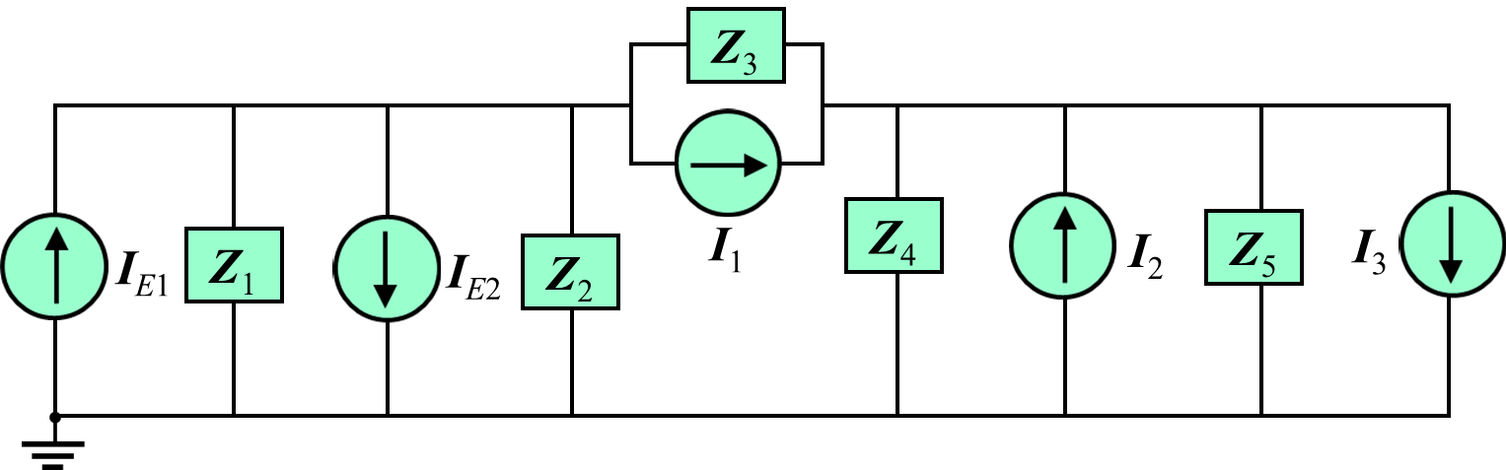
Developed Nodal Equations for the Following Circuit:
Step 1: Convert voltage sources to current sources.
Here:
3

Slide 4
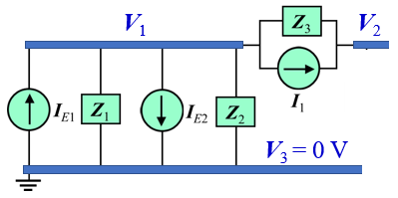
Step 2 and Step 3:
V₁
V₂
Consider node 3 as a reference i.e.
V₃ = 0 V
V₃ = 0 V
Consider node V₁:
Write the Nodal Equation by Applying Kirchhoff’s current law (KCL):
Assume all unknown currents leave the node
I_{Z3}
I_{Z1}
I_{Z2}
4

Slide 5
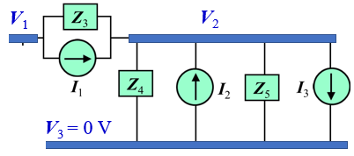
Consider node V₂:
Write the Nodal Equation by Applying Kirchhoff’s current law (KCL):
Assume all unknown currents leave the node
I_{Z3}
I_{Z4}
I_{Z5}
Nodal equations in matrix form as follows:
5

Slide 6
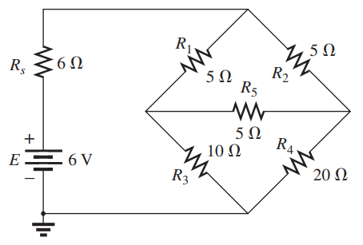
Write the nodal equations for the following networks.
V₁
V₂
V₃
6

Slide 7
Example
NODAL ANALYSIS [DC]
7

Slide 8
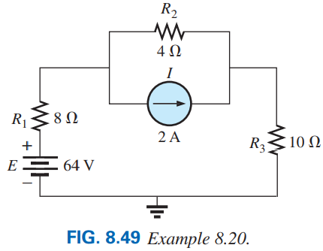
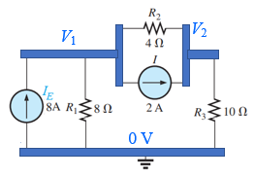
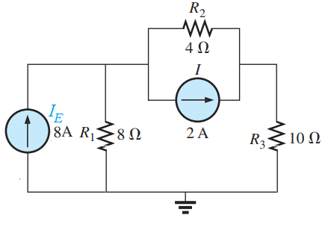
EXAMPLE 8.20 Apply nodal analysis to the network in Fig. 8.49.
Step 1 and 2: The network has three nodes with the bottom node defined as the reference node (at ground potential, or zero volts), and the other nodes as V₁ and V₂.
Step 3: For node V₁, the currents are defined as shown in the following Figure (b) and Kirchhoff’s current law is applied:
I₂
Solution: Convert the voltage sources to current sources as shown in Figure (a).
I₁
V₁
V₂
(b)
0 V
(a)
8

Slide 9
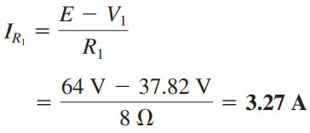
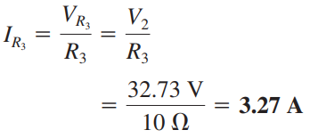
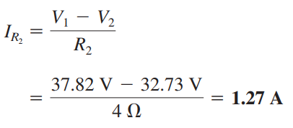
For node V₂, the currents are defined as shown in the following Figure (c) and Kirchhoff’s current law is applied:
I₂
I₃
(c)
9

Slide 10
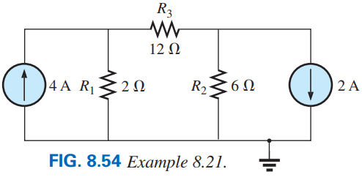
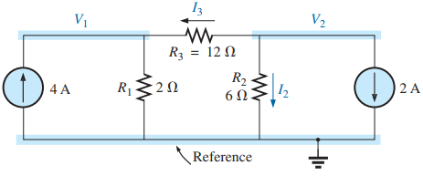
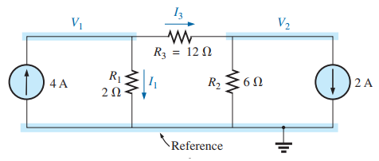
Step 3: For node V₁, the currents are defined as shown in the following Figure (a) and Kirchhoff’s current law is applied:
For node V₂, the currents are defined as shown in the following Figure (b) and Kirchhoff’s current law is applied:
Step 1 and 2: The network has three nodes with the bottom node defined as the reference node (at ground potential, or zero volts), and the other nodes as V₁ and V₂.
(b)
(a)
10

Slide 11
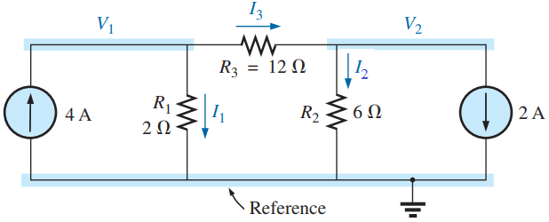



Here, V₁> V₁
11

Slide 12
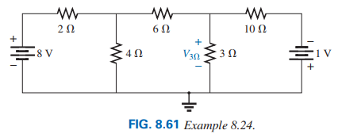
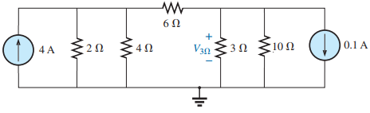
EXAMPLE 8.24 Find the voltage across the 3 Ω resistor in Fig. 8.61 by nodal analysis.
Step 3: For node V₁, the currents are defined as shown in the following Figure (b) and Kirchhoff’s current law is applied:
For node V₂:
Solution: First convert two voltage sources to current sources.
V₁
V₂
Simplified form:
Step 1 and 2: The network has three nodes with the bottom node defined as the reference node (at ground potential, or zero volts), and the other nodes as V₁ and V₂.
12

Slide 13
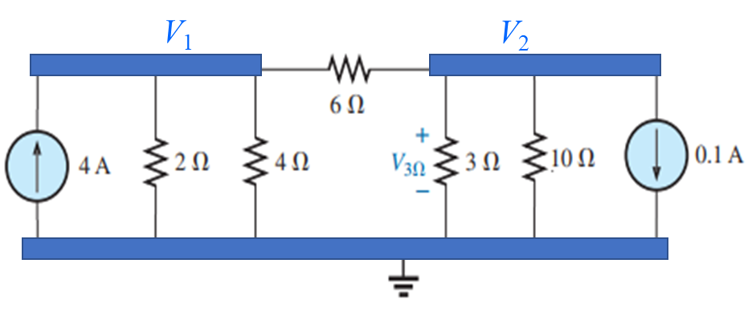
Current of branches:
13

Slide 14
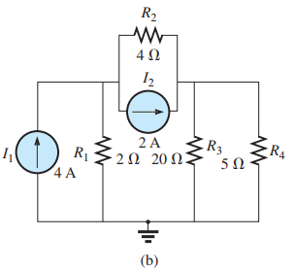
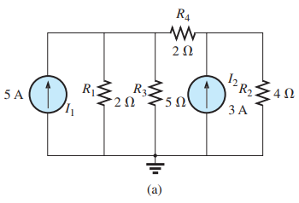
Write the nodal equations for the following networks.
V₁
V₂
V₁
V₂
14

Slide 15
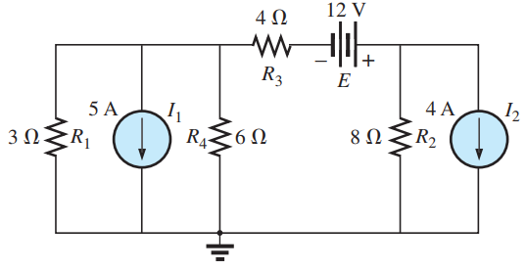
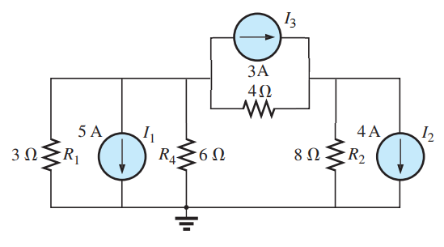
Write the nodal equations for the following networks.
V₁
V₂
15

Slide 16
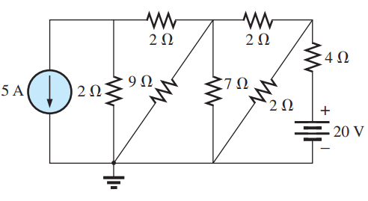
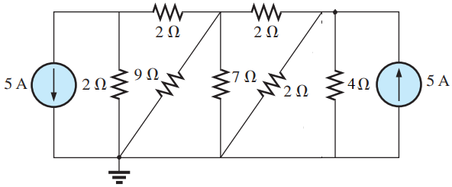
Write the nodal equations for the following networks.
V₁
V₂
V₃
Practice Book [Ch 8] Problem: 41 ~ 44
16

Slide 17
Example
NODAL ANALYSIS [AC]
17

Slide 18
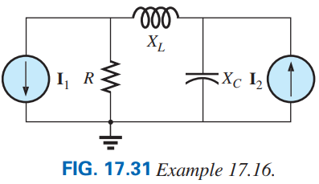
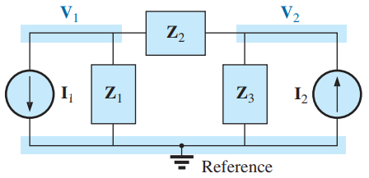
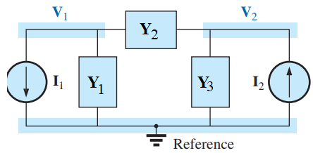
EXAMPLE 17.16: Find the voltage across the resistor R, and X_{C} in Fig. 17.31 by nodal analysis.
Here, R = 4 Ω, X_{L} = 5 Ω, X_{C} = 2 Ω, I₁ = 6A∠0º, and I₂ = 4A∠0º.
Solution: The network is redrawn in Fig. 17.32 with subscripted impedances:
Nodal equation for V₁:
Nodal equation for V₂:
Nodal equations in matrix form as follows:
18

Slide 19
19

Slide 20
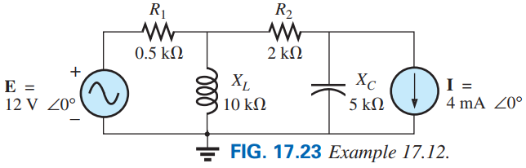
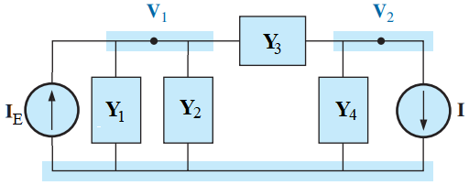
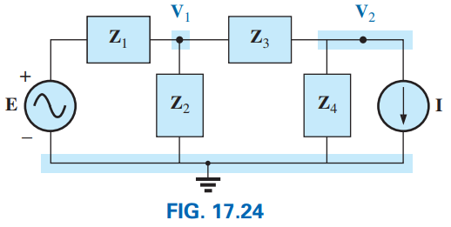
EXAMPLE 17.12: Find the voltage across the resistor X_{L} and X_{C} in Fig. 17.12 by nodal analysis.
Solution: The network is redrawn in Fig. 17.32 with subscripted impedances:
Nodal equation for V₁:
Nodal equation for V₂:
20

Slide 21
Nodal equations in matrix form as follows:
Practice Book [Ch 17] Problem: 14 ~ 20
21

Slide 22
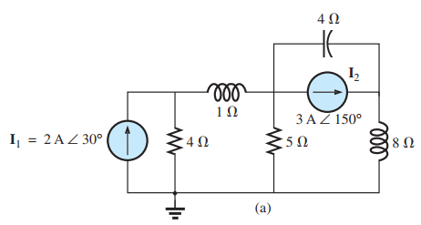
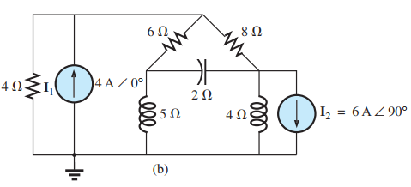
Write the nodal equations for the following networks.
V₁
V₁
V₂
V₃
V₃
V₂
Nodal equation for V₁:
Nodal equation for V₁:
Nodal equation for V₂:
Nodal equation for V₂:
Nodal equation for V₃:
Nodal equation for V₃:
Practice Book [Ch 17] Problem: 14 ~ 20
22

Slide 23
23

Slide 24
8.12 Y−Δ (T−Π) and Δ−Y (Π−T) CONVERSIONS
Circuit configurations are often encountered in which the resistors do not appear to be in series or parallel. Under these conditions, it may be necessary to convert the circuit from one form to another [i.e. convert from Y/T to Δ/Π or Δ/Π to Y/T] to solve for any unknown quantities
24

Slide 25
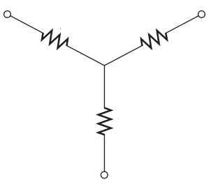
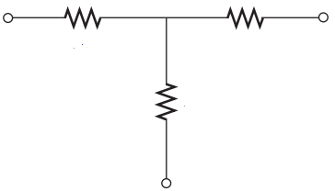
Y (Wye)
a
c
R_{c}
R_{a}
R_{b}
b
T (Tee)
a
R_{a}
R_{c}
c
R_{b}
b
25

Slide 26
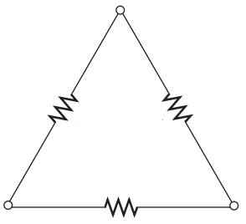
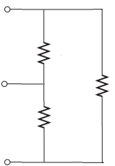
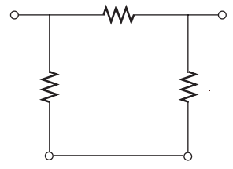
Δ (Delta)
a
a
R_{ab}
R_{ab}
R_{ca}
b
R_{ca}
R_{bc}
R_{bc}
b
c
c
Π (Pai)
a
R_{ab}
b
R_{ca}
R_{bc}
c
c
26

Slide 27
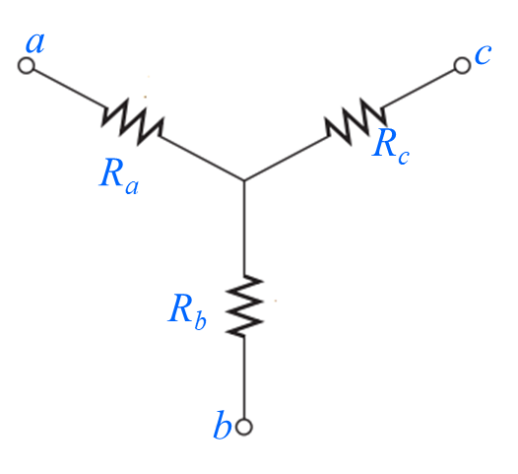
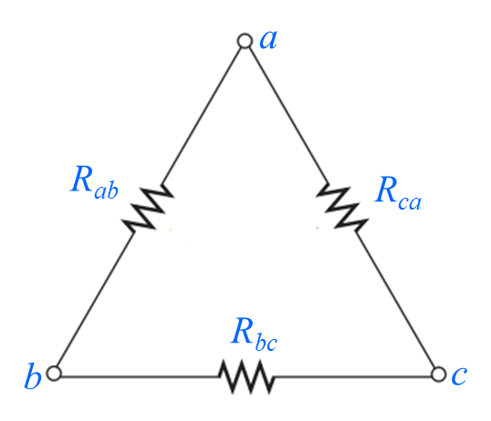
Conversion from Y (T) to Δ (Π)
Calculate R_{ab}, R_{bc} and R_{ca}
Here, R_{a}, R_{b} and R_{c} are known.
For derivation of these equations go through Eq. (8.3a) to (8.4 c)
27

Slide 28
Conversion from Δ (Π) to Y (T)
Calculate R_{a}, R_{b} and R_{c}
Here, R_{ab}, R_{bc} and R_{ca} are known.
For derivation of these equations go through Eq. (8.5a) to (8.5c)
28

Slide 29
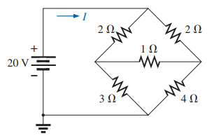
Problem 51(a) [P. 342]. Using a Δ-Y or Y-Δ conversion, find the current I in each of the networks in Fig. 8.134(a).
a
R_{ad}
R₁
d
b
R_{cd}
R_{bd}
R₂
c
Solution: First, marked four nodes (a, b, c, and d) in the circuit.
Let, R_{ad} = 2 Ω, R_{bd} = 1 Ω, R_{cd} = 3 Ω, R₁ = 2 Ω, and R₂ = 4 Ω
Here, R_{ad}, R_{bd}, and R_{cd} made Y connection where d is common point. So, this Y connection is going to convert Δ connection.
29

Slide 30


a
I
R_{ab}
3.67 Ω
R₁
2 Ω
+
R_{ca}
11 Ω
b
20 V
−
R_{bc}
5.5 Ω
R₂
4 Ω
c
30

Slide 31
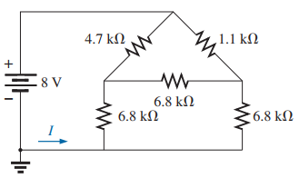
Problem 51(b) [P. 342]. Using a Δ-Y or Y-Δ conversion, find the current I in each of the networks in Fig. 8.134(b).
R₁
R₂
R_{ab}
a
b
R_{bc}
R_{ca}
c
Solution: First, marked four nodes (a, b, and c) in the circuit.
R₁
4.7 kΩ
R₂
1.1 kΩ
+
a
b
Let, R₁=4.7 kΩ, R₂=1.1 kΩ, R_{ab}=R_{bc}=R_{ca}= 6.8 kΩ
8 V
R_{a}
2.27 Ω
R_{b}
2.27 Ω
−
Here, R_{ab}, R_{bc}, and R_{ca} made Δ connection. So, this Δ connection is going to convert Y connection.
R_{c}
2.27 Ω
I
c
31

Slide 32
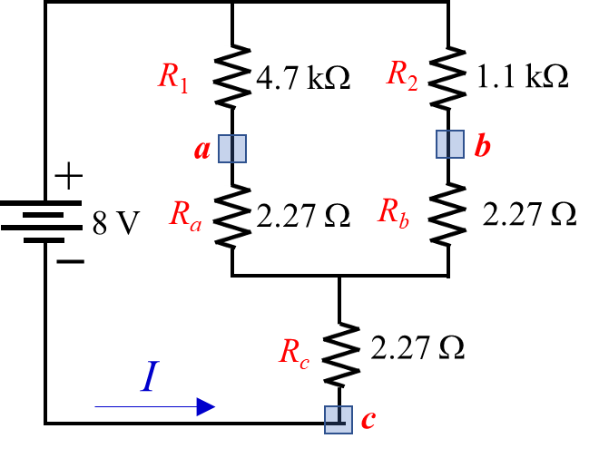
Practice Book [Ch 8] Problem: 51 ~ 56
32

Slide 33
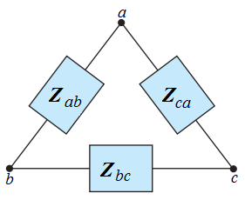
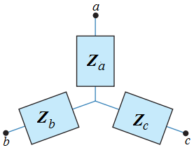
Δ (Π) to Y (T) Conversion
Y (T) to Δ (Π) Conversion
Z_{ab}, Z_{bc} and Z_{ca} are know.
Z_{a}, Z_{b} and Z_{c} are know.
33

Slide 34
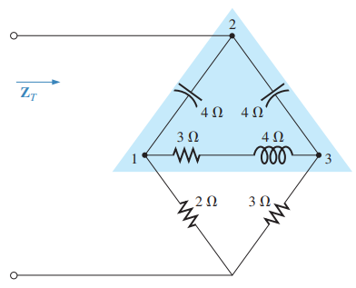
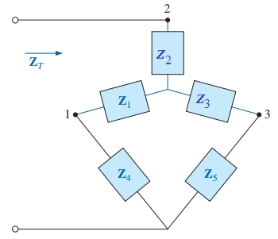
Solution:
34

Slide 35
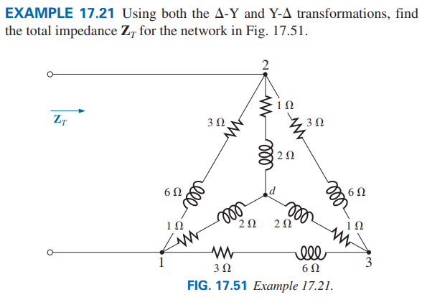
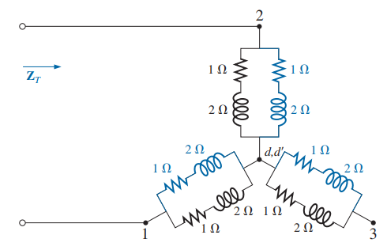

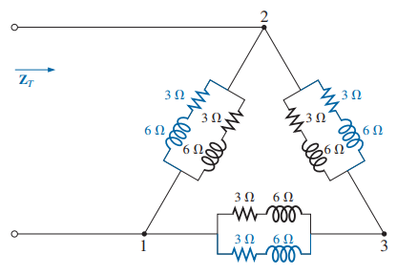
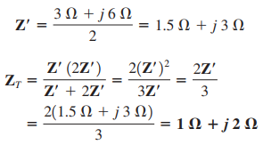
35

Slide 36

Example: Find the Current I for the following circuit.
Z_{ca}
b
Z₁
Z_{ab}
Z_{bc}
c
I
a
V
Z₂
Z₃
36

Slide 37
Z_{an}
Z_{bn}
Z_{cn}
Z₁
a
b
c
I
V
Z₂
Z₃
Z₄
I
V
Z₅
Z₆
Practice Book [Ch 17] Problem: 32 ~ 33
37

Slide 38

8.11 BRIDGE NETWORKS
1
1
1
4
2
4
2
4
2
3
3
3
38

Slide 39



Balanced Bridge Network
If the ratio of R₁ to R₃ is equal to that of R₂ to R₄, the bridge is balanced, and I = 0 A or V = 0 V.
If this condition is not satisfied, to solve the bridge circuit use the other techniques.
39

Slide 40





Example 8.11.1: Find the current I for the following network.
Solution: Here:
40

