Slide 1
Network Theorems
Chapter 9 [DC]
Chapter 18 [AC]

Slide 2
9.4 NORTON’S THEOREM
2

Slide 3
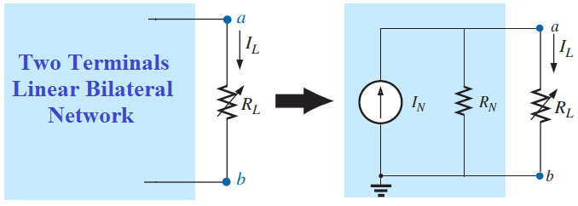
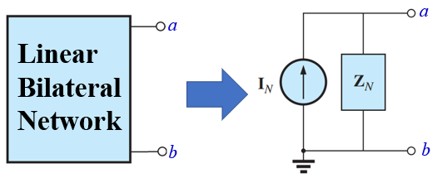
Statement of Norton’s Theorem
Any two-terminal, linear bilateral network can be replaced by an equivalent circuit consisting of a current source and a parallel resistance/impedance, as shown in the following figure.
R_{N}: Norton’s equivalent resistance
I_{N}: Norton’s equivalent current
Z_{N}: Norton’s equivalent impedance
I_{N}: Norton’s equivalent current
3

Slide 4
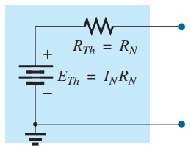
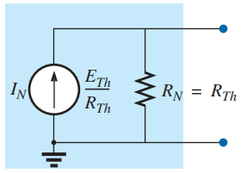

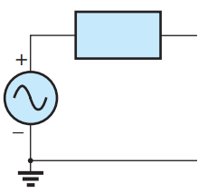
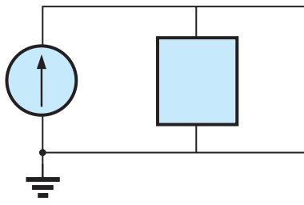
Conversion Between Thevenin and Norton’s Equivalent Circuit
Z_{Th} = Z_{N}
E_{Th}
E_{Th} = Z_{N}I_{N}
I_{N}
Z_{N}=Z_{Th}
Z_{Th}
4

Slide 5
Steps to Apply Norton’s Theorem
Step 1: | Remove that portion of the network where the Thévenin equivalent circuit is found.
Step 2: | Mark the terminals of the remaining two-terminal network.
Step 3: | Calculate R_{N}/Z_{N} by first setting all sources to zero (voltage sources are replaced by short circuits, and current sources by open circuits) and then finding the resultant resistance/impedance between the two marked terminals. (If the internal resistance/impedance of the voltage and/or current sources is included in the original network, it must remain when the sources are set to zero.)
Step 4: | Calculate I_{N} by first returning all sources to their original position and then finding the short-circuit current between the marked terminals. It is the same current that would be measured by an ammeter placed between the marked terminals.
Step 5: | Draw the Norton’s equivalent circuit with the portion of the circuit previously removed replaced between the terminals of the equivalent circuit.
Step 6: | Do the remaining required calculation
5

Slide 6
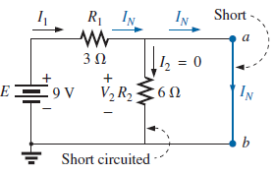
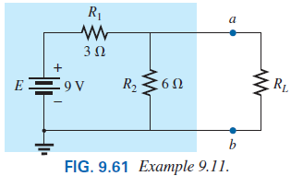
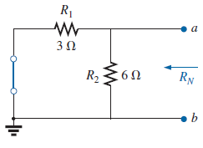

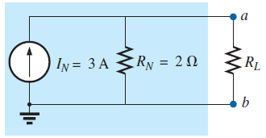
Example 9.11 [P364] Find the Norton equivalent circuit for the network in the shaded area in Fig. 9.61.
Step 3: Calculate R_{N} by first setting all sources to zero and then finding the resultant resistance between the two marked terminals (a and b).
Step 5: Draw the Norton equivalent circuit with the portion of the circuit previously removed replaced between the terminals of the equivalent circuit.
Step 1: Remove that portion of the network where the Norton equivalent circuit is found.
Step 2: Mark the terminals (such as a and b).
Step 4: Calculate I_{N} by first returning all sources to their original position then finding the short-circuit current between the marked terminals. (a and b).
6

Slide 7
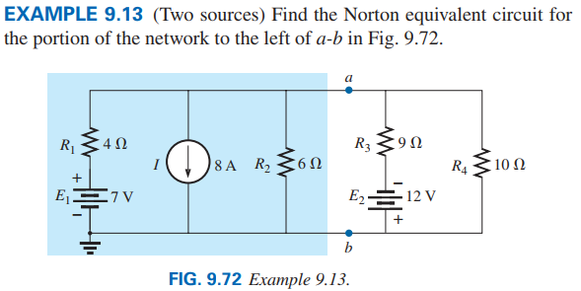
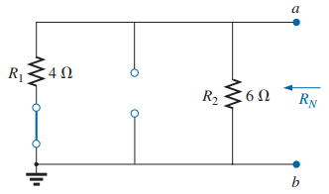
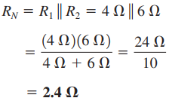
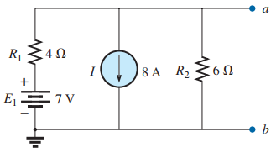
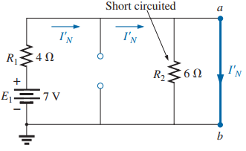

Step 3: Calculate R_{N}:
Step 4: Calculate I_{N}: Since there are two sources Superposition theorem has to be applied.
Step 1 and Step 2:
Consider 7 V:
7

Slide 8
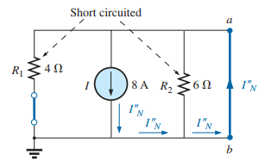
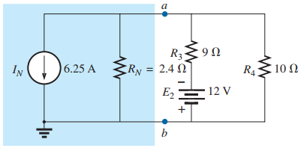

Consider 8 A:
Step 5: Draw the Norton equivalent circuit:
According to Superposition Theorem
8

Slide 9
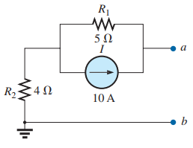
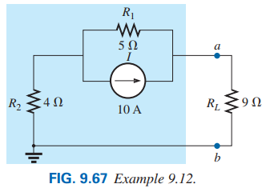
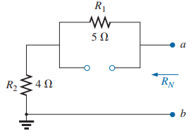
Example 9.12 [P365] Using the Norton Theorem to terminal a and b of Fig. 9.67, find the value of current which is passing through 9 Ω resistor.
Step 3: Calculate R_{N} by first setting all sources to zero and then finding the resultant resistance between the two marked terminals (a and b).
Step 1: Remove that portion of the network where the Norton equivalent circuit is found.
Step 2: Mark the terminals (such as a and b).
9

Slide 10
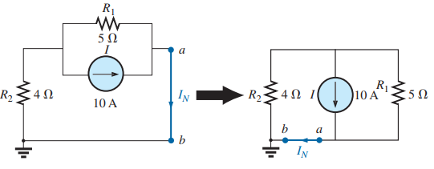

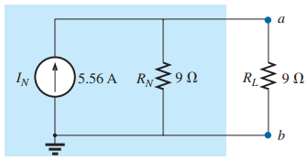
Step 4: Calculate I_{N} by first returning all sources to their original position then finding the short-circuit current between the marked terminals. (a and b).
Step 5: Draw the Norton equivalent circuit with the portion of the circuit previously removed replaced between the terminals of the equivalent circuit.
10

Slide 11
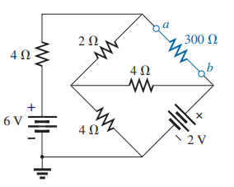
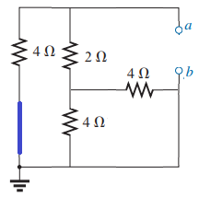
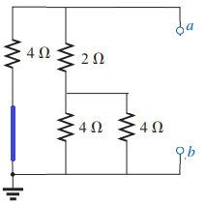
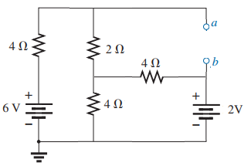
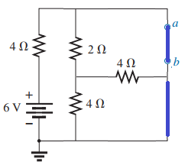
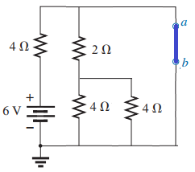
Problem 23 [P392] Find the Norton equivalent circuit for the portions of the networks in Fig. 9.136(b) external to branch a-b.
Step 3: Calculate R_{N}:
R_{N}
R_{N}
Step 1 and Step 2:
Step 4: Calculate I_{N}: Since there are two sources Superposition theorem has to be applied.
Consider 6 V:
I_{N1}
I_{N1}
11

Slide 12
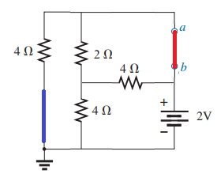
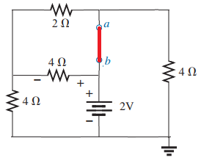
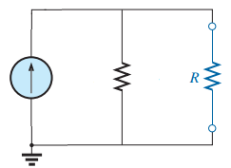
Consider 2 V:
I₂
I₄
According to Superposition Theorem
I_{N2}
I_{N2}
V₂
Step 5: Draw the Norton equivalent circuit:
I_{N}
R_{N}
2 Ω
300 Ω
0.75 A
Practice Book [Ch 9] Problem: 18 ~ 23
12

Slide 13
NORTON’S THEOREM [AC]
13

Slide 14
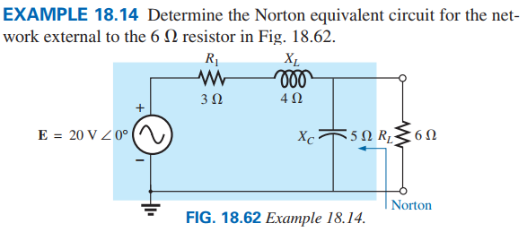

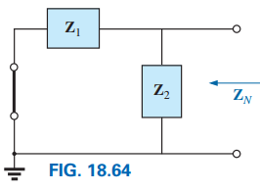
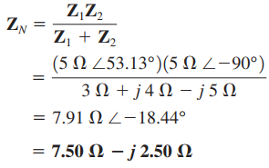


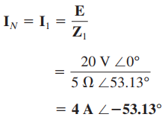
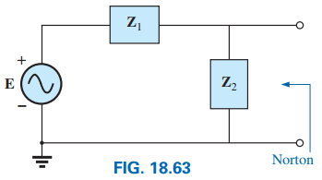
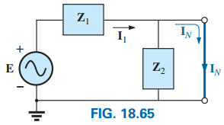
14

Slide 15
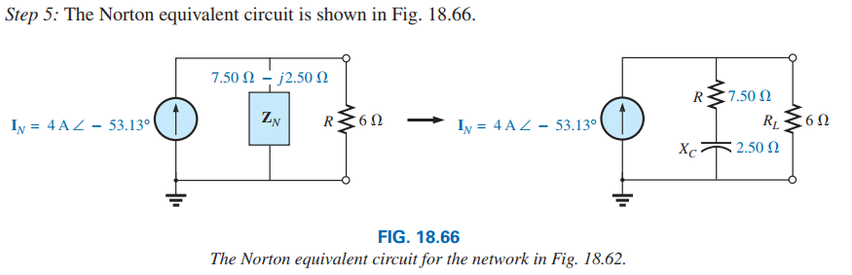
15

Slide 16
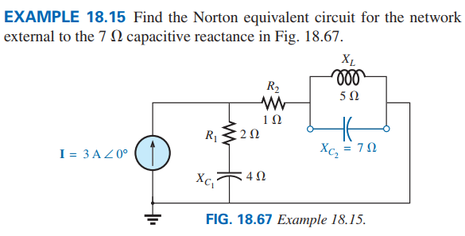

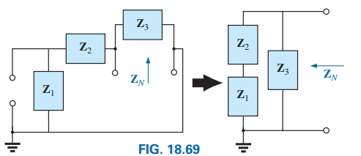


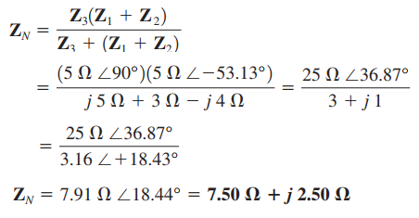
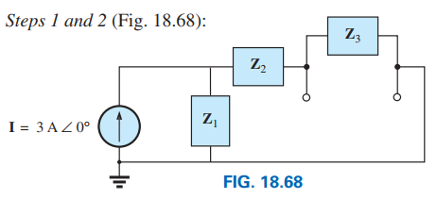
16

Slide 17
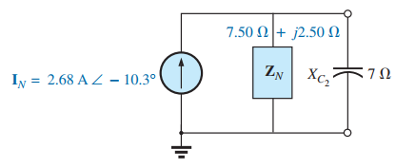
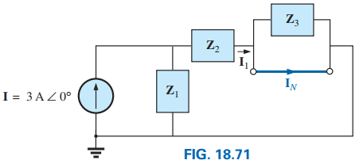
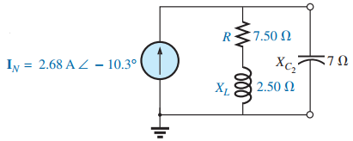
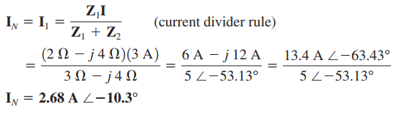
Practice Book Remaining Examples
And
Problem 26- 29 [Ch. 18]
17

Slide 18
9.5 MAXIMUM POWER TRANSFER THEOREM
18

Slide 19
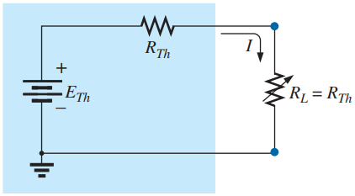




Statement of Maximum Power Transfer Theorem
A load will receive/consume/absorb maximum power from a network when its resistance is exactly equal to the Thévenin resistance of the network applied to the load. That is:
When R_{L} = R_{Th}, the maximum power delivered to the load can be determined by first finding the current:
Power can be calculated as follows:
19

Slide 20

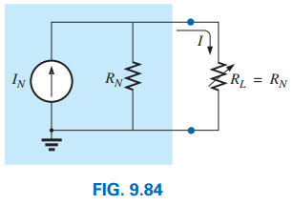

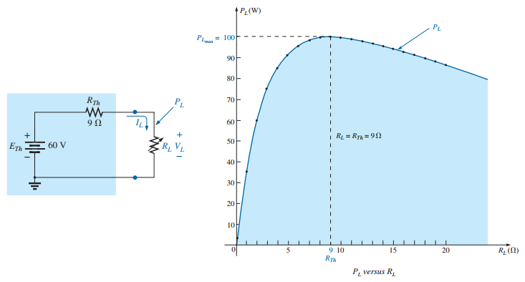
For the Norton equivalent circuit in Fig. 9.84, maximum power will be delivered to the load when
Power can be calculated as follows:
20

Slide 21
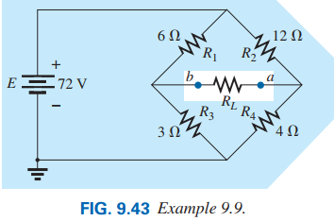



Example 9.5.1 For the following network , find the value of R_{L} for maximum power to RL and determine the maximum power to R_{L}.
Step 3: Calculate R_{Th} by first setting all sources to zero (voltage sources are replaced by short circuits, and current sources by open circuits) and then finding the resultant resistance between the two marked terminals (a and b).
Step 1: Remove that portion of the network where the Thévenin equivalent circuit is found.
Step 2: Mark the terminals (such as a and b) of the remaining two-terminal network.
21

Slide 22



Step 4: Calculate E_{Th} by first returning all sources to their original position and finding the open-circuit voltage between the marked terminals (a and b).
Step 5: Draw the Thévenin equivalent circuit with the portion of the circuit previously removed replaced between the terminals of the equivalent circuit.
22

Slide 23




Example 9.5.2 For the following network , find the value of R_{L} for maximum power to R_{L} and determine the maximum power to R_{L}.
Step 3: Calculate R_{Th}
Step 1 and Step 2: for Thévenin equivalent circuit
23

Slide 24




Step 4: Calculate E_{Th}
Since there are two sources Superposition theorem has to be applied.
Consider E₁ then E₂ = 0 V (shorted).
Step 5: Draw the Thévenin equivalent circuit
Consider E₂ then E₁ = 0 V (shorted).
24

Slide 25





Example 9.5.2
(a) Find the Norton equivalent circuit for the network external to the resistor R for the network in Fig. 9.127.
(b) find the value of R for maximum power to R and determine the maximum power to R.
Step 3: Calculate R_{N}
Step 5: Draw the Norton equivalent circuit:
Step 4: Calculate I_{N}
Step 1: and Step 2 for the Norton equivalent circuit.
a
Practice Book [Ch 9] Problem: 18 ~ 23
b
25

Slide 26
MAXIMUM POWER TRANSFER THEOREM [AC]
26

Slide 27




Maximum Power Transfer or Impedance Matching Theorem
Statement: Maximum power will be delivered to a load when the load impedance is the complex conjugate of the Thévenin impedance across its terminals.
Then, according to maximum power transfer theorem:
27

Slide 28




Special Situation: If the load resistance is adjustable but the magnitude of the load reactance cannot be set equal to the magnitude of the Thévenin reactance, then the maximum power that can be delivered to the load will occur when the load reactance is made as close to the Thévenin reactance as possible, and the load resistance is set to the following value:
Z_{Th}
R_{L}
E_{Th}
X_{load}
28

Slide 29







According to maximum power transfer theorem:
Maximum power received by load:
29

Slide 30





30

Slide 31



PROBLEM: Find the load impedance Z_{L} for the networks in following Figure for maximum power to the load, and find the maximum power to the load.
Solution: Z₁ = R Ω = 10 Ω; Z₂ = jX_{L} Ω = j8 Ω;
Z₃ = − jX_{C} Ω = − j8 Ω;
Step 3: Z_{Th} calculation
Z₁
Z₃
Step 1 and Step 2:
Z_{Th}
a
Z₁
Z₃
Z₂
+
a
b
E₁
Z₂
I
Fig. (b)
−
b
Fig. (a)
31

Slide 32

Step 4: E_{Th} calculation
Considering I:
Z₁
Z₃
Since there are two sources, Thevenin’s voltage can be calculated by using Superposition Theorem.
+
a
Z₂
I
E_{Th2}
−
b
Considering E₁:
Fig. (d)
Z₁
Z₃
+
+
a
E₁
E_{Th1}
According Superposition Theorem:
Z₂
−
−
b
Fig. (c)
Z_{Th}
a
a
+
+
3.9 Ω
3.12 Ω
Z_{Load}
Z_{Load}
E_{Th}
E_{Th}
−
b
−
b
−
32

Slide 33
According to maximum power transfer theorem:
Maximum power received by load:
Practice Book Remaining Examples
And
Problem 39, 40, 45 and 46 [Ch. 18]
33

Slide 34
Chapter 24
Poly-phase System

Slide 35

Poly-Phase Generator
An ac generator designed to develop a single sinusoidal voltage for each rotation of the shaft (rotor) is referred to as a single-phase ac generator.
If the number of coils on the rotor is increased in a specified manner, the result is a polyphase ac generator, which develops more than one ac phase voltage per rotation of the rotor.
For a balanced three phase source, the peak value of voltage e_{AN}(t), e_{BN}(t), and e_{CN}(t) are equal and the phase displacement from each other is 120º.
Let, the rms value of voltages e_{AN}(t), e_{BN}(t), and e_{CN}(t) is E_{p} then these voltage are in phasor form as folows:
In a balanced system, at any instant of time, the algebraic sum of the three phase voltages of a three-phase generator is zero. That means:
35

Slide 36




Phase Sequence or Phase Order
There are two phase sequence or phase orders:
(a) ABC−sequence [B lags A by 120º and C lags B by 120º that means C lags A by 240º]
(b) ACB−sequence [C lags A by 120º and B lags C by 120º that means B lags A by 240º]
36

Slide 37





Connection of Three-Phase System
Balanced source voltages are equal in magnitude and are out of phase with each other by 120º.
Three phase system can be connected two different ways:
(a) Star or Y (Wye) or T (Tee) connection
(b) Mesh or Δ (delta) or Π (pai) connection
A balanced load is one which the phase impedance are equal in magnitude and in phase (also, equal in real part and equal in imaginary part).
37

Slide 38

Star or Y (Wye) or T (Tee) connection
Phase Voltages: E_{AN}, E_{BN} and E_{CN}
Line Voltage ≠ Phase Voltage
Line Voltages: E_{AB}, E_{BC} and E_{CA}
Phase Currents: I_{NA}, I_{NB} and I_{NC}
Line Currents: I_{Aa}, I_{Bb} and I_{Cc}
Line Currents = Phase Currents
I_{Aa} = I_{NA}; I_{Bb} = I_{NB}; and I_{Cc} = I_{NC}
Phase Voltages: V_{an}, V_{bn} and V_{cn}
Line Voltages: V_{ab}, V_{bc} and V_{ca}
Let,
V_{P} and E_{P}: RMS value of phase voltage
V_{L} and E_{L}: RMS value of line voltage
I_{P}: RMS value of phase current
I_{L}: RMS value of line current
Phase Currents: I_{an}, I_{bn} and I_{cn}
Line Currents: I_{Aa}, I_{Bb} and I_{Cc}
Line Currents = Phase Currents
I_{Aa} = I_{an}; I_{Bb} = I_{bn}; and I_{Cc} = I_{cn}
38

Slide 39

Mesh or Δ (delta) or Π (pai) connection
Phase Voltages: E_{AB}, E_{BC} and E_{CA}
Line Current ≠ Phase Current
Line Voltages: E_{AB}, E_{BC} and E_{CA}
Phase Currents: I_{BA}, I_{AC} and I_{CB}
Line Currents: I_{Aa}, I_{Bb} and I_{Cc}
Line Voltage = Phase Voltage
Phase Voltages: V_{ab}, V_{bc} and V_{ca}
Line Voltages: V_{ab}, V_{bc} and V_{ca}
Let,
V_{P} and E_{P}: RMS value of phase voltage
V_{L} and E_{L}: RMS value of line voltage
I_{P}: RMS value of phase current
I_{L}: RMS value of line current
Phase Currents: I_{ab}, I_{bc} and I_{ca}
Line Currents: I_{Aa}, I_{Bb} and I_{Cc}
Line Voltage = Phase Voltage
39

Slide 40
Power Calculation
Instantaneous Power Equation:
V_{m} and E_{m}: Peak value of phase voltage
I_{m} : Peak value of phase current
V_{P} and E_{P}: RMS value of phase voltage
V_{L} and E_{L}: RMS value of line voltage
I_{P}: RMS value of phase current
I_{L}: RMS value of line current
Source Side
Load Side
40

Slide 41
Example: The line voltage and line current of a three-phase system are 440 V and 40 A. Calculate the phase voltage and phase current for (i) star-connection, and (ii) mesh-connection.
Solution: Given: V_{L} =440 V, I_{L} = 40 A
For Star connection
For Mesh connection
Example 4.1.6: The phase voltage and phase current of a three-phase system are 400 V and 20 A. Calculate the line voltage and line current for (i) star or Wye-connection, and (ii) mesh or Delta-connection.
Solution: Given: V_{P} =400 V, I_{P} = 20 A, n=3
Star or Wye connection
Mesh or Delta connection
41

Slide 42
Example: A 500 volts three-phase supply is connected with a Δ-connected load having R = 18 Ω and X_{C} = 24 Ω in series in per phase. Calculate (i) the real power, (ii) the reactive power, (iii) the apparent, (iv) the power factor and (v) the reactive factor.
Solution: Given,
42

Slide 43
Example: A three-phase Y-connected motor draws 5.6 kW at a power factor of 0.8 lagging when the line voltage is 220 V. Determine (i) the line current and (ii) the impedance of the motor.
Solution: Given, P = 5.6 kW = 5600 W; pf = cosθ_{z} = cosθ = 0.8 lagging, V_{L} = 220 V
Since
For Y-connection:
The magnitude of impedance is:
Since power factor is lagging, we have
The impedance is:
43

