Slide 1
Learning a High-Precision Robotic Assembly Task Using Pose Estimation from Simulated Depth Images
Litvak, Y., Biess, A., & Bar-Hillel, A. (2019, May, ICRA). ‏
Presented By: Guy Farjon, Amit Cohen, Nitzan Levy

Slide 2
Robotic Agenda
Siemens Innovation Challenge (SIC) – solving a generic assembly task with flexible conditions
Overcoming related works constraints
Assembly task as a pose estimation problem
Coarse and refined pose estimation
Bridging the simulation-reality gap
Fusing the components to the final assembly
Results

Slide 3
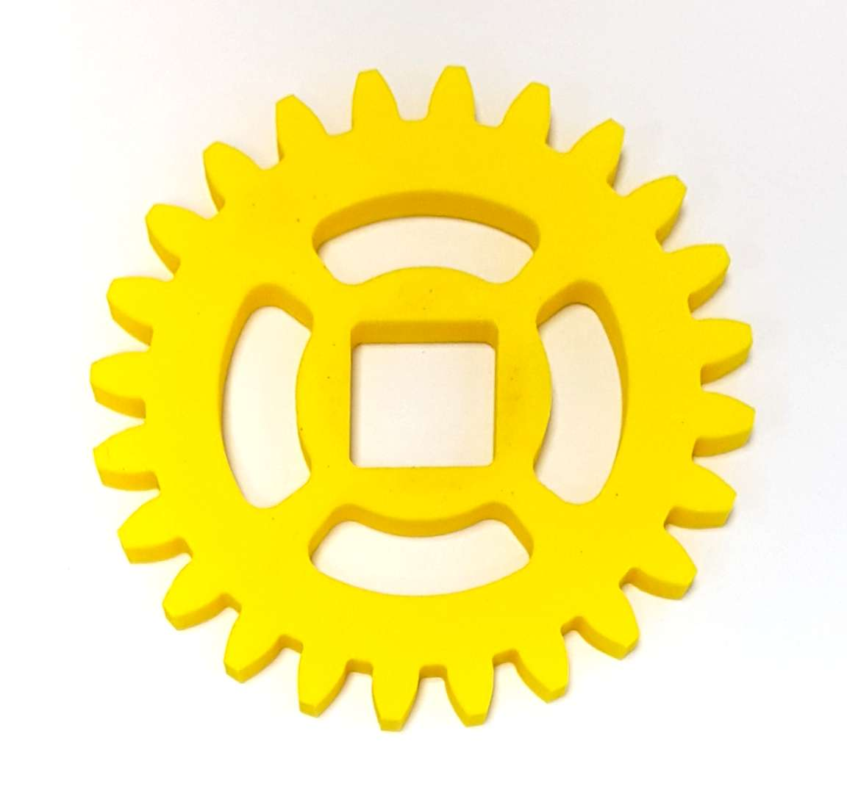
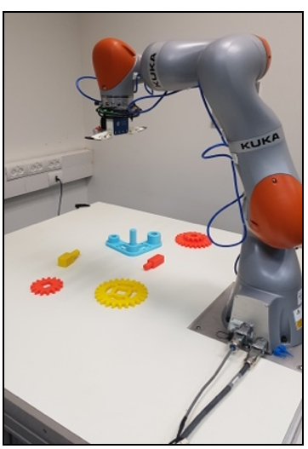
SIC – HW, SW and Components
SIC – A task in which a robot needs to assemble a gear-like mechanism with high precision into an operating system
The environment contains the KUKA LBR IIWA 14 R820, SAKE ROBOTICS EZGripper and an Intel RealSense D415 depth camera
The software which was developed in ROS ecosystem, consists of a motion planner named Moveit! A pose estimation process using python with TensorFlow, And Gazebo simulation environment.
Up until this experiment, solvers assumed a predefined location of each part. This experiment now uses perception to eliminate this assumption.

Slide 4
Critical Evaluation
The problem was solved with an extremely … point of view,
The solution requires a CAD model

