Slide 1
Learning a High-Precision Robotic Assembly Task Using Pose Estimation from Simulated Depth Images
Litvak, Y., Biess, A., & Bar-Hillel, A. (2019, May, ICRA). ‏
Presented By: Guy Farjon, Amit Cohen, Nitzan Levy

Slide 2
Robotic Agenda
Siemens Innovation Challenge (SIC) – solving a generic assembly task with flexible conditions
Overcoming related works constraints
Assembly task as a pose estimation problem
Coarse and refined pose estimation
Bridging the simulation-reality gap
Fusing the components to the final assembly
Results

Slide 3
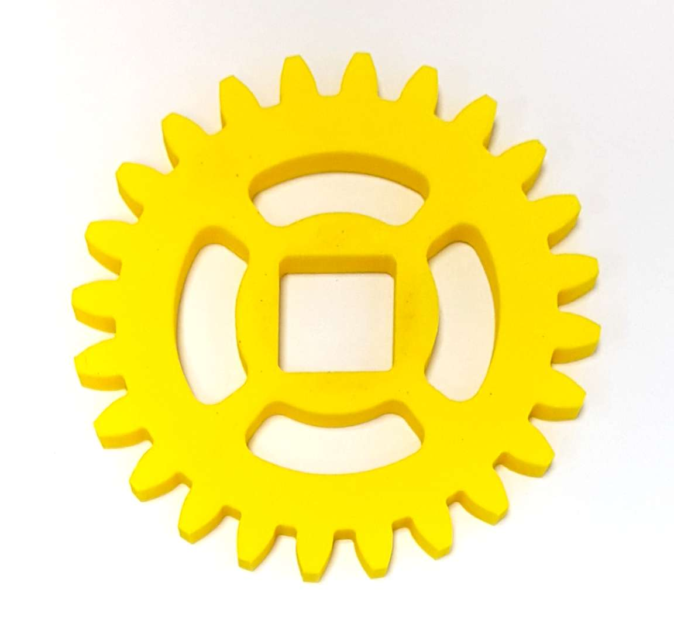
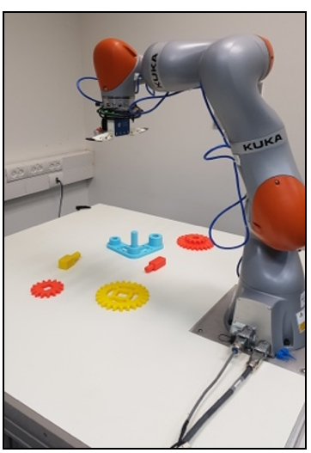
SIC – HW, SW and Components
SIC – A task in which a robot needs to assemble a gear-like mechanism with high precision into an operating system
The environment contains the KUKA LBR IIWA 14 R820, SAKE ROBOTICS EZGripper and an Intel RealSense D415 depth camera
The software which was developed in ROS ecosystem, consists of a motion planner named Moveit! A pose estimation process using python with TensorFlow, And Gazebo simulation environment.
Up until this experiment, solvers assumed a predefined location of each part. This experiment now uses perception to eliminate this assumption.

Slide 4
Method
Creating synthetic depth images in simulation
Training a pose estimation pipeline based on deep convolutional neural networks
Estimating the parts’ poses in reality, using a camera mounted near the robot’s end-effector
Calculating pick-and-place motions based on the estimated poses

Slide 5
Results
Total of 30 experiments.
Pose estimation resulted in an average translational accuracy of 2.14mm and a rotational accuracy of 1.09 degrees.
Out of 150 grasps and attempts to assemble, 133 were successful (88.67%)
In 15 experiments, all parts were successfully assembled (50%).
In 5 of the 15 failed attempts, the gripper succeeded to grasp one of the shafts but let it slip while lifting.
In the remaining 10 attempts, the grasped part contacted the base plate which triggered a search, during which the part slipped

Slide 6
Conclusion
An assembly task with given 3D CAD files, an accurate pose estimation algorithm can be trained to achieve high assembly success rates.
The simulation-to-reality gap can be significantly bridged by using depth images and the assembly task can be learned on simulated images only.

Slide 7
Critical Evaluation
Each subproblem was solved independently, which will cause more difficult adaption to new domain related problems.
The solution requires a CAD model – which is rarely accessible to the end user which aims to solve the assembly task.
We would suggest a use of reinforcement learning regarding the grip of the parts.
Expand the use of depth information (e.g., point cloud etc.) in order to avoid the need of CAD models.

