Slide 1
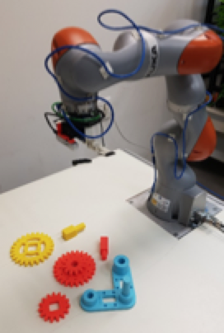
Learning a High-Precision Robotic Assembly Task Using Pose Estimation from Simulated Depth Images
Litvak, Y., Biess, A., & Bar-Hillel, A., 2019, International Conference of Robotics and Automation‏
Presented by: Guy Farjon, Amit Cohen, Nitzan Levy

Slide 2
Today’s Talk
Introducing the Siemens Innovation Challenge
Solving a generic assembly task
Why is it hard?
Changing perspective – parts assembly as a pose estimation problem
Coarse and refined pose estimation
Bridging the simulation-reality gap
Fusing components for task completion
Experiments and Results
Conclusions
Our thoughts

Slide 3
The Task
Assembling of a gear-like mechanism
A base, 3 gears, and 2 shafts
Previous work mainly focused on grasping the objects
Grasping unknown objects
Plan the motion towards the object
This work focuses on the full assembly task
Perception as a main component
Combine multiple HW and SW solutions
Bottom line – observe, detect, grasp, assemble
An engineered solution to a complex task
ROS
Kuka LBR IIWA 14 R820
SAKE ROBOTICS EZGripper
Intel RealSense D415
SunRise
Gazebo
Moveit!
Python (TensorFlow)
OpenCV
…

Slide 4
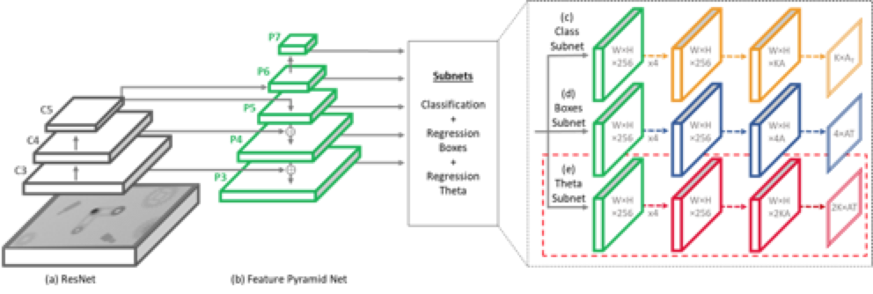
Method
Simulate the environment
Create a huge datasets in seconds
Train a pose estimation pipe on synthetic images (based on RetinaNet¹)
1. Lin, T. Y., Goyal, P., Girshick, R., He, K., & Dollár, P. (2017). Focal loss for dense object detection. ICCV‏

Slide 5
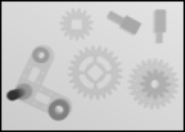

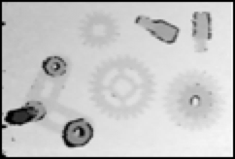
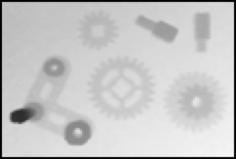
Method
Simulate the environment
Create a huge datasets in seconds
Train a pose estimation pipe on synthetic images (based on RetinaNet¹)
Estimate the parts’ poses using RGB-D images
Average 10-images to eliminate noise
Bridge the simulation-reality gap
before
after
Sim.
Reality
1. Lin, T. Y., Goyal, P., Girshick, R., He, K., & Dollár, P. (2017). Focal loss for dense object detection. ICCV‏

Slide 6
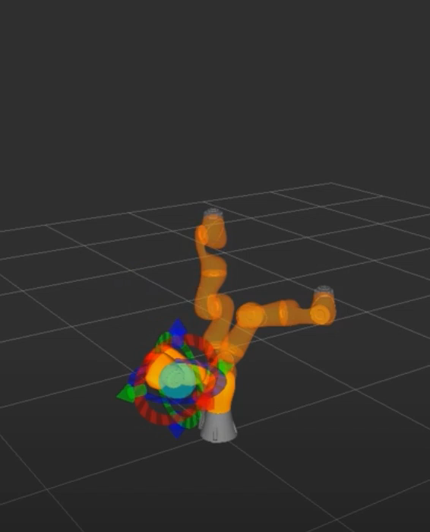
Method
Simulate the environment
Create a huge datasets in seconds
Train a pose estimation pipe on synthetic images (based on RetinaNet¹)
Estimate the parts’ poses using RGB-D images
Average 10-images to eliminate noise
Bridge the simulation-reality gap
Calculate pick-and-place motions for each part
Use prior knowledge to place the parts in the correct location
‘Moveit!’ for motion trajectory
1. Lin, T. Y., Goyal, P., Girshick, R., He, K., & Dollár, P. (2017). Focal loss for dense object detection. ICCV‏

Slide 7
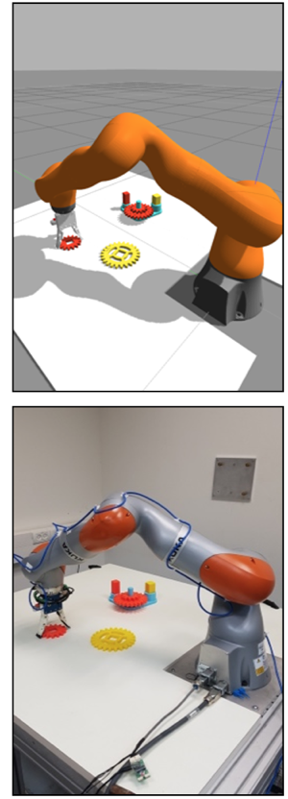
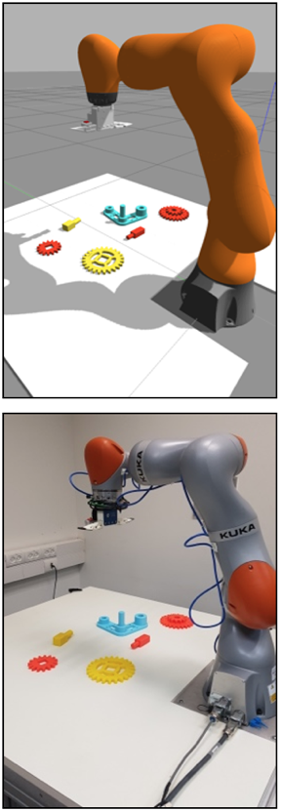
Method
Simulate the environment
Create a huge datasets in seconds
Train a pose estimation pipe on synthetic images (based on RetinaNet¹)
Estimate the parts’ poses using RGB-D images
Average 10-images to eliminate noise
Bridge the simulation-reality gap
Calculate pick-and-place motions for each part
Use prior knowledge to place the parts in the correct location
‘Moveit!’ for motion trajectory
Anything you can do, I can do better
Manipulate the robot from the simulation
1. Lin, T. Y., Goyal, P., Girshick, R., He, K., & Dollár, P. (2017). Focal loss for dense object detection. ICCV‏

Slide 8
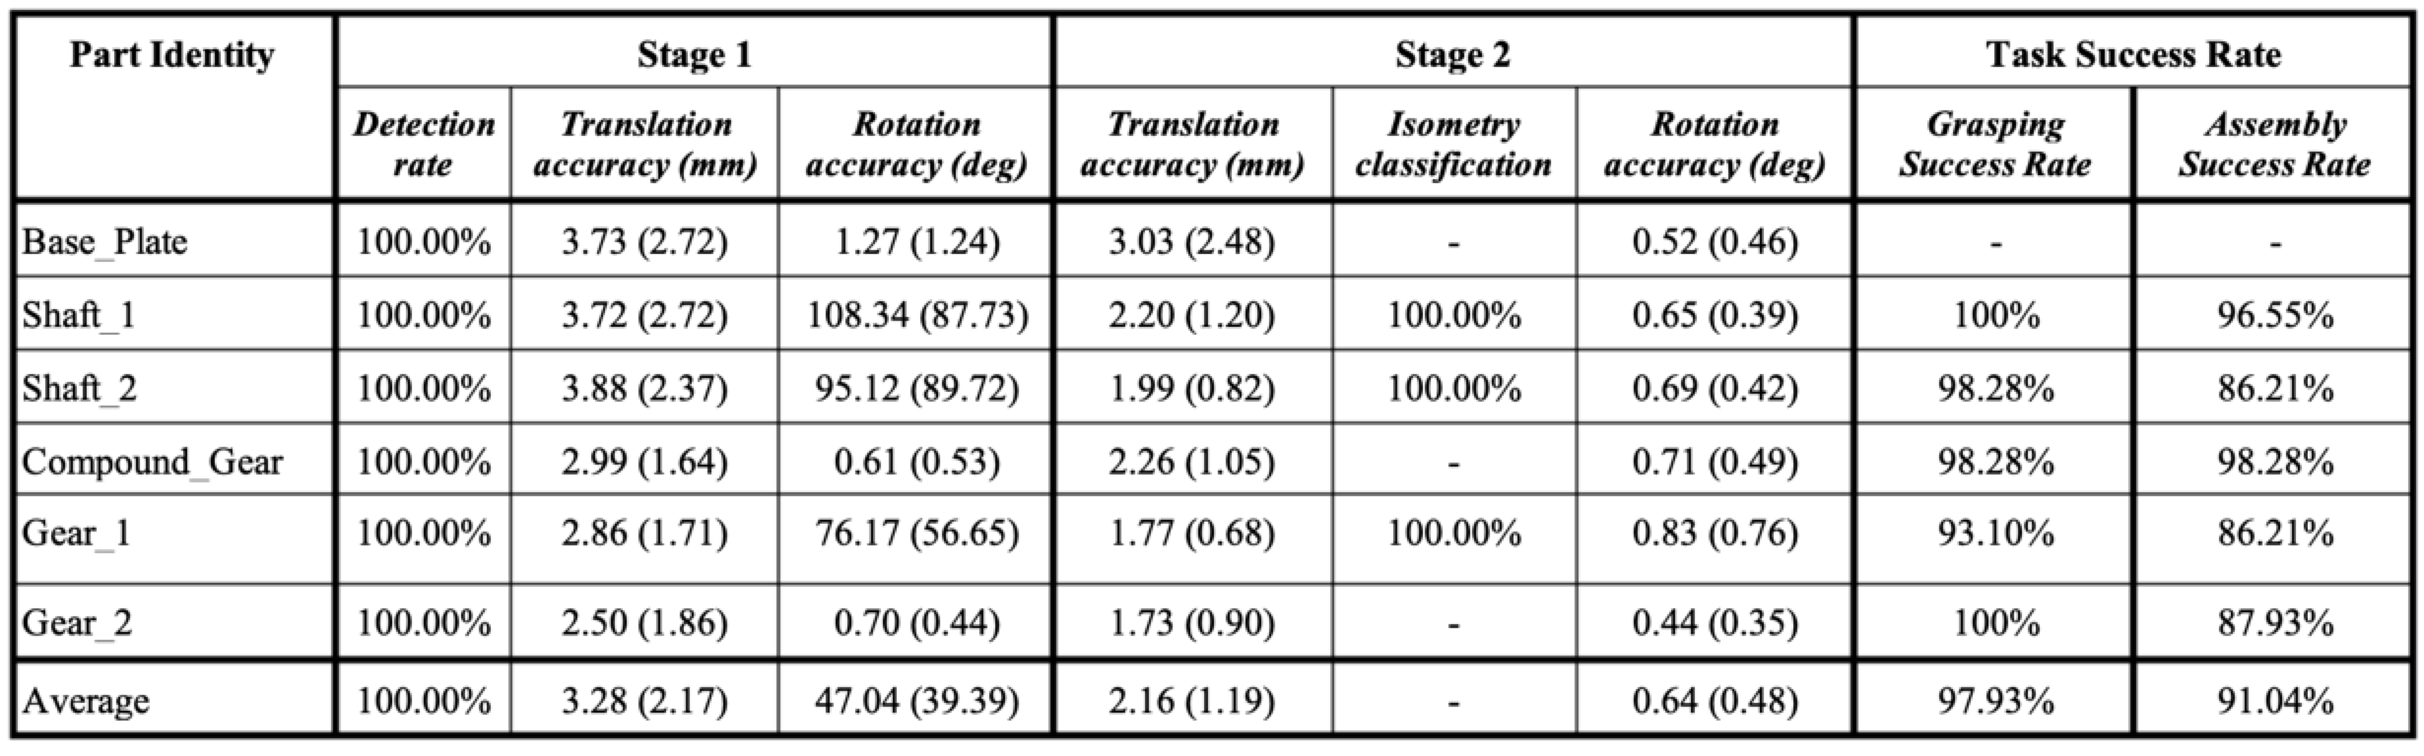
Experiments and Results
58 assembly attempts with a success rate of 67.2%
Average results and standard deviations
https://www.youtube.com/watch?v=uMvq2-Tg-9g&t=62s

Slide 9
Conclusion
Assembly tasks can be treated as a pose estimation problem
With simulated components
When 3D CAD files are available
Using pre-defined conditions and configurations
The simulation-to-reality gap can be significantly bridged
Using depth images and image processing tools
Don’t give up
3 stages for extremely accurate pose estimation
Stitching up a solution for each specific problem

Slide 10
Our thoughts
Each subproblem was solved independently
May result with difficulties when trying new assembly tasks
Only rigid objects were examined
The solution requires a CAD model
Usually not accessible to the end user
Utilize depth information (e.g., point cloud etc.) instead of prior knowledge
Grasping and placing of objects is pre-defined
RL methods might reduce the high setup costs
Does not include planning algorithms for optimized assembly
Overall – amazing solution of extremely complex assembly task

