Slide 1
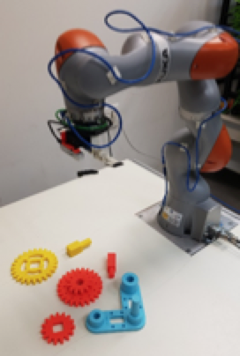
Learning a High-Precision Robotic Assembly Task Using Pose Estimation from Simulated Depth Images
Litvak, Y., Biess, A., & Bar-Hillel, A., 2019, International Conference of Robotics and Automation‏
Presented by: Guy Farjon, Amit Cohen, Nitzan Levy

Slide 2
Today’s Talk
Introducing the Siemens Innovation Challenge
solving a generic assembly task
Why is it hard?
Changing perspective – parts assembly as a pose estimation problem
Coarse and refined pose estimation
Bridging the simulation-reality gap
Fusing components for task completion
Experiments and Results
Our thoughts

Slide 3
The Task
Assembling of a gear-like mechanism
A base, 3 gears, and 2 shafts
Previous work mainly focused on grasping the objects
Aaa
Up until this experiment, solvers assumed a predefined location of each part.
This experiment now uses perception to eliminate this assumption.
ROS
Kuka LBR IIWA 14 R820
SAKE ROBOTICS EZGripper
Intel RealSense D415
SunRise
Gazebo
Moveit!
Python (TensorFlow)
OpenCV

Slide 4
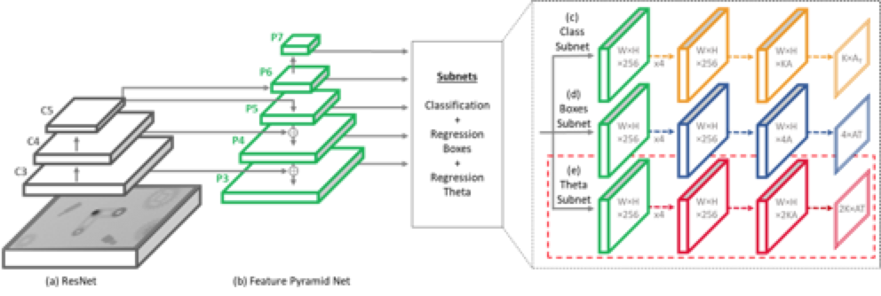
Method
Simulate the environment
Create a huge datasets in seconds
Train a pose estimation pipe on synthetic images (based on RetinaNet¹)
1. Lin, T. Y., Goyal, P., Girshick, R., He, K., & Dollár, P. (2017). Focal loss for dense object detection. ICCV‏

Slide 5
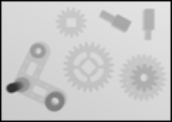

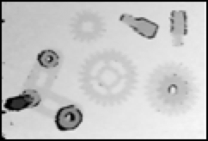
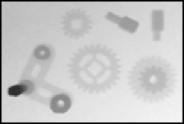
Method
Simulate the environment
Create a huge datasets in seconds
Train a pose estimation pipe on synthetic images (based on RetinaNet¹)
Estimate the parts’ poses using RGB-D images
Average 10-images to eliminate noise
Bridge the simulation-reality gap
before
after
1. Lin, T. Y., Goyal, P., Girshick, R., He, K., & Dollár, P. (2017). Focal loss for dense object detection. ICCV‏

Slide 6
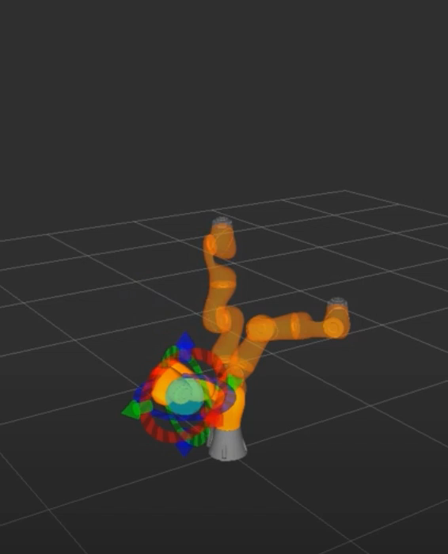
Method
Simulate the environment
Create a huge datasets in seconds
Train a pose estimation pipe on synthetic images (based on RetinaNet¹)
Estimate the parts’ poses using RGB-D images
Average 10-images to eliminate noise
Bridge the simulation-reality gap
Calculate pick-and-place motions for each part
‘Moveit!’ for motion trajectory
Use prior knowledge to place the parts in the correct location
1. Lin, T. Y., Goyal, P., Girshick, R., He, K., & Dollár, P. (2017). Focal loss for dense object detection. ICCV‏

Slide 7
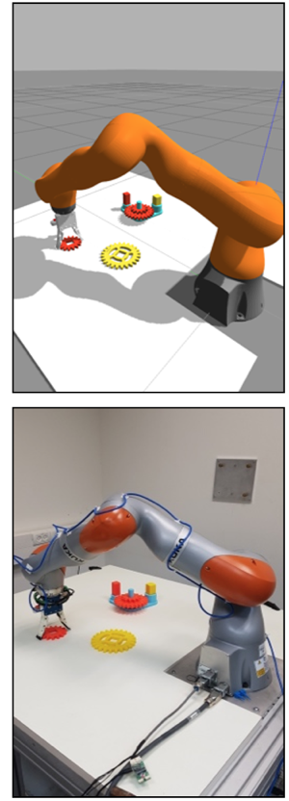
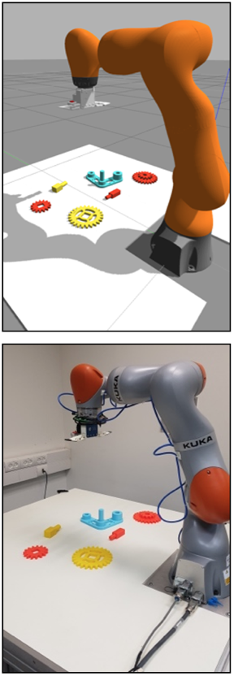
Method
Simulate the environment
Create a huge datasets in seconds
Train a pose estimation pipe on synthetic images (based on RetinaNet¹)
Estimate the parts’ poses using RGB-D images
Average 10-images to eliminate noise
Bridge the simulation-reality gap
Calculate pick-and-place motions for each part
‘Moveit!’ for motion trajectory
Use prior knowledge to place the parts in the correct location
Anything you can do, I can do better
Manipulate the robot from the simulation
1. Lin, T. Y., Goyal, P., Girshick, R., He, K., & Dollár, P. (2017). Focal loss for dense object detection. ICCV‏

Slide 8
Experiments and Results
We performed a total of 58 real experiments.
The below table shows the detection, pose estimation and assembly rate accuracy for parts of the Siemens Innovation Challenge.
Pose estimation resulted in an average translational accuracy of 2.16mm and a rotational accuracy of 0.64 degrees. Out of 290 grasps and attempts to assemble, 264 were successful (91%). In 39 experiments, all parts were successfully assembled (67.2%).

Slide 9
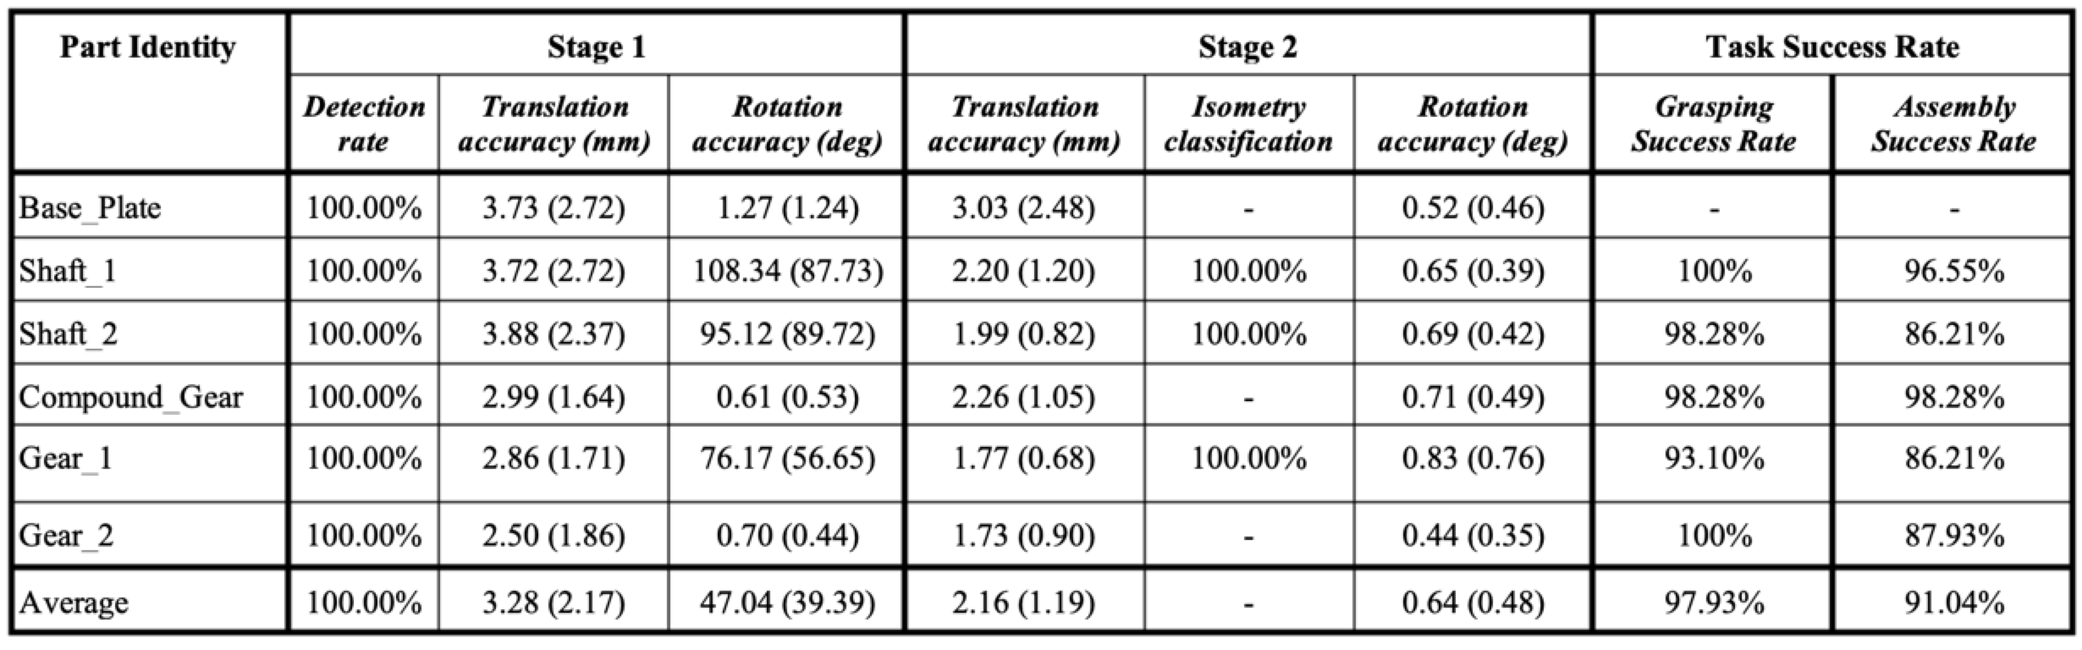
Experiments and Results
Total of 58

Slide 10
Conclusion
An assembly task with given 3D CAD files, an accurate pose estimation algorithm can be trained to achieve high assembly success rates.
The simulation-to-reality gap can be significantly bridged by using depth images and the assembly task can be learned on simulated images only.

Slide 11
Our thoughts
Each subproblem was solved independently, which will cause more difficult adaption to new domain related problems.
The solution requires a CAD model – which is rarely accessible to the end user which aims to solve the assembly task.
We would suggest a use of reinforcement learning regarding the grip of the parts.
Expand the use of depth information (e.g., point cloud etc.) in order to avoid the need of CAD models.
No planning algorithms used

