Slide 1
Tensorflow Neural Network and Visualization

Slide 2
What is Tensorflow?
Dataflow library
Two main concepts:
Tensors, that flow between operations
Dataflow Graphs, where the tensors are passed from one node to another

Slide 3
Tensors
Consists of set of primitive values shaped into an array of any number of dimensions
Matrix manipulation is pervasive
Rank = number of dimensions
Shape = array of array bounds

Slide 4
Creating a Neural Network Using Tensorflow
The following slides will walkthrough an implementation of a simple Multi-Layer Perceptron Neural Network using Tensorflow and the MNIST dataset.
In order to load the MNIST data-set use the DataLoader.py and mnist_downloader.py found at github.
There is a stub for this program started in NNExample.py
The file ClassificationNN.py is very similar to the example in these slides so it can be used as a guide as well.
https://github.com/julianClayton/Classification-Neural-Network

Slide 5
Imports
import numpy as np
import tensorflow as tf
import DataReader
The DataReader class will handle all the data downloading and the seperation of testing and training sets. It further provides a next_batch method that returns a returns a random batch of data from the dataset. In this case it is the MNIST images

Slide 6
PART 1: Constructor/ Creating the Graph
The constructor is provided in the NNExample code.
The following fields are specified in the constructor:
Learning rate
Training Iterations – This is the number of epochs that the neural network will run
Batch Size – Number of samples from the training set retrieved with each batch
Hidden layer n – Number of neurons in the hidden layer. (Only one hidden layer for now)

Slide 7
Input and Output Layers
For the input layer x, a Tensorflow placeholder is used because it must have data fed to it, it cannot be evaluated and it isnot initialized to a value. We will be feeding data into the input layer. Furthermore, we will create placeholder y that we will feed the labels into. The labels are converted to one-hot vectors by the data_loader class.
Recall that a flattened MNIST image is size 784 and it will classify handwritten digits 0-9. Thus we have:
input_layer_n = 784
output_layer_n = 10
self.x = tf.placeholder("float", [None, input_layer_n]) #Input
self.y = tf.placeholder("float", [None, output_layer_n]) #Output
We use ‘None’ in the first dimension to indicate that these placeholders are vectors and not matrices.

Slide 8
Weights
Unlike the input and output layers, the weights will be initialized to a value then further changed once we begin feeding values into the network. Thus the weights will be initialized to a tensorflow variable
Since this network has 1 hidden layer, there will be 2 sets of weights, one between the input and the hidden layer and the the other between the hidden layer and the output.
W1 = tf.Variable(tf.random_normal([input_layer_n, hidden_layer_n], stddev=0.1))
W2 = tf.Variable(tf.random_normal([hidden_layer_n, output_layer_n], stddev=0.1))
The weights are initialized to be random normal (gaussian) distribution around 0, with a standard deviation of 0.1.

Slide 9
Biases
The biases will also be initialized to variables.
b1 = tf.Variable(tf.random_normal([hidden_layer_n], stddev=0.1))
b2 = tf.Variable(tf.random_normal([output_layer_n], stddev=0.1))

Slide 10
Model
The model will specify how the network will produce an output using the weight and biases.
For each layer we will use Wx + b to generate output and apply the sigmoid function to the output from the hidden layer. For the output from the output layer we will apply the softmax function as we will be taking the most likely result from the output layer. Thus our model can be defined as:
layer_1 = tf.nn.sigmoid(tf.matmul(self.x, W1) + b1)
output_layer = tf.nn.softmax(tf.matmul(layer_1, W2) +b2)
self.model = output_layer

Slide 11
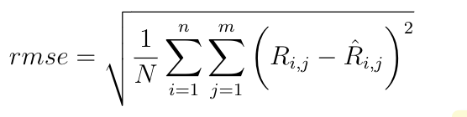
Objective Function (Cost Function)
The objective function is the function we want to minimize using Gradient Descent
For the objective function we will want to minimize the difference between the output of the NN the images and the labels.
We will use Root Mean Squared Error to measure the error between the outputs of the NN and the labels. RMSE is shown below:
Where R is the output and hat(R) is the label

Slide 12
Objective Function implementation
The Objective function can be implemented:
self.objective_function = tf.sqrt(tf.reduce_sum(tf.square(tf.subtract(self.model, self.y))))
Recall that the self.model variable is the output of the neural network and the self.y placeholder will hold the label for the image.

Slide 13
Optimizer
We want to minimize the objective function using gradient descent. Tensorflow provides an easy way to implement this:
self.optimizer = tf.train.GradientDescentOptimizer(learning_rate).minimize(self.objective_function)

Slide 14
Initalize the variables
Now that we have created all the variables for our ‘graph’ we initialize them before we actuall run it.
self.init = tf.global_variables_initializer()
Then we will get a summary of this graph- which can be visualized later.
self.merged_summary_op = tf.summary.merge_all()

Slide 15
Part 2: Running the Neural Network
In the run(self) method:
def run(self):
with tf.Session() as sess:
sess.run(self.init)
This launches the graph that we created in Part 1.

Slide 16
Summary
We will initialize a summary writer to write to a local directory. More on this later.
summary_writer = tf.summary.FileWriter('data/logs', graph=sess.graph)

Slide 17
Training
Now to loop through the training iterations initialized in the constructor.
for iteration in range(self.training_iteration):
Now initialize the average cost variable and the number of batches. The number of batches is the number of training items divided by the batch size.
num_batches = int(self.dataset.num_examples/self.batch_size)

Slide 18
Iterate through the training set in batches
Each iteration uses all the training data in this case (epoch).
The number of batches per epoch corresponds to the number of training examples divided by the batch size
for iteration in range(self.training_iteration):
avg_cost = 0
num_batches = int(self.dataset.num_examples/self.batch_size)
Now iterate through the number of batches of size self.batch_size and grab a batch of training items from the dataset.
for i in range(num_batches):
batch_xs, batch_ys = self.dataset.next_batch(self.batch_size)

Slide 19
Run examples in the batches through the placeholders
Now the inputs are run through the self.x placeholder and the labels (expected outputs) are ran through the self.y placeholder initiated earlier on. These values are then fed into the optimizer.
Everything in TensorFlow is lazy evaluated so nothing actually gets evaluated until tf.run is called.
sess.run(self.optimizer, feed_dict={self.x: batch_xs, self.y: batch_ys})
The current evaluation of the objective function is retrieved in a similar fashion:
sess.run(self.optimizer, feed_dict={self.x: batch_xs, self.y: batch_ys})

Slide 20
Display current cost during iteration
We don’t want to display info at every epoch so we can display it every 3 epochs:
if iteration % self.display_step == 0:
print("Epoch:" + str(iteration+1) + " cost=", "{:.9f}".format(avg_cost))

Slide 21
After training, evaluate the model using the test set
As before, we must create a way for the model to be evalutated:
predictions = tf.equal(tf.argmax(self.model, 1), tf.argmax(self.y, 1))
accuracy = tf.reduce_mean(tf.cast(predictions, tf.float64))
Again, these are not evaluated yet and we will use the run tensorflow method to run values through placeholders and into thsese above functions.
The predictions function will evaluate the maximum value as output from the model (a one-hot vector), against the label for that item (another one-hot vector).
The accuracy function simply casts the predictions into a float

Slide 22
Run the evalutation
Now to run the functions from the previous slide by inputting the test-data into the self.x placeholder and running it through the model while also running the labels through the self.y placeholder to compare results:
print("Accuracy:", accuracy.eval({self.x: self.dataset.testing_X, self.y: self.dataset.testing_y}))
This will evaluate all the testing data and provide the accuracy of classifying the testing data.

Slide 23
Run the program
The Neural Network should run now:
if __name__== "__main__":
nn = NNExample()
nn.run()
Maybe around 97-98% accuracy.

Slide 24
Visualization
After running the NN, run Tensorboard.:
tensorboard --logdir=data/logs/
Navigate to http://localhost:6006 in a browser

Slide 25
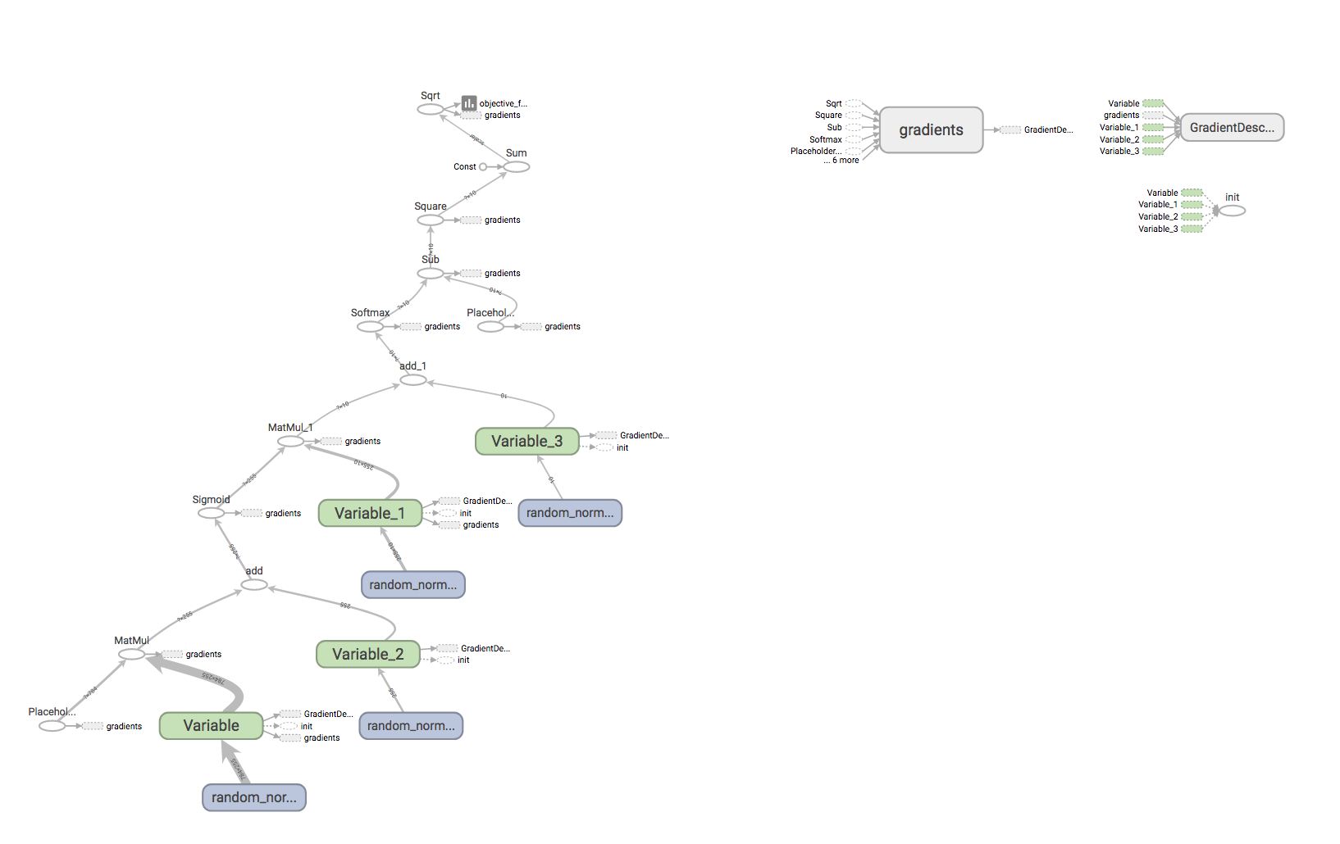
You will see something like this:

Slide 26
Tensorflow Graph
This is a visualization of the Graph that was created.
It can be made to look less confusing by encapsulating variables and placeholders into subgraphs using name_scope. For example:
with tf.name_scope("weights") as scope:
W1 = tf.Variable(tf.random_normal([input_layer_n, hidden_layer_n], stddev=0.1))
W2 = tf.Variable(tf.random_normal([hidden_layer_n, output_layer_n], stddev=0.1))
This will encapsulate the weights into a single subgraph and will appear as a node on the overall graph

Slide 27
with tf.name_scope("biases") as scope:
b1 = tf.Variable(tf.random_normal([hidden_layer_n], stddev=0.1))
b2 = tf.Variable(tf.random_normal([output_layer_n], stddev=0.1))
with tf.name_scope("model") as scope:
layer_1 = tf.nn.sigmoid(tf.matmul(self.x, W1) + b1)
output_layer = tf.nn.softmax(tf.matmul(layer_1, W2) + b2)
self.model = output_layer
with tf.name_scope("objective_function") as scope:
self.objective_function = tf.sqrt(tf.reduce_sum(tf.square(tf.subtract(self.model, self.y))))
Name scope can be applied to the biases, model and objective function to allow for a more readable graph

Slide 28
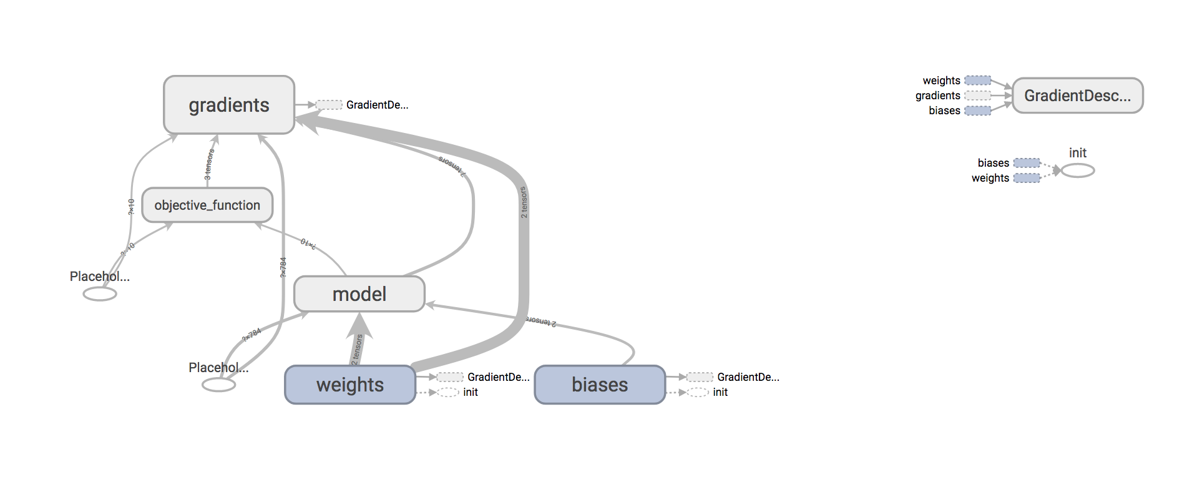
Run the NN again and the graph will look like this:

Slide 29
Histograms and Scalars
Tensorflow provides many ways to visualize generated data.
For example histograms can be produced for the weights and biases in this example:
weights_histogram1 = tf.summary.histogram("weights 1", W1)
biases_histogram1 = tf.summary.histogram("biases 1", b1)
weights_histogram2 = tf.summary.histogram("weights 2", W2)
biases_histogram2 = tf.summary.histogram("biases 2", b2)
The above block can be inserted after the biases are initialized.

Slide 30
The objective function
It is useful to plot the Objective Function so that we can see it (hopefully) decreasing. Insert code in red
with tf.name_scope("objective_function") as scope:
self.objective_function = tf.sqrt(tf.reduce_sum(tf.square(tf.subtract(self.model,self.y))
tf.summary.scalar("objective_function",self.objective_function)

Slide 31
Write the summaries to the logs
The summaries, like the functions, need values fed through them.
We will write the summaries to log at each iteration:
for i in range(num_batches):
batch_xs, batch_ys = self.dataset.next_batch(self.batch_size)
sess.run(self.optimizer, feed_dict={self.x: batch_xs, self.y: batch_ys})
avg_cost += sess.run(self.objective_function, feed_dict={self.x: batch_xs, self.y: batch_ys})/num_batches
summary_str = sess.run(self.merged_summary_op, feed_dict={self.x: batch_xs, self.y: batch_ys})
summary_writer.add_summary(summary_str, iteration*num_batches + i)

Slide 32
Further Classification
A further example is shown in ClassificationNN.py
This example can be used on 5 datasets:
1. MNIST
2. Poker-hands: Different 5-card poker-hands are input into the NN and classified as one of 10 different poker-hands. https://archive.ics.uci.edu/ml/datasets/Poker+Hand
3. Bank: Client data from a bank marketing campaign conducted via phone. The NN classifies whether the client signed up for a term deposit. (Yes/No) https://archive.ics.uci.edu/ml/datasets/Bank+Marketing

Slide 33
Datasets continued….
4. HAR: Human Activity Recognition. Participants wore a Samsung Galaxy smartphone and performed 1 of 6 different activities (walking, sitting, standing.. ). Based on the accelerometer and gyroscope from the Galaxy the NN classifies what activity the participant is performing. https://archive.ics.uci.edu/ml/datasets/human+activity+recognition+using+smartphones
5. WINE. Stats of various wines. The NN classifies the quality of the wine.

Slide 34
Posiible tasks for ClassificationNN.py
There is only one hidden layer at the moment, another layer could be added.
The WINE dataset only has a 50% accuracy rate. Perhaps this can be improved.
Other datasets can be configured for this NN from https://archive.ics.uci.edu/ml/datasets.html

