Slide 1
IUT OPPORTUNITY HUB
SWE 4304: Software Project Lab I
Group 16
Farnaz Rahman Maliha 240042117
Tasnova Tahia 240042138
Tasnita Raida 240042113

Slide 2
INTRODUCTION
  A centralized platform for the IUT community
  Aims to make academic and professional opportunities
easier to discover.
  Helps faculty and alumni find students for research
projects.
  Connects students, alumni, and faculty for collaboration
and guidance.
2

Slide 3
MOTIVATION
THE BEGINNING:
A PERSONAL CHALLENGE
  Wanted to start research but didn't know how.
  Research opportunities were limited.
  Struggled to connect with seniors and teammates.
THE REALIZATION:
AN OPPORTUNITY TO CONNECT THE IUT COMMUNITY
  Many IUT students face similar challenges.
  Talented students, experienced alumni, and research-oriented faculty lack a common platform to connect.
  No easy way to bring them together.
3

Slide 4
PROBLEM STATEMENT
The Existing Gap
IUT students face difficulties finding relevant opportunities, research collaborators, mentors, and experienced seniors or alumni because connections and information are scattered across informal networks and separate communication channels.
Create a need for
IUT Opportunity Hub
A centralized platform for discovering opportunities, finding research collaborators, connecting with mentors, and building academic and professional relationships within the IUT community.
4

Slide 5
TARGET STAKEHOLDERS
STUDENTS
ALUMNI
FACULTY
Search jobs,internships and assistanships.
Share academic and professional experience
Discover potential research collaborators
Discover,research projects and supervisors
Guide students interested in their fields.
Recieve and manage requests
Request mentorship or project participation
Publish job and higher study opportunities
Update supervision availability
Track application and request status
A clearer path to academic and career growth
Meaningful connections and a lasting impact on future graduates.
Less time searching for suitable students ,less time for research and supervision
5

Slide 6
KEY FEATURES
01. OPPORTUNITY MANAGEMENT
02.Alumni & Mentorship
  browse
  search, filter
  apply
  Track and manage
  Search alumni
  View Profile
  Send connection,mentorship requests,response
04.Recommendation System
03.Research Collaboration
  Publish
  browse by domain
  request participation
  Rank relevant opportunities
and mentors using profile skills .academic background,previous projects and experience
6
6

Slide 7

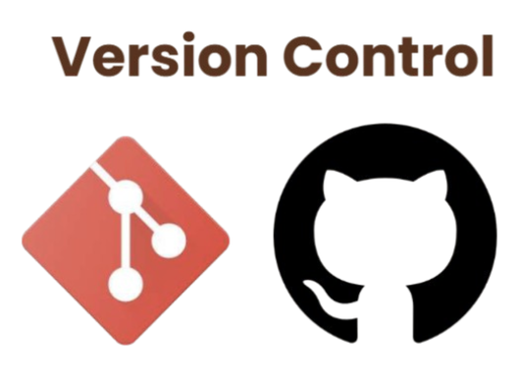


Tools & Technology
Programming
Language
Version
Control
JDBC
IDE
Database
7

Slide 8
Timeline
We are
here
Task list
Week 2 Week 3 Week 4 Week 5 Week 6 Week 7 Week 8 Week 9 Week 10 Week 11 Week 12 Week 13 Week 14
Team formation &
idea generation
Registration &
login
Role-specific
profiles & dashboards
Opportunity
management
Alumni search &
mentorship
Research
collaboration
Opportunity
recommendations
Debugging
& testing
Documentation &
final demo
8

Slide 9
THANK YOU
9

