Slide 1
Compiler Technology of Programming Languages
Chapter 2
A Simple Compiler
Prof. Farn Wang
Prof. Farn Wang, Department of Electrical Engineering

Slide 2

Design of a Simple Compiler
Build a simple compiler for a very small language: AC (Adding Calculator).
  Computation and printing of numerical values for integer and FP variables
Although simple, AC serves the purpose of studying the phases and data structures of a compiler.
This chapter covers basic techniques that will be discussed in more details in Chapter 3 through Chapter 9
Prof. Farn Wang, Department of Electrical Engineering

Slide 3
Informal AC definition
Types
  Support only two types: integer and float
  Integer: a sequence of decimal numerals.
  Float: allows 5 fractional digits after the decimal point.
Keywords
  Keywords vs. Reserved words
  All languages have some keywords such as if, while, …
  Three reserved words in AC: f (declare for float), i (declare for integer), p (print the value of a variable).
Variables
  AC offers 23 variable names, from a to z, excluding the three reserved words: i, f, and p.
  Variables must be declared before using them
Prof. Farn Wang, Department of Electrical Engineering

Slide 4
Informal AC definition (cont.)
Type Conversion
Implicit type conversion is also called type coercion. e.g.
  int I; float f; double d;
  f = I; f = I*1.25+3; d = d+f;
  Quiz:
  unsigned ux;
  Is (ux > -1) TRUE or FALSE?
Explicit type conversion is often called type casting
AC allows type coercion from integer to float, but not the other direction.
Prof. Farn Wang, Department of Electrical Engineering
Notes:
Usually type coercion to the more general types. Thus ux==0xffffffff will be coerced to -1 in most platform, but problematically not all.

Slide 5
Structure of the AC Compiler
AC program
char stream
Token
stream
DC (desk calculator)
code
Lexical
analyzer
Syntax
directed
translator
(scanner)
(parser + semantic routines)
AC-to-DC Compiler or
AC-to-DC Converter
Prof. Farn Wang, Department of Electrical Engineering

Slide 6
Formal AC definition
Must define the syntax and the semantics
Use a CFG (Context Free Grammar) to describe its syntax
Use RE (Regular Expression) to define its token specification
Formal definition
enables automatic compiler construction
minimizes ambiguity
Prof. Farn Wang, Department of Electrical Engineering

Slide 7
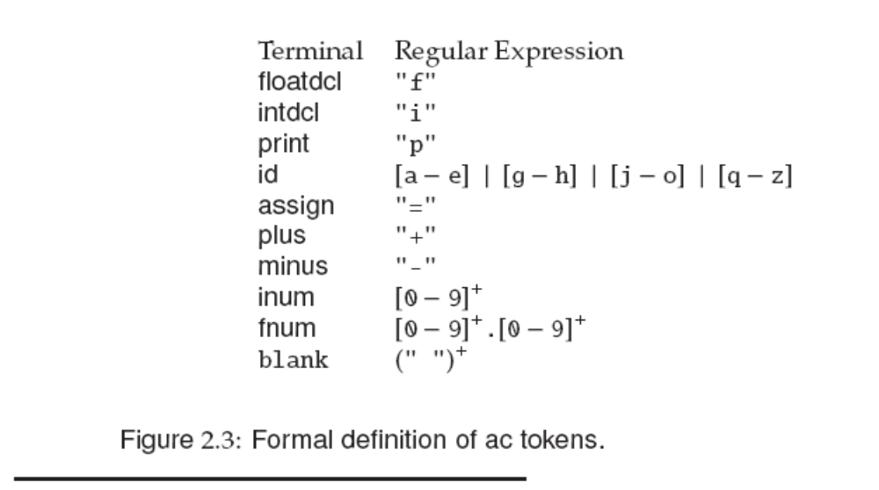
An AC Scanner
There are 10 tokens in AC.
our scanner will be defined as a function that returns token (with attributes).
Which tokens
need attributes?
Id, inum, fnum
Prof. Farn Wang, Department of Electrical Engineering

Slide 8
Syntax Definition
CFG (Context Free Grammar) is a set of rewriting rules. It is also called Backus-Naur Form (BNF) grammar.
The rewriting rule is called a production.
Example:
A → B C D … Z
where
  A is the left-hand side (LHS) of the production.
  B C D … Z is the right-hand side (RHS).
  This means any occurrence of A can be replaced by the RHS.
Prof. Farn Wang, Department of Electrical Engineering

Slide 9
Production Example
<program> → begin <stmt_list> end
LHS is the name of the syntactic construct; the RHS shows a possible form of the syntactic construct.
LHS are always nonterminals, RHS can have terminals and nonterminals.
“begin”, “end” lexical elements are called tokens, or terminal symbols
For example, <program> is a nonterminal. <stmt_list> is also a nonterminal.
Prof. Farn Wang, Department of Electrical Engineering

Slide 10
CFG
A set of tokens
A set of non-terminals
A set of productions
A start symbol (one of the non-terminals)
A string is derived by repeatedly applying productions to a non-terminal symbol
The language defined by a CFG is the token strings that can be derived from the start symbol
Prof. Farn Wang, Department of Electrical Engineering

Slide 11
Recursion and Empty String
Recursion enables repetitions
Example:
<stmt_list> → <stmt> <stmt_tail>
<stmt_tail> → <stmt> <stmt_tail>
The empty or null string is represented by λ or ε
Example:
<stmt_tail> → λ
The empty string is very useful in representing optional items.
Prof. Farn Wang, Department of Electrical Engineering

Slide 12
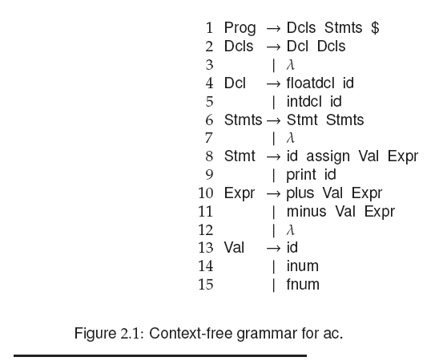
Syntax of AC
$ means end-of-file
Prof. Farn Wang, Department of Electrical Engineering

Slide 13
Syntax of AC
f
i
id
=
p
+
-
I number
f number
All tokens in AC
blank
Prof. Farn Wang, Department of Electrical Engineering

Slide 14
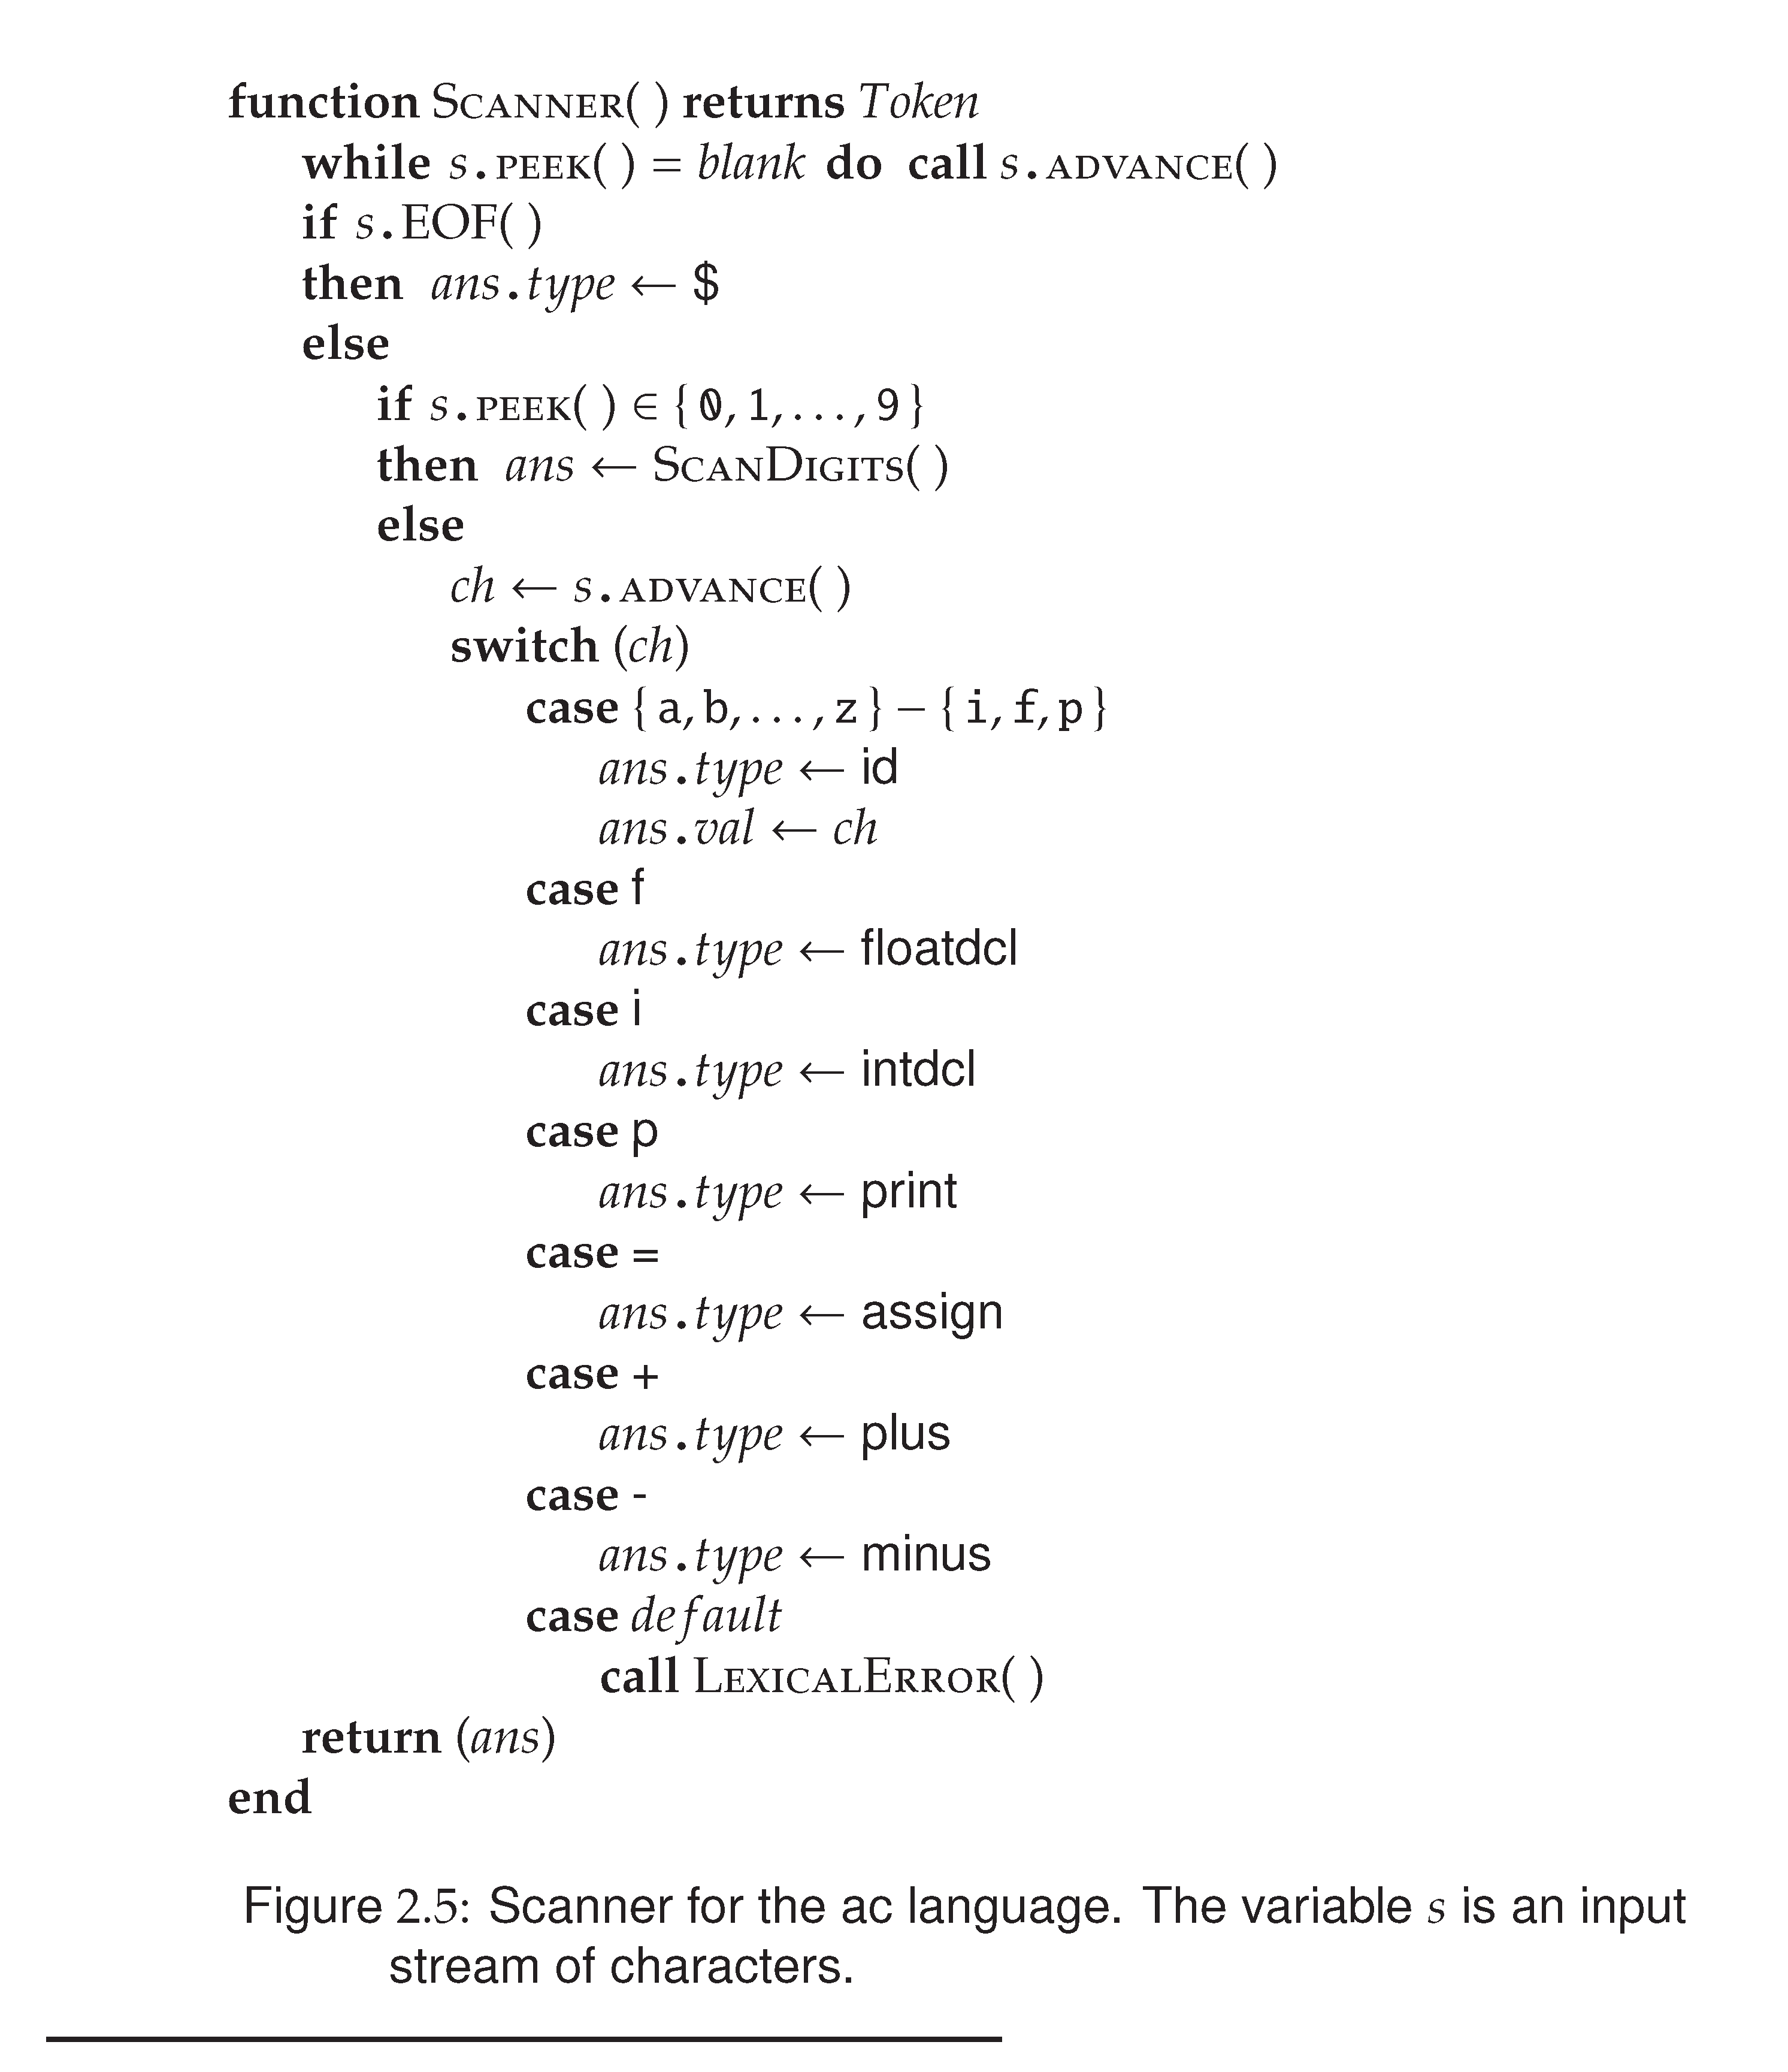
Prof. Farn Wang, Department of Electrical Engineering

Slide 15
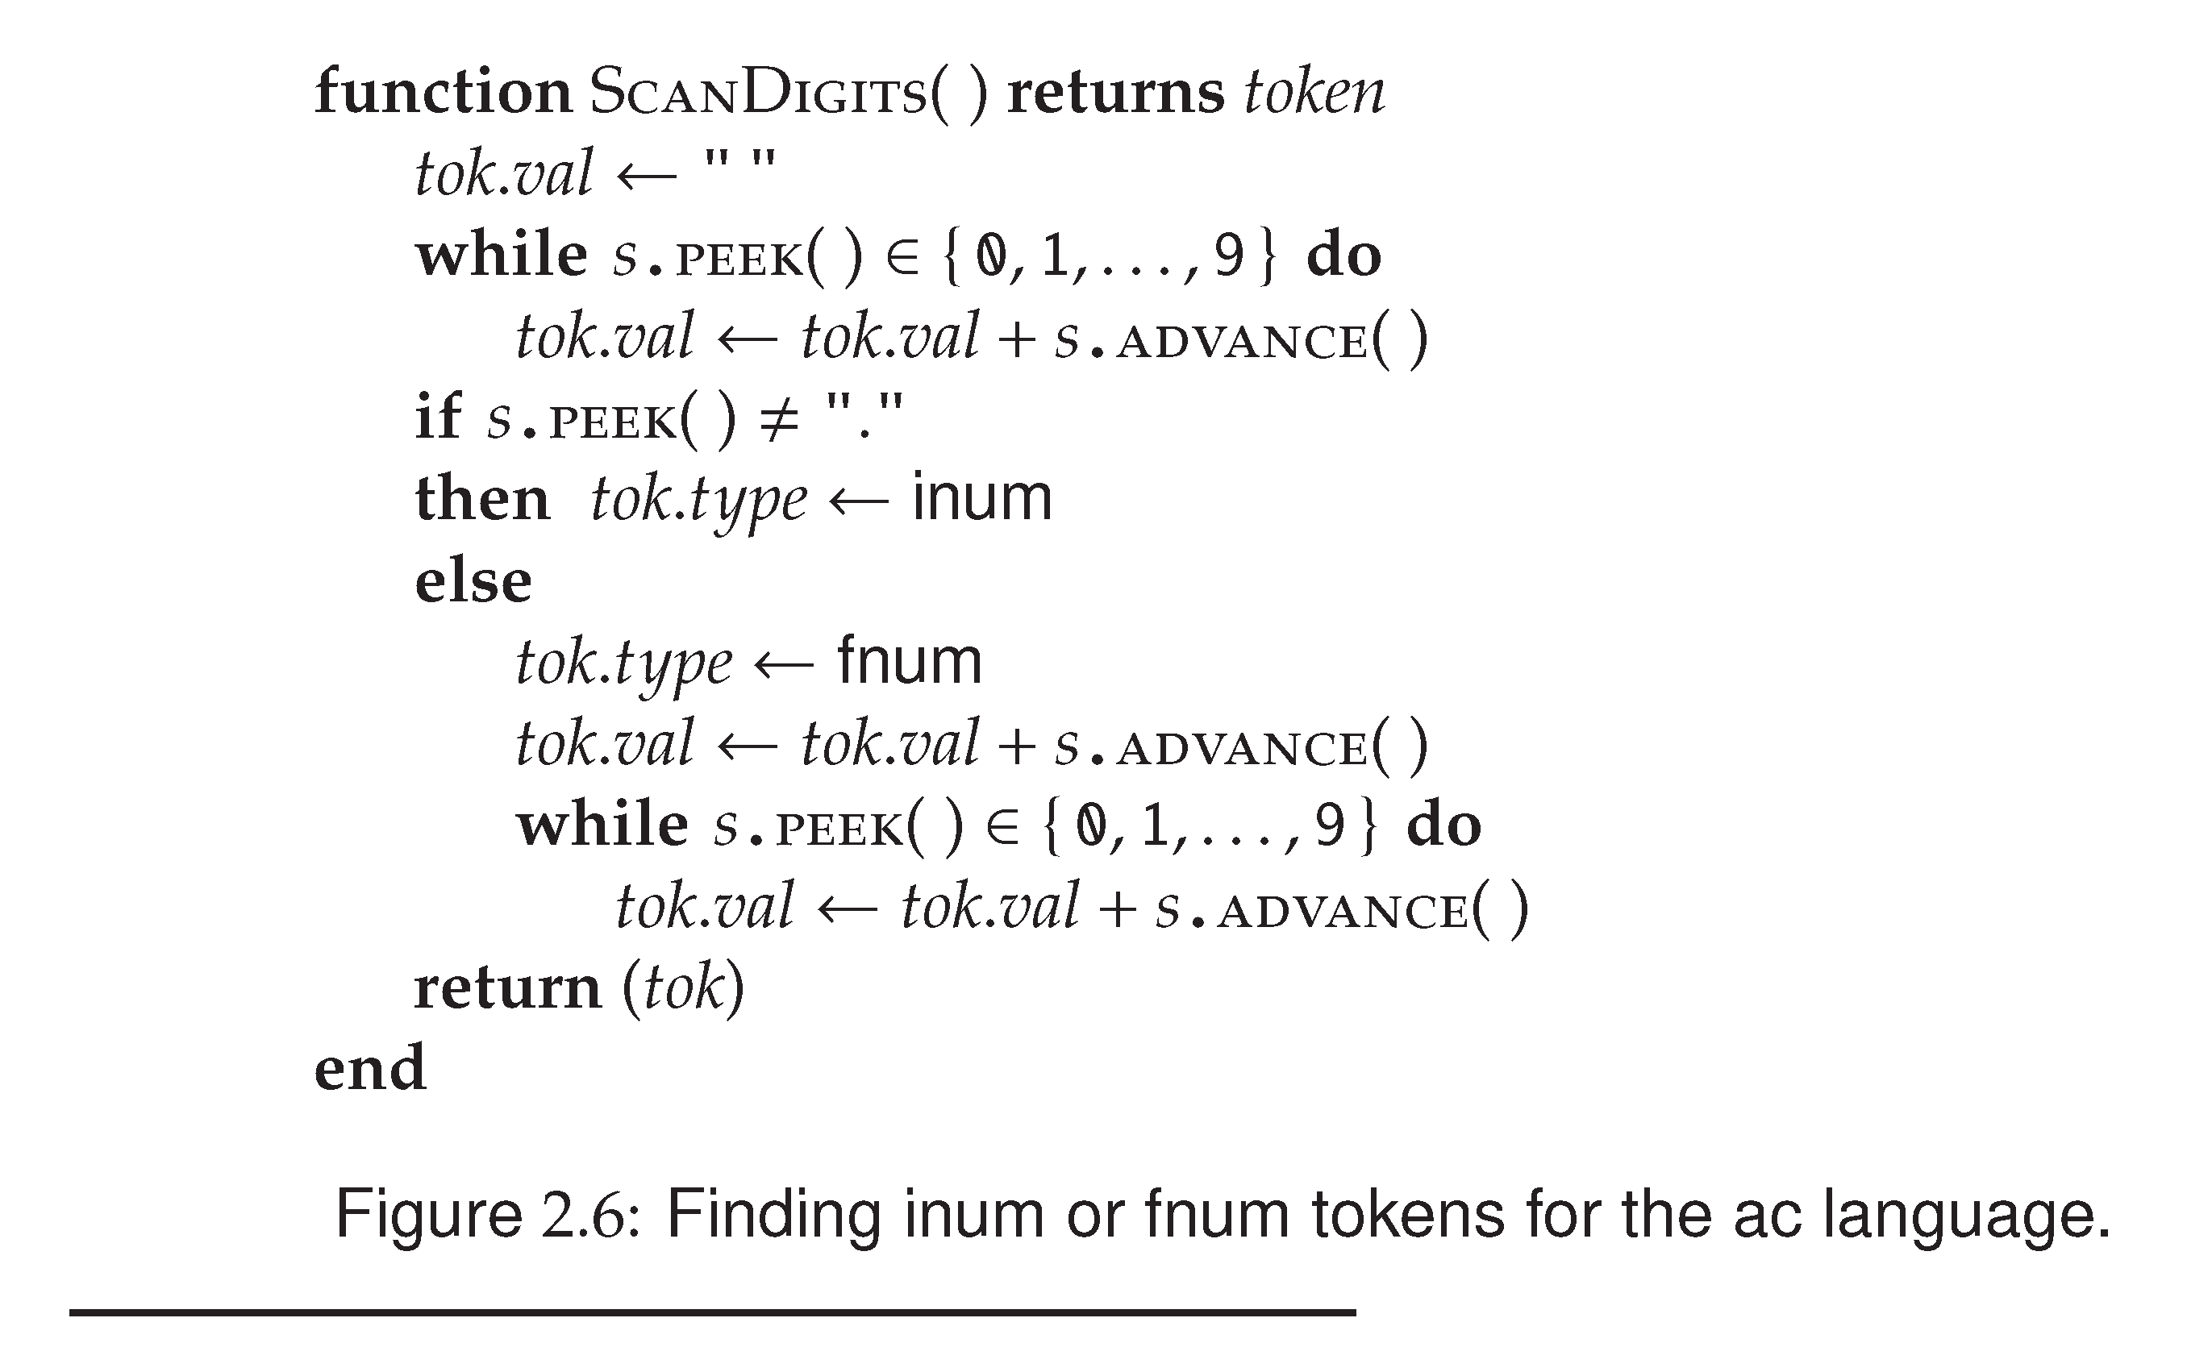
integer
float
Prof. Farn Wang, Department of Electrical Engineering

Slide 16
Quick Overview
A Simple PL
Some formalisms are used
Why do we need formalism
What is the job of a scanner?
What are the four components of a CFG?
AC
CFG + RE
Precise definition + automation
Grouping chars into tokens
Tokens, Non-terminals, Productions, Start symbol
Prof. Farn Wang, Department of Electrical Engineering

Slide 17
How to derive an AC program
  Remember:
  The language defined by a CFG is the token strings that can be derived from the start symbol.
  Let us check if the following code fragment is a valid AC program?
  f b i a a = 5 b = a + 3.2 p b
  First, the scanner converts this program to
  floatdcl id intdcl id id assign inum id assign id plus fnum print id $
Prof. Farn Wang, Department of Electrical Engineering

Slide 18
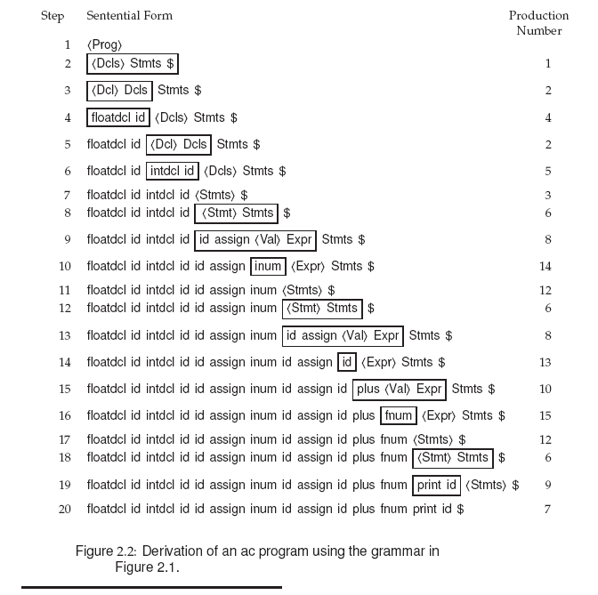
prog → dcls stmts $
dcls → dcl dcls
| λ
dcl → floatdcl id
| intdcl id
stmts → stmt stmts
| λ
stmt → id assign val expr
stmt → print id
…
  f b i a a = 5 b = a + 3.2 p b
Prof. Farn Wang, Department of Electrical Engineering

Slide 19
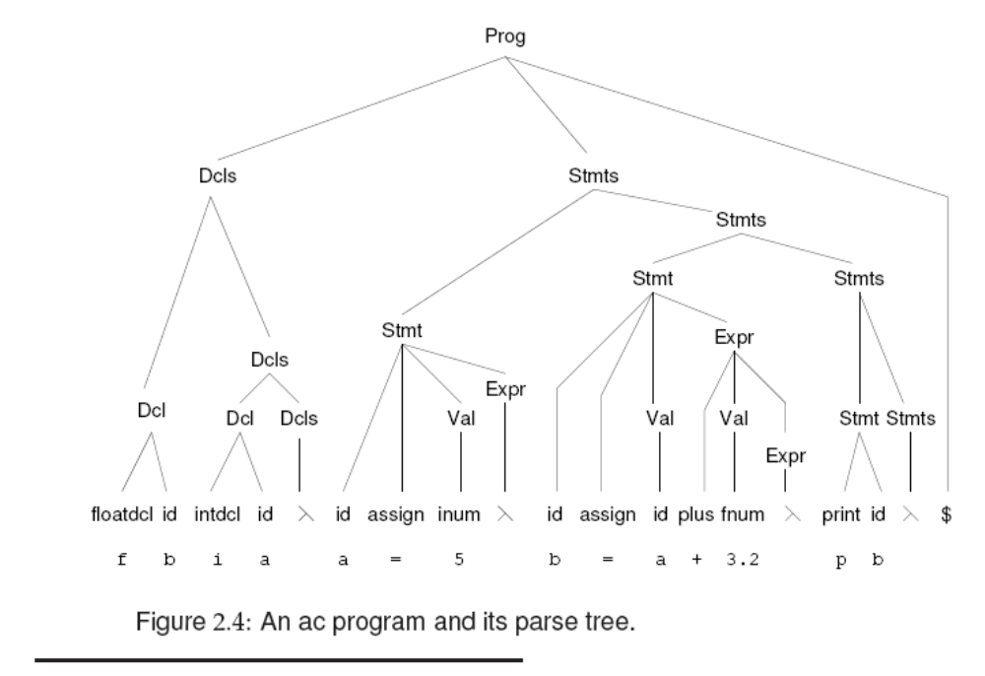
Prof. Farn Wang, Department of Electrical Engineering

Slide 20
Quiz: Which of the following are in the language defined by the AC syntax
  f b i a a = 0 b = a + 3.2 p b
  b) p 15
  c) An empty file
  d) f b a = 1.0 i c c = 0 p a
  e) f b i a a = 0 b = - a - 3.2 p b
Prof. Farn Wang, Department of Electrical Engineering

Slide 21
Quiz: Which of the following are in the language defined by the AC syntax
  f b i a a = 0 b = a + 3.2 p b
  b) p 15
  c) An empty file
  d) f b a = 1.0 i c c = 0 p a
  e) f b i a a = 0 b = - a - 3.2 p b
8. stmt → id assign val expr
9. stmt → print id
10. expr → plus val expr
| minus val expr
| λ
val → id
| inum
| fnum
Prof. Farn Wang, Department of Electrical Engineering

Slide 22
Parse Tree
A Parse Tree shows how the start symbol derives a string.
Example: A→ XYZ
Example: expr → term + ID
A
X
Y
Z
expr
term
+
ID
Prof. Farn Wang, Department of Electrical Engineering

Slide 23
Example
A subset of C grammar:
<function_decl> → <type> id ( <expr_list> ) { <block> }
<block> → <decl_list> <statement_list> | λ
A C program – a token string
int func() {}
A derivation:
Parsing: to come up with the parse tree and validate the token string is a correct C program.
function_decl
type
id
(
expr_list
)
int
?
Prof. Farn Wang, Department of Electrical Engineering

Slide 24
Parse Tree
A Parse Tree has the following properties
  The root is labeled by the start symbol
  Each leaf is labeled by a token or by λ
  Each internal node is labeled by a non-terminal
  If A is the non-terminal labeling, and X,Y,Z are labels of the children of A from left to right, then A→ XYZ is a production
Parsing is the process of finding a parse tree for a given string of token.
If a grammar can have more than one parse tree for a given string, this grammar is ambiguous.
Prof. Farn Wang, Department of Electrical Engineering

Slide 25
Ambiguous Grammar
Example CFG
  String → String + String
  String → String – String
  String → digit
The string 9-2+4 can have two parse trees
ST
ST
ST
ST
ST
ST
ST
ST
ST
ST
4
9
-
2
+
4
9
-
2
+
Prof. Farn Wang, Department of Electrical Engineering

Slide 26

Association and Precedence
Left Association and Right Association
  An operator associates to the left if an operand has operators on both side, and the operand is taken by the operator to its left.
  Left associative operators:
    +, -, *, /
    e.g. A + B + C, A-B-C, A*B*C
  Right associative operators:
    Exponential and the assign operator
    e.g. A = B =C, (A?B:C?D:E)
Prof. Farn Wang, Department of Electrical Engineering
Notes:
A=(B=C)
A?B:(C:D:E) or (A?B:C)?D:E

Slide 27
Exercise
<expr> → <expr> { <add_op> <primary>}
+ and – are left associative operators, see how a string is derivated.
A {+ B} {+ C……
In the above example, B will be associated with the left operator
However, if the operator is right associative, how would the CFG be different? Consider the assignment operator, for example.
Department of Computer Science and Engineering
1/25/2006
Prof. Farn Wang, Department of Electrical Engineering

Slide 28
Exercise (cont.)
<expr> → {<primary> <assign_op> } <expr>
➔ …. {A= } { B = } C
In the above example, B will be associated with the right operator.
Another way to define the production is
<expr> → <primary> <assign_op> <expr>
Use right recursion instead.
Department of Computer Science and Engineering
1/25/2006
Prof. Farn Wang, Department of Electrical Engineering

Slide 29
Exercise (cont.)
CFG1. <expr> → <expr> OP <primary>
CFG2. <expr> → <primary> OP <expr>
In CFG1, OP is ?
Left Associative
In CFG2, OP is
Right Associative
Focus on what is repeating!!
(op primary) → left associative
(primary op) → right associative
Department of Computer Science and Engineering
3/03/2008
Prof. Farn Wang, Department of Electrical Engineering

Slide 30
Precedence of Operators
* (multiply) and / (divide) have higher precedence than + and -. How is precedence of operators handled?
We can create two non-terminals for the two levels of precedence.
Example CFG
  Expr → expr + term | expr – term | term
  Term → term * factor | term / factor | factor
  Factor → digit | (expr)
But what if there are many levels
of precedences?
Operator Precedence parsing !!
table of operator priority + a stack …
Prof. Farn Wang, Department of Electrical Engineering

Slide 31
Precedence of Operators in C
Operators | Associativity
() [] - > . | Left to Right
! ~ ++ -- + - * & (type) sizeof | Right to Left
* / % | Left to Right
+ - | Left to Right
<< >> | Left to Right
< <= > >= | Left to Right
== != | Left to Right
& | Left to Right
^ | Left to Right
| | Left to Right
&& | Left to Right
|| | Left to Right
?: | Right to Left
= += -= *= /= %= &= ^= |= <<= >>= | Right to Left
, | Left to Right
(unary operators)
Prof. Farn Wang, Department of Electrical Engineering

Slide 32
Semantic Analysis
Parse Tree → Syntax Tree
list
+
list
digit
-
4
list
digit
digit
9
2
9
-
2
+
4
Syntax Tree
(also called AST)
Parse Tree
Prof. Farn Wang, Department of Electrical Engineering
Notes:
AST: abstract syntax tree, generated after parse treee

Slide 33
Semantic Analysis
Parse Tree → Syntax Tree
stmt
while
while
(
expr
)
body
>
body
expr
term
term
A
0
Internal node: nonterminals
Internal node:
operators
A
>
0
Parse Tree
Syntax Tree
Prof. Farn Wang, Department of Electrical Engineering

Slide 34
Prof. Farn Wang, Department of Electrical Engineering

Slide 35
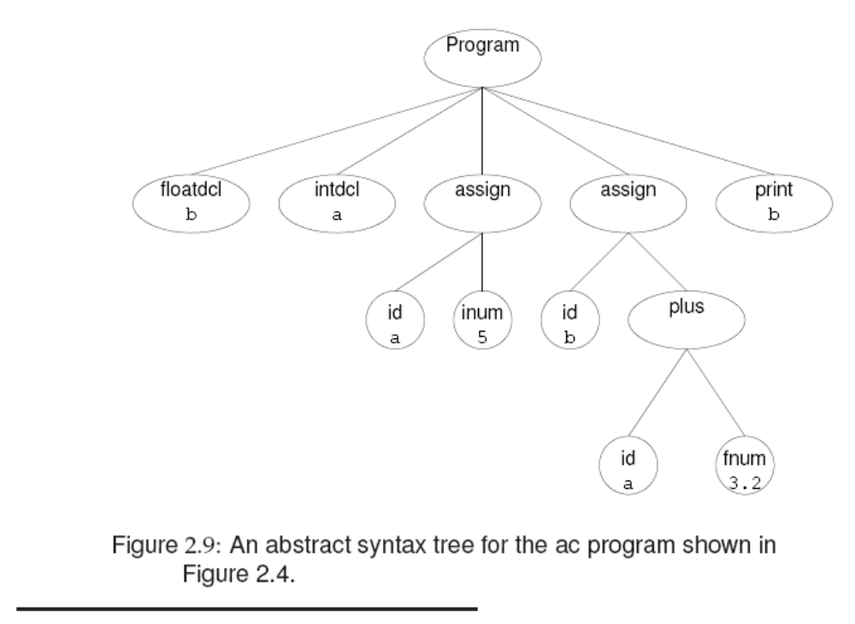
Prof. Farn Wang, Department of Electrical Engineering

Slide 36
Parsing
Parsing is to determine if a token string can be generated by a CFG
Two common parsing methods: Top-down and bottom-up to come up with the parse tree.
Top-down starts at the root and proceeds towards leaves
Bottom-up starts at the leaves and proceeds towards the root
Prof. Farn Wang, Department of Electrical Engineering

Slide 37
Parsing Example
Top-down
Bottom-up
String: abcxy
Productions:
S → AB
A → abc | w
B→ de | xy
S
S
A
B
A
B
abc
xy
abc
xy
Department of Computer Science and Engineering
1/25/2006
Prof. Farn Wang, Department of Electrical Engineering

Slide 38
Top-down vs. Bottom-up
Top-down | Bottom-up
Easy to understand | Can handle a larger class of grammars
Efficient parsers can be built by hand | Efficient parsers can be built by tools
Some restrictions on grammars, may need to modify productions | Less restrictions on grammars
Also known as predictive parsing | More commonly used in production compilers
Prof. Farn Wang, Department of Electrical Engineering
Notes:
You have to guess which rules to use in the top-down parsing.

Slide 39
Top Down Parsing
Bottom-Up Parsing
Prof. Farn Wang, Department of Electrical Engineering

Slide 40
Recursive Descent Parsing
One of the simplest parsing method
Basic idea
  Each non-terminal has a parsing procedure
  For symbols on RHS,
    to match a non-terminal A, call the parsing procedure A,
    to match a terminal t, call match(t).
example
  Void system_goal (void)
  /* <system_goal> → <program> SCANEOF */
  {
  program();
  match (SCANEOF);
  }
Department of Computer Science and Engineering
Prof. Farn Wang, Department of Electrical Engineering

Slide 41
Abstract Example
A → BCD
Function A
{
call B;
call C;
call D;
}
A → BxCyD
Function A
{
call B;
match(x);
call C;
match(y);
call D;
}
B,C,D are non-terminals
x,y are tokens
Prof. Farn Wang, Department of Electrical Engineering

Slide 42
Abstract Example
A → BCD | EF
Function A
{
if (lookahead∈First(BCD))
{call B; call C; call D;}
elseif (lookahead ∈ First (EF))
{call E; call F;}
}
First() is a set of terminal symbols (tokens) that can begin
a string derivable from a string of grammar symbols
If First(BCD) ∩ First(EF)≠∅, then parsing may fail.
Prof. Farn Wang, Department of Electrical Engineering

Slide 43
Parsing Statement
Stmt → ID = Val Expr | Print ID
Stmt() {
token t=next_token(); /* does not consume the token */
if (t == ID) { match(ID);
match(ASSIGN);
Val();
Expr();}
else if (t==Print) { match(Print); match(ID);} }
the next_token is used to determine what production to apply
Prof. Farn Wang, Department of Electrical Engineering

Slide 44
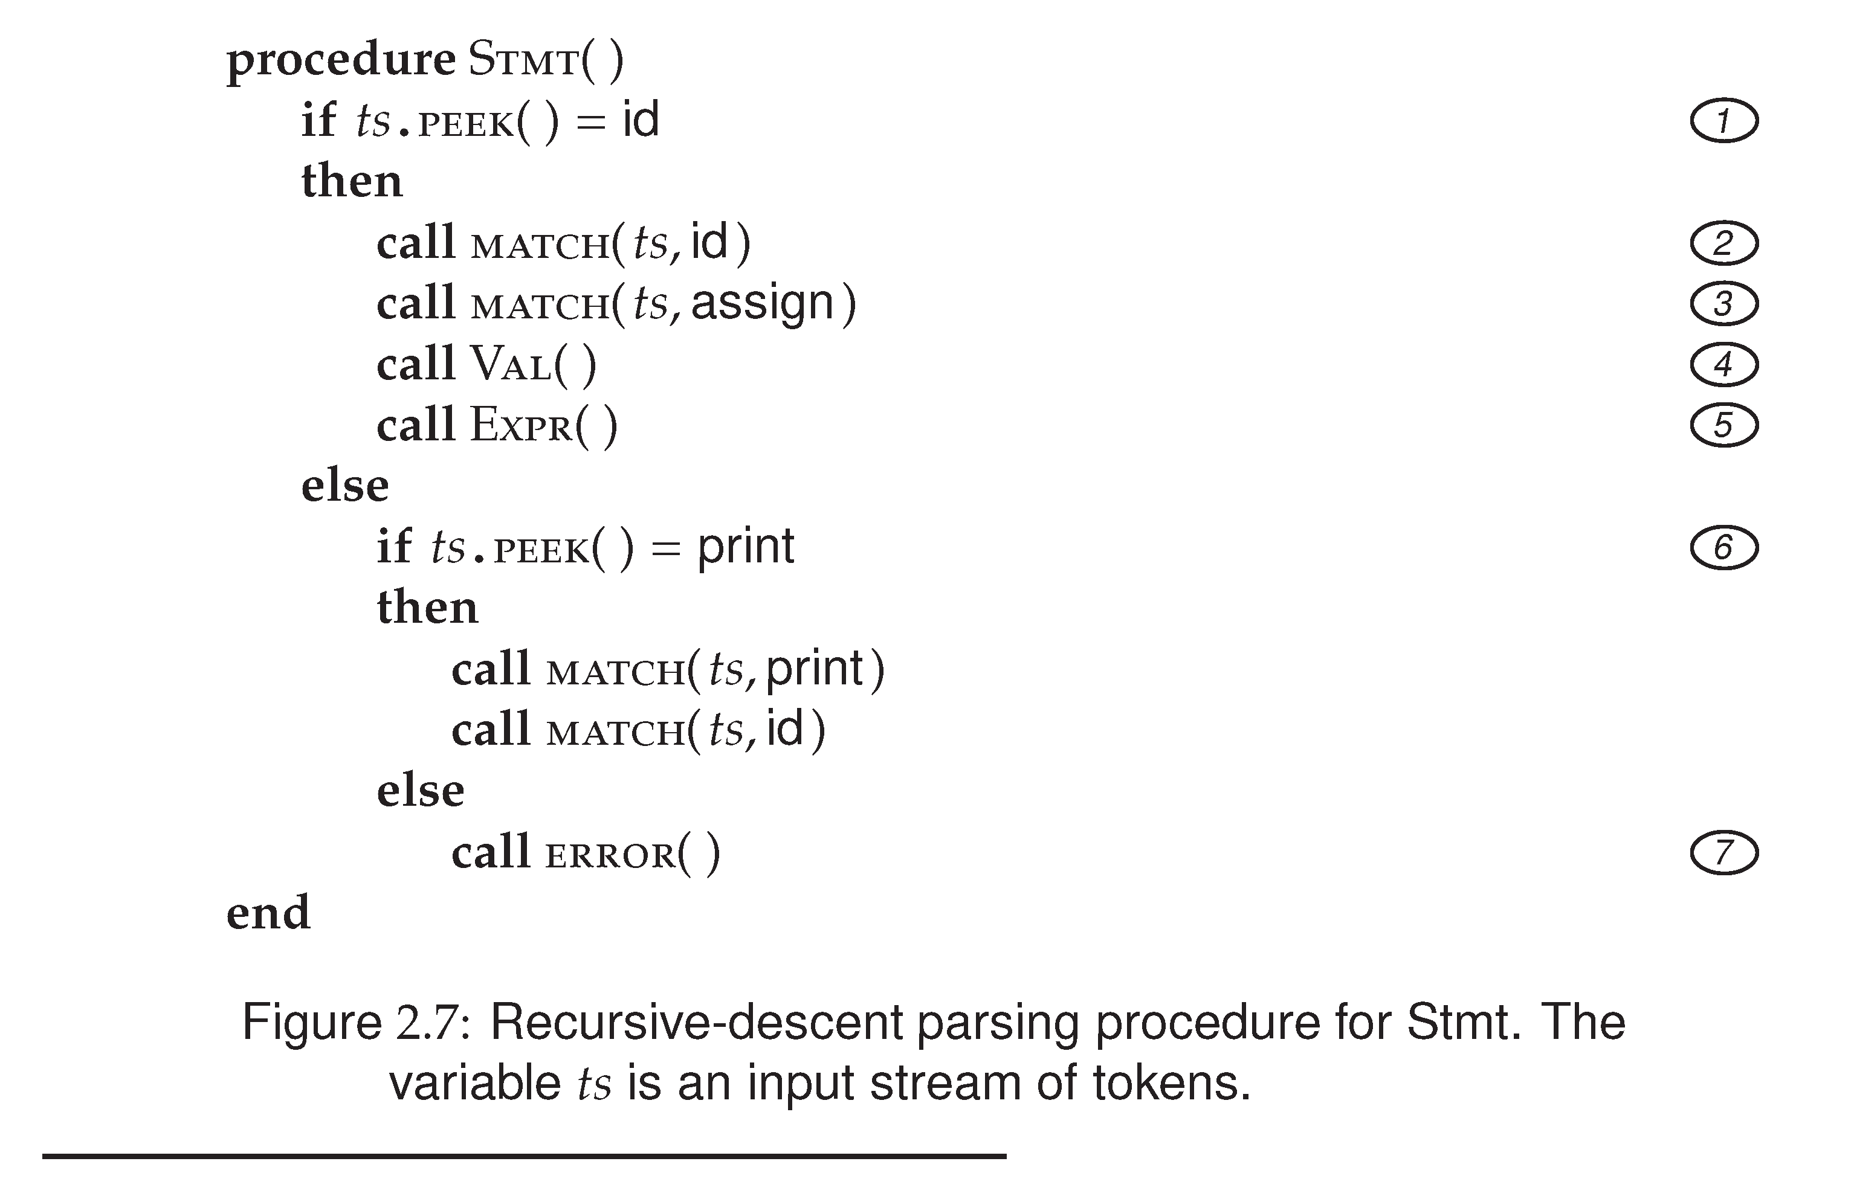
Prof. Farn Wang, Department of Electrical Engineering

Slide 45
Constructing a Predictive Parser
Create a procedure for each non-terminal
It decides which production to use by looking at the lookahead symbol.
  The lookahead token can uniquely determine which production to apply.
The procedure mimicking the right hand side: non-terminal will be a call, and a token match with the lookahead will cause the next token to be read.
Action routines can be copied into the parser.
Department of Computer Science and Engineering
Prof. Farn Wang, Department of Electrical Engineering

Slide 46
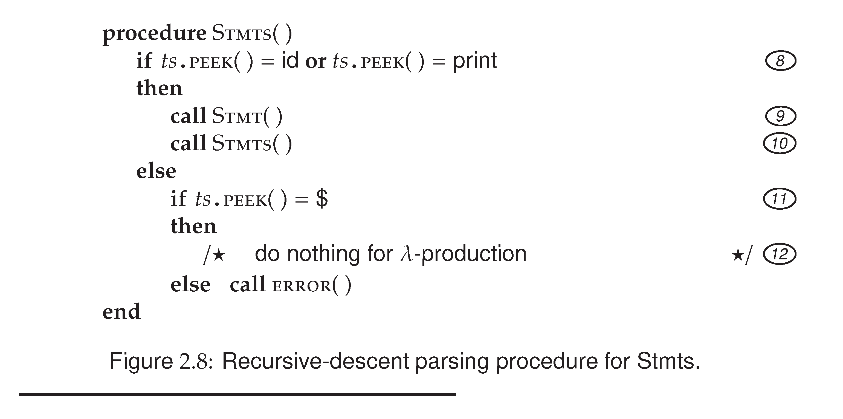
Stmts → Stmt Stmts
| λ
Prof. Farn Wang, Department of Electrical Engineering

Slide 47
Predictive Parsing
In predictive parsing, the lookahead symbol can uniquely select the procedure for each non-terminal.
The FIRST(α) is defined to be the set of tokens that appear as the first symbols that can be generated from α.
example:
FIRST(Stmt) = {ID, print}
λ-production is used as default when no other productions can be used.
Prof. Farn Wang, Department of Electrical Engineering

Slide 48
Predictive Parsing (cont.)
Not all CFG have the property of predictive parsing -- productions sharing the same LHS can be distinguished by the FIRST() set.
CFG with the above property is called LL(1) grammar.
LL(1) stands for
  “Left-to-Right,
  Left-most derivation”
  (1) means only one lookahead token is required in predictive parsing.
The AC CFG is LL(1).
Prof. Farn Wang, Department of Electrical Engineering

Slide 49

2022/09/20 stopped here.
同學們，compiler要上課了
Prof. Farn Wang, Department of Electrical Engineering

Slide 50
Left Recursion Removal
Left recursion creates troubles for recursive descent parsing
Example of left recursion
expr → expr + term
A → Aα | β{ β, βα, βαα, βααα, …..}
To eliminate left recursion, we can rewrite the productions.
A → β R
R → α R | λ { β, βα, βαα, βααα, …..}
Prof. Farn Wang, Department of Electrical Engineering

Slide 51
Exercise
CFG
Expr → Expr + term
Expr → Expr – term
Expr → term
After rewriting:
Expr → term Rest
Rest → + term Rest
Rest → - term Rest
Rest → λ
What is α ?

What is β ?
α is + term and – term
β is term
Prof. Farn Wang, Department of Electrical Engineering

Slide 52
Another Exercise
ID_List → ID_List , ID | ID
After rewriting
ID_List → ID Rest
Rest → , ID Rest | λ
What is α ?

What is β ?
α is , ID
β is ID
Department of Computer Science and Engineering
Prof. Farn Wang, Department of Electrical Engineering

Slide 53
Quick Review
Parsing
  What is parsing
  Two common methods of parsing
  Recursive descent parsing
  Predictive parsing
  Challenges to predicative parsing
  How to eliminate left recursions
A process of finding a parse tree
Top-down & Bottom up
1st lookahead can uniquely select
a production (parsing procedure).
Left recursion &
Left factoring
A → Aα | β
A → βR
R → αR | λ
Department of Computer Science and Engineering
Prof. Farn Wang, Department of Electrical Engineering

Slide 54
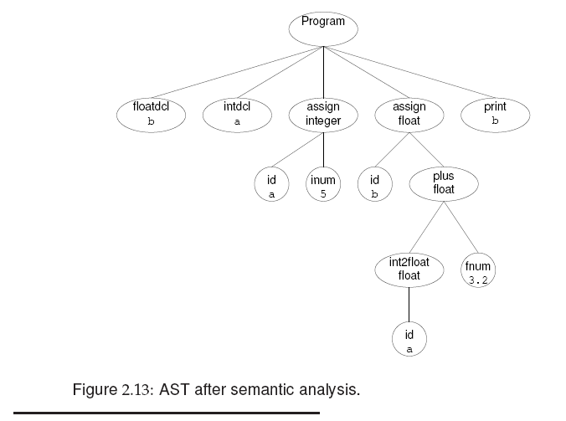
Prof. Farn Wang, Department of Electrical Engineering

Slide 55
Building AST
AST is built during parsing
Example:
ParseStatement()
{
switch (source.peek().type) {
case: Token.identifier:
  Token identifier = source.nextToken();
  Token assign = source.peek();
  if (source.peek().type() == Token.AssignmentOp) {
  source.nextToken();
  AST v=parseValue();
  return AST.makeTree(assign, identifier, v, parseExpressionTail(v));
Prof. Farn Wang, Department of Electrical Engineering

Slide 56
Building AST
Example A = 6
Example A = B + 6
=
AST.makeTree(assign, identifier, v, parseExpressionTail(v));
A
6
λ
=
makeTree(=, A, B, ParseExpTail)
A
+
(+, 6)
B
6
Prof. Farn Wang, Department of Electrical Engineering

Slide 57
Semantic Analysis
Post-parsing processing to enforce aspects of a language’s definition that are not easily checked by syntax analysis.
  Symbol table
  Type checking
  Types are examined for consistency
  Type-dependent behavior becomes explicit
Prof. Farn Wang, Department of Electrical Engineering

Slide 58
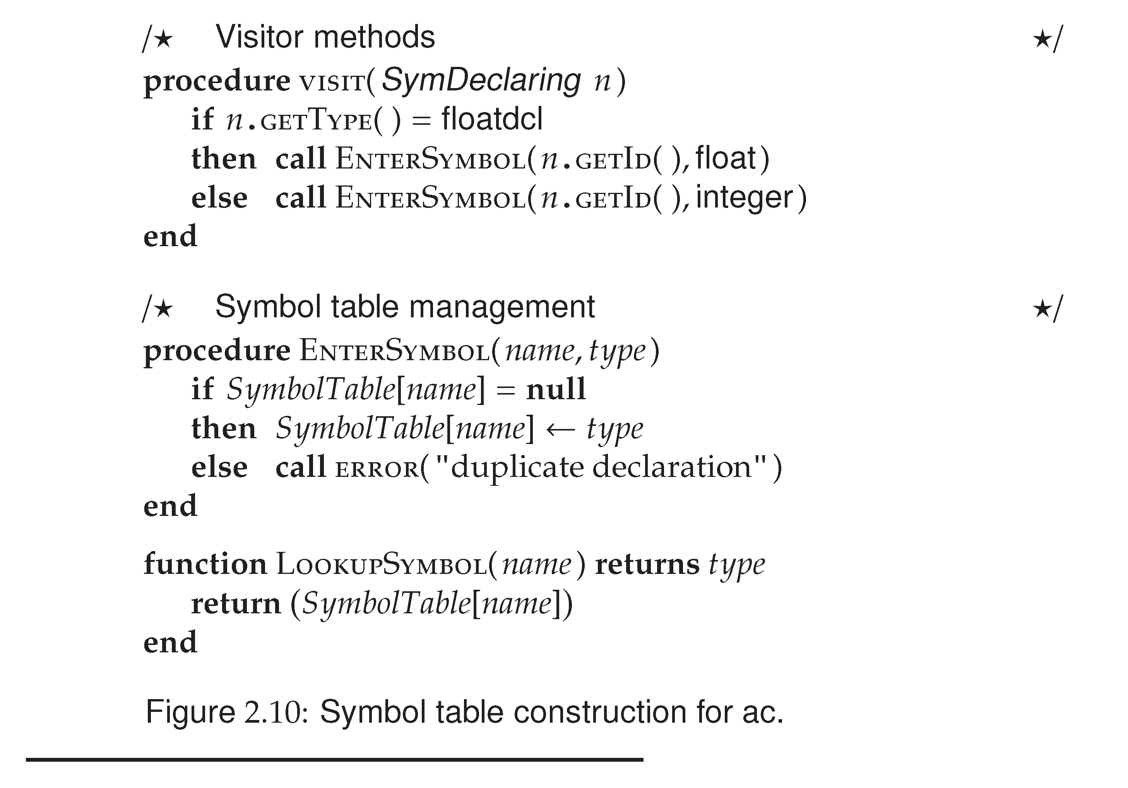
Prof. Farn Wang, Department of Electrical Engineering

Slide 59
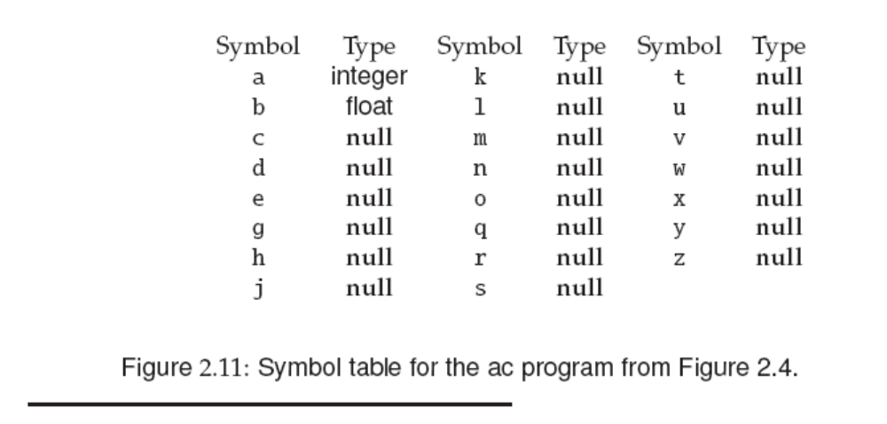
Prof. Farn Wang, Department of Electrical Engineering

Slide 60
Type Checking in AC
All identifiers must be declared.
  After symbol table construction, executable statements can be checked for type consistency.
Automatic widening (e.g. from integer to float) is allowed in AC.
Narrowing is considered illegal in AC.
This process walks the AST bottom-up, from its leaves toward its root.
  At each node, the appropriate visitor method is applied.
Prof. Farn Wang, Department of Electrical Engineering

Slide 61
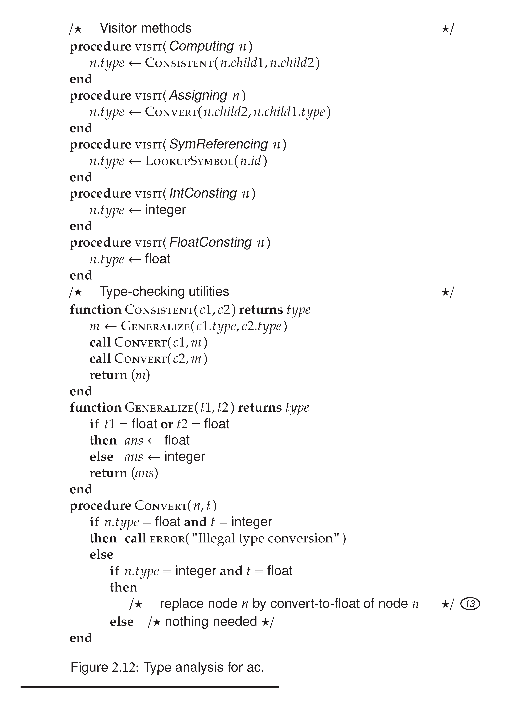
=
Float A
+
+
5
Int B
5.234
Prof. Farn Wang, Department of Electrical Engineering

Slide 62
Prof. Farn Wang, Department of Electrical Engineering

Slide 63
Translating AC
Target language: DC (desk calculator)
Note that we do not worry about registers at this time.
  temporaries: To evaluate expressions, we need to hold temporary values.
    e.g. A+B+C
      ADD A,B,TEMP&1
      ADD TEMP&1,C,TEMP&2
  In real compilers, registers are typically used as temporaries.
  For our target code DC, we use the stack for temporaries.
Prof. Farn Wang, Department of Electrical Engineering
Notes:
DC: desktop calculator

Slide 64
About Project #1
Loading/Storing variables
  DC allows single character named registers for storing variables and for later retrieval.
  e.g.
  sc
  means popping the top of the stack and stores it in register c
  lc
  means pushing the value of register c
  onto the stack
  To simplify our first assignment, we limit the
  number of variables declared/used to be <= 23.
Prof. Farn Wang, Department of Electrical Engineering

Slide 65
Some Questions
What are differences among Top-down, recursive descent, and predictive parsing?
Top-down parsing: build the parse tree top-down, left-to-right.
Recursive descent: one way to implement top-down parsing, may need to backtrack
Predictive parsing: recursive descent parsing when the CFG is LL(k), no backtracking.
Prof. Farn Wang, Department of Electrical Engineering

Slide 66
Example
What parsing method is used by the AC compiler?
Top-down parsing
Recursive descent parsing
Predictive parsing
Bottom-up parsing
a,b,c
Prof. Farn Wang, Department of Electrical Engineering

Slide 67
About AST building
CFG with left recursion
Expr → Expr + Term
maketree(“+”, Expr(), Term());
AC CFG with right recursion
Stmt → id assign Val Expr
Expr → + Val Expr
| - Val Expr
maketree(op,previous-subtree,Val);
Prof. Farn Wang, Department of Electrical Engineering

Slide 68
Code Generation for AC
Code generation proceeds by traversing the AST, starting at its root and walking toward its leaves.
  Computing node: + and –
  code generator is called recursively to generate code for the left and right subtrees.
  Assigning node
    Evaluate the expression first, then the result is stored to a DC register.
    Also reset the precision to integer initially.
  SymReferencing node, Printing node, Converting node
Prof. Farn Wang, Department of Electrical Engineering

Slide 69
Code Generation for AC
  Procedure visit(Computing n)
  call CodeGen(n.child1);
  call CodeGen(n.child2);
  call Emit(n.operation);
  End
  Procedure (SymReferencing n)
  call Emit(“l”); /* load a variable */
  call Emit(n.id); /* In our assignment, this n.id should be the register the n.id has mapped to */
  End
Prof. Farn Wang, Department of Electrical Engineering

Slide 70
Syntax Directed Translation
Syntax-directed definition
  CFG + semantic rules
  Translation of a construct is specified by
    attributes associated with the grammar symbol
    semantic rules associated with each production
  Semantic rules can be actual code known as semantic routines (or action routines)
  Attributes can be type, name, memory location, structure, .. etc
  Most of the translation is done by semantic routines
e.g. Exp1→Exp2+Term (Exp2.type == numeric &&
Term.type==numeric).
attributes
Semantic rules
Prof. Farn Wang, Department of Electrical Engineering

Slide 71
Single Pass vs. Multi-Pass Compilation
For our term projects, semantic check and code generation can be accomplished together.
  Single pass compilation: compilation process only goes through the code once.
Production compilers usually adopt multiple pass compilation.
  They usually generate AST (Abstract Syntax Tree) as IR, and conduct semantic check, code generation, and optimization in multiple passes.
  Each phase is implemented as a separate pass.
Prof. Farn Wang, Department of Electrical Engineering

Slide 72
Semantic Routines
Action Symbols
  The bulk of a translation is done by semantic routines
  Action symbols can be added to a grammar to specify when semantic processing should take place
    Placed anywhere in the RHS of a production
  translated into procedure-calls in the parsing procedures
    #add corresponds to a semantic routine named add()
  No impact on the languages recognized by a parser driven by a CFG
Prof. Farn Wang, Department of Electrical Engineering

Slide 73
Semantic Records
In the code example, the semantic record for <expr> needs to specify information like type, what location is the expression saved (e.g. a temporary name), a constant value, … etc
Semantic record for a non-terminal (LHS) is created by a semantic routine after using the information of the symbols on RHS.
Example
<expr> → <expr1> + <primary> #gen_infix
The gen-infix routine uses the information in the two semantic records for <expr1> and <primary> to generate a new record for <expr>.
Such as the constant
folding optimization in your
assignment
Prof. Farn Wang, Department of Electrical Engineering

Slide 74
Semantic Record (cont.)
When the semantic routine gen_infix is called, it must be given the semantic records of the two symbols <expre1> and <primary>.
Semantic records of non-terminals can be returned by the parsing routine (either as a result parameter or as a function return value)
Variant record (and nested variant record)
Information stored for various symbols are often different.
  So variant records (i.e. union in C) is often used to define one structure for all semantic records (especially true for using a parser generator)
Prof. Farn Wang, Department of Electrical Engineering

Slide 75
Semantic Record for Expr
typedef struct operator {
enum op {PLUS, MINUS} operator;
} op_rec;
enum expr {IDexpr, LITexpr, TEMPexpr}
typedef struct expression {
enum expr kind;
union {
string name;
int value; }
} expr_rec;
Prof. Farn Wang, Department of Electrical Engineering

Slide 76
Combined Variant Record
enum sem_type {op_type, expr_type}
typedef struct semantic_record {
enum sem_type tag;
union {
op_rec *op;
expr_rec *expr; } u;
} semantic_rec;
Prof. Farn Wang, Department of Electrical Engineering

Slide 77
Combined Variant Record
Example:
union {
char *lexeme;
int intval;
float floatval;
decl *dcl;
id_list *idl;
par_list *pal;
ArrayInfo *arrinfo;
…}
Prof. Farn Wang, Department of Electrical Engineering

Slide 78
Summary
A syntax-directed translator for simple language AC
Syntax definition – using CFG
Predictive parsing – recursive descent parsing with unique FIRST() set
Left recursion elimination
Single pass translation: action symbols and semantic records
Multi-pass translation: AST generation and tree traversals for type checking and code generation.
Prof. Farn Wang, Department of Electrical Engineering

