Slide 1
Compiler Technology of Programming Languages
Chapter 4
Formal Grammars and Parsing
Prof. Farn Wang
Prof. Farn Wang, Department of Electrical Engineering

Slide 2

Formal Grammars and Parsing
Contents:
Context-Free Grammars:
Concepts and Notation
Properties of CFG
Parsers and Recognizers
Grammar Analysis Algorithms
Prof. Farn Wang, Department of Electrical Engineering

Slide 3
Introduction
Why using CFG
  CFG gives a precise syntactic specification of a programming language.
  Enabling automatic translator generator
  Language extension becomes easier
The role of the parser
  Taking tokens from scanner, parsing, reporting syntax errors
  Not just parsing, in a syntax-directed translator, the parser also conducts type checking, semantic analysis and IR generation.
Prof. Farn Wang, Department of Electrical Engineering

Slide 4
Example of CFG
A C– program is made out of functions,
a function out of declarations and blocks,
a block out of statements,
a statement out of expressions, … etc
<program> → <global_decl_list>
<global_decl_list> → <global_decl_list><global_decl> | λ
<global_decl> → <decl_list> <function_decl>
<function_decl> → <type> id ( <param_list> ) { <block> }
<block> → <decl_list> <statement_list> | λ
<decl_list> → <decl_list> <decl> | <decl> | λ
<decl> → <type_decl> | <var_decl>
<type> → void | int | float
<statement_list> → ….
<statement> → { <block> }
pay attention to
Repetitions and Recursions !!
Prof. Farn Wang, Department of Electrical Engineering

Slide 5
Example of Statements
Selection statements
if ( <expression> ) <statement>
if ( <expression> ) <statement> else <statement>
Iteration statements
while ( <expression> ) <statement>
for ( <expression>; <expression>; <expression>) <statement>
Other C statements
do <statement> while ( <expression> ) ;
switch ( <expression> ) <statement>
labeled statements, jump statement, … etc.
Prof. Farn Wang, Department of Electrical Engineering

Slide 6

CFG
A context-free grammar G = (Vt, Vn, S, P)
  Vt: A finite terminal vocabulary
    The token set produced by scanner
  Vn: A finite set of nonterminal vocabulary
    Intermediate symbols
  S: A start symbol, S ∈Vn that starts all derivations
      Also called goal symbol
  P: a finite set of productions (rewriting rules) of the form A→ X1X2 … Xm
    A∈Vn, Xi ∈ Vn∪Vt, 1≤i ≤m
    A →λ is a valid production
How is CFG different from RE/DFA ?
Prof. Farn Wang, Department of Electrical Engineering

Slide 7
CFG
Other notation
  Vocabulary V of G,
    V= Vn∪Vt
  L(G), the set of string s derivable from S
    Context-free language of grammar G
  Notational conventions
    a,b,c, … denote symbols in Vt
    A,B,C, … denote symbols in Vn
    (or some names enclosed in <>)
    U,V,W, … denote symbols in V
    α,β,γ,… denote strings in V*
    u,v,w, … denote strings in Vt*
Prof. Farn Wang, Department of Electrical Engineering

Slide 8

CFG
Derivation
  One step derivation
    If A→γ, then αAβ⇒ αγβ
  One or more steps derivation ⇒⁺
  Zero or more steps derivation ⇒∗
If S ⇒∗β, then β is said to be sentential form of the CFG
  SF(G) is the set of sentential forms of grammar G
The language L(G) generated by G is the set of terminal strings w such that S ⇒+ w. The string w is called a sentence of G.
L(G) = {w ∈V_{t}*|S⇒⁺ w}
Prof. Farn Wang, Department of Electrical Engineering

Slide 9

2022/10/04 stopped here.
同學！Compiler上課了
Prof. Farn Wang, Department of Electrical Engineering

Slide 10
CFG
Left-most derivation
  denoted by ⇒_{lm} , ⇒+ _{lm} , ⇒∗ _{lm}
example of leftmost derivation of b(c+c)
E→Prefix(E)
E→c Tail
Prefix→b
Prefix→λ
Tail→+Ε
Tail→ λ
E⇒ _{lm} Prefix(E)
⇒ _{lm} b(E)
⇒ _{lm} b(c Tail)
⇒ _{lm} b(c+E)
⇒ _{lm} b(c+c Tail)
⇒ _{lm} b(c+c)
G₀
Top-down parsing is to come up with a leftmost derivation.
Prof. Farn Wang, Department of Electrical Engineering

Slide 11
CFG
Right-most derivation
  denoted by ⇒_{rm} , ⇒+ _{rm} , ⇒∗ _{rm}
example of rightmost derivation of b(c+c)
E→Prefix(E)
E→c Tail
Prefix→b
Prefix→λ
Tail→+Ε
Tail→ λ
E⇒ _{rm} Prefix(E)
⇒ _{rm} Prefix(c Tail)
⇒ _{rm} Prefix(c+E)
⇒ _{rm} Prefix(c+c Tail)
⇒ _{rm} Prefix(c+c)
⇒ _{rm} b(c+c)
G₀
Bottom-up parsing is to discover a rightmost derivation, it reverses the derivation.
Prof. Farn Wang, Department of Electrical Engineering

Slide 12
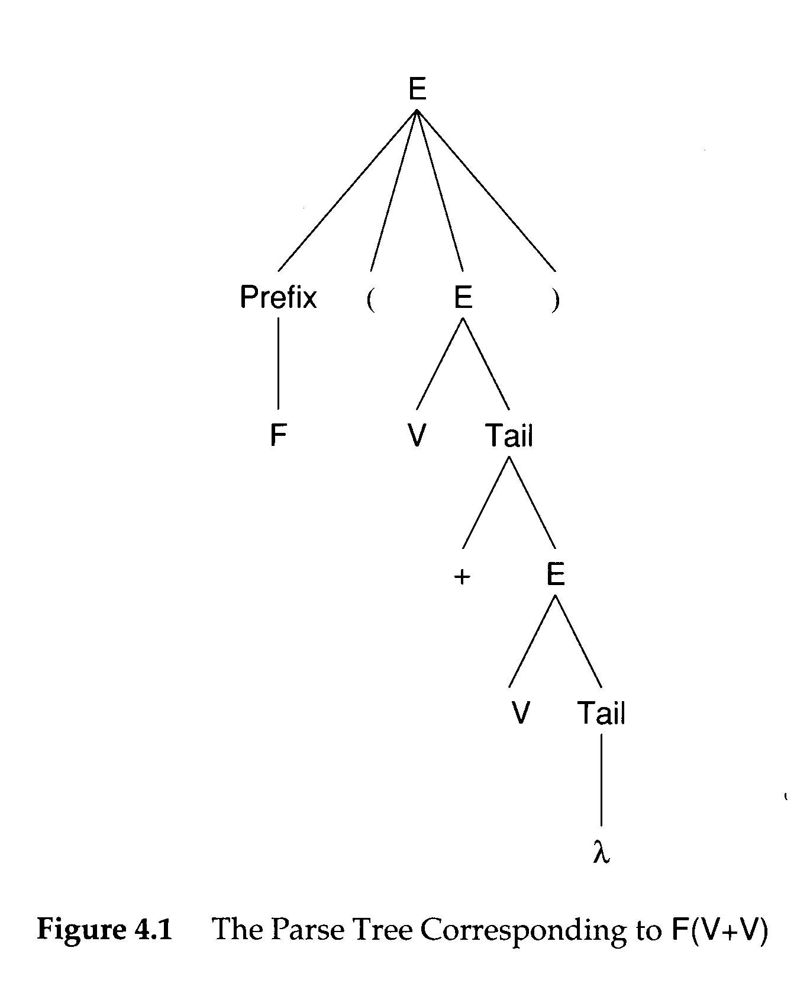
Parse Tree and Derivation
A Parse tree can be viewed as a graphical representation
for a derivation that ignore replacement order.
Prof. Farn Wang, Department of Electrical Engineering

Slide 13
Phrases and Handles
phrase
  a sequence of symbols descended from a single nonterminal in the parse tree
  A simple or prime phrase is a phrase that contains no smaller phrase.
The handle of a sentential form is the left-most simple phrase
Prof. Farn Wang, Department of Electrical Engineering

Slide 14
Phrases and Handles
F ( E) is a sentential form.
F is a phrase, also a handle
V Tail is a simple phrase
+ E is a simple phrase
V+E is NOT a simple phrase
(+E is a smaller phrase)
A handle allows the parser to reduce it to a non-terminal
Prof. Farn Wang, Department of Electrical Engineering

Slide 15
Phrases and Handles
Example
abbabb
S
a sentence
aAbabB
A
B
a
a sentential
form
aAb
A
B
a
b
b
a handle
bB
a simple phrase
b
b
abb
a phrase of A
Prof. Farn Wang, Department of Electrical Engineering

Slide 16
E→Prefix(E)
E→c Tail
Prefix→b
Prefix→λ
Tail→+Ε
Tail→ λ
E⇒ _{rm} Prefix(E)
⇒ _{rm} Prefix(c Tail)
⇒ _{rm} Prefix(c+E)
⇒ _{rm} Prefix(c+c Tail)
⇒ _{rm} Prefix(c+c)
⇒ _{rm} b(c+c)
G₀
E⇒ Prefix(E)
⇒ Prefix(c Tail)
⇒Prefix(c+E)
⇒ Prefix(c+c Tail )
⇒ Prefix(c+c)
⇒ b(c+c)
rightmost derivation
E ⇐ Prefix(E)
⇐ Prefix(c Tail)
⇐ Prefix(c+E)
⇐ Prefix(c+c Tail )
⇐ Prefix(c+c)
⇐ b(c+c)
bottom-up parsing
Prof. Farn Wang, Department of Electrical Engineering

Slide 17
Rightmost Derivation
E
E→Prefix(E)
E→c Tail
Prefix→b
Prefix→λ
Tail→+Ε
Tail→ λ
E⇒ _{rm} Prefix(E)
⇒ _{rm} Prefix(c Tail)
⇒ _{rm} Prefix(c+E)
⇒ _{rm} Prefix(c+c Tail)
⇒ _{rm} Prefix(c+c)
⇒ _{rm} b(c+c)
G₀
Prefix
(
E
)
b
c
Tail
+
E
c
Tail
Prof. Farn Wang, Department of Electrical Engineering
λ

Slide 18
Bottom-up Parsing (1/13)
E
E→Prefix(E)
E→c Tail
Prefix→b
Prefix→λ
Tail→+Ε
Tail→ λ
E⇒ _{rm} Prefix(E)
⇒ _{rm} Prefix(c Tail)
⇒ _{rm} Prefix(c+E)
⇒ _{rm} Prefix(c+c Tail)
⇒ _{rm} Prefix(c+c)
⇒ _{rm} b(c+c)
G₀
Prefix
(
E
)
b
c
Tail
+
E
b
c
Tail
Prof. Farn Wang, Department of Electrical Engineering
λ

Slide 19
Bottom-up Parsing (2/13)
E
E→Prefix(E)
E→c Tail
Prefix→b
Prefix→λ
Tail→+Ε
Tail→ λ
E⇒ _{rm} Prefix(E)
⇒ _{rm} Prefix(c Tail)
⇒ _{rm} Prefix(c+E)
⇒ _{rm} Prefix(c+c Tail)
⇒ _{rm} Prefix(c+c)
⇒ _{rm} b(c+c)
G₀
Prefix
(
E
)
b
c
Tail
+
E
b
c
Tail
Prof. Farn Wang, Department of Electrical Engineering
λ

Slide 20
Bottom-up Parsing (3/13)
E
E→Prefix(E)
E→c Tail
Prefix→b
Prefix→λ
Tail→+Ε
Tail→ λ
E⇒ _{rm} Prefix(E)
⇒ _{rm} Prefix(c Tail)
⇒ _{rm} Prefix(c+E)
⇒ _{rm} Prefix(c+c Tail)
⇒ _{rm} Prefix(c+c)
⇒ _{rm} b(c+c)
G₀
Prefix
(
E
)
b
c
Tail
+
E
prefix
(
c
+
c
c
Tail
Prof. Farn Wang, Department of Electrical Engineering
λ

Slide 21
Bottom-up Parsing (4/13)
E
E→Prefix(E)
E→c Tail
Prefix→b
Prefix→λ
Tail→+Ε
Tail→ λ
E⇒ _{rm} Prefix(E)
⇒ _{rm} Prefix(c Tail)
⇒ _{rm} Prefix(c+E)
⇒ _{rm} Prefix(c+c Tail)
⇒ _{rm} Prefix(c+c)
⇒ _{rm} b(c+c)
G₀
Prefix
(
E
)
b
c
Tail
+
E
prefix
(
c
+
c
Tail
c
Tail
Prof. Farn Wang, Department of Electrical Engineering
λ

Slide 22
Bottom-up Parsing (5/13)
E
E→Prefix(E)
E→c Tail
Prefix→b
Prefix→λ
Tail→+Ε
Tail→ λ
E⇒ _{rm} Prefix(E)
⇒ _{rm} Prefix(c Tail)
⇒ _{rm} Prefix(c+E)
⇒ _{rm} Prefix(c+c Tail)
⇒ _{rm} Prefix(c+c)
⇒ _{rm} b(c+c)
G₀
Prefix
(
E
)
b
c
Tail
+
E
prefix
(
c
+
c
Tail
c
Tail
Prof. Farn Wang, Department of Electrical Engineering
λ

Slide 23
Bottom-up Parsing (6/13)
E
E→Prefix(E)
E→c Tail
Prefix→b
Prefix→λ
Tail→+Ε
Tail→ λ
E⇒ _{rm} Prefix(E)
⇒ _{rm} Prefix(c Tail)
⇒ _{rm} Prefix(c+E)
⇒ _{rm} Prefix(c+c Tail)
⇒ _{rm} Prefix(c+c)
⇒ _{rm} b(c+c)
G₀
Prefix
(
E
)
b
c
Tail
+
E
prefix
(
c
+
c
Tail
c
Tail
Prof. Farn Wang, Department of Electrical Engineering
λ

Slide 24
Bottom-up Parsing (7/13)
E
E→Prefix(E)
E→c Tail
Prefix→b
Prefix→λ
Tail→+Ε
Tail→ λ
E⇒ _{rm} Prefix(E)
⇒ _{rm} Prefix(c Tail)
⇒ _{rm} Prefix(c+E)
⇒ _{rm} Prefix(c+c Tail)
⇒ _{rm} Prefix(c+c)
⇒ _{rm} b(c+c)
G₀
Prefix
(
E
)
b
c
Tail
+
E
prefix
(
c
+
E
c
Tail
Prof. Farn Wang, Department of Electrical Engineering
λ

Slide 25
Bottom-up Parsing (8/13)
E
E→Prefix(E)
E→c Tail
Prefix→b
Prefix→λ
Tail→+Ε
Tail→ λ
E⇒ _{rm} Prefix(E)
⇒ _{rm} Prefix(c Tail)
⇒ _{rm} Prefix(c+E)
⇒ _{rm} Prefix(c+c Tail)
⇒ _{rm} Prefix(c+c)
⇒ _{rm} b(c+c)
G₀
Prefix
(
E
)
b
c
Tail
+
E
prefix
(
c
+
E
c
Tail
Prof. Farn Wang, Department of Electrical Engineering
λ

Slide 26
Bottom-up Parsing (9/13)
E
E→Prefix(E)
E→c Tail
Prefix→b
Prefix→λ
Tail→+Ε
Tail→ λ
E⇒ _{rm} Prefix(E)
⇒ _{rm} Prefix(c Tail)
⇒ _{rm} Prefix(c+E)
⇒ _{rm} Prefix(c+c Tail)
⇒ _{rm} Prefix(c+c)
⇒ _{rm} b(c+c)
G₀
Prefix
(
E
)
b
c
Tail
+
E
prefix
(
c
c
Tail
Prof. Farn Wang, Department of Electrical Engineering
λ

Slide 27
Bottom-up Parsing (10/13)
E
E→Prefix(E)
E→c Tail
Prefix→b
Prefix→λ
Tail→+Ε
Tail→ λ
E⇒ _{rm} Prefix(E)
⇒ _{rm} Prefix(c Tail)
⇒ _{rm} Prefix(c+E)
⇒ _{rm} Prefix(c+c Tail)
⇒ _{rm} Prefix(c+c)
⇒ _{rm} b(c+c)
G₀
Prefix
(
E
)
b
c
Tail
+
E
prefix
(
c
Tail
c
Tail
Prof. Farn Wang, Department of Electrical Engineering
λ

Slide 28
Bottom-up Parsing (11/13)
E
E→Prefix(E)
E→c Tail
Prefix→b
Prefix→λ
Tail→+Ε
Tail→ λ
E⇒ _{rm} Prefix(E)
⇒ _{rm} Prefix(c Tail)
⇒ _{rm} Prefix(c+E)
⇒ _{rm} Prefix(c+c Tail)
⇒ _{rm} Prefix(c+c)
⇒ _{rm} b(c+c)
G₀
Prefix
(
E
)
b
c
Tail
+
E
prefix
(
c
Tail
c
Tail
Prof. Farn Wang, Department of Electrical Engineering
λ

Slide 29
Bottom-up Parsing (12/13)
E
E→Prefix(E)
E→c Tail
Prefix→b
Prefix→λ
Tail→+Ε
Tail→ λ
E⇒ _{rm} Prefix(E)
⇒ _{rm} Prefix(c Tail)
⇒ _{rm} Prefix(c+E)
⇒ _{rm} Prefix(c+c Tail)
⇒ _{rm} Prefix(c+c)
⇒ _{rm} b(c+c)
G₀
Prefix
(
E
)
b
c
Tail
+
E
prefix
(
E
)
c
Tail
Prof. Farn Wang, Department of Electrical Engineering
λ

Slide 30
Bottom-up Parsing (13/13)
E
E→Prefix(E)
E→c Tail
Prefix→b
Prefix→λ
Tail→+Ε
Tail→ λ
E⇒ _{rm} Prefix(E)
⇒ _{rm} Prefix(c Tail)
⇒ _{rm} Prefix(c+E)
⇒ _{rm} Prefix(c+c Tail)
⇒ _{rm} Prefix(c+c)
⇒ _{rm} b(c+c)
G₀
Prefix
(
E
)
b
c
Tail
+
E
E
c
Tail
Prof. Farn Wang, Department of Electrical Engineering
λ

Slide 31
Properties of CFG
Useless nonterminals
  S → A | B
  A → a
  B → Bb
  C → c
Reduced Grammar
  A grammar is reduced after all useless non-terminals are removed
Ambiguity
<derives no terminal string>
<unreachable>
Prof. Farn Wang, Department of Electrical Engineering

Slide 32

Ambiguity
A grammar is ambiguous if it produces more than one parse tree for some sentences
example 1: A+B+C ( is it (A+B)+C or A+(B+C) )
  Improper production: expr → expr + expr | id
example 2: A+B*C ( is it (A+B)*C or A+(B*C) )
  Improper production: expr → expr + expr | expr * expr
example 3: if E1 then if E2 then S1 else S2 (which then does the else match with)
  Improper production:
    stmt → if expr then stmt
    | if expr then stmt else stmt
Prof. Farn Wang, Department of Electrical Engineering

Slide 33
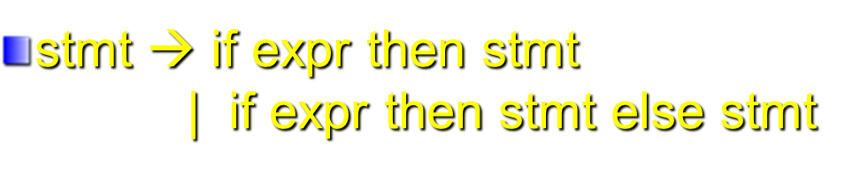
Ambiguity
if E1 then if E2 then S1 else S2
Two parse trees of example 3
stmt
stmt
if
E1
then
stmt
if
E1
then
stmt
else
S2
if
E2
then
S1
else
S2
if
E2
then
S1
Prof. Farn Wang, Department of Electrical Engineering

Slide 34
Dangling Else Example
if ((k >=0) && (k < Table_SIZE))
if (table[k] >=0)
printf(“Entry %d is %d\n”, k, table[k]);
else printf(“Error: index %d out of range \n”), k);
In ANSI C, an else is always assumed to belong to the innermost if statement possible.
if ((k >=0) && (k < Table_SIZE)) {
if (table[k] >=0)
printf(“Entry %d is %d\n”, k, table[k]); }
else printf(“Error: index %d out of range \n”), k);
Prof. Farn Wang, Department of Electrical Engineering

Slide 35
Eliminating Ambiguity
Operator Associativity
  expr → expr + term | term
Operator Precedence
  expr → expr + term | term
  term → term * factor | factor
Dangling Else
  In YACC, shift is favored over reduction to enforce the dangling “else” to associate with the innermost if.
A+B+C
Prof. Farn Wang, Department of Electrical Engineering

Slide 36
Eliminating Ambiguity
Operator Associativity
  expr → expr + term | term
Operator Precedence
  expr → expr + term | term
  term → term * factor | factor
Dangling Else
  In YACC, shift is favored over reduction to enforce the dangling “else” to associate with the innermost if.
A+B+C
+
expr
C
Prof. Farn Wang, Department of Electrical Engineering

Slide 37
Eliminating Ambiguity
Operator Associativity
  expr → expr + term | term
Operator Precedence
  expr → expr + term | term
  term → term * factor | factor
Dangling Else
  In YACC, shift is favored over reduction to enforce the dangling “else” to associate with the innermost if.
A+B*C
+
expr
term
Prof. Farn Wang, Department of Electrical Engineering

Slide 38
Eliminating Ambiguity
Operator Associativity
  expr → expr + term | term
Operator Precedence
  expr → expr + term | term
  term → term * factor | factor
Dangling Else
  In YACC, shift is favored over reduction to enforce the dangling “else” to associate with the innermost if.
A+B*C
+
expr
*
term
factor
Prof. Farn Wang, Department of Electrical Engineering

Slide 39
Left Factoring
Consider the following grammar
A → αβ | αγ
It is not easy to determine whether to expand
A to αβ or αγ
A transformation called left factoring can be
applied. It becomes:
A → αA’
A’ → β | γ
Prof. Farn Wang, Department of Electrical Engineering

Slide 40
Exercise
    stmt → if expr then stmt
    | if expr then stmt else stmt
    For the following grammar form:
    A → αβ | αγ
    What is α? β? γ?
: if expr then stmt
β1: λ
γ: else stmt
Prof. Farn Wang, Department of Electrical Engineering

Slide 41
Exercise
    stmt → if expr then stmt
    | if expr then stmt else stmt
    For the following grammar form:
    A → αβ | αγ
    What is α? β1? β2?
: if expr then stmt
β: λ
γ: else stmt
    stmt → if expr then stmt S’
    S’ → λ | else stmt
Prof. Farn Wang, Department of Electrical Engineering

Slide 42
Exercise
    stmt → if expr then stmt
    | if expr then stmt else stmt
    For the following grammar form:
    A → αβ | αγ
    What is α? β1? β2?
: if expr then stmt
β: λ
γ: else stmt
Just one example --
in this case, left factoring does not solve the problem
you may try the new grammar on the example stmt in slide 30.
    stmt → if expr then stmt S’
    S’ → λ | else stmt
Prof. Farn Wang, Department of Electrical Engineering

Slide 43
Parsers and Recognizers
Recognizer
  An algorithm that does boolean-valued test
    “Is this input syntactically valid according to G?”
    “Is this input in L(G)?”
Parser
  Answers more general questions
    Is this input valid?
    And, if it is, what is its structure (parse tree)?
Two general approaches to parsing
  Top-down and Bottom-up
Prof. Farn Wang, Department of Electrical Engineering

Slide 44
Naming of parsing techniques
The way to parse
token sequence
(e.g. from Left to R)
Number of
Lookahead
tokens
L: Leftmost
R: Righmost
Top-down
  LL(1)
Bottom-up
  LR(1)
Prof. Farn Wang, Department of Electrical Engineering

Slide 45
Parsing
CFG
Input
program
E→Prefix(E)
E→c Tail
Prefix→b
Prefix→λ
Tail→+Ε
Tail→ λ
G₀
b (c + c)
Is the input program valid for the given CFG?
Prof. Farn Wang, Department of Electrical Engineering

Slide 46
E
E→Prefix(E)
E→c Tail
Prefix→b
Prefix→λ
Tail→+Ε
Tail→ λ
b (c + c)
G₀
Prefix
(
E
)
b
c
Tail
+
E
c
Tail
Prof. Farn Wang, Department of Electrical Engineering
λ

Slide 47
E
E→Prefix(E)
E→c Tail
Prefix→b
Prefix→λ
Tail→+Ε
Tail→ λ
b (c + c)
G₀
Prefix
(
E
)
b
c
Tail
+
E
Top-Down Parsing:
Leftmost Derivation
c
Tail
Prof. Farn Wang, Department of Electrical Engineering
λ

Slide 48
E
E→Prefix(E)
E→c Tail
Prefix→b
Prefix→λ
Tail→+Ε
Tail→ λ
b (c + c)
G₀
Prefix
(
E
)
b
c
Tail
+
E
Bottom-Up Parsing:
Leftmost Derivation
c
Tail
Prof. Farn Wang, Department of Electrical Engineering
λ

Slide 49
Grammar Analysis Algorithms
Goal of this section:
  Discuss a number of important analysis algorithms for Grammars
What non-terminals can derive λ (called nullable symbols)?
  A ⇒ BCD ⇒ BC ⇒ B ⇒ λ
  An iterative marking algorithm
    Marking non-terminals that derive λ in one step, then marking non-terminals requires a parse tree of height 2, continue with increasing heights until no change.
Prof. Farn Wang, Department of Electrical Engineering

Slide 50
What non-terminals can derive λ?
count
Worklist:
B,D
count
Worklist:
C
A → BCD
B → BX
B → λ
C → EFG
C → BDD
D → E
D → λ
3
1
2
1
0
3
3
3
0
1
1
0
Prof. Farn Wang, Department of Electrical Engineering

Slide 51
What non-terminals can derive λ?
count
Worklist:
C
count
Worklist:
A
A → BCD
B → BX
B → λ
C → EFG
C → BDD
D → E
D → λ
1
0
1
1
3
3
0
1
1
Prof. Farn Wang, Department of Electrical Engineering

Slide 52
Definition of Follow and FIRST
Follow(A)
  Follow(A) is the set of terminals that may follow A in some sentential form. It provides the lookaheads that might signal the recognition of a production with A as the left hand side
  Follow(A)={a∈Vt|S⇒* … Aa … }
First(α)
  The set of all the terminal symbols that can begin a sentential form derivable from α
  If α is the right-hand side of a production, then First(α) contains terminal symbols that begin strings derivable from α
  First(α)={a∈Vt| α ⇒* aβ} ∪ {λ| α ⇒* λ}
Prof. Farn Wang, Department of Electrical Engineering

Slide 53
Definition of Follow and FIRST
Follow(A)
  Follow(A) is the set of terminals that may follow A in some sentential form. It provides the lookaheads that might signal the recognition of a production with A as the left hand side
  Follow(A)={a∈Vt|S⇒* … Aa … }
First(α)
  The set of all the terminal symbols that can begin a sentential form derivable from α
  If α is the right-hand side of a production, then First(α) contains terminal symbols that begin strings derivable from α
  First(α)={a∈Vt| α ⇒* aβ} ∪ {λ| α ⇒* λ}
Example:
A → b X → WAa
B → b Y → WBc
………….ba………
Should b be reduced to A or B?
Prof. Farn Wang, Department of Electrical Engineering

Slide 54
Computing Follow and FIRST
FIRST(Z)
  If Z is a terminal, then FIRST(Z) = {Z}
  If Z is a non-terminal, and Z→ Y1Y2…Yk for some k >=1, then place a in FIRST(Z) if for some i, a is in FIRST(Yi), and λ is in all of FIRST(Y1),… FIRST(Yi-1).
  If Z→ λ is a production, then add λ to FIRST(Z)
FOLLOW(A)
  Place $ in FOLLOW(S)
  If there is a production B → αAβ , then everything in FIRST(β) except λ, is in FOLLOW(A)
  If there is a production B → αA, or a production B → αAβ, where FIRST(β) contains λ, then everything in FOLLOW(B) is in FOLLOW(A).
When computing First(A), be careful of left recursion !
or any indirect recursion caused cycles !
Prof. Farn Wang, Department of Electrical Engineering

Slide 55
Example 1
S → aSe
S → B
B → bBe
B → C
C → cCe
C → d
First (S) = { ? }
First (B) = { ? }
First (C) = { ? }
Follow (S) = {? }
Follow (B) = {? }
Follow (C) = {? }
Prof. Farn Wang, Department of Electrical Engineering

Slide 56
Example 1
S → aSe
S → B
B → bBe
B → C
C → cCe
C → d
First (S) = {a,b,c,d}
First (B) = {b,c,d}
First (C) = {c,d}
Follow (S) = {e, $}
Follow (B) = {e, $}
Follow (C) = {e, $}
Prof. Farn Wang, Department of Electrical Engineering

Slide 57
Example 2
First (S) = { ? }
First (A) = { ? }
First (B) = { ? }
S → ABc
A → a
A → λ
B → b
B → λ
Follow (S) = { ? }
Follow (A) = { ? }
Follow (B) = { ? }
Prof. Farn Wang, Department of Electrical Engineering

Slide 58
Example 2
First (S) = {a,b,c}
First (A) = {a, λ}
First (B) = {b, λ}
S → ABc
A → a
A → λ
B → b
B → λ
Follow (S) = {$}
Follow (A) = {b,c}
Follow (B) = {c}
Prof. Farn Wang, Department of Electrical Engineering

