Slide 1
Compiler Technology of Programming Languages
Chapter 5
Top-Down Parsing
Prof. Farn Wang
Prof. Farn Wang, Department of Electrical Engineering

Slide 2
The LL(k) Predict Function
Given the productions
  A→α₁
  A→α₂
  …
  A→α_{n}
During a (leftmost) derivation
  … A … ⇒ … α₁ … or
  … α₂ … or
  … α_{n} …
Deciding which production to match
  Using k lookahead symbols
Prof. Farn Wang, Department of Electrical Engineering

Slide 3
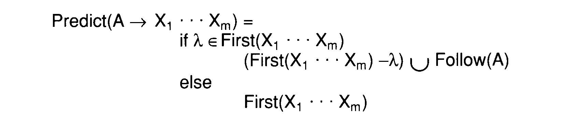

The LL(1) Predict Function
The limitation of LL(1)
  LL(1) contains exactly those grammars that have disjoint predict sets for productions that share a common left-hand side
Prof. Farn Wang, Department of Electrical Engineering

Slide 4
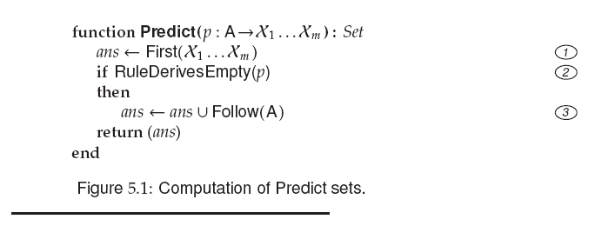
Prof. Farn Wang, Department of Electrical Engineering

Slide 5
The LL(1) Parse Table
An LL(1) parse table
  T:V_{n} x V_{t} → P∪{Error}
The definition of T
  T[ A ][ t ]=A→X_{1…}X_{m} if t ∈ Prediction( A→X_{1…}X_{m} );
  T[ A ][ t ]=Error otherwise
Prof. Farn Wang, Department of Electrical Engineering

Slide 6
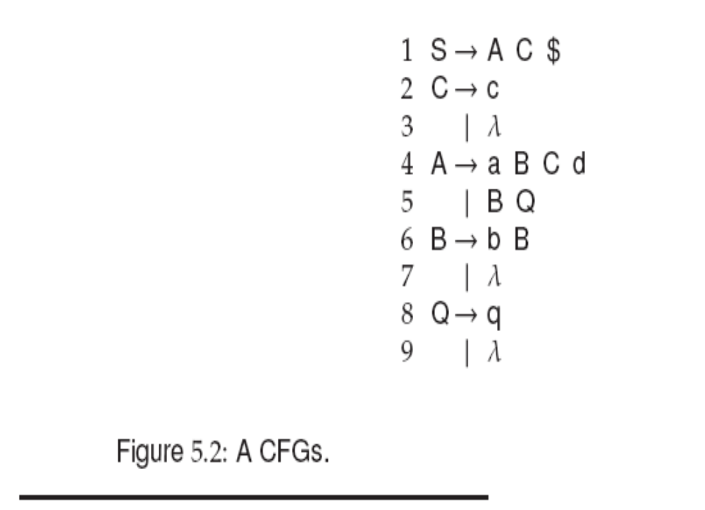
Prof. Farn Wang, Department of Electrical Engineering

Slide 7
Example:
FIRST(AC)
compute FIRST(A)
{a, FIRST(BQ)}
{a,b,FIRST(Q)}
{a,b,q, λ}
{a,b,q} + FIRST(C)
{a,b,q}+{c, λ}
{a,b,q,c, λ} + {$}
{a,b,q,c,$}
Prof. Farn Wang, Department of Electrical Engineering

Slide 8
Predict Set
{a,b,q,c,$}
{c}
{a}
{b}
{q}
{c,$}
Prof. Farn Wang, Department of Electrical Engineering

Slide 9
Predict Set
{a,b,q,c,$}
{c}
{$,d}
{a}
{b,q,c,$}
{b}
{q,c,d,$}
{q}
{c,$}
Prof. Farn Wang, Department of Electrical Engineering

Slide 10
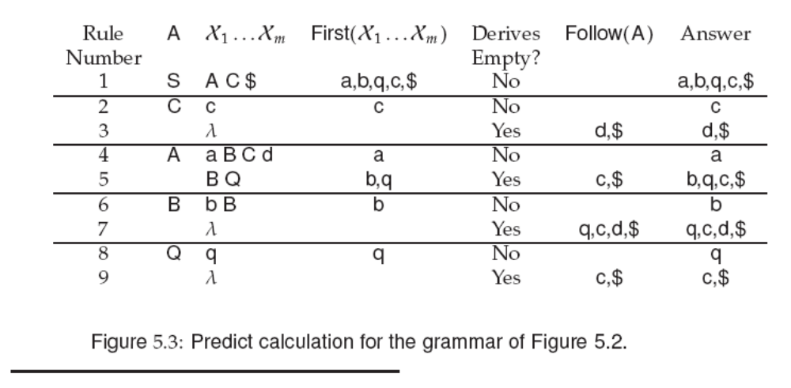
Prof. Farn Wang, Department of Electrical Engineering

Slide 11
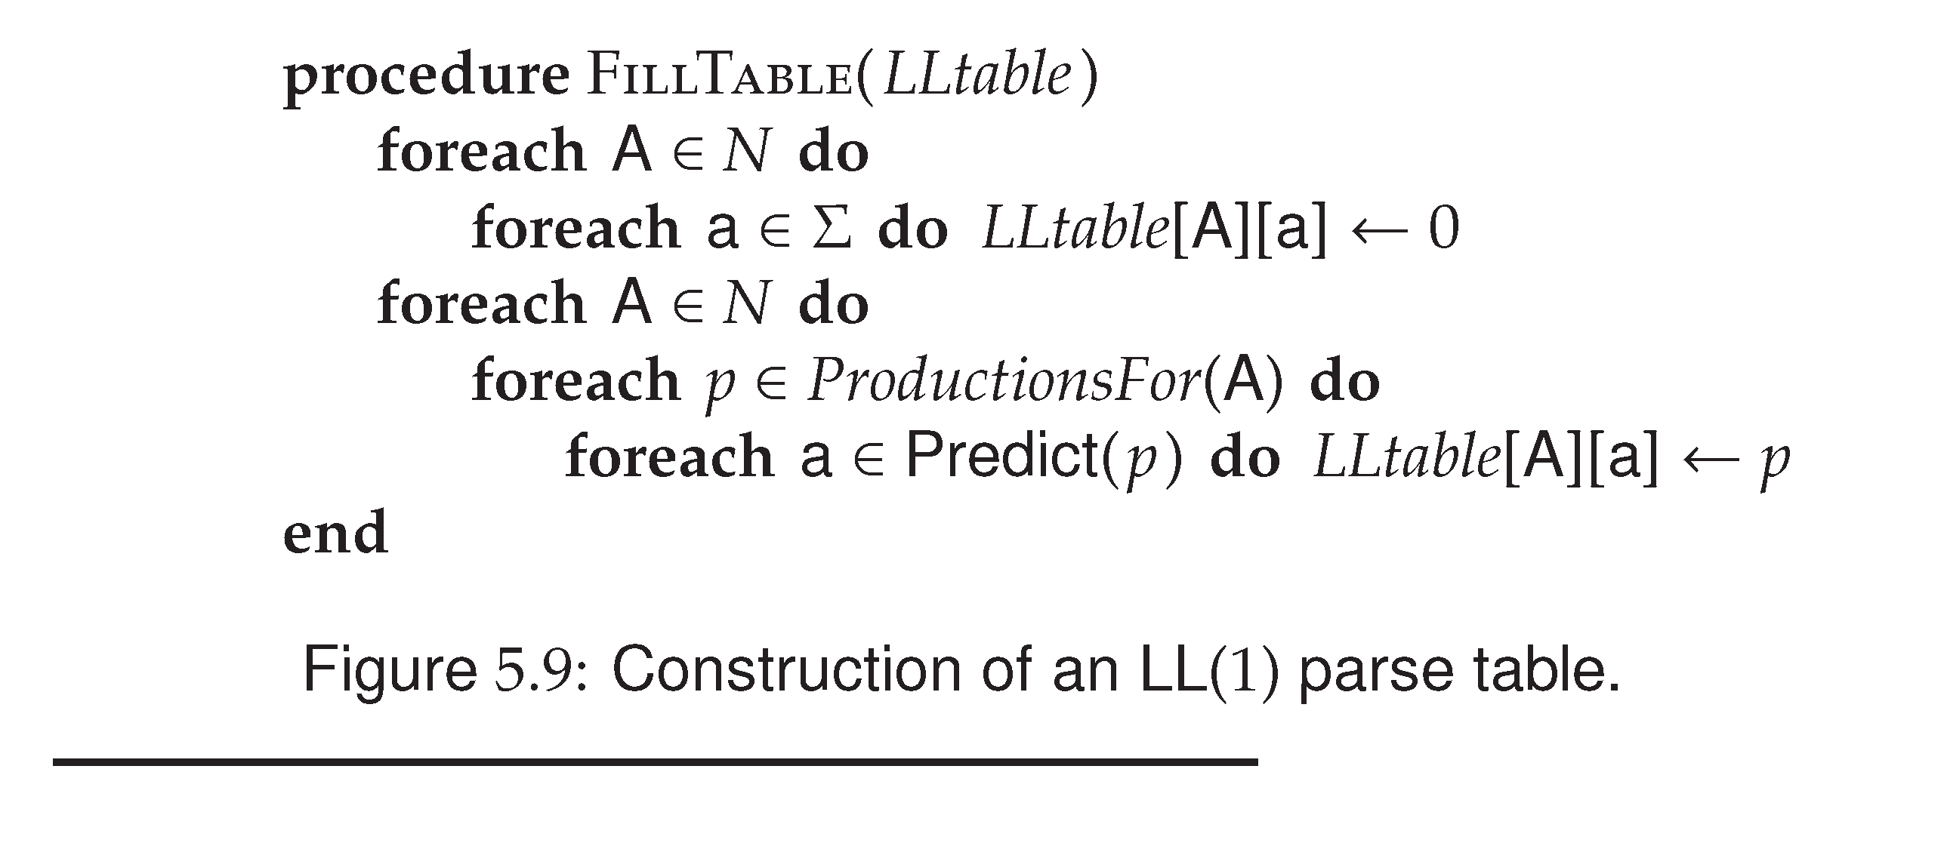
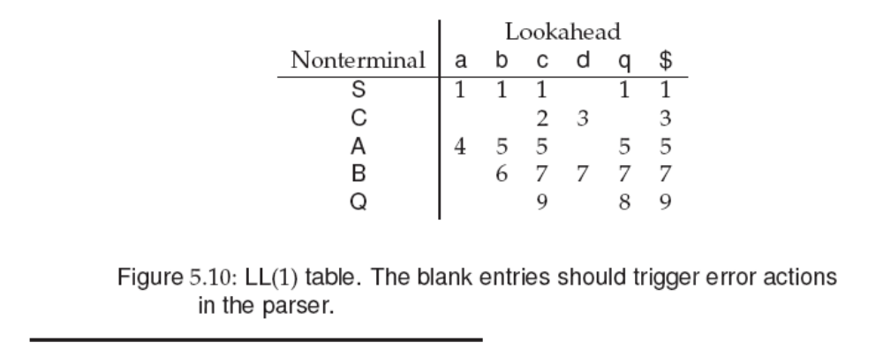
Error
Prof. Farn Wang, Department of Electrical Engineering

Slide 12

Building Recursive Descent Parsers from LL(1) Tables
Similar to the implementation of a scanner, there are two kinds of parsers
  Build in
    The parsing decisions recorded in LL(1) tables can be hardwired into the parsing procedures used by recursive descent parsers
  Table-driven
Prof. Farn Wang, Department of Electrical Engineering

Slide 13
An LL(1) Parser Driver
Rather than using the LL(1) table to build parsing procedures, it is possible to use the table in conjunction with a driver program to form an LL(1) parser
Smaller and faster than a corresponding recursive descent parser
Changing a grammar and building a new parser is easy
  New LL(1) driver are computed and substituted for the old tables
Prof. Farn Wang, Department of Electrical Engineering

Slide 14
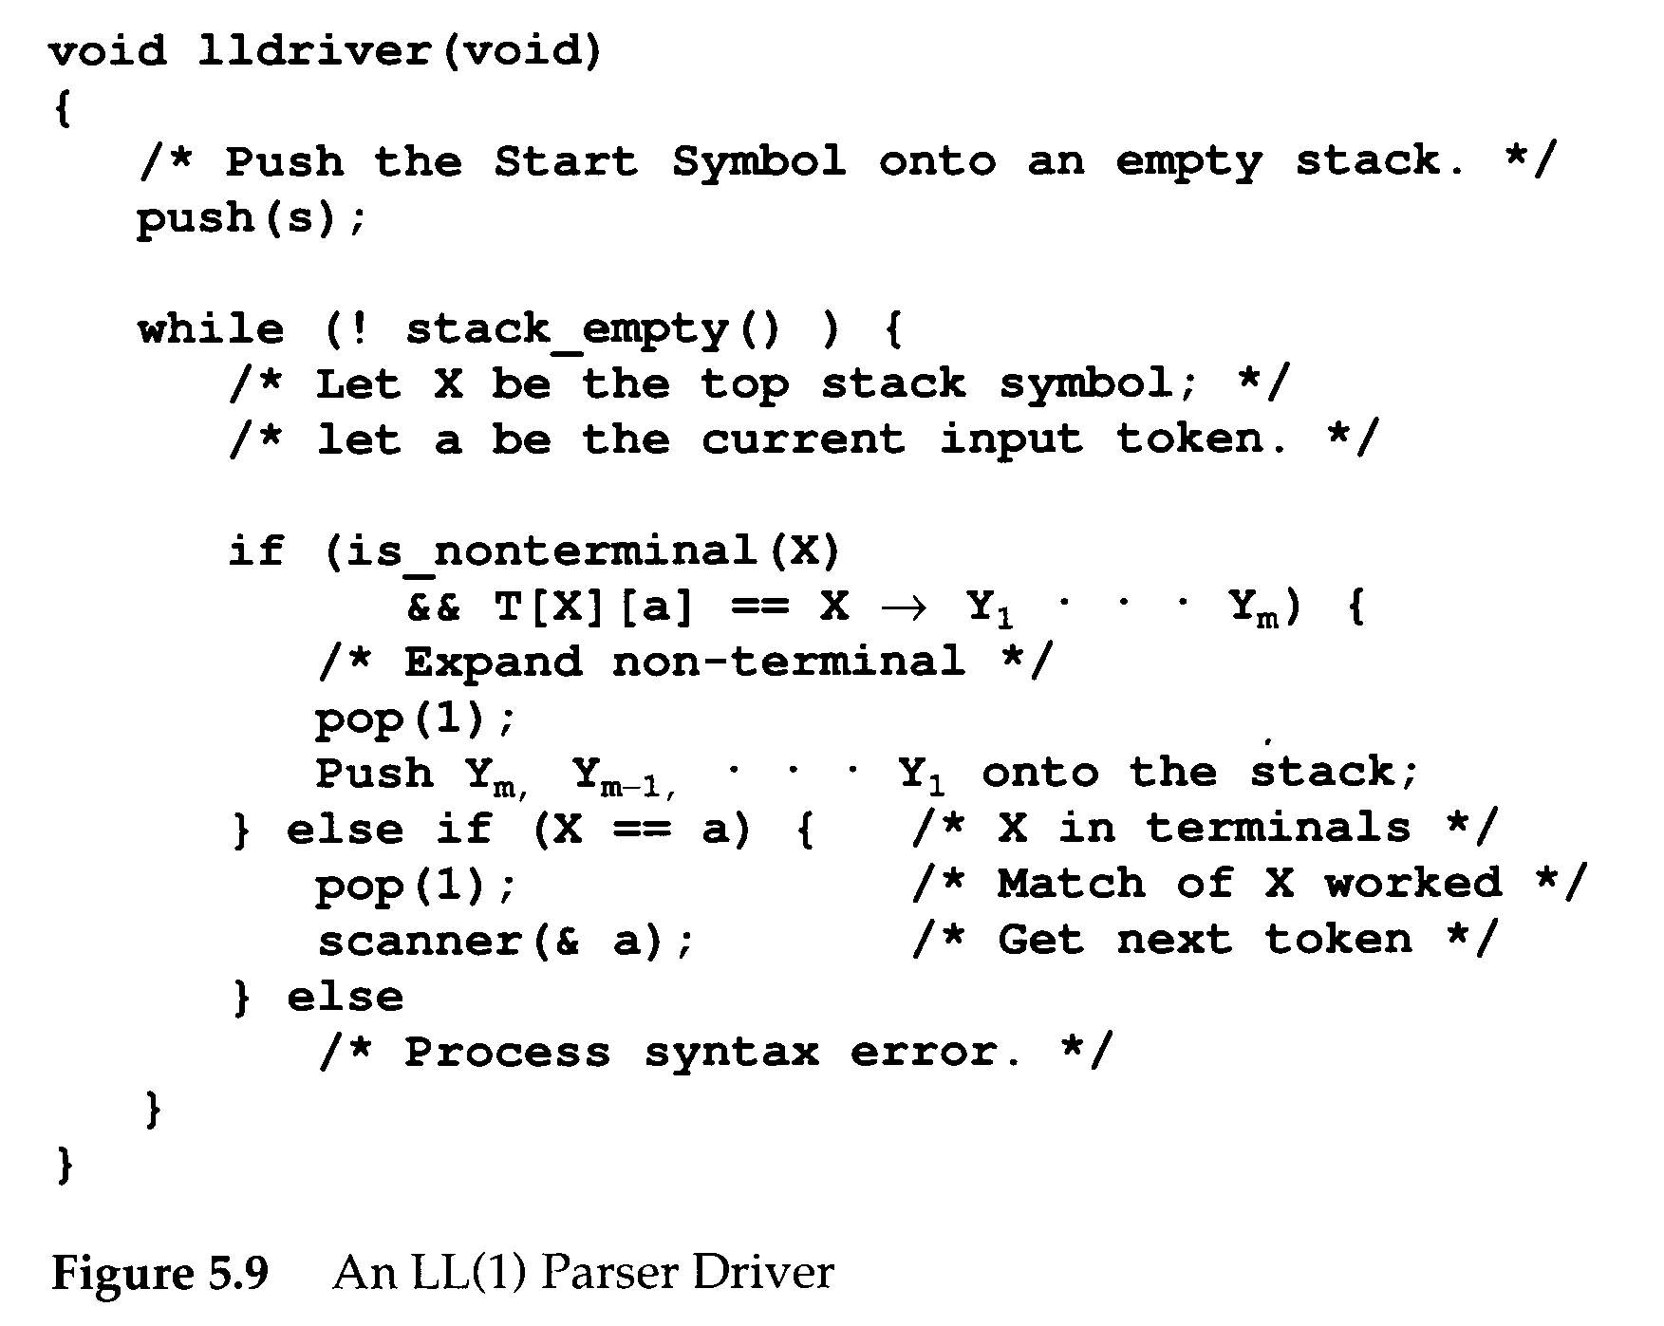
a
B
A
c
D
A→aBcD
Prof. Farn Wang, Department of Electrical Engineering

Slide 15

2022/10/11 stopped here.
寶貝！Compiler上課了！
Prof. Farn Wang, Department of Electrical Engineering

Slide 16
LL(1) Action Symbols
During parsing, the appearance of an action symbol in a production will serve to initiate the corresponding semantic action – a call to the corresponding semantic routine.
ID := <expression> #gen_assign ;
match(ID);
match(ASSIGN);
exp();
gen_assign();
match(semicolon);
Prof. Farn Wang, Department of Electrical Engineering

Slide 17
LL(1) Action Symbols
The semantic routine calls pass no explicit parameters
  Necessary parameters are transmitted through a semantic stack
  Semantic stack ≠ parse stack
Semantic stack is a stack of semantic records.
Action symbols are pushed to the parse stack
Prof. Farn Wang, Department of Electrical Engineering

Slide 18
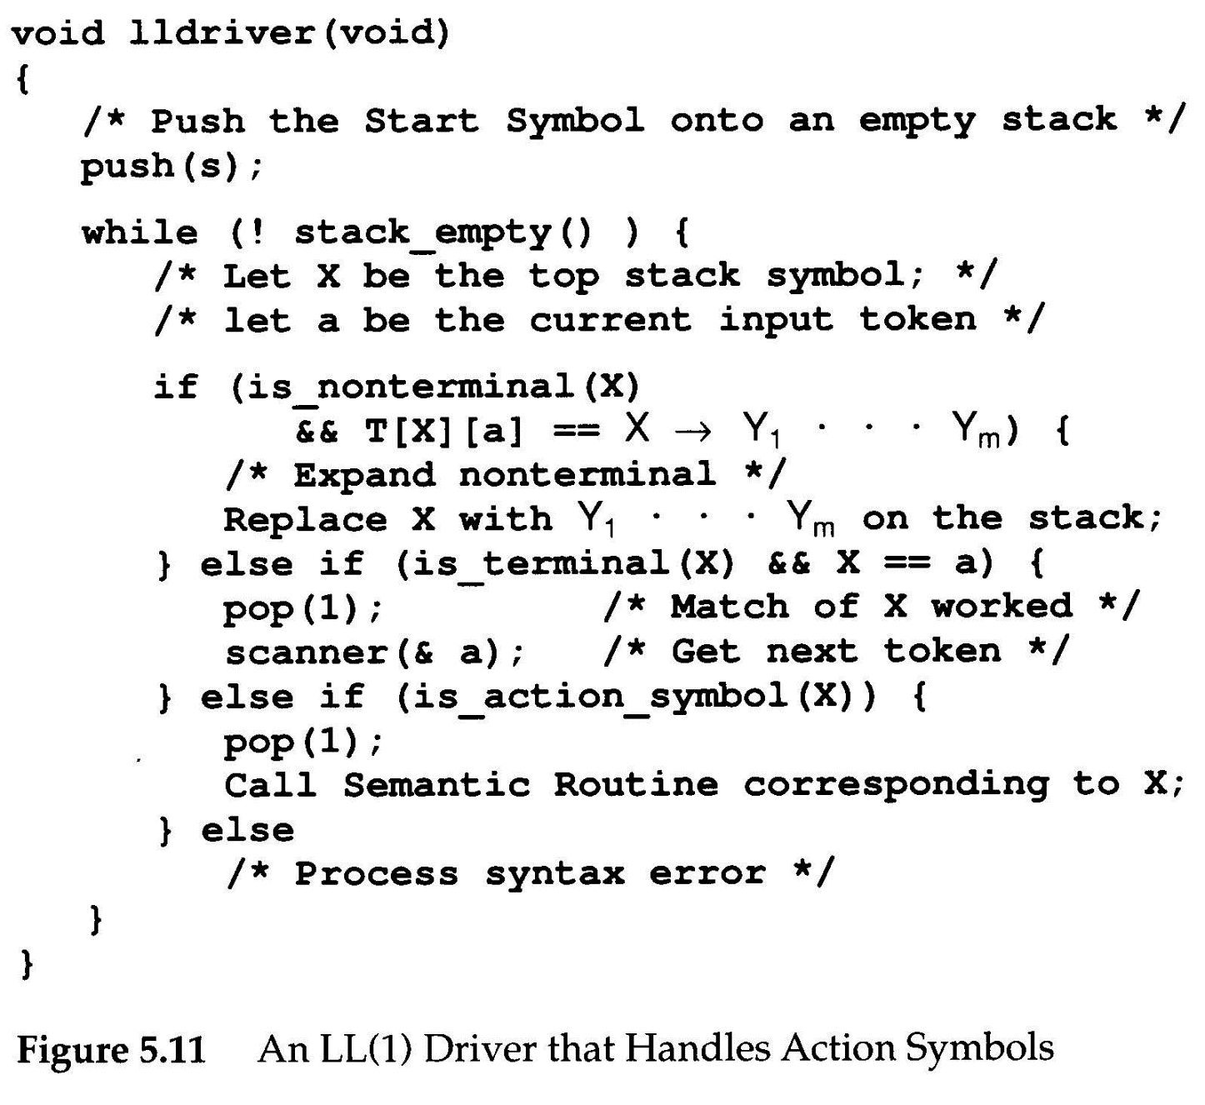
Prof. Farn Wang, Department of Electrical Engineering

Slide 19
Making Grammars LL(1)
Not all grammars are LL(1). However, some non-LL(1) grammars can be made LL(1) by simple modifications.
When a grammar is not LL(1) ?
This is called a conflict, which means we do not know which production to use when <stmt> is on stack top and a is the next input token.
a
<stmt>
2,5
Prof. Farn Wang, Department of Electrical Engineering

Slide 20
Making Grammars LL(1)
Major LL(1) prediction conflicts
  Common prefixes
  Left recursion
Common prefixes
<stmt> → if <exp> then <stmt>
<stmt> → if <exp> then <stmt> else <stmt>
Solution: left factoring
<stmt> → if <exp> then <stmt> <elseStmt>
<elseStmt> → | else <stmt>
Prof. Farn Wang, Department of Electrical Engineering

Slide 21
Making Grammars LL(1)
Grammars with left-recursive production can never be LL(1)
  A → A β
  Why? A will be the top stack symbol, and hence the same production would be predicted forever
Prof. Farn Wang, Department of Electrical Engineering

Slide 22
FAQ
How is First(A→P) different from Predict(A→P)?
Why do we need the stack for LL Parsing?
  Recursion
How is First(A) different from First(A→P)?
Prof. Farn Wang, Department of Electrical Engineering

Slide 23
Making Grammars LL(1)
Other transformations may be needed
  No common prefixes, no left recursion, but conflicts still exist.
1 <stmt> → <label> <unlabeled stmt>
2 <label> → ID :
3 <label> → λ
4 <unlabeled stmt> → ID := <exp> ;
A: B := C ;
B := C ;
ID
2,3
LL(2) will work
<label>
Prof. Farn Wang, Department of Electrical Engineering

Slide 24
Making Grammars LL(1)
<stmt> → ID <suffix>
<suffix> → : <unlabeled stmt>
<suffix> → := <exp> ;
<unlabeled stmt> → ID := <exp> ;
Example
A: B := C ;
B := C ;
Prof. Farn Wang, Department of Electrical Engineering

Slide 25
Dangling else
<stmt> → if <expr> then stmt
<stmt> → if <expr> then stmt else stmt
<stmt> → while ( <expr> ) stmt
<stmt> → for ( expr; expr; expr) stmt
<stmt> → if <expr> then stmt V
<V> → else stmt
→ λ
Prof. Farn Wang, Department of Electrical Engineering

Slide 26
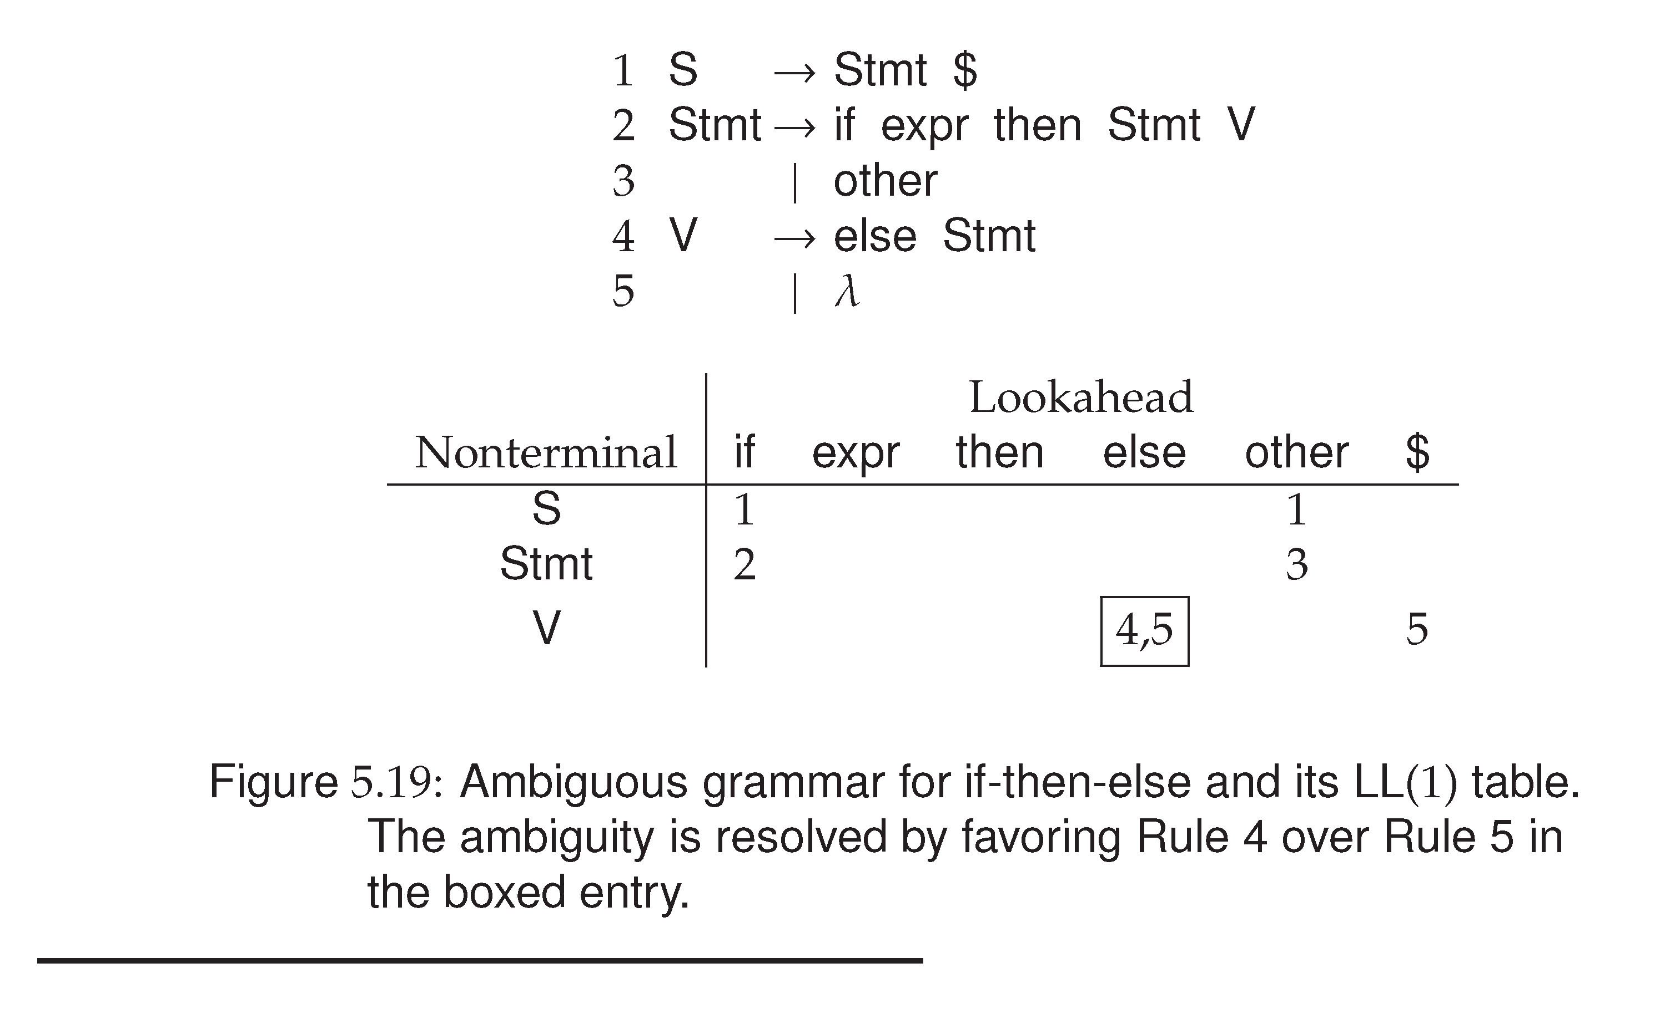
Left factoring may
fail to solve the
problem !
e.g. after left factoring,
the dangling IF’s
problem remains…
Prof. Farn Wang, Department of Electrical Engineering

Slide 27
The If-Then-Else Problem in LL(1)
Solution: conflicts + special rules
In Figure 5.19, T[V, else] = 4 and 5
We can enforce that T[V, else] = 4th rule.
This essentially forces “else “ to be matched with the nearest unpaired “ if “.
Prof. Farn Wang, Department of Electrical Engineering

Slide 28
The If-Then-Else Problem in LL(1)
If all if statements are terminated with an end if, or some equivalent symbol, the problem disappears.
    S → if S E
    S → Other
    E → else S end if
    E → end if
An alternative solution
  Change the language
Prof. Farn Wang, Department of Electrical Engineering

