Slide 1
Chapter 3 Scanning – Theory and Practice

Slide 2
Overview
Formal notations for specifying the precise structure of tokens are necessary
  Quoted string in Pascal
  Can a string split across a line?
  Is a null string allowed?
  Is .1 or 10. ok?
  the 1..10 problem
Scanner generators
  tables
  Programs
What formal notations to use?

Slide 3
Regular Expressions
Tokens are built from symbols of a finite vocabulary.
We use regular expressions to define structures of tokens.

Slide 4
Regular Expressions
The sets of strings defined by regular expressions are termed regular sets
Definition of regular expressions
  ∅ is a regular expression denoting the empty set
  λ is a regular expression denoting the set that contains only the empty string
  A string s is a regular expression denoting a set containing only s
  if A and B are regular expressions, so are
    A | B (alternation)
    AB (concatenation)
    A* (Kleene closure)

Slide 5
Regular Expressions (Cont’d)
some notational convenience
  P+ == PP*
  Not(A) == V - A
  Not(S) == V* - S
  A^{K} == AA …A (k copies)

Slide 6
Regular Expressions (Cont’d)
Some examples
  Let D = (0 | 1 | 2 | 3 | 4 | ... | 9 )
  L = (A | B | ... | Z)
  comment = -- not(EOL)* EOL
  decimal = D+ • D+
  ident = L (L | D)* (_ (L | D)⁺)*
  comments = ##((#| λ )not(#))* ##

Slide 7
Regular Expressions (Cont’d)
Is regular expression as power as CFG?
{ [^{i}]^{i} | i≥1}

Slide 8
Finite Automata and Scanners
A finite automaton (FA) can be used to recognize the tokens specified by a regular expression
A FA consists of
  A finite set of states
  A set of transitions (or moves) from one state to another, labeled with characters in V
  A special start state
  A set of final, or accepting, states

Slide 9
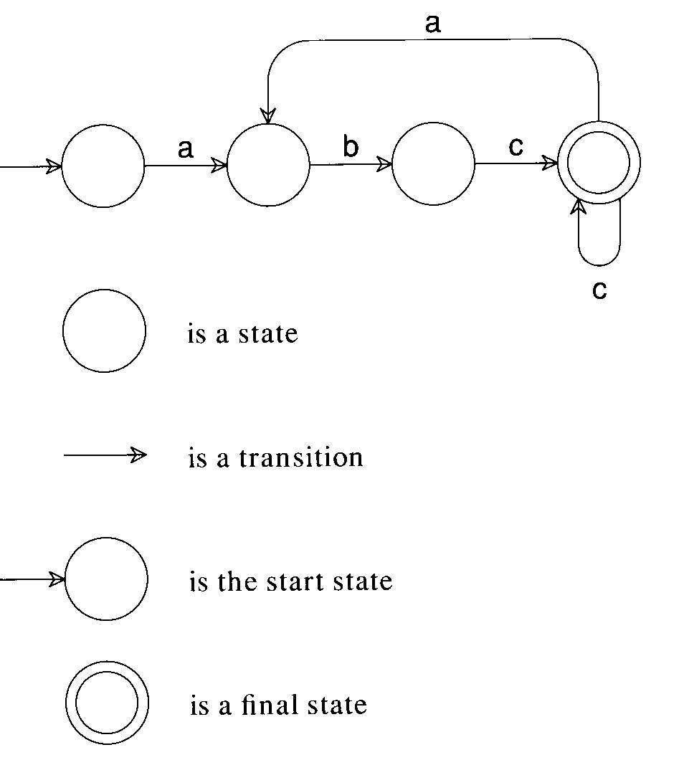
A transition diagram
This machine accepts abccabc, but it rejects abcab.
This machine accepts (abc⁺)⁺.

Slide 10
Example
(0|1)*0(0|1)(0|1)
1
0 0,1 0,1
2
3
4
0,1 0
5
0,1

Slide 11
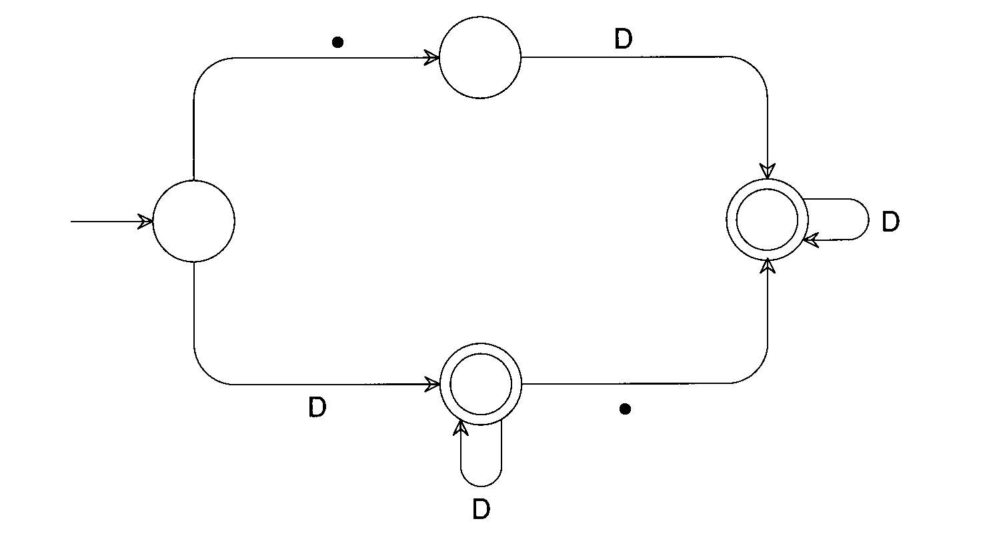
Example
RealLit = (D⁺(λ|.))|(D*.D⁺)

Slide 12
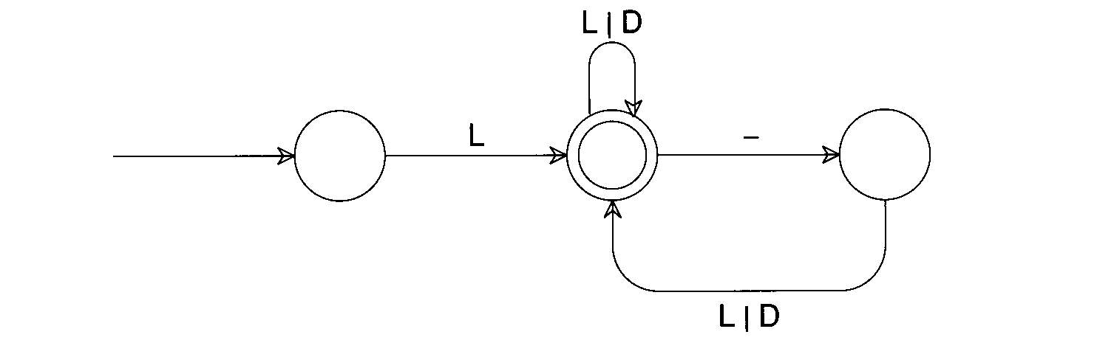
Example
ID = L(L|D)*(_(L|D)⁺)*

Slide 13
Finite Automata and Scanners
Two kinds of FA:
  Deterministic: next transition is unique
  Non-deterministic: otherwise
a
...
...
a

Slide 14
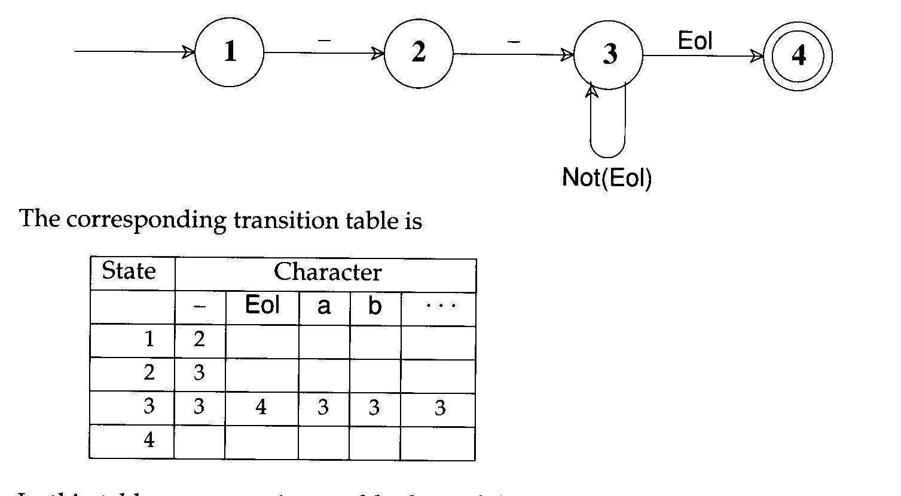
A transition table of a DFA

Slide 15
Finite Automata and Scanners
Any regular expression can be translated into a DFA that accepts the set of strings denoted by the regular expression
The transition can be done
  Automatically by a scanner generator
  Manually by a programmer

Slide 16
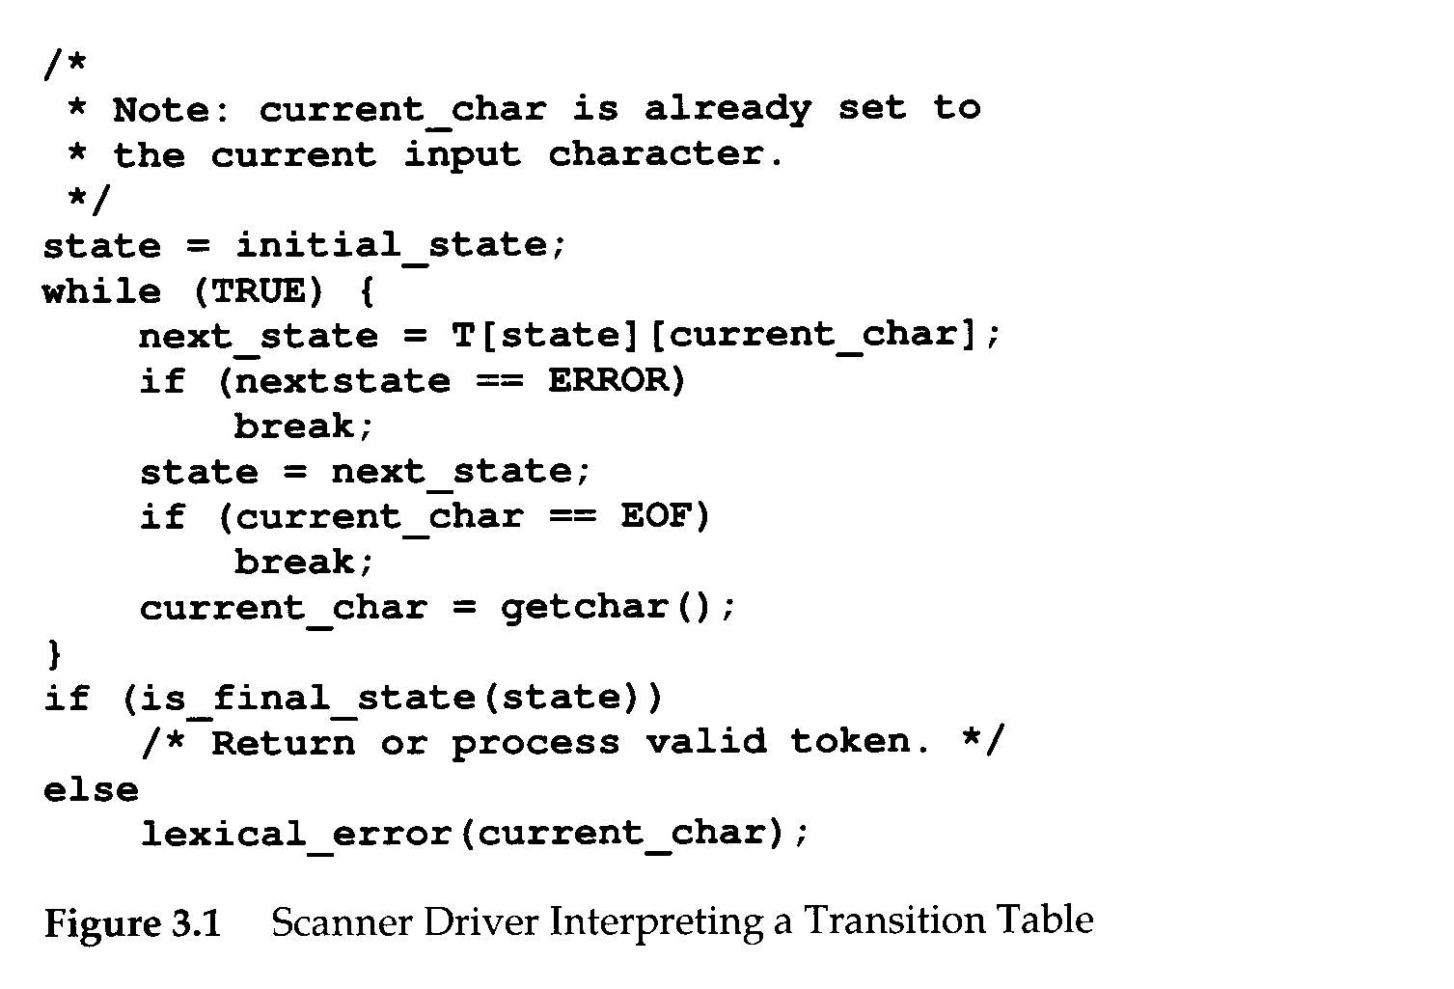

Slide 17
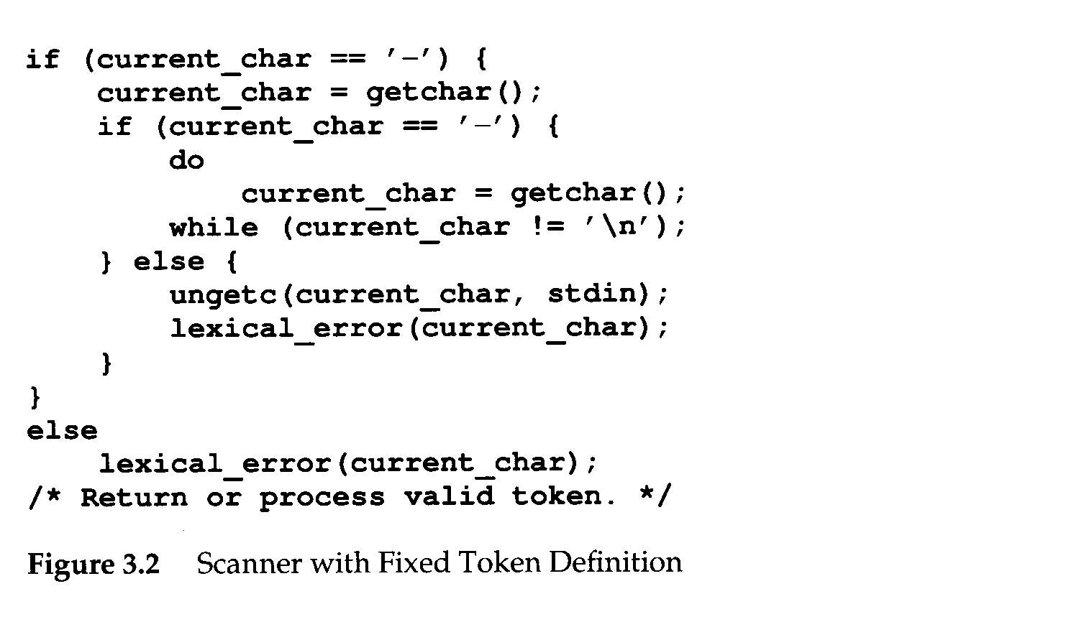

Slide 18
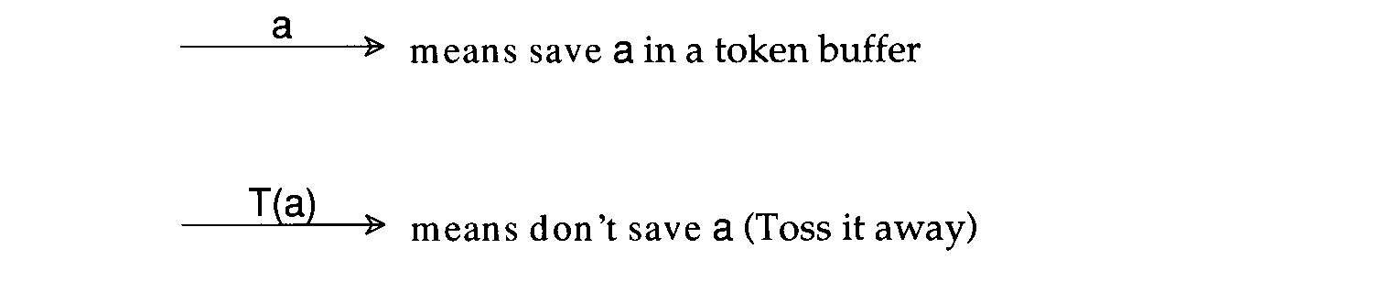
Finite Automata and Scanners
Transducer
  We may perform some actions during state transition.

Slide 19
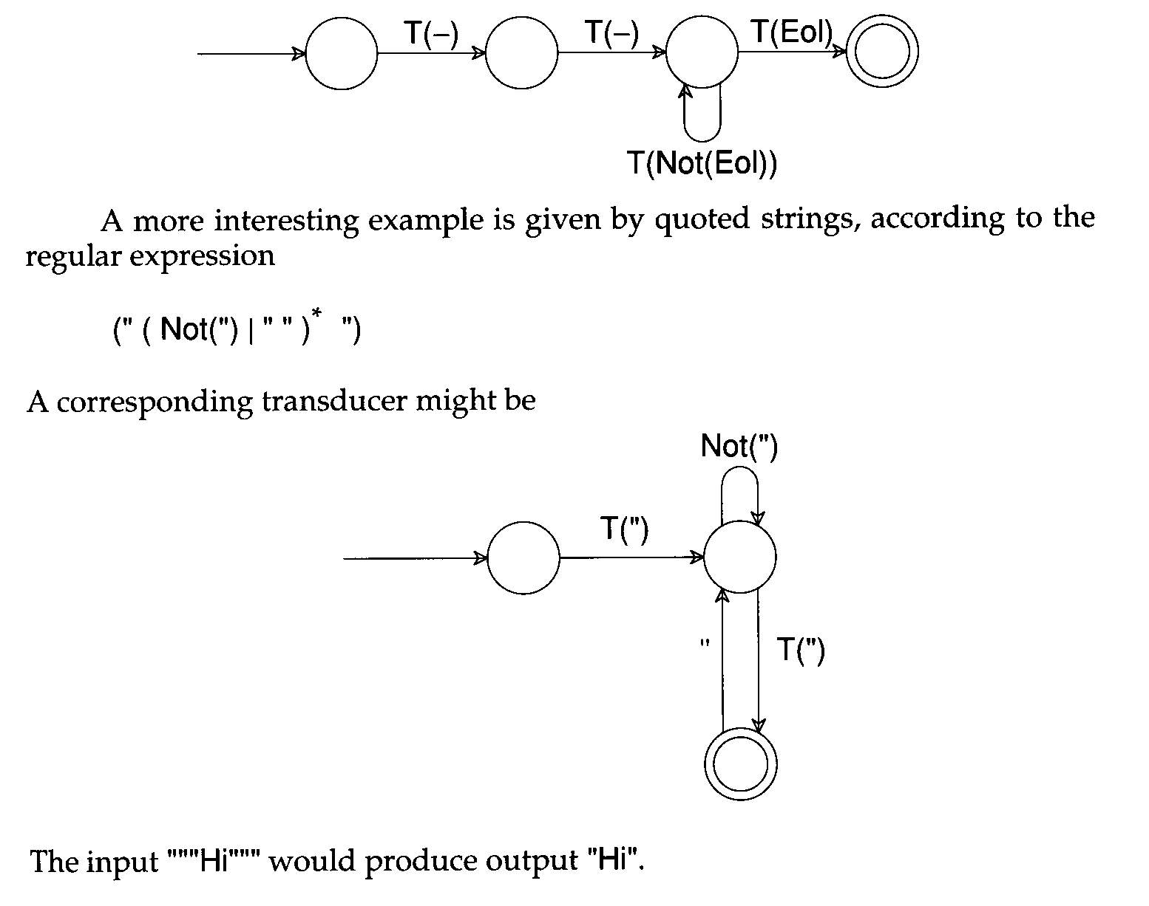

Slide 20
Practical Consideration
Reserved Words
  Usually, all keywords are reserved in order to simplify parsing.
  In Pascal, we could even write
  begin
  begin; end; end; begin;
  end
  if else then if = else;
The problem with reserved words is that they are too numerous.
  COBOL has several hundrens of reserved words!

Slide 21
Practical Consideration (Cont’d)
Compiler Directives and Listing Source Lines
  Compiler options e.g. optimization, profiling, etc.
    handled by scanner or semantic routines
    Complex pragmas are treated like other statements.
  Source inclusion
    e.g. #include in C
    handled by preprocessor or scanner
  Conditional compilation
    e.g. #if, #endif in C
    useful for creating program versions

Slide 22
Practical Consideration (Cont’d)
Entry of Identifiers into the Symbol Table
Who is responsible for entering symbols into symbol table?
  Scanner?
  Consider this example:
  { int abc;
  …
  { int abc; }
  }

Slide 23
Practical Consideration (Cont’d)
How to handle end-of-file?
  Create a special EOF token.
    EOF token is useful in a CFG
Multicharacter Lookahead
  Blanks are not significant in Fortran
    DO 10 I = 1,100
      Beginning of a loop
    DO 10 I = 1.100
      An assignment statement DO10I=1.100
    A Fortran scanner can determine whether the O is the last character of a DO token only after reading as far as the comma

Slide 24
Practical Consideration (Cont’d)
Multicharacter Lookahead (Cont’d)
  In Ada and Pascal
    To scan 1..100
      There are three token
        1
        ..
        100
      Two-character lookahead after the 10

Slide 25
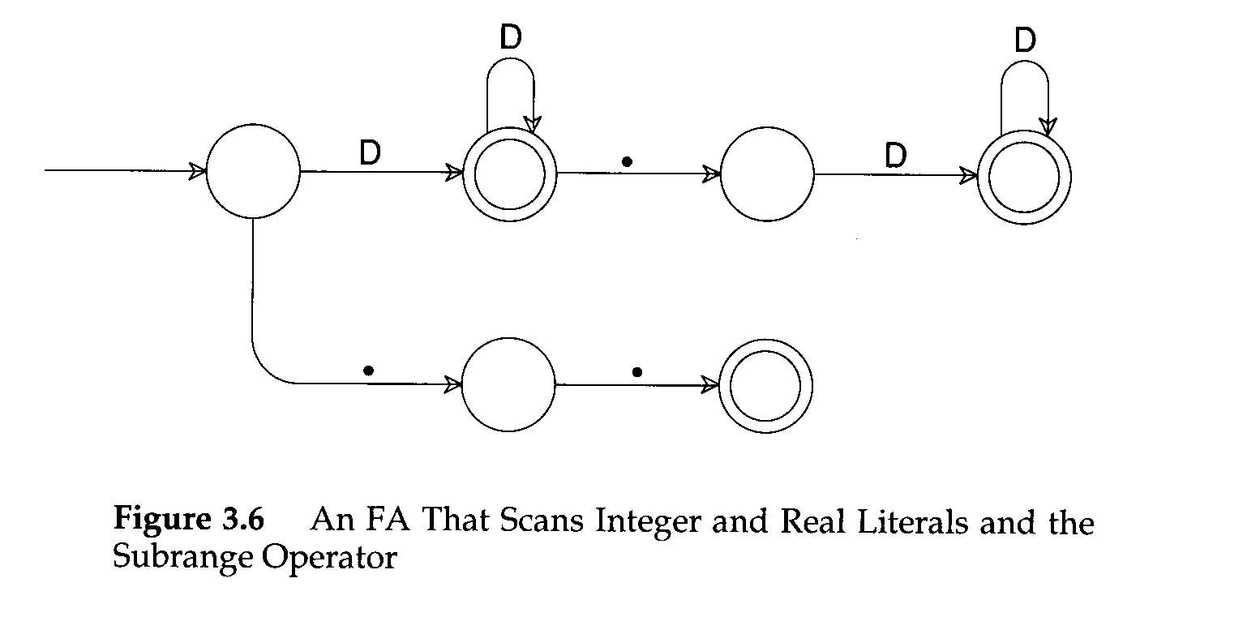
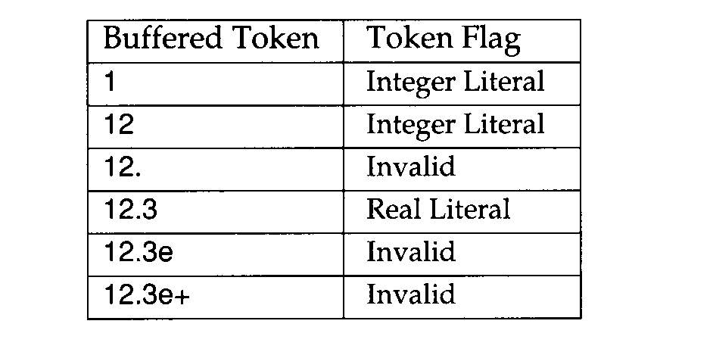
Practical Consideration (Cont’d)
Multicharacter Lookahead (Cont’d)
  It is easy to build a scanner that can perform general backup.
  If we reach a situation in which we are not in final state and cannot scan any more characters, backup is invoked.
    Until we reach a prefix of the scanned characters flagged as a valid token

Slide 26
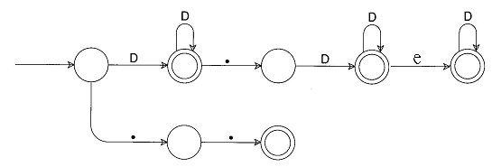

Slide 27
Translating Regular Expressions into Finite Automata
Regular expressions are equivalent to FAs
The main job of a scanner generator
  To transform a regular expression definition into an equivalent FA
A regular
expression
Nondeterministic
FA
Deterministic
FA
minimize # of states
Optimized
Deterministic
FA

Slide 28
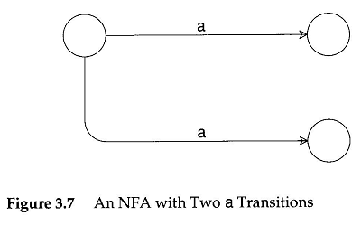
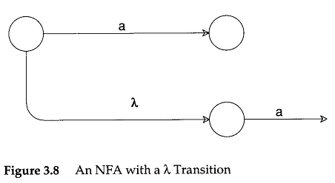
Translating Regular Expressions into Finite Automata
A FA is nondeterministic:

Slide 29
Translating Regular Expressions into Finite Automata
We can transform any regular expression into an NFA with the following properties:
  There is an unique final state
  The final state has no successors
  Every other state has either one or two successors

Slide 30
Translating Regular Expressions into Finite Automata
We need to review the definition of regular expression
1. λ (null string)
2. a (a char of the vocabulary)
3. A|B (or)
4. AB (cancatenation)
5. A* (repetition)

Slide 31
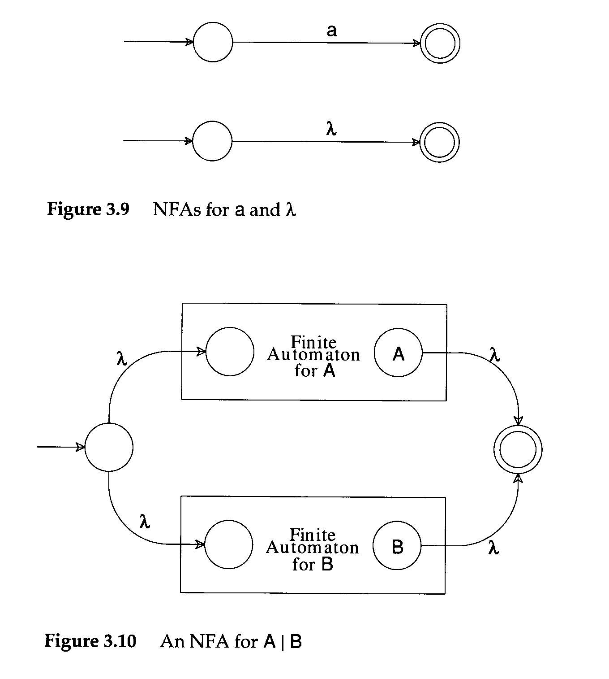

Slide 32
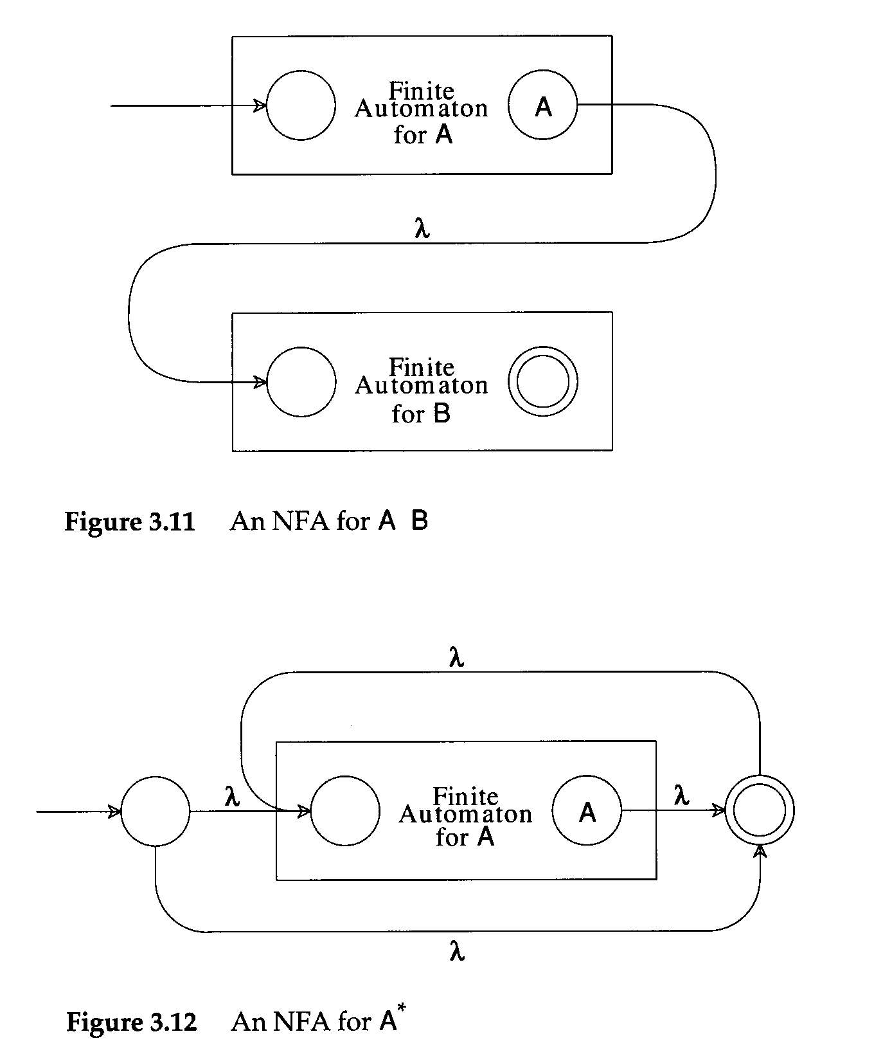

Slide 33
Construct an NFA for Regular Expression 01*+1
01*+1 ⇒ (0(1*))+1
λ
λ
1
λ
1*⇒
start
λ
λ
0
λ
λ
1
λ
01*⇒
start
λ
1
λ
λ
λ
01*+1⇒
start
λ
0
λ
λ
1
λ
λ

Slide 34
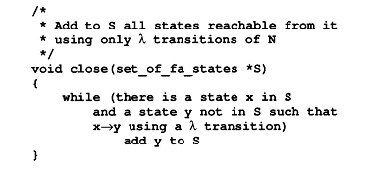
Creating Deterministic Automata
The transformation from an NFA N to an equivalent DFA M works by what is sometimes called the subset construction
  Step 1: The initial state of M is the set of states reachable from the initial state of N by λ-transitions

Slide 35
Creating Deterministic Automata
  Step 2: To create the successor states
    Take any state S of M and any character c, and compute S’s successor under c
      S is identified with some set of N’s states, {n₁, n₂,…}
      Find all possible successor states to {n₁, n₂,…} under c
        Obtain a set {m₁, m₂,…}
      T=close({m₁, m₂,…})
S
T
{n₁, n₂,…}
close({m₁, m₂,…})

Slide 36
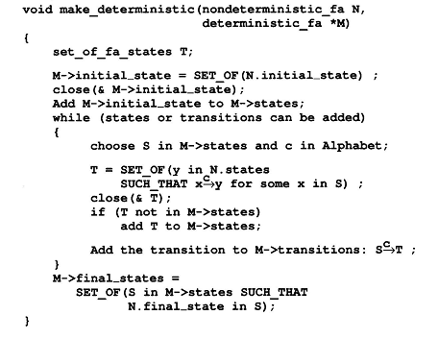
Creating Deterministic Automata

Slide 37
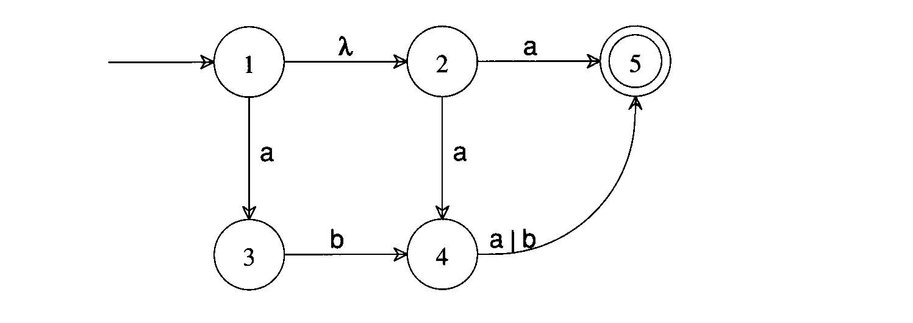
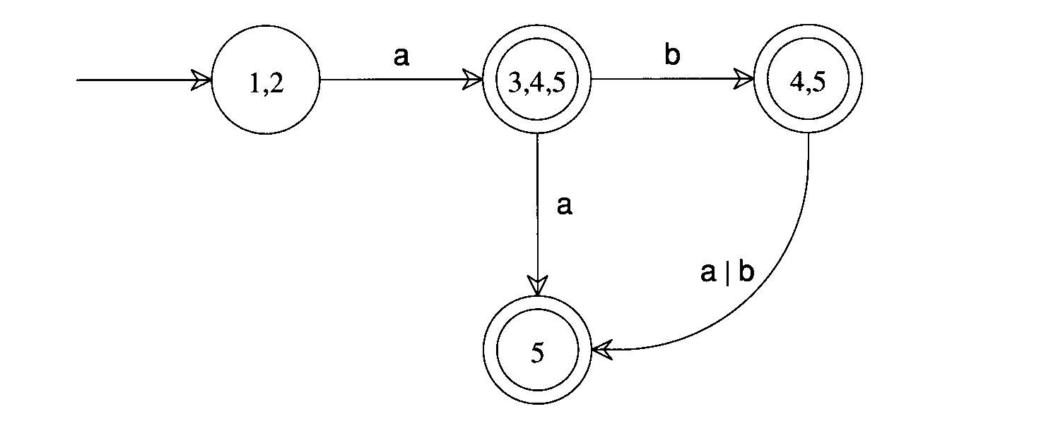

Slide 38
Optimizing Finite Automata
minimize number of states
  Every DFA has a unique smallest equivalent DFA
  Given a DFA M, we use splitting to construct the equivalent minimal DFA.
  Initially, there are two sets, one consisting all accepting states of M, the other the remaining states.
(S₁, S₂, … , S_{i}, …, S_{j}, … S_{k}, … ,S_{l}, …)
c
c
c
c
c
c
(P₁, P₂, … , P_{n})
(N₁, N₂, … , N_{m})

Slide 39
(S₁, S₂, … , S_{i}, …, S_{j}, … S_{k}, … ,S_{l}, … ,S_{x}, ,S_{y}, )
c
c
c
c
c
c
(P₁, P₂, … , P_{n})
(N₁, N₂, … , N_{m})
(S₁, S₂, S_{j}, …)
(S_{i}, S_{k}, S_{l}, …)
(S_{x}, S_{y}, …)
Note that S_{x} and S_{y} no transaction on c

Slide 40
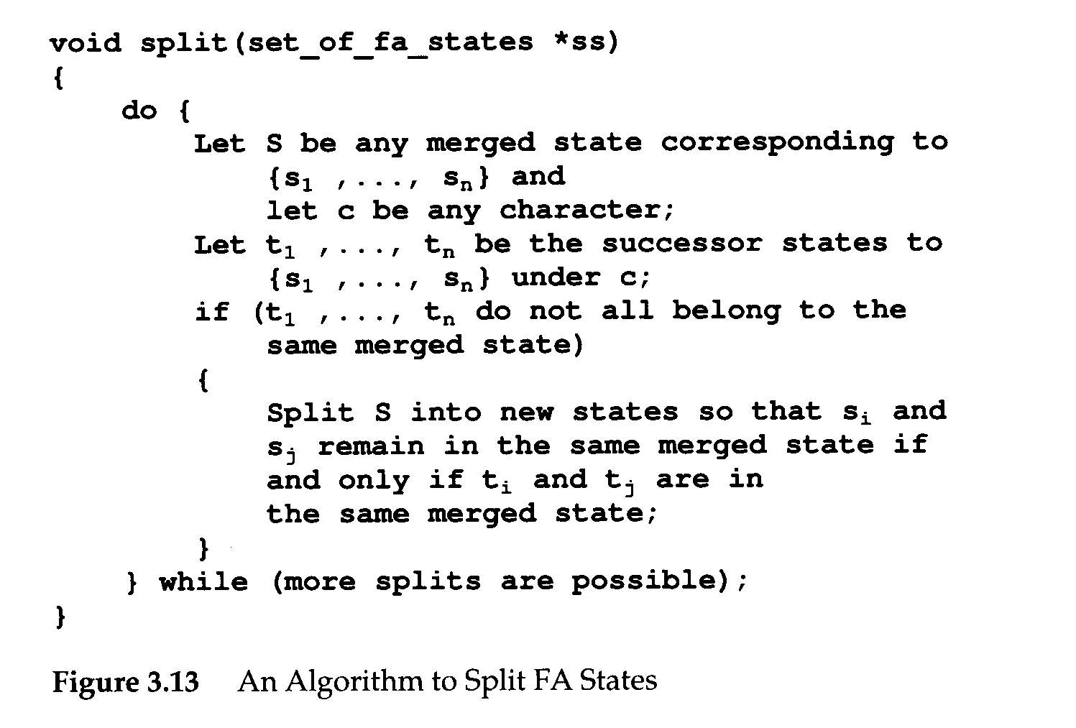

Slide 41
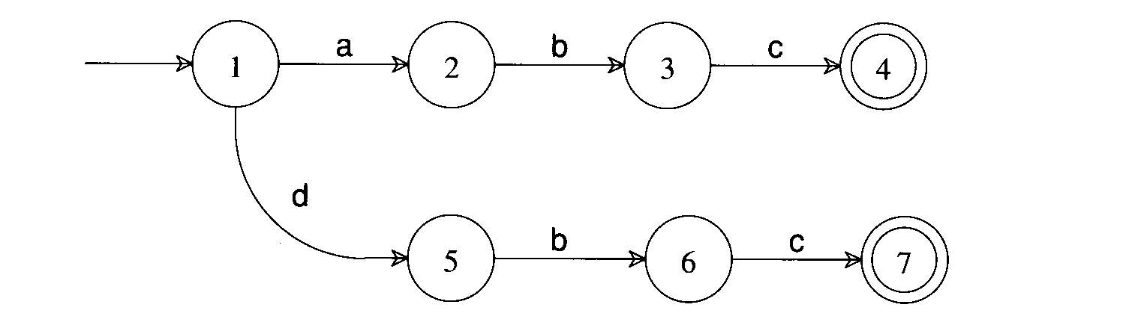

Initially, two sets {1, 2, 3, 5, 6}, {4, 7}.
{1, 2, 3, 5, 6} splits {1, 2, 5}, {3, 6} on c.
{1, 2, 5} splits {1}, {2, 5} on b.

