Slide 1
Chapter 6 LR Parsing Techniques

Slide 2
Shift-Reduce Parsers
Reviewing some technologies:
  Phase
  Simple
  Handle of a sentential form
S
A sentential form
A
b
C
α b C b a C
handle
Simple phase
α
b
C
a
C

Slide 3
Shift-reduce parser
A parse stack
  Initially empty, contains symbols already parsed
    Elements in the stack are not terminal or nonterminal symbols
  The parse stack catenated with the remaining input always represents a right sentential form
  Tokens are shifted onto the stack until the top of the stack contains the handle of the sentential form

Slide 4
Shift-reduce parser
Two questions
  Have we reached the end of handles and how long is the handle?
  Which nonterminal does the handle reduce to?
We use tables to answer the questions
  ACTION table
  GOTO table

Slide 5
Shift-reduce parser
LR parsers are driven by two tables:
  Action table, which specifies that actions to take
    Shift, reduce, accept or error
  Goto table, which specifies state transition
We push states, rather than symbols onto the stack
Each state represents the possible subtrees of the parse tree

Slide 6
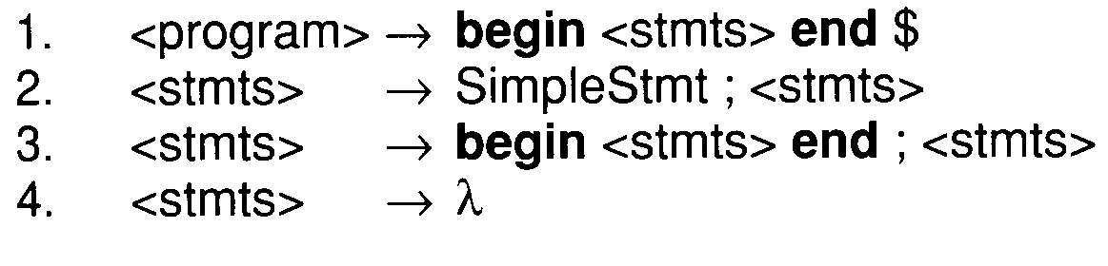
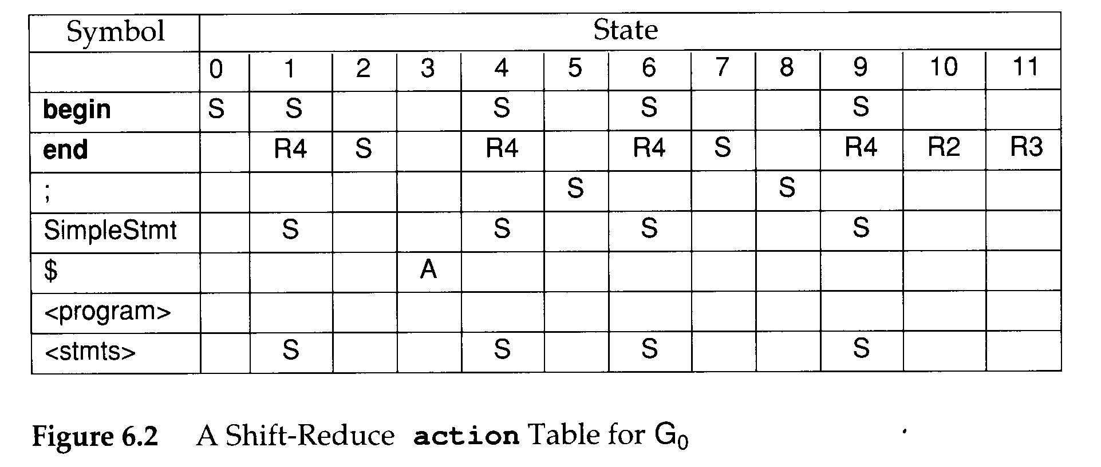
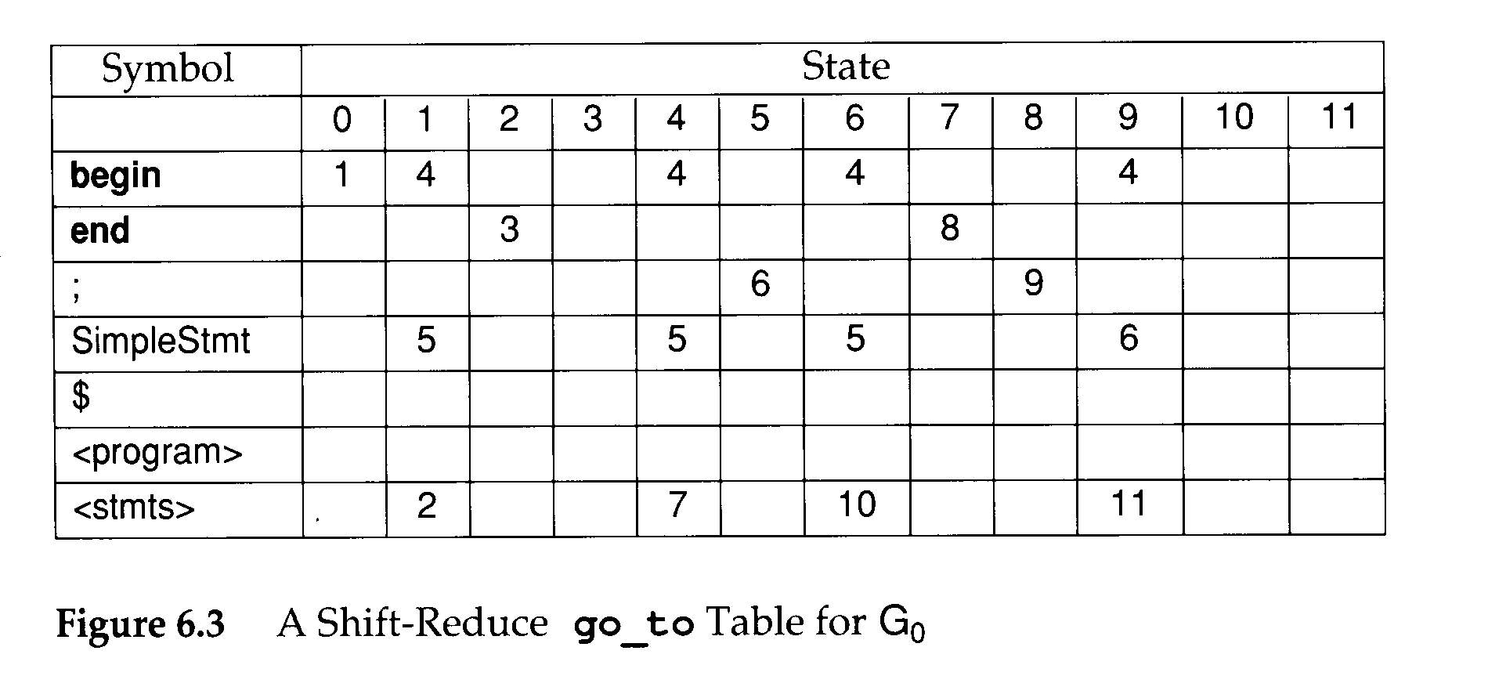
Shift-reduce parser

Slide 7
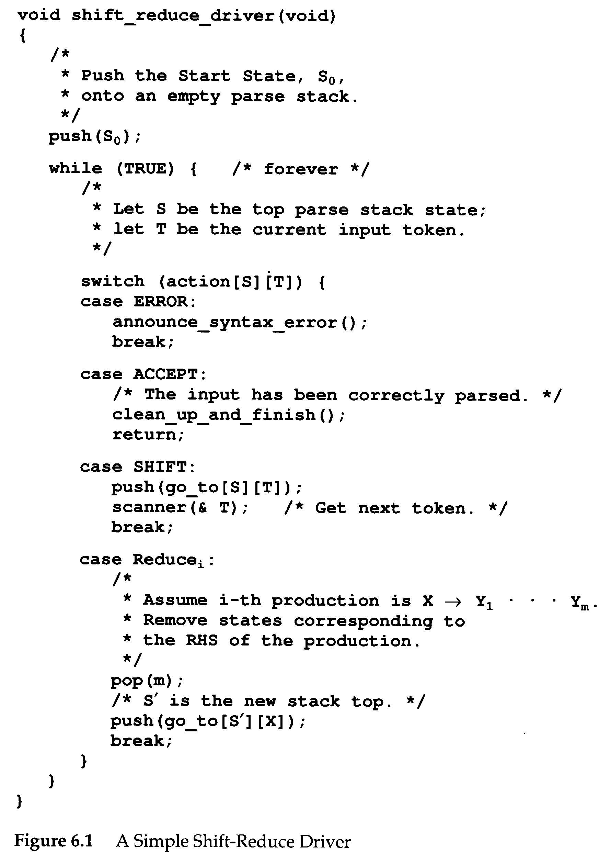

Slide 8
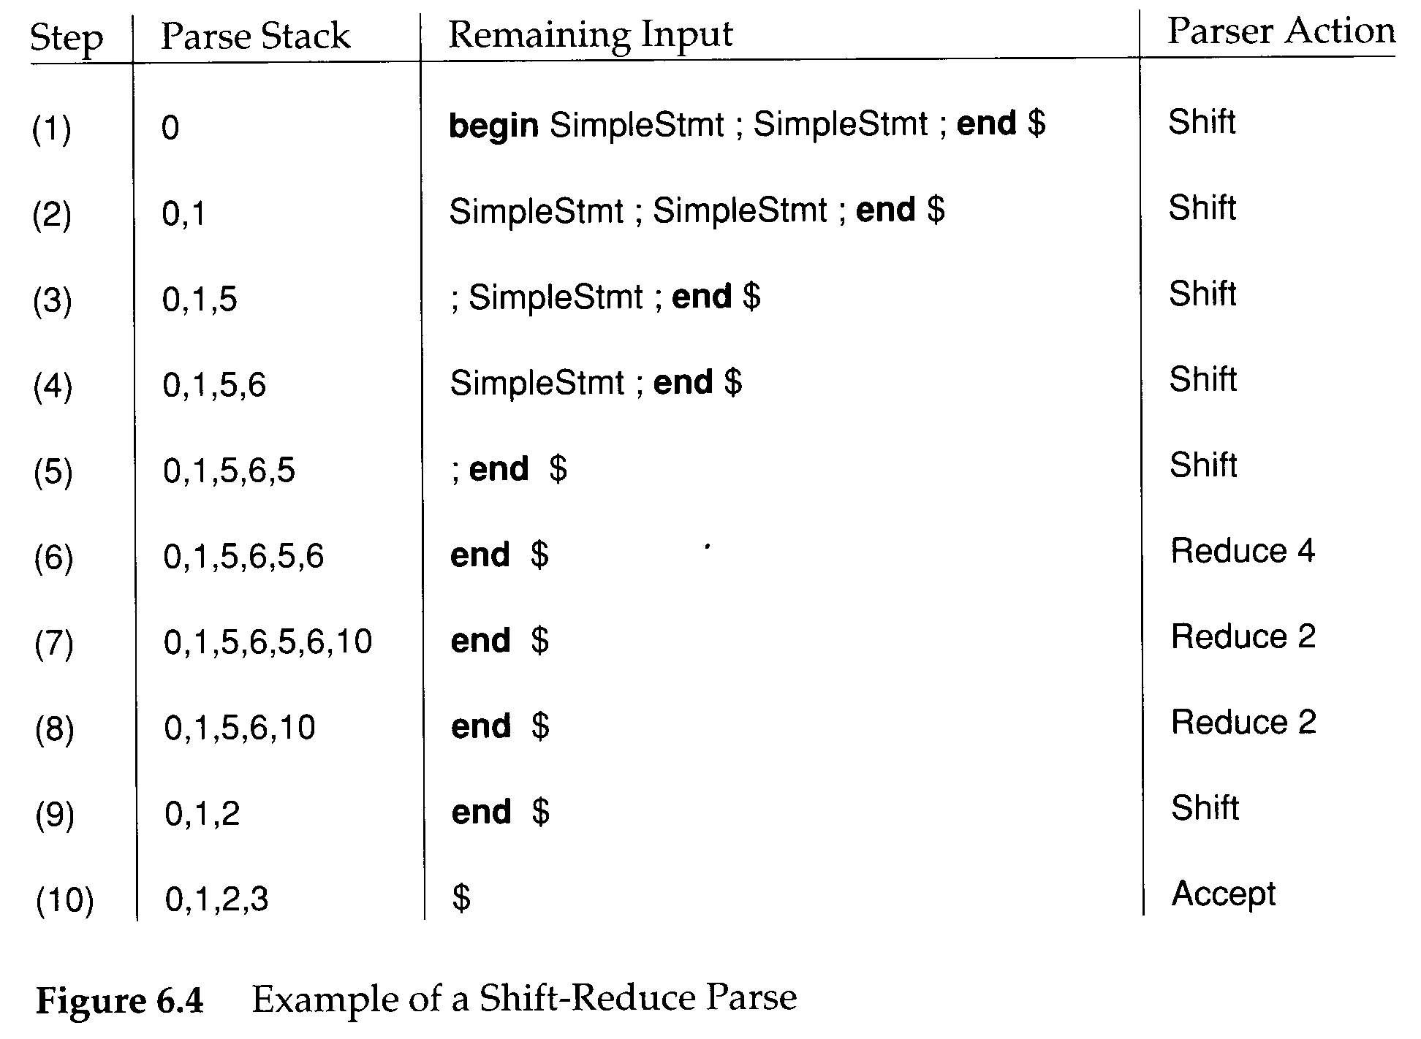

Slide 9
<program>
begin
<stmts>
R 2
end
$
SimpleStmt
;
<stmts>
R 2
SimpleStmt
;
<stmts>
R 4
λ

Slide 10
LR Parsers
LR(1):
  left-to-right scanning
  rightmost derivation(reverse)
  1-token lookahead
LR parsers are deterministic
  no backup or retry parsing actions
LR(k) parsers
  decide the next action by examining the tokens already shifted and at most k lookahead tokens
  the most powerful of deterministic bottom-up parsers with at most k lookahead tokens.

Slide 11
LR(0) Parsing
A production has the form
  A→X₁X₂…X_{j}
By adding a dot, we get a configuration (or an item)
  A→•X₁X₂…X_{j}
  A→X₁X₂…X_{i} • X_{i+1} … X_{j}
  A→X₁X₂…X_{j} •
The • indicates how much of a RHS has been shifted into the stack.

Slide 12
LR(0) Parsing
An item with the • at the end of the RHS
  A→X₁X₂…X_{j} •
  indicates (or recognized) that RHS should be reduced to LHS
An item with the • at the beginning of RHS
  A→•X₁X₂…X_{j}
  predicts that RHS will be shifted into the stack

Slide 13
LR(0) Parsing
An LR(0) state is a set of configurations
  This means that the actual state of LR(0) parsers is denoted by one of the items.
The closure0 operation:
  if there is an configuration B→δ • A ρ in the set then add all configurations of the form A→ • γ to the set.
The initial configuration
  s0 = closure0({S→ • α $})

Slide 14
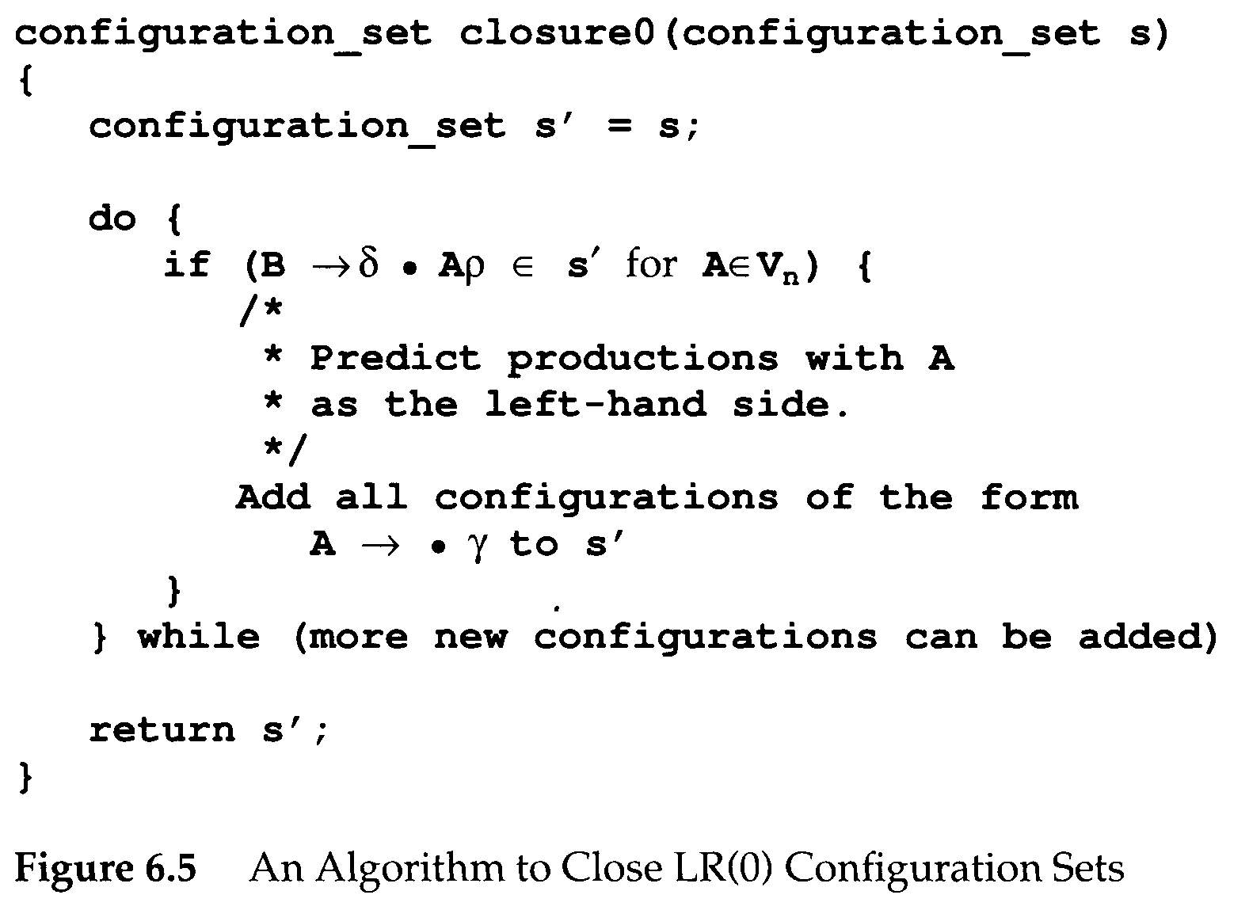
LR(0) Parsing

Slide 15
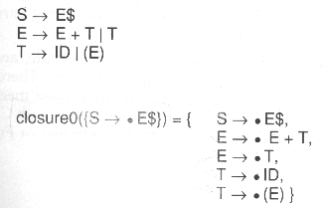

Slide 16
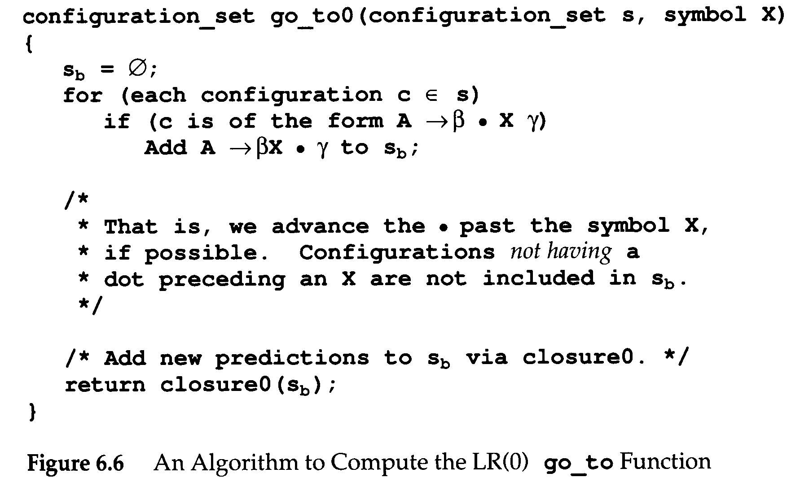
LR(0) Parsing
Given a configuration set s, we can compute its successor, s', under a symbol X
  Denoted go_to0(s,X)=s'

Slide 17
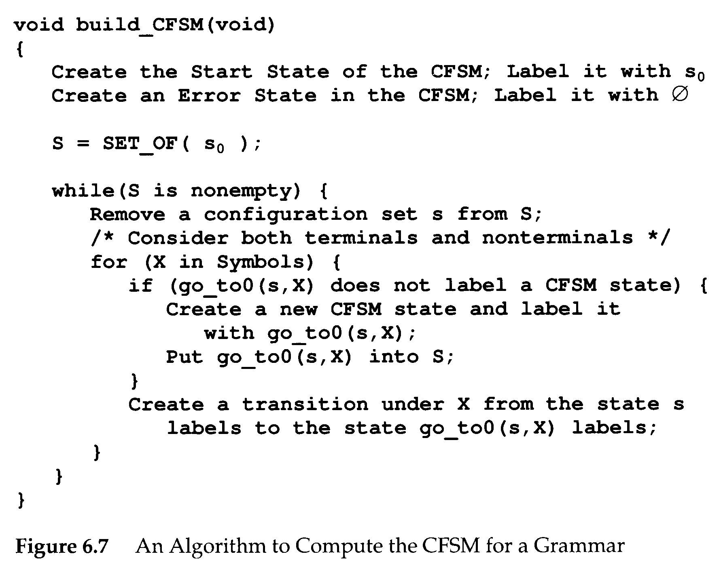
LR(0) Parsing
Characteristic finite state machine (CFSM)
  It is a finite automaton, p.148, para. 2.
  Identifying configuration sets and successor operation with CFSM states and transitions

Slide 18
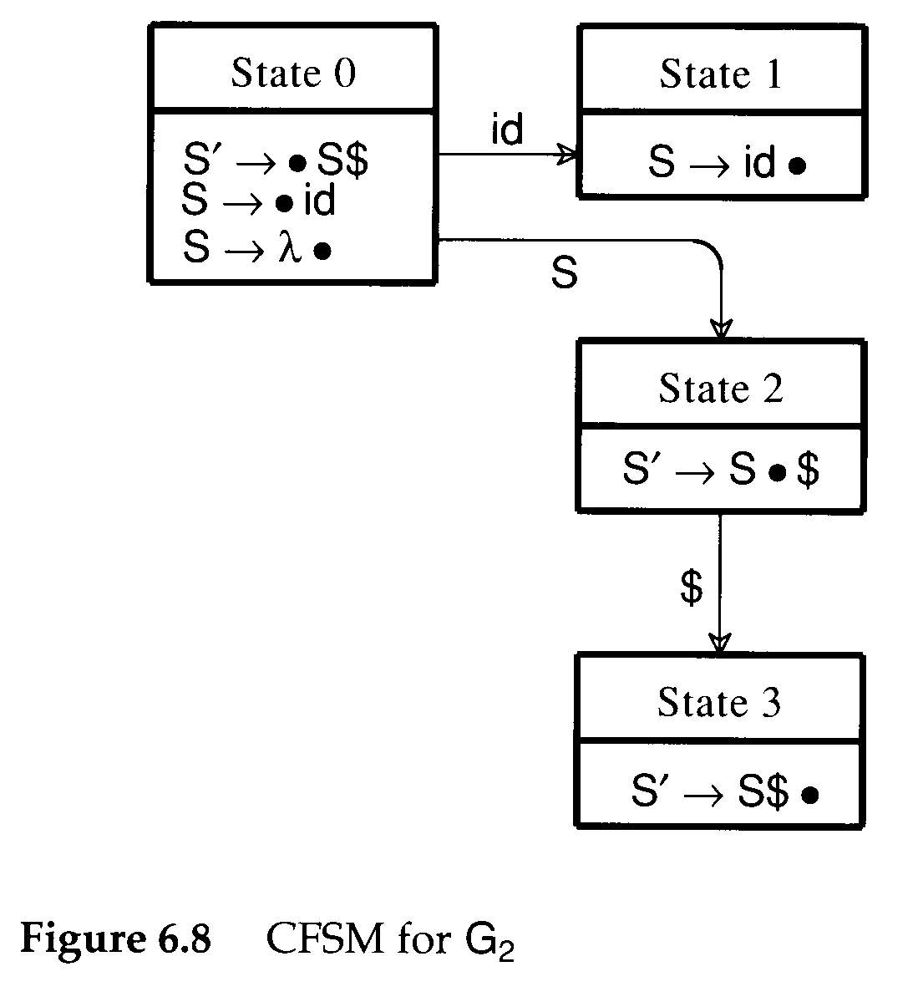
LR(0) Parsing
For example, given grammar G₂
  S'→S$
  S→ID|λ

Slide 19
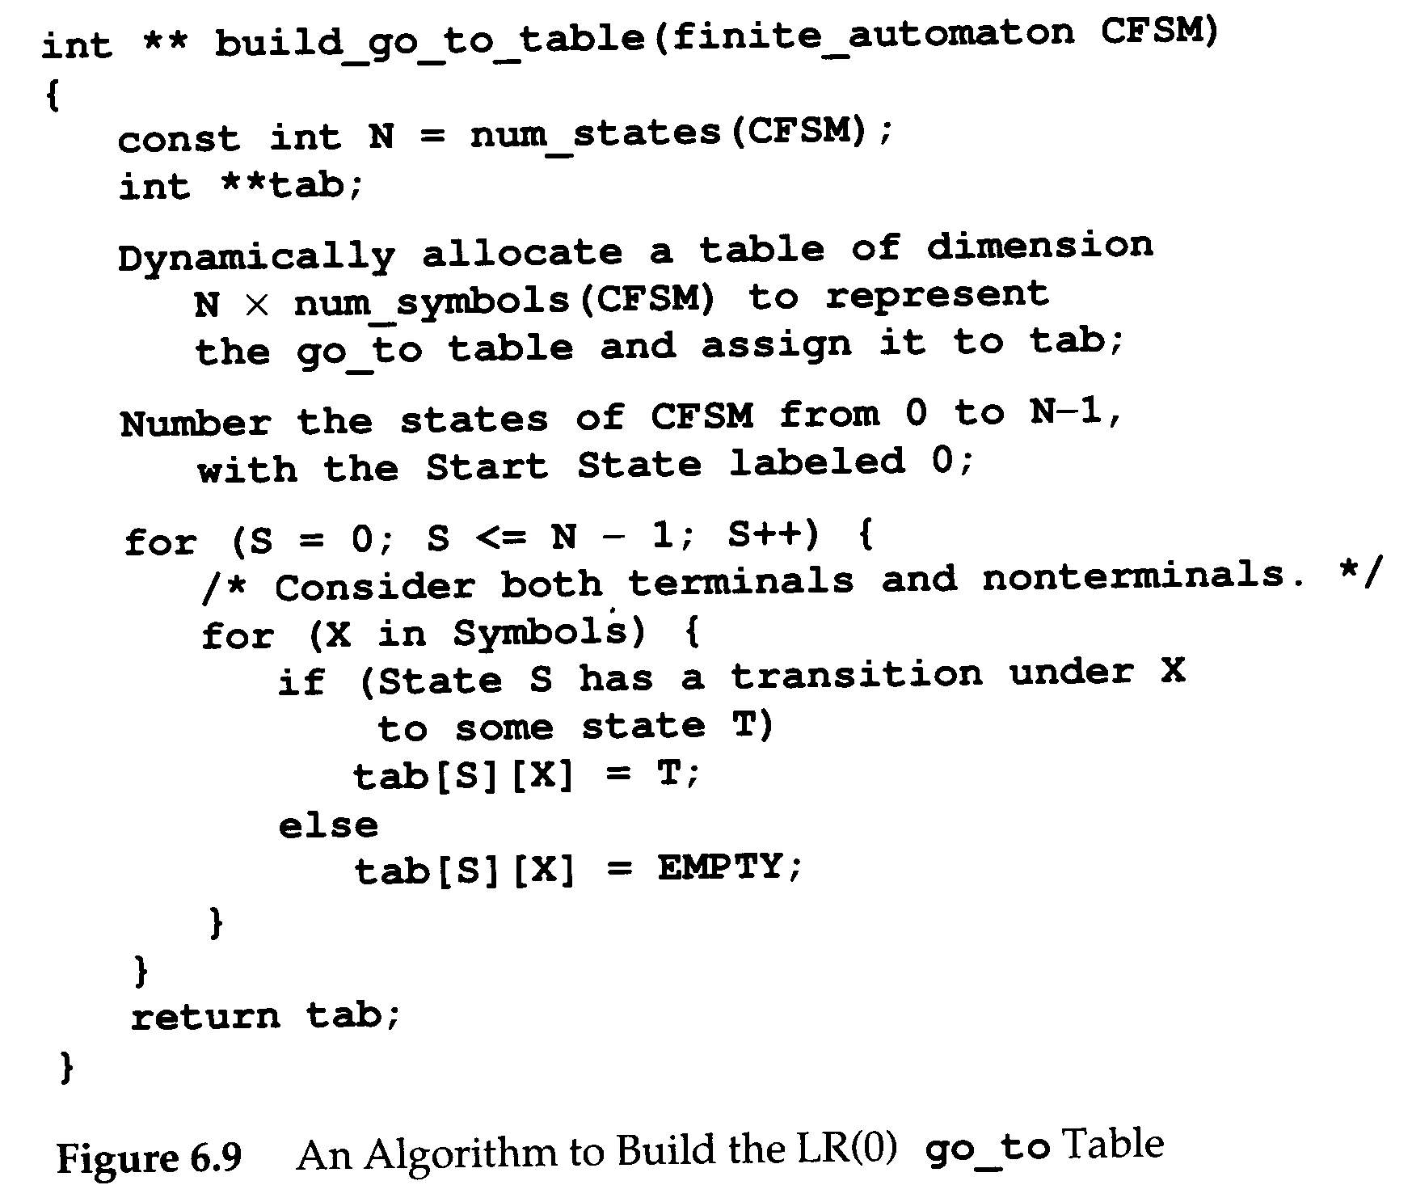
LR(0) Parsing
CFSM is the goto table of LR(0) parsers.

Slide 20
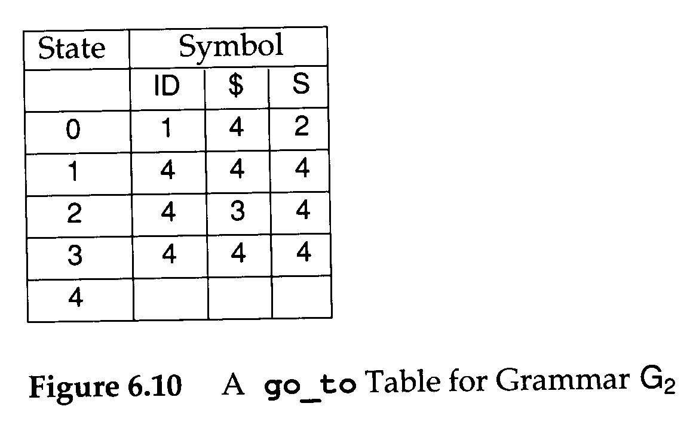

Slide 21
LR(0) Parsing
Because LR(0) uses no lookahead, we must extract the action function directly from the configuration sets of CFSM
Let Q={Shift, Reduce₁, Reduce₂ , …, Reduce_{n}}
  There are n productions in the CFG
S₀ be the set of CFSM states
  P:S₀→2^{Q}
P(s)={Reduce_{i} | B→ρ • ∈ s and production i is B→ρ } ∪ (if A→ α• aβ ∈ s for a ∈V_{t} Then {Shift} Else ∅)

Slide 22
LR(0) Parsing
G is LR(0) if and only if ∀ s ∈ S₀ |P(s)|=1
If G is LR(0), the action table is trivially extracted from P
  P(s)={Shift} ⇒ action[s]=Shift
  P(s)={Reduce_{i}}, where production j is the augmenting production, ⇒ action[s]=Accept
  P(s)={Reduce_{i}}, i≠j, action[s]=Reduce_{i}
  P(s)=∅ ⇒ action[s]=Error

Slide 23
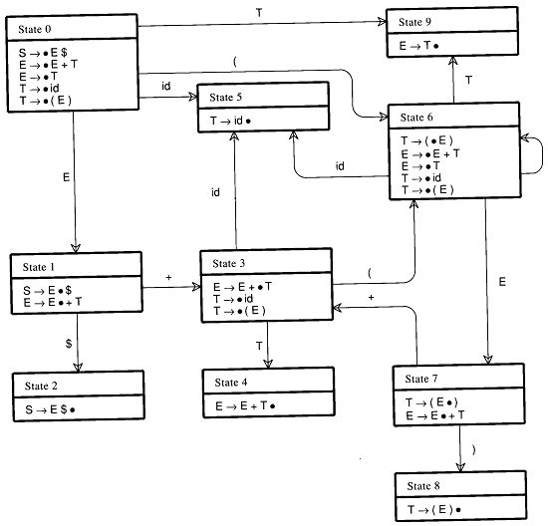
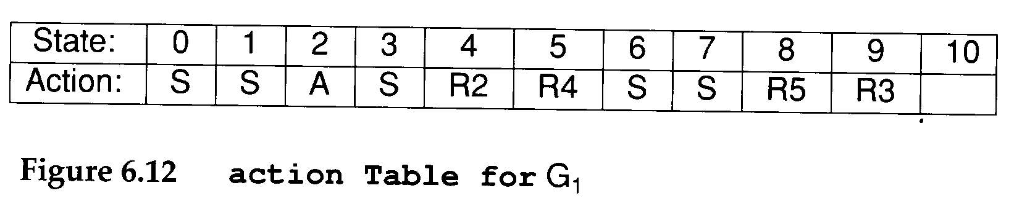
Consider G₁
  S→E$
  E→E+T | T
  T→ID|(E)
CFSM for G₁ ⇒

Slide 24
LR(0) Parsing
Any state s ∈ S₀ for which |P(s)|>1 is said to be inadequate
Two kinds of parser conflicts create inadequacies in configuration sets
  Shift-reduce conflicts
  Reduce-reduce conflicts

Slide 25
LR(0) Parsing
If is easy to introduce inadequacies in CFSM states
  Hence, few real grammars are LR(0). For example,
    Consider λ-productions
      The only possible configuration involving a λ-production is of the form A→ λ•
      However, is A can generate any terminal string other than λ, then a shift action must also be possible (First(A))
    LR(0) parser will have problems in handling operator precedence properly

Slide 26
LR(1) Parsing
An LR(1) configuration, or item is of the form
  A→X₁X₂…X_{i} • X_{i+1} … X_{j}, l where l ∈ V_{t}∪{λ}
    The look ahead commponent l represents a possible lookahead after the entire right-hand side has been matched
    The λ appears as lookahead only for the augmenting production because there is no lookahead after the endmarker

Slide 27
LR(1) Parsing
We use the following notation to represent the set of LR(1) configurations that shared the same dotted production
  A→X₁X₂…X_{i} • X_{i+1} … X_{j}, {l₁…l_{m}}
  ={A→X₁X₂…X_{i} • X_{i+1} … X_{j}, l₁} ∪
  {A→X₁X₂…X_{i} • X_{i+1} … X_{j}, l₂} ∪
  …
  {A→X₁X₂…X_{i} • X_{i+1} … X_{j}, l_{m}}

Slide 28
LR(1) Parsing
There are many more distinct LR(1) configurations than LR(0) configurations.
In fact, the major difficulty with LR(1) parsers is not their power but rather finding ways to represent them in storage-efficient ways.

Slide 29
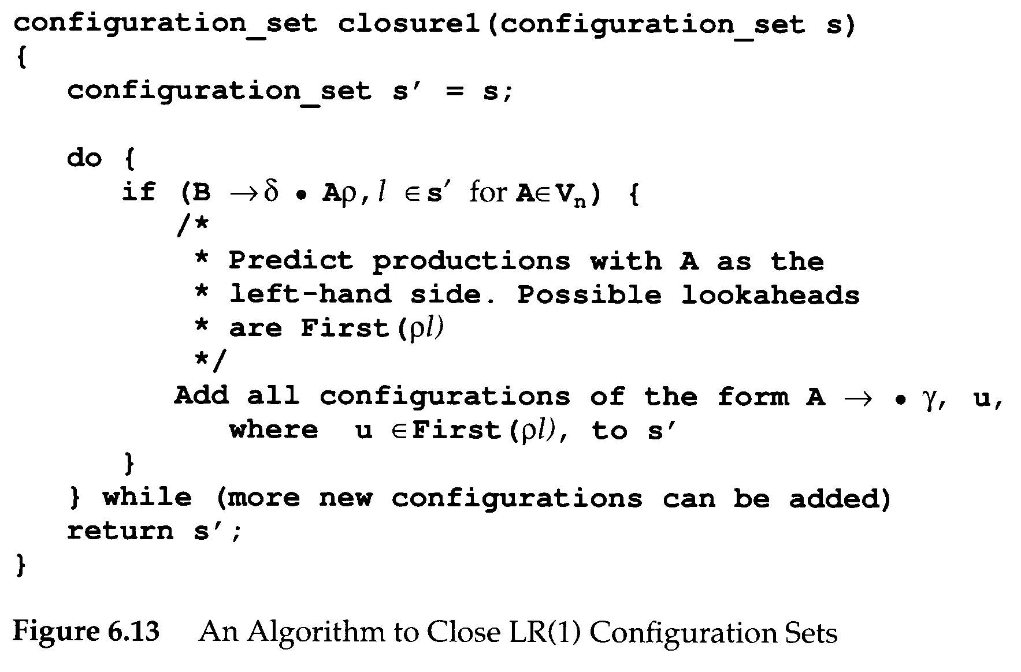
LR(1) Parsing
Parsing begins with the configuration
  closure1({S→ • α $, {λ}})

Slide 30
LR(1) Parsing
Consider G₁
  S→E$
  E→E+T | T
  T→ID|(E)
closure1(S→ • E$, {λ})
S→ • E$, {λ}
closure1(S→ • E$, {λ})=
{
S→ • E$, {λ};
E→ • E+T, {$+}
E→ • T, {$+}
T→ • ID, {$+}
T→ • (E), {$+}
}
E→ • E+T, {+}
E→ • E+T, {$}
E→ • T, {+}
E→ • T, {$}
T→ • ID, {+}
T→ • ID, {$}
T→ • (E), {+}
T→ • (E), {$}

Slide 31
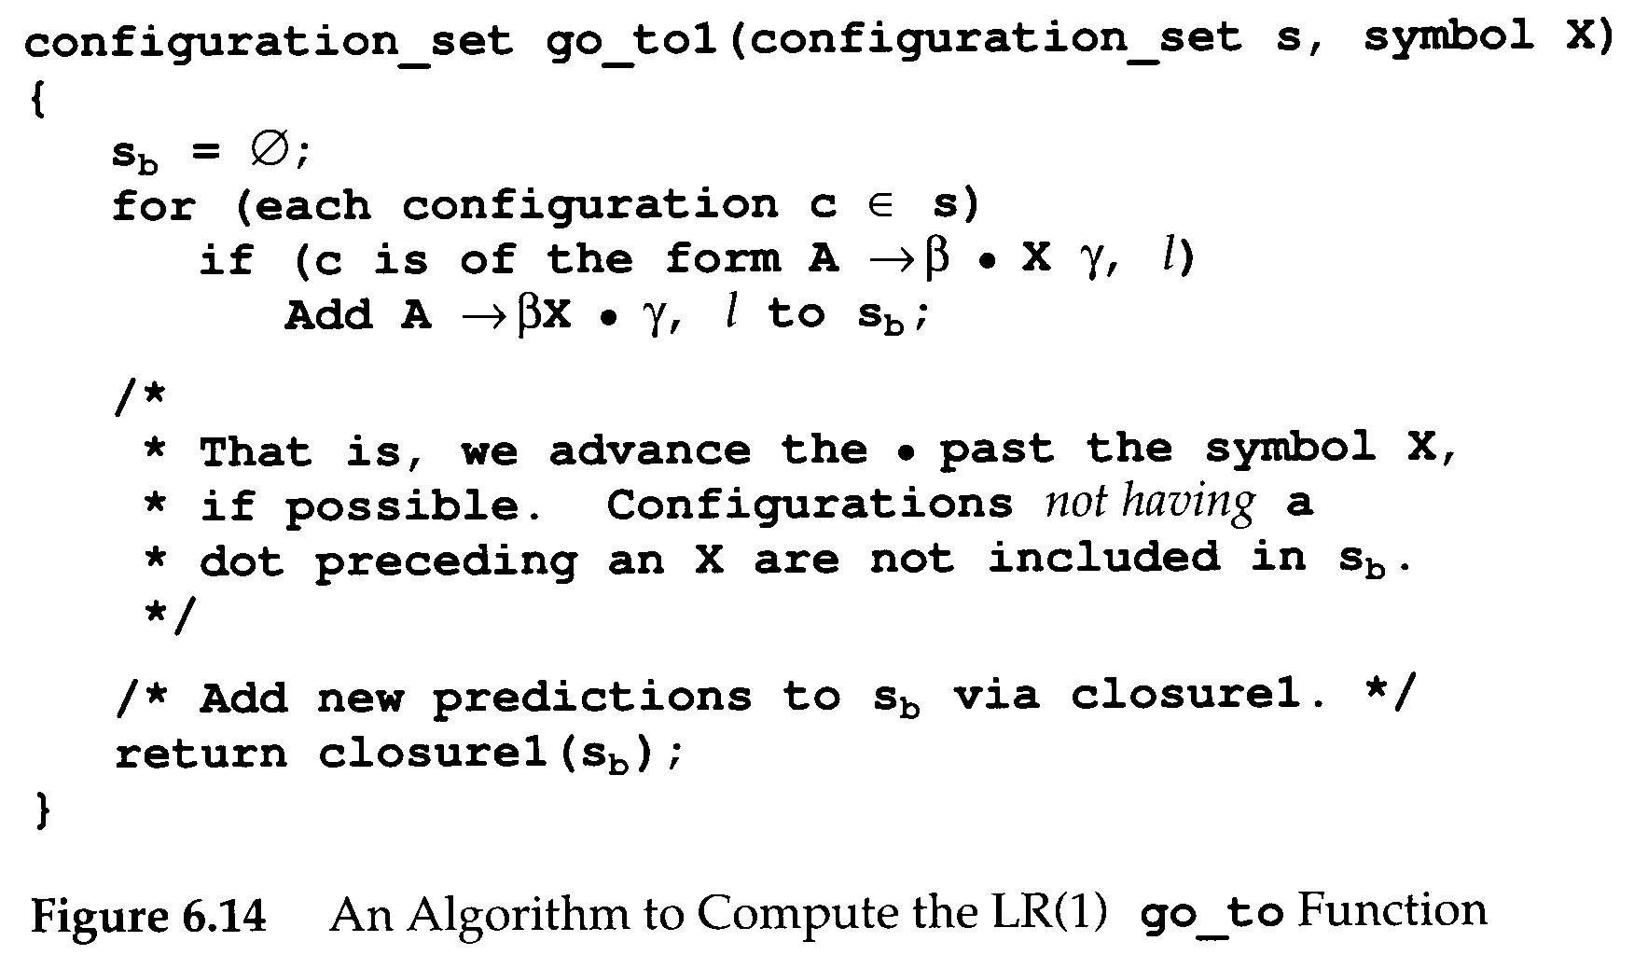
LR(1) Parsing
Given an LR(1) configuration set s, we compute its successor, s', under a symbol X
  go_to1(s,X)

Slide 32
LR(1) Parsing
We can build a finite automation that is analogue of the LR(0) CFSM
  LR(1) FSM, LR(1) machine
The relationship between CFSM and LR(1) macine
  By merging LR(1) machine’s configuration sets, we can obtain CFSM

Slide 33
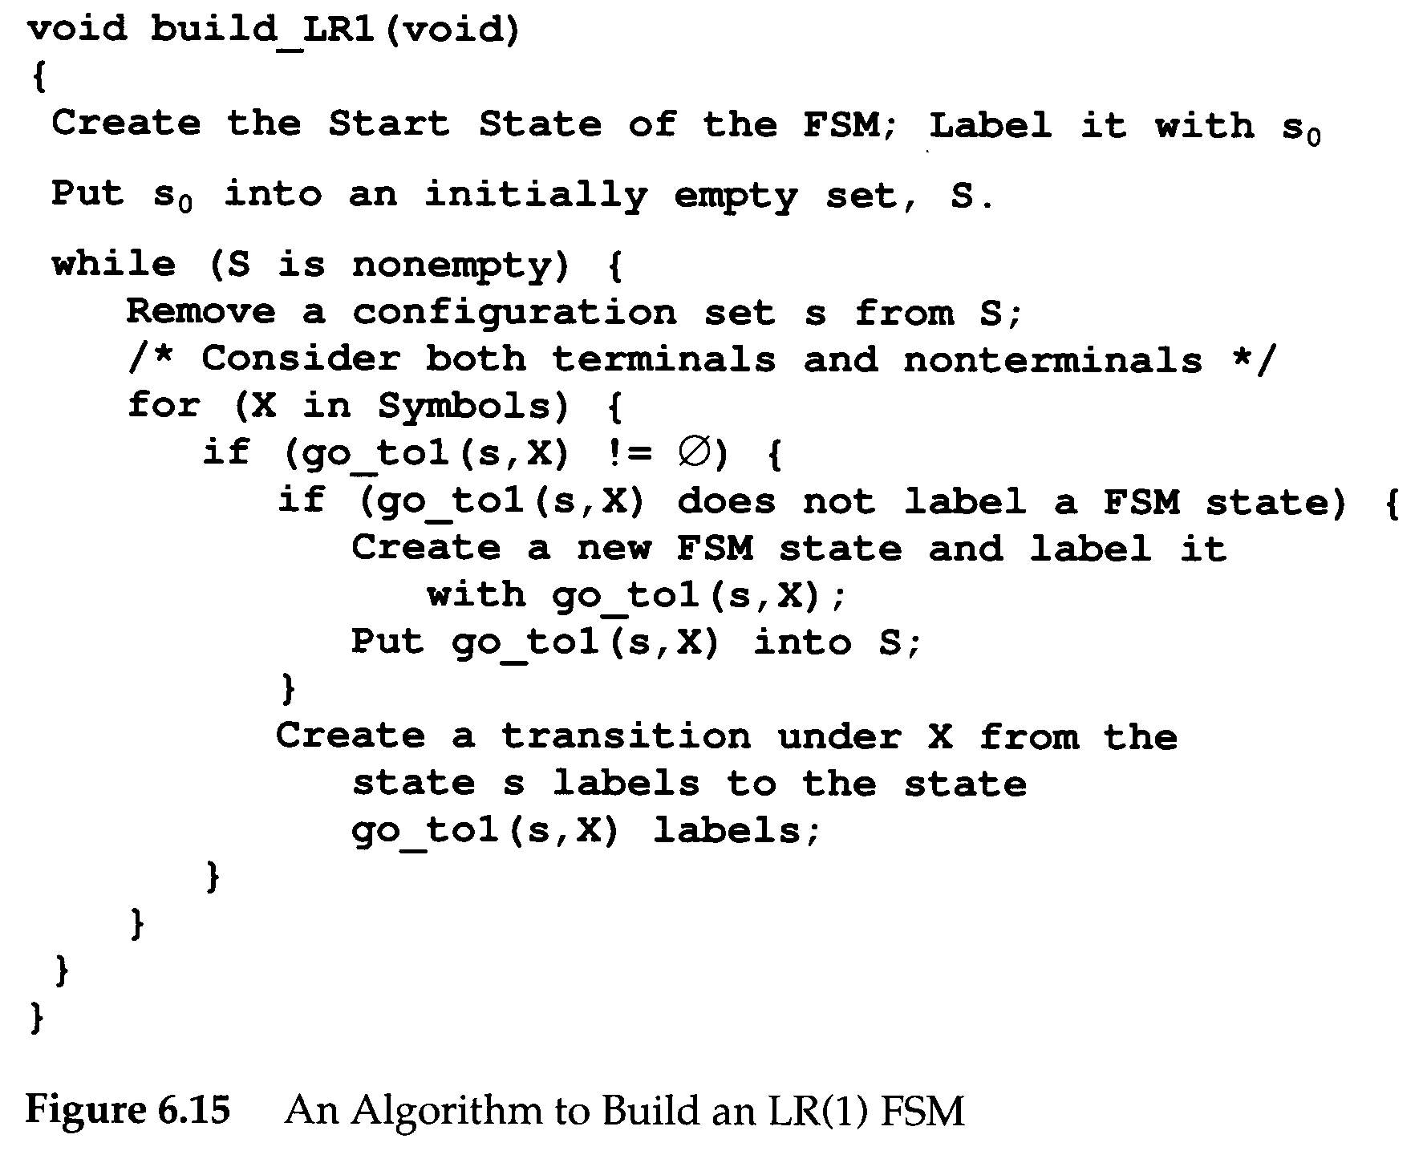
G₃
S→E$
E→E+T|T
T→T*P|P
P→ID|(E)

Slide 34
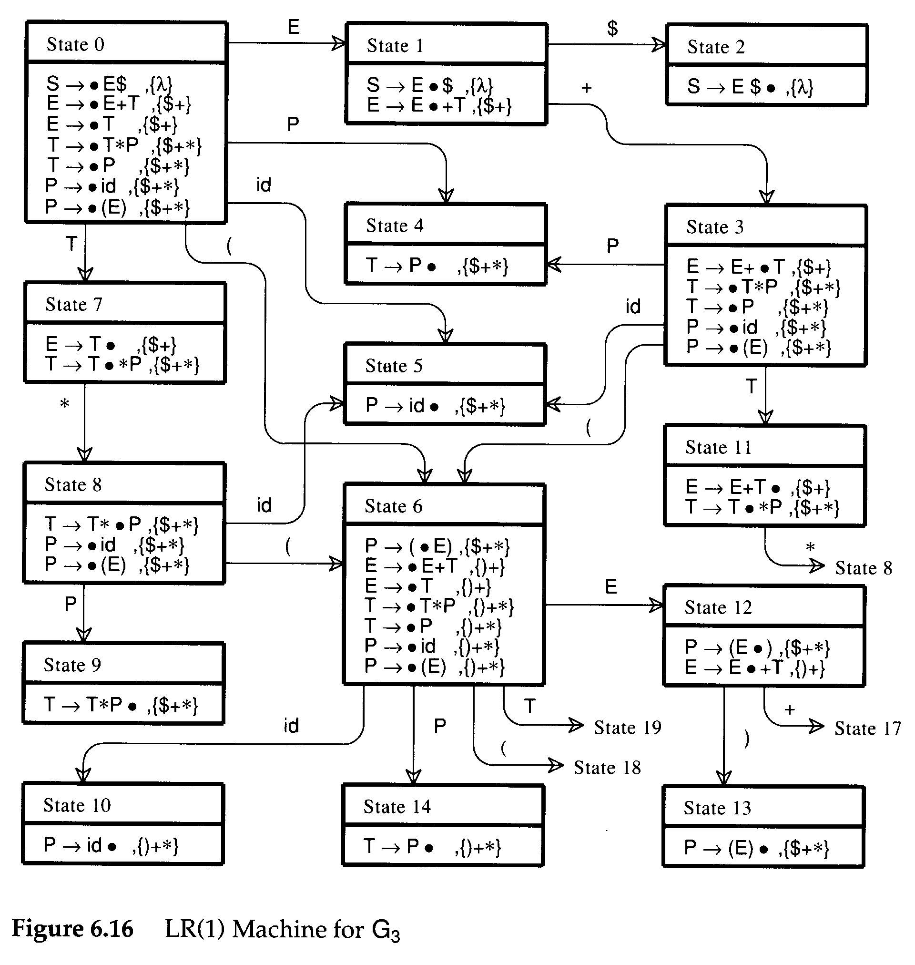
G₃
S→E$
E→E+T|T
T→T*P|P
P→ID|(E)

Slide 35
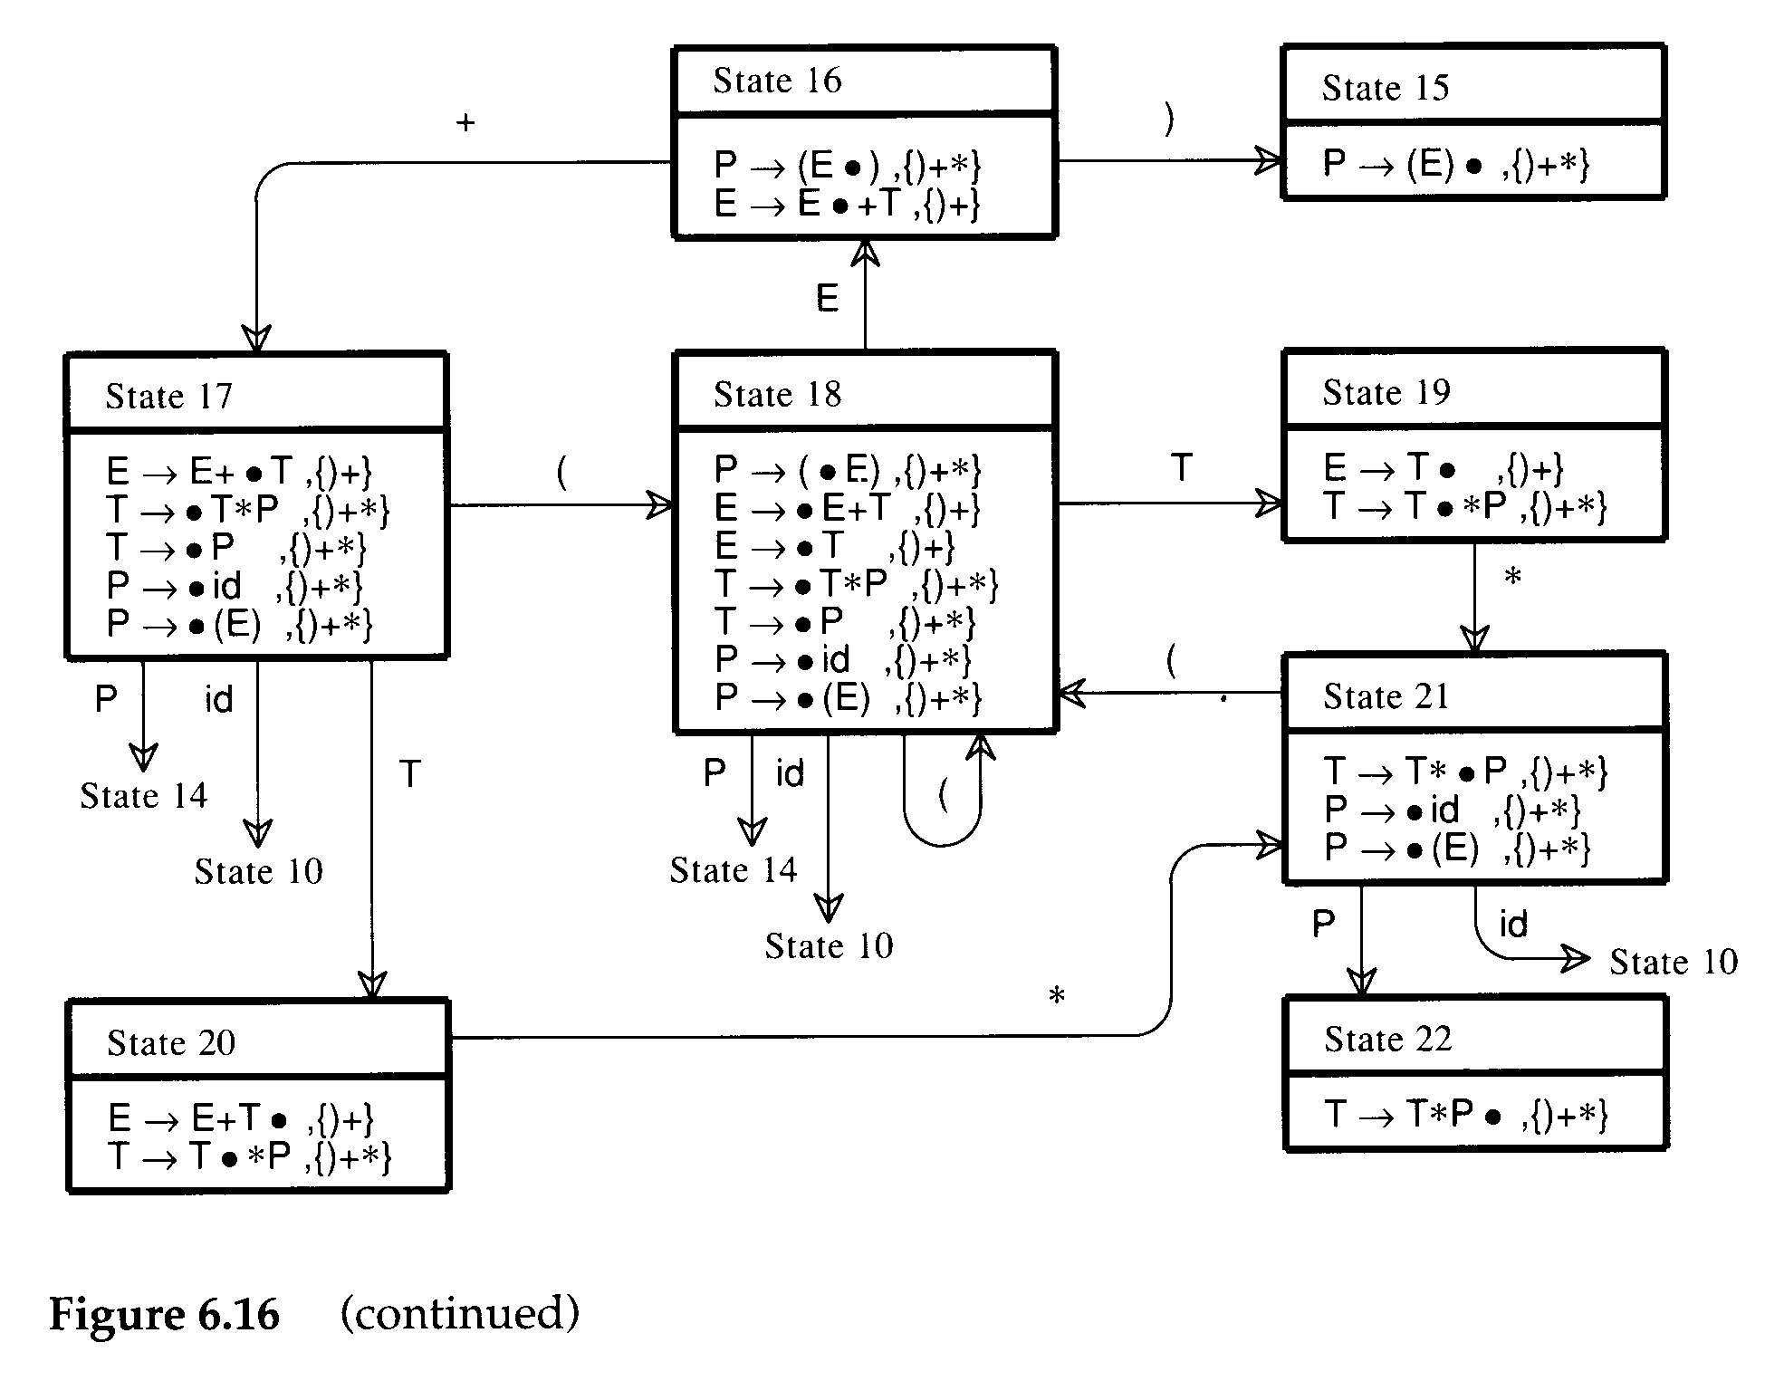

Slide 36
LR(1) Parsing
The go_to table used to drive an LR(1) is extracted directly from the LR(1) machine

Slide 37
LR(1) Parsing
Action table is extracted directly from the configuration sets of the LR(1) machine
A projection function, P
  P : S₁×V_{t}→2^{Q}
    S₁ be the set of LR(1) machine states
P(s,a)={Reduce_{i} | B→ρ •,a∈ s and production i is B→ρ } ∪ (if A→ α• aβ,b ∈ s Then {Shift} Else ∅)

Slide 38
LR(1) Parsing
G is LR(1) if and only if
  ∀s∈ S₁ ∀a∈ V_{t} |P(s,a)|≤1
If G is LR(1), the action table is trivially extracted from P
  P(s,$)={Shift} ⇒ action[s][$]=Accept
  P(s,a)={Shift}, a≠$ ⇒ action[s][a]=Shift
  P(s,a)={Reduce_{i}}, ⇒ action[s][a]=Reduce_{i}
  P(s,a)=∅ ⇒ action[s][a]=Error

Slide 39
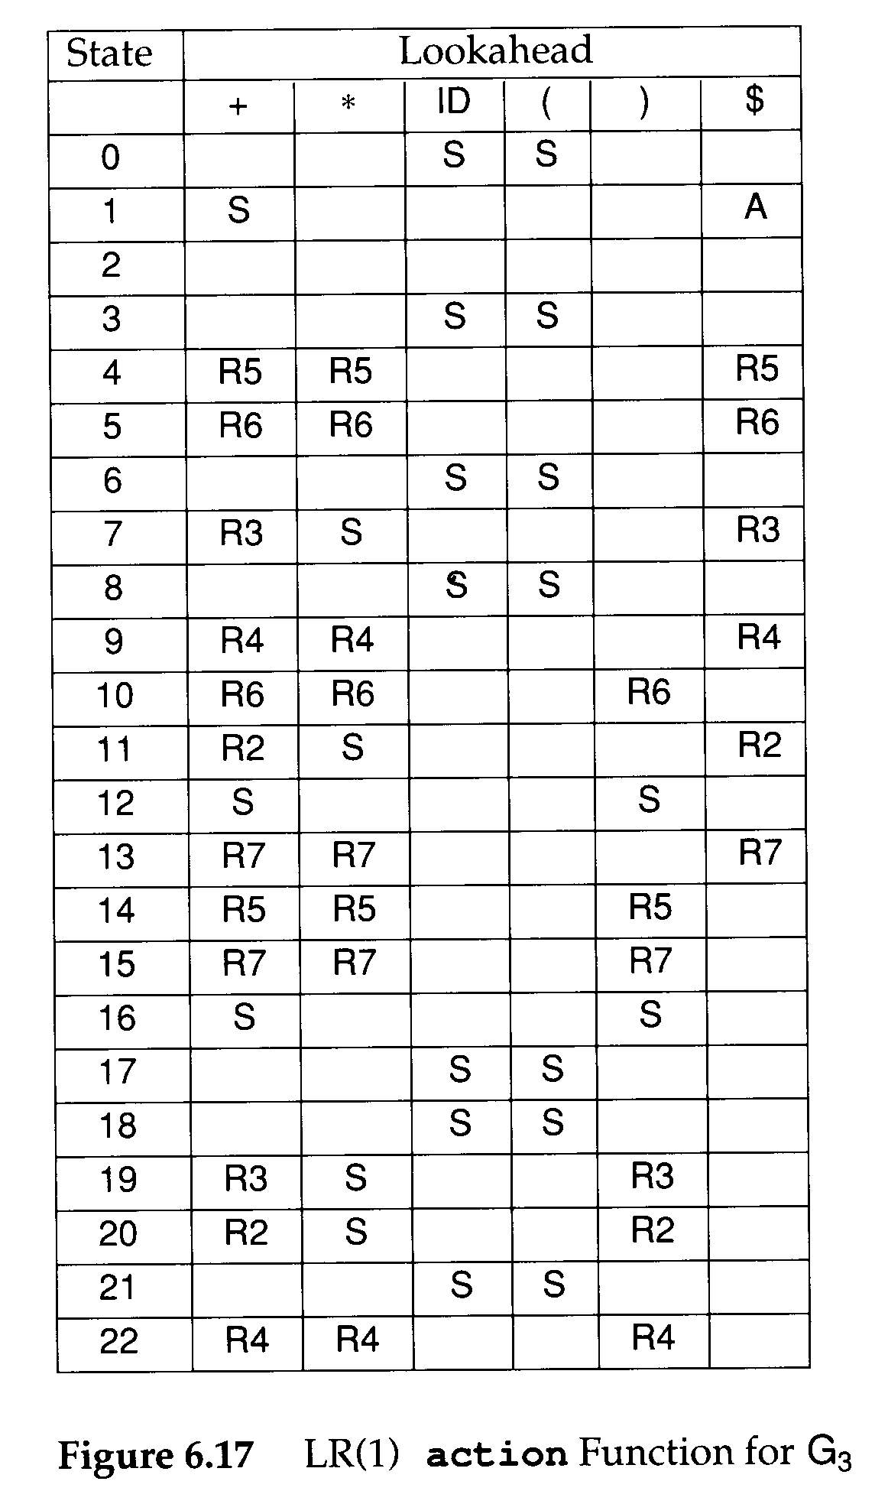

Slide 40
SLR(1) Parsing
LR(1) parsers are the most powerful clas of shift-reduce parsers, using a single lookahead
  LR(1) grammars exist for virtually all programming languages
  LR(1)’s problem is that the LR(1) machine contains so many states that the go_to and action tables become prohibitively large

Slide 41
SLR(1) Parsing
In reaction to the space inefficiency of LR(1) tables, computer scientists have devised parsing techniques that are almost as powerful as LR(1) but that require far smaller tables
  One is to start with the CFSM, and then add lookahead after the CFSM is build
    SLR(1)
  The other approach to reducing LR(1)’s space inefficiencies is to merger inessential LR(1) states
    LALR(1)

Slide 42
SLR(1) Parsing
SLR(1) stands for Simple LR(1)
  One-symbol loookahead
  Lookaheads are not built directly into configurations but rather are added after the LR(0) configuration sets are built
  An SLR(1) parser will perform a reduce action for configuration B→ ρ • if the lookahead symbol is in the set Follow(B)

Slide 43
SLR(1) Parsing
The SLR(1) projection function, from CFSM states,
  P : S₀×V_{t}→2^{Q}
  P(s,a)={Reduce_{i} | B→ρ •,a∈ Follow(B) and production i is B→ρ } ∪ (if A→ α• aβ ∈ s for a∈ V_{t} Then {Shift} Else ∅)

Slide 44
SLR(1) Parsing
G is SLR(1) if and only if
  ∀s∈ S₀ ∀a∈ V_{t} |P(s,a)|≤1
If G is SLR(1), the action table is trivially extracted from P
  P(s,$)={Shift} ⇒ action[s][$]=Accept
  P(s,a)={Shift}, a≠$ ⇒ action[s][a]=Shift
  P(s,a)={Reduce_{i}}, ⇒ action[s][a]=Reduce_{i}
  P(s,a)=∅ ⇒ action[s][a]=Error
Clearly SLR(1) is a proper superset of LR(0)

Slide 45
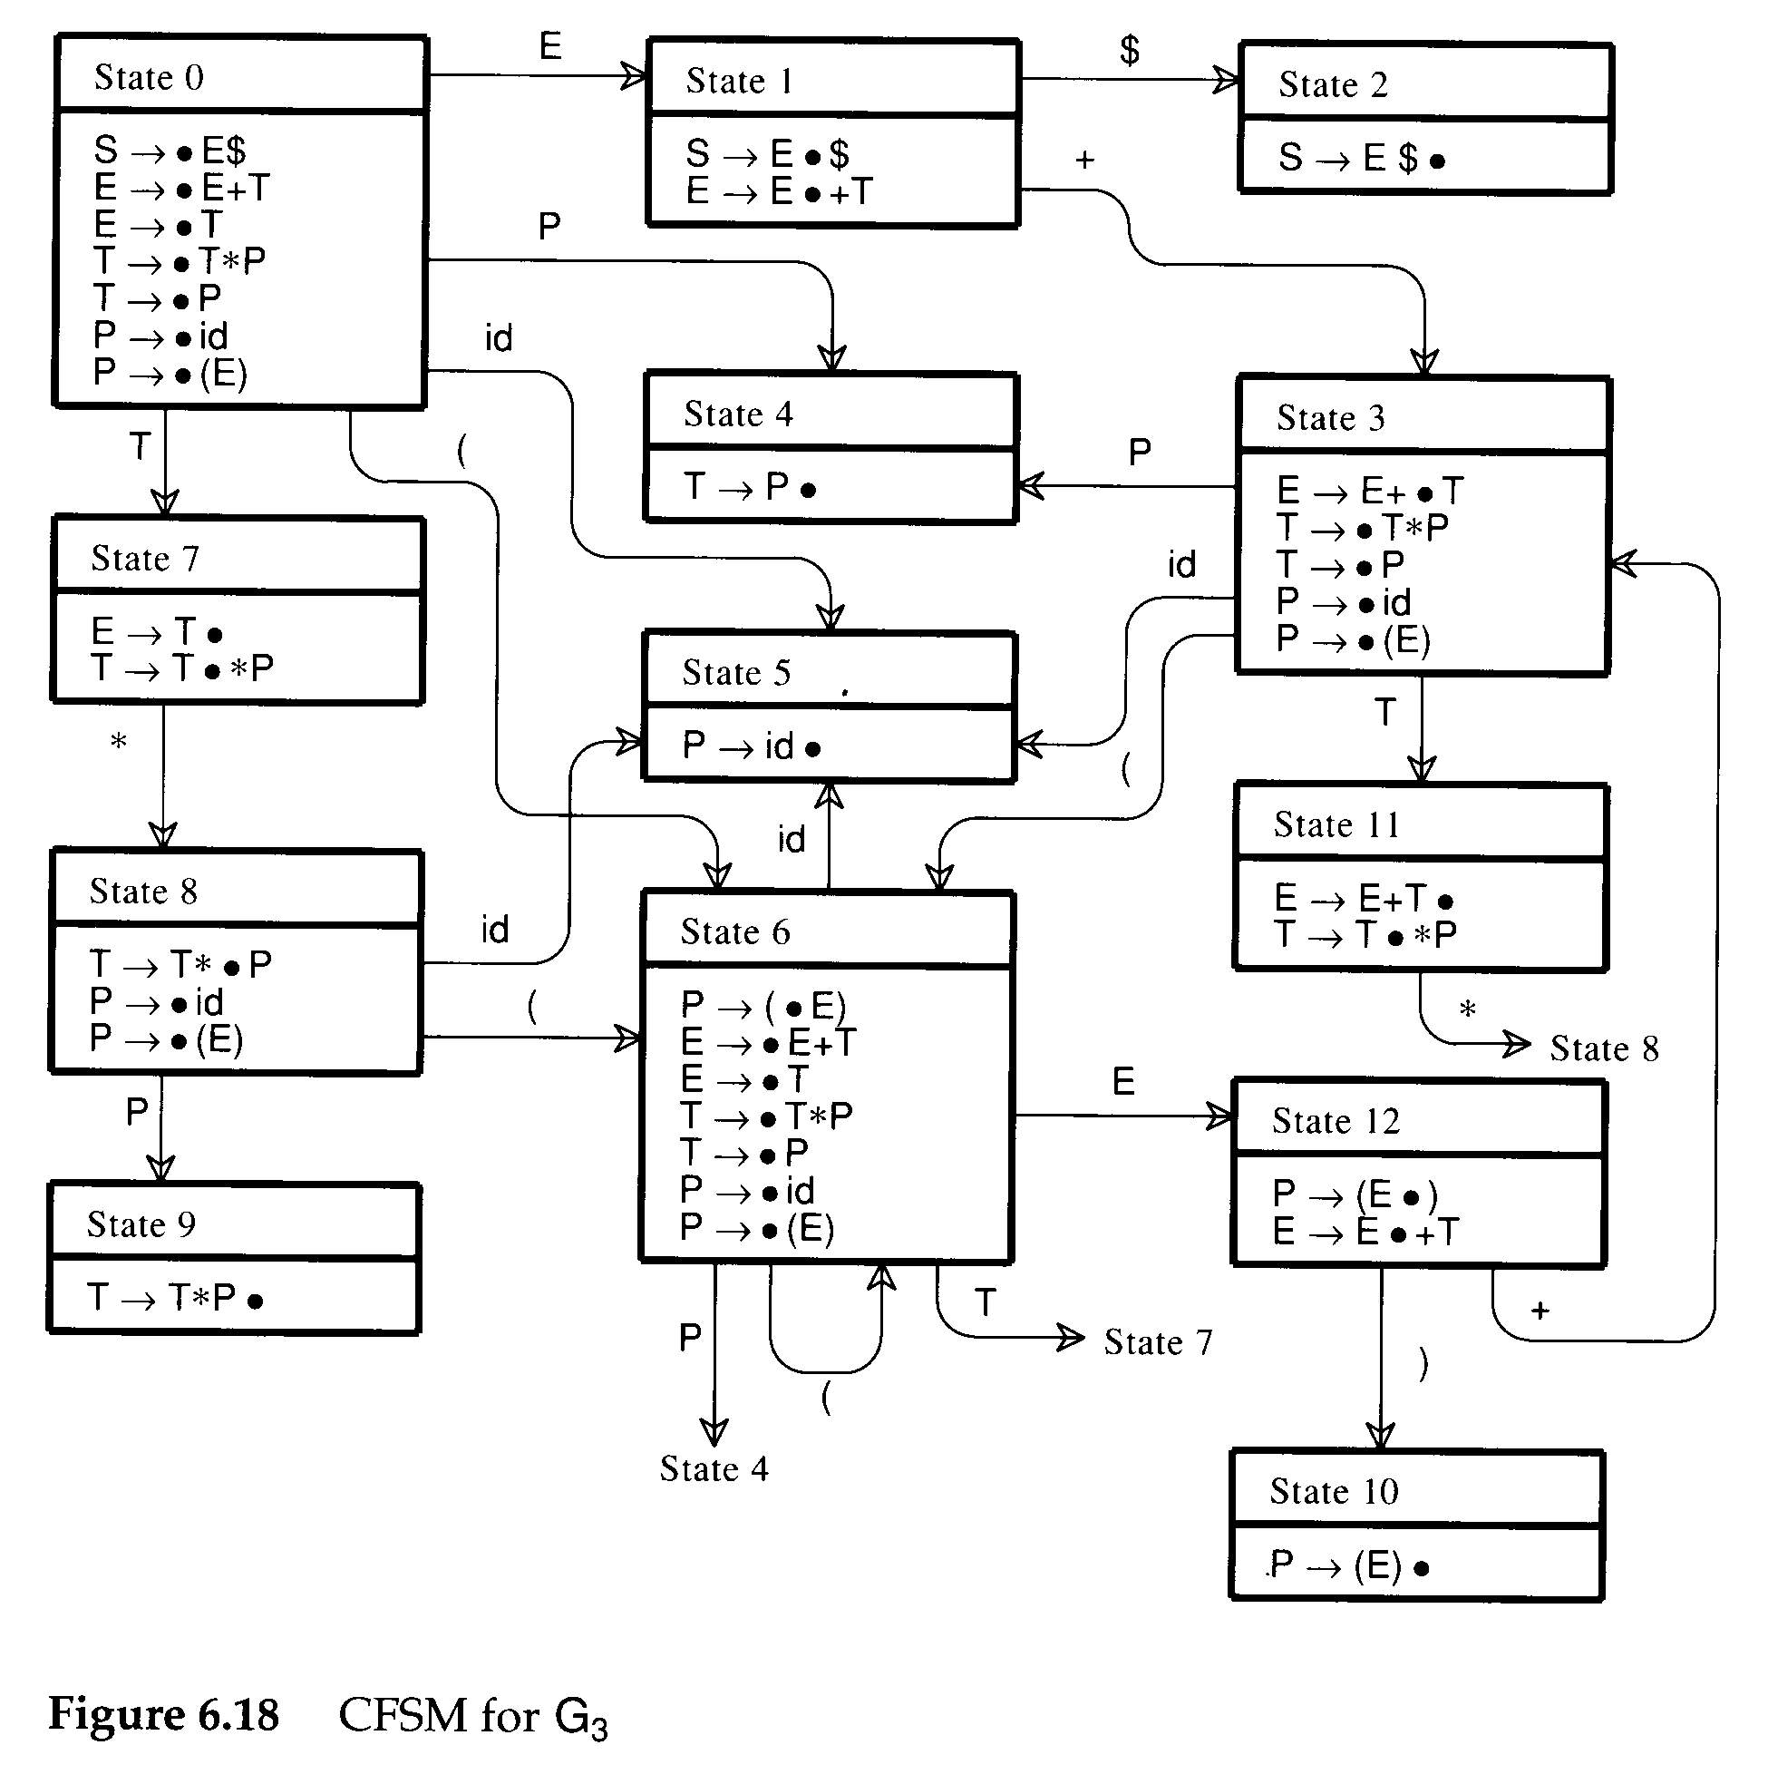
SLR(1) Parsing
Consider G₃
  It is LR(1) but not LR(0)
  See states 7,11
  Follow(E)={$,+,)}
S→E$
E→E+T|T
T→T*P|P
P→ID|(E)

Slide 46
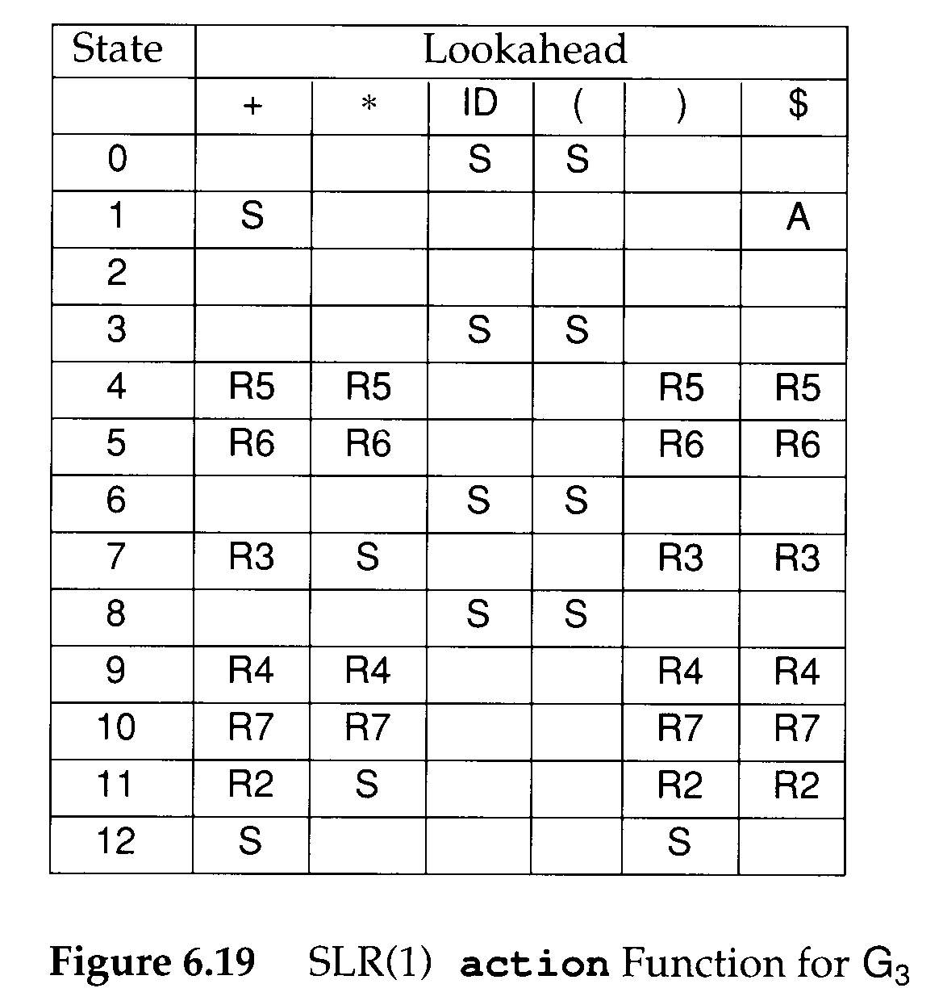
S→E$
E→E+T|T
T→T*P|P
P→ID|(E)

Slide 47
Limitations of the SLR(1) Technique
The use of Follow sets to estimate the lookaheads that predict reduce actions is less precise than using the exact lookaheads incorporated into LR(1) configurations
  Consider G₄
Elem→(List, Elem)
Elem→Scalar
List→List,Elem
List →Elem
Scalar →ID
Scalar→(Scalar)
Fellow(Elem)={“)”,”,”,….}

Slide 48
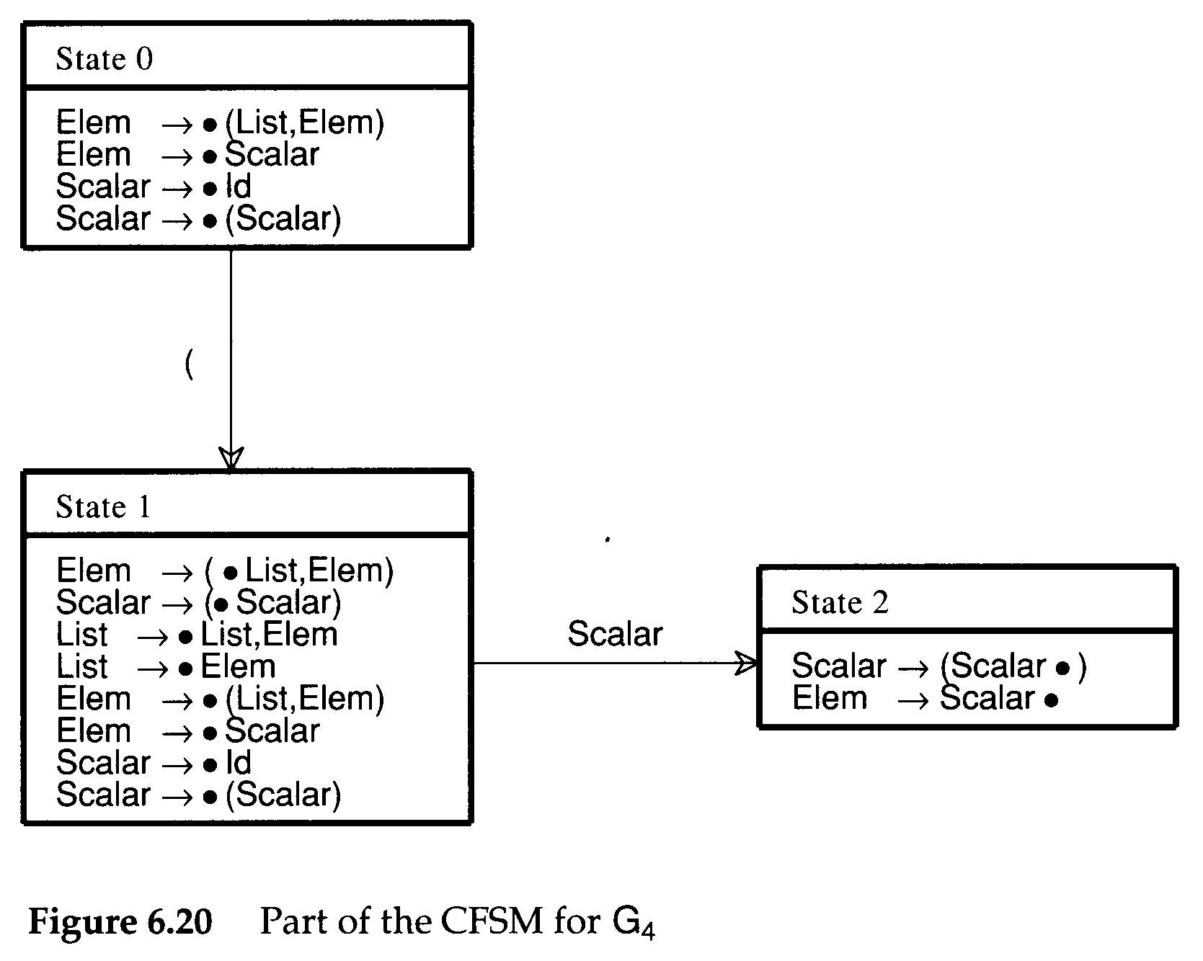
LR(1) lookahead for
Elem→Scalar • is “,”
Fellow(Elem)={“)”,”,”,….}

Slide 49
LALR(1)
LALR(1) parsers can be built by first constructing an LR(1) parser and then merging states
  An LALR(1) parser is an LR(1) parser in which all states that differ only in the lookahead components of the configurations are merged
  LALR is an acronym for Look Ahead LR

Slide 50

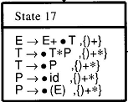
The core of a configuration
The core of the above two configurations is the same
E→E+•T
T → •T*P
T→ •P
P→ •id
P→ •(E)

Slide 51
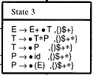
States Merge
E→E+•T
T → •T*P
T→ •P
P→ •id
P→ •(E)
Cognate(s′)={c|c∈s, core(s)=s′}
s′

Slide 52
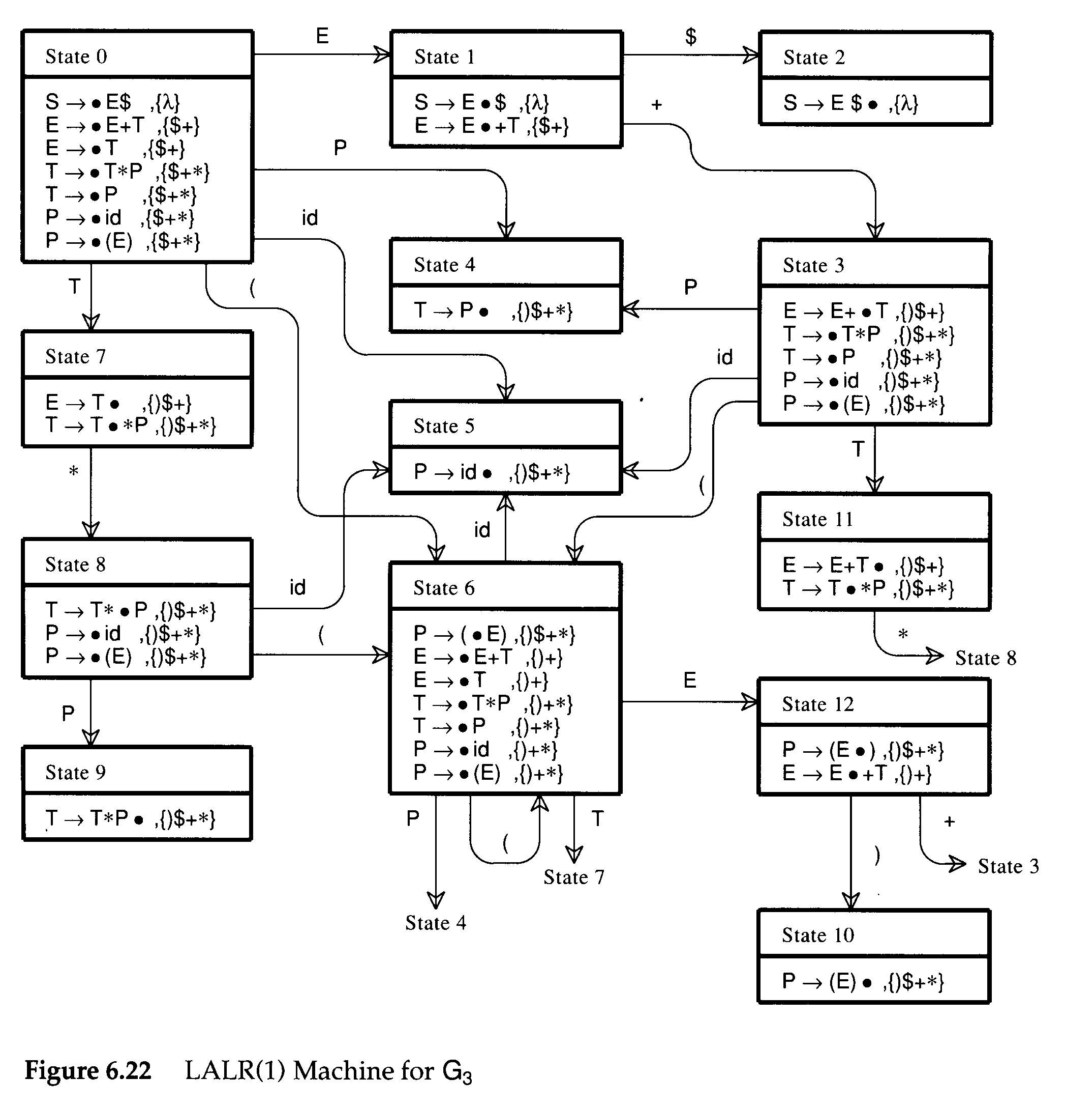
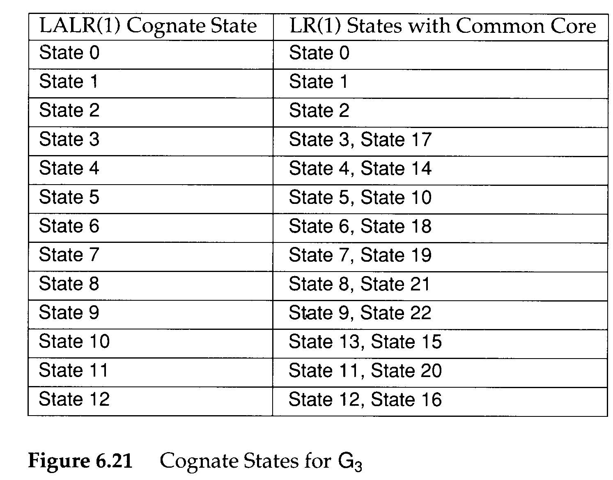
LALR(1)
LALR(1) machine

Slide 53
LALR(1)
The CFSM state is transformed into its LALR(1) Cognate
  P : S₀×V_{t}→2^{Q}
  P(s,a)={Reduce_{i} | B→ρ •,a∈ Cognate(s) and production i is B→ρ } ∪ (if A→ α• aβ ∈ s Then {Shift} Else ∅)

Slide 54
LALR(1) Parsing
G is LALR(1) if and only if
  ∀s∈ S₀ ∀a∈ V_{t} |P(s,a)|≤1
If G is LALR(1), the action table is trivially extracted from P
  P(s,$)={Shift} ⇒ action[s][$]=Accept
  P(s,a)={Shift}, a≠$ ⇒ action[s][a]=Shift
  P(s,a)={Reduce_{i}}, ⇒ action[s][a]=Reduce_{i}
  P(s,a)=∅ ⇒ action[s][a]=Error

Slide 55
LALR(1) Parsing
Consider G₅
<stmt>→ID
<stmt>→<var>:=<expr>
<var> →ID
<var> →ID [expr>]
<expr>→<var>
Assume statemetns are separated by ;’s, the grammar is not SLR(1) because
  ; ∈ Follow(<stmt>) and
  ; ∈ Follow(<var>), since <expr>→<var>

Slide 56
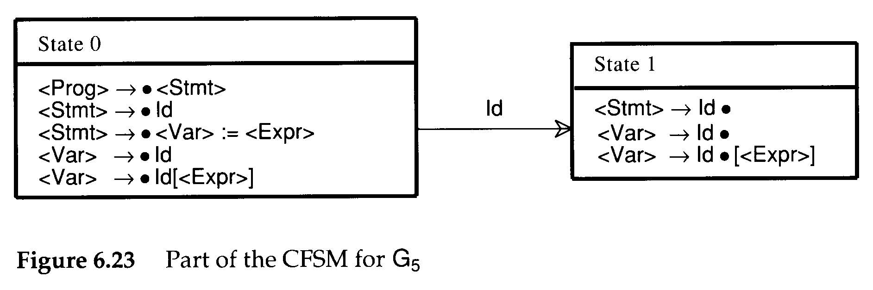
LALR(1) Parsing
However, in LALR(1), if we use <var> → ID the next symbol must be :=
  so action[ 1, := ] = reduce(<var> → ID)
  action[ 1, ; ] = reduce(<stmt> → ID)
  action[ 1,[ ] = shift
There is no conflict.

Slide 57
LALR(1) Parsing
A common technique to put an LALR(1) grammar into SLR(1) form is to introduce a new nonterminal whose global (I.e. SLR) lookaheads more nearly correspond to LALR’s exact look aheads
  Follow(<lhs>) = {:=}
<stmt>→ID
<stmt>→<var>:=<expr>
<var> →ID
<var> →ID [expr>]
<expr>→<var>
<stmt>→ID
<stmt>→<lhs>:=<expr>
<lhs> →ID
<lhs> →ID [expr>]
<var> →ID
<var> →ID [expr>]
<expr>→<var>

Slide 58
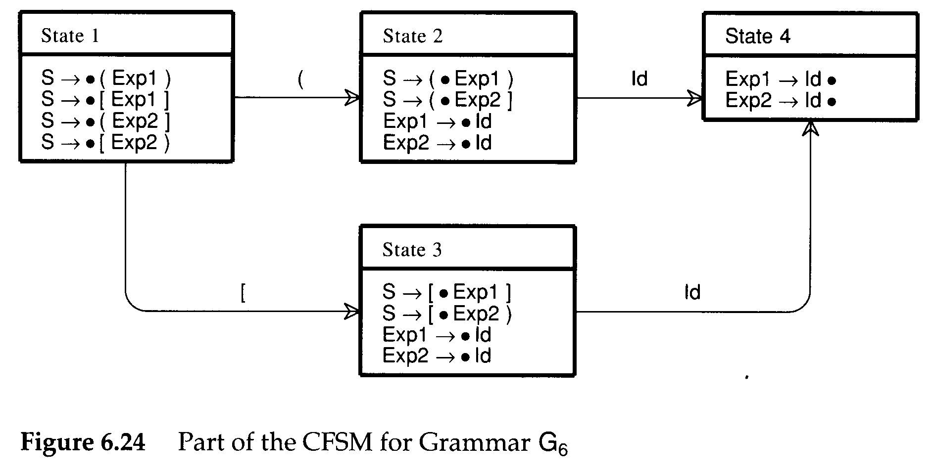
LALR(1) Parsing
At times, it is the CFSM itself that is at fault.
S→(Exp1)
S→[Exp1]
S→(Exp1]
S→[Exp1)
<Exp1>→ID
<Exp2>→ID
A different expression nonterminal is used to allow error or warning diagnostics

Slide 59
Building LALR(1) Parsers
In the definition of LALR(1)
  An LR(1) machine is first built, and then its states are merged to form an automaton identical in structure to the CFSM
    May be quite inefficient
  An alternative is to build the CFSM first.
    Then LALR(1) lookaheads are “propagated” from configuration to configuration

Slide 60
Building LALR(1) Parsers
Propagate links:
  Case 1: one configuration is created from another in a previous state via a shift operation
A→ α•Xγ , L₁
A→ αX• γ , L₂

Slide 61
Building LALR(1) Parsers
Propagate links:
  Case 2: one configuration is created as the result of a closure or prediction operation on another configuration
B→ β•Aγ , L₁
A→ •α , L₂
L₂={ x|x∈First(γt) and t ∈L₁ }

Slide 62
Building LALR(1) Parsers
Step 1: After the CFSM is built, we can create all the necessary propagate links to transmit lookaheads from one configuration to another
Step 2: spontaneous lookaheads are determined
  By including in L₂, for configuration A→•α,L₂, all spontaneous lookaheads induced by configurations of the form B → β • Aγ,L₁
    These are simply the non-λ values of First(γ)
Step 3: Then, propagate lookaheads via the propagate links
  See figure 6.25

Slide 63
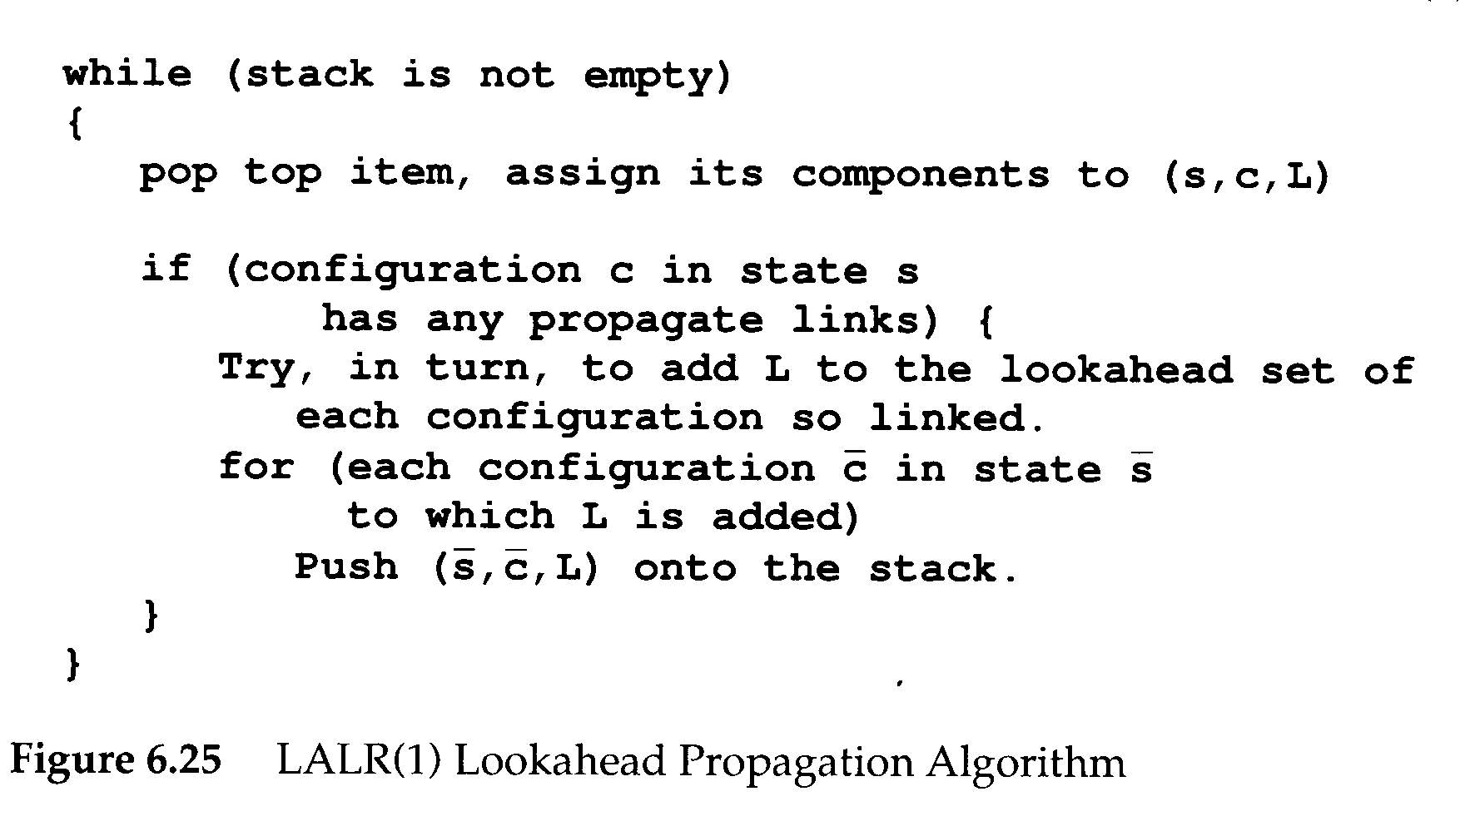
Building LALR(1) Parsers

Slide 64
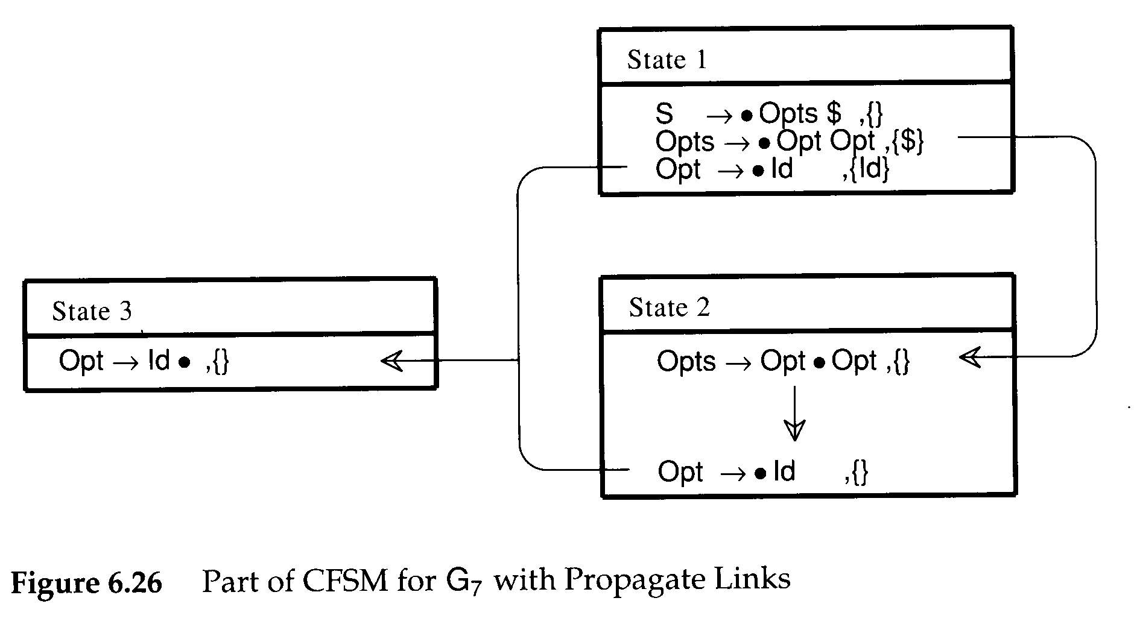
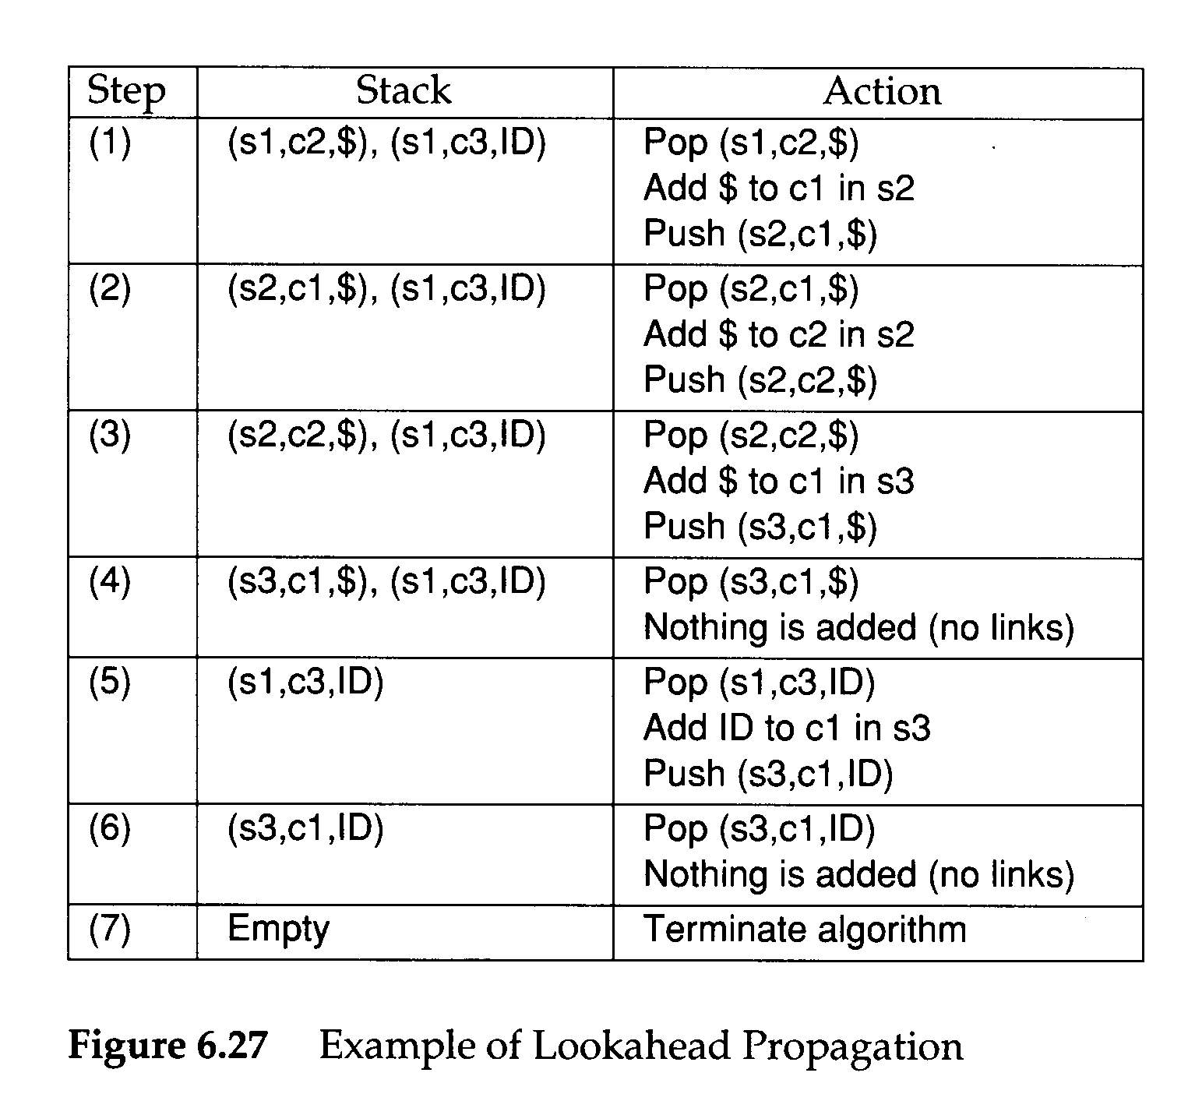

Slide 65
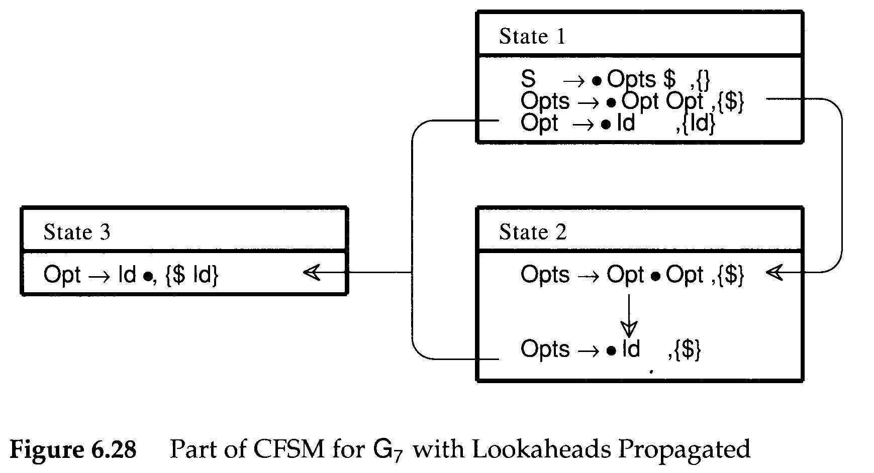

Slide 66
Building LALR(1) Parsers
A number of LALR(1) parser generators use lookahead propagation to compute the parser action table
  LALRGen uses the propagation algorithm
  YACC examines each state repeatedly
An intriguing alternative to propagating LALR lookaheads is to compute them as needed by doing a backward search through the CFSM
  Read it yourself. P. 176, Para. 3

Slide 67
Calling Semantic Routines in Shift-Reduce Parsers
Shift-reduce parsers can normally handle larger classes of grammars than LL(1) parsers, which is a major reason for their popularity
Shift-reduce parsers are not predictive, so we cannot always be sure what production is being recognized until its entire right-hand side has been matched
  The semantic routines can be invoked only after a production is recognized and reduced
    Action symbols only at the extreme right end of a right-hand side

Slide 68
Calling Semantic Routines in Shift-Reduce Parsers
Two common tricks are known that allow more flexible placement of semantic routine calls
For example,
  <stmt>→if <expr> then <stmts> else <stmts> end if
We need to call semantic routines after the conditional expression else and end if are matched
  Solution: create new nonterminals that generate λ
  <stmt>→if <expr> <test cond>
  then <stmts> <process then part>
  else <stmts> end if
  <test cond>→λ
  <process than part>→λ

Slide 69
Calling Semantic Routines in Shift-Reduce Parsers
If the right-hand sides differ in the semantic routines that are to be called, the parser will be unable to correctly determine which routines to invoke
  Ambiguity will manifest. For example,
  <stmt>→if <expr> <test cond1>
  then <stmts> <process then part>
  else <stmts> end if;
  <stmt>→if <expr> <test cond2>
  then <stmts> <process then part>
  else <stmts> end if;
  <test cond1>→λ
  <test cond2>→λ
  <process than part>→λ

Slide 70
Calling Semantic Routines in Shift-Reduce Parsers
An alternative to the use of λ–generating nonterminals is to break a production into a number of pieces, with the breaks placed where semantic routines are required
  <stmt>→<if head><then part><else part>
  <if head>→if <expr>
  <then part>→then <stmts>
  <else part>→then <stmts> end if;
  This approach can make productions harder to read but has the advantage that no λ–generating are needed

