Slide 1

Chapter 4
Formal Grammars and Parsing
Context-Free Grammars:
Concepts and Notation
Properties of CFG
Parsers and Recognizers
Grammar Analysis Algorithms
Department of Computer Science
1

Slide 2
Introduction
Why using CFG
  CFG gives a precise syntactic specification of a programming language.
  Enabling automatic translator generator
  Language extension becomes easier
The role of the parser
  Taking tokens from scanner, parsing, reporting syntax errors
  Not just parsing, in a syntax-directed translator, the parser also conducts type checking, semantic analysis and IR generation.
Department of Computer Science

Slide 3
Example of CFG
A C– program is made out of functions, a function out of declarations and blocks, a block out of statements, a statement out of expressions, … etc
<program> → <global_decl_list>
<global_decl_list> → <global_decl_list><global_decl> | λ
<global_decl> → <decl_list> <function_decl>
<function_decl> → <type> id ( <param_list> ) { <block> }
<block> → <decl_list> <statement_list> | λ
<decl_list> → <decl_list> <decl> | <decl> | λ
<decl> → <type_decl> | <var_decl>
<type> → void | int | float
<statement_list> → ….
<statement> → { <block> }
pay attention to
Repetitions and Recursions !!
Department of Computer Science

Slide 4
Example of Statements
Selection statements
if ( <expression> ) <statement>
if ( <expression> ) <statement> else <statement>
Iteration statements
while ( <expression> ) <statement>
for ( <expression>; <expression>; <expression>) <statement>
Other C statements
do <statement> while ( <expression> ) ;
switch ( <expression> ) <statement>
labeled statements, jump statement, … etc.
Department of Computer Science

Slide 5

A context-free grammar G = (Vt, Vn, S, P)
  Vt: A finite terminal vocabulary
    The token set produced by scanner
  Vn: A finite set of nonterminal vocabulary
    Intermediate symbols
  S: A start symbol, S ∈Vn that starts all derivations
      Also called goal symbol
  P: a finite set of productions (rewriting rules) of the form A→ X1X2 … Xm
    A∈Vn, Xi ∈ Vn∪Vt, 1≤i ≤m
    A →λ is a valid production
How is CFG different from RE/DFA ?
Department of Computer Science

Slide 6
Other notation
  Vocabulary V of G,
    V= Vn∪Vt
  L(G), the set of string s derivable from S
    Context-free language of grammar G
  Notational conventions
    a,b,c, … denote symbols in Vt
    A,B,C, … denote symbols in Vn
    (or some names enclosed in <>)
    U,V,W, … denote symbols in V
    α,β,γ,… denote strings in V*
    u,v,w, … denote strings in Vt*
Department of Computer Science

Slide 7

Derivation
  One step derivation
    If A→γ, then αAβ⇒ αγβ
  One or more steps derivation ⇒⁺
  Zero or more steps derivation ⇒∗
If S ⇒∗β, then β is said to be sentential form of the CFG
  SF(G) is the set of sentential forms of grammar G
The language L(G) generated by G is the set of terminal strings w such that S ⇒+ w. The string w is called a sentence of G.
L(G) = {w ∈V_{t}*|S⇒⁺ w}
04/01/2014
Department of Computer Science

Slide 8
Left-most derivation
  denoted by ⇒_{lm} , ⇒+ _{lm} , ⇒∗ _{lm}
example of leftmost derivation of b(c+c)
E→Prefix(E)
E→c Tail
Prefix→b
Prefix→λ
Tail→+Ε
Tail→ λ
E⇒ _{lm} Prefix(E)
⇒ _{lm} b(E)
⇒ _{lm} b(c Tail)
⇒ _{lm} b(c+E)
⇒ _{lm} b(c+c Tail)
⇒ _{lm} b(c+c)
G₀
Top-down parsing is to come up with a leftmost derivation.
Department of Computer Science

Slide 9
Right-most derivation
  denoted by ⇒_{rm} , ⇒+ _{rm} , ⇒∗ _{rm}
example of rightmost derivation of b(c+c)
E→Prefix(E)
E→c Tail
Prefix→b
Prefix→λ
Tail→+Ε
Tail→ λ
E⇒ _{rm} Prefix(E)
⇒ _{rm} Prefix(c Tail)
⇒ _{rm} Prefix(c+E)
⇒ _{rm} Prefix(c+c Tail)
⇒ _{rm} Prefix(c+c)
⇒ _{rm} b(c+c)
G₀
Bottom-up parsing is to discover a rightmost derivation, it reverses the derivation.
Department of Computer Science

Slide 10
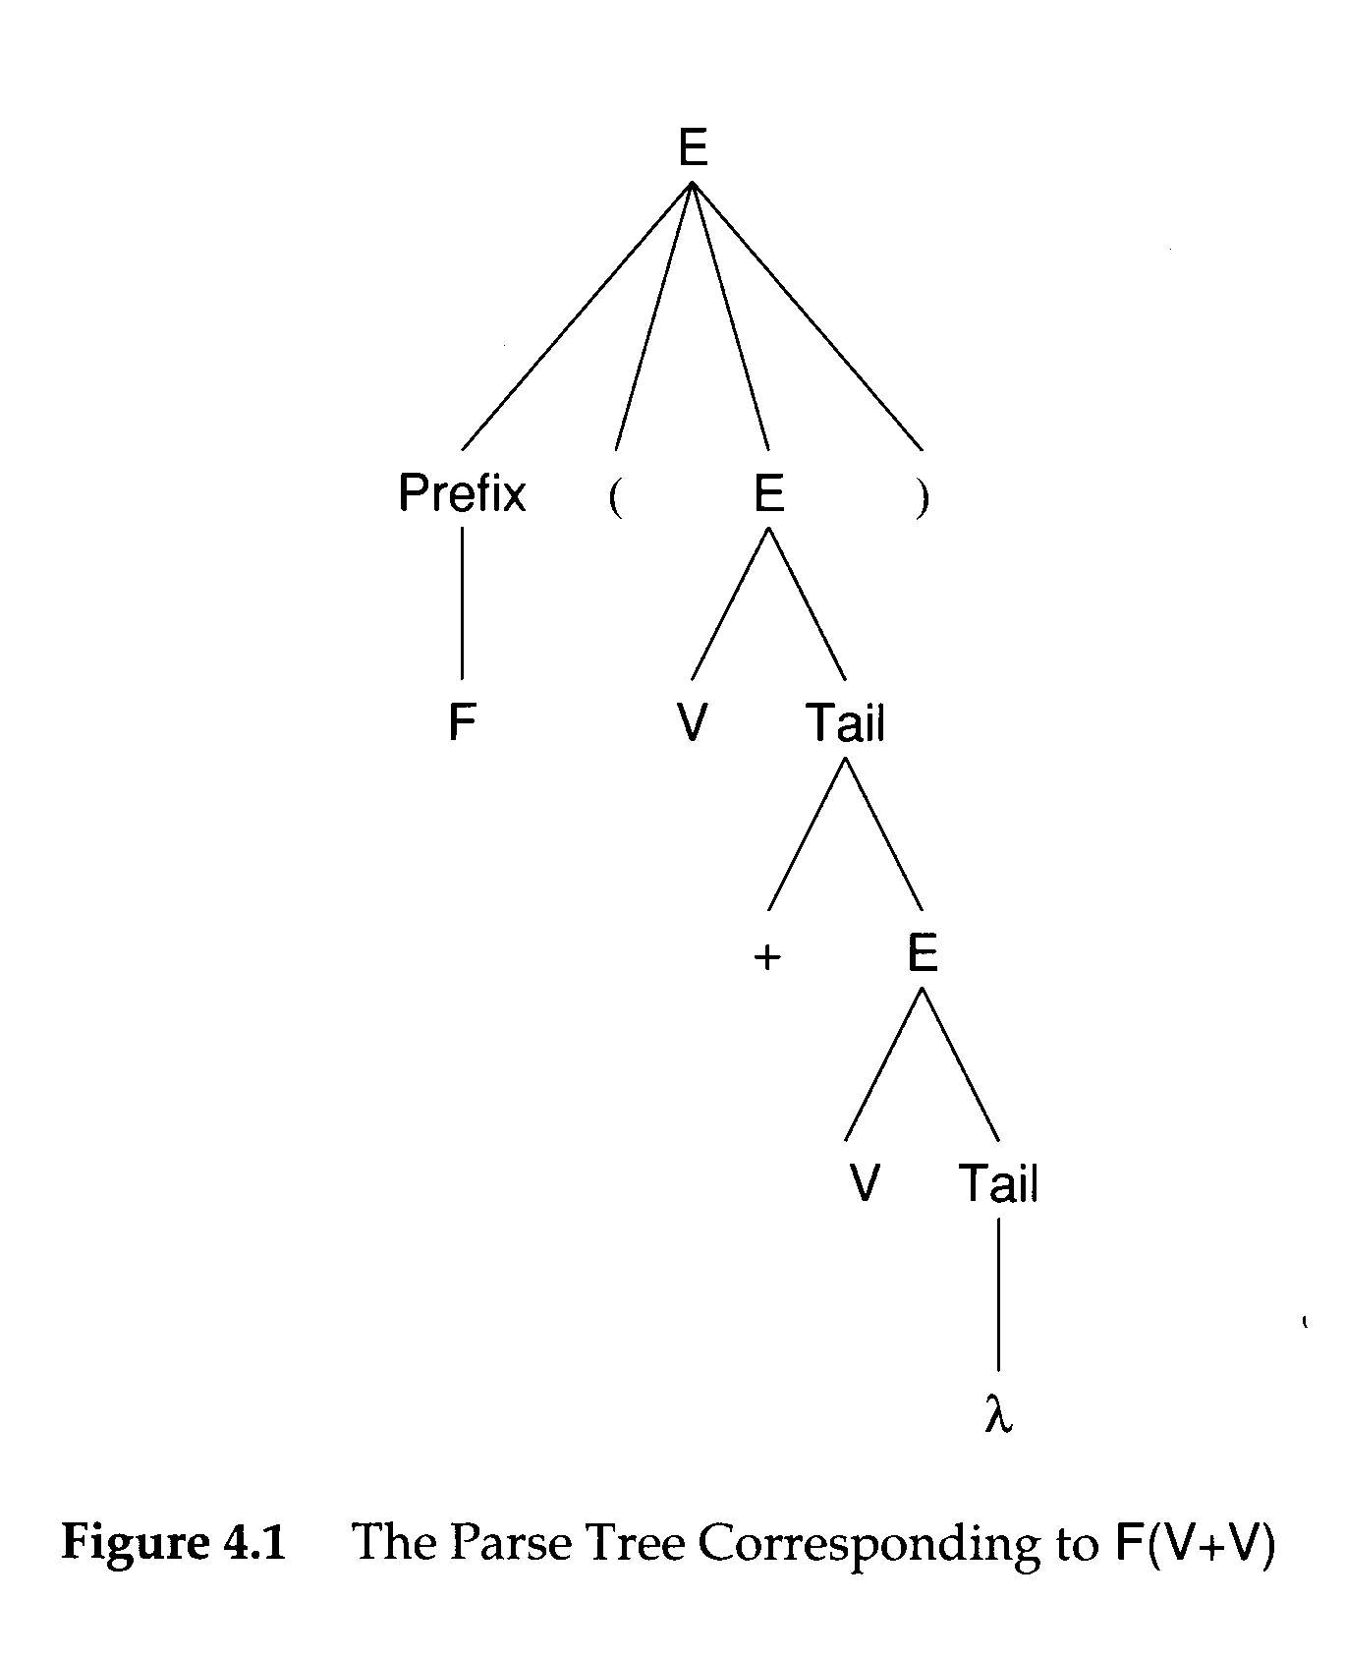
Parse Tree and Derivation
A Parse tree can be viewed as a graphical representation
for a derivation that ignore replacement order.
04/01/2014
Department of Computer Science

Slide 11
Phrase and Handle
A phrase of a sentential form is a sequence of symbols descended from a single nonterminal in the parse tree
  A simple or prime phrase is a phrase that contains no smaller phrase.
The handle of a sentential form is the left-most simple phrase
03/24/2008
Department of Computer Science

Slide 12
F ( E) is a sentential form.
F is a phrase, also a handle
V Tail is a simple phrase
+ E is a simple phrase
V+E is NOT a simple phrase
(+E is a smaller phrase)
A handle allows the parser to reduce it to a non-terminal
04/01/2014
Department of Computer Science

Slide 13
Example
abbabb
S
a sentence
aAbabB
A
B
a
a sentential
form
aAb
A
B
a
b
b
a handle
bB
a simple phrase
b
b
abb
a phrase of A
03/24/2008
Department of Computer Science

Slide 14
E→Prefix(E)
E→c Tail
Prefix→b
Prefix→λ
Tail→+Ε
Tail→ λ
E⇒ _{rm} Prefix(E)
⇒ _{rm} Prefix(c Tail)
⇒ _{rm} Prefix(c+E)
⇒ _{rm} Prefix(c+c Tail)
⇒ _{rm} Prefix(c+c)
⇒ _{rm} b(c+c)
G₀
E⇒ Prefix(E)
⇒ Prefix(c Tail)
⇒Prefix(c+E)
⇒ Prefix(c+c Tail )
⇒ Prefix(c+c)
⇒ b(c+c)
rightmost derivation
E ⇐ Prefix(E)
⇐ Prefix(c Tail)
⇐ Prefix(c+E)
⇐ Prefix(c+c Tail )
⇐ Prefix(c+c)
⇐ b(c+c)
bottom-up parsing
Department of Computer Science

Slide 15
E
E→Prefix(E)
E→c Tail
Prefix→b
Prefix→λ
Tail→+Ε
Tail→ λ
E⇒ _{rm} Prefix(E)
⇒ _{rm} Prefix(c Tail)
⇒ _{rm} Prefix(c+E)
⇒ _{rm} Prefix(c+c Tail)
⇒ _{rm} Prefix(c+c)
⇒ _{rm} b(c+c)
G₀
Prefix
(
E
)
b
c
Tail
+
E
c
Tail
Department of Computer Science
λ

Slide 16
E
E→Prefix(E)
E→c Tail
Prefix→b
Prefix→λ
Tail→+Ε
Tail→ λ
E⇒ _{rm} Prefix(E)
⇒ _{rm} Prefix(c Tail)
⇒ _{rm} Prefix(c+E)
⇒ _{rm} Prefix(c+c Tail)
⇒ _{rm} Prefix(c+c)
⇒ _{rm} b(c+c)
G₀
Prefix
(
E
)
b
c
Tail
+
E
b
c
Tail
Department of Computer Science
λ

Slide 17
E
E→Prefix(E)
E→c Tail
Prefix→b
Prefix→λ
Tail→+Ε
Tail→ λ
E⇒ _{rm} Prefix(E)
⇒ _{rm} Prefix(c Tail)
⇒ _{rm} Prefix(c+E)
⇒ _{rm} Prefix(c+c Tail)
⇒ _{rm} Prefix(c+c)
⇒ _{rm} b(c+c)
G₀
Prefix
(
E
)
b
c
Tail
+
E
b
c
Tail
Department of Computer Science
λ

Slide 18
E
E→Prefix(E)
E→c Tail
Prefix→b
Prefix→λ
Tail→+Ε
Tail→ λ
E⇒ _{rm} Prefix(E)
⇒ _{rm} Prefix(c Tail)
⇒ _{rm} Prefix(c+E)
⇒ _{rm} Prefix(c+c Tail)
⇒ _{rm} Prefix(c+c)
⇒ _{rm} b(c+c)
G₀
Prefix
(
E
)
b
c
Tail
+
E
prefix
(
c
+
c
c
Tail
Department of Computer Science
λ

Slide 19
E
E→Prefix(E)
E→c Tail
Prefix→b
Prefix→λ
Tail→+Ε
Tail→ λ
E⇒ _{rm} Prefix(E)
⇒ _{rm} Prefix(c Tail)
⇒ _{rm} Prefix(c+E)
⇒ _{rm} Prefix(c+c Tail)
⇒ _{rm} Prefix(c+c)
⇒ _{rm} b(c+c)
G₀
Prefix
(
E
)
b
c
Tail
+
E
prefix
(
c
+
c
Tail
c
Tail
Department of Computer Science
λ

Slide 20
E
E→Prefix(E)
E→c Tail
Prefix→b
Prefix→λ
Tail→+Ε
Tail→ λ
E⇒ _{rm} Prefix(E)
⇒ _{rm} Prefix(c Tail)
⇒ _{rm} Prefix(c+E)
⇒ _{rm} Prefix(c+c Tail)
⇒ _{rm} Prefix(c+c)
⇒ _{rm} b(c+c)
G₀
Prefix
(
E
)
b
c
Tail
+
E
prefix
(
c
+
c
Tail
c
Tail
Department of Computer Science
λ

Slide 21
E
E→Prefix(E)
E→c Tail
Prefix→b
Prefix→λ
Tail→+Ε
Tail→ λ
E⇒ _{rm} Prefix(E)
⇒ _{rm} Prefix(c Tail)
⇒ _{rm} Prefix(c+E)
⇒ _{rm} Prefix(c+c Tail)
⇒ _{rm} Prefix(c+c)
⇒ _{rm} b(c+c)
G₀
Prefix
(
E
)
b
c
Tail
+
E
prefix
(
c
+
c
Tail
c
Tail
Department of Computer Science
λ

Slide 22
E
E→Prefix(E)
E→c Tail
Prefix→b
Prefix→λ
Tail→+Ε
Tail→ λ
E⇒ _{rm} Prefix(E)
⇒ _{rm} Prefix(c Tail)
⇒ _{rm} Prefix(c+E)
⇒ _{rm} Prefix(c+c Tail)
⇒ _{rm} Prefix(c+c)
⇒ _{rm} b(c+c)
G₀
Prefix
(
E
)
b
c
Tail
+
E
prefix
(
c
+
E
c
Tail
Department of Computer Science
λ

Slide 23
E
E→Prefix(E)
E→c Tail
Prefix→b
Prefix→λ
Tail→+Ε
Tail→ λ
E⇒ _{rm} Prefix(E)
⇒ _{rm} Prefix(c Tail)
⇒ _{rm} Prefix(c+E)
⇒ _{rm} Prefix(c+c Tail)
⇒ _{rm} Prefix(c+c)
⇒ _{rm} b(c+c)
G₀
Prefix
(
E
)
b
c
Tail
+
E
prefix
(
c
+
E
c
Tail
Department of Computer Science
λ

Slide 24
E
E→Prefix(E)
E→c Tail
Prefix→b
Prefix→λ
Tail→+Ε
Tail→ λ
E⇒ _{rm} Prefix(E)
⇒ _{rm} Prefix(c Tail)
⇒ _{rm} Prefix(c+E)
⇒ _{rm} Prefix(c+c Tail)
⇒ _{rm} Prefix(c+c)
⇒ _{rm} b(c+c)
G₀
Prefix
(
E
)
b
c
Tail
+
E
prefix
(
c
c
Tail
Department of Computer Science
λ

Slide 25
E
E→Prefix(E)
E→c Tail
Prefix→b
Prefix→λ
Tail→+Ε
Tail→ λ
E⇒ _{rm} Prefix(E)
⇒ _{rm} Prefix(c Tail)
⇒ _{rm} Prefix(c+E)
⇒ _{rm} Prefix(c+c Tail)
⇒ _{rm} Prefix(c+c)
⇒ _{rm} b(c+c)
G₀
Prefix
(
E
)
b
c
Tail
+
E
prefix
(
c
Tail
c
Tail
Department of Computer Science
λ

Slide 26
E
E→Prefix(E)
E→c Tail
Prefix→b
Prefix→λ
Tail→+Ε
Tail→ λ
E⇒ _{rm} Prefix(E)
⇒ _{rm} Prefix(c Tail)
⇒ _{rm} Prefix(c+E)
⇒ _{rm} Prefix(c+c Tail)
⇒ _{rm} Prefix(c+c)
⇒ _{rm} b(c+c)
G₀
Prefix
(
E
)
b
c
Tail
+
E
prefix
(
c
Tail
c
Tail
Department of Computer Science
λ

Slide 27
E
E→Prefix(E)
E→c Tail
Prefix→b
Prefix→λ
Tail→+Ε
Tail→ λ
E⇒ _{rm} Prefix(E)
⇒ _{rm} Prefix(c Tail)
⇒ _{rm} Prefix(c+E)
⇒ _{rm} Prefix(c+c Tail)
⇒ _{rm} Prefix(c+c)
⇒ _{rm} b(c+c)
G₀
Prefix
(
E
)
b
c
Tail
+
E
prefix
(
E
)
c
Tail
Department of Computer Science
λ

Slide 28
E
E→Prefix(E)
E→c Tail
Prefix→b
Prefix→λ
Tail→+Ε
Tail→ λ
E⇒ _{rm} Prefix(E)
⇒ _{rm} Prefix(c Tail)
⇒ _{rm} Prefix(c+E)
⇒ _{rm} Prefix(c+c Tail)
⇒ _{rm} Prefix(c+c)
⇒ _{rm} b(c+c)
G₀
Prefix
(
E
)
b
c
Tail
+
E
E
c
Tail
Department of Computer Science
λ

Slide 29
Properties of CFG
Useless nonterminals
  S → A | B
  A → a
  B → Bb
  C → c
Reduced Grammar
  A grammar is reduced after all useless non-terminals are removed
Ambiguity
<derives no terminal string>
<unreachable>
Department of Computer Science

Slide 30

Ambiguity
A grammar is ambiguous if it produces more than one parse tree for some sentences
example 1: A+B+C ( is it (A+B)+C or A+(B+C) )
  Improper production: expr → expr + expr | id
example 2: A+B*C ( is it (A+B)*C or A+(B*C) )
  Improper production: expr → expr + expr | expr * expr
example 3: if E1 then if E2 then S1 else S2 (which then does the else match with)
  Improper production:
    stmt → if expr then stmt
    | if expr then stmt else stmt
Department of Computer Science

Slide 31
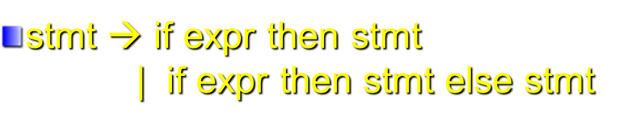
if E1 then if E2 then S1 else S2
Two parse trees of example 3
stmt
stmt
if
E1
then
stmt
if
E1
then
stmt
else
S2
if
E2
then
S1
else
S2
if
E2
then
S1
Department of Computer Science

Slide 32
Dangling Else Example
if ((k >=0) && (k < Table_SIZE))
if (table[k] >=0)
printf(“Entry %d is %d\n”, k, table[k]);
else printf(“Error: index %d out of range \n”), k);
In ANSI C, an else is always assumed to belong to the innermost if statement possible.
if ((k >=0) && (k < Table_SIZE)) {
if (table[k] >=0)
printf(“Entry %d is %d\n”, k, table[k]); }
else printf(“Error: index %d out of range \n”), k);
Department of Computer Science

Slide 33
Eliminating Ambiguity
Operator Associativity
  expr → expr + term | term
Operator Precedence
  expr → expr + term | term
  term → term * factor | factor
Dangling Else
  In YACC, shift is favored over reduction to enforce the dangling “else” to associate with the innermost if.
A+B+C
Department of Computer Science

Slide 34
Eliminating Ambiguity
Operator Associativity
  expr → expr + term | term
Operator Precedence
  expr → expr + term | term
  term → term * factor | factor
Dangling Else
  In YACC, shift is favored over reduction to enforce the dangling “else” to associate with the innermost if.
A+B+C
+
expr
C
Department of Computer Science

Slide 35
Eliminating Ambiguity
Operator Associativity
  expr → expr + term | term
Operator Precedence
  expr → expr + term | term
  term → term * factor | factor
Dangling Else
  In YACC, shift is favored over reduction to enforce the dangling “else” to associate with the innermost if.
A+B*C
+
expr
term
Department of Computer Science

Slide 36
Eliminating Ambiguity
Operator Associativity
  expr → expr + term | term
Operator Precedence
  expr → expr + term | term
  term → term * factor | factor
Dangling Else
  In YACC, shift is favored over reduction to enforce the dangling “else” to associate with the innermost if.
A+B*C
+
expr
*
term
factor
Department of Computer Science

Slide 37
Left Factoring
Consider the following grammar
A → αβ1 | αβ2
It is not easy to determine whether to expand
A to αβ1 or αβ2
A transformation called left factoring can be
applied. It becomes:
A → αA’
A’ → β1 | β2
03/24/2008
Department of Computer Science

Slide 38
Exercise
    stmt → if expr then stmt
    | if expr then stmt else stmt
    For the following grammar form:
    A → αβ1 | αβ2
    What is α? β1? β2?
: if expr then stmt
β1: λ
β2: else stmt
Department of Computer Science

Slide 39
Exercise
    stmt → if expr then stmt
    | if expr then stmt else stmt
    For the following grammar form:
    A → αβ1 | αβ2
    What is α? β1? β2?
: if expr then stmt
β1: λ
β2: else stmt
    stmt → if expr then stmt S’
    S’ → λ | else stmt
Department of Computer Science

Slide 40
Exercise
    stmt → if expr then stmt
    | if expr then stmt else stmt
    For the following grammar form:
    A → αβ1 | αβ2
    What is α? β1? β2?
: if expr then stmt
β1: λ
β2: else stmt
Just one example --
in this case, left factoring does not solve the problem
you may try the new grammar on the example stmt in slide 20
    stmt → if expr then stmt S’
    S’ → λ | else stmt
Department of Computer Science

Slide 41
Parsers and Recognizers
Recognizer
  An algorithm that does boolean-valued test
    “Is this input syntactically valid?”
Parser
  Answers more general questions
    Is this input valid?
    And, if it is, what is its structure (parse tree)?
Two general approaches to parsing
  Top-down and Bottom-up
Department of Computer Science

Slide 42
Naming of parsing techniques
The way to parse
token sequence
(e.g. from Left to R)
Number of
Lookahead
tokens
L: Leftmost
R: Righmost
Top-down
  LL(1)
Bottom-up
  LR(1)
Department of Computer Science

Slide 43
CFG
Input
program
E→Prefix(E)
E→c Tail
Prefix→b
Prefix→λ
Tail→+Ε
Tail→ λ
G₀
b (c + c)
Is the input program valid for the given CFG?

Slide 44
E
E→Prefix(E)
E→c Tail
Prefix→b
Prefix→λ
Tail→+Ε
Tail→ λ
b (c + c)
G₀
Prefix
(
E
)
b
c
Tail
+
E
c
Tail
Department of Computer Science
λ

Slide 45
E
E→Prefix(E)
E→c Tail
Prefix→b
Prefix→λ
Tail→+Ε
Tail→ λ
b (c + c)
G₀
Prefix
(
E
)
b
c
Tail
+
E
Top-Down Parsing:
Leftmost Derivation
c
Tail
Department of Computer Science
λ

Slide 46
E
E→Prefix(E)
E→c Tail
Prefix→b
Prefix→λ
Tail→+Ε
Tail→ λ
b (c + c)
G₀
Prefix
(
E
)
b
c
Tail
+
E
Bottom-Up Parsing:
Leftmost Derivation
c
Tail
Department of Computer Science
λ

Slide 47
Grammar Analysis Algorithms
Goal of this section:
  Discuss a number of important analysis algorithms for Grammars
What non-terminals can derive λ (called nullable symbols)?
  A ⇒ BCD ⇒ BC ⇒ B ⇒ λ
  An iterative marking algorithm
    Marking non-terminals that derive λ in one step, then marking non-terminals requires a parse tree of height 2, continue with increasing heights until no change.
Department of Computer Science

Slide 48
What non-terminals can derive λ?
count
Worklist:
B,D
count
Worklist:
C
A → BCD
B → BX
B → λ
C → EFG
C → BDD
D → E
D → λ
3
1
2
1
0
3
3
3
0
1
1
0
Department of Computer Science

Slide 49
What non-terminals can derive λ?
count
Worklist:
C
count
Worklist:
A
A → BCD
B → BX
B → λ
C → EFG
C → BDD
D → E
D → λ
1
0
1
1
3
3
0
1
1
Department of Computer Science

Slide 50
Definition of Follow and FIRST
Follow(A)
  Follow(A) is the set of terminals that may follow A in some sentential form. It provides the lookaheads that might signal the recognition of a production with A as the left hand side
  Follow(A)={a∈Vt|S⇒* … Aa … }
First(α)
  The set of all the terminal symbols that can begin a sentential form derivable from α
  If α is the right-hand side of a production, then First(α) contains terminal symbols that begin strings derivable from α
  First(α)={a∈Vt| α ⇒* aβ} ∪ {if α ⇒* λ then {λ} else ∅}
Department of Computer Science

Slide 51
Definition of Follow and FIRST
Follow(A)
  Follow(A) is the set of terminals that may follow A in some sentential form. It provides the lookaheads that might signal the recognition of a production with A as the left hand side
  Follow(A)={a∈Vt|S⇒* … Aa … }
First(α)
  The set of all the terminal symbols that can begin a sentential form derivable from α
  If α is the right-hand side of a production, then First(α) contains terminal symbols that begin strings derivable from α
  First(α)={a∈Vt| α ⇒* aβ} ∪ {if α ⇒* λ then {λ} else ∅}
Example:
A → b X → WAa
B → b Y → WBc
………….ba………
Should b be reduced to A or B?
Department of Computer Science

Slide 52
Computing Follow and FIRST
FIRST(Z)
  If Z is a terminal, then FIRST(Z) = {Z}
  If Z is a non-terminal, and Z→ Y1Y2…Yk for some k >=1, then place a in FIRST(Z) if for some i, a is in FIRST(Yi), and λ is in all of FIRST(Y1),… FIRST(Yi-1).
  If Z→ λ is a production, then add λ to FIRST(Z)
FOLLOW(A)
  Place $ in FOLLOW(S)
  If there is a production B → αAβ , then everything in FIRST(β) except λ, is in FOLLOW(A)
  If there is a production B → αA, or a production B → αAβ, where FIRST(β) contains λ, then everything in FOLLOW(B) is in FOLLOW(A).
When computing First(A) be careful of left recursion !
or any indirect recursion caused cycles !
Department of Computer Science

Slide 53
Example 1
S → aSe
S → B
B → bBe
B → C
C → cCe
C → d
First (S) = { ? }
First (B) = { ? }
First (C) = { ? }
Follow (S) = {? }
Follow (B) = {? }
Follow (C) = {? }
Department of Computer Science

Slide 54
Example 1
S → aSe
S → B
B → bBe
B → C
C → cCe
C → d
First (S) = {a,b,c,d}
First (B) = {b,c,d}
First (C) = {c,d}
Follow (S) = {e, $}
Follow (B) = {e, $}
Follow (C) = {e, $}
Department of Computer Science

Slide 55
Example 2
First (S) = { ? }
First (A) = { ? }
First (B) = { ? }
S → ABc
A → a
A → λ
B → b
B → λ
Follow (S) = { ? }
Follow (A) = { ? }
Follow (B) = { ? }
Department of Computer Science

Slide 56
Example 2
First (S) = {a,b,c}
First (A) = {a, λ}
First (B) = {b, λ}
S → ABc
A → a
A → λ
B → b
B → λ
Follow (S) = {$}
Follow (A) = {b,c}
Follow (B) = {c}
Department of Computer Science

