Slide 1
Chapter 9
Semantic Analysis
Department of Computer Science

Slide 2

Outlines of Chapter 9
Semantic analysis for control structures
  Reachability and Termination Analysis
  If statements
  Switch and Case
  While, Do and Repeat Loops
  For loops
  Break, Continue, Return and GoTo
  Exception Handling
Semantic analysis of Calls
Select statements
Iterative statements
Departure from normal path
Notes:
Syntactic differences do not matter. AST hides such differences.

Slide 3

Semantic Analysis for Control Structures
Three aspects of semantic analysis
  Type Correctness
    Chapter 8 covered this type of analysis
  Reachability and termination
    determines if a construct will ever be executed and will terminate normally
    required by Java and C#
  Exception Handling
    Constructs may throw exceptions rather than terminate normally.

Slide 4
Semantic Analysis for Control Structures
Three type of visitors
  Semantics visitor
  checks type rules
  Reachability visitor
    Analyzes control structures for reachability and proper termination
  Throw visitor
    Computes the ThrowsSet field, which records exceptions that may be thrown
Required by Java and C#
Optional for C and C++

Slide 5
Exceptions
Anomalous or exceptional conditions during execution that require special processing.
Hardware exception handling/traps
  Traps are internal interrupts, if no registered exception handler, traps will cause core dump – program termination.
  Example: misaligned access, segmentation faults, floating point underflow.
  OS provides signal supports:
    E.g. SIGSEGV, SIGILL, SIGBUS, SIGFPE
Software exception handling
  Offer programmers a chance to handle it gracefully.
  Many modern PLs (C++,C#, Java, ML, Objective-C, Python, Ruby, Scala, .NET languages) support exception handling.
Notes:
Exception handling is expensive, unpleasant.
Pipelined process. Vector computer, GPGPU, …. Any high performance computers hate exceptions/interrupts
Yet without exception handling, the processor is incomplete.

Slide 6
Rules for Java Exceptions
Catch or Declare Rule
  All checked exceptions that may occur in a procedure must be caught by that procedure or are listed in that procedure’s throws clause
  All checked exceptions that may be propagated to a caller from a procedure must be listed in that procedure’s throws clause.
  All checked exceptions that are listed in a procedure’s throws clause must be propagated to a caller from that procedure in some situations.

Slide 7
Checked vs. Unchecked Exceptions
Checked exceptions must be dealt with in a try/catch block or by declaring a “throws” clause in a method. Unchecked exceptions are normally runtime exceptions like NullPointerException.
Checked exceptions: if you know how to deal with using some alternative code.
Unchecked exceptions: you don’t know how to deal with, and they should never happen – if they do, it is a bug. If they happen, let them come up to the surface and displayed to the user.
Programmers usually tend to ignore that responsibility.

Slide 8
Basic Try-Throw-Catch
try { if (num==0)
throw new exception(“error! …”);
….}
catch (exception e)
{
String message = e.getMessage();
System.out.println(message);
System.exit(0);
}
Exception handler

Slide 9
Throwing Exceptions in a Method
Public void safedivide(int top, into bottom)
throws divbyzeroException
{
if (bottom == 0)
throw new divbyzeroException();
return top/bottom;
}
Public class divbyzeroException extends Exception
{
constructor…
access methods …
}

Slide 10
Catching Exceptions in the Caller
Public void calldivide() {
try {
int result = safedivide(2,0);
….}
catch (divbyzeroException, e);
// do something with the exception

Slide 11
Propagate Exceptions
Public void calldivide()
throws divbyzeroException
{
int result = safedivide(2,0);
….
}
Uncaught exceptions must propagate up the call stack

Slide 12
Reachability and Termination Analysis
Java requires unreachable statements be identified.
example:
…; return; ; a=a+1; …
the assignment statement here is unreachable. In the general case, to tell whether a statement is unreachable is undecideable. So the reachability analysis is conservative.
conservative here means “err on one side”

Slide 13
Example
1) for (i=0; c < n; i++) { c = f(i); }
Will this loop ever terminate?
2) If (a > b) {…}
else if (a > c) { S1 }
Will S1 be reachable?
What if when a <= b then a is always <= c ?

Slide 14
Example
1) for (i=0; c < n; i++) { c = f(i); }
Will this loop ever terminate?
2) If (a > b) {…}
else if (a > c) { S1 }
Will S1 be reachable?
What if when a <= b then a is always <= c ?
Conservative: TerminateNormally
Conservative: isReachable

Slide 15
Conservative Analysis in Compilers
Example 1
isReachable ➔ may be reachable
Example 2:
terminateNormally ➔ may terminate normally
Example 3:
variable a is initialized ➔ may be initialized
Example 4:
*p may alias with *q
*p may alias with variable a,b,c

Slide 16
A statement terminates normally if execution continues to the next statement.
According to this criterion, statements such as break, continue, return, etc. do not terminate normally.
An infinite loop, such as for (;;) {}
does not terminate normally, either.

Slide 17
Rules for isReachable and TerminateNormally
Each STMT and STMT_list (nonterminals) AST nodes will include two attributes:
isReachable and TerminateNormally
If a statement list is reachable, it is also true for its first statement
If TerminateNormally is false for the last statement in a statement list, it is also false for the whole list.
The statement list that comprises the body of a method, constructor or a static initializer is always considered reachable.

Slide 18
A local variable declaration or an expression statement always have TerminateNormally true.
A null statement never generates an error message if it is not reachable. The isReachable value is propagated to the successor.
A statement is reachable if and only if its predecessor terminate normally.
True meaning:
isReachable → is possibly reachable
TerminateNormally → may terminate normally

Slide 19
Example
Void example ()
{ int v;
v++; return; ; v=10; v=20; }
the method body is reachable
the declaration is reachable
the declaration and the increment terminate normally
The return is reachable, but does not terminate normally
the null statement is not reachable
V=10 is not reachable, and generate an error msg

Slide 20
Function
If the STMT list of a function body is terminate abnormally, that means it does not a return. So the needs to issue an error message.

Slide 21
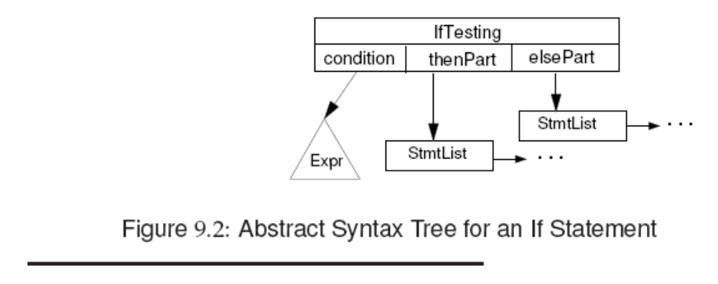
IF statements
Check whether the predicate has the
boolean or errorType type.
Type check for children (then and else)
Reachability check and collect exceptions from each child.
What if the predicate is known (T or F)?

Slide 22
Example of Checking an IF statement
If (b) a = 1;
else a = 2;
Check that the predicate b produces a boolean value
Two children (then and else) are type checked.
Since the two statements terminate normally, so does the whole IF statement.

Slide 23
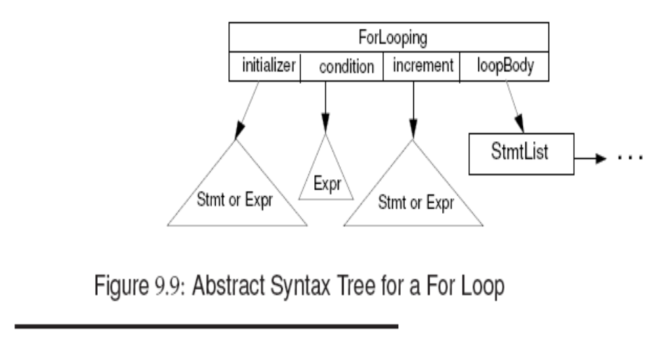
For Loops

Slide 24
Semantic Checking of For
In C++, C# and Java, a new index variable local to the for loop may be declared.
e.g. for (int n = 1; n < 10; n++)
A null condition and a constant-true predicate make the loop non-terminating
Gather all the ThrowsSet from all children

Slide 25
Exception Checks
Exceptions may be thrown explicitly or implicitly
Thrown exceptions may be propagated several times and then finally get caught by a handler.
Java exceptions are typed: all exceptions are subclasses of the Throwable class.
Two kinds of exceptions: checked and unchecked. A checked exception must be caught by an enclosing try statement or is listed in the throws clause of the enclosing method.
exceptions that are exempt from the Catch or
Declare rule are called unchecked exceptions.

Slide 26
Exception Checks
class ExitComputation extends Exception { . . . }
try { . . .
if (a > b) throw new ExitComputation();
if (v < 0.0) throw new ArithemticException();
else a =Math.sqrt(v)
}
catch (ExitComputation e) { print(e); return(0); }
catch (ABCException e) { print(e); return(5); }
finally { a := b + c; }

Slide 27
An unchecked exception (i.e. a RuntimeException or an Error) may optionally be handled in a try statement. If not caught by the program, it will be passed to the Java runtime system, and the program will terminate. For example, the ArithemeticException, a subclass of RuntimeException, is an unchecked exception.
For the catch clause, we must check
  if indeed an exception is thrown
  if the exception subsumes (i.e. hide) a later exception in the list. (the compiler may either warn, or reverse the order)
For the throw statement
  Check if indeed the parameter is an exception object

Slide 28
Error Case 1
int mm() throws A, B {
try { throw new E;
} catch (C e) { ... }
catch (D e) { ... } }
Error Case 2
int mm() throws A, B {
try {
... throw new A;
... throw new B;
... throw new C;
// never throw new D;
} catch (C e) { ... }
catch (D e) { ... } // this D handler is redundant }

