Slide 1
Chapter 8.8
Register Allocation (p.553)
(CS5405)
Jenq-Kuen Lee
Department of Computer Science
National Tsing-Hua Univ.
Hsinchu, Taiwan

Slide 2
Outline
Introduction
Idea
Yorktown allocator
Optimistic allocator

Slide 3
Introduction
Register allocation phase stands between the optimization phase and the final code assembly and emission phase
When the intermediate or internal language (IL) enters register allocation, it is written assuming a hypothetical target machine having an unlimited number of high-speed general-purpose CPU registers
Register allocation phase maps the unlimited number of symbolic registers into n registers which are actually present in the CPU

Slide 4
Idea
Finding a k-coloring for an arbitrary graph is NP-complete
Yorktown allocator devised by Chaitin
  Heuristic
  O(n+e) time, where n is the number of live ranges to be colored and e is the number of edges in the interference graph

Slide 5
Example
Ld r1, b
Ld r2, c
a = b + c
Add r0, r1, r2
St a, r0

Slide 6
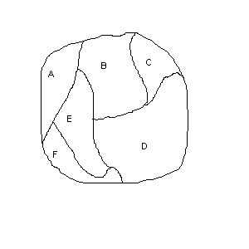
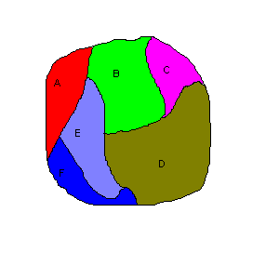
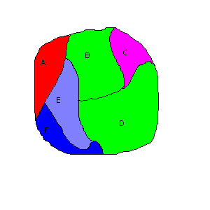
Origin of the problem
From: www.ioz.pwr.wroc.pl

Slide 7
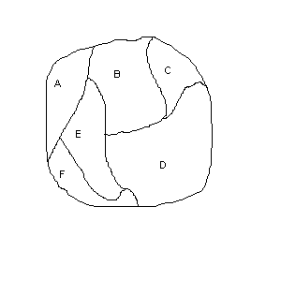
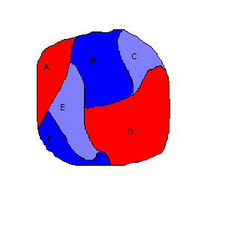
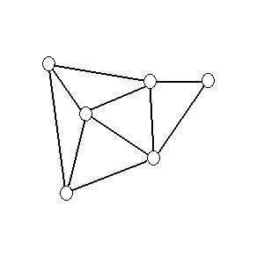
Origin of the problem
From: www.ioz.pwr.wroc.pl

Slide 8
Graph Coloring Problem
Problem: A graph G is said to be k-colorable iff the nodes can be labeled with integers 1… k so that no edge in G connects two nodes with the same label
K = 3
K = 4
No color for
this node
A 4-colorable example
Determining if a graph is k-colorable is NP-complete for k>2
CS640 Fall 2009 GMU
Register Allocation

Slide 9
Live Range
A group of flow graph nodes in which a variable is defined and referenced
Live Ranges are discovered by finding connected groups of def-use chains
LR₁
W = 2
X = 5
Y = W * X
Z = Y + W
A = Z + Y
LR₂
LR₃
LR₄

Slide 10
Interference Graph
Key to understanding graph coloring allocators
Two live ranges interfere one of them is ever live simultaneously, more precisely, if one of them is live at a definition point of the other
LR₁
1
W = 2
X = 5
Y = W * X
Z = Y + W
A = Z + Y
LR₂
2
LR₃
3
LR₄
4

Slide 11
Coloring
3 colors (registers)
1
2
3
4
A result based on a coloring order, 2 -> 1 -> 4 -> 3

Slide 12
Why Spill?
2 colors (registers)
1
1
2
Spill
2
3
3a
3b
4
4
Can’t be colored!
LR₁
LR₁
LR₂
LR₂
LR₃
LR_{3a}
LR₄
LR_{3b}
LR₄

Slide 13
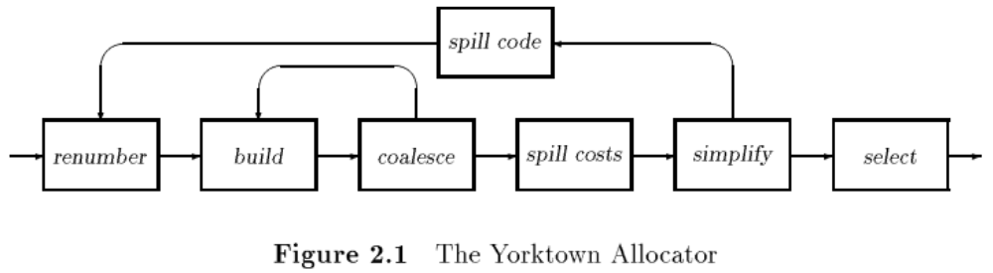
Yorktown Allocator
It’s future work by Chaitin yielded an improved coloring heuristic that attacked the problems of coloring and spilling in a integrated fashion, derived from the original one he and his colleagues did as part of the PL.8 compiler at IBM Reasearch in Yorktown Heights

Slide 14
Yorktown Allocator (Cont’d)
Renumber
  Find all the live ranges in a routine and numbers them uniquely, i.e., Each live range is given a unique index
  Live ranges are discovered by finding connected groups of def-use chains
Build
  Construct the interference graph G
Coalesce
  Eliminate the copy instruction itself and combine the source and target live ranges
  At each copy instruction, check to see if the source and target live ranges interference; if not, they may be coalesced and the copy instruction may be deleted

Slide 15
Yorktown Allocator (Cont’d)
Spill Costs
  The spill cost for l, used in choosing node to spill, is an estimate of the cost of load and store instructions that would be required to spill l

Slide 16
Yorktown Allocator (Cont’d)
Simplify
  Together with select, cooperate to color the interference graph
  Repeatedly examine the nodes in G, removing all nodes with degree < k. As each node is removed, its edges are also removed and it is pushed on a stack s
  If we reach a point where every node remaining in G has degree >= k, a node is chosen for spilling
Select
  Colors are chosen for nodes in the order determined by simplify
  In turn, each node is popped from s, reinserted in G, and given a color distinct from its neighbors

Slide 17
Selection
When the graph is completely reduced
  we pop the stack one node at a time
  we rebuild the interference graph and at the same time we assign a color to the popped-out node so that its color is different from the colors of its neighbours
This is called the selection phase
If we can't assign a color to a node, we spill out the node into memory
  a node selected to be spilled out during the spill phase does not necessarily mean that it will actually spilled into memory at the end
If there are spilled nodes, we use a memory access for each spilled variable
  eg. we can use the frame location $fp-24 to store the spilled temporary variable and we replace all occurrences of this variable in the program with M[$fp-24]
From: Leonidas Fegaras

Slide 18
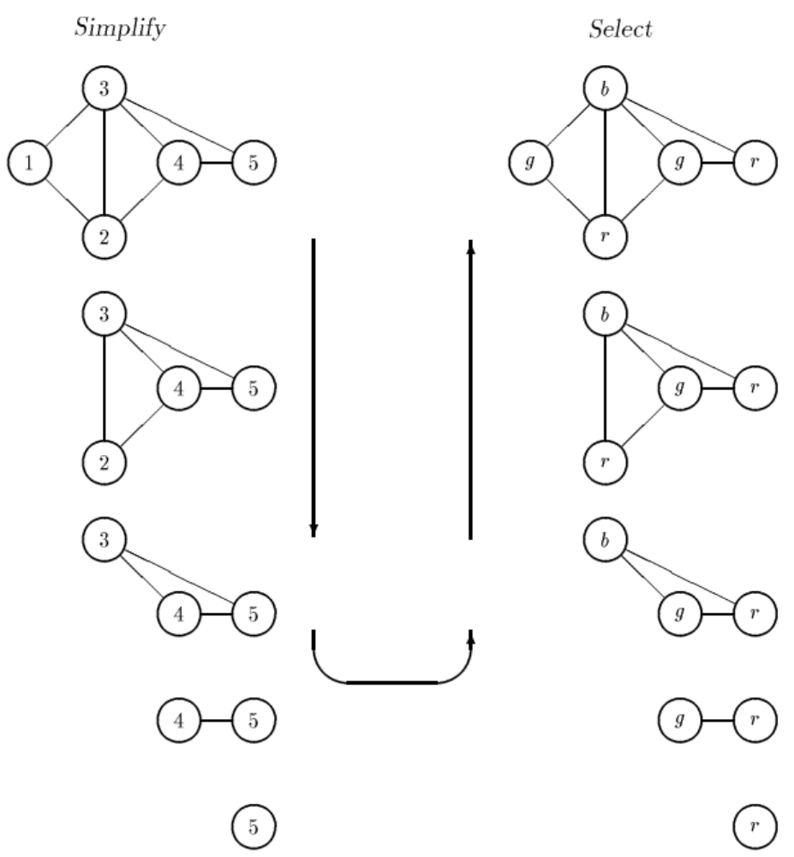

Slide 19
Summary of Heuristic (p.557)
By repeatedly eliminating nodes having fewer than k edges from the register interference graph , either we obtain the empty graph, in which we can produce a k-coloring for the original graph by coloring the nodes in the reverse order in which they were removed, or we obtain a graph in which each node has k or more adjacent nodes.
In the latter case, a k-coloring is impossible, spill is used.

Slide 20
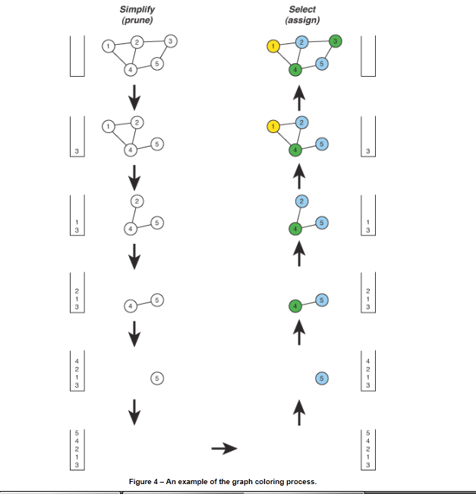

Slide 21
Graph Coloring Heuristic
Observation:
  Pick a node t with fewer than k neighbors in RIG
  Eliminate t and its edges from RIG
  If the resulting graph has a k-coloring then so does the original graph
Why:
  Let c₁,…,c_{n} be the colors assigned to the neighbors of t in the reduced graph
  Since n < k we can pick some color for t that is different from those of its neighbors
From: http://web.cecs.pdx.edu/~mperkows/CLASS_574/574-fall-08/0015.register-allocation-graph-coloring.ppt

Slide 22
Graph Coloring Heuristic
The following works well in practice:
  Pick a node t with fewer than k neighbors
  Put t on a stack and remove it from the RIG
  Repeat until the graph has one node
Then start assigning colors to nodes on the stack (starting with the last node added)
  At each step pick a color different from those assigned to already colored neighbors
From: http://web.cecs.pdx.edu/~mperkows/CLASS_574/574-fall-08/0015.register-allocation-graph-coloring.pp

Slide 23
Graph Coloring Example (1)
Start with the RIG and with k = 4:
a
b
f
Stack: {}
c
e
d
Remove a and then d
From: http://web.cecs.pdx.edu/~mperkows/CLASS_574/574-fall-08/0015.register-allocation-graph-coloring.pp

Slide 24
Graph Coloring Example (2)
Now all nodes have fewer than 4 neighbors and can be removed: c, b, e, f
b
f
Stack: {d, a}
c
e
From: http://web.cecs.pdx.edu/~mperkows/CLASS_574/574-fall-08/0015.register-allocation-graph-coloring.pp

Slide 25
Graph Coloring Example (2)
Start assigning colors to: f, e, b, c, d, a
a
r₂
b
r₃
r₁
f
c
r₄
r₂
e
d
r₃
From: http://web.cecs.pdx.edu/~mperkows/CLASS_574/574-fall-08/0015.register-allocation-graph-coloring.pp

Slide 26
What if the Heuristic Fails?
What if during simplification we get to a state where all nodes have k or more neighbors ?
Example: try to find a 3-coloring of the RIG:
a
b
f
c
e
d
From: http://web.cecs.pdx.edu/~mperkows/CLASS_574/574-fall-08/0015.register-allocation-graph-coloring.pp

Slide 27
Yorktown Allocator (Cont’d)
Spill
  Spilling requires a load instruction before each reference to a spilled live range and a store after each definition of a spilled live ranges

Slide 28
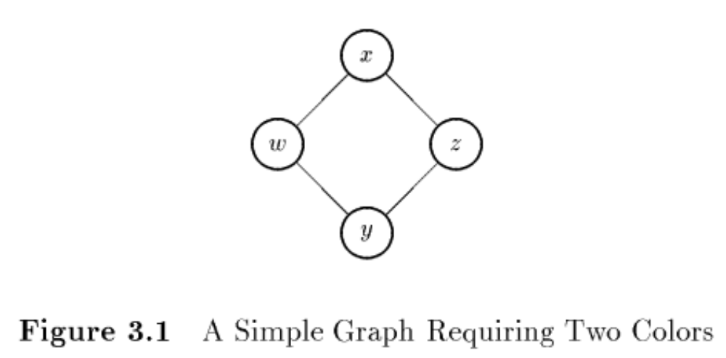
Potential Problem in Yorktown Allocator
2-coloring for the graph
Simplify is forced to spill – there are no nodes with degree < 2
Chaitin’s heuristic does not always find a k-coloring, even when one exists

Slide 29
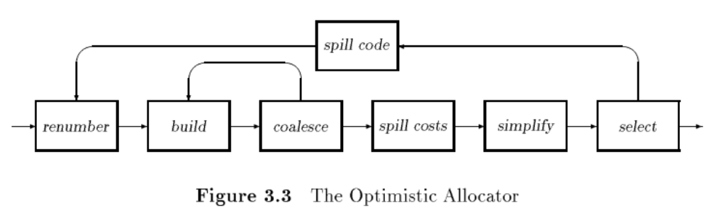
Optimistic Allocator
Spill decisions are now made by select rather simplify

Slide 30
Changes in Optimistic Allocator
Simplify
  Remove nodes with degree < k in an arbitrary order. Whenever it discovers that all remaining nodes have degree >= k, it chooses a spill candidate. That node is removed from the graph; but instead of marking it for spilling, simplify optimistically pushes it on the stack, hoping a color will be available in spite of its high degree. Thus, nodes are removed in the same order as Chaitin’s heuristic, but spill candidates are included on the stack for coloring.
Select
  Discover that it has no color available for some node. In that case, it leaves the node uncolored and continues with the next node. Note that any uncolored node would also have been spilled by Chaitin’s allocator

Slide 31
Graph coloring and NP-Complete
[Karp, 1972] seems the first paper to prove that graph coloring is NP-complete.
[Chaitin, 1982] and [Briggs, 1994] are the famous papers of register allocation, and both of them mentioned that graph coloring is NP-complete.
    Graph coloring can be many-to-one reduced from 3SAT.
[Bouchez, 2006] discussed the complexity of register allocation itself (not graph coloring) and concluded that register allocation is NP-complete in general.

Slide 32
Reducibility among combinatorial problems (Karp, 1972)
Main Theorem. All the problems on the following list are complete.
...
Chromatic number
Input: graph G, positive integer k
Property: There is a function φ:N -> Z_{k} such that, if u and v are adjacent, then φ(u) ≠ φ(v)
R.M. Karp,
Reducibility Among Combinatorial Problems, Complexity of Computer Computations (R.E. Miller and J.W. Thatcher, eds.), Plenum Press, 1972, pp. 85–103.

Slide 33
Register Allocation Via Coloring (Chaitin, 1981)
It is well-known [5] that given a graph G and a natural number > 2, the problem of determining whether G is n-coloring, i.e. whether or not there is an n-coloring of G, is NP-complete.
Chaitin, G.J., Auslander, M.A., Chandra, A.K., Cocke, J., Hopkins, M.E., and Markstein, P.W.
Register Allocation Via Coloring.
In Proceedings of Comput. Lang.. 1981, 47-57.

Slide 34
Improvements to graph coloring register allocation (Briggs, 1994)
To find an allocation from G, the compiler looks for a k-coloring of G; that is, an assignment of k colors to the nodes of G such that adjacent nodes always have distinct colors. If we choose k to match the number of machine registers, then we can map a k-coloring of G into a feasible register assignment for the underlying code. Because graph coloring is NP-complete [21], the compiler uses a heuristic method to search for a coloring; it is not guaranteed to find a k-coloring for all k-colorable graphs.
Preston Briggs, Keith D. Cooper, and Linda Torczon. 1994.
Improvements to graph coloring register allocation.
ACM Trans. Program. Lang. Syst. 16, 3 (May 1994), 428-455.

Slide 35
Register allocation: what does the NP-completeness proof of Chaitin et al. really prove? (Bouchez, 2006)
Recently, Pereira and Palsberg [26] proved that, if k is arbitrary and the program is a simple loop, then the problem is still NP-complete with the constraint that live-range splitting is only allowed on a block of the back edge and register swaps are not available. This is a particular form of register allocation through SSA. We showed that Chaitin et al's proof can be extended to show a bit more. When register swaps are not available, the problem remains NP-complete for a fixed k ≥ 3 (but for a general control-flow graph), even if the program has no critical edge and if live-range splitting can be done on any control-flow edge, i.e., on entry and exit of blocks, but not inside basic blocks.
Florent Bouchez, Alain Darte, Christophe Guillon, and Fabrice Rastello. 2006.
Register allocation: what does the NP-completeness proof of Chaitin et al. really prove? or revisiting register allocation: why and how.
In Proceedings of the 19th international conference on Languages and compilers for parallel computing (LCPC'06).
Springer-Verlag, Berlin, Heidelberg, 283-298.

Slide 36
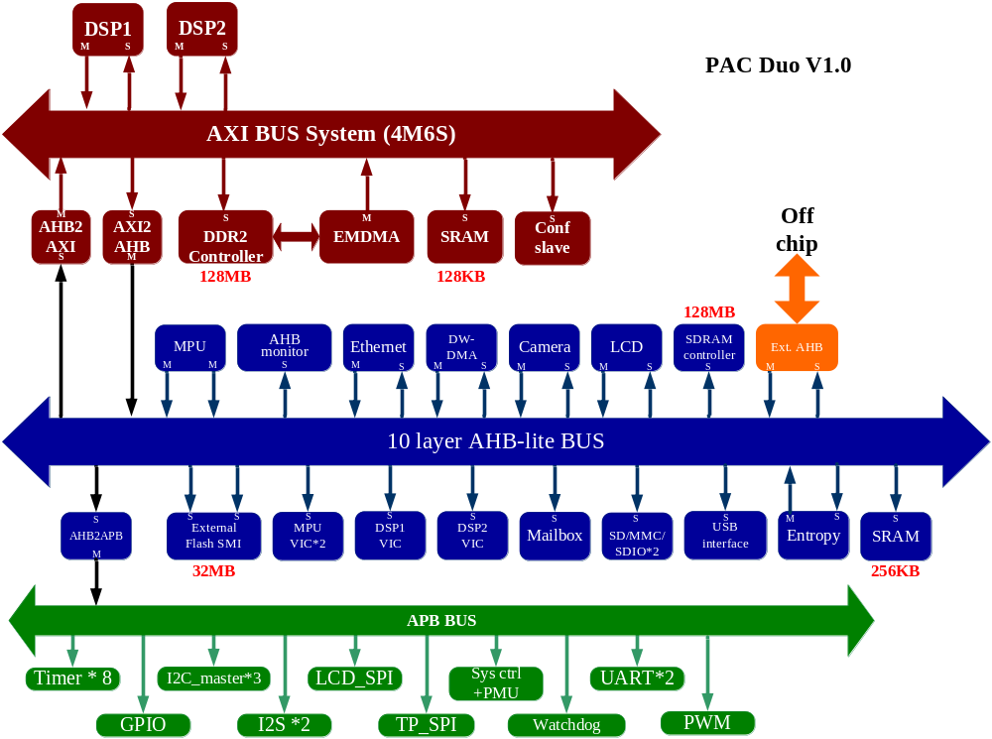
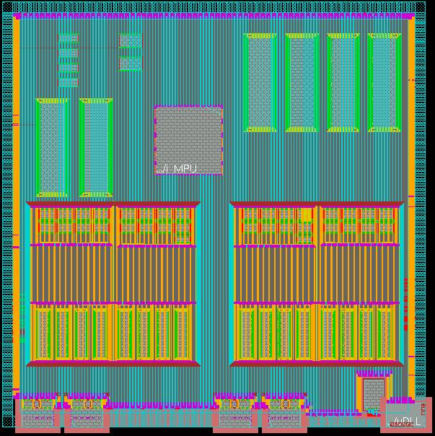
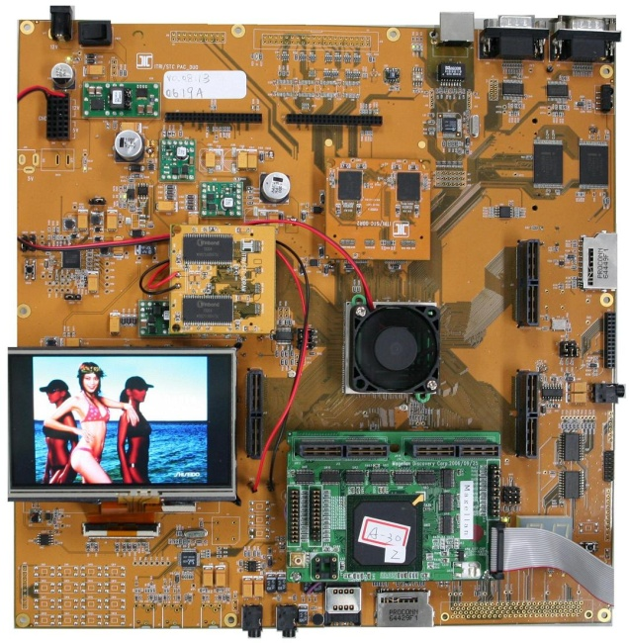
PAC Duo SoC
ARM
DSP1
DSP2
From ITRI ICL

Slide 37
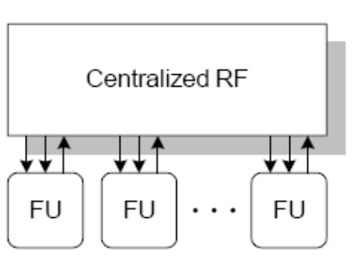
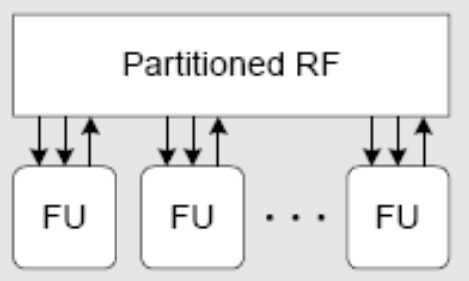

Clustered Data Path and Distributed Register File
- Evaluation Result
Compare with Centralized Register File
  Area : 76.8% area are saved
  Access Time : 46.9% access time are saved
From ITRI STC

Slide 38
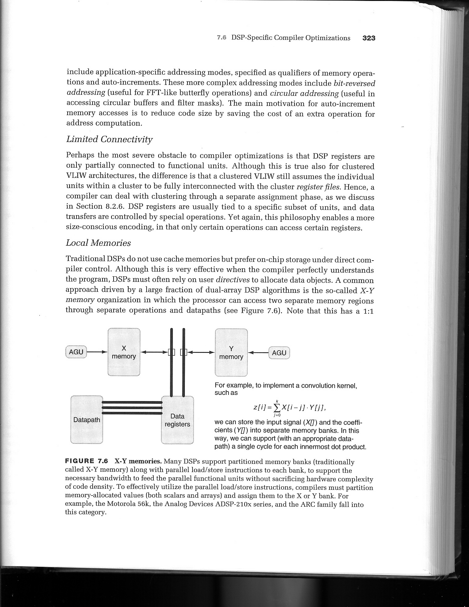
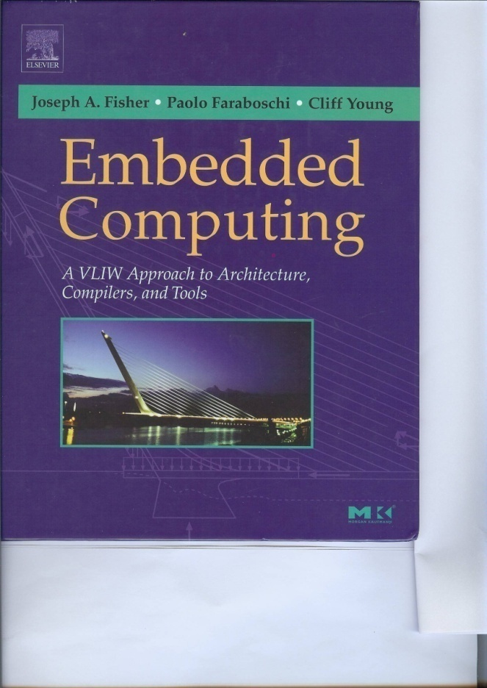
DSP Compilers
Heterogeneous Registers
Addressing Modes
Limited Connectivities
Local Memories
Harvard Architecture
Sub-word/SIMD Performances

Slide 39
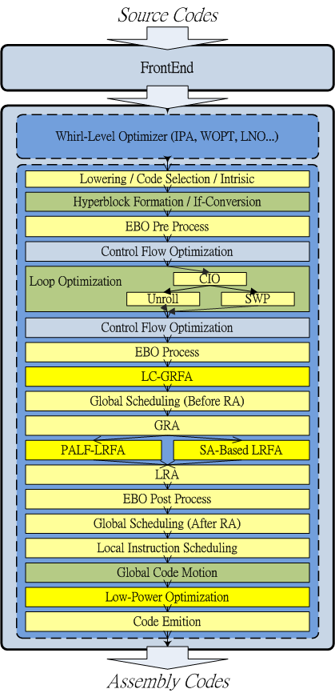
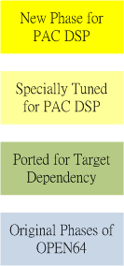
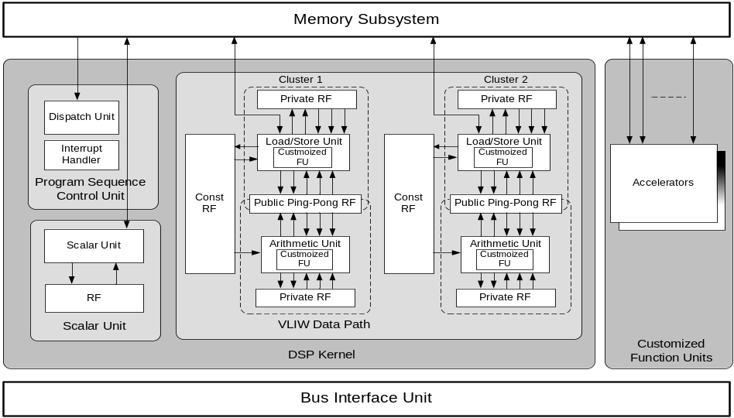
PACDSP Compiler
Based on Open64 compiler
VLIW DSP compilers for distributed register files
PALF scheduling policies for ILP (CPC 2006)
GRA scheme for distributed register files (CPC 2007)
SIMD compiler optimizations + intrinsics/extrinsics
Copy propagations for distributed register architectures (LCPC 2006)
Register spills among distributed register banks (CPC 2009)
Notes:
Allright, since we have proposed the idea, it is necessary to create an experiment platform to verify our strategy.
We selected Open64 compiler as our compiler infrastructure.
The compilation starts with processing by the front-end, generating an intermediate representation WHIRL, and feeding it into back-end. The back-end is made up of different phases. The lower level it reaches, the closer to the assembly code.
In our laboratory, we did lots of works to retarget Open64 as our PACDSP compiler.
And the work I presented today is implemented inside the register file assignment and register allocation phase.
We use PACDSP cycle-accurate simulator to evalute our experiment.
Besides, DSPstone and Mibench are the Benchmarks we tested.

Slide 40

Solution:
Concepts for PALF Register Allocation Scheme
Which RF to be allocated?
How to utilize ping-pong banks?
How to utilize clusters?
Higher
Priority
Constant
RF
Local
RF
Global
RF
Less
Usability
More Scheduling
Interference
To maximize parallelism between banks!
⬅ Hard to determine without scheduling
If the results are not worse than using global RF,
why not use local RF instead?
Only allocate Global RF for:
M-Unit
I-Unit
To partition operations into two clusters if it worth!

Slide 41
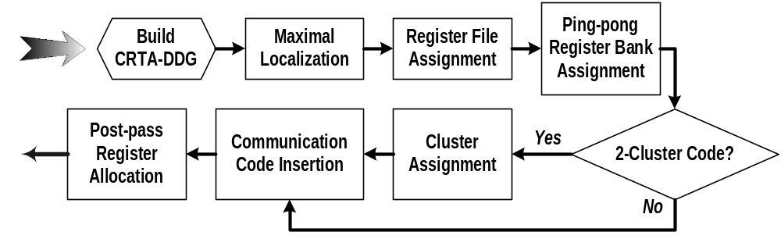
PALF Register Allocation Scheme
Ping-pong Aware Local Favorable (PALF)
  ➔ To allocate local RF first
  ➔ To assign ping-pong banks for minimizing interference
PALF determines RF allocation, then applies usual register allocation to each RF

Slide 42
Compiler Supports for Distributed Register Files
Local register allocation
  Compiler Supports and Optimizations for PAC VLIW DSP Processors [Lin, LCPC’05]
  Register Allocation for VLIW DSP Processors with Irregular Register Files [Lin, CPC’06]
  PALF: Compiler Supports for Irregular Register Files in Clustered VLIW DSP Processors [Lin, CC:PE’07]
  Effective Code Generation for Distributed and Ping-Pong Register Files: a Case Study on PAC VLIW DSP Cores [Lin, JoVSPS’08]
  Expression Rematerialization for VLIW DSP Processors with Distributed Register Files [Wu, CPC’09]
Global register allocation
  A Local-Conscious Global Register Allocator for VLIW DSP Processors with Distributed Register Files [Lu, CPC’07]
  LC-GRFA: Global Register File Assignment with Local Consciousness for VLIW DSP Processors with Non-uniform Register Files [Lu, CC:PE’09]
Local optimization
  Copy Propagation Optimizations for VLIW DSP Processors with Distributed Register Files [Wu, LCPC’06]
Loop optimization
  Enabling Compiler Flow for Embedded VLIW DSP Processors with Distributed Register Files [Chen, LCTES’07]
Notes:
1. When the difficulty of assembly programming is considered, compiler supports for such VLIW DSP processors are demanded.
- I use this slide to list (our previous efforts in providing) (compiler supports and optimizations) for (distributed register files).
- They include (local register allocation) for essential code generation; (global register allocation), (copy propagation) and (loop optimization) for performance.

Slide 43
Register Allocation and Spilling
An interference graph G. Nodes in G represents live ranges; edges represent interferences.
There is an edge from node i to node j if and only if live range l_{i} interferes with live range l_{j}
Compiler looks for a k-coloring of G; that is, an assignment of k colors to the nodes of G such that neighboring nodes always have distinct colors.
4 registers ➔ k=4
Notes:
What is spill code? Let’s take a look at some slides.
During the register allocation phase, we build an interference graph G. Nodes in G represents live ranges. Edges represent interferences.
If a live range i interferes with live range j, we would construct an edge from node i to node j.
Then the compiler looks for a k-coloring of G where neighboring nodes always have distinct colors.
Of course, k is the number of physical registers.
This is known as graph coloring problem.

Slide 44
Register Spilling (build graph)
Rz = …
Rj = …
Ri = …
… = Rj
Rk = …
… = Ri
… = Rk
node i
j
node j
i
z
node k
k
node z
2 registers
… = Rz
Notes:
But nothing is perfect.
Most of the time, the graph G is not k colorable.
This graph is an example. The live range z interferences with node i, j, and k.
Apparently, 2 registers are not able to color this graph.
So we must do register spilling.

Slide 45
Register Spilling (load/store)
Rz = …
store Rz → mem
Rj = …
Ri = …
… = Rj
Rk = …
… = Ri
… = Rk
node i
j
node j
i
z
node k
k
node z
load Rz ← mem
2 registers
… = Rz
Notes:
We insert store instruction after DEF point of live range z and insert load intruction before USE.

Slide 46
Register Spilling
Rz = …
z1
store Rz → mem
Rj = …
Ri = …
… = Rj
Rk = …
… = Ri
… = Rk
node i
j
node j
i
z
node k
k
node z
load Rz ← mem
2 registers
… = Rz
z2
Notes:
So the live range z is split into two small ones without interference to others.

Slide 47
Register Spilling
Rz = …
z1
store Rz → mem
Rj = …
Ri = …
… = Rj
Rk = …
… = Ri
… = Rk
node i
j
node j
i
node k
node k
k
node z2
node z1
load Rz ← mem
2 registers
… = Rz
z2
Notes:
Then the new graph is produced and it is colorable with 2 registers.
However, we know that the performance will be degraded because of the memory access of load/store instructions.
Those new instructions are called “spill code”.

Slide 48
Previous Works for Dealing with Spilling
Reduce unnecessary spill code
  “Spill code minimization techniques for optimizing compilers.”, D. Bernstein and D.Q. Goldin, Programming Language Design and Implementation, 1989.
  “Rematerialization”, P. Briggs, Programming Language Design and Implementation, 1992.
Limit spill code within interference region
  “Load/Store range analysis for global register allocation.”, P. Kolte and M.J. Harrold, Programming Language Design and Implementation, 1993.
  “Spill code minimization via interference region spilling.”, P. Bergner and P. Dahl, Programming Language Design and Implementation, 1997.
Precise knowledge of registers availability
  “Spill code minimization by spill code motion”, Akira Koseki and Hideaki Komatsu, Parallel Architectures and Compilation Techniques, 2003.
They all address the case of
single bank for unified registers
Notes:
Fortunately, in practice, many spill code can be avoided.
In earlier time, some works have developed spilling heuristic and utilize rematerialization to reduce unnecessary spill code.
Later works, the concept of interference region has been proposed to limit spilling range.
And recently, with precise knowledge of registers availability, spill code motion partially allocating registers by their availability information.
But they all address the case of single bank for unified registers.

Slide 49
Spilling Issue on Distributed Register File
Methods in reducing spill code
  single bank of unified registers
  not sufficient to handle distributed live ranges
Register File Assignment
  local-favorable
    its purpose is to minimize the communication cost
    may have too many live ranges crowded in one register file.
minimize communication
register file
live ranges
Notes:
Like I said, while existing methods have made successful improvement in reducing spill code,
they still focus on a single bank of registers.
Their approaches are not sufficient to handle live ranges spreaded on different register files where the register allocator can do nothing but spilling.
Moreover, we also notice that register file assignment stage is local-favorable to pick up register file because its purpose is to minimize the communication cost.
It always lacks of precise information of register pressure so that it sometimes causes too many live ranges crowded in one register file.

Slide 50
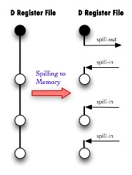

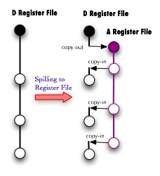
Characteristic of Distributed Register Files
Could we find any idea of reducing spill code with characteristic of distributed register files?
  Spill to memory
    store the value in memory
    expensive memory access
  Spill to register files
    an alternative option
    communication cost
Memory
But live range migration does not guarantee positive improvement
  decrease register pressure
  in D Register File
  increase register pressure
  in A Register File
Notes:
The situation encourages us to consider a question:
Could we find any idea of reducing spill code with characteristic of distributed register files??
Think about it, spill code is to store the value in memory to release the regiser usage.
Since we have distributed register files, why don’t we take other register files as a kind of memory?
In this figure, suppose this live range is the one which is selected to do spilling.
Black circle denotes DEF point and white cirle denotes USE in the operations.
Traditionally, the spilling process would do spill-out to memory after the definition and get the value by doing spill-in from memory before every use.
On the contrary, the idea at bottom-right employs data communication instructions to move live range from D register file to A register file.
It is obvious that the later strategy is much better since the cost of memory access is always expensive.
But live range migration does not guarantee positive improvement.
Because even we can decrease register pressure in D register file, we also increase register pressure in another.
This may cause new spill code and have the performance got worse.
So we cannot just pick one register file casually,
we better have some models or algorithm to estimate which register file could be used as spilled destination.

Slide 51
References
[1] Preston Briggs, “Register Allocation via Graph Coloring”, Houston Texas, April 1992
[2] Preston Briggs, Keith D. Copper, and Linda Torczon, “Improvements to Graph Coloring Register Allocation”, ACM Transactions on Programming Languages and Systems, Vol. 16, No. 3, pp. 428-455, May 1994
[3] Gregory J. Chaitin, “Register Allocation and Spilling via Graph Coloring”, Proceedings of the ACM SIGPLAN ’82 Symposium on Compiler Construction, June 1982

Slide 52
Final Exam Preview
Grammar Comparison
  LR(0)
  SLR(1)
  LR(1)
  LALR(1)
Can the LALR(1) parser process any ambiguous grammar?
Is left-recursion grammar or right-recursion grammar more desirable when used with a bottom-up parsing scheme (such as LR(1))?

Slide 53
Final Exam (II)
LR(0) Items
LR(0) Parsing Table
Lookahead Set
SLR(1)

Slide 54
Final Exam (III)
Project;
  Write a YACC-like grammar for variable declaration in C
  (b) Write a YACC-like grammar for for-loop programs.
  (c) Write a YACC-like grammar for switch programs.
  (d) Write a YACC-like grammar for function and function body
  Explain the techniques needed in handling "Symbol Table"
  . . .

Slide 55
Final Exam (IV)
Optimization
  Flow Graph
  Data Dependence
  Dominator
  Reducible Graph
  Code Motion
  Peehole Optimization
Data Flow Equations
  Reaching Definitions
  Common Available Expression
  Live Variable Analysis
  Copy Propagation
Register Allocation

