Slide 1
編譯器設計
黃元欣
shin@cs.ntou.edu.tw

Slide 2
Syllabus
Text Books
  Compilers: Principles, Techniques, and Tools
  A.V. Aho, R. Sethi, and J.D. Ullman
  Addison-Wesley 1986
  ISBN 0-201-10194-7
  Introduction to the Theory of Computation
  Michael Sipser
  PWS Publishing 1997
  ISBN 0-534-94728-X

Slide 3
Syllabus
Reference Books
  lex & yacc
  J.R. Levine, T. Mason, and D. Brown
  O’Reilly 1995
  ISBN 1-56592-000-7

Slide 4
Syllabus
Course Outline
  Introduction
  Lexical Analysis (Chap. 3)
  Syntax Analysis (Chap. 4)
  Syntax-Directed Translation (Chap. 5)
  Run-time Organization (Chap.7)
  Intermediate Code Generation (Chap.8)
  Type Checking (Chap. 6)
  Code Generation (Chap. 9)

Slide 5
Syllabus
Grading
  Programming Assignments 30%
  Midterm 30%
  Final 30%
  Participation 10%
Office Hour
  Monday 1:00-2:00 (Room 547)

Slide 6
編譯器設計
Chapter 1:
Introduction to Compiling

Slide 7
Compilers
source program
Compiler
target program
error messages
A compiler is a program that reads a program that
  reads a program written in one language (the source language) and
  translates it into an equivalent program in another language (the target language)

Slide 8
Compilers
Examples
  Compilers of C/C++, Fortran, Java, etc
  Text formatters, e.g. TeX, LaTeX
  Silicon compilers
  Query interpreters, e.g SQL compilers
  Preprocessors
  Assemblers
  Browsers
  Parallelizing compilers

Slide 9
Compilers and Assemblers
H
i
g
h
-
l
e
v
e
l
s
w
a
p
(
i
n
t
v
[
]
,
i
n
t
k
)
l
a
n
g
u
a
g
e
{
i
n
t
t
e
m
p
;
t
e
m
p
=
v
[
k
]
;
p
r
o
g
r
a
m
v
[
k
]
=
v
[
k
+
1
]
;
(
i
n
C
)
v
[
k
+
1
]
=
t
e
m
p
;
}
C
c
o
m
p
i
l
e
r
s
w
a
p
:
A
s
s
e
m
b
l
y
m
u
l
i
$
2
,
$
5
,
4
l
a
n
g
u
a
g
e
a
d
d
$
2
,
$
4
,
$
2
p
r
o
g
r
a
m
l
w
$
1
5
,
0
(
$
2
)
l
w
$
1
6
,
4
(
$
2
)
(
f
o
r
M
I
P
S
)
s
w
$
1
6
,
0
(
$
2
)
s
w
$
1
5
,
4
(
$
2
)
j
r
$
3
1
A
s
s
e
m
b
l
e
r
B
i
n
a
r
y
m
a
c
h
i
n
e
0
0
0
0
0
0
0
0
1
0
1
0
0
0
0
1
0
0
0
0
0
0
0
0
0
0
0
1
1
0
0
0
l
a
n
g
u
a
g
e
0
0
0
0
0
0
0
0
1
0
0
0
1
1
1
0
0
0
0
1
1
0
0
0
0
0
1
0
0
0
0
1
1
0
0
0
1
1
0
0
0
1
1
0
0
0
1
0
0
0
0
0
0
0
0
0
0
0
0
0
0
0
0
0
p
r
o
g
r
a
m
1
0
0
0
1
1
0
0
1
1
1
1
0
0
1
0
0
0
0
0
0
0
0
0
0
0
0
0
0
1
0
0
1
0
1
0
1
1
0
0
1
1
1
1
0
0
1
0
0
0
0
0
0
0
0
0
0
0
0
0
0
0
0
0
(
f
o
r
M
I
P
S
)
1
0
1
0
1
1
0
0
0
1
1
0
0
0
1
0
0
0
0
0
0
0
0
0
0
0
0
0
0
1
0
0
0
0
0
0
0
0
1
1
1
1
1
0
0
0
0
0
0
0
0
0
0
0
0
0
0
0
0
0
1
0
0
0
Adapted from Computer Organization & Design by Patterson & Hennessy. Copyright 1998 Morgan Kaufmann Publishers

Slide 10
Analysis-Synthesis Model
There are two parts to compilation
  Analysis (front end)
    Breaks up the source program into constituent pieces
    Creates an intermediate representation (IR)
  Synthesis (back end)
    Constructs the desired target program from the IR
    (Optionally) performs optimizations
source program
front end
IR
back end
target program
error messages

Slide 11
Analysis-Synthesis Model
Some tools that perform analysis
  Structure editors
    Takes a sequence of commands as input to build a source program, e.g. with the user types while, the editor supplies the matching do
  Pretty printers
    Analyzes a program and prints it in such a way that the structure of the program becomes clearly visible
  Static checkers
    Reads and analyzes a program, and attempts to discover potential bugs without running the program
  Interpreters
    Instead of producing a target program as a translation, an interpreter performs the operations implied by the program

Slide 12
Analysis of the Source Program
Analysis (front end) consists of 3 phases:
  Linear Analysis (Lexical Analysis)
    scan characters and group them into tokens
  Hierarchical Analysis (Syntax Analysis)
    group tokens into grammatical phrases
  Semantic Analysis
    identify semantic errors and gather type information
parse tree
parse tree
source program
scanner
tokens
parser
type
checker

Slide 13
Lexical Analysis
Mapping characters into tokens
  Tokens: the basic unit of syntax
  position := initial + rate * 60
  becomes
  〈id, position〉:=〈id, initial〉+〈id, rate〉* 60

Slide 14
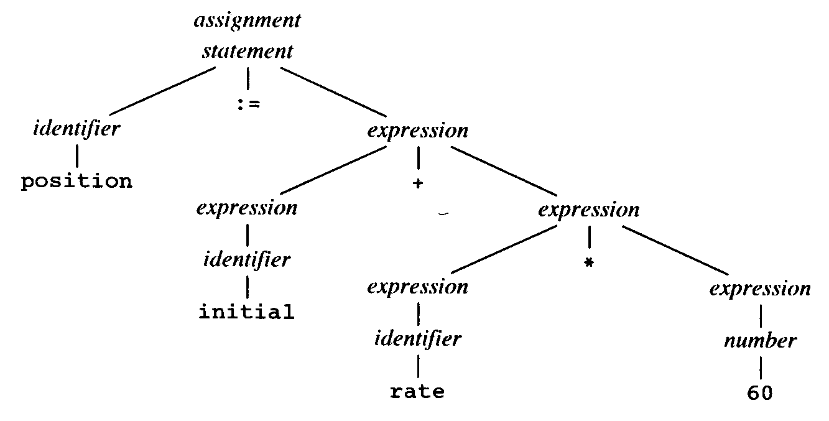
Syntax Analysis
Tokens are grouped into grammatical phrases that are used to synthesize output

Slide 15
Syntax Analysis
The hierarchical structure of a program is usually expressed by recursive rules, e.g.
  Any identifier is an expression
  Any number is an expression
  If expression₁ and expression₂ are expressions, so are
  expression₁ op expression₂
  (expression₁)

Slide 16
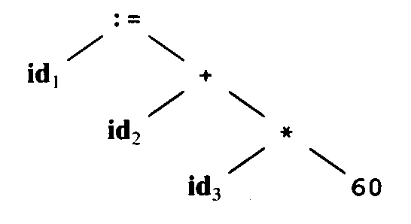
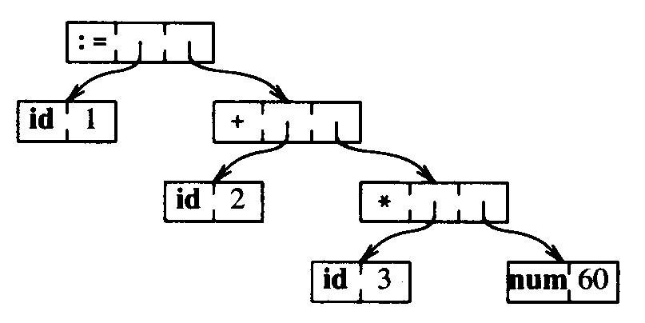
Parse Tree vs. Syntax Tree
Parse tree
  describes the syntactic structure of the source program
Syntax tree
  A more common internal representation of this syntactic structure
  A compressed representation of the parse tree

Slide 17
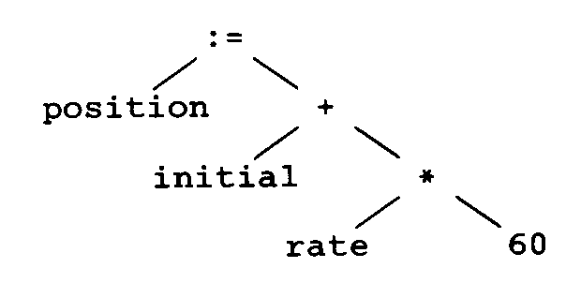
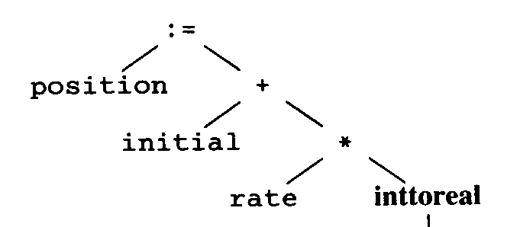

Semantic Analysis
Checks for semantic errors
Gathers type information for the subsequent code-generation phase

Slide 18
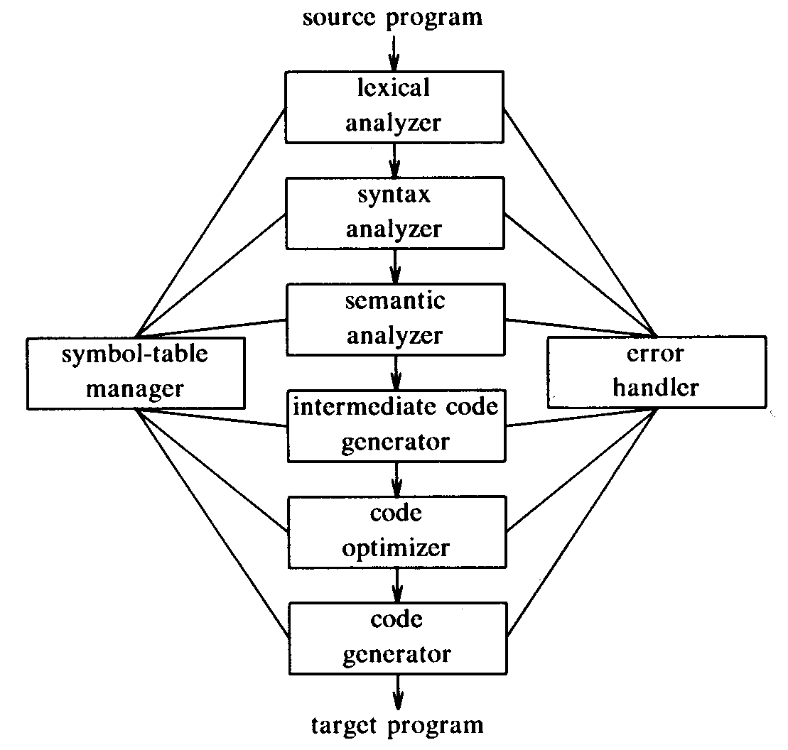
Phases of a Compiler
A compiler operates in phases, each of which transforms the source program from one representation to another

Slide 19
Symbol-Table Management
Essential function of a compiler
  To record the identifiers used in the source program and collect information about various attributes of each identifier
    e.g. allocated storage, type, scope, etc.
Symbol table
  A data structure containing a record for each identifier, with fields for the attributes
  When an identifier is detected by the lexical analysis, it is entered into the symbol table
  The attributes are determined during syntax analysis and semantic analysis
  e.g. position, initial, rate: real;

Slide 20
Error Detection and Reporting
Each phase can encounter errors
  After detecting an error, a phase must deal with the error, so that compilation can proceed
    allowing further errors to be detected
  Lexical phase can detect errors where characters remaining in the input do not form any token
  Syntax analysis phase detects errors where the token stream violates the syntax of the language
  Semantic analysis phase tries to detect constructs that have the right syntactic structures but no meaning to the operation involved
    e.g. a = b + c; where b is an array and c an integer

Slide 21
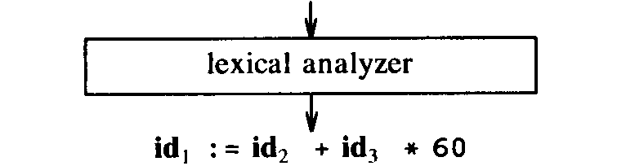
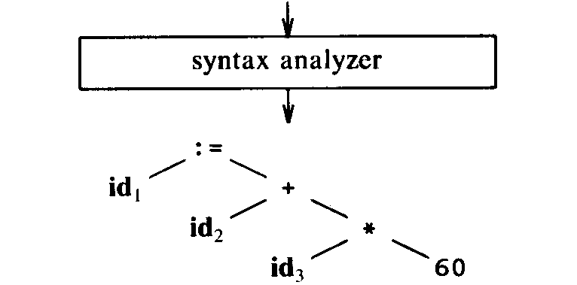
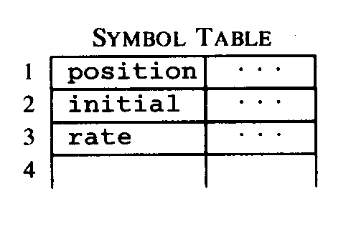
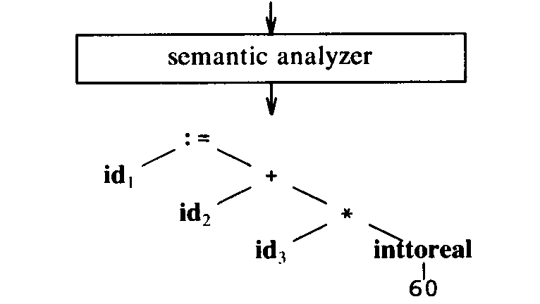
Analysis Phases
Lexical Analysis
Syntax Analysis
Semantic Analysis

Slide 22
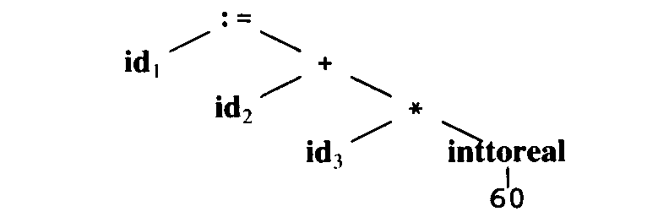
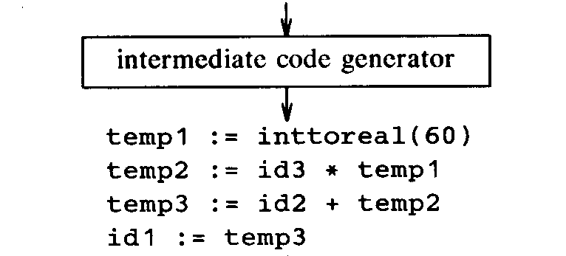
Intermediate Code Generation
Two properties
  Easy to produce
  Easy to translate into the target program
Examples
  Graph representations
  Postfix notation
  Three-address code

Slide 23
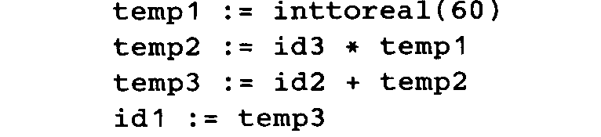
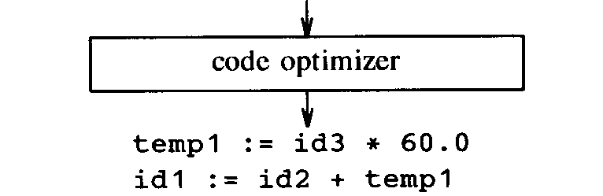
Code Optimization
Attempts to improve the intermediate code
  So that faster-running machine code will result

Slide 24

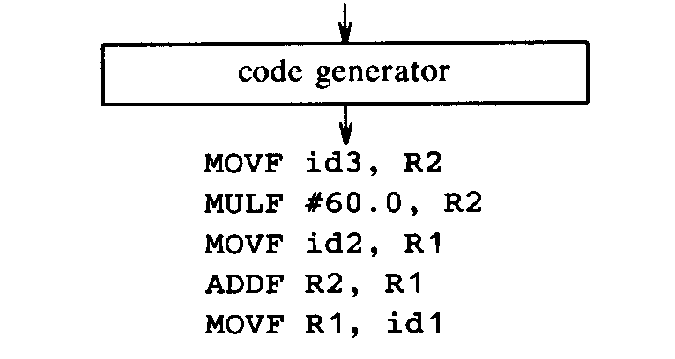
Code Generation
Generates target code
  Consisting of relocatable machine code or assembly code

Slide 25
Cousins of the Compiler
Preprocessors
  Preprocessors produce input to compilers
  Macro processing
    Allows users to define macros
  File inclusion
    Includes header files into the program text, e.g.
    #include <stdio.h>
  “Rational” preprocessors
    Augment older languages with more modern flow-of-control and data-structuring facilities
  Language extensions
    Add capabilities to languages by what amounts to built-in macro
      e.g. HPF

Slide 26
Cousins of the Compiler
Assemblers
  mov a, R1 0001 01 00 00000000
  add #2, R1 0011 01 10 00000010
  mov R1, b 0010 01 00 00000100
Loaders and Link-Editors

Slide 27
Compiler-Construction Tools
Some general tools have been created for the automatic design of specific compiler components
  Parser generators
    Producing syntax analyzers, normally from input that is based on a context-free grammar
  Scanner generators
    Automatically generating lexical analyzers, normally from a specification based on regular expressions
  Automatic code generators
    Taking a collection of rules that define the translation of each operation of the intermediate language into the machine language

