Slide 1
編譯器設計
Chapter 4:
Syntax Analysis

Slide 2
Syntax Analysis
The role of the syntax analyzer
  To accept a string of tokens from the scanner
  To verify the string can be generated by the grammar
source program
lexical
analyzer
tokens
parser
parse tree
symbol
table
Three general types of parsers for grammars
  Universal parsing methods
    e.g. Cocke-Younger-Kasami, Earley’s
  Top-down
  Bottom-up

Slide 3
Syntax Error Handling
The goals of the error handler in a parser
  It should report the presence of errors clearly and accurately
  It should recover from each error quickly enough to be able to detect subsequent errors
  If should not significantly slow down the processing of correct programs
Many errors could be classified [Ripley et al 1978]:
  60% punctuation errors
  20% operator and operand errors
  15% keyword errors
  5% others

Slide 4
Error Recovery Strategies
Panic mode
  The simplest method and can be used by most parsers
  On discovering an error, the parser discards input symbols one at a time until one of synchronizing tokens is found
    The synchronizing tokens are usually delimiters, e.g. ; or end
Phrase level
  On discovering an error, a parser may perform local correction on the remaining input
    e.g. replacing a comma by a semicolon, inserting a missing ;
Error production
  Augment the grammar with productions that generate the erroneous constructs
Global correction
  Make as few changes as possible in processing the input

Slide 5
Context-Free Grammars
The syntax of programming language constructs can be described by context-free grammars
  Or BNF (Backus-Naur Form)
Grammars offer significant advantages
  A grammar gives a precise syntactic specification of a programming language
  From certain classes of grammars we can automatically construct an efficient parser
    The parser construction process can reveal syntactic ambiguities and difficult-to-parse constructs
  A properly designed grammar facilitates the translation into target code
  New language constructs can be added easily

Slide 6
Context-Free Grammars
A context-free grammar G can be denoted by G = (V_{N}, V_{T}, P, S)
  V_{N} : nonterminals
    Syntactic variables that denotes sets of strings
  V_{T} : terminals
    The basic symbols (i.e. tokens) from which strings are formed
  P : productions
    The manner in which the terminals and nonterminals can be combined for form strings, e.g.
    expr → expr op expr
    expr → id
    op → + | − | ∗ | /
  S : start symbol

Slide 7
Why Not Using Regular Languages
Regular languages are not power enough to represent certain constructs in program languages, e.g. {^{n} }^{n}
  i.e. {^{n} }^{n} is not a regular language
Recall the ways to prove a language is regular
  Find a regular grammar (or regular expressions) that generates the language
  Find an NFA that recognizes the language
However, they can not prove {^{n} }^{n} is not regular
  The pumping lemma of regular languages will be used
  Prove by contradiction

Slide 8
Pumping Lemma
If A is a regular language and string s ∈ A, where ∃n ∈ N such that |s| ≥ n, then s = xyz, where
  xy ^{i}z ∈ A, i ≥ 0,
  |y | > 0, and
  |xy | ≤ n
Example: prove L = {0 ^{n}1^{n} | n ≥ 0} is not regular
  Assume L is regular. Let s = wyz, s ∈ L
  If y consists of 0’s only, then
  xy ^{i}z has more 0’s than 1’s
  If y consists of 1’s only, then
  xy ^{i}z has more 1’s than 0’s
  If y consists of 0’s and 1’s, then
  xy ^{i}z ≠ 0 ^{n}1^{n}

Slide 9
Pushdown Automata
M = (K, Σ, Γ, δ, q₀, Z₀, F )
  K : Finite set of states
  Σ : Input alphabet
  Γ : Pushdown alphabet
  δ : Mapping K × (Σ ∪ є) × Γ → K × Γ*
  q₀ : Initial state (q₀ ∈ K )
  Z₀ : Initial pushdown symbol (Z₀ ∈ Γ )
  F : Set of final states
Example: L = {0 ^{n}1^{n} | n ≥ 0}
  M = ({q₀, q₁}, {0, 1}, {0, 1}, δ, q₀, є, ∅)
    δ(q₀ , 0, є) = (q₀ , 0)
    δ(q₀ , 0, 0) = (q₀ , 00)
    δ(q₀ , 1, 0) = (q₁ , є)
    δ(q₁ , 1, 0) = (q₁ , є)
0, є → 0
0, 0 → 00
q₀
1, 0 → є
q₁
1, 0 → є

Slide 10
Pushdown Automata
Example: L = {w cw ^{R} | w ∈ {0, 1}*}
  M = ({q₀, q₁}, {0, 1, c}, {R, G, B}, δ, q₀, R, ψ)
    δ(q₀ , 0, R) = (q₀ , BR)
    δ(q₀ , 0, G) = (q₀ , BG)
    δ(q₀ , 0, B) = (q₀ , BB)
    δ(q₀ , 1, R) = (q₀ , GR)
    δ(q₀ , 1, G) = (q₀ , GG)
    δ(q₀ , 1, B) = (q₀ , GB)
    δ(q₀ , c, R) = (q₁ , R)
    δ(q₁ , c, G) = (q₁ , G)
    δ(q₁ , c, B) = (q₁ , B)
    δ(q₀ , 0, B) = (q₁ , є)
    δ(q₁ , 1, G) = (q₁ , є)
    δ(q₁ , є, R) = (q₁ , є)
1, R → GR
1, G → GG
1, B → GB
0, R → BR
0, G → BG
0, B → BB
q₀
c, R → R
c, G → G
c, B → B
q₁
0, B → є
1, G → є
є, R → є

Slide 11
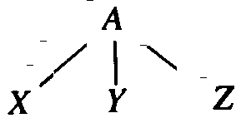
Parse Trees
A parse tree pictorially shows how the start symbol of a grammar derives a string in the language
  e.g. A → XYZ
Formally, given a context-free grammar, a parse tree is a tree with the following properties
  The root is labeled by the start symbol
  Each leaf is labeled by a token or by є
  Each interior node is labeled by a nonterminal
  If A is the nonterminal labeling some interior node and X₁, X₂, …, X _{n} are the labels of the children of that node from left to right, then A → X₁ X₂ … X _{n} is a production

Slide 12
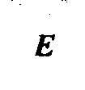
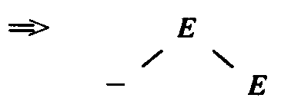
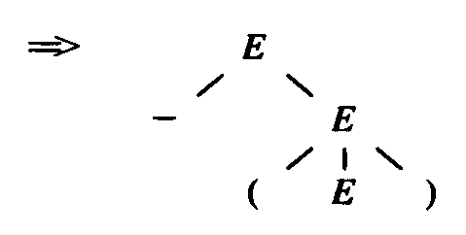
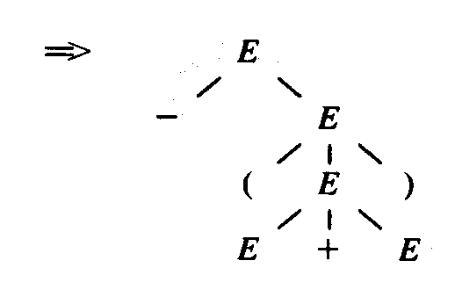
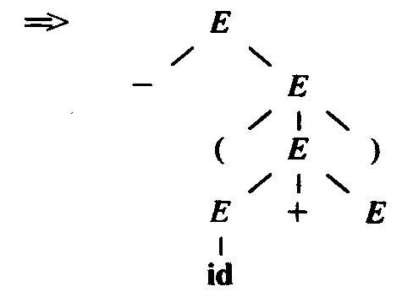
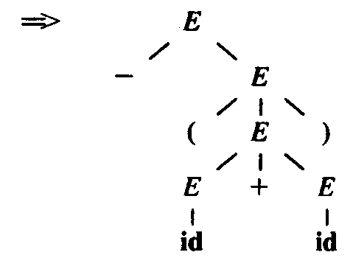
Parse Trees and Derivations
There are several ways to view the process by which a grammar defines a language
  Building parse trees
  Derivations
Derivations give a precise description of the top-down construction of a parse tree
  Example: E → E + E | E * E | (E ) | −E | id
  w = − (id + id)
  Derivation:
  E ⇒ −E
  ⇒ − (E )
  ⇒ − (E + E )
  ⇒ − (id + E )
  ⇒ − (id + id)

Slide 13
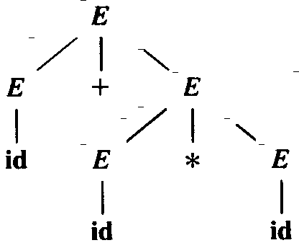
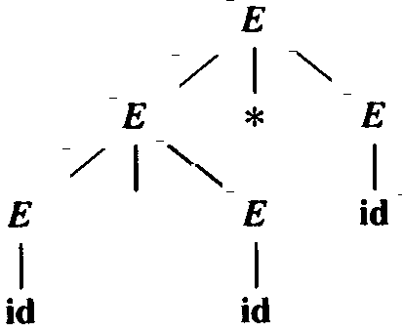
Parse Trees and Derivations
Every parse tree has associated with it a unique leftmost and a unique rightmost derivation
  However, not every sentence has exactly one leftmost or rightmost derivation
  e.g. id + id * id
  E ⇒ E + E
  ⇒ id + E
  ⇒ id + E * E
  ⇒ id + id * E
  ⇒ id + id * id
  E ⇒ E * E
  ⇒ E + E * E
  ⇒ id + E * E
  ⇒ id + id * E
  ⇒ id + id * id

Slide 14
Ambiguity
A grammar that produces more than one parse tree for some sentence is said to be ambiguous
  i.e. more than one leftmost or rightmost derivation for the same sentence
Two options to deal with ambiguity
  Disambiguating rules are used to throw away undesirable parse trees
  To eliminate ambiguity
    Precedence and associativity
    Rewriting the grammar

Slide 15
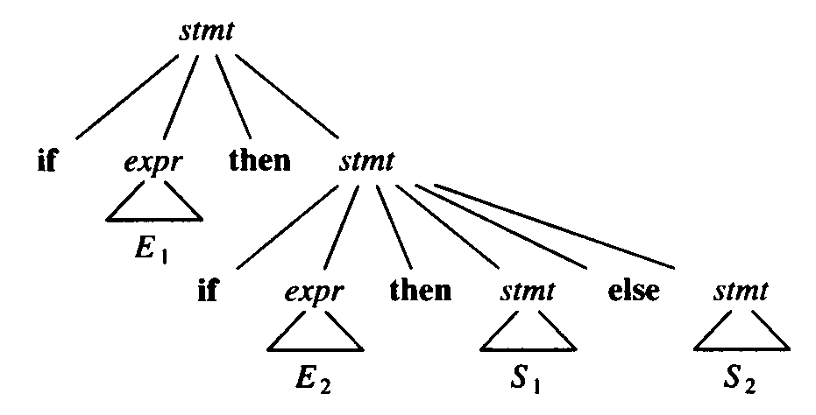
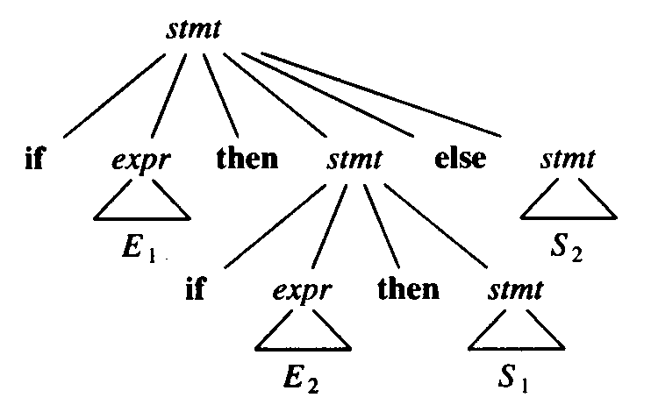
Eliminating Ambiguity
Example (Dangling Else):
  stmt → if expr then stmt
  stmt → if expr then stmt else stmt
  stmt → other
  if E₁ then if E₂ then S₁ else S₂

Slide 16
Eliminating Ambiguity
Rewrite the grammar:
  stmt → matched_stmt
  | unmatched_stmt
  matched_stmt → if expr then matched_stmt else matched_stmt
  | other
  unmatched_stmt → if expr then stmt
  | if expr then matched_stmt else unmatched_stmt

Slide 17
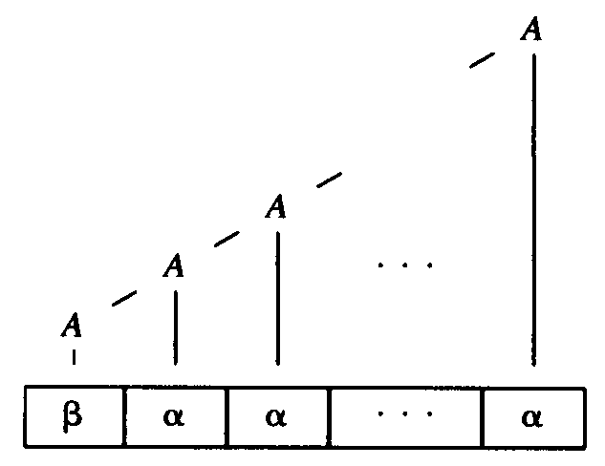
Left Recursion
A grammar is left recursive if it has a nonterminal A such that there is a derivation A ⇒ A α
+
  e.g. A → A α | β
It is possible that a parser to loop forever if the grammar is left recursive

Slide 18
Eliminating Left Recursion
A left-recursive pair of productions A → A α | β can be changed to non-left-recursive productions
  A → β A’
  A’ → α A’ | є
without changing the set of strings derivable from A
Example:
  E → E + T | T
  T → T * F | F
  F → (E ) | id
  ⇒ E → TE’
  E’ → +TE’ | є
  T → FT’
  T’ → *FT’ | є
  F → (E ) | id

Slide 19
Eliminating Left Recursion
Algorithm
  Input. Grammar G with no cycles on є-productions
  Output. An equivalent grammar with no left recursion
  Method.
Arrange the nonterminals in some order A₁, A₂, …, A _{n}
for i = 1 to n do
for j = 1 to i-1 do
replace each production of the form A _{i} → A _{j}γ by
the production A _{i} → δ₁γ | δ₂γ | … | δ_{k}γ,
where A _{j} → δ₁ | δ₂ | … | δ_{k} are all the current A _{j}-productions
eliminate the immediate left recursion among the A _{i}-productions
end
end

Slide 20
Eliminating Left Recursion
Example
  S → A a | b
  A → A c | S d | є
  Arrange the nonterminals in order S, A
  i = 1
    No immediate left recursion among the S -productions
  i = 2
    Substitute the S-productions in A → S d to obtain
    A → A c | A a d | b d | є
    Eliminate the left recursion and yield
    S → A a | b
    A → b d A’ | A’
    A → c A’ | a d A’ | є

Slide 21
Left Factoring
Left factoring is a grammar transformation
  Usually applied when it is not clear which of two alternative productions to use to expand a nonterminal A
  Rewrite the A-productions to defer the decision
  e.g. stmt → if expr then stmt else stmt
  stmt → if expr then stmt
Algorithm
  For each nonterminal A find the longest prefix α common to two or more of its alternatives
  Replace A → αβ₁ | αβ₂ | … | αβ_{n} | γ by
  A → αA’ | γ
  A’ → β₁ | β₂ | … | β_{n}

Slide 22
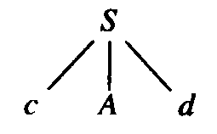
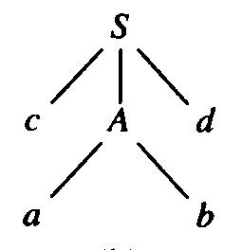
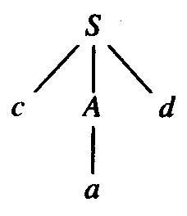
Top-Down Parsing
Top-down parsing an be viewed as an attempt to find a leftmost derivation for an input string
  Equivalently, it can be viewed as an attempt to construct a parse tree for the input starting from the root and creating the nodes of the parse tree in preorder
Example
  S → cA d
  A → ab | a

Slide 23
Top-Down Parsing
Recursive-Descent Parsing
  Start with the root, labeled with the starting symbol, and repeatedly perform the following steps
    At node n labeled with nonterminal A, select one of the productions for A and construct children at n for the symbols on the right side of the production
    When a terminal is added that does not match the input string, then backtrack
    find the next node
Predictive Parsing
  Recursive-descent parsing without backtracking

Slide 24
Designing a Predictive Parser
A predictive parser is a program consisting a procedure for every nonterminal. Each procedure does two things
  For all A-productions it decides which production to use by looking at the lookahead symbol, say a, i.e.
    The production A → α is used if
    a ∈ FIRST(α)
    where FIRST(α) is the set of terminals that begins the strings derived from α, or
    The production A → є is used if
    a ∉ FIRST(α)
  The procedure uses a production by mimicking the right side:
    A nonterminal results a call to the procedure for the nonterminal
    A token matching the lookahead symbol results in the next input toke being read

Slide 25
Designing a Predictive Parser
Example
  type → simple | ^id | array [ simple ] of type
  simple → integer | char | num dotdot num
procedure match (t : token);
begin
if lookahead = t then
lookahead : = nextoken
else error
end;
procedure type ;
begin
if lookahead ∈ {integer, char, num} then
simple
else if lookahead = ‘^' then begin
match(‘^'); match (id)
end
else if lookahead = array then begin
match (array); match('['); simple;
match(']'); match (of); type
end
else error
end;
procedure simple ;
begin
if lookahead = integer then
match (integer)
else if lookahead = char then
match (char)
else if lookahead = num then begin
match(num); match(dotdot); match(num)
end
else error
end;

Slide 26
Transition Diagrams for Predictive Parsers
Features
  There is one diagram (procedure) for each nonterminal
  The labels of edges are tokens (terminals) and nonterminals
  A transition on a token is taken if that token is the next input symbol
  A transition on a nonterminal A is a call of the procedure of A
To construct the transition diagram from a grammar
  Eliminate left recursion from the grammar
  Left factor the grammar
  For each nonterminal A, do the following
    Create an initial and final (return) state
    For each production A → X₁X₂…X_{n}, create a path from the initial to the final state, with edges labeled X₁, X₂, …, X_{n}

Slide 27
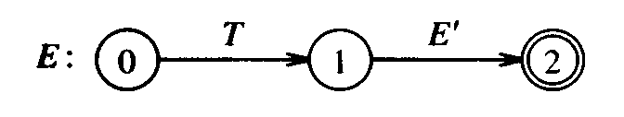
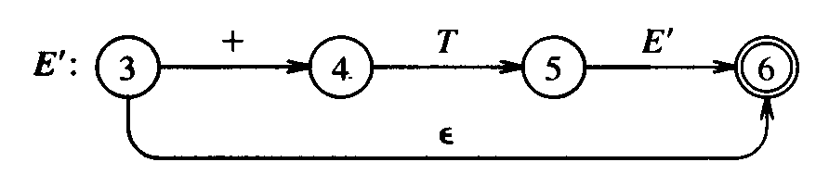
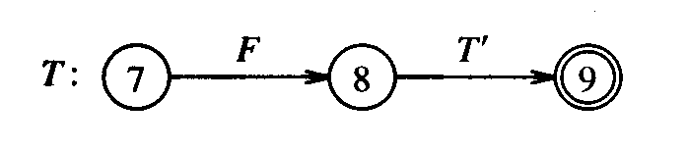
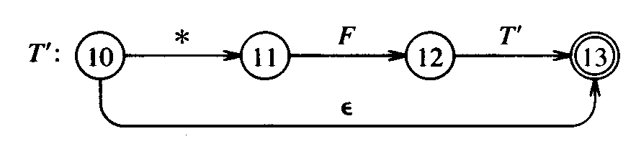
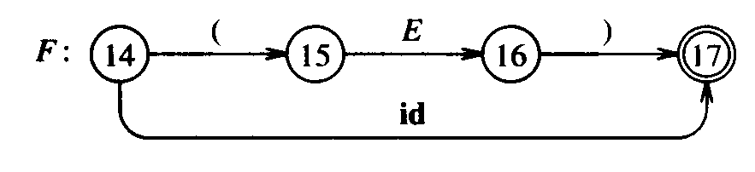
Transition Diagrams for Predictive Parsers
Example
  E → TE’
  E’ → +TE’ | є
  T → FT’
  T’ → *FT’ | є
  F → (E ) | id
  w = id + id * id
E( ) {
T( ); E’( );
}
E’( ) {
if (lookahead == ‘+’) {
T( ); E’( );
}
}

Slide 28
Nonrecursive Predictive Parser
The key problem during predictive parsing is that of determining the production to be applied for a nonterminal
A table-drive predictive parser has an input buffer, a stack, a parsing table, and an output stream
The action of the parser is determined by X, the symbol on top of the stack, and a, the current input symbol
  If X = a = ‘$’, the parser halts and announces successful completion of parsing
  If X = a ≠ ‘$’, the parser pops X off the stack and advances the input pointer to the next input symbol
  If X is a nonterminal, the program consults entry M[X, a] of the parsing table M.
    If, for example, M[X, a] = {X → UVW }, the parser replaces X on top of the stack by WVU (with U on top).
    If M[X, a] = error, the parser calls an error recovery routine.

Slide 29
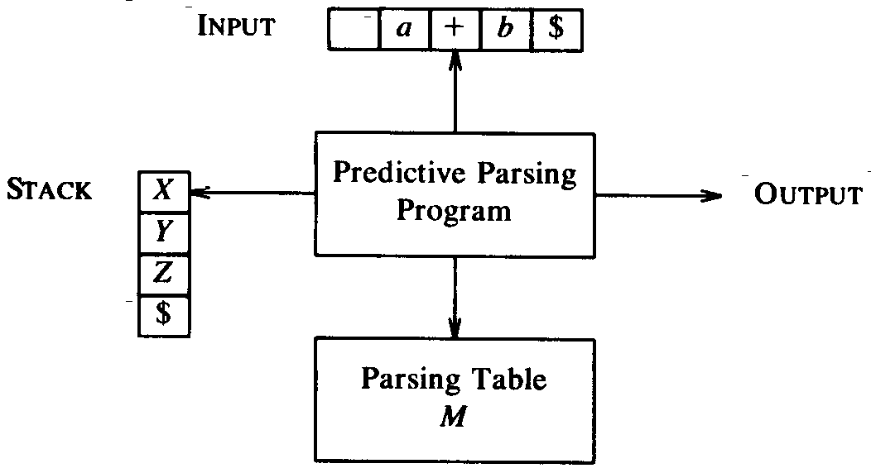
Nonrecursive Predictive Parser
Algorithm
  Input. A string w$ and a parsing table M
  Output. A leftmost derivation of w
  Method. Initially, stack = $S
  set ip to point to the first symbol of w$
  repeat
    let X be the top stack symbol and a the symbol pointed by ip
    if X is a termonal or $ then
      if X = a then
        pop X off the stack and advance ip
    else /* X is a nonterminal */
      if M[X, a] = X → Y₁ Y₂ …Y_{k}, then
        pop X from the stack
        push Y_{k}, Y_{k-1}, …, Y₁ onto the stack, with Y₁ on the top
        Output the production X → Y₁ Y₂ …Y_{k}
      else error( )
  until X = $ /* stack is empty */

Slide 30
Nonrecursive Predictive Parser
  Stack Input Output
  $E id + id * id$
  $E’T id + id * id$ E → TE’
  $E’T’F id + id * id$ T→ FT’
  $E’T’ id id + id * id$ F → id
  $E’T’ + id * id$
  $E’ + id * id$ T’ → є
  $E’T + + id * id$ E’ → +TE’
  $E’T id * id$
  $E’T’F id * id$ T→ FT’
  $E’T’ id id * id$ F→ id
  $E’T’ * id$
  $E’T’F * * id$ T’→ *FT’
  $E’T’F id$
  $E’T’ id id$ F→ id
  $E’T’ $
  $E’ $ T’→ є
  $ $ E’→ є
  Leftmost Derivation
  E ⇒
  TE’ ⇒
  FT’E’ ⇒
  idT’E’ ⇒
  idE’ ⇒
  id +TE’ ⇒
  id +FT’E’ ⇒
  id + idT’E’ ⇒
  id + id *FT’ E’ ⇒
  id + id * id T’ E’ ⇒
  id + id * id E’ ⇒
  id + id * id
Example
  E → TE’
  E’ → +TE’ | є
  T → FT’
  T’ → *FT’ | є
  F → (E ) | id
Parsing Table
  Fig. 4.15

Slide 31
FIRST and FOLLOW
The construction of a predictive parser is aided by two functions associated with a grammar G
FIRST(α)
  The set of terminals that begins the strings derived from α
  To compute FIRST(X ) for all grammar symbols X, apply the following rules until no more terminals or є can be added
    If X is a terminal, then FIRST(X ) = {X }
    If X → є is a production, then add є to FIRST(X )
    If X → Y₁ Y₂ … Y_{k} is a production, then
      Place a in FIRST(X ) if
      ∃i (1 ≤ i ≤ k) ∋ a ∈ FIRST(Y_{i} ) and є ∈ FIRST(Y_{j} ) ∀j (1 ≤ j ≤ i)
      Place є in FIRST(X) if
      ∀i (1 ≤ i ≤ k) є ∈ FIRST(Y_{i} )

Slide 32
FIRST and FOLLOW
FOLLOW(A)
  The set of terminals a that can appear immediately to the right of A in some sentential form, i.e.
  a ∈ FOLLOW(A) if there exists a derivation S ⇒ αA aβ
  To compute FOLLOW(A) for all nonterminals A, apply the following rules until nothing can be added
    Place $ in FOLLOW(S )
    If there is production A → αB β, then
    add FIRST(β) − {є} to FOLLOW(B )
    If there is production A → αB , then
    add FOLLOW(A) to FOLLOW(B )
    If there is production A → αB β and є ∈ FIRST(β), then
    add FOLLOW(A) to FOLLOW(B )

Slide 33
FIRST and FOLLOW
Example
  E → TE’
  E’ → +TE’ | є
  T → FT’
  T’ → *FT’ | є
  F → (E ) | id
FIRST
  FIRST(E) = FIRST(T) = FIRST(F) = {(, id}
  FIRST(E’) = {+, є}
  FIRST(T’) = {*, є}
FOLLOW
  FOLLOW(E) = FOLLOW(E’) = {), $}
  FOLLOW(T) = FOLLOW(T’) = {+, ), $}
  FOLLOW(F) = = {+, *, ), $}

Slide 34
Construction of Predictive Parsing Table
Algorithm
  Input. Grammar G
  Output. Parsing table M
  Method.
    For each production A → α, do steps 2 to 4
    For each terminal a ∈ FIRST(α), then
    add A → α to M[A, a]
    If є ∈ FIRST(α), then
    add A → α to M[A, b] for each terminal b ∈ FOLLOW(A)
    If є ∈ FIRST(α) and $ ∈ FOLLOW(A), then
    add A → α to M[A, $]
    Make each undefined entry of M be error

Slide 35
Construction of Predictive Parsing Table
  Example
  E → TE’
  E’ → +TE’ | є
  T → FT’
  T’ → *FT’ | є
  F → (E ) | id
  FIRST(E) = {(, id}
  FIRST(T) = {(, id}
  FIRST(F) = {(, id}
  FIRST(E’ ) = {+, є}
  FIRST(T’ ) = {*, є}
  FOLLOW(E) ={), $}
  FOLLOW(E’ ) = {), $}
  FOLLOW(T) = {+, ), $}
  FOLLOW(T’ ) = {+, ), $}
  FOLLOW(F) = = {+, *, ), $}
Nonter-minal | Input Symbol
 | id | + | * | ( | ) | $
E
E’
T
T’
F
E → TE’
E → TE’
E’ → +TE’
E’ → є
E’ → є
T → FT’
T → FT’
T’ → є
T’ → *FT’
T’ → є
T’ → є
F → id
F→ (E )

Slide 36
Construction of Predictive Parsing Table
  Example
  S → iE tSS’ | a
  S’ → eS | є
  E → b
  FIRST(S) = {i, a}
  FIRST(S’) = {e, є}
  FIRST(E) = {b}
  FOLLOW(S) ={e, $}
  FOLLOW(S’) = {e, $}
  FOLLOW(E) = {t}
Nonter-minal | Input Symbol
 | a | b | e | i | t | $
S
S’
E
S → a
S → iE tSS’
S’ → eS
S’ → є
S’ → є
E → b

Slide 37
LL(1) Grammars
A grammar whose parsing table has no multiply-defined entries is said to be LL(1)
  1st L: scanning the input from left to right
  2nd L: producing a leftmost derivation
  1: using one input symbol for lookahead at each step
Properties
  Not ambiguous
  Not left recursive
  Where A → α | β are two distinct productions in G, the following conditions hold:
    For no terminal a do both α and β derive strings beginning with a
      i.e. FIRST(α) ∩ FIRST(β) = ψ
    At most one of α and β can derive the empty string
    If β derives the empty string then α does not derive any string beginning with a terminal in FOLLOW(A)
      i.e. FIRST(α) ∩ FOLLOW(A) = ψ

Slide 38
Error Handling in Predicting Parsing
An error is detected when
  The terminal on top of the stack does not match the next input symbol, or
  Nonterminal A is on top of the stack, a is the next input symbol, and M[A, a] is empty
Panic-mode error recovery
  Based on the idea of skipping symbols on the input until a token in a selected set of synchronizing tokens appears
  Some heuristics of choosing the synchronizing tokens
    Place all symbols in FOLLOW(A) into the synchronizing set of A
    Add symbols in FIRST(A) to the synchronizing set of A
    If a nonterminal can generate є, then the production deriving є can be used as a default
    If a terminal on top of the stack cannot be matched, then pop the terminal

Slide 39
Error Handling in Predicting Parsing
  Stack Input Output
  $E + id * + id$ error, skip +
  $E id * + id$ id ∈ FIRST(E)
  $E’T id * + id$
  $E’T’ F id * + id$
  $E’T’ id id * + id$
  $E’T’ * + id$
  $E’T’F * * + id$
  $E’T’F + id$ error, M[F,+] = sync
  $E’T’ + id$ F has been popped
  $E’ + id$
  $E’T + + id$
  $E’T id$
  $E’T’F id$
  $E’T’ id id$
  $E’T’ $
  $E’ $
  $ $
Example
  E → TE’
  E’ → +TE’ | є
  T → FT’
  T’ → *FT’ | є
  F → (E ) | id
Parsing table
  Fig. 4.18
Actions
  M[A, a] = ψ
  input symbol is skipped
  M[A, a] = sync
  nonterminal is popped
  Token on stack isn’t matched
  pop the token

Slide 40
Bottom-Up Parsing
Attempt to construct a parse tree for an input string beginning at the leaves (the bottom) and working up towards to the start symbol
  Example. Consider the grammar
    S → aABe
    A → Abc | b
    B → d
  The sentence abbcde can be reduced to S:
  abbcde
  aAbcde
  aAde
  aABe
  S
  Rightmost Derivation
  S ⇒
  aABe ⇒
  aAde ⇒
  aAbcde ⇒
  abbcde

Slide 41
Bottom-Up Parsing
A general style of bottom-up syntax analysis, known as shift-reduce parsing, will be introduced
  The process of constructing a parse tree can be thought of as “reducing” a string w to the start symbol
  It is equivalent to performing a rightmost derivation in reverse
  At each reduction step, a particular substring matching the right side of a production is replaced by the symbol on the left
    The matched substring can be called a handle
    The reduction of a handle represents one step along the rightmost derivation in reverse
  Formally, a handle of γ is
    A production A → β, and
    A position of γ where the substring β may be found
    e.g. A → b at position 2 is a handle of abbcde
    A → Abc at position 2 is a handle of aAbcde

Slide 42
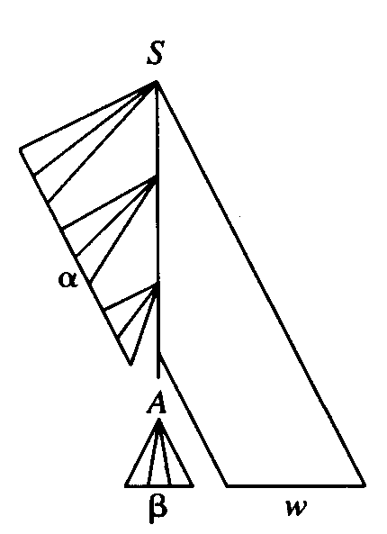
Handle Pruning
Suppose A → β is a handle
  It represents a leftmost complete subtree consisting of a node and all its children
  Reducing β to A in αβw can be thought of “pruning the handle”
    i.e. removing the children of A
A rightmost derivation in reverse can be obtained by handle pruning

Slide 43
Stack Implementation of Shift-Reduce Parsing
Two problems for parsing by handle pruning
  To locate the substring to be reduced
  To determine what production to choose in case there is more than one production with that substring
A convenient way to implement a shift-reduce parser is to use a stack to hold grammar symbols
  Actions
    Shift
      the next input symbol is shifted onto the top of the stack
    Reduce
      The handle is at the top of the stack
      Remove the handle and place the left side nonterminal on the stack
    Accept
      Announce successful completion of parsing
    error

Slide 44
Stack Implementation of Shift-Reduce Parsing
Example. (1) E → E + E
  (2) E → E * E
  (3) E → (E )
  (4) E → id
  Stack Input Action
  $ id + id * id$ shift
  $id + id * id$ reduce by (4)
  $E + id * id$ shift
  $E + id * id$ shift
  $E + id * id$ reduce by (4)
  $E + E * id$ shift
  $E + E * id$ shift
  $E + E * id $ reduce by (4)
  $E + E * E $ reduce by (2)
  $E + E $ reduce by (1)
  $E $ accept
  Stack Input Action
  $ id + id * id$ shift
  $id + id * id$ reduce by (4)
  $E I + id * id$ shift
  $E + id * id$ shift
  $E + id * id$ reduce by (4)
  $E + E * id$ reduce by (1)
  $E * id$ shift
  $E * id$ shift
  $E * id $ reduce by (4)
  $E * E $ reduce by (2)
  $E $ accept

Slide 45
Conflicts During Shift-Reduce Parsing
For some grammars, a shift-reduce parser can’t decide
  whether to shift or to reduce (a shift/reduce conflict), or
  which of several reductions to make (a reduce/reduce conflict)
  Example 1
  Stack Input Action Stack Input Action
  $E + E * id$ shift $E + E * id$ reduce by E → E + E
  $E + E * id$ $E * id$
  Example 2
  stmt → if expr then stmt
  | if expr then stmt else stmt
  | other
  Stack Input
  … if expr then stmt else … $

Slide 46
LR Parsers
LR(k) parsing
  an efficient, bottom-up parsing technique
  L: scanning the input from left to right
  R: producing a rightmost derivation in reverse
  k: the number of input symbols of lookahead
Advantages
  Can recognize virtually all programming-language constructs for which context-free grammars can be written
  The most general nonbacktracking shift-reduce parsing
  The class of grammars that can be parsed using LR methods is a proper superset of the class of grammars that can be parsed with predictive parsers
  Can detect a syntactic error as soon as possible
Drawback
  Too much work to construct an LR parser by hand

Slide 47
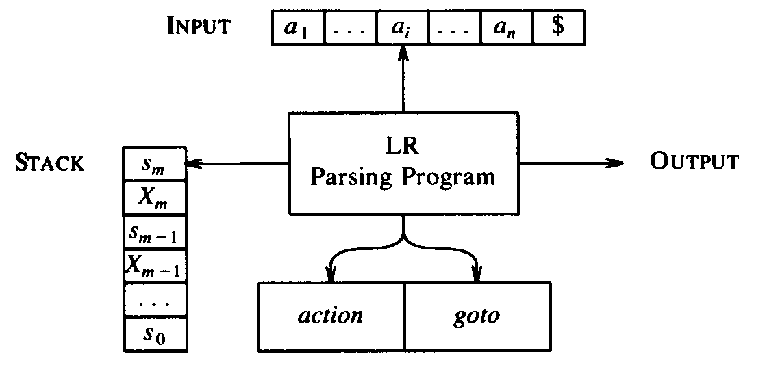
LR Parsing Algorithm
Configuration
  The stack contents
  The unexpended input
  (s₀ X₁ s₁ X₂ s₂ … X_{m} s_{m}, a_{i} a_{i+1} … a_{n}$)
  It represents the sentential form
  X₁X₂… X_{m}a_{i} a_{i+1} … a_{n}
Next move is determined by the input symbol a_{i} and stack top s_{m}
  action[s_{m}, a_{i}] = shift s
  (s₀ X₁ s₁ X₂ s₂ … X_{m} s_{m} a_{i} s, a_{i+1} … a_{n}$)
  action[s_{m}, a_{i}] = reduce A → β
  (s₀ X₁ s₁ X₂ s₂ … X_{m-r} s_{m-r} A s, a_{i} … a_{n}$)
  where s = goto[s_{m-r}, A] and | β | = r
  action[s_{m}, a_{i}] = accept
  action[s_{m}, a_{i}] = error

Slide 48
LR Parsing Algorithm
  Input. String w and an LR parsing table
  Output. A bottom-up parsing for w
  Method. Initially, stack = s₀ and input = w $
set ip to point to the first symbol of w $
repeat forever
let s be the state on stack top and a the symbol pointed by ip
if action[s, a] = shift s’ then
push s’ onto the stack and advance the ip
else if action[s, a] = reduce A → β then
push 2*|β| symbols off the stack and now s’ is the top state
push A and then goto[s’ , A] on top of the stack
output A → β
else if action[s, a] = accept then
return
else error()
end

Slide 49
LR Parsing Algorithm
Example.
  (1) E → E + T
  (2) E → T
  (3) T → T * F
  (4) T → F
  (5) F → (E )
  (6) F → id
Parsing table
  Fig. 4.31
  Stack Input Action
  $0 id * id + id$ shift 5
  $0 id 5 * id + id$ reduce by F → id
  $0 F 3 * id + id$ reduce by T → F
  $0 T 2 * id + id$ shift
  $0 T 2 * 7 id + id$ shift
  $0 T 2 * 7 id 5 + id$ reduce by F → id
  $0 T 2 * 7 F 10 + id$ reduce by T → T * F
  $0 T 2 + id$ reduce by E → T
  $0 E 1 + id$ shift
  $0 E 1 + 6 id$ shift
  $0 E 1 + 6 id 5 $ reduce by F → id
  $0 E 1 + 6 F 3 $ reduce by T → F
  $0 E 1 + 6 T 9 $ reduce by E → E + T
  $0 E 1 $ accept

Slide 50
Constructing SLR Parsing Tables
Three techniques for constructing an LR parsing table
  Simple LR (SLR)
  Canonical LR (LR)
  Lookahead LR (LALR)
LR(0) item
  A production of G with a dot at some position of the right side,
  e.g. production A → XYZ yields
  A → ⋅XYZ
  A → X⋅YZ
  A → XY⋅Z
  A → XYZ⋅
  Production A → є yields
  A → ⋅
Augmented grammar G’
  G with a new start symbol S’ and production S’ → S
  Acceptance occurs when the parser is to reduce by S’ → S

Slide 51
Closure Operation
  If I is a set of items, then closure (I ) is the set of items constructed from I:
    Initially, every item in I is added to closure (I )
    If A → α⋅B β is in closure (I ) and B → γ is a production, then add the item B → ⋅ γ to closure (I )
    Repeat until no more new items can be added
function closure (I )
J = I
repeat
for each item A → α⋅B β ∈ J
and each B → γ
such that B → ⋅ γ ∉ J do
  add B → ⋅ γ to J
until no more items can be added to J
return J
end
Example
E’ → E
E → E + T
  E → T
  T → T * F
  T → F
  F → (E )
  F → id
closure({E’ → E }) = {
E’ → ⋅E
E → ⋅ E + T
  E → ⋅ T
  T → ⋅ T * F
  T → ⋅ F
  F → ⋅(E )
  F → ⋅ id }

Slide 52
Goto Operation
  If I is a set of items and X is a grammar symbol, then goto (I, X ) is defined to be the closure of the set of all items A → αX ⋅β such that A → α⋅X β is in I
Example
E’ → E
E → E + T
  E → T
  T → T * F
  T → F
  F → (E )
  F → id
goto ({E’ → E ⋅, E → E ⋅ + T }, +) =
closure ({E → E + ⋅T }) = {
E → E + ⋅T
  T → ⋅ T * F
  T → ⋅ F
  F → ⋅(E )
  F → ⋅ id }
  Viable prefixes
    The set of prefixes of right sentential forms that can appear on the stack of a shift-reduce parser

Slide 53
Set-of-Items Construction
procedure items (G’ )
C = {closure{S’→ ⋅S })}
repeat
for each set of items I in C and each grammar symbol X
such that goto(I, X ) is not empty and not in C do
  add goto(I, X ) to C
until no more set of items can be added to C
end
Example G =
E’ → E
E → E + T
  E → T
  T → T * F
  T → F
  F → (E )
  F → id
I₀: E’ → ⋅E
E → ⋅ E + T
  E → ⋅ T
  T → ⋅ T * F
  T → ⋅ F
  F → ⋅(E )
  F → ⋅ id

Slide 54
Set-of-Items Construction
I₀: E’ → ⋅E
E → ⋅ E + T
  E → ⋅ T
  T → ⋅ T * F
  T → ⋅ F
  F → ⋅(E )
  F → ⋅ id
goto(I₀, “(“) =
I₄: F → (⋅ E )
E → ⋅ E + T
  E → ⋅ T
  T → ⋅ T * F
  T → ⋅ F
  F → ⋅(E )
  F → ⋅ id
goto(I₂, “*“) =
I₇: T → T * ⋅F
  F → ⋅(E )
  F → ⋅ id
goto(I₆, F) = I₃
goto(I₆, “(“) = I₄
goto(I₆, id) = I₅
goto(I₄, E) =
I₈: F → (E ⋅)
E → E ⋅ + T
goto(I₇, F ) =
I₁₀: T → T * F ⋅
goto(I₇, “(“) = I₄
goto(I₀, E) =
I₁: E’ → E ⋅
E → E ⋅ + T
goto(I₄, T) = I₂
goto(I₀, id) =
I₅: F → id ⋅
goto(I₇, id) = I₅
goto(I₄, F) = I₃
goto(I₄, “(“) = I₄
goto(I₈, “)“) =
I₁₁: F → (E) ⋅
goto(I₀, T) =
I₂: E → T ⋅
  T → T ⋅ * F
goto(I₁, “+“) =
I₆: E → E + ⋅T
  T → ⋅ T * F
  T → ⋅ F
  F → ⋅(E )
  F → ⋅ id
goto(I₄, id) = I₅
goto(I₈, “+“) = I₆
goto(I₆, T ) =
I₉: E → E + T ⋅
  T → T ⋅ * F
goto(I₀, F) =
I₃:T → F ⋅
goto(I₉, “*“) = I₇

Slide 55
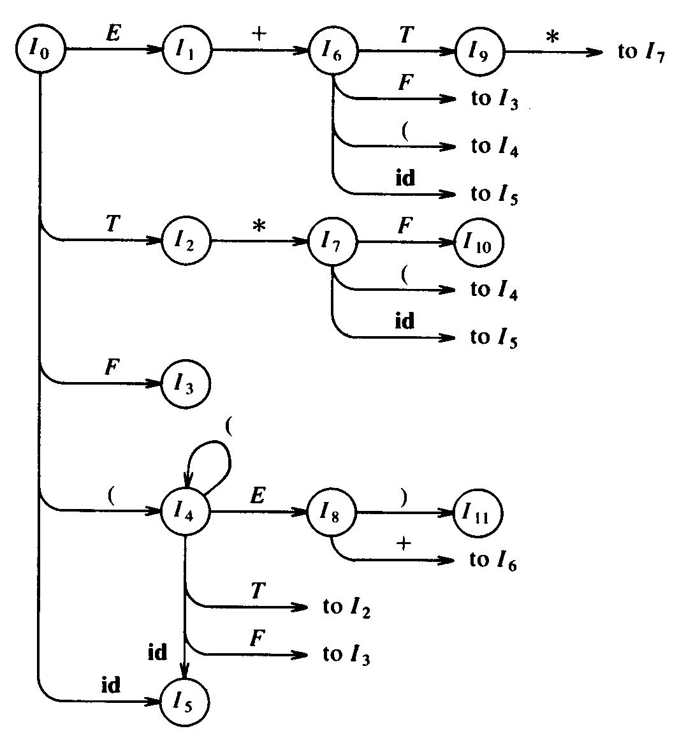
Transition Diagram of DFA for Viable Prefixes
The goto function for the sets of items can be represented as the transition diagram of a DFA D
  Each set of items I_{i} is a state of D
  Rightmost Derivation
  E ⇒
  E +T ⇒
  E +F ⇒
  E + id ⇒
  T + id ⇒
  T * F + id ⇒
  T * id + id ⇒
  F * id + id ⇒
  id + id * id

Slide 56
Transition Diagram of DFA for Viable Prefixes
D recognizes exactly the viable prefixes of G if
  Each state is a final state, and
  I₀ is the initial state
For every grammar G, the goto function of the collection of sets of items defines a DFA that recognizes the viable prefix of G
  If each item is treated as a state, an NFA N can be formed:
    There is a transition from A → α ⋅X β to A → αX ⋅β label X, and
    There is a transition from A → α ⋅B β to B → ⋅γ labeled є
  Then closure (I ) for the set of items I is exactly the є-closure of a set of NFA states
  Thus goto(I, X ) gives the transition from I on symbol X in the DFA constructed from N by the subset construction
  The procedure items (G’ ) is just the subset construction itself applied to the NFA N

Slide 57
Constructing an SLR Parsing Table
Algorithm
  Input. An augmented grammar G’
  Output. The SLR parsing table for G’
  Method.
    Construct C = {I₀, I₁, I₂, …, I_{n}}, the sets of LR(0) items
    State i is constructed from I_{i}. Actions for state i
      If A → α ⋅ aβ ∈ I_{i} and goto(I_{i}, a) = I_{j}, then
      action[i, a] = shift j
      If A → α ⋅ ∈ I_{i} , then
      action[i, a] = reduce A → α ∀a ∈ FOLLOW(A)
      If S’ → S ⋅ ∈ I_{i} , then
      action[i, $] = accept
    If goto(I_{i} , A) = I_{j}, then
      goto[i, A] = j
    The set of items containing S’ → S ⋅ is the initial state

Slide 58
Constructing an SLR Parsing Table
  Example
  (0) E’ → E
  (1) E → E +T
  (2) E → T
  (3) T → T * F
  (4) T → F
  (5) F → (E )
  (6) F → id
  FOLLOW(E ) ={+, ), $}
  FOLLOW(T) = {+, *, ), $}
  FOLLOW(F) = {+, *, ), $}
 | action |  |  |  |  |  | goto
 | id | + | * | ( | ) | $ | E | T | F
0
1
2
3
4
5
6
7
8
9
10
11
s5
s4
1
2
3
s6
acc
r2
s7
r2
r2
goto(I₆, T ) =
I₉: E → E + T ⋅
  T → T ⋅ * F
r4
r4
r4
r4
goto(I₉, “*“) = I₇
I₀: E’ → ⋅E
E → ⋅ E + T
  E → ⋅ T
  T → ⋅ T * F
  T → ⋅ F
  F → ⋅(E )
  F → ⋅ id
goto(I₀, id) =
I₅: F → id
goto(I₇, id) = I₅
goto(I₈, “)“) =
I₁₁: F → (E) ⋅
goto(I₀, E) =
I₁: E’ → E ⋅
E → E ⋅ + T
goto(I₂, “*“) =
I₇: T → T * ⋅F
  F → ⋅(E )
  F → ⋅ id
goto(I₄, E) =
I₈: F → (E ⋅)
E → E ⋅ + T
goto(I₄, F) = I₃
goto(I₆, “(“) = I₄
goto(I₀, F) =
I₃:T → F ⋅
goto(I₆, id) = I₅
goto(I₀, “(“) =
I₄: F → (⋅ E )
E → ⋅ E + T
  E → ⋅ T
  T → ⋅ T * F
  T → ⋅ F
  F → ⋅(E )
  F → ⋅ id
goto(I₆, F) = I₃
goto(I₈, “+“) = I₆
goto(I₄, T) = I₂
goto(I₄, “(“) = I₄
goto(I₄, id) = I₅
goto(I₇, F ) =
I₁₀: T → T * F
goto(I₀, T) =
I₂: E → T ⋅
  T → T ⋅ * F
goto(I₇, “(“) = I₄
goto(I₁, “+“) =
I₆: E → E + ⋅T
  T → ⋅ T * F
  T → ⋅ F
  F → ⋅(E )
  F → ⋅ id
s5
s4
8
2
3
r6
r6
r6
r6
s5
s4
9
3
s5
s4
10
s6
s11
r1
s7
r1
r1
r3
r3
r3
r3
r5
r5
r5
r5

Slide 59
Constructing an SLR Parsing Table
  Some grammars are not SLR, e.g.
  (0) S’ → S
  (1) S → L = R
  (2) S → R
  (3) L → *R
  (4) L → id
  (5) R → L
goto(I₀, S) =
I₁: S’ → S ⋅
goto(I₂, “=”) =
I₆: S → L = ⋅ R
R → ⋅ L
  L → ⋅ * R
  L → ⋅ id
goto(I₀, L) =
I₂: S → L ⋅ = R
  R → L ⋅
goto(I₄, “=”) =
I₇: L → *R ⋅
goto(I₀, R) =
I₃: S → R ⋅
goto(I₀, “*”) =
I₄: L → * ⋅ R
R → ⋅ L
  L → ⋅ * R
  L → ⋅ id
goto(I₄, L) =
I₈: R → L ⋅
I₀: S’ → ⋅S
S → ⋅ L = R
  S → ⋅ R
  L → ⋅ *R
  L → ⋅ id
  R → ⋅ L
goto(I₆, R) =
I₆: S → L = R ⋅
goto(I₀, id) =
I₅: L → id ⋅

Slide 60
Constructing an SLR Parsing Table
  Some grammars are not SLR, e.g.
  (0) S’ → S
  (1) S → L =R
  (2) S → R
  (3) L → * R
  (4) L → id
  (5) R → L
 | action |  |  |  | goto
 | id | = | * | $ | S | L | R
0
1
2
3
4
5
6
7
8
s6
r5
  FOLLOW(S ) ={$}
  FOLLOW(L) = {=, $}
  FOLLOW(R) = {=, $}
I₂: S → L ⋅ = R
  R → L ⋅

Slide 61
Constructing Canonical LR Parsing Tables
Why does SLR sometimes fail
  R → L ⋅ ∈ I₂ ⇨ action[2, ‘=‘] = reduce R → L
    ∵ = ∈ FOLLOW(R )
  However, there is no sentential form begins R = …
  Extra information will be incorporated by redefining items
LR(1) items
  The general form of an items becomes [A →α ⋅ β, a]
    The lookahead a has no effect when β ≠ є
    [A →α ⋅, a] calls for a reduction by A →α if the next symbol is a
  Formally, LR(1) is valid for a viable prefix γ if there is a derivation S ⇒ δAw ⇒ δαβw, where
*
    γ = δα, and
    Either a is the first symbol of w, or w is є and a is $

Slide 62
Sets of LR(1) Items
function closure (I )
J = I
repeat
for each item [A → α⋅B β, a] ∈ J
each B → γ in G’ and
each terminal b ∈ FIRST(βa)
such that [B → ⋅ γ, b] ∉ J do
  add [B → ⋅ γ, b] to J
until no more items can be added to J
return J
end
function goto (I, X )
J = set of items [A → αX ⋅ β, a]
such that [A → α⋅X β, a] ∈ I
return closure (J )
end
procedure items (G’ )
C = {closure ({S’ → ⋅ S })}
repeat
for each set of item I ∈ C and each grammar symbol X
such that goto (I, X ) ∉ C do
  add goto (I, X ) to C
until no more sets of items can be added to C
end

Slide 63
Sets of LR(1) Items
Example G’ =
S’ → S
S → CC
  C → cC
  C → d
goto (I₀, S) =
I₁: S’ → S ⋅, $
goto (I₀, d) =
I₄: C → d ⋅, c/d
goto (I₂, d) =
I₇: C → d ⋅, $
goto (I₀, C) =
I₂: S → C ⋅ C, $
  C → ⋅ cC, $
  C → ⋅ d, $
goto (I₂, C) =
I₅: S → CC ⋅, $
goto (I₃, C) =
I₈: C → cC ⋅ , c/d
I₀: S’ → ⋅S, $
S → ⋅ CC, $
  C → ⋅ cC, c/d
  C → ⋅ d, c/d
goto (I₃, c) = I₃
goto (I₃, d) = I₄
goto (I₀, c) =
I₃: C → c ⋅ C, c/d
  C → ⋅ cC, c/d
  C → ⋅ d, c/d
goto (I₂, c) =
I₆: C → c ⋅ C, $
C → ⋅ cC, $
  C → ⋅ d, $
goto (I₆, C) =
I₉: C → cC ⋅ , $
goto (I₆, c) = I₆
goto (I₆, d) = I₇

Slide 64
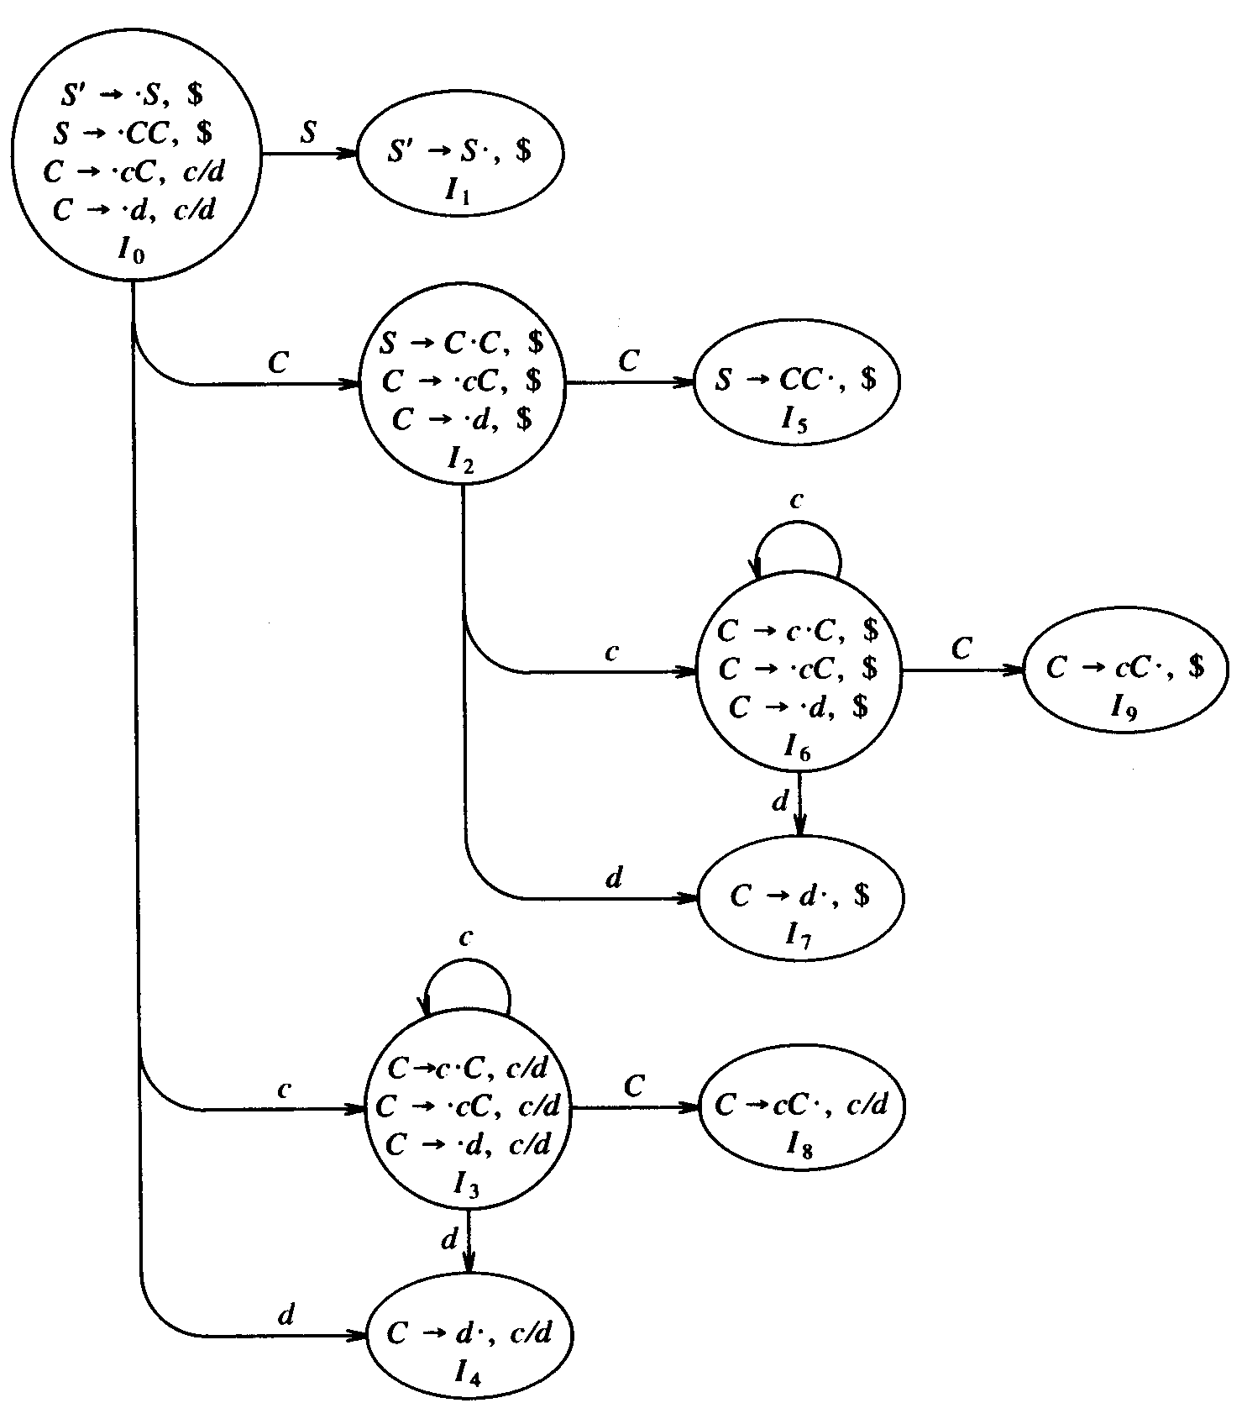
Sets of LR(1) Items
The goto graph

Slide 65
Construction of the LR Parsing Table
Algorithm
  Input. An augmented grammar G’
  Output. The canonical LR parsing table for G’
  Method.
    Construct C = {I₀, I₁, I₂, …, I_{n}}, the sets of LR(1) items
    State i is constructed from I_{i}. Actions for state i
      If [A → α ⋅ aβ, b] ∈ I_{i} and goto(I_{i}, a) = I_{j}, then
      action[i, a] = shift j
      If [A → α ⋅, a] ∈ I_{i} and , A ≠ S’ then
      action[i, a] = reduce A → α
      If [S’ → S ⋅, $] ∈ I_{i} , then
      action[i, $] = accept
    If goto(I_{i} , A) = I_{j}, then
      goto[i, A] = j
    The set of items containing [S’ → S ⋅, $] is the initial state

Slide 66
Constructing an LR Parsing Table
Example G’ =
S’ → S
S → CC
  C → cC
  C → d
 | action |  |  | goto
 | c | d | $ | S | C
0
1
2
3
4
5
6
7
8
9
s3
s4
1
2
acc
s6
s7
5
s3
s4
8
r3
r3
r1
s6
s7
9
r3
r2
r2
r2

Slide 67
Constructing LALR Parsing Tables
Lookahead LR (LALR) technique
  Often used in practice because the tables are much smaller than the LR tables
  Yet most common syntactic constructs of programming languages can be expressed by an LALR grammar
  Consider the following sets of LR(1) items
I₃: C → c ⋅ C, c/d
  C → ⋅ cC, c/d
  C → ⋅ d, c/d
I₆: C → c ⋅ C, $
C → ⋅ cC, $
  C → ⋅ d, $
I₄: C → d ⋅, c/d
I₇: C → d ⋅, $
    The only difference is the lookahead symbols
    Note the G’ generates the language c*dc*d
  An LALR parsing table can be obtained by merging the sets of items of a LR table with the same core

Slide 68
Construction of the LALR Parsing Table
Algorithm
  Input. An augmented grammar G’
  Output. The LALR parsing table for G’
  Method.
    Construct C = {I₀, I₁, I₂, …, I_{n}}, the sets of LR(1) items
    For each core in C, find all sets with that core and replace these sets by their union. Let result be C’ = {J₀, J₁, J₂, …, J_{m}}
    State i is constructed from J_{i}. Actions for state i
      If [A → α ⋅ aβ, b] ∈ J and goto(J_{i}, a) = J_{j}, then
      action[i, a] = shift j
      If [A → α ⋅, a] ∈ J_{i} and , A ≠ S’ then
      action[i, a] = reduce A → α
      If [S’ → S ⋅, $] ∈ J_{i} , then
      action[i, $] = accept
    If J_{i} = I₁∪I₂∪…∪I_{k}, then goto(I₁,X)=goto(I₂,X)=…=goto(I_{k},X)=J_{j}
      ∴ goto[i, X] = j

Slide 69
Construction of the LALR Parsing Table
I₃: C → c ⋅ C, c/d
  C → ⋅ cC, c/d
  C → ⋅ d, c/d
I₆: C → c ⋅ C, $
C → ⋅ cC, $
  C → ⋅ d, $
 | action |  |  | goto
 | c | d | $ | S | C
0
1
2
3
4
5
6
7
8
9
s3
s4
1
2
s36
s47
acc
I₄: C → d ⋅, c/d
I₇: C → d ⋅, $
s6
s7
5
s36
s47
s3
s4
8
I₈: C → cC ⋅ , c/d
36
s36
s47
89
I₉: C → cC ⋅ , $
47
r3
r3
r3
r1
s6
s7
9
r3
89
r2
r2
r2
r2

Slide 70
Error Detection by LALR
LALR parser may proceed to do some reductions after the LR parser has declared an error
  LALR parser will never shift another symbol after the LR parser declares an error
  Example w = ccd$
  Stack Input Action
  $0 ccd$ shift 36
  $0 c 36 cd$ shift 36
  $0 c 36 c 36 d$ shift 36
  $0 c 36 c 36 d 47 $ reduce by C → d
  $0 c 36 c 36 C 89 $ reduce by C → cC
  $0 c 36 C 89 $ reduce by C → cC
  $0 C 2 $ error
  Stack Input Action
  $0 ccd$ shift 3
  $0 c 3 cd$ shift 3
  $0 c 3 c 3 d$ shift 3
  $0 c 3 c 3 d 4 $ error

Slide 71
Conflicts Caused by Merging States
Merging states with common cores might cause conflicts
  No shift-reduce conflicts will be introduced
    Because shift actions depend only on the core, not the lookahead
  Reduce-reduce conflicts might be produced by merging
Example G’ =
S’ → S
S → aA d | bB d | aB e | bA e
  A → c
  B → c
I₀: S’ → ⋅S, $
S → ⋅ aA d | ⋅ bB d | ⋅ aB e | ⋅ bA e, $
goto (I₀, S) = I₁: S’ → S ⋅, $
goto (I₀, a) =
I₂: S → a ⋅ A d | a ⋅ B e, $
  A → ⋅ c, d
  B → ⋅ c, e
goto (I₀, b) =
I₃: S → b ⋅ B d | b ⋅ A e, $
  A → ⋅ c, e
  B → ⋅ c, d
merge I₄ and I₅ =
I₄₅: A → c ⋅, d/e
  B → c ⋅, d/e
goto (I₂, b) =
I₄: A → c ⋅, e
  B → c ⋅, d
goto (I₃, a) =
I₅: A → c ⋅, d
  B → c ⋅, e

Slide 72
Using Ambiguous Grammars
Every ambiguous grammar fails to be LR
  Certain types of ambiguous grammars are useful in the specification and implementation of languages
    An ambiguous grammar provides a shorter, more natural specification than any equivalent unambiguous grammar
    e.g. E → E + E | E * E | (E ) | id
    Ambiguous grammars can be used to isolate commonly occurring syntactic constructs for special case optimization
  Disambiguating rules must be specified to allow only one parse tree for each sentence
    e.g. using precedence and associativity to resolve conflicts
    In this way, the overall language specification still remains unambiguous

Slide 73
Using Precedence and Associativity
Example G’
(0) E’ → E
(1) E → E + E
  (2) E → E * E
  (3) E → (E )
  (4) E → id
goto (I₀, ‘(‘) =
I₂: E → (⋅ E )
E → ⋅ E + E
  E → ⋅ E * E
  E → ⋅ (E )
  E → ⋅ id
goto (I₁, ‘*‘) =
I₅: E → E * ⋅ E
E → ⋅ E + E
  E → ⋅ E * E
  E → ⋅ (E )
  E → ⋅ id
goto (I₅, E ) =
I₈: E → E * E ⋅
E → E ⋅ + E
  E → E ⋅ * E
goto (I₆, ‘)’) =
I₆: E → (E ) ⋅
I₀: E’ → ⋅ E
E → ⋅ E + E
  E → ⋅ E * E
  E → ⋅ (E )
  E → ⋅ id
goto (I₀, id) =
I₃: E → ⋅ id
goto (I₀, E ) =
I₆: E → (E ⋅ )
E → E ⋅ + E
  E → E ⋅ * E
goto (I₁, ‘+‘) =
I₄: E → E + ⋅ E
E → ⋅ E + E
  E → ⋅ E * E
  E → ⋅ (E )
  E → ⋅ id
 | action |  |  | goto
 | + | * | …
…
7
8
9
goto (I₄, E ) =
I₇: E → E + E ⋅
E → E ⋅ + E
  E → E ⋅ * E
goto (I₀, E) =
I₁: E’ → E ⋅
E → E ⋅ + E
  E → E ⋅ * E
s4
s5
r2
r2
s4
s5
r3
r3

Slide 74
The “Dangling-else” Ambiguity
Example G’
(0) S’ → S
(1) S → iS eS
  (2) S → iS
  (3) S → a
goto (I₀, i) =
I₂: S → i ⋅ S eS
  S → i ⋅ S
  S → ⋅ iS eS
  S → ⋅ iS
  S → ⋅ a
goto (I₄, e) =
I₅: S → i S e ⋅ S
  S → ⋅ iS eS
  S → ⋅ iS
  S → ⋅ a
goto (I₅, S ) =
I₆: S → iS eS ⋅
I₀: S’ → ⋅ S
S → ⋅ iS eS
  S → ⋅ iS
  S → ⋅ a
goto (I₀, a) =
I₃: S → a ⋅
 | action |  |  | goto
 | i | e | …
…
4
8
9
s5
goto (I₂, S) =
I₄: S → iS ⋅ eS
  S → iS ⋅
r2
goto (I₀, S) =
I₁: S’ → S ⋅

Slide 75
Ambiguities from Special-Case Productions
Example G’
(0) E’ → E
(1) E → E sub E sup E
  (2) E → E sub E
  (3) E → E sup E
  (4) E → {E }
  (5) E → c
I₇: E’ → E ⋅
E → E ⋅ sub E sup E
E → E sub E ⋅ sup E
  E → E ⋅ sub E
  E → E sub E ⋅
  E → E ⋅ sup E
 | action |  |  |  | goto
 | sub | sup | } | $
…
7
8
9
11
I₈: E’ → E ⋅
E → E ⋅ sub E sup E
E → E ⋅ sub E
  E → E ⋅ sub E
  E → E sup E ⋅
I₀: E’ → ⋅ E
E → ⋅ E sub E sup E
  E → ⋅ E sub E
  E → ⋅ E sup E
  E → ⋅ {E }
  E → ⋅ c
s4
s10
r2
r2
r2
r2
s4
s5
I₁₁: E’ → E ⋅
E → E ⋅ sub E sup E
E → E sub E sup E ⋅
  E → E ⋅ sub E
  E → E ⋅ sup E
  E → E sup E ⋅
r3
r3
r3
r3
s4
s5
r1
r1
r1
r1
r3
r3
r3
r3

Slide 76
Operator-Precedence Parsing
Works on a class of grammars: operator grammars
  No production right side is є or has two adjacent nonterminals
  e.g. E → EAE | (E ) | -E | id
  A → + | - | * | /
  is not an operator grammar
  E → E + E | E - E | E * E | E / E | (E ) | -E | id
  is an operator grammar
Advantages
  Easy to implement
Disadvantages
  Hard to handle tokens like the minus sign (with 2 precedence)
  Can’t be sure the parser accepts exactly the desired language
  Only a small class of grammars can be parsed

Slide 77
Operator-Precedence Parsing
Precedence relations
Relation
Meaning
a <⋅ b
a “yields precedence to” b
a ≐ b
a “has the same precedence as” b
a ⋅> b
a “takes precedence over” b
  Example E → E + E | E - E | E * E | E / E | (E ) | -E | id
 | id | + | * | $
id |  | ⋅> | ⋅> | ⋅>
+ | <⋅ | ⋅> | <⋅ | ⋅>
* | <⋅ | ⋅> | ⋅> | ⋅>
$ | <⋅ | <⋅ | <⋅

Slide 78
Operator-Precedence Parsing
The handle can be found by the steps
  Scan the string from left until the first ⋅> is encountered
  Then scan back backwards over any ≐ until a <⋅ is encountered
  The handle contains everything within the <⋅ and ⋅> above, including any intervening or surrounding nonterminals
  e.g. w = id + id * id
  $ <⋅ id ⋅> + <⋅ id ⋅> * <⋅ id ⋅> $
  $ <⋅ E + <⋅ id ⋅> * <⋅ id ⋅> $
  $ <⋅ E + <⋅ E * <⋅ id ⋅> $
  $ <⋅ E + <⋅ E * E ⋅> $
  $ <⋅ E + E ⋅> $
  $E $

