Slide 1
編譯器設計
Chapter 7:
Run-Time Environment

Slide 2
Run-Time Environment
Run-time environment
  Relate the static source text of a program to the action that must occur at run time to implement the program
  As execution proceeds, the same name in source text an denote different data objects in the target machine
    e.g. Fig. 7.1
activation
  Each execution of a procedure is referred to as an activation of the procedure
    If the procedure is recursive, several of its activations may be alive at the same time
Assumption about the flow of control
  Control flow sequentially
  Each execution of a procedure starts at the beginning of the procedure body and eventually returns control to the point immediately following the place where the procedure is called

Slide 3
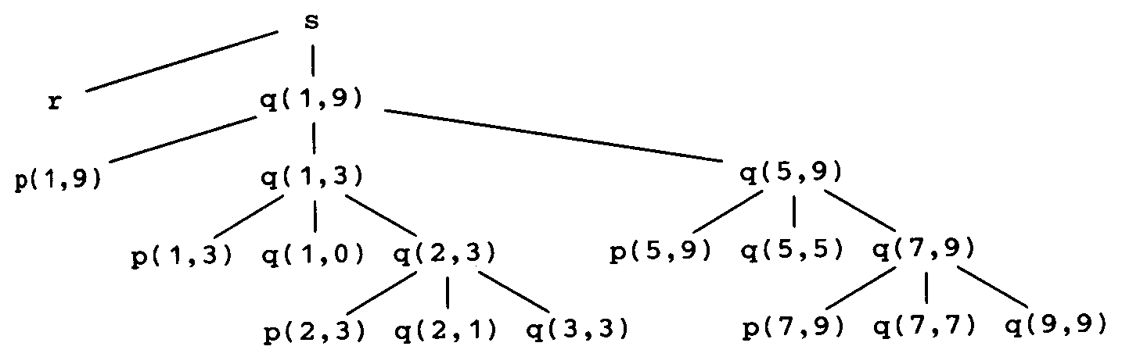
Activation Trees
Lifetime of an activation of a procedure
  The sequence of steps between the first and last steps in the execution of the procedure body
Activation Trees
  Depicts the way control enters and leaves activations
  In an activation tree
    Each node represents an activation of a procedure
    The root represents the activation of the main program
    The node for a is the parent of the node for b iff control flows from action a to b, and
    The node for a is to the left of the node for b iff the lifetime of a occurs before the lifetime of b

Slide 4
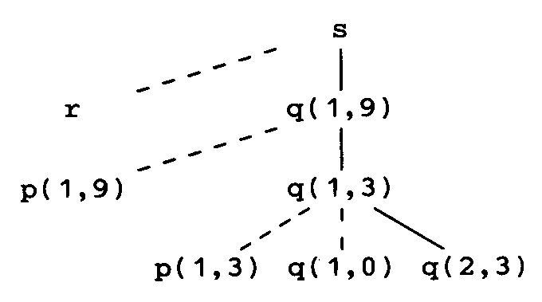
Control Stacks
The flow of control in a program
  corresponds to a depth-first traversal of the activation tree
Control stack
  To keep track of live procedure activations
    To push the node for an activation onto the control stack as the activation begins
    To pop the node when the activation ends

Slide 5
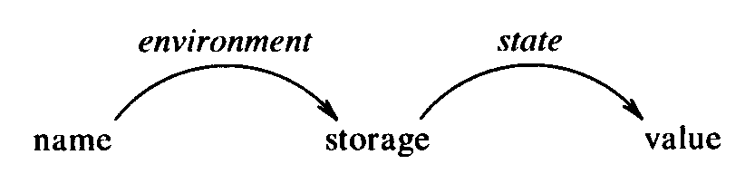
Bindings of Names
Environment
  In programming language semantics, the term environment refers to a function that maps a name to a storage location
State
  refers to a function that maps a storage location to the value held there
Environments vs. States
  An assignment changes the state, but not the environment

Slide 6
Bindings of Names
A binding of x
  When an environment associates storage location s with a name x, we say that x is bound to s
    The association itself is referred to as a binding of x
Scope
  The portion of the program to which a declaration applies
A binding is the dynamic counterpart of a declaration
Static Notion | Dynamic Counterpart
declaration of a procedure | activation of the procedure
declaration of a name | binding of the name
scope of a declaration | lifetime of a binding

Slide 7
Questions to Ask
The way a compiler must organize its storage and bind names is determined by answers to questions:
  May procedures be recursive?
  What happens to the values of local names when control returns from an activation of a procedure?
  May a procedure refer to nonlocal names?
  How are parameters are passed when a procedure is called?
  May procedures be returned as parameters?
  May procedures be returned as results?
  May storage be allocated dynamically under program control?
  Must storage be deallocated explicitly?

Slide 8
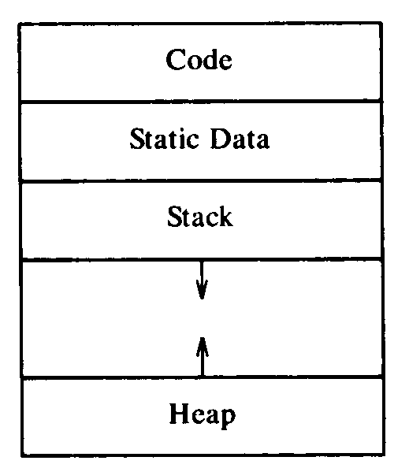
Storage Organization
Runtime storage might be subdivided to hold
  The generated target code
  Data objects, and
  A counterpart of the control stack to keep track of procedure activations
  Heap

Slide 9
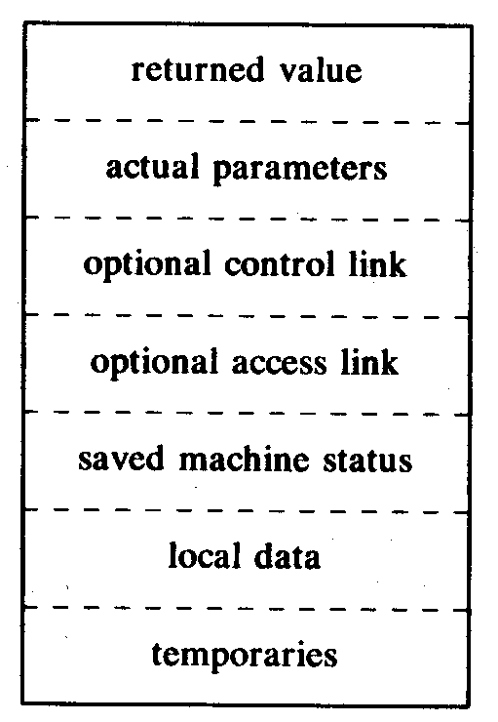
Activation Records
An activation record (or frame)
  Information needed by a single execution of a procedure is managed using a contiguous block of storage
  Fields
    The field for temporaries
      Temporary values, such as those arising in the evaluation of expressions
    The field for local data
      Data that is local to an execution of a procedure
    The field for saved machine status
      Information about the state of the machine just before the procedure is called, e.g. PC and registers
    Access link (optional)
      Used to refer to nonlocal data held in other activation records
    Control link (optional)
      Points to the activation of the caller
    Actual parameters
    Return value

Slide 10
Storage-Allocation Strategies
Strategies
  Static allocation
    lays out storage for all data objects at compile time
  Stack allocation
    manages the runtime storage as a stack
  Heap allocation
    allocates and deallocates storage as needed at runtime from heap

Slide 11
Static Allocation
Names are bound to storage at compile time
  Every time a procedure is activated, its names are bound to the same storage locations
Advantages
  Activation records are at fixed positions
  Values of local names can be retained across activations of a procedure
Disadvantages
  The size of a data object and constraints on its position in memory must be known at compile time
  Recursive procedures are restricted
  Data structures cannot be created dynamically

Slide 12
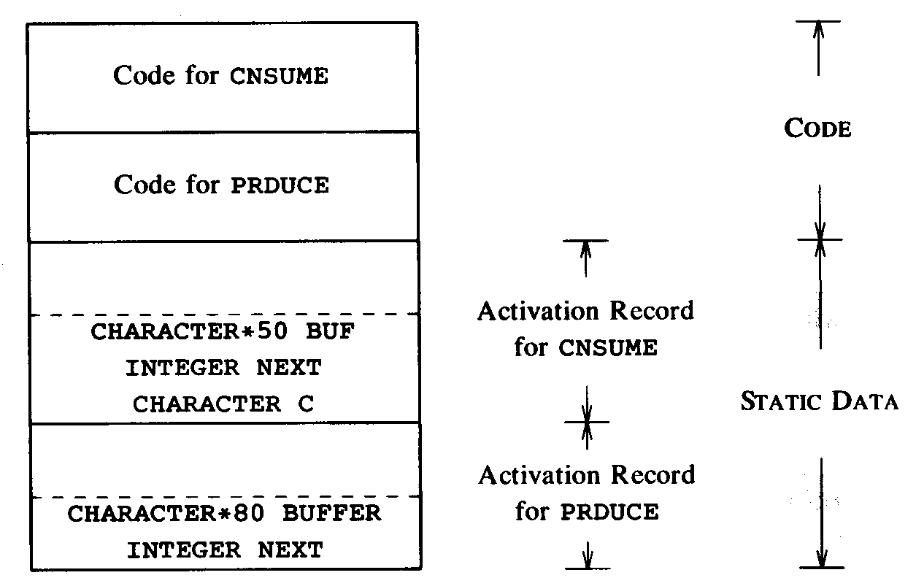
Static Allocation
Example
  Fig. 7.10 (p. 402)

Slide 13
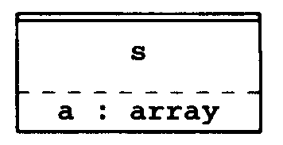
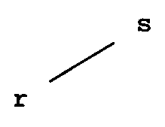
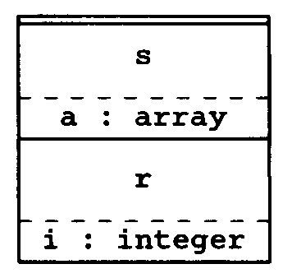
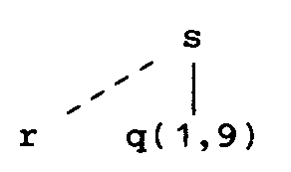
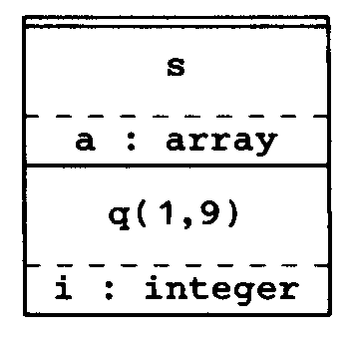
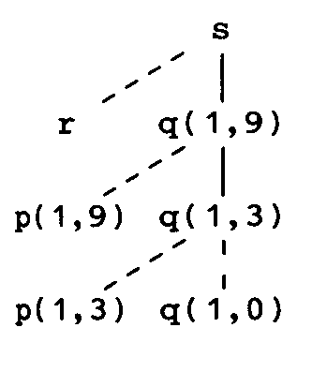
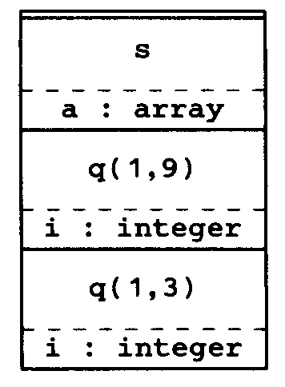
Stack Allocation
Based on the idea of a control stack
  Storage is organized as a stack
  Activation records are pushed and popped as activations begin and end, respectively
  Storage for the locals in each call of a procedure is contained in the activation record for the call
    Locals are bound to fresh storage in each activation
    Values of locals are deleted when activation ends

Slide 14
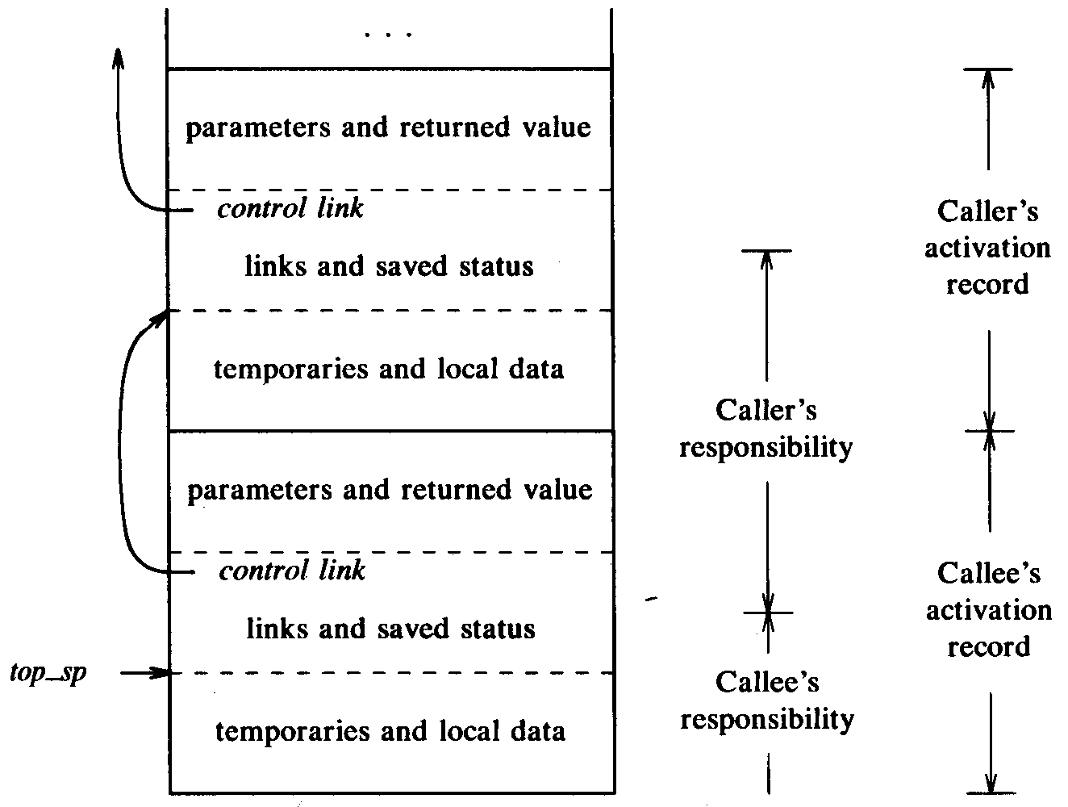
Calling Sequences
Procedure calls are implemented by generating calling sequences in the target code
  Call sequence
    Allocates an activation record and enter information into its fields
  Return sequence
    Restores the state of the machine so the calling procedure can continue execution
Calling sequences are activation records differ
  The code in a calling sequence is often divided between the calling procedure (caller) and the procedure it calls (callee)

Slide 15
Calling Sequences
Call sequence
  The caller evaluates actuals
  The caller stores a return address and the old value of top-sp into the callee’s activation record. Then it increments top-sp
  The callee saves register values and other status information
  The callee initializes its local data and begin execution
Return sequence
  The callee places a return value next to the activation record of the caller
  Using the information in the status field, the callee restores top-sp and other registers and branches to a return address in the caller’s code
  The caller can copy the returned value into it’s own activation record and use it to evaluate an expression

Slide 16
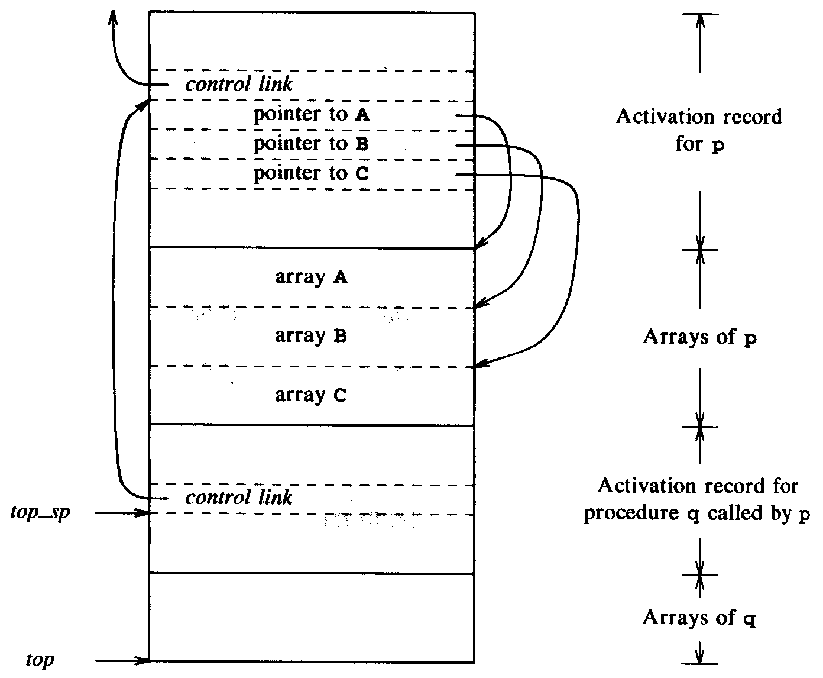
Variable-Length Data
Storage for variable-length data
  Not part of activation record
  Only a pointer to the beginning of each object object appears in the activation record
    The relative addresses of these pointers are known at compile time, so the target code can access array elements through the pointers

Slide 17
Dangling References
Whenever storage can be deallocated, the problem of dangling references arises
  A dangling reference occurs when there is a reference to storage that has been deallocated
  It’s a logical error to use dangling references, since the value of the deallocated storage is undefined according to semantics
main() {
int *p;
p = dangle();
}
int *dangle() {
int i = 23;
return &i;
}

Slide 18
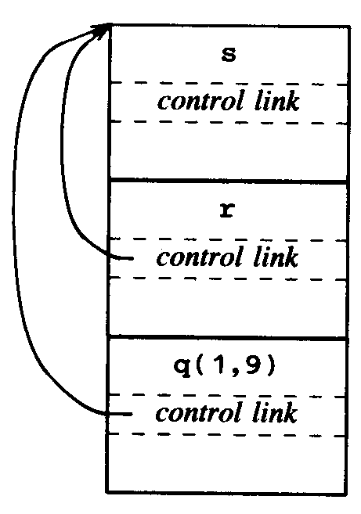
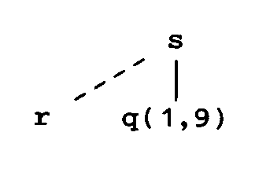
Heap Allocation
Stack allocation strategy cannot be used if
  The value of local names must be retained when an activation ends
  A called activation outlives the caller
Heap allocation
  Parcels out piece of contiguous storage, as needed for activation records or other objects
  Pieces may be deallocated in any order

Slide 19
Access to Nonlocal Names
The scope rules of a language determine the treatment of nonlocal names
  Static-scope (or lexical-scope) rule
    Determines the declaration that applies to a name by examining the program text alone
    e.g. C, Pascal
  Dynamic-scope rule
    Determines that declaration applicable to a name at run time, by considering the current activations
    e.g. Lisp, APL

Slide 20
Static-Scope Rule
Blocks
  A block is statement containing its own local data declaration
  e.g. in C, a block has the syntax { declarations statements }
  A characteristic of blocks is their nesting structure
Most closely nested rule
  The scope of a declaration in a block B includes B
  If a name x is not declared in a block B, then an occurrence of x in B is in the scope of a declaration of x in an enclosing block B’ such that
    B’ has a declaration of x, and
    B’ is more closely nested around B than any other block with a declaration of x
  e.g. Fig. 7.18 (p. 413)

Slide 21
Lexical Scope without Nested Procedures
The scope of a declaration outside a function
  consists of the function bodies that follow the declaration, with holes if the same name is redeclared within a function
  Fig. 7.20 (p. 414)
  Storage for all names declared outside any procedures can be allocated statically
  Any name nonlocal to one procedure is nonlocal to all procedures

Slide 22
Lexical Scope with Nested Procedures
A nonlocal occurrence of a name
  is in the scope of the most closely nested declaration of a in the static program text
  Fig. 7.22 (p.416)
  Nesting depth
    Let the name of the main program be at nesting depth 1
    We add 1 to the nesting depth as we go from an enclosing to an enclosed procedure

Slide 23
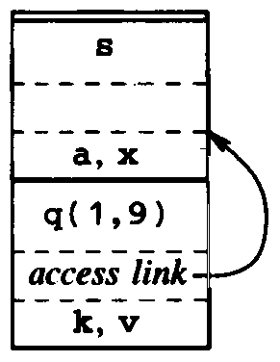
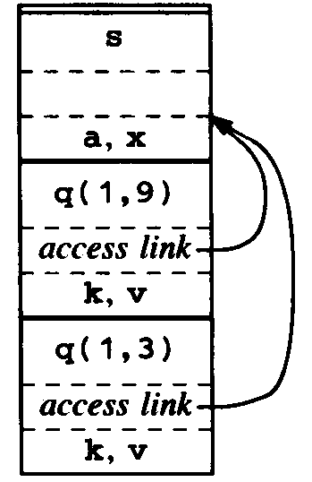
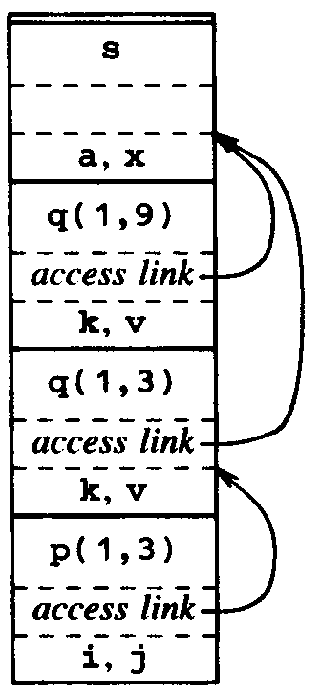
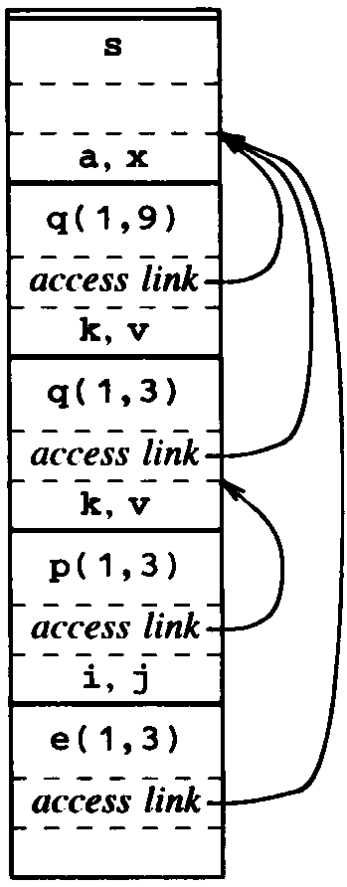
Access Links
Access link
  A pointer to an activation record
  If procedure p is nested immediately within q in the source text, then the access in an activation record for p points to the access link in the record for the most recent activation of q

Slide 24
Access Links
Suppose procedure p at nesting depth n_{p} refers to a nonlocal a with nesting depth n_{a} ≤ n_{p}
  When control is in p, an activation record for p is at stack top
  Follow access n_{p} − n_{a} links
    The value of n_{p} − n_{a} can be precomputed at compile time
  After following access n_{p} − n_{a} links, we reach an activation record for the procedure that a is local to
  Hence, the address of a nonlocal a is given by
  (n_{p} − n_{a}, offset within activation record containing a)

Slide 25
Access Links
The code to set up access links is part of call sequence
  Suppose procedure p at nesting depth n_{p} calls procedure x at nesting depth n_{x}
  Case n_{p} < n_{x}
    The called procedure x is nested more deeply than p
      e.g. Fig. 7.23(a) and 7.23(c)
    The access link in the called procedure must point to the access link in the activation record of the caller just below in the stack

Slide 26
Access Links
  Case n_{p} ≥ n_{x}
    The enclosing procedures at nesting depths 1, 2, …, n_{x}-1 of the called and calling procedures must be the same
      e.g. Fig. 7.23(b) and 7.23(d)
    Following n_{p} − n_{x} + 1 access links from the caller
      We reach the most recent activation record of the procedure that encloses the call and called procedures most closely
    The access link reached by the activation record

Slide 27
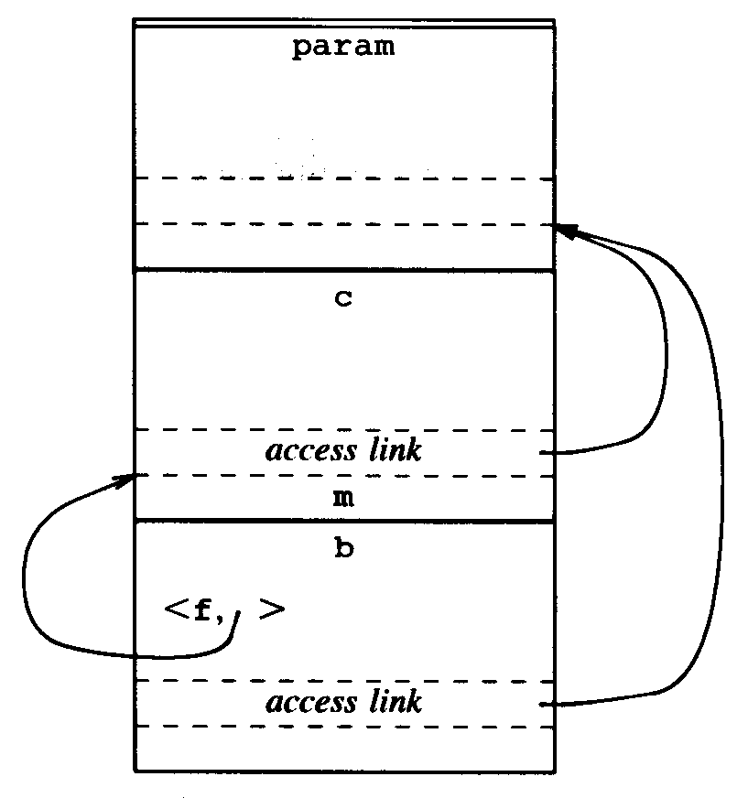
Procedure Parameters
Lexical scope rules apply even when a nested procedure is passed as a parameter
  Fig. 7.24 (p. 419)
  A nested procedure that is passed as a parameter must take its access link along with it

Slide 28
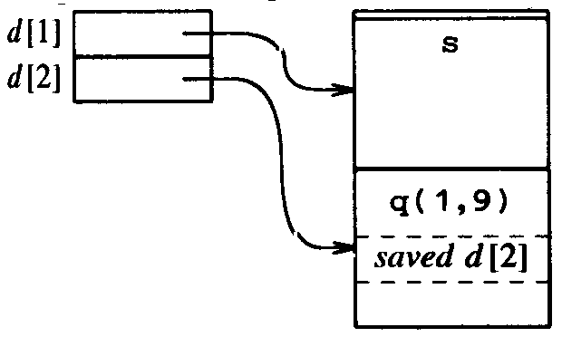
Displays
Display
  An array of pointers to activation records
  Storage for a nonlocal a at nesting depth i is in the activation record pointed to by display element d [i ]
The display changes when a new activation occurs
  When a new activation record for a procedure at nesting depth i is set up
    Save the value of d [i ] in the new activation record, and
    Set d [i ] to point to the new activation record

Slide 29
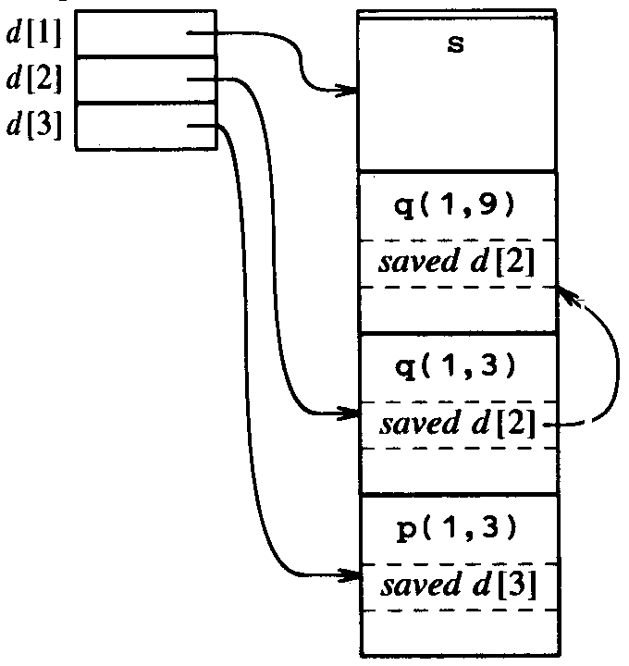
Displays
Suppose a procedure at nesting depth j calls a procedure at depth i
  Case j < i
    Then i = j + 1 and the called procedure is nested with the caller
    The first j elements of the display do not need to be changed
    Set d [i ] to the new activation record

Slide 30
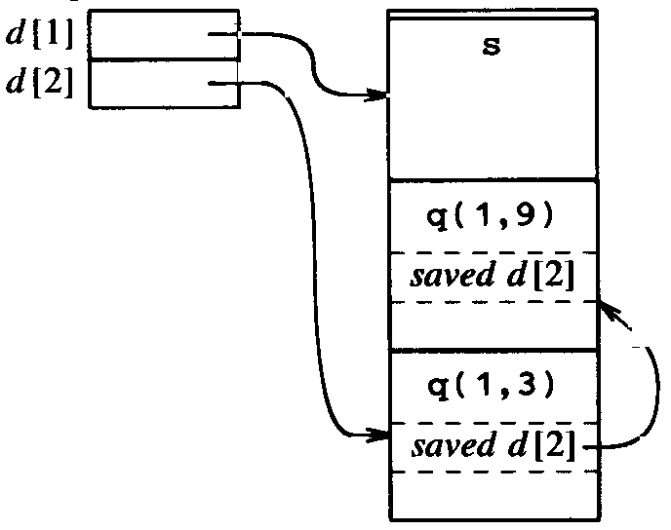
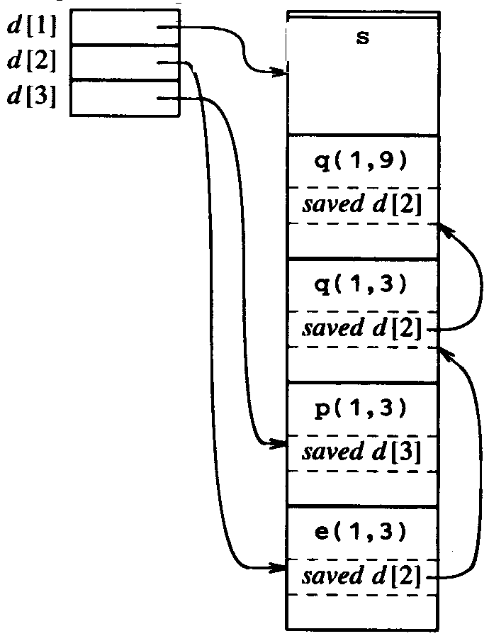
Displays
  Case j ≥ i
    The enclosing procedures at nesting depths 1, 2, …, i -1 of the called and calling procedures must be the same
    Set the old d [i ] in the new activation record
    Make d [i ] point to the new activation record

Slide 31
Dynamic Scope
Under dynamic scope
  The bindings of nonlocal names to storage do not change when a new activation is set up
  New bindings are set up for local names of the callee
    The names refer to storage in the new activation record
(1) program dynamic(input,output);
(2) var r : real ;
(3) procedure show;
(4) begin write( r : 5:3 ) end;
(5) procedure small; (6) var r : real ;
(7) begin r := 0.125; show end;
(8) begin
(9) r := 0.25;
(10) show; small; writeln;
(11) show; small; writeln
(12) end.

Slide 32
Dynamic Scope
Approaches to implement dynamic scope
  Deep access
    Conceptually, dynamic scope results if access links point to the same activation record that control links do
    A simple implementation is to dispense with access links and use the control link to search info the stack
      looking for the first activation record containing storage for the nonlocal name
  Shallow access
    The idea is to hold the current value of each name in statically allocated storage
    When a new activation of a procedure p occurs, a local name n in p takes over the storage statically allocated for n
      The previous value of n can be saved in activation for p and must be restored when the activation of p ends

Slide 33
Parameter Passing
Several common methods for associating actual and formal parameters
  Call-by-value
  Call-by-reference
  Copy-restore
  Call-by-name
  Macro expansion
Differences between parameter-passing methods
  Whether an actual parameter represents an r-value, an l-value, or the text of the actual parameter itself

Slide 34
Call-by-Value
Call-by-value can be implemented
  A formal parameter is treated just like a local name, so the storage for the formal is in the activation of the callee
  The caller evaluates the actual parameters and places their r-values in the storage for the formals
Feature
  Operations on the formal parameters do not affect values in the activation record of the caller
(1) swap(x,y)
(2) int *x, *y;
(3) { int temp;
(4) temp = *x; *x = *y; *y = temp;
(5) }
(6) main( )
(7) { int a = 1 , b = 2 ;
(8) swap ( &a, &b ) ;
(9) printf( I.a is now %d, b is now %d\n" ,a,b) ;
(10)}

Slide 35
Call-by-Reference
When parameters are passed by reference
  The caller passes to the callee a pointer to the storage address of each actual parameter
  If an actual parameter is a name or an expression having an l-value, then that l-value itself value is passed
  If the actual parameter is an expression that has no l-value, then the expression is evaluated in a new location, and the address of the location is passed
  Fig. 7.29 (p. 425)

Slide 36
Call-Restore
A hybrid between call-by-value and call-by-reference
  Before control flows to the callee, the actual parameters are evaluated
    The r -values of the actuals are passed to the called procedure as in call-by-value
    In addition, the l-value of those actual parameters are determined before the call
  When the control returns, the current r -values of the formal parameters are copied back into the l-value of the actuals, using the l-values computed before the call
(I) program copyout(input,output);
(2) var a: integer;
(3) procedure unsafe(var x: integer);
(4) begin x := 2; a := 0 end;
(5) begin
(6) a := 1; unsafe(a); writeln(a)
(7) end .

Slide 37
Call-by-Name
Traditionally defined by the copy-rule of Algol
  The procedure is treated as if it were a macro
    Its body is substituted for the call in the caller, with that actual parameters literally substituted for the formals
    Such a literal substitution is called macro-expansion or in-line expansion
  The local names of the called procedure are kept distinct from the names of the calling procedure
  Example 7.8 (p.428)

