Slide 1

Selenium 2014/11/17
Speaker: TA: Hung-Jr, Shiu
Adviser: Farn Wang

Slide 2
Outline
Selenium Introduction
Test case: launch google home page -> type “farn wang software test” -> click software class
References

Slide 3
Selenium Introduction
Selenium IDE: for Firefox only, proposes a scripting user interface.
Selenium Remote Control: use programming language and include selenium API to test web.
Selenium Core HTA: for IE.
Selenium Grid: for parallel testing.

Slide 4
Test case
Go to http://simple.0123456789.tw/
Input 123+234=
See if the result = 357

Slide 5
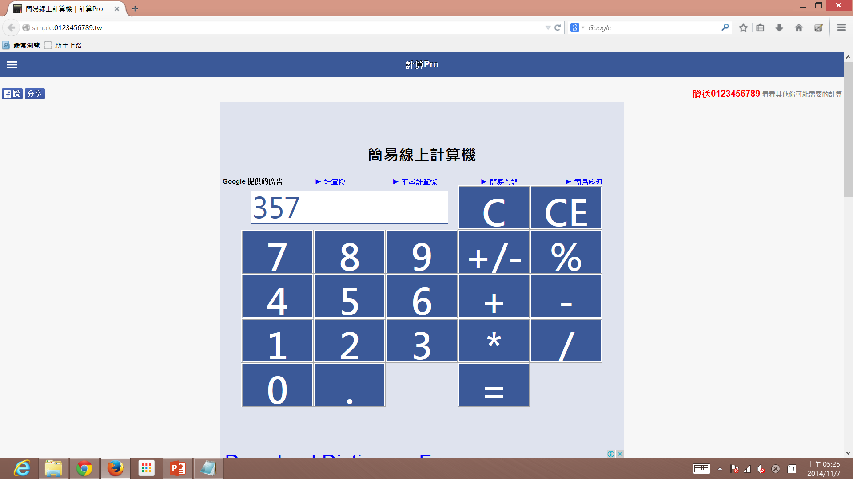
Test case

Slide 6
Selenium and Junit
You should first download selenium webdriver and selenium java api.
Then use selenium IDE to export your test script into Junit4(webdriver)
Next, open eclipse, new a java project, create a package and new a jave file.
Copy the exported java test script to the eclipse project.

Slide 7
Selenium and Junit
On the java project, add the selenium webdriver and API of the project.
Finally, run the project as Junit, you could see the testing flow.

Slide 8
Project Demo
Selenium IDE of firefox.
Selenium IDE + Junit4

Slide 9
References
[1]http://www.cnblogs.com/hyddd/archive/2009/05/20/1473146.html
[2]http://www.cnblogs.com/hyddd/archive/2009/05/22/1487332.html
[3]http://www.cnblogs.com/hyddd/archive/2009/05/22/1487346.html
[4]http://www.cnblogs.com/hyddd/archive/2009/05/24/1487967.html
[5]http://www.cnblogs.com/hyddd/archive/2009/05/24/1488377.html
[6]http://www.cnblogs.com/cnblogsfans/archive/2008/12/23/1360320.html
[7]http://www.openqa.org/?pageId=763
[8] http://docs.seleniumhq.org/

