Slide 1

Software Testing Suppliment & Proj.1: Junit Instructor (Eclipse) 2015/10/7
Speaker: TA: Hung Shiu-Jr.
Adviser: Farn Wang

Slide 2
Outline
Industrial software testing project (V model)
IEEE 829 (software testing process standard)
Industrial sample (Bluetooth communication)
Project 1 sample

Slide 3
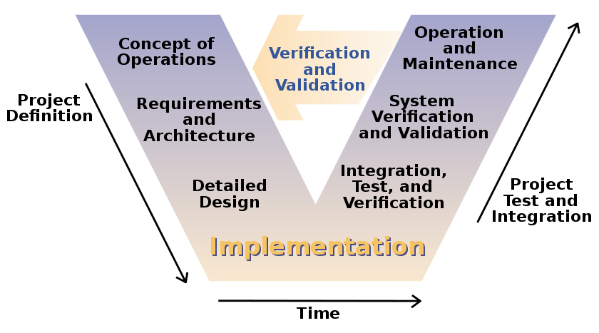
V model

Slide 4
V model
Operation and Maintenance: decide the testing flow, includes languages, report forms…etc.
System verification and validation: decide testing specifications.
Integration testing and verifications: translate testing spec. to testing procedure.
Implementation: design auto/non-auto test scripts. (For RD, also implement unit test.)

Slide 5
IEEE 829
Test design spec. (based on design spec.)
Test plan (collection of test items)
Test cases (test procedures of test items)
Tools and outputs (languages)
Simulators (scripts or programs)
Static and dynamic generators (random testing samples: positive, negative, stress…etc)
Error and execution logs
Reports and actions

Slide 6
Project 1
Eclipse (create a java project and class)
https://www.youtube.com/watch?v=v2F49zLLj-8
Eclipse (create JUnit test cases)
https://www.youtube.com/watch?v=I8XXfgF9GSc
Junit test methods
Junit assert types
Sample demonstration
References

Slide 7
Junit test methods
@Test public void method()
@Test(timeout = int)
@Before public void method()
@After public void method()
@BeforeClass public static void method()
@AfterClass public static void method()
@Ignore

Slide 8
Junit assert types
assertTrue(string message, boolean condition)
assertFalse(string message, boolean condition)
assertEquals(string message, expected, actual)
assertEquals(string message, expected, actual, tolerance)
assertSame(string message, expected, actual)
assertNotSame(string message, expected, actual)

Slide 9
Sample demonstration
Test Requirements:
-Test a given prime number.
-Test a given non-prime number.
-Test a given negative integer.
-Test a given large prime number to check timeout tolerance.
-Test a given integer to count it’s number of prime factors.
-Test a given negative integer.
-Test a given large number to check timeout tolerance.
Test cases:
-positive test
-negative test
-stress test for negative input
-stress test
-positive test
-negative test
-stress test

Slide 10
References
[1] http://www.vogella.com/tutorials/JUnit/article.html
[2] http://junit.org/
[3] http://eclipse.org/

