Slide 1
Software Testing EE 5170/921 U9550 Fall 2015
Professor: Farn Wang （王凡教授）
farn＠ntu.edu.tw
http://cc.ee.ntu.edu.tw/~farn

Slide 2
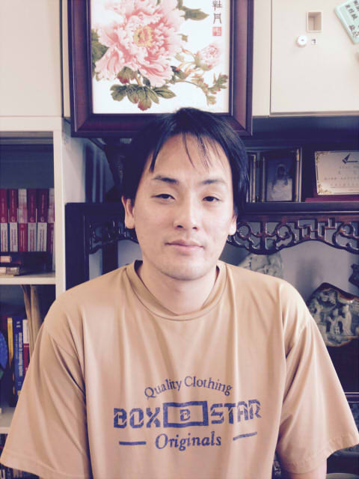
Software Testing EE 5170/921 U9550 Fall 2015
Professor: Farn Wang （王凡教授）
farn＠ntu.edu.tw
http://cc.ee.ntu.edu.tw/~farn
Office: BL 616
Phone: +886-2-33663602
Semester: Fall 2015
Time: Every Friday, 9:10am-12:00noon.
Classroom: BL 103
Credits: 3

Slide 3
Background
sizes and functionalities of software keep on growing,
more than half of their budget in testing and debugging.
For Taiwan's high-tech industry,
do not think should spend money in software testing.
OEM and ODM business
hurting Taiwan's effort in brand business.

Slide 4
Goals
teaching the students the background theory of software testing
letting them play with advanced testing tools from
academia and
industry
In the long-term,
produce skillful professionals in software testing business for Taiwan's high-tech industry
Knowing the fundamentals and resources in software testing;
Utilizing the research results from academia;
Deploying software testing technology to various companies.

Slide 5
Course planning
1. first module: foundations (slides)
2. second module: Testing criteria
2.1 Graph testing (slides)
2.2 Logic testing (slides)
2.3 Input space testing (slides)
2.4 Syntax testing (slides)
3. third module: practical consideration. (slides)
4. Criterias for new app types (slides)

Slide 6
Pre-requisites
Basic Computer Concepts,
C/C++ or Java programming,
Data-Structures,
Algorithms

Slide 7
Evaluation
Final exam (45%)
80+% variations from textbook exercises
Projects
Project 1 (15%): CUnit, CppUnit, or JUnit, due by Nov. 20, 2014
Project 2 (15%): GUI testing with Selenium (with Firefox on either Linux or Windows) due by Dec. 18, 2014
Project 3 (15%): Image-based testing due by Jan. 22, 2015
with Sikuli (with Firefox on either Linux or Windows), or
with Android devices
Homework (10%)

Slide 8
Requirement on students' projects
One student one team.
About 10 mins every students with PPT files.
One min about the app and its challenge to software testing

Slide 9
Project evaluation criteria
Explanation of the SUT. (10% of total points)
User requirements. (10% of totoal points)
Test specification correspondence to user requirements. (10% of total points)
Test adequacy. (30% of total points)
How many (combinations of) data intervals are tested ?
How many permutations of test input events are tested ?
Test evaluation (test oracle) ? (10% of total points)
Purely by human decision ?
By test verdicts (or as assertion) encoded in the test scripts ?
Or by a test evaluation method ?
Test execution demonstration (10% of total points)
Test execution analysis ? (10% of total points)
How many bugs detected ?
What kind of bugs detected ?
Communication quality ? (10% of total points)

Slide 10

Textbook
Introduction to Software Testing
Paul Ammann and Jeff Offutt
With related course materials in http://cs.gmu.edu/~offutt/softwaretest/

Slide 11
Homework
Chapter 1:
Section 1.1, exercise 1 (page 10).
Section 1.2, exercise 3 (page 16).
Section 1.3, exercise 1 (page 21).
Chapter 2:
Section 2.1, exercise 2, 4 (page 32).
Section 2.2.1, exercise 2, 3 (page 42), 5, 7 (page 43).
Section 2.2.3, exercise 1 (page 51).
Section 2.3, exercise 1 (page 60), 5 (page 61), 6 (page 62).
Section 2.4, exercise 3 (page 74).
Section 2.5, exercise 1 (page 85).
Section 2.6, exercise 1 (page 91).
Section 2.7, exercise 6, 7 (page 100).
Chapter 3:
Section 3.1, exercise 2 (page 105).
Section 3.2, exercise 6(a)-(h), 8(a)-(h) (page 119).
Section 3.3, exercise 2 (page 130).
Section 3.4, exercise 1 (page 134).
Section 3.5, exercise 1 (page 137), 3 (page 138).
Section 3.6, exercise 2(a)-(e), 4(a)-(e) (page 146).
Chapter 4:
Section 4.1, exercise 2 (page 159).
Section 4.2, exercise 3, 4 (page 163), 5 (page 164).
Chapter 5:
Section 5.1.1, exercise 2 (page 173).
Section 5.1.2, exercise 2, 3 (page 175).
Section 5.2, exercise 2 (page 189), 6 (page 190).
Section 5.5, exercise 3 (page 208), 4, 5 (page 209).

Slide 12
Teaching Assistant
許宏誌
Mail: hsuhongzhi@gmail.com
Room: BL 604
Office Hour: 13:00-14:00pm, every Friday

