Slide 1
Introduction to Software Testing
Chapter 1
Introduction
&
The Model-Driven Test Design Process
Paul Ammann & Jeff Offutt
http://www.cs.gmu.edu/~offutt/softwaretest/
Updated 24-August 2010

Slide 2
Testing in the 21st Century
Software defines behavior
  network routers, finance, switching networks, other infrastructure
Today’s software market :
  is much bigger
  is more competitive
  has more users
Embedded Control Applications
  airplanes, air traffic control
  spaceships
  watches
  ovens
  remote controllers
Agile processes put increased pressure on testers
  Programmers must unit test – with no training, education or tools !
  Tests are key to functional requirements – but who builds those tests ?
Industry is going through a revolution in what testing means to the success of software products
  PDAs
  memory seats
  DVD players
  garage door openers
  cell phones
Introduction to Software Testing (Ch 1)
© Ammann & Offutt

Slide 3
OUTLINE
Spectacular Software Failures
Why Test?
What Do We Do When We Test ?
  Test Activities and Model-Driven Testing
Software Testing Terminology
Changing Notions of Testing
Test Maturity Levels
Summary
Introduction to Software Testing (Ch 1)
© Ammann & Offutt

Slide 4

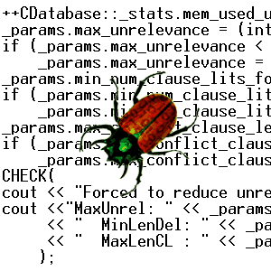

The First Bugs
“an analyzing process must equally have been performed in order to furnish the Analytical Engine with the necessary operative data; and that herein may also lie a possible source of error. Granted that the actual mechanism is unerring in its processes, the cards may give it wrong orders. ” – Ada, Countess Lovelace (notes on Babbage’s Analytical Engine)
“It has been just so in all of my inventions. The first step is an intuition, and comes with a burst, then difficulties arise—this thing gives out and [it is] then that 'Bugs'—as such little faults and difficulties are called—show themselves and months of intense watching, study and labor are requisite. . .” – Thomas Edison
Introduction to Software Testing (Ch 1)
© Ammann & Offutt

Slide 5
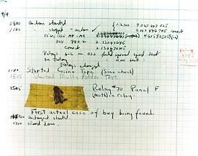
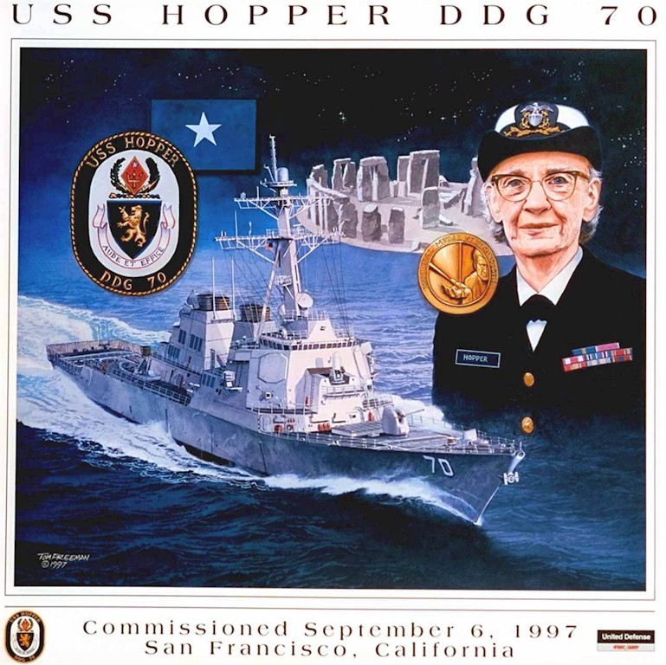


The First Bugs
Grace Hopper
USS Navy Rear Admiral (二星少將）
The 1st COBOL compiler
Introduction to Software Testing (Ch 1)
© Ammann & Offutt

Slide 6
Costly Software Failures
CoPQ
NIST report, “The Economic Impacts of Inadequate Infrastructure for Software Testing” (2002)
  Inadequate software testing costs the US alone between $22 and $59 billion annually
  Better approaches could cut this amount in half
Huge losses due to web application failures
  Financial services : $6.5 million per hour (just in USA!)
  Credit card sales applications : $2.4 million per hour (in USA)
In Dec 2006, amazon.com’s BOGO offer turned into a double discount
2007 : Symantec says that most security vulnerabilities are due to faulty software
World-wide monetary loss due to poor software is staggering
Introduction to Software Testing (Ch 1)
© Ammann & Offutt

Slide 7


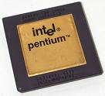
Spectacular Software Failures
NASA’s Mars lander: September 1999, crashed due to a units integration fault
Ariane 5:
exception-handling
bug : forced self
destruct on maiden
flight (64-bit to 16-bit
conversion: about
370 million $ lost)
Mars Polar
Lander crash
site?
Toyota brakes : Dozens dead, thousands of crashes
Major failures: Ariane 5 explosion,
Intel’s Pentium FDIV bug
We need our software to be dependable
Testing is one way to assess dependability
Introduction to Software Testing (Ch 1)
© Ammann & Offutt

Slide 8
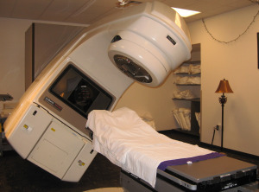
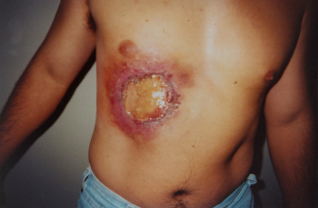
Poor testing of safety-critical software
Therac-25: medical linear accelerator by AECL
6 accidents with 3 death and serious injuries from 6/1985 to 1/1987

Slide 9
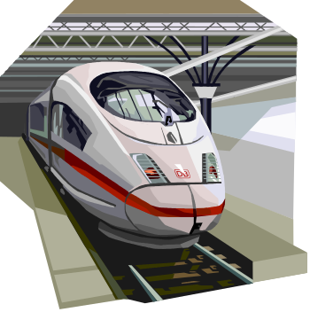

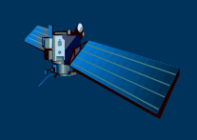
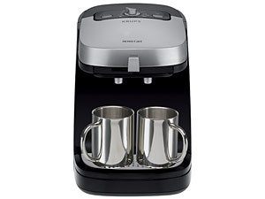



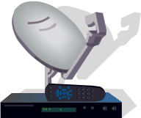
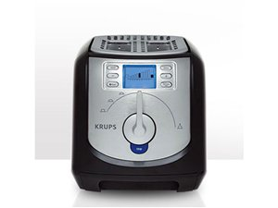



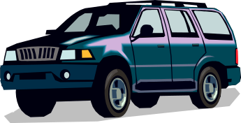

Software is a Skin that Surrounds Our Civilization
Quote due to Dr. Mark Harman
Introduction to Software Testing (Ch 1)
© Ammann & Offutt

Slide 10
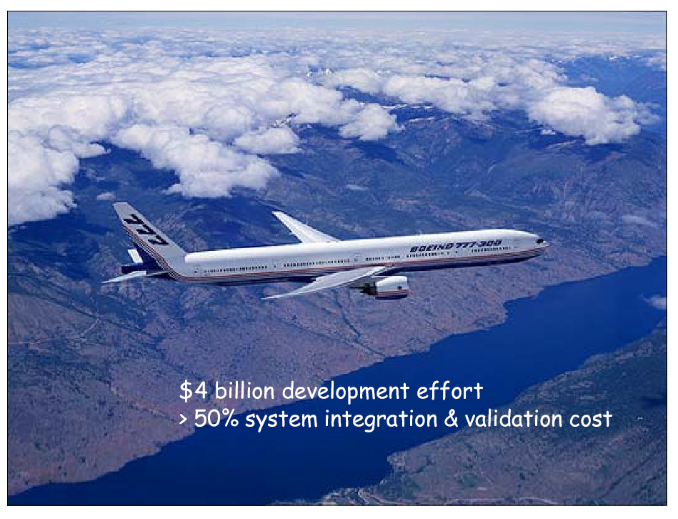
Embedded and real-time systems
- the modern ones
2,500,000+1,500,000 lines of codes (most in Ada)

Slide 11
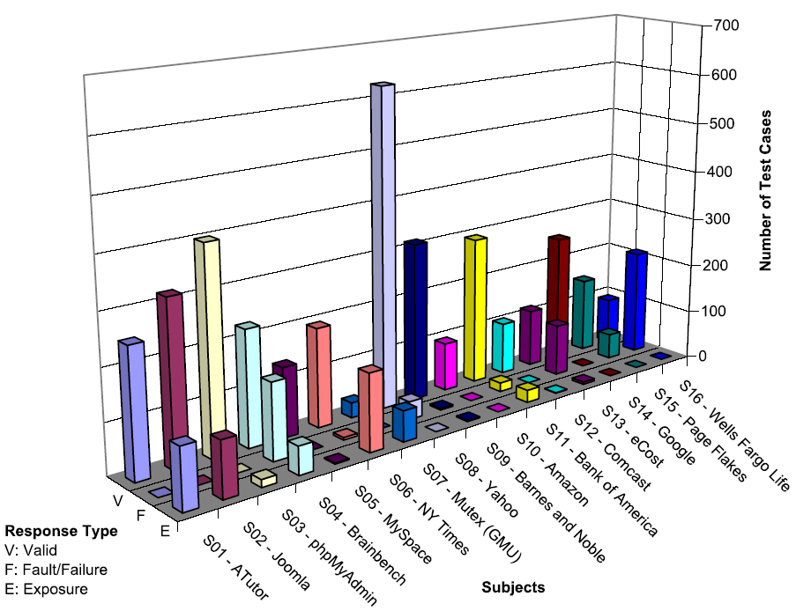
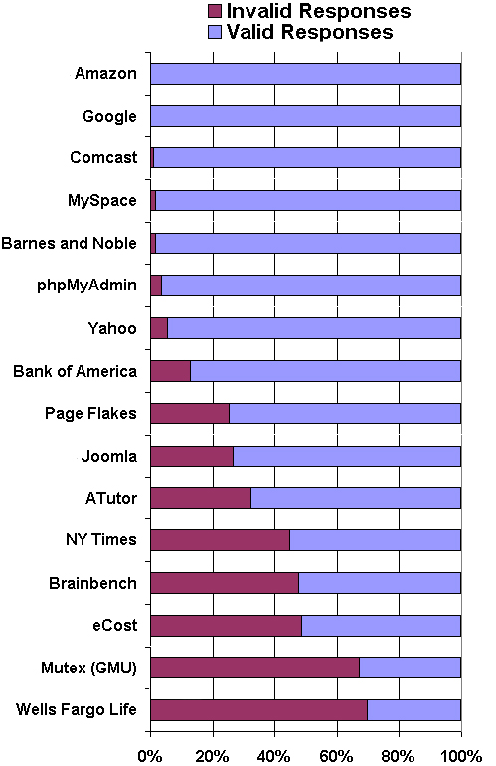
Bypass Testing Results for web input validations
v
— Vasileios Papadimitriou. Masters thesis, Automating Bypass Testing for Web Applications, GMU 2006
Introduction to Software Testing (Ch 1)
© Ammann & Offutt

Slide 12

Airbus 319 Safety Critical Software Control
Loss of autopilot
Loss of most flight deck lighting and intercom
Loss of both the commander’s and the co‑pilot’s primary flight and navigation displays !
Introduction to Software Testing (Ch 1)
© Ammann & Offutt

Slide 13

Northeast Blackout of 2003
508 generating units and 256 power plants shut down
Affected 10 million people in Ontario, Canada
Affected 40 million people in 8 US states
Financial losses of
$6 Billion USD
The alarm system in the energy management system failed due to a software error and operators were not informed of the power overload in the system
Introduction to Software Testing (Ch 1)
© Ammann & Offutt

Slide 14

What Does This Mean?
Software testing is getting more important
Introduction to Software Testing (Ch 1)
© Ammann & Offutt

Slide 15
Testing in the 21st Century
More safety critical, real-time software
Embedded software is ubiquitous … check your pockets
Enterprise applications means bigger programs, more users
Paradoxically, free software increases our expectations !
Security is now all about software faults
  Secure software is reliable software
The web offers a new deployment platform
  Very competitive and very available to more users
  Web apps are distributed
  Web apps must be highly reliable
Industry desperately needs our inventions !
Introduction to Software Testing (Ch 1)
© Ammann & Offutt

Slide 16
OUTLINE
Spectacular Software Failures
Why Test?
What Do We Do When We Test ?
  Test Activities and Model-Driven Testing
Software Testing Terminology
Changing Notions of Testing
Test Maturity Levels
Summary
Introduction to Software Testing (Ch 1)
© Ammann & Offutt

Slide 17

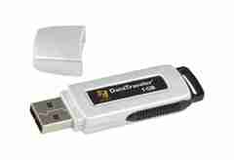
Here! Test This!
My first “professional” job
Big software program
MicroSteff – big
software system
for the mac
V.1.5.1 Jan/2007
Jan/2007
Verdatim
DataLife
MF2-HD
1.44 MB
A stack of computer printouts—and no documentation
Introduction to Software Testing (Ch 1)
© Ammann & Offutt

Slide 18
Cost of Testing
You’re going to spend at least half of your development budget on testing, whether you want to or not
In the real-world, testing is the principle post-design activity
Restricting early testing usually increases cost
Extensive hardware-software integration requires more testing
Introduction to Software Testing (Ch 1)
© Ammann & Offutt

Slide 19
Why Test?
If you don’t know why you’re conducting each test, it won’t be very helpful
Written test objectives and requirements must be documented
What are your planned coverage levels?
How much testing is enough?
Common objective – spend the budget … test until the ship-date …
  Sometimes called the “date criterion”
Introduction to Software Testing (Ch 1)
© Ammann & Offutt

Slide 20
Why Test?
If you don’t start planning for each test when the functional requirements are formed, you’ll never know why you’re conducting the test
1980: “The software shall be easily maintainable”
Threshold reliability requirements?
What fact is each test trying to verify?
Requirements definition teams need testers!
Introduction to Software Testing (Ch 1)
© Ammann & Offutt

Slide 21
Cost of Not Testing
Program Managers often say: “Testing is too expensive.”
Not testing is even more expensive
Planning for testing after development is prohibitively expensive
A test station for circuit boards costs half a million dollars …
Software test tools cost less than $10,000 !!!
Introduction to Software Testing (Ch 1)
© Ammann & Offutt

Slide 22
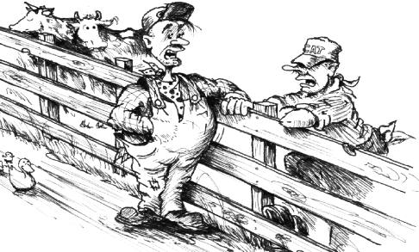
1990s Thinking
They’re teaching a new way
of plowing over at the Grange
tonight - you going?
Naw - I already don’t plow as good as I know how...
Fail !!!
“Knowing is not enough, we must apply. Willing is not enough, we must do.” Goethe
Introduction to Software Testing (Ch 1)
© Ammann & Offutt

Slide 23
OUTLINE
Spectacular Software Failures
Why Test?
What Do We Do When We Test ?
  Test Activities and Model-Driven Testing
Software Testing Terminology
Changing Notions of Testing
Test Maturity Levels
Summary
Introduction to Software Testing (Ch 1)
© Ammann & Offutt

Slide 24

Test Design in Context
Test Design is the process of designing input values that will effectively test software
Test design is one of several activities for testing software
  Most mathematical
  Most technically challenging
http://www.cs.gmu.edu/~offutt/softwaretest/
Introduction to Software Testing (Ch 1)
© Ammann & Offutt

Slide 25
Types of Test Activities
Testing can be broken up into four general types of activities
  Test Design
  Test Automation
  Test Execution
  Test Evaluation
Each type of activity requires different skills, background knowledge, education and training
No reasonable software development organization uses the same people for requirements, design, implementation, integration and configuration control
    1.a) Criteria-based
    1.b) Human-based
Why do test organizations still use the same people for all four test activities??
This is clearly a waste of resources
Introduction to Software Testing (Ch 1)
© Ammann & Offutt

Slide 26
1. Test Design – (a) Criteria-Based
Design test values to satisfy coverage criteria or other engineering goal
This is the most technical job in software testing
Requires knowledge of :
  Discrete math
  Programming
  Testing
Requires much of a traditional CS degree
This is intellectually stimulating, rewarding, and challenging
Test design is analogous to software architecture on the development side
Using people who are not qualified to design tests is a sure way to get ineffective tests
Introduction to Software Testing (Ch 1)
© Ammann & Offutt

Slide 27
1. Test Design – (b) Human-Based
Design test values based on domain knowledge of the program and human knowledge of testing
This is much harder than it may seem to developers
Criteria-based approaches can be blind to special situations
Requires knowledge of :
  Domain, testing, and user interfaces
Requires almost no traditional CS
  A background in the domain of the software is essential
  An empirical background is very helpful (biology, psychology, …)
  A logic background is very helpful (law, philosophy, math, …)
This is intellectually stimulating, rewarding, and challenging
  But not to typical CS majors – they want to solve problems and build things
Introduction to Software Testing (Ch 1)
© Ammann & Offutt

Slide 28
2. Test Automation
Embed test values into executable scripts
This is slightly less technical
Requires knowledge of programming
  Fairly straightforward programming – small pieces and simple algorithms
Requires very little theory
Very boring for test designers
Programming is out of reach for many domain experts
Who is responsible for determining and embedding the expected outputs ?
  Test designers may not always know the expected outputs
  Test evaluators need to get involved early to help with this
Introduction to Software Testing (Ch 1)
© Ammann & Offutt

Slide 29
3. Test Execution
Run tests on the software and record the results
This is easy – and trivial if the tests are well automated
Requires basic computer skills
  Interns
  Employees with no technical background
Asking qualified test designers to execute tests is a sure way to convince them to look for a development job
If, for example, GUI tests are not well automated, this requires a lot of manual labor
Test executors have to be very careful and meticulous with bookkeeping
Introduction to Software Testing (Ch 1)
© Ammann & Offutt

Slide 30
4. Test Evaluation
Evaluate results of testing, report to developers
This is much harder than it may seem
Requires knowledge of :
  Domain
  Testing
  User interfaces and psychology
Usually requires almost no traditional CS
  A background in the domain of the software is essential
  An empirical background is very helpful (biology, psychology, …)
  A logic background is very helpful (law, philosophy, math, …)
This is intellectually stimulating, rewarding, and challenging
  But not to typical CS majors – they want to solve problems and build things
Introduction to Software Testing (Ch 1)
© Ammann & Offutt

Slide 31
Other Activities
Test management : Sets policy, organizes team, interfaces with development, chooses criteria, decides how much automation is needed, …
Test maintenance : Save tests for reuse as software evolves
  Requires cooperation of test designers and automators
  Deciding when to trim the test suite is partly policy and partly technical – and in general, very hard !
  Tests should be put in configuration control
Test documentation : All parties participate
  Each test must document “why” – criterion and test requirement satisfied or a rationale for human-designed tests
  Ensure traceability throughout the process
  Keep documentation in the automated tests
Introduction to Software Testing (Ch 1)
© Ammann & Offutt

Slide 32
Types of Test Activities – Summary
1a. | Design | Design test values to satisfy engineering goals
 | Criteria | Requires knowledge of discrete math, programming and testing
1b. | Design | Design test values from domain knowledge and intuition
 | Human | Requires knowledge of domain, UI, testing
2. | Automation | Embed test values into executable scripts
 |  | Requires knowledge of scripting
3. | Execution | Run tests on the software and record the results
 |  | Requires very little knowledge
4. | Evaluation | Evaluate results of testing, report to developers
 |  | Requires domain knowledge
These four general test activities are quite different
It is a poor use of resources to use people inappropriately
Introduction to Software Testing (Ch 1)
© Ammann & Offutt

Slide 33
Organizing the Team
A mature test organization needs only one test designer to work with several test automators, executors and evaluators
Improved automation will reduce the number of test executors
  Theoretically to zero … but not in practice
Putting the wrong people on the wrong tasks leads to inefficiency, low job satisfaction and low job performance
  A qualified test designer will be bored with other tasks and look for a job in development
  A qualified test evaluator will not understand the benefits of test criteria
Test evaluators have the domain knowledge, so they must be free to add tests that “blind” engineering processes will not think of
The four test activities are quite different
Many test teams use the same people for ALL FOUR activities !!
Introduction to Software Testing (Ch 1)
© Ammann & Offutt

Slide 34
Applying Test Activities
To use our people effectively
and to test efficiently
we need a process that
lets test designers
raise their level of abstraction
Introduction to Software Testing (Ch 1)
© Ammann & Offutt

Slide 35
Using MDTD in Practice
This approach lets one test designer do the math
Then traditional testers and programmers can do their parts
  Find values
  Automate the tests
  Run the tests
  Evaluate the tests
  Just like in traditional engineering … an engineer constructs models with calculus, then gives direction to carpenters, electricians, technicians, …
Testers ain’t mathematicians !
Introduction to Software Testing (Ch 1)
© Ammann & Offutt

Slide 36
Model-Driven Test Design
refined requirements / test specs
model / structure
test requirements
test requirements
DESIGN
ABSTRACTION
LEVEL
IMPLEMENTATION
ABSTRACTION
LEVEL
software artifact
input values
pass / fail
test results
test scripts
test cases
Introduction to Software Testing (Ch 1)
© Ammann & Offutt

Slide 37
Model-Driven Test Design – Steps
criterion
refine
refined requirements / test specs
model / structure
test requirements
generate
analysis
test requirements
domain analysis
DESIGN
ABSTRACTION
LEVEL
IMPLEMENTATION
ABSTRACTION
LEVEL
software artifact
input values
feedback
evaluate
execute
automate
prefix
postfix
expected
pass / fail
test results
test scripts
test cases
Introduction to Software Testing (Ch 1)
© Ammann & Offutt

Slide 38

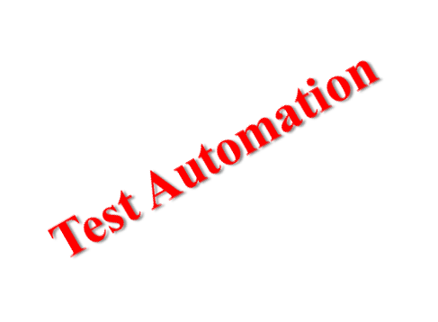
Model-Driven Test Design – Activities
refined requirements / test specs
model / structure
test requirements
Test Design
DESIGN
ABSTRACTION
LEVEL
Raising our abstraction level makes
test design MUCH easier
IMPLEMENTATION
ABSTRACTION
LEVEL
software artifact
input values
pass / fail
test results
test scripts
test cases
Test Evaluation
Test Execution
Introduction to Software Testing (Ch 1)
© Ammann & Offutt

Slide 39
Small Illustrative Example
Software Artifact : Java Method
/**
* Return index of node n at the
* first position it appears,
* -1 if it is not present
*/
public int indexOf (Node n)
{
for (int i=0; i < path.size(); i++)
if (path.get(i).equals(n))
return i;
return -1;
}
Control Flow Graph
1
i = 0
2
i < path.size()
3
if
5
4
return -1
return i
Introduction to Software Testing (Ch 1)
© Ammann & Offutt

Slide 40
Example (2)
Support tool for graph coverage
http://www.cs.gmu.edu/~offutt/softwaretest/
Edges
1 2
2 3
3 2
3 4
2 5
Initial Node: 1
Final Nodes: 4, 5
6 requirements for Edge-Pair Coverage
1. [1, 2, 3]
2. [1, 2, 5]
3. [2, 3, 4]
4. [2, 3, 2]
5. [3, 2, 3]
6. [3, 2, 5]
Graph
Abstract version
1
2
3
Test Paths
[1, 2, 5]
[1, 2, 3, 2, 5]
[1, 2, 3, 2, 3, 4]
Find values …
5
4
Introduction to Software Testing (Ch 1)
© Ammann & Offutt

Slide 41
Types of Activities in the Book
Most of this book is on test design.
Other activities are well covered elsewhere.
Introduction to Software Testing (Ch 1)
© Ammann & Offutt

