Slide 1
Introduction to Software Testing Chapter 1 Introduction & The Model-Driven Test Design Process
Paul Ammann & Jeff Offutt
http://www.cs.gmu.edu/~offutt/softwaretest/
Updated 24-August 2010

Slide 2
Testing in the 21st Century
Software defines behavior
network routers, finance, switching networks, other infrastructure
Today’s software market :
is much bigger
is more competitive
has more users
Embedded Control Applications
airplanes, air traffic control
spaceships
watches
ovens
remote controllers
Agile processes put increased pressure on testers
Programmers must unit test – with no training, education or tools !
Tests are key to functional requirements – but who builds those tests ?
Industry is going through a revolution in what testing means to the success of software products
PDAs
memory seats
DVD players
garage door openers
cell phones

Slide 3
OUTLINE
Spectacular Software Failures
Why Test?
What Do We Do When We Test ?
Test Activities and Model-Driven Testing
Software Testing Terminology
Changing Notions of Testing
Test Maturity Levels
Summary

Slide 4


The First Bugs
“an analyzing process must equally have been performed in order to furnish the Analytical Engine with the necessary operative data; and that herein may also lie a possible source of error. Granted that the actual mechanism is unerring in its processes, the cards may give it wrong orders. ” – Ada, Countess Lovelace (notes on Babbage’s Analytical Engine)
“It has been just so in all of my inventions. The first step is an intuition, and comes with a burst, then difficulties arise—this thing gives out and [it is] then that 'Bugs'—as such little faults and difficulties are called—show themselves and months of intense watching, study and labor are requisite. . .” – Thomas Edison

Slide 5
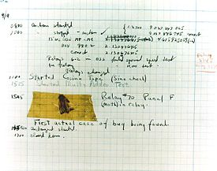
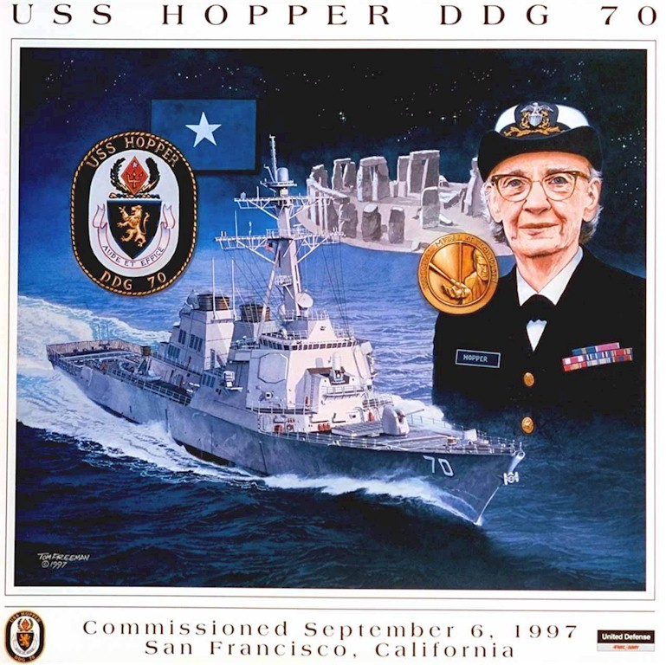
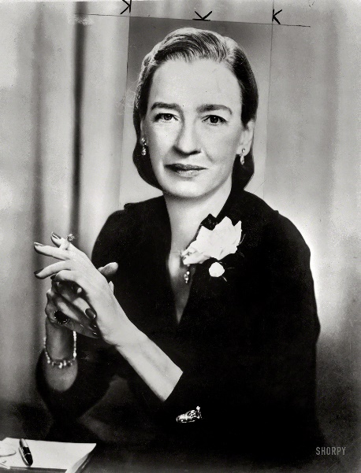

The First Bugs
Grace Hopper
USS Navy Rear Admiral (二星少將）
The 1st COBOL compiler

Slide 6
Costly Software Failures
CoPQ
NIST report, “The Economic Impacts of Inadequate Infrastructure for Software Testing” (2002)
Inadequate software testing costs the US alone between $22 and $59 billion annually
Better approaches could cut this amount in half
Huge losses due to web application failures
Financial services : $6.5 million per hour (just in USA!)
Credit card sales applications : $2.4 million per hour (in USA)
In Dec 2006, amazon.com’s BOGO offer turned into a double discount
2007 : Symantec says that most security vulnerabilities are due to faulty software
World-wide monetary loss due to poor software is staggering

Slide 7

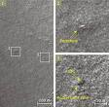

Spectacular Software Failures
NASA’s Mars lander: September 1999, crashed due to a units integration fault
Ariane 5: exception-handling bug : forced self destruct on maiden flight (64-bit to 16-bit conversion: about 370 million $ lost)
Mars Polar Lander crash site?
Toyota brakes : Dozens dead, thousands of crashes
Major failures: Ariane 5 explosion,
Intel’s Pentium FDIV bug
We need our software to be dependable
Testing is one way to assess dependability

Slide 8
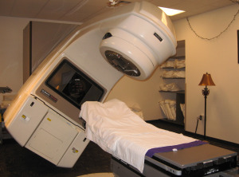
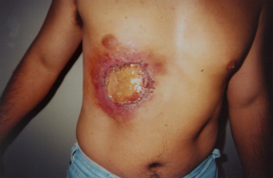
Poor testing of safety-critical software
Therac-25: medical linear accelerator by AECL
6 accidents with 3 death and serious injuries from 6/1985 to 1/1987

Slide 9
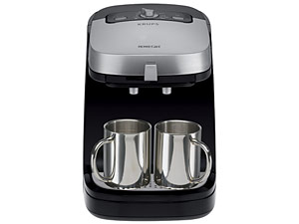
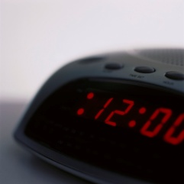
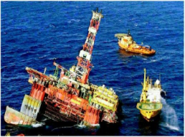
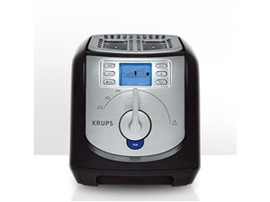

Software is a Skin that Surrounds Our Civilization
Quote due to Dr. Mark Harman

Slide 10
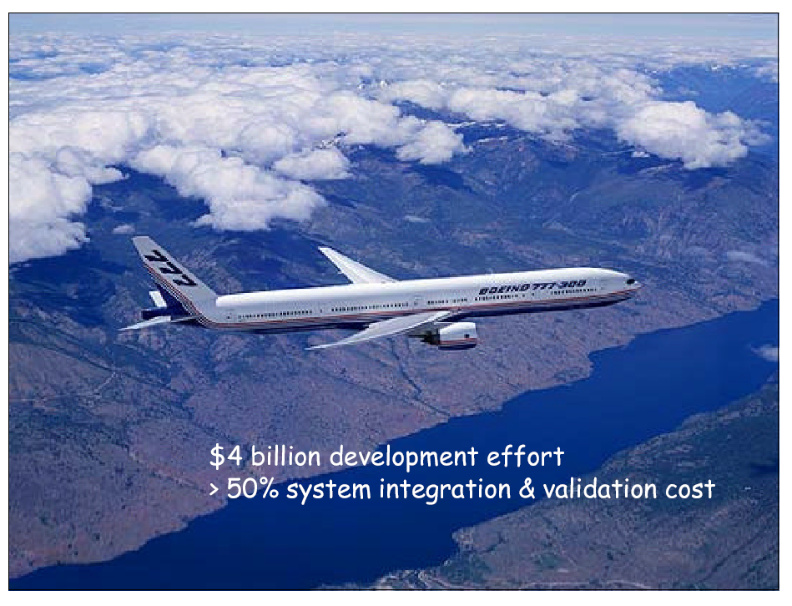
Embedded and real-time systems - the modern ones
2,500,000+1,500,000 lines of codes (most in Ada)

Slide 11
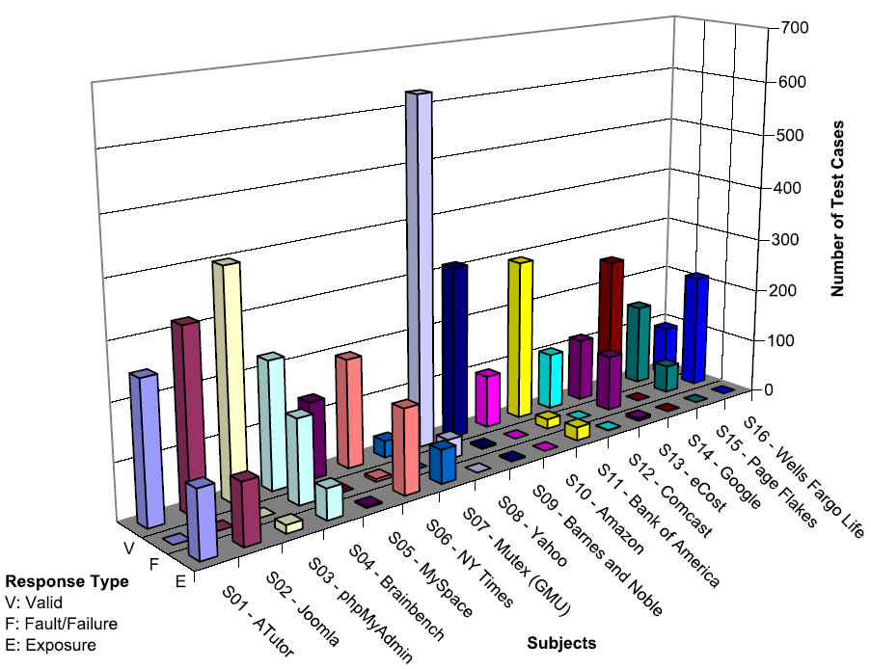
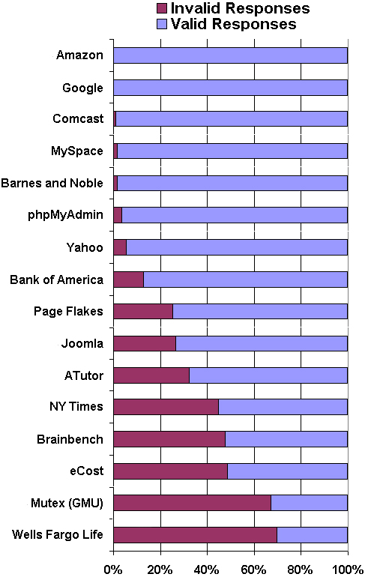
Bypass Testing Results for web input validations
v
— Vasileios Papadimitriou. Masters thesis, Automating Bypass Testing for Web Applications, GMU 2006

Slide 12

Airbus 319 Safety Critical Software Control
Loss of autopilot
Loss of most flight deck lighting and intercom
Loss of both the commander’s and the co‑pilot’s primary flight and navigation displays !

Slide 13

Northeast Blackout of 2003
508 generating units and 256 power plants shut down
Affected 10 million people in Ontario, Canada
Affected 40 million people in 8 US states
Financial losses of
$6 Billion USD
The alarm system in the energy management system failed due to a software error and operators were not informed of the power overload in the system

Slide 14
What Does This Mean?
Software testing is getting more important

Slide 15
Testing in the 21st Century
More safety critical, real-time software
Embedded software is ubiquitous … check your pockets
Enterprise applications means bigger programs, more users
Paradoxically, free software increases our expectations !
Security is now all about software faults
Secure software is reliable software
The web offers a new deployment platform
Very competitive and very available to more users
Web apps are distributed
Web apps must be highly reliable
Industry desperately needs our inventions !

Slide 16
OUTLINE
Spectacular Software Failures
Why Test?
What Do We Do When We Test ?
Test Activities and Model-Driven Testing
Software Testing Terminology
Changing Notions of Testing
Test Maturity Levels
Summary

Slide 17

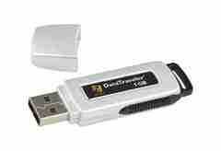
Here! Test This!
My first “professional” job
Big software program
MicroSteff – big
software system
for the mac
V.1.5.1 Jan/2007
Jan/2007
Verdatim
DataLife
MF2-HD
1.44 MB
A stack of computer printouts—and no documentation

Slide 18
Cost of Testing
You’re going to spend at least half of your development budget on testing, whether you want to or not
In the real-world, testing is the principle post-design activity
Restricting early testing usually increases cost
Extensive hardware-software integration requires more testing

Slide 19
Why Test?
If you don’t know why you’re conducting each test, it won’t be very helpful
Written test objectives and requirements must be documented
What are your planned coverage levels?
How much testing is enough?
Common objective – spend the budget … test until the ship-date …
Sometimes called the “date criterion”

Slide 20
Why Test?
If you don’t start planning for each test when the functional requirements are formed, you’ll never know why you’re conducting the test
1980: “The software shall be easily maintainable”
Threshold reliability requirements?
What fact is each test trying to verify?
Requirements definition teams need testers!

Slide 21
Cost of Not Testing
Program Managers often say: “Testing is too expensive.”
Not testing is even more expensive
Planning for testing after development is prohibitively expensive
A test station for circuit boards costs half a million dollars …
Software test tools cost less than $10,000 !!!

Slide 22
OUTLINE
Spectacular Software Failures
Why Test?
What Do We Do When We Test ?
Test Activities and Model-Driven Testing
Software Testing Terminology
Changing Notions of Testing
Test Maturity Levels
Summary

Slide 23
Model-Driven Test Design
refined requirements / test specs
model / structure
test requirements
test requirements
DESIGN
ABSTRACTION
LEVEL
IMPLEMENTATION
ABSTRACTION
LEVEL
software artifact
input values
pass / fail
test results
test scripts
test cases

Slide 24
Model-Driven Test Design – Steps
criterion
refine
refined requirements / test specs
model / structure
test requirements
generate
analysis
test requirements
domain analysis
DESIGN
ABSTRACTION
LEVEL
IMPLEMENTATION
ABSTRACTION
LEVEL
software artifact
input values
feedback
evaluate
execute
automate
prefix
postfix
expected
pass / fail
test results
test scripts
test cases

Slide 25
Types of Test Activities – Summary
1a. | Design | Design test values to satisfy engineering goals
 | Criteria | Requires knowledge of discrete math, programming and testing
1b. | Design | Design test values from domain knowledge and intuition
 | Human | Requires knowledge of domain, UI, testing
2. | Automation | Embed test values into executable scripts
 |  | Requires knowledge of scripting
3. | Execution | Run tests on the software and record the results
 |  | Requires very little knowledge
4. | Evaluation | Evaluate results of testing, report to developers
 |  | Requires domain knowledge
These four general test activities are quite different
It is a poor use of resources to use people inappropriately

Slide 26
Other Activities
Test management : Sets policy, organizes team, interfaces with development, chooses criteria, decides how much automation is needed, …
Test maintenance : Save tests for reuse as software evolves
Requires cooperation of test designers and automators
Deciding when to trim the test suite is partly policy and partly technical – and in general, very hard !
Tests should be put in configuration control
Test documentation : All parties participate
Each test must document “why” – criterion and test requirement satisfied or a rationale for human-designed tests
Ensure traceability throughout the process
Keep documentation in the automated tests

Slide 27
Organizing the Team
A mature test organization needs only one test designer to work with several test automators, executors and evaluators
Improved automation will reduce the number of test executors
Theoretically to zero … but not in practice
Putting the wrong people on the wrong tasks leads to inefficiency, low job satisfaction and low job performance
A qualified test designer will be bored with other tasks and look for a job in development
A qualified test evaluator will not understand the benefits of test criteria
Test evaluators have the domain knowledge, so they must be free to add tests that “blind” engineering processes will not think of
The four test activities are quite different
Many test teams use the same people for ALL FOUR activities !!

Slide 28
Using MDTD in Practice
This approach lets one test designer do the math
Then traditional testers and programmers can do their parts
Find values
Automate the tests
Run the tests
Evaluate the tests
Just like in traditional engineering … an engineer constructs models with calculus, then gives direction to carpenters, electricians, technicians, …
Testers ain’t mathematicians !

Slide 29
Small Illustrative Example
Software Artifact : Java Method
/**
* Return index of node n at the
* first position it appears,
* -1 if it is not present
*/
public int indexOf (Node n)
{
for (int i=0; i < path.size(); i++)
if (path.get(i).equals(n))
return i;
return -1;
}
Control Flow Graph
1
i = 0
2
i < path.size()
3
if
5
4
return -1
return i

Slide 30
Example (2)
Support tool for graph coverage
http://www.cs.gmu.edu/~offutt/softwaretest/
Edges
1 2
2 3
3 2
3 4
2 5
Initial Node: 1
Final Nodes: 4, 5
6 requirements for Edge-Pair Coverage 1. [1, 2, 3] 2. [1, 2, 5] 3. [2, 3, 4] 4. [2, 3, 2] 5. [3, 2, 3] 6. [3, 2, 5]
Graph
Abstract version
1
2
3
Test Paths
[1, 2, 5]
[1, 2, 3, 2, 5]
[1, 2, 3, 2, 3, 4]
Find values …
5
4

