Slide 1
Software Testing & Security Checking EE 5191 Syllabus
王凡 （Farn Wang）
farn@ntu.edu.tw
http://cc.ee.ntu.edu.tw/ST
國立臺灣大學 電機工程學系

Slide 2
Teaching Plan
With the availiability of lecture videos, class lecture of each week is administered as follows.
Presenting the guideline to the materials
showing some videos
Q&A sessions
a quiz (open book and open internet)
We expect the students to prepare well enough for the quizzes with the slides and videos online.

Slide 3
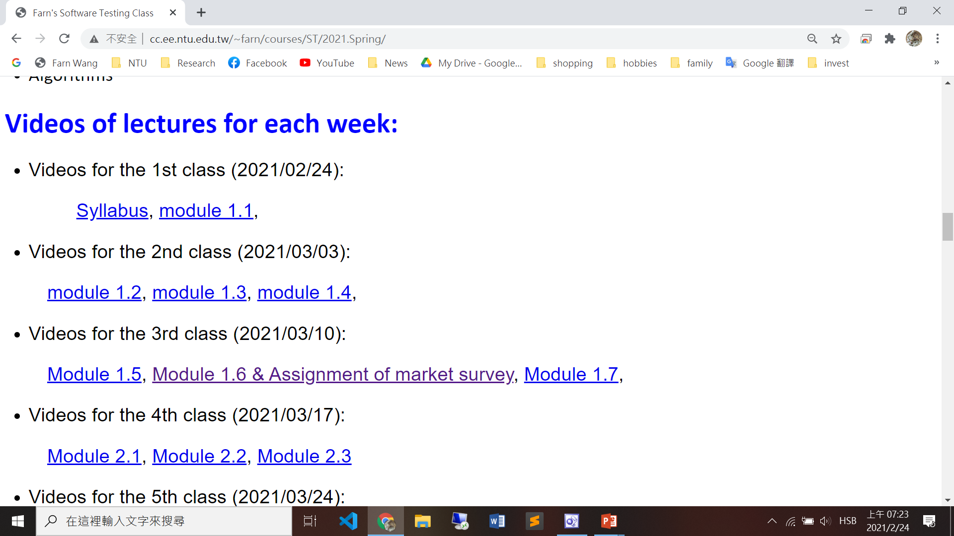
Teaching Plan
Video links in the course webpage.

Slide 4
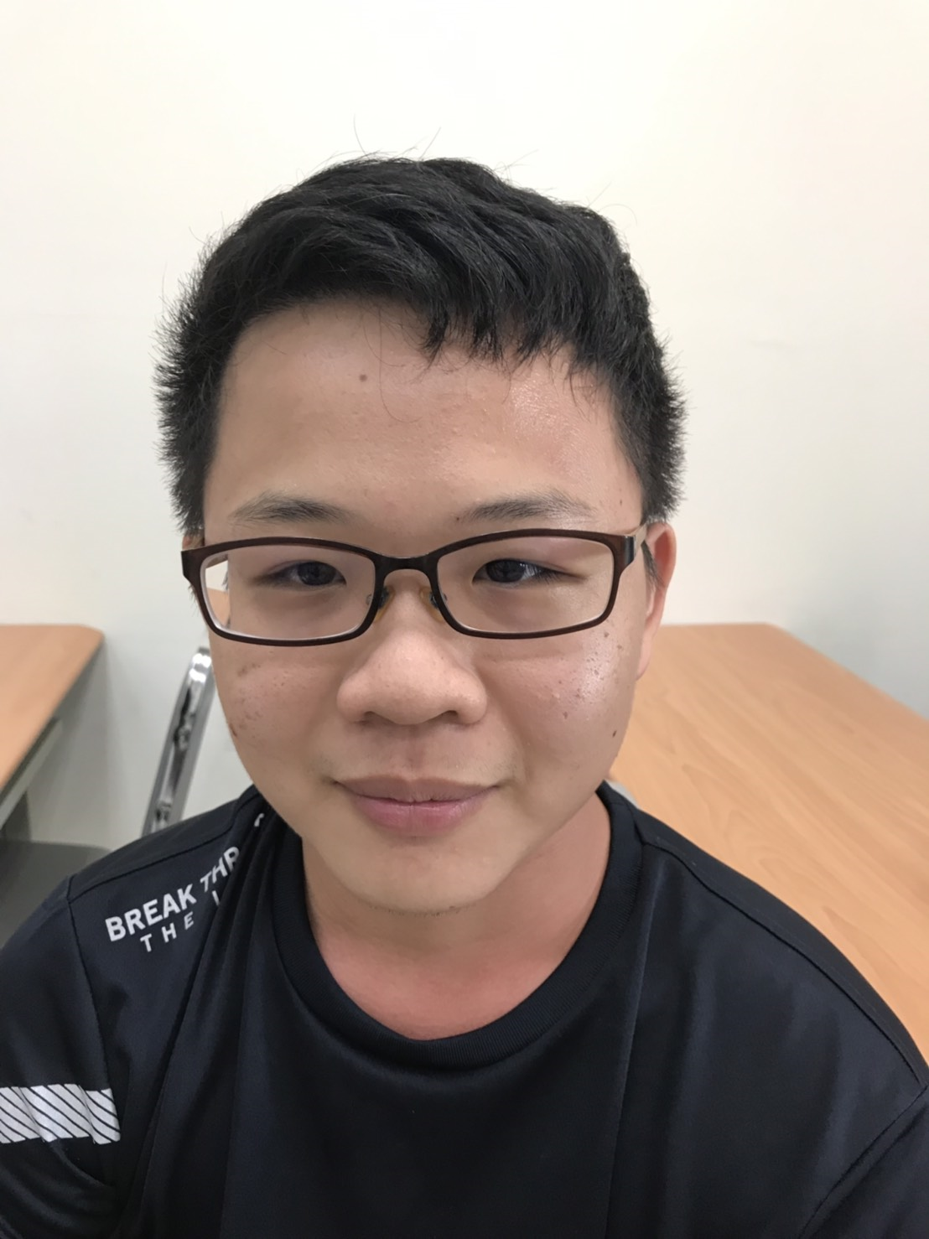
授課資訊
課號：EE 5191
Spring 2020
Wednesday, 9:10am-12:00noon
Classroom: BL 113 Credits: 3
王 凡 教授
博理館616，02-33663602
farn@ntu.edu.tw
http://cc.ee.ntu.edu.tw/~farn/courses/ST
助教：李恩瑋
博理館618
r08921105@ntu.edu.tw

Slide 5
Background
Software projects have spent more than half of their budget in testing and debugging.
Software security is a highly visible and fast-growing sector of software testing.
government regulations
companies willing to pay
Taiwan's high-tech companies do not think that they should spend money in software testing.
Taiwan's industrial strength in OEM and ODM
Without the know-how in software QA, Taiwan has no hope.

Slide 6
Types of Software Testing
Functional Testing
Unit testing
Integration testing
End-to-end testing
Smoke testing
Sanity testing
Regression testing
Acceptance testing
Interface testing
White box testing
Black box testing

Slide 7
Types of Software Testing
Non-functional Testing
Performance testing
Security testing
Load testing
Failover testing
Compatibility testing
Usability testing
Scalability testing
Volume testing
Stress testing
Accessibility testing
Alpha testing
Beta testing
Maintainability testing
Compliance testing
Efficiency testing
Reliability testing
Endurance testing
Disaster recovery testing
Localization testing
Internationalization testing
Ad-hoc testing

Slide 8
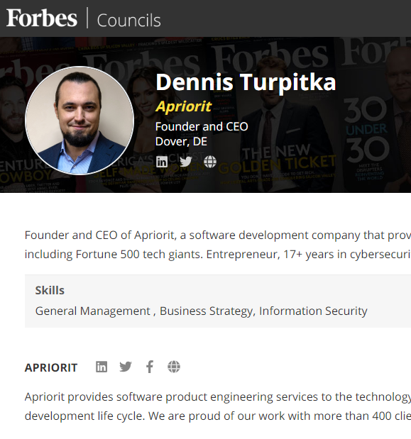
產業分析
Testing costs
20 percent of the overall development time for a single-component application,
20 to 30 percent for a two-component application and
30 to 35 percent for an application with GUI.
35 to 50 percent for a distributed application with GUI.

Slide 9
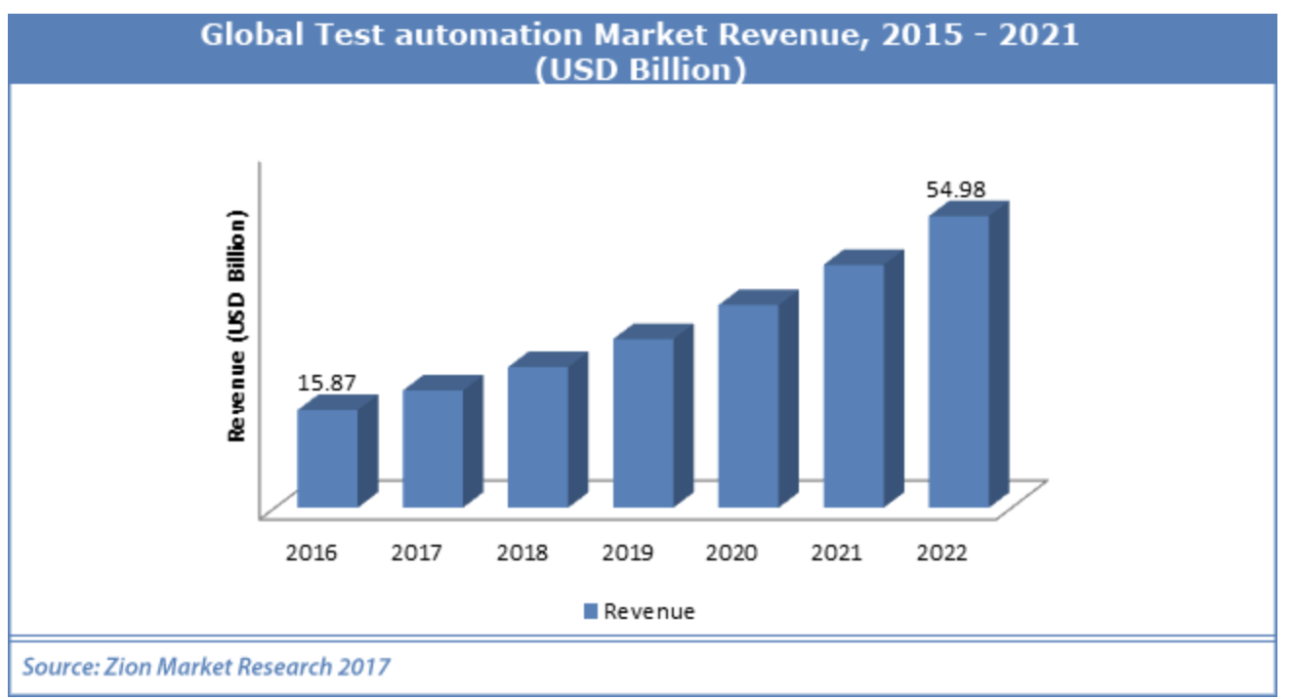
產業分析

Slide 10
軟體自動測試市場主要競爭者說明 - Open-Source Solutions
https://phoenixnap.com/blog/best-automation-testing-tools
Tools | Com | web | And. | iOS | GUI | API | src | AI | TRG shop
TaaD |  | √ | √ | √ | √ | X | X | √ | √
Citrus | Telerik | √ | X | X | X | √ | X | X | X
Galen |  | √ | X | X | X | X | X | X | X
Karate-DSL |  | √ | X | X | X | √ | X | X | X
Robot Framework |  | √ | √ | √ | X | √ | √ | X | X
Selenium |  | √ | X | X | √ | √ | √ | X | X
Watir | MS | √ | X | X | X | X | √ | X | X
Gauge (β) | HP | √ | √ | √ | X | √ | √ | X | X
RedwoodHQ |  | √ | X | X | √ | √ | X | X | X
Serenity BDD |  | √ | X | X | √ | X | X | X | X
Appium |  | X | √ | √ | √ | X | X | X | X
Apache JMeter |  | √ | X | X | X | √ | X | X | X

Slide 11
軟體自動測試市場主要競爭者 - vs. Commercial Solutions
https://phoenixnap.com/blog/best-automation-testing-tools
Tools | Com | $$ | web | And. | iOS | GUI | API | src | AI | TRG Shop
TaaD |  | 6000/y | √ | √ | √ | √ | X | X | √ | √
Rat’al Funct’al Tester | IBM | 8140/y | √ | √ | √ | √ | √ | √ | X | X
Katalon Studio |  | 759/y | √ | √ | √ | √ | √ | √ | X | X
Ranorex |  | 1120/y | √ | √ | √ | √ | √ | √ | √ | X
Sahi Pro |  | 1390/y | √ | X | X | √ | X | X | X | X
TestComplete |  | 4515/y | √ | √ | √ | √ | √ | √ | √ | X
TestPlant eggPlant | MS |  | √ | √ | √ | √ | √ | √ | X | X
Tricentis Tosca | HP |  | √ | √ | √ | √ | √ | √ | X | X
Unif. Funct’al Testing |  | 3200/y | √ | X | X | X | √ | X | √ | X
Cypress |  | 1188/y | √ | X | X | X | √ | X | X | X

Slide 12
軟體自動測試市場主要競爭者年營收
年營收 M：1 百萬美元Revenue
QualityLogic, https://www.qualitylogic.com/ (9.7M)
V-Cubed Solutions, https://www.v-cubed.net/ (27M)
Value Stream Engineering, http://www.valuestreamengineers.com/ (3.8M)
IT Automation LLC, http://www.itautomation.com/ (8.8M)
NeoTys, https://www.neotys.com/ (8.8M)
Parasoft, https://www.parasoft.com/ (55M)
Performancelab, https://www.performancelab.com.br/home (25.3M)
ScienceSoft, https://www.scnsoft.com/ (22M)
Symbio, https://www.symbio.com/ (150M)
tenio.io, https://tenon.io/
≈310.4 Millions
Avg. 34.5Millions

Slide 13
軟體自動測試市場主要競爭者說明 - 您看見機會了嗎？
Huge opportunity!
Only
310.4M (<1%)
of testing service market is captured by top 9.

Slide 14

產業分析 from the Boss‘ perspective
Once upon a time in a QA meeting when MS hired 10000 testers,
“I know I pay a lot of testers, but I really have no idea what they do.“
https://softwaretesting.cioreview.com/cxoinsight/the-cost-of-software-testing-nid-27746-cid-112.html

Slide 15
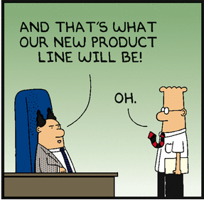
產業分析 from Taiwana Boss‘ perspective
If our product does not crash before clients, all your testing is wasted.

Slide 16
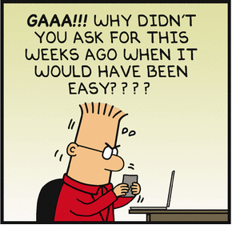
產業分析 from the QA engineers‘ perspective
Can work in a big company!
Can test a few products in the company.
Low self-esteem.
I am a loser.
I don‘t have value to the company.
I have no life!

Slide 17
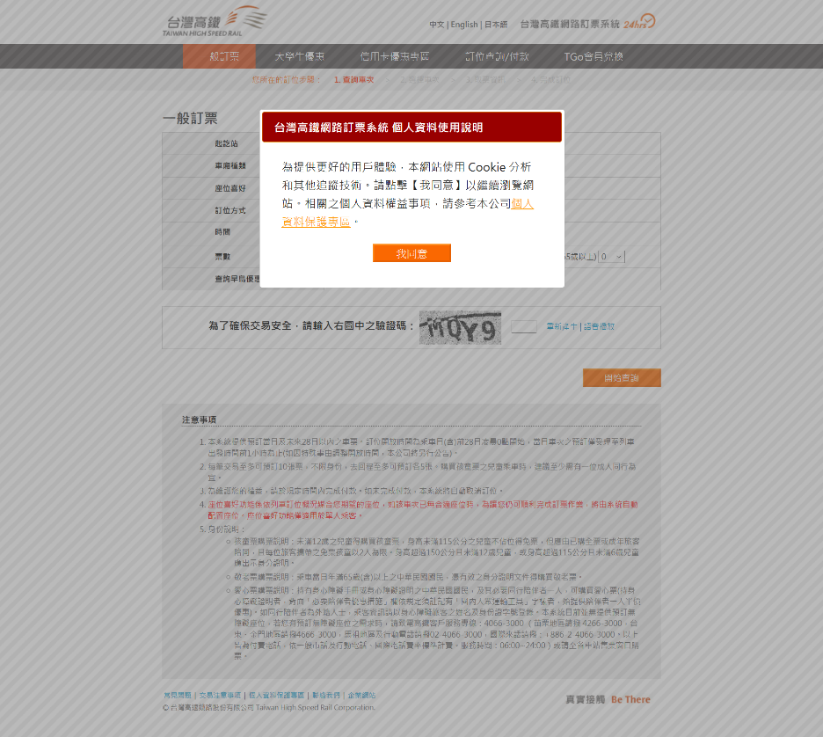
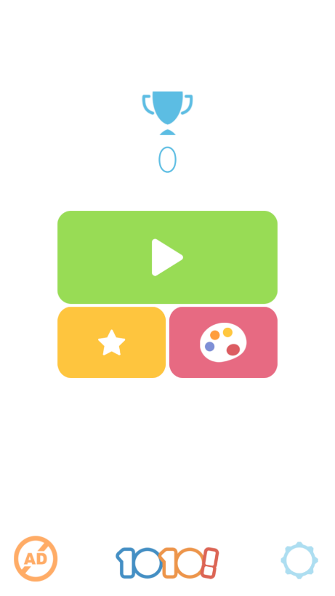
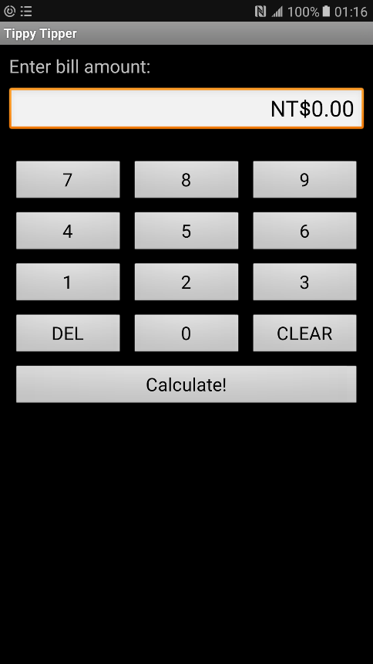
產業分析 Reality
Basically record/replay and test management.
Need human to design tests
Need human to recognize screens
Need human to understand traces.
Huge labor
low efficiency inconsistent quality

Slide 18

產業分析 Reality
test traces
test input
Testbed
human
test
oracle
Record/replay.
Test management!
High automation!
Very low
automation!
Low consistency!
Low efficiency.
Poor coverage.
Low reusability
System
under
Test
Test reports

Slide 19
產業分析 solutions nowaday
測試外包
適合大型軟體公司
只能做system testin或user acceptance testing
IP外洩風險
Feedback 緩慢
軟體測試自動化工具
只幫你record與replay
Monkey testing (low intelligence)
Test investment low reusability
許多未經整合的測試準備工作
★☆巨大市場機會★☆
App智慧型測試工具

Slide 20
產業分析
軟體品管預算膨脹迅速
目前一般軟體開發計畫，50％以上成本與時間都花在測試與品管。
若能降低10％軟體品管成本，就可提昇公司5％獲利。
軟體品管技術交流不易
空有天下優良軟體工程師，卻只能進行手工測試。
目前一般透過網路廣告，測試需求顧客與軟體測試服務公司個別接洽！
底層結構（infrastructure）把持在少數測試工具公司！

Slide 21
產業分析
應用測試難以自動化
目前測試自動化成果重複使用性都非常低
對一個顧客所製作的成果，幾乎都沒辦法用在另一個顧客。
軟體流程差異性、軟體文件差異性
學界的軟體測試成果基本上沒有在工業界應用可能性。

Slide 22
Goal
Theory in software testing.
Advanced testing and security-checking tools
Capability of deploying software testing technology to various companies.
Basic concepts and skills in security checking.

Slide 23
Course Plan
The first module: foundations
The second module: Testing criteria
Graph testing
Logic testing
Input space testing
Syntax testing
Third module: practical consideration.
Criterias for new app types
Security checking overview.

Slide 24
Pre-requisites
Basic Computer Concepts
C/C++, Java programming
Python
Data-Structures
Algorithms

Slide 25
Evaluation
Final exam (40%) , June 23, 2021
Mid-term report (8%), deadline on April 28, 2021.
A Software Testing Market Survey Report (2%)
Deadline March 17, 2021
Quizzes (10%), open book, open internet, no discussion
4 projects (40%)

Slide 26
Evaluation
Midterm presentation (8%)
The topic must be technologically related to one of the chapter in the textbook.
a main paper
must be a regular paper published in ACM/IEEE ICSE 2019-20, ACM FSE 2019-20, IEEE ASE 2019-20, ACM ISSTA 2019-20, or ACM PLDI 2019-20.
2 comparison papers
Comparing the three papers that you selected in the above.

Slide 27
Evaluation
4 projects (40%):
Project 1 (10%): Continuous testing and unit testing,
due by April 7, 2021
Project 2 (10%): GUI testing with Selenium
with Firefox on either Linux or Windows
due by May 5, 2021
Project 3 (10%): mobile app testing
due by May 26, 2021
Project 4 (10%): security check
due by June 16, 2021

Slide 28

Textbook
Introduction to Software Testing
Paul Ammann and Jeff Offutt
related materials in
http://cs.gmu.edu/~offutt/softwaretest/

Slide 29
Course Schedule (1/2)
1. | 2/24 | a) Syllabus, b) Chapter 1
2. | 3/3 | Chapter 1
3. | 3/10 | a) Chapter 1 b) Survey assignement announcement c) Deadline for midterm presentation registration
4. | 3/17 | a) Chapter 2 b) Survey assignment deadline c) Confirmation of midterm presentation registration d) Project 1 announcement: unit testing
5. | 3/24 | Chapter 2
6. | 3/31 | Chapter 2
7. | 4/7 | a) Chapter 2b) Project 1 deadline c) Project 2 announcement: web-testing
8. | 4/14 | Chapter 3
9. | 4/21 | Chapter 3

Slide 30
Course Schedule (2/2)
10. | 4/28 | a) Deadline of midterm presentation submission b) Midterm presentation 1
11. | 5/5 | a) Chapter 3 b) Project 2 deadline c) Project 3 announcement: mobile app testing
12. | 5/12 | Midterm presentation 2
13. | 5/19 | Chapter 4
14. | 5/26 | a) Chapter 5b) Project 3 deadline c) Project 4 announcement: security checking
15. | 6/2 | Chapter 5
16. | 6/9 | Security checking
17. | 6/16 | a) Security checking b) Project 4 deadline
18. | 6/23 | Final exam

