Slide 1
Software Testing & Security Checking Spring 2023, EE 5191 Syllabus
王凡 （Farn Wang）
farn@ntu.edu.tw
http://cc.ee.ntu.edu.tw/ST
國立臺灣大學 電機工程學系

Slide 2
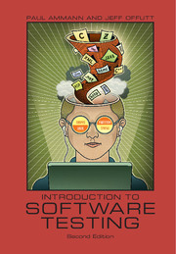
Textbook
Introduction to Software Testing
Paul Ammann and Jeff Offutt
related materials in
http://cs.gmu.edu/~offutt/softwaretest/

Slide 3
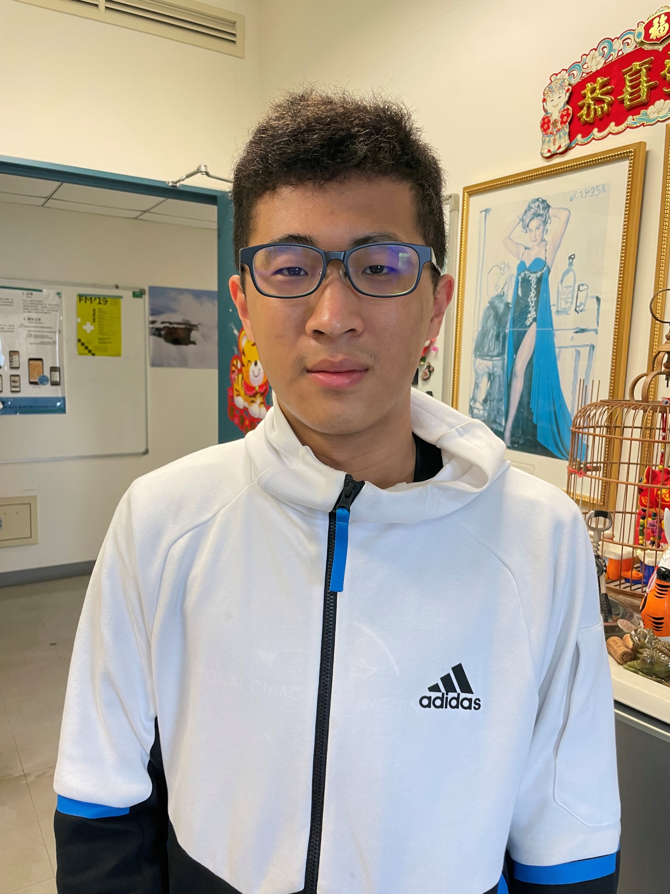
Class Information
課號：EE 5191 Credits: 3
Spring 2023, Wednesday, 9:10am-12:00noon
Classroom: BL 112
王 凡 教授
博理館616，02-33663602
farn@ntu.edu.tw
http://cc.ee.ntu.edu.tw/~farn/courses/ST
助教：劉宗翰
博理館618
r11921094@ntu.edu.tw
Office hour: Wednesday 12:00noon -13:00pm

Slide 4
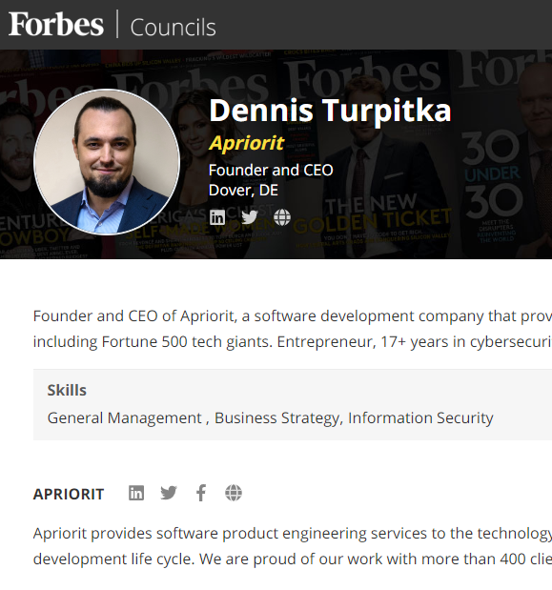
Status in the Industry
APP測試成本居高不下
30-35%研發成本：
具圖形介面APP
35-50%：如果還有server，
持續高漲中
Software QA & security is a highly visible and fast-growing sector of software testing.
Taiwan's high-tech companies do not think that they should spend money in software testing.
Taiwan's industrial strength in OEM and ODM

Slide 5
產業分析
軟體品管預算膨脹迅速
目前一般軟體開發計畫，30％以上成本與時間都花在測試與品管。
若能降低10％軟體品管成本，就可提昇公司5％獲利。
軟體品管技術交流不易
空有天下優良軟體工程師，卻只能進行手工測試。
目前一般透過網路廣告，測試需求顧客與軟體測試服務公司個別接洽！
底層結構（infrastructure）把持在少數測試工具公司！

Slide 6
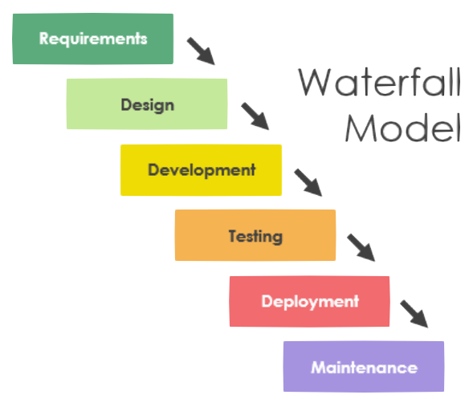
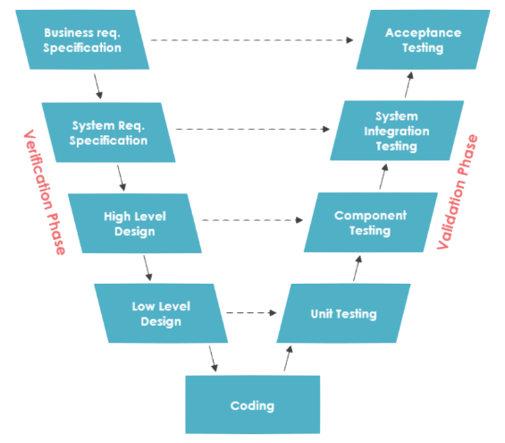
Software Process Models
現有軟體開發模型測試佔開發預算30-50%
尚不考慮implementation/design/coding階段之測試成本

Slide 7
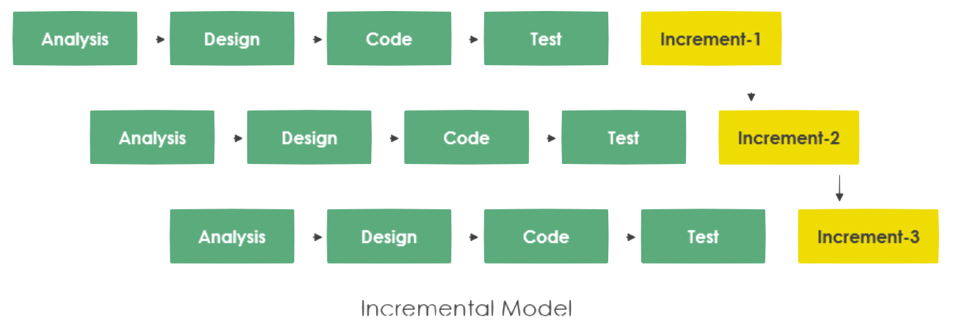
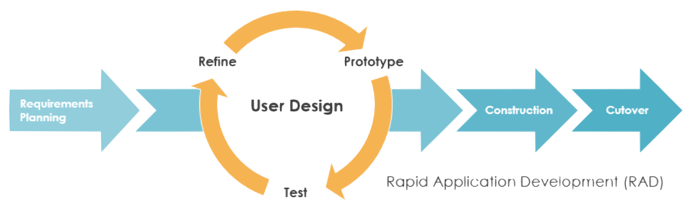
Software Process Models
現有軟體開發模型測試佔開發預算30-50%
尚不考慮implementation/design/coding階段之測試成本

Slide 8
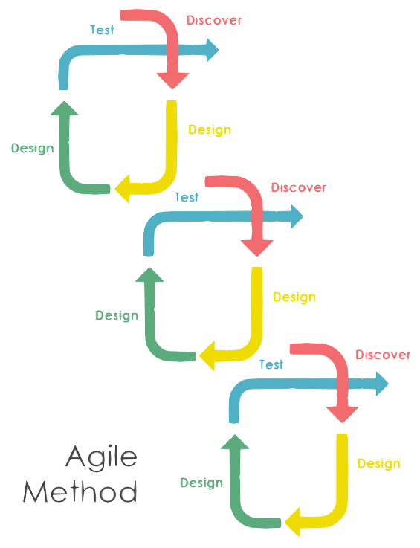
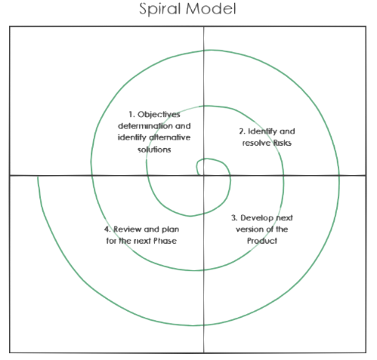
Software Process Models
現有軟體開發模型測試佔開發預算30-50%
尚不考慮implementation/design/coding階段之測試成本

Slide 9
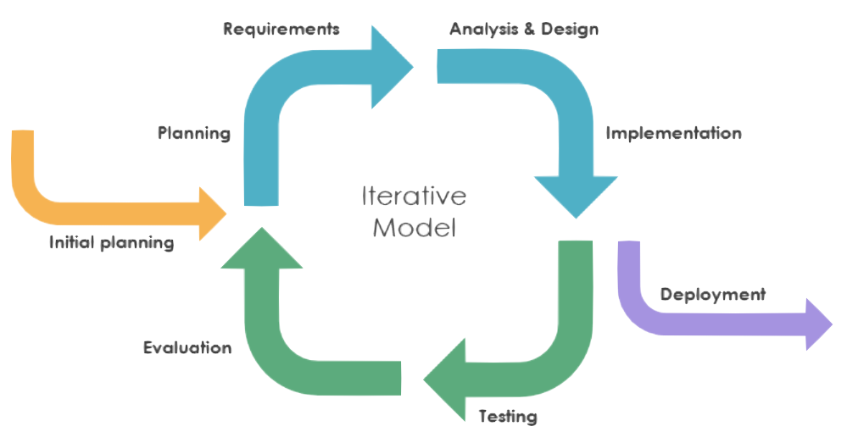
Software Process Models
現有軟體開發模型測試佔開發預算30-50%
尚不考慮implementation/design/coding階段之測試成本

Slide 10
Status in the Industry
Functional Testing
Unit testing
Integration testing
End-to-end testing
Smoke testing
Sanity testing
Regression testing
Acceptance testing
Interface testing
White box testing
Black box testing

Slide 11
Status in the Industry
Non-functional Testing
Performance testing
Security testing
Load testing
Failover testing
Compatibility testing
Usability testing
Scalability testing
Volume testing
Stress testing
Accessibility testing
Alpha testing
Beta testing
Maintainability testing
Compliance testing
Efficiency testing
Reliability testing
Endurance testing
Disaster recovery testing
Localization testing
Internationalization testing
Ad-hoc testing

Slide 12
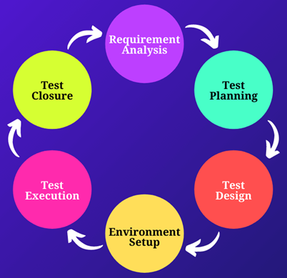


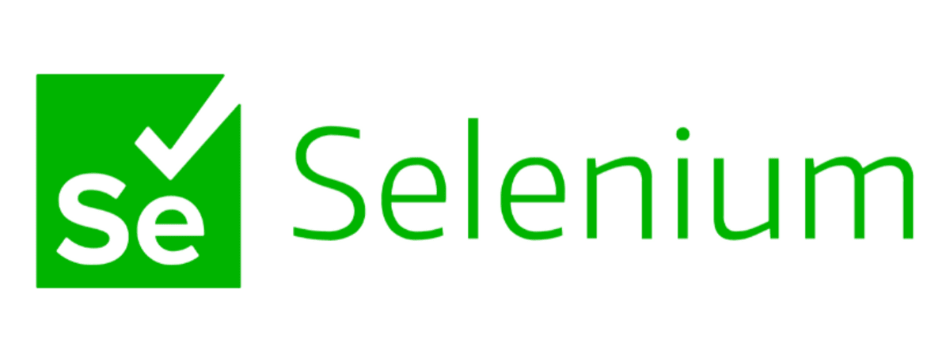
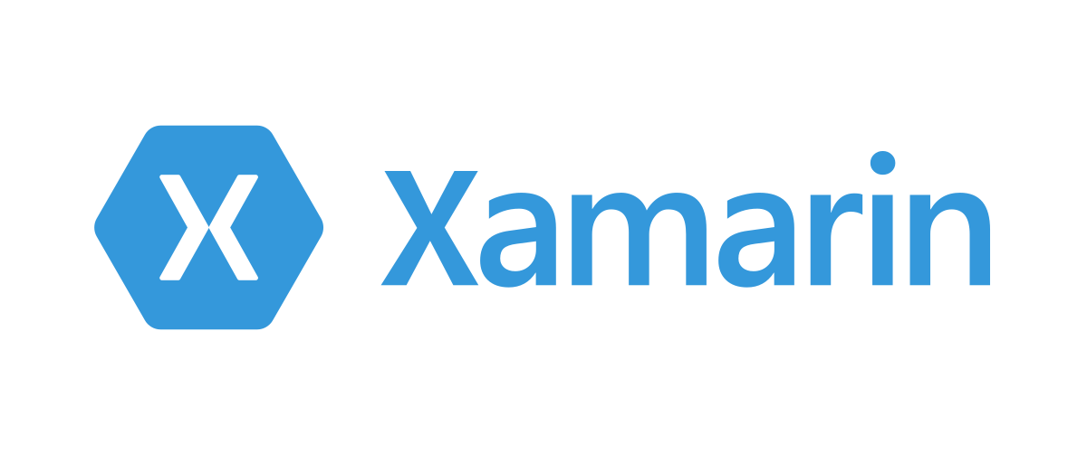
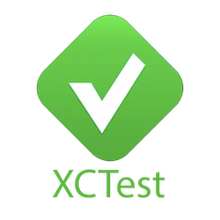





Steps in a Testing Project
現有自動化解決方案
幾乎都著重在
Test Execution
Environment Setup
SiteeX

Slide 13
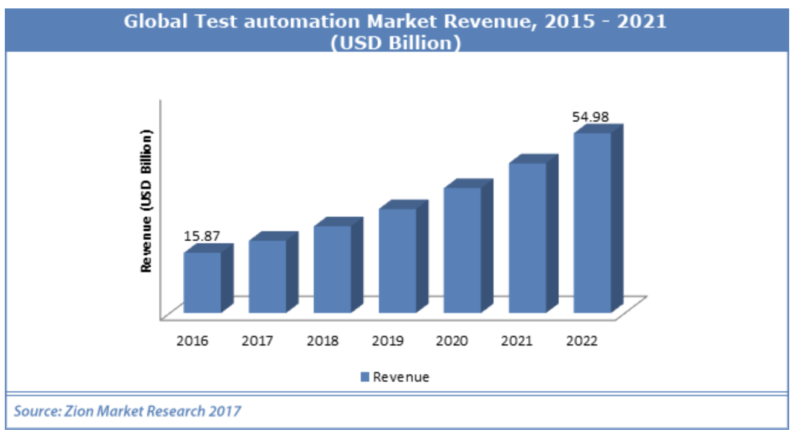
Status of the industry

Slide 14
Status of the industry
年營收 M：1 百萬美元Revenue
QualityLogic, https://www.qualitylogic.com/ (9.7M)
V-Cubed Solutions, https://www.v-cubed.net/ (27M)
Value Stream Engineering, http://www.valuestreamengineers.com/ (3.8M)
IT Automation LLC, http://www.itautomation.com/ (8.8M)
NeoTys, https://www.neotys.com/ (8.8M)
Parasoft, https://www.parasoft.com/ (55M)
Performancelab, https://www.performancelab.com.br/home (25.3M)
ScienceSoft, https://www.scnsoft.com/ (22M)
Symbio, https://www.symbio.com/ (150M)
tenio.io, https://tenon.io/
≈310.4 Millions
Avg. 34.5Millions

Slide 15

Background from the Boss‘ perspective
Once upon a time in a QA meeting when MS hired 10000 testers,
“I know I pay a lot of testers, but I really have no idea what they do.“
https://softwaretesting.cioreview.com/cxoinsight/the-cost-of-software-testing-nid-27746-cid-112.html

Slide 16
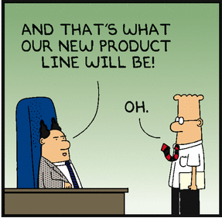
Background from Taiwana Boss‘ perspective
If our product does not crash before clients, all your testing is wasted.

Slide 17
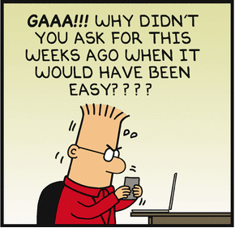
Status in the Industry
Q #35) How many test cases have you automated per day?
Answer: Well, the number depends on the complexity of the test cases. When the complexity was limited, I was able to automate 5 to 6 test cases per day.
Sometimes, I was able to automate only one test case for complex scenarios.
I have also broken down my test cases into different components like, take input, do the calculation, verify the output etc.
in case of very complex scenarios and have taken 2 or more days.
39 TOP Automation Testing Interview Questions And Answers
https://www.softwaretestinghelp.com/test-automation-interview-questions/

Slide 18
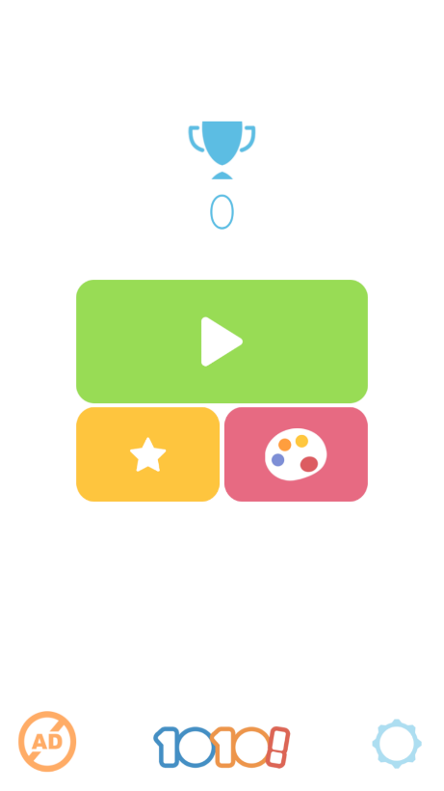
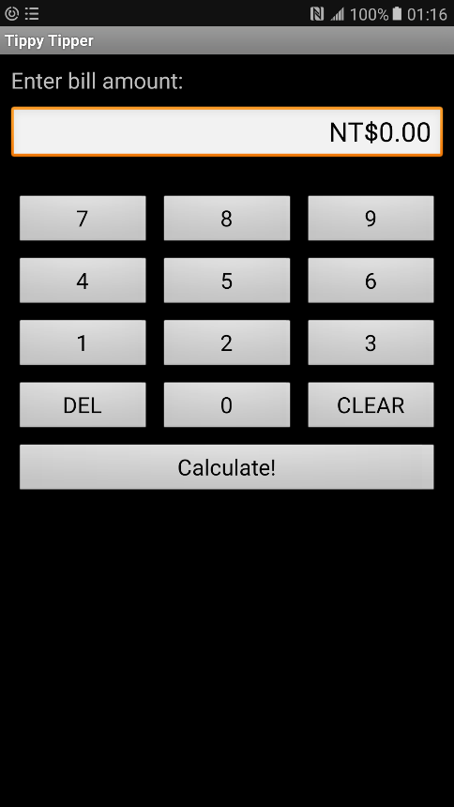
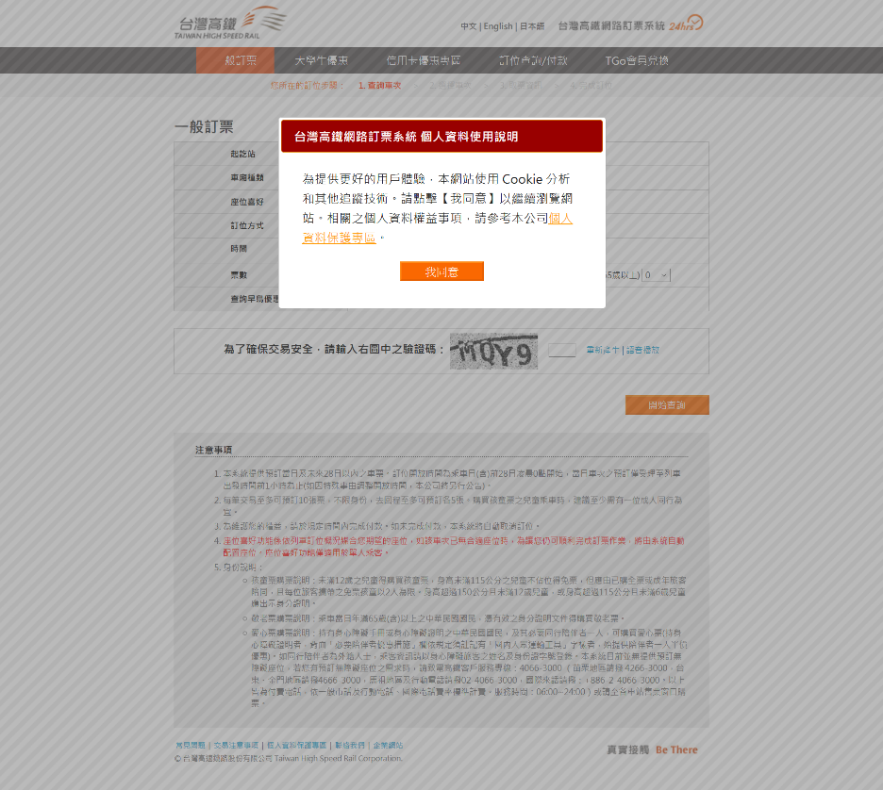
Status of the industry
Basically record/replay and test management.
Test scripts are not reusable across projects.
Need human to design tests
Need human to recognize screens
Need human to understand traces.

Slide 19
產業分析 solutions nowaday
測試外包
適合大型軟體公司
只能做system testin或user acceptance testing
IP外洩風險
Feedback 緩慢
軟體測試自動化工具
只幫你record與replay
Monkey testing (low intelligence)
Test investment low reusability
許多未經整合的測試準備工作
★☆巨大市場機會★☆
App智慧型測試工具

Slide 20
產業分析
應用測試難以自動化
目前測試自動化成果重複使用性都非常低
對一個顧客所製作的成果，幾乎都沒辦法用在另一個顧客。
軟體流程差異性、軟體文件差異性
學界的軟體測試成果基本上沒有在工業界應用可能性。

Slide 21
Goal
Theory in software testing.
Advanced testing and security-checking tools
Capability of deploying software testing technology to various companies.
Basic concepts and skills in security checking.

Slide 22
Course Plan
The first module: foundations
The second module: Testing criteria
Graph testing
Logic testing
Input space testing
Syntax testing
Third module: practical consideration.
Criterias for new app types
Security checking overview.

Slide 23
Pre-requisites
Basic Computer Concepts
C/C++, Java programming
Python
Data-Structures
Algorithms

Slide 24
Evaluation
Final exam (40%) , June 7, 2023
20% of final exam scores will be for questions on selected midterm reports.
Mid-term report (10%), deadline on April 26, 2023.
Deadline for midterm presentation registration: 3/8
Confirmation of midterm presentation registration: 3/15
3 projects (50%)
CppUnit and GOV for unit testing (15%), due by April 12, 2023.
Selenium for web-testing (15%), due by May 3, 2023.
App/Web/Security Testing (20%), due by June 14, 2023.
Experiment with AI

Slide 25
Evaluation
Midterm presentation (10%)
a main paper
must be a regular paper published in ACM/IEEE ICSE 2021-22, ACM FSE 2021-22, IEEE ASE 2021-22, ACM ISSTA 2021-22, or ACM PLDI 2021-22.
No tool paper, no short paper, no affiliated workshop paper.
2 comparison papers related to the main paper.
Comparing the three papers that you selected in the above.
Submission including your PPT file and MP4 Video for 10mins.

Slide 26
Evaluation project 1
White-box unit testing with CPP and GOV. (15%)
Software under test (SUT) is a github open-source cpp module.
Must write assertions to evaluate the pass or fail of the test scripts.
Submission:
CPPUnit test modules, test reports, and SUT source code.
PPT explains the SUT, your test requirements, your test plan, and your test result with coverage analysis.
Your score is
(line coverage) × log(#lines+#classes) + 10*(bugs detected)

Slide 27
Evaluation project 2
Web testing with Selenium. (15%)
Software under test (SUT) is an open-source web program from github.
Must write assertions to evaluate the pass or fail of the test scripts.
Submission:
Selenium test scripts, test reports with coverage analysis of the test items.
PPT explains the SUT, your test requirements, your test plan, and your test result.
Your score is
(coverage of the test items) × log(#actionables+html sizes)
+ 10*(bugs detected)

Slide 28
Evaluation project 3
App/web/security testing on an AI test automation platform. (20%)
Software under test (SUT) could be a mobile APP or a web program.
The test items will be announced.
Writing a python program as a test robot that generates test reports.
Submission:
A test robot that can be used by other classmates.
Online documents of your test robot.
Your score is based on the rating and reviews of peer classmates.

Slide 29
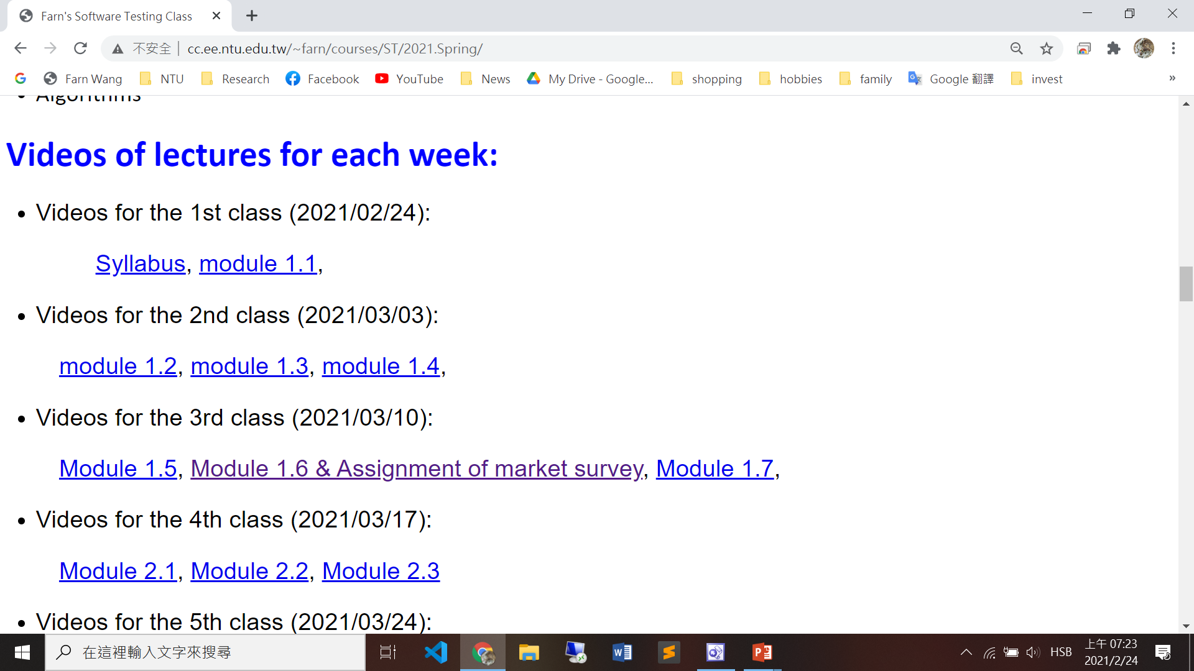
Videos

Slide 30
Course Schedule (1/2)
1. | 2/22 | a) Syllabus, b) Chapter 1
2. | 3/1 | Chapter 1
3. | 3/8 | a) Chapter 2 b) Deadline for midterm presentation registration c) Project 1 announcement: unit testing
4. | 3/15 | a) Chapter 2 b) Confirmation of midterm presentation registration
5. | 3/22 | Chapter 2
6. | 3/29 | Chapter 3
7. | 4/5 | 清明節
8. | 4/12 | Chapter 3 Project 1 deadline c) Project 2 announcement: web-testing

Slide 31
Course Schedule (2/2)
9. | 4/19 | Chapter 3
10. | 4/26 | Deadline of midterm presentation submission Chapter 3
11. | 5/3 | a) Chapter 4 b) Project 2 deadline c) Project 3 announcement: app/web/security testing
12. | 5/10 | Chapter 4
13. | 5/17 | Chapter 5
14. | 5/24 | Chapter 5
15. | 5/31 | Security Checking
16. | 6/7 | Final exam
17. | 6/14 | Project 3 deadline

