Slide 1
Project 1 -
Unit Testing
CppUnit & Gcovr
TA:劉宗翰
Email:r11921094@ntu.edu.tw
Software Testing and Security Checking
Department of EE, National Taiwan University

Slide 2
Unit Test
White-box testing
For the quality assurance(QA) of a unit part of a program
A must step before submitting a unit to a big project

Slide 3
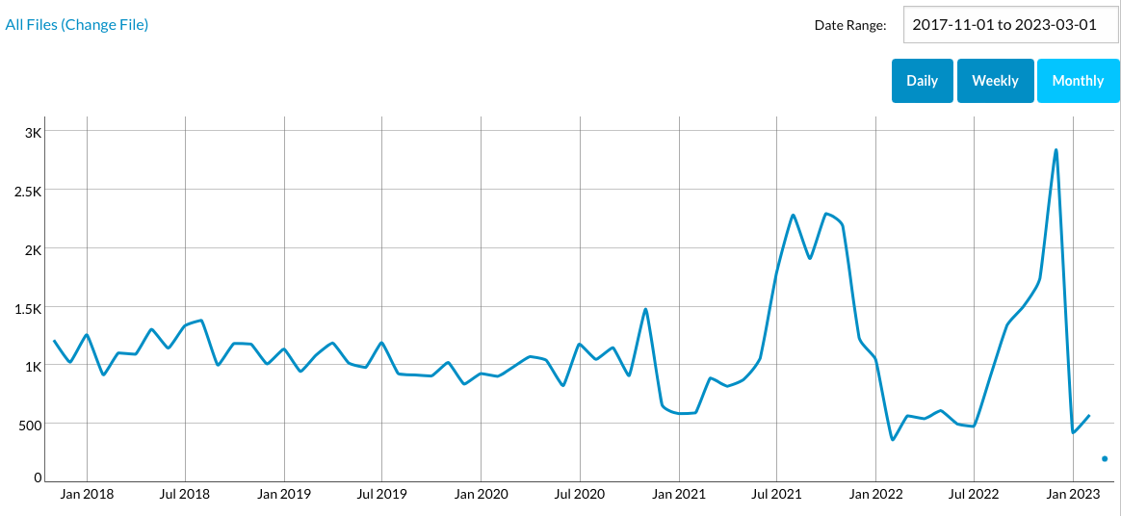
CppUnit
The C++ port of the famous JUnit framework for unit testing
Started around 2000 by Michael Feathers
A defacto standard of C++ unit testing package
https://cppunit.sourceforge.net/doc/cvs/index.html

Slide 4
Gcovr
Generate GCC code coverage reports
Gcovr provides a utility for managing the use of the GNU gcov utility and generating summarized code coverage results
use special compiler options to compile enables gcovr to analyze
https://gcovr.com/en/stable/index.html

Slide 5
Implementing Test Framework with CppUnit
Design your test cases in TestFixture
test under specific scenario whether it has expected result
Add test cases to your TestSuite
usually combine related test cases into one test suite
Regist TestSuite to TestFactoryRegistry
Add TestSuite from TestFactoryRegistry to TestRunner
Invoke TestRunner::run() to run the testing
Compile and Run

Slide 6
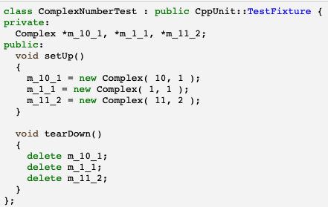
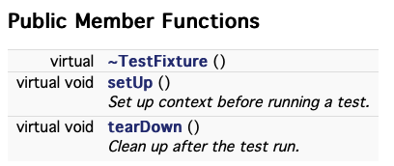
TestFixture
Used to provide a common environment for a set of test cases

Slide 7
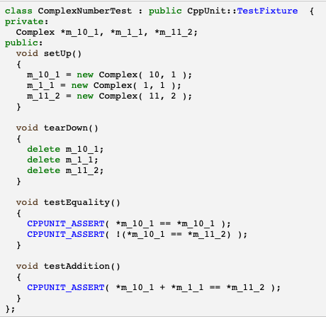
Test Cases
How to write and invoke individual tests using a fixture?
Write the test cases as a method in the fixture class
Create a TestCaller which runs that particular method
Test functions in TestFixture

Slide 8

Test Cases
How to write and invoke individual tests using a fixture?
Write the test cases as a method in the fixture class
Create a TestCaller which runs that particular method
TestCaller in main function

Slide 9
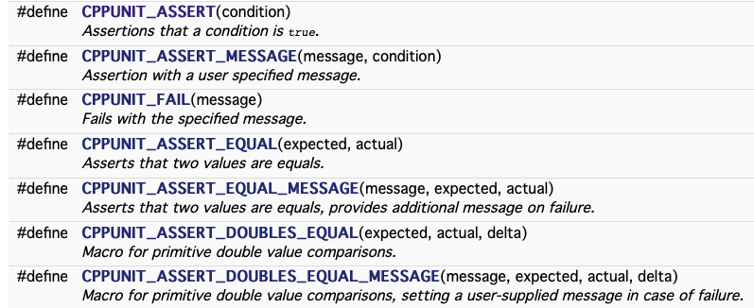
Assertions
Verification statement as a function call to CppUnit
CppUnit also provides some useful assertions
https://cppunit.sourceforge.net/doc/cvs/group___assertions.html

Slide 10
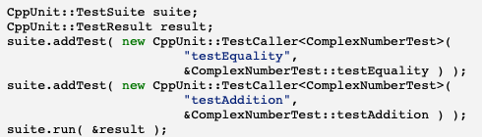

TestSuite
Set up tests so that you can run them all at once
Combine together into one TestSuite
Combine multiple suites into one suite
Add test cases to TestSuite

Slide 11
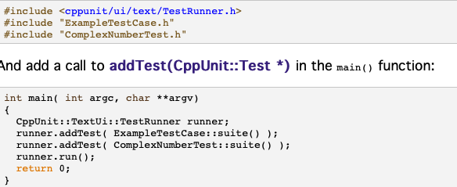
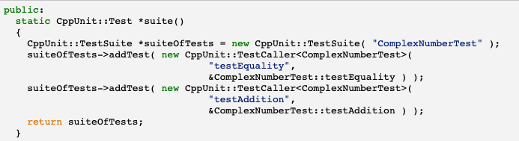
TestRunner
Run suite and collect the results
Add two suites to TestRunner and run
Implement TestSuite in the test class

Slide 12
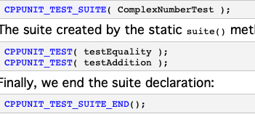
Helper Macros
Shorten the code
An test suite implementation equivalent to below
Suites implementation in the test class

Slide 13

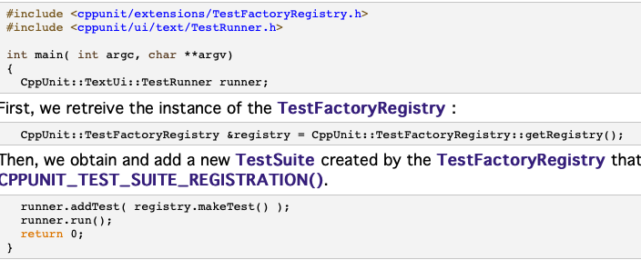
TestFactoryRegistry
Store fixture suite
Register fixture suites at initialization time
Created to solve two pitfalls
forget to add your fixture suite to the test runner
compilation bottleneck caused by the inclusion of all test case headers
Regist test suite in test class
Retrieve suite from TestFactoryRegistry

Slide 14
Installation
Ubuntu 20.04
this tutorial was written and tested on Ubuntu 20.04
For CppUnit
sudo apt-get install libcppunit-dev
For gcovr (line coverage tool)
sudo apt-get install gcovr

Slide 15
Example Project
Refer to NUS: Crash Course in using CppUnit
Program under test
Student
記錄修過的課程(Course)
Course
記錄課程名稱及成績
Test cases
Student的constructor
Student成績的assign和retrieve

Slide 16
Execution Flow
Regist suites to TestFactoryRegistry at initialization time
Retrieve suite from TestFactoryRegistry
Add the suite to TestRunner
TestRunner run the suite and output the result

Slide 17
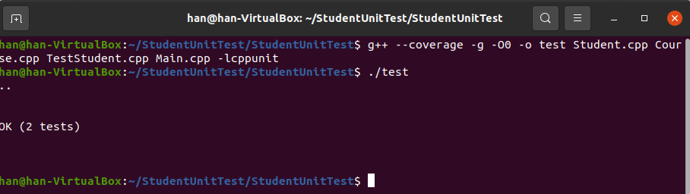
Compile & Run
$ g++ --coverage -g -O0 -o output_filename [cppfiles] -lcppunit
coverage file(.gcno) is generated after compiling
$ ./output_filename
run the executable file then the coverage data(.gcda) is generated

Slide 18
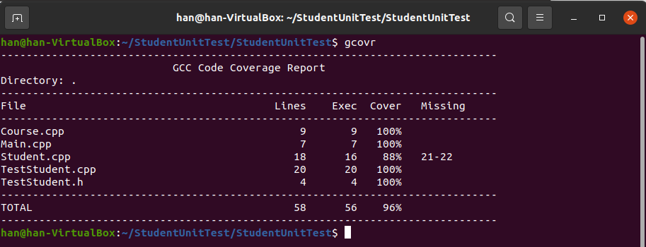
Check Line Coverage
$ gcovr
analyzing coverage data generated when compiling and running

Slide 19
Requirement of Project1
Find an external library and do unit test on it with CppUnit
Write a report specifies
testcases you designed
testing result
external library you found

Slide 20
Scoring
rawScore(you) = #of bugs-found + line-coverage * log2(# of total lines of your library SUT)
# of bugs-found is at most 3
projectScore(you) = 15 * rawScore(you) / max(rawScore(anyStudents))

Slide 21
Submission
Hand in the following files to NTU COOL
the external library you found
your testing code
report
Deadline: 2023/4/12 23:59

