Slide 1
Project 2 -
Web Testing
Selenium
TA:劉宗翰
Email:r11921094@ntu.edu.tw
Software Testing and Security Checking
Department of EE, National Taiwan University

Slide 2

Selenium
A suite of tools for automating web browsers
First launched at 2002/04/30
Written in Java
A cross platform software
Support programming languages
C#, Javascript, Java, Python, Ruby

Slide 3

Selenium IDE
A browser extension that records and plays back a user’s actions
Web ready
Easy debugging
Cross-browser execution
Notes:
網絡就緒：快速使用，適用於任何網站。可快速編寫可靠的端對端測試。
簡易除錯：多功能的 IDE，可以輕鬆進行測試除錯，設置斷點和暫停異常。
跨瀏覽器執行：使用 Command-line Runner 在任何瀏覽器/OS上進行測試。

Slide 4

Selenium WebDriver
Designed as a simple and more concise programming interface

Slide 5

Selenium Grid
Provide an easy way to run tests in parallel on multiple machines
Allow testing on different browser versions
Enable cross platform testing

Slide 6
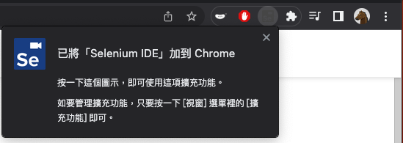
Installation (Selenium IDE)
Install Selenium IDE extension on Chrome/FireFox
use Chrome here
https://chrome.google.com/webstore/detail/selenium-ide/mooikfkahbdckldjjndioackbalphokd

Slide 7
Start with Selenium IDE
Create a new project / Open an old project
Add a new test to project
For a single test in a project
Recording
Insert and Delete commands
Playback
Export to programming language
Save the project into .side file

Slide 8
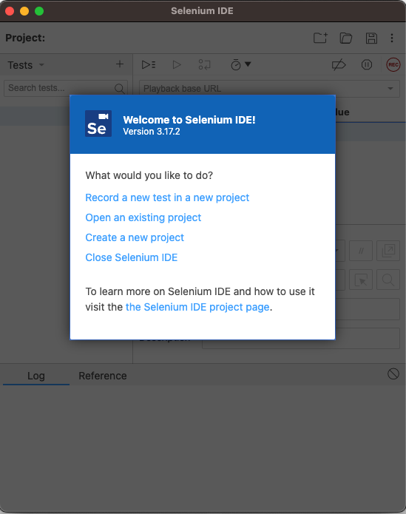
Record a Test
Record your actions and save as a list of commands
e.g.
open https://www.google.com/
type ‘facebook’ in search bar
press enter
click ‘Facebook’ page
close the page

Slide 9
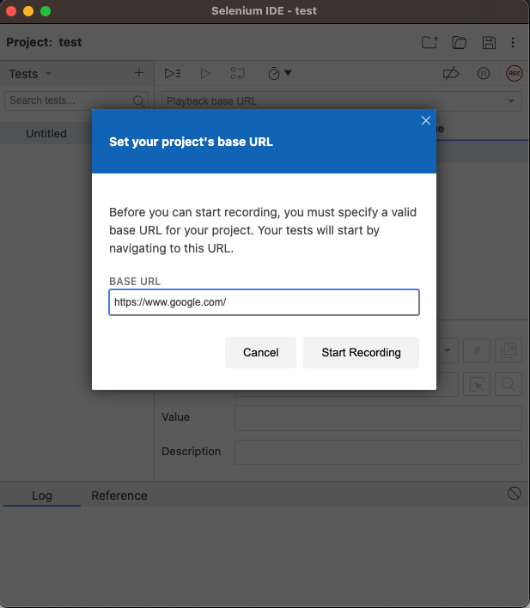
Record a Test
Record your actions and save as a list of commands
e.g.
open https://www.google.com/
type ‘facebook’ in search bar
press enter
click ‘Facebook’ page
close the page

Slide 10
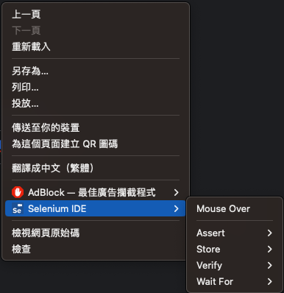
Record a Test
Record your actions and save as a list of commands
e.g.
open https://www.google.com/
type ‘facebook’ in search bar
press enter
click ‘Facebook’ page
close the page
Right click on the page

Slide 11
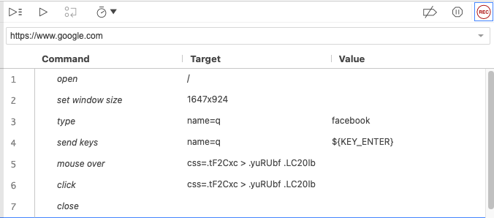
Record a Test
Record your actions and save as a list of commands
e.g.
open https://www.google.com/
type ‘facebook’ in search bar
press enter
click ‘Facebook’ page
close the page

Slide 12
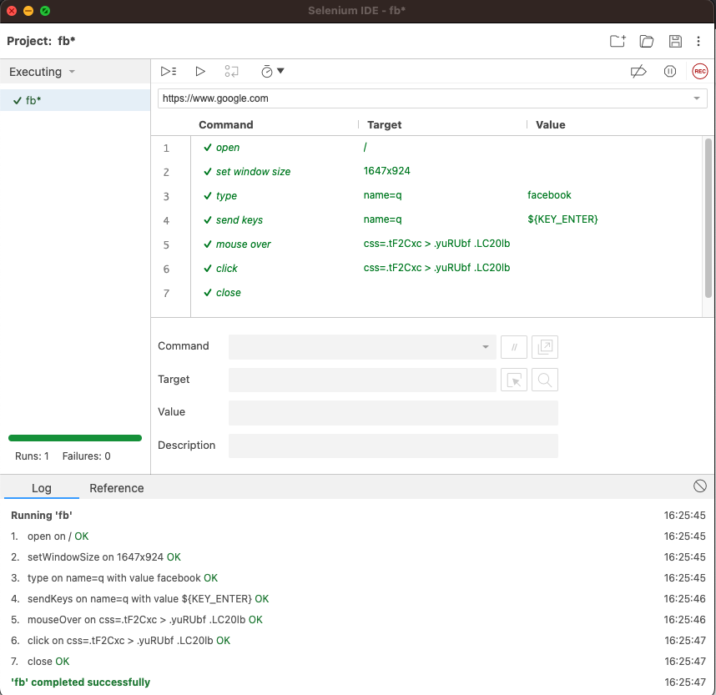
Run a Test
Run the recorded actions
Selenium IDE provides result of running with logs

Slide 13
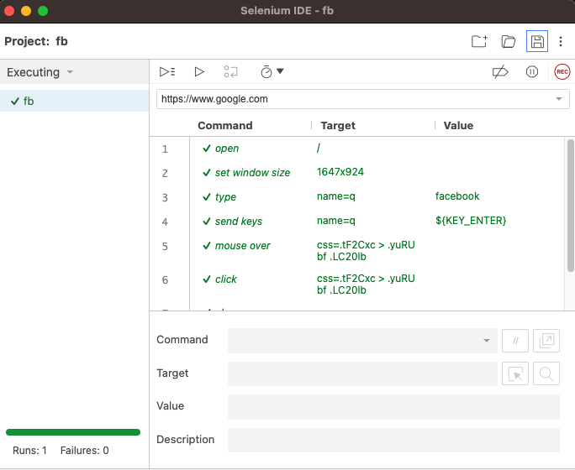
Save a Test to Project
Save the recorded actions to .side file

Slide 14
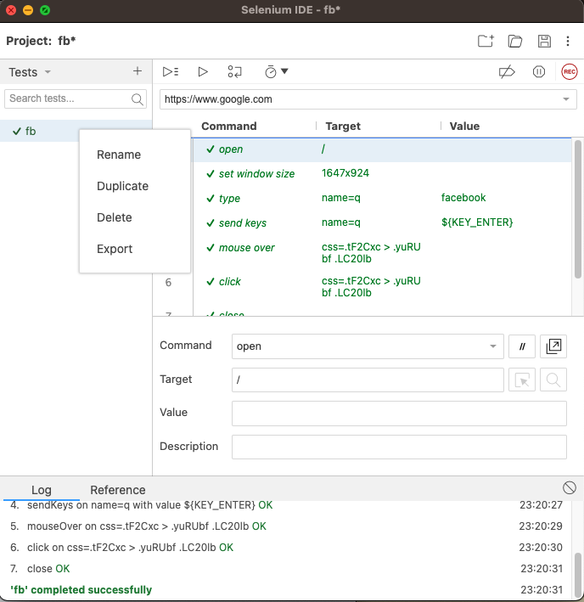
Export a Test
Export the recorded actions into programming language

Slide 15
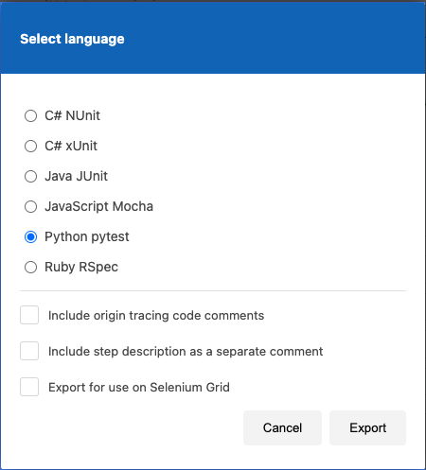
Export a Test
Export the recorded actions into programming language

Slide 16
Requirement & Evaluation of Project2
Find one website with multiple language choices
Register the website different from other students
https://docs.google.com/spreadsheets/d/13_GNUfqFi0Wk2N2mh-_DcKhDZwMYpm6iAKFxQoCV_gk/edit?usp=sharing
(10%) Use assertions to test whether the contents change appropriately according to language selection
(9%) The navigation bar
(1%) Webpage title
(5%) Pick two other pages in the same website and test if language selection is properly remembered
Total 10% + 5% = 15%

Slide 17
Requirement & Evaluation of Project2 (cont.)
Write a report specifies
the webpage you choose
test script you design
testing result

Slide 18
Submission
Hand in the following files to NTU COOL
your testing script (.side)
report
Deadline: 2023/5/3 23:59

