Slide 1
Software Testing & Security Checking Fall 2023, EE 5191 Syllabus
王凡 （Farn Wang）
farn@ntu.edu.tw
http://cc.ee.ntu.edu.tw/ST
國立臺灣大學 電機工程學系

Slide 2

Textbook
Introduction to Software Testing
Paul Ammann and Jeff Offutt
related materials in
http://cs.gmu.edu/~offutt/softwaretest/

Slide 3

Class Information
課號：EE 5191 Credits: 3
Fall 2023, Wednesday, 9:10am-12:00noon
Classroom: BL 112
王 凡 教授
博理館616，02-33663602
farn@ntu.edu.tw
http://cc.ee.ntu.edu.tw/~farn/courses/ST
助教：黃浩然
博理館618
r11921104@ntu.edu.tw
Office hour: Wednesday 12:00noon -13:00pm

Slide 4
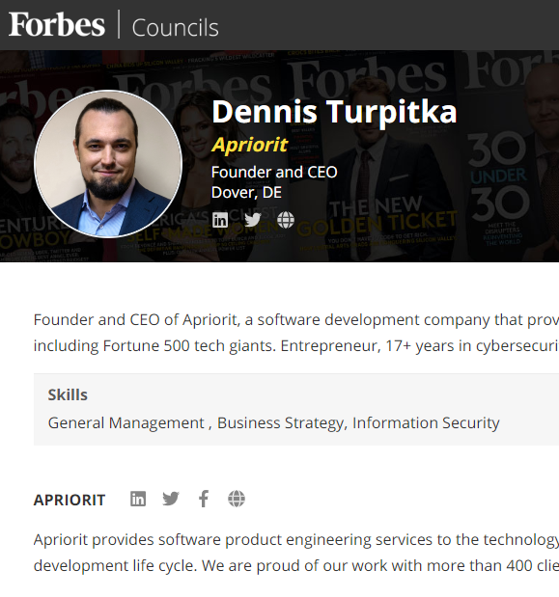
Status in the Industry
APP測試成本居高不下
30-35%研發成本：
具圖形介面APP
35-50%：如果還有server，
持續高漲中
Software QA & security is a highly visible and fast-growing sector of software testing.
Taiwan's high-tech companies do not think that they should spend money in software testing.
Taiwan's industrial strength in OEM and ODM

Slide 5
產業分析
軟體品管預算膨脹迅速
目前一般軟體開發計畫，30％以上成本與時間都花在測試與品管。
若能降低10％軟體品管成本，就可提昇公司5％獲利。
軟體品管技術交流不易
空有天下優良軟體工程師，卻只能進行手工測試。
目前一般透過網路廣告，測試需求顧客與軟體測試服務公司個別接洽！
底層結構（infrastructure）把持在少數測試工具公司！

Slide 6
產業分析
產品差異化訴求 - 軟體開發業者的核心痛點
晚一天交件
罰0.1％
痛點 2 -產品交件延誤，所造成的營收損失
SA/SD（33％）
系統分析/系統設計
程式撰寫（50％）
測試（33％）
Notes:
顏色太多，不要一行一種顏色，highlight才用不同顏色。
把上一版的四個測試步驟講出來，
跨計劃在手工部分，可能不要使用這個詞，就是人工變成自動化
[DW]
投影片內容格式可以稍爲優化一下，讓它看起來不會令人感覺眼花撩亂。
針對分列項目，做了小幅度文字修飾如下：
測試人力嚴重不足（這是整個結論，可以不列如分項）
佔開發預算30-50%，尚不考慮程式撰寫階段測試成本。(這一項感覺是量化總結，可以列在最後一項，做爲結論）
大量仰賴人力製作／維護測試腳本
一個熟練測試人員一天只能寫一個腳本（這·是上面那一項的源由之一，不比分列，口述就好）
缺乏功能與使用者經驗測試工具
程式撰寫階段基本沒有自動化測試工具可用。
許多外包或上傳的測試服務存在疑慮IP外洩疑慮
總結：如果能夠在功能測試部份，針對痛點提出有效解決方案，不止提升產品總體品質，還可大幅降低整體開發時間與成本，客戶將願意為此買單！
[/DW]
《DW》
建議將 p2 and p3 的次序對調，感覺這樣敘述的邏輯比較順。你說呢？
《/DW》

Slide 7
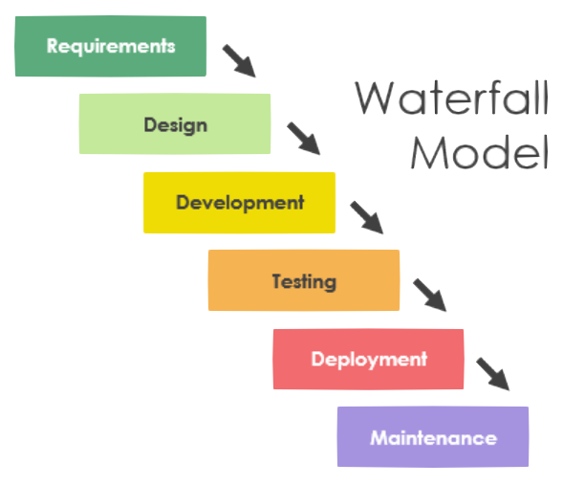
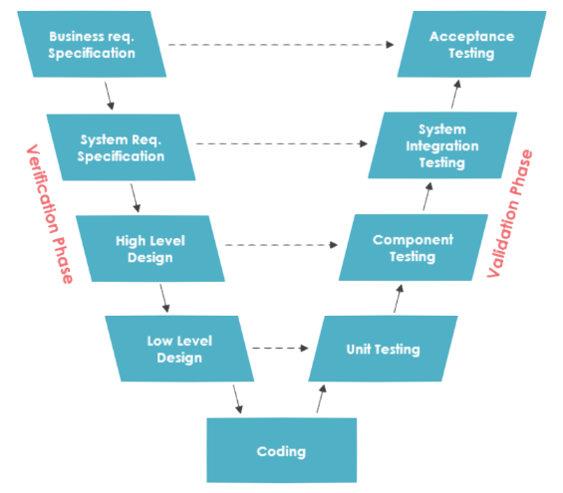
Software Process Models
現有軟體開發模型測試佔開發預算30-50%
尚不考慮implementation/design/coding階段之測試成本

Slide 8
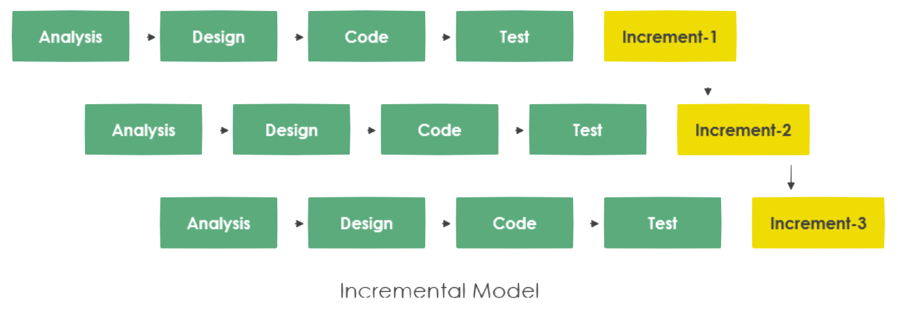
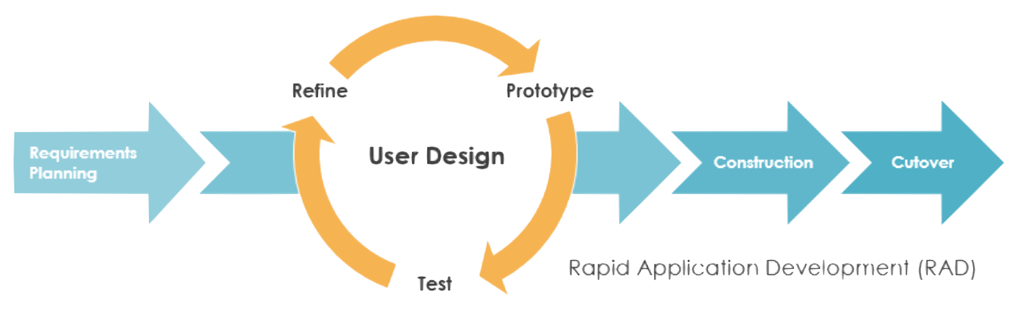
Software Process Models
現有軟體開發模型測試佔開發預算30-50%
尚不考慮implementation/design/coding階段之測試成本

Slide 9
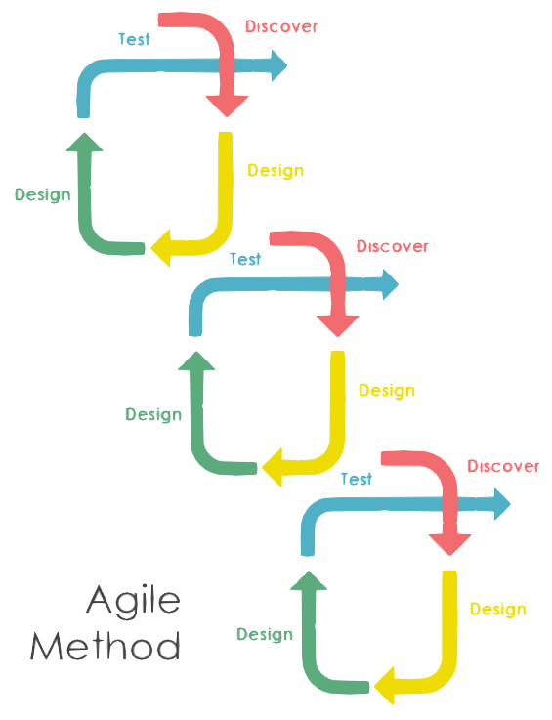
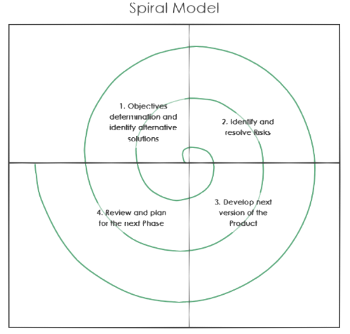
Software Process Models
現有軟體開發模型測試佔開發預算30-50%
尚不考慮implementation/design/coding階段之測試成本

Slide 10
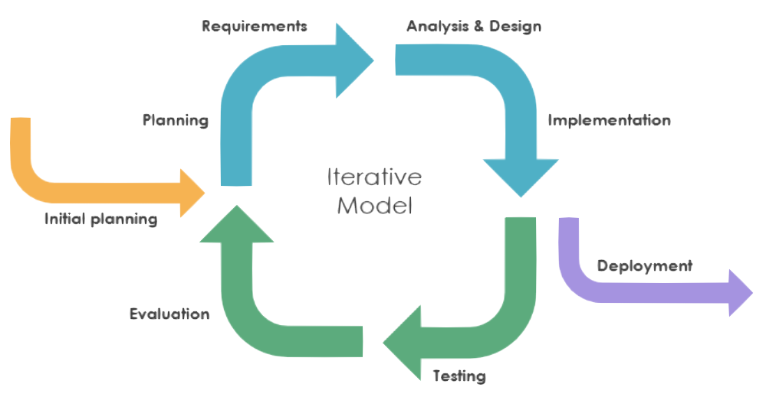
Software Process Models
現有軟體開發模型測試佔開發預算30-50%
尚不考慮implementation/design/coding階段之測試成本

Slide 11
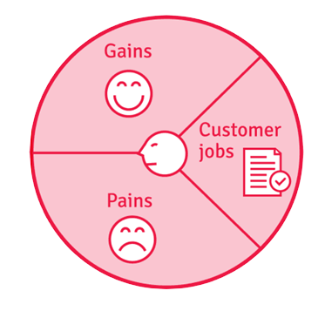
產業分析
產品差異化訴求 - 客戶素描 1
顧客素描（XXXX科技股份有限公司）
準時通過客戶驗收
提昇產品形象
30+人
與電信公司作聯合資訊服務
或自行經營資訊服務
無專門QA/測試人力
專案可能有2/3名測試人力，也負責程式
全人力，沒自動化
人力不穩定/不足
系統/測試需求變更
客戶測試不過恐慌
遲交每日罰1/1000
Notes:
《DW》
因爲只有一個客戶素描的個案，建議將前面的數字 1 拿掉
我不太能夠理解 ‘Customer Job’ 那邊所列的那幾個項目的意義。請你稍稍解釋一下，那裡要表述的重點是什麼

Slide 12
產業分析
產品差異化訴求 - 客戶素描 2
顧客素描（飛象資訊股份有限公司）
準時通過客戶驗收
降低測試工具費用
降低人力成本
12人
資訊整合服務
資安掃瞄服務
一個QA支援三個PM
自動化工具效果不佳
Selenium投資回饋低
人力不穩定/不足
自動掃瞄工具授權昂貴
系統/測試需求變更
客戶測試不過恐慌
遲交每日罰1/1000，最高達20％
Notes:
《DW》
因爲只有一個客戶素描的個案，建議將前面的數字 1 拿掉
我不太能夠理解 ‘Customer Job’ 那邊所列的那幾個項目的意義。請你稍稍解釋一下，那裡要表述的重點是什麼

Slide 13
Status in the Industry
Functional Testing
Unit testing
Integration testing
End-to-end testing
Smoke testing
Sanity testing
Regression testing
Acceptance testing
Interface testing
White box testing
Black box testing

Slide 14
Status in the Industry
Non-functional Testing
Performance testing
Security testing
Load testing
Failover testing
Compatibility testing
Usability testing
Scalability testing
Volume testing
Stress testing
Accessibility testing
Alpha testing
Beta testing
Maintainability testing
Compliance testing
Efficiency testing
Reliability testing
Endurance testing
Disaster recovery testing
Localization testing
Internationalization testing
Ad-hoc testing

Slide 15
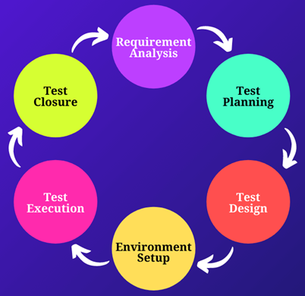


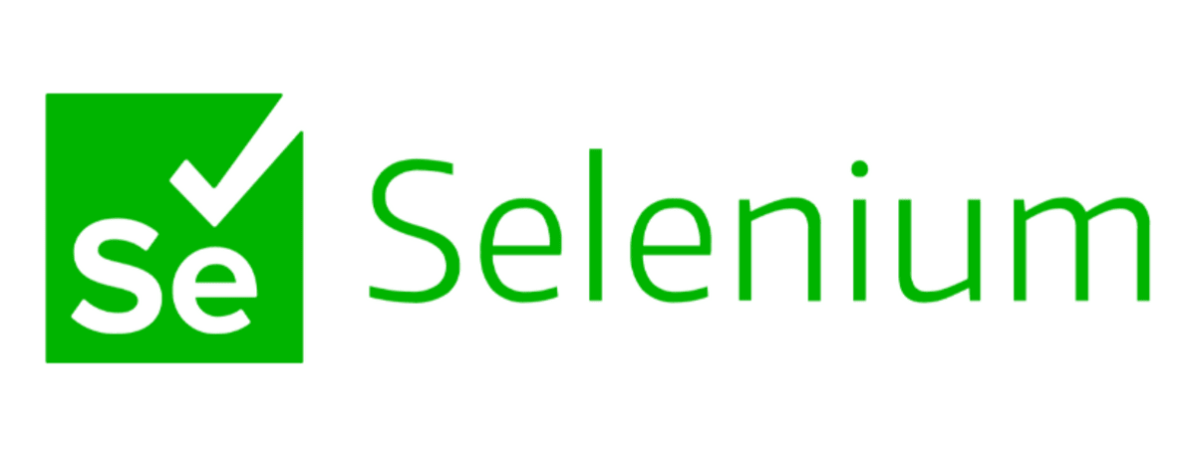

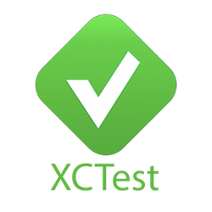





Steps in a Testing Project
現有自動化解決方案
幾乎都著重在
Test Execution
Environment Setup
SiteeX

Slide 16
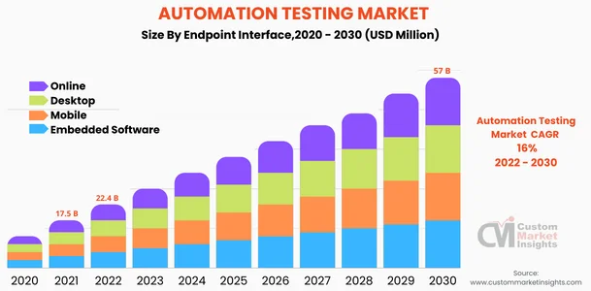
Status of the industry
預估 2030 年全球E2E SW Testing 市場規模約為 US$19B
若能取得 2.5% 市佔率，營收規模可達到 US$475M

Slide 17
Status of the industry
年營收 M：1 百萬美元Revenue
QualityLogic, https://www.qualitylogic.com/ (9.7M)
V-Cubed Solutions, https://www.v-cubed.net/ (27M)
Value Stream Engineering, http://www.valuestreamengineers.com/ (3.8M)
IT Automation LLC, http://www.itautomation.com/ (8.8M)
NeoTys, https://www.neotys.com/ (8.8M)
Parasoft, https://www.parasoft.com/ (55M)
Performancelab, https://www.performancelab.com.br/home (25.3M)
ScienceSoft, https://www.scnsoft.com/ (22M)
Symbio, https://www.symbio.com/ (150M)
tenio.io, https://tenon.io/
≈310.4 Millions
Avg. 34.5Millions

Slide 18

Background from the Boss‘ perspective
Once upon a time in a QA meeting when MS hired 10000 testers,
“I know I pay a lot of testers, but I really have no idea what they do.“
https://softwaretesting.cioreview.com/cxoinsight/the-cost-of-software-testing-nid-27746-cid-112.html

Slide 19
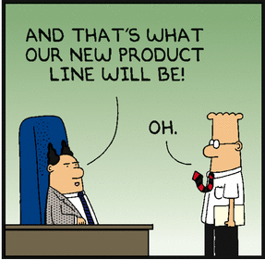
Background from Taiwana Boss‘ perspective
If our product does not crash before clients, all your testing is wasted.

Slide 20
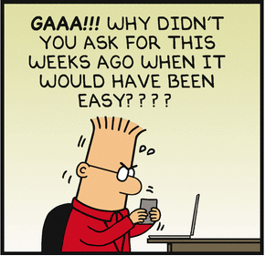
Status in the Industry
Q #35) How many test cases have you automated per day?
Answer: Well, the number depends on the complexity of the test cases. When the complexity was limited, I was able to automate 5 to 6 test cases per day.
Sometimes, I was able to automate only one test case for complex scenarios.
I have also broken down my test cases into different components like, take input, do the calculation, verify the output etc.
in case of very complex scenarios and have taken 2 or more days.
39 TOP Automation Testing Interview Questions And Answers
https://www.softwaretestinghelp.com/test-automation-interview-questions/

Slide 21
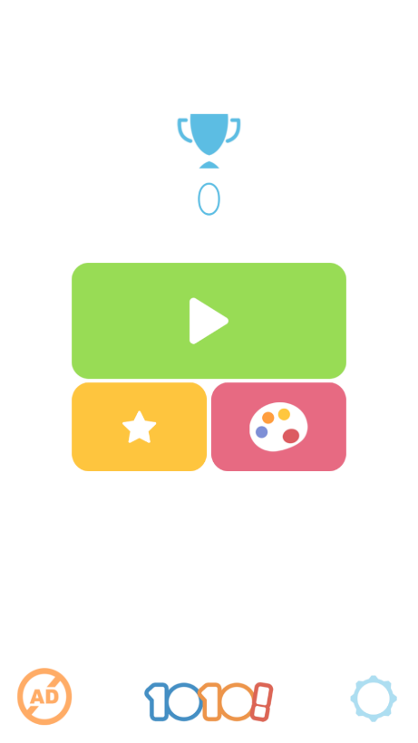
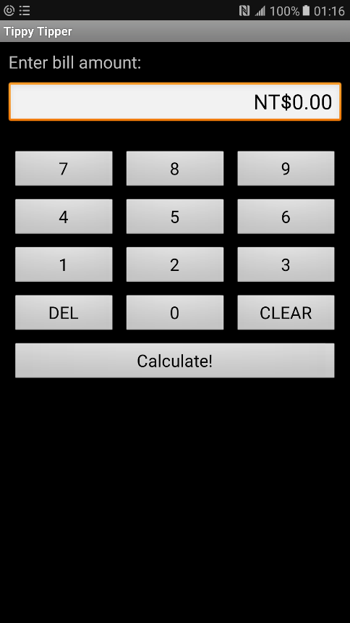
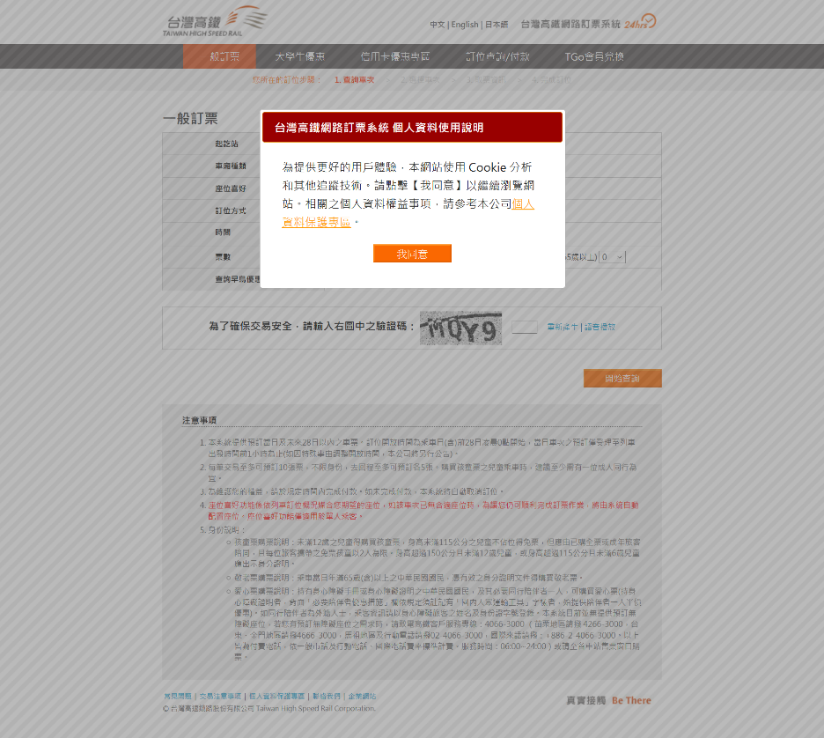
Status of the industry
Basically record/replay and test management.
Test scripts are not reusable across projects.
Need human to design tests
Need human to recognize screens
Need human to understand traces.

Slide 22
產業分析 solutions nowaday
測試外包
適合大型軟體公司
只能做system testin或user acceptance testing
IP外洩風險
Feedback 緩慢
軟體測試自動化工具
只幫你record與replay
Monkey testing (low intelligence)
Test investment low reusability
許多未經整合的測試準備工作
★☆巨大市場機會★☆
App智慧型測試工具

Slide 23
產業分析
應用測試難以自動化
目前測試自動化成果重複使用性都非常低
對一個顧客所製作的成果，幾乎都沒辦法用在另一個顧客。
軟體流程差異性、軟體文件差異性
學界的軟體測試成果基本上沒有在工業界應用可能性。

Slide 24
Goal
Theory in software testing.
Advanced testing and security-checking tools
Capability of deploying software testing technology to various companies.
Basic concepts and skills in security checking.

Slide 25
Lecture Plan
The first module: foundations
The second module: Testing criteria
Graph testing
Logic testing
Input space testing
Syntax testing
Third module: practical consideration.
Criterias for new app types
Security checking overview.

Slide 26
Pre-requisites
Basic Computer Concepts
C/C++, Java programming
Python
Data-Structures
Algorithms

Slide 27
Evaluation
Final exam (40%) , Dec. 20, 2023
20% of final exam scores will be for questions on selected midterm reports.
Mid-term report (10%), deadline on Nov. 1, 2023.
Deadline for midterm presentation registration: Sept. 20
Confirmation of registration: Sept. 27
3 projects (50%)
CppUnit and GOV for unit testing (15%), due by Oct. 18, 2023.
Selenium for web-testing (15%), due by Nov. 22, 2023.
App/Web/Security Testing (20%), due by Dec. 27, 2023.
Experiment with AI

Slide 28
Evaluation
Midterm presentation (10%)
a main paper
must be a regular paper published in ACM/IEEE ICSE 2022-23, ACM FSE 2022-23, IEEE ASE 2022-23, ACM ISSTA 2022-23, ACM PLDI 2022-23, IEEE S&P 2022-23, ACM CCS 2022-2023, or USENIX Security 2022-2023.
No tool paper, no short paper, no affiliated workshop paper.
2 comparison papers related to the main paper.
Comparing the three papers that you selected in the above.
Submission including your PPT file and MP4 Video for 10mins.

Slide 29
Evaluation project 1
White-box unit testing with CPP and GOV. (15%)
Software under test (SUT) is a github open-source cpp module.
Must write assertions to evaluate the pass or fail of the test scripts.
Submission:
CPPUnit test modules, test reports, and SUT source code.
PPT explains the SUT, your test requirements, your test plan, and your test result with coverage analysis.
Your score is
(line coverage) × log(#lines+#classes) + 10*(bugs detected)

Slide 30
Evaluation project 2
Web testing with Selenium. (15%)
Software under test (SUT) is an open-source web program from github.
Must write assertions to evaluate the pass or fail of the test scripts.
Submission:
Selenium test scripts, test reports with coverage analysis of the test items.
PPT explains the SUT, your test requirements, your test plan, and your test result.
Your score is
(coverage of the test items) × log(#actionables+html sizes)
+ 10*(bugs detected)

Slide 31
Evaluation project 3
App/web/security testing on an AI test automation platform. (20%)
Software under test (SUT) could be a mobile APP or a web program.
The test items will be announced.
Writing a python program as a test robot that generates test reports.
Submission:
A test robot that can be used by other classmates.
Online documents of your test robot.
Your score is based on the rating and reviews of peer classmates.

Slide 32
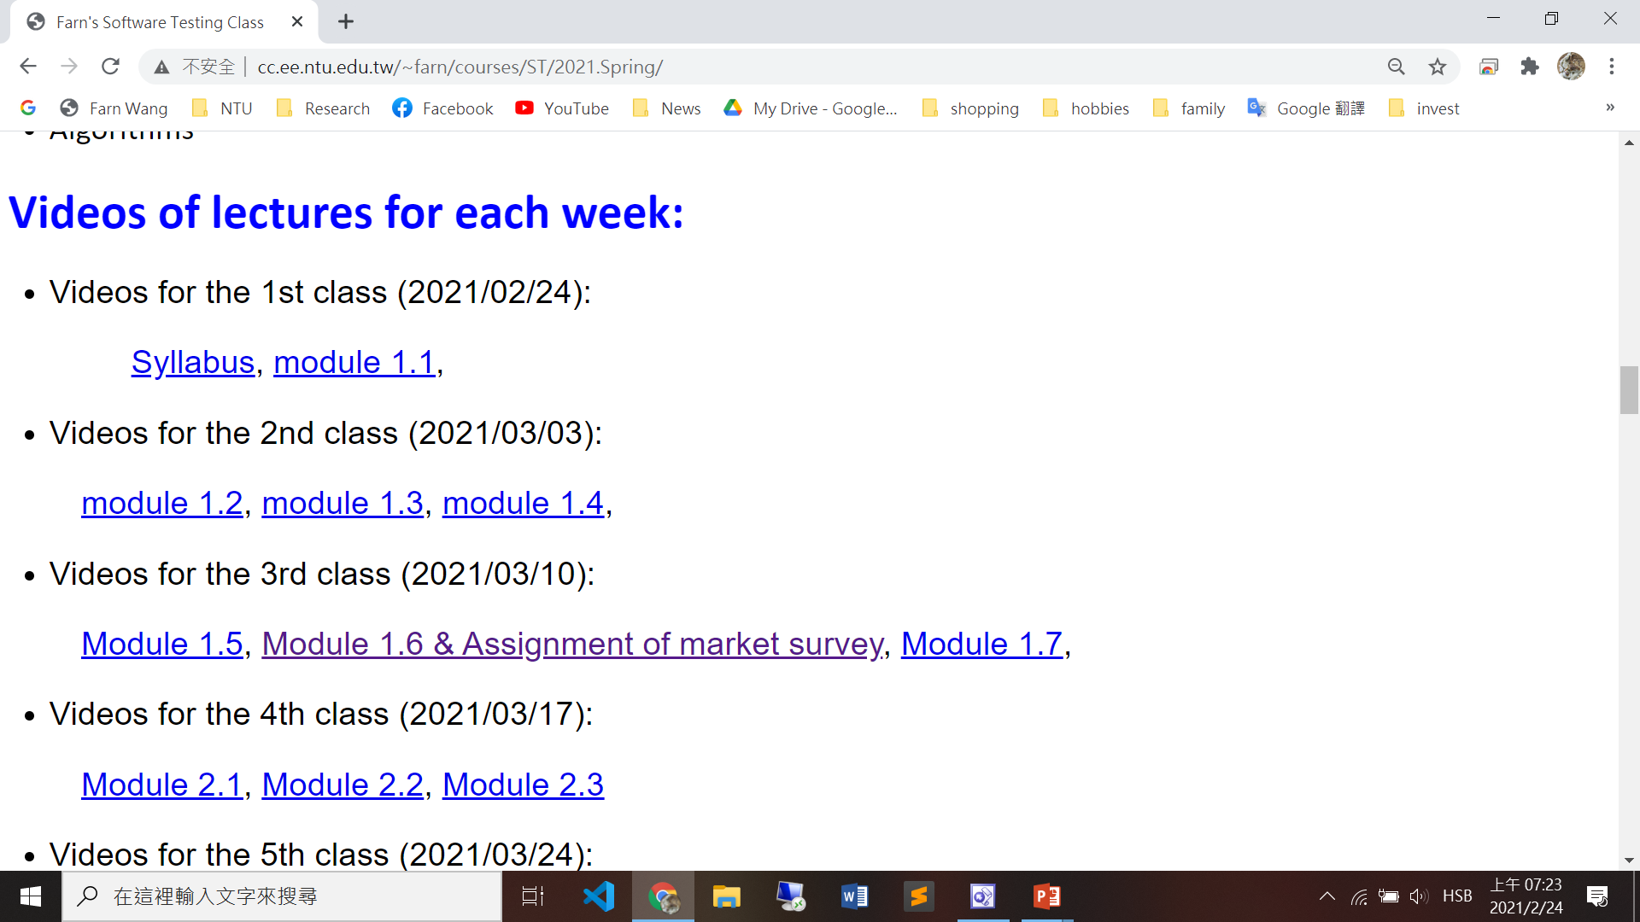
Videos

Slide 33
Course Schedule (1/2)
1. | 9/6 | a) Syllabus, b) Chapter 1: introduction
2. | 9/13 | Chapter 1: introduction
3. | 9/20 | a) Chapter 2: Graph-based Testing b) Deadline for midterm presentation registration c) Project 1 announcement: unit testing
4. | 9/27 | a) Chapter 2: Graph-based Testing b) Confirmation of midterm presentation registration
5. | 10/4 | Chapter 2: Graph-based Testing
6. | 10/11 | Chapter 3: Logic-based Testing
7. | 10/18 | a) Chapter 3: Logic-based Testing b) Project 1 deadline c) Project 2 announcement: web-testing
8. | 10/25 | Chapter 3: Logic-based Testing

Slide 34
Course Schedule (2/2)
9. | 11/1 | a) Deadline of midterm presentation submission b) Chapter 3: Logic-based Testing
10. | 11/8 | Chapter 4: Input-Space Partition Testing
11. | 11/15 | 校慶停課
12. | 11/22 | a) Chapter 5: Mutation Testing b) Project 2 deadline c) Project 3 announcement: app/web RWD testing
13. | 11/29 | Chapter 5: Mutation Testing
14. | 12/6 | Symbolic Model-Checking
15. | 12/13 | Security Checking
16. | 12/20 | Final exam
17. | 12/27 | Project 3 deadline and demonstration!

