Slide 1

Software Testing & Security Checking
Project 3: Fuzz Testing on Mobile Apps and Web Programs
Farn Wang
Software Testing Lab.
National Taiwan University

Slide 2
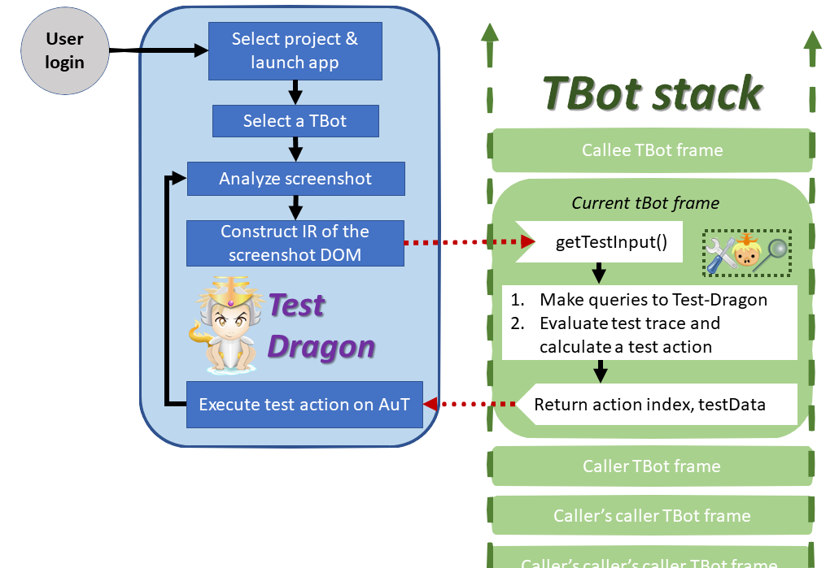
Test Dragon
AI for GUI E2E-Testing
Platform for easy implementation of GUI E2E-Testing Algorithm.
Test Data card management & matching
Trace recording and replay
Automata construction

Slide 3
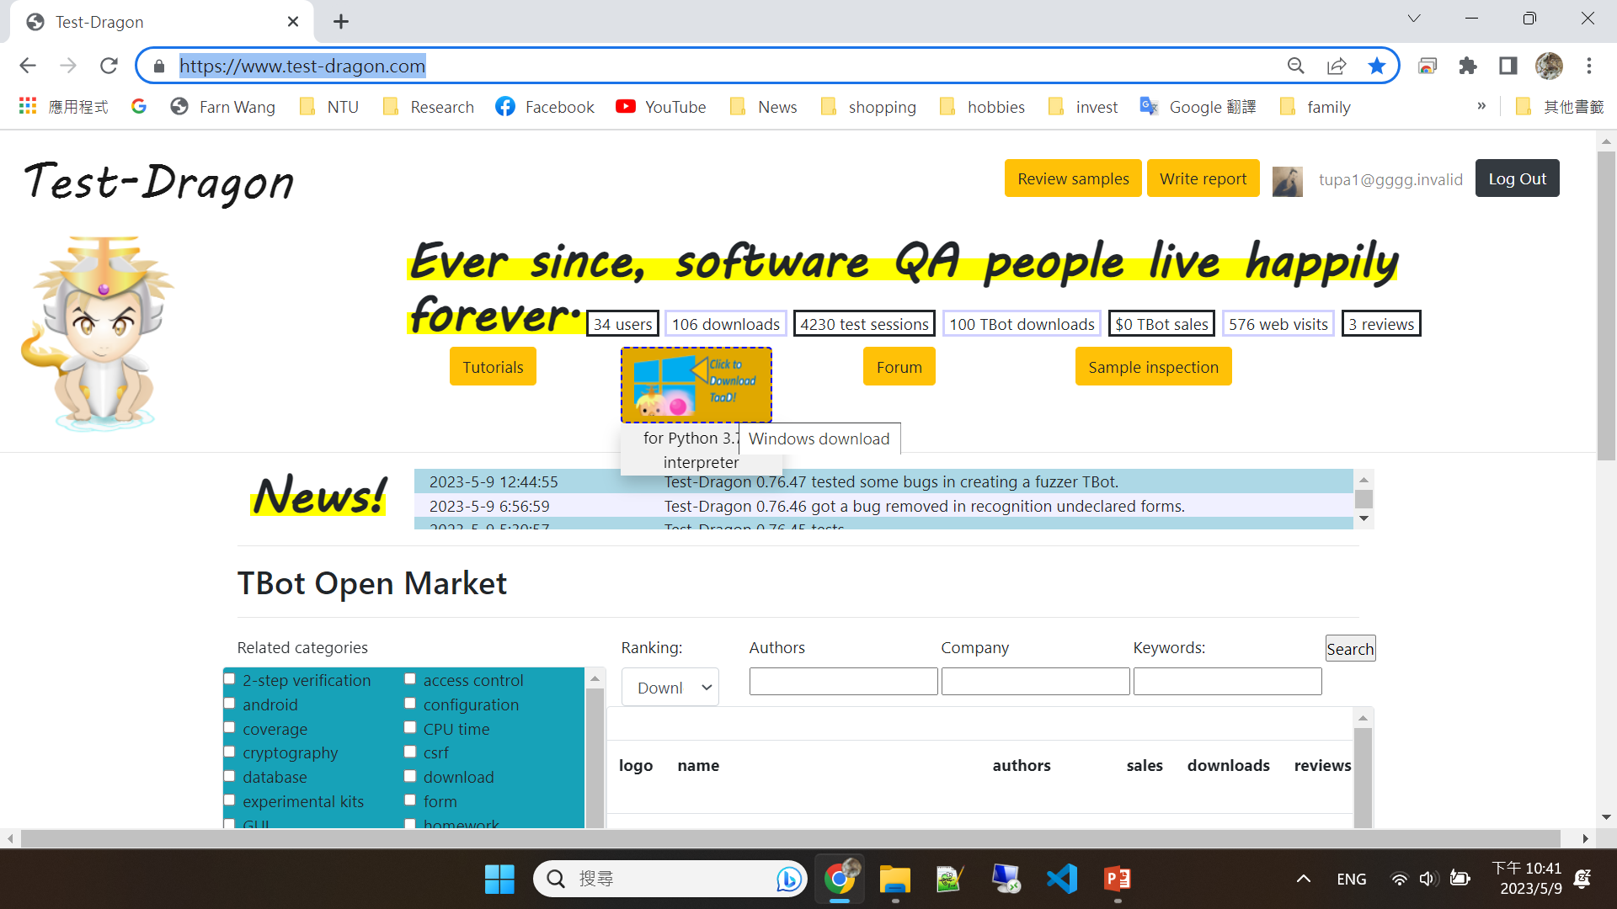
Test Dragon
- Downloading at https://www.test-dragon.com
Get an account!
Download here!
  pyc and python
  Including a
  python
  interpreter.

Slide 4
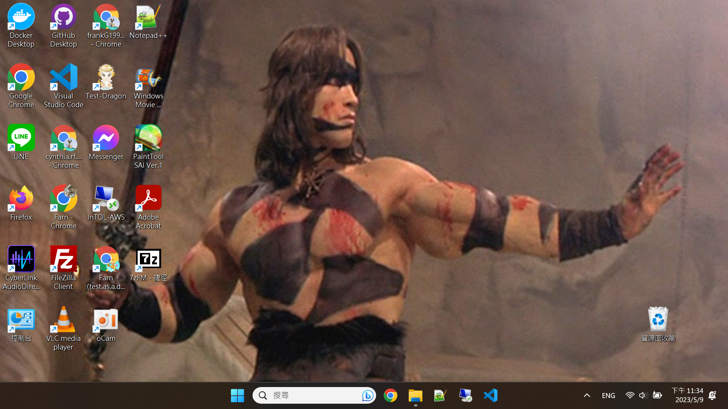

Test Dragon
- Executing from desktop!
Click to execute

Slide 5
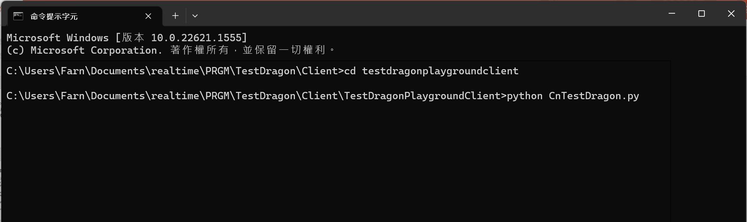
Test Dragon
- Executing from command line!
Must be python 3.7!
Click to execute

Slide 6
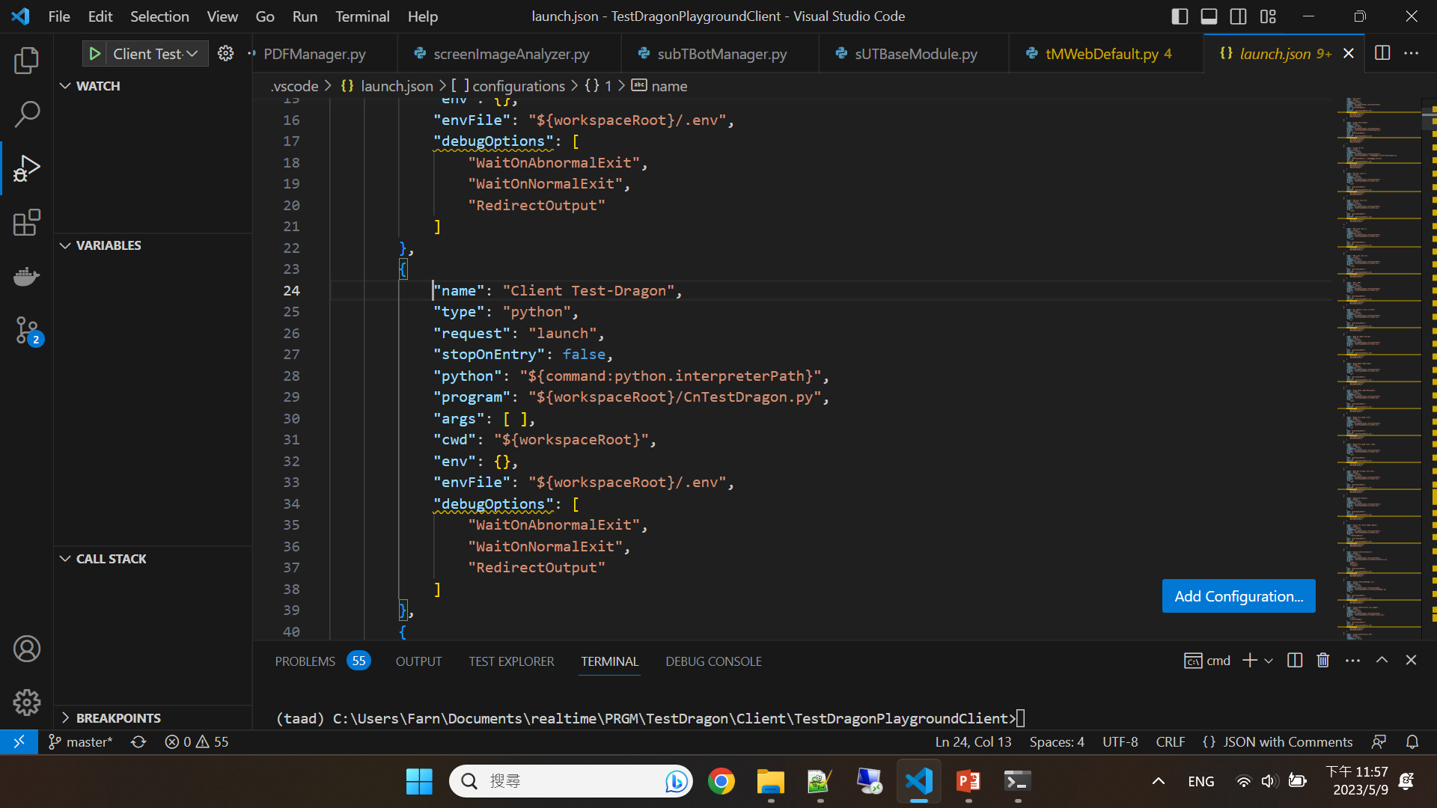
Test Dragon
- Executing from VSCode for debugging fuzzer.py and your own TBots!
Must be
python 3.7!
Click to execute

Slide 7
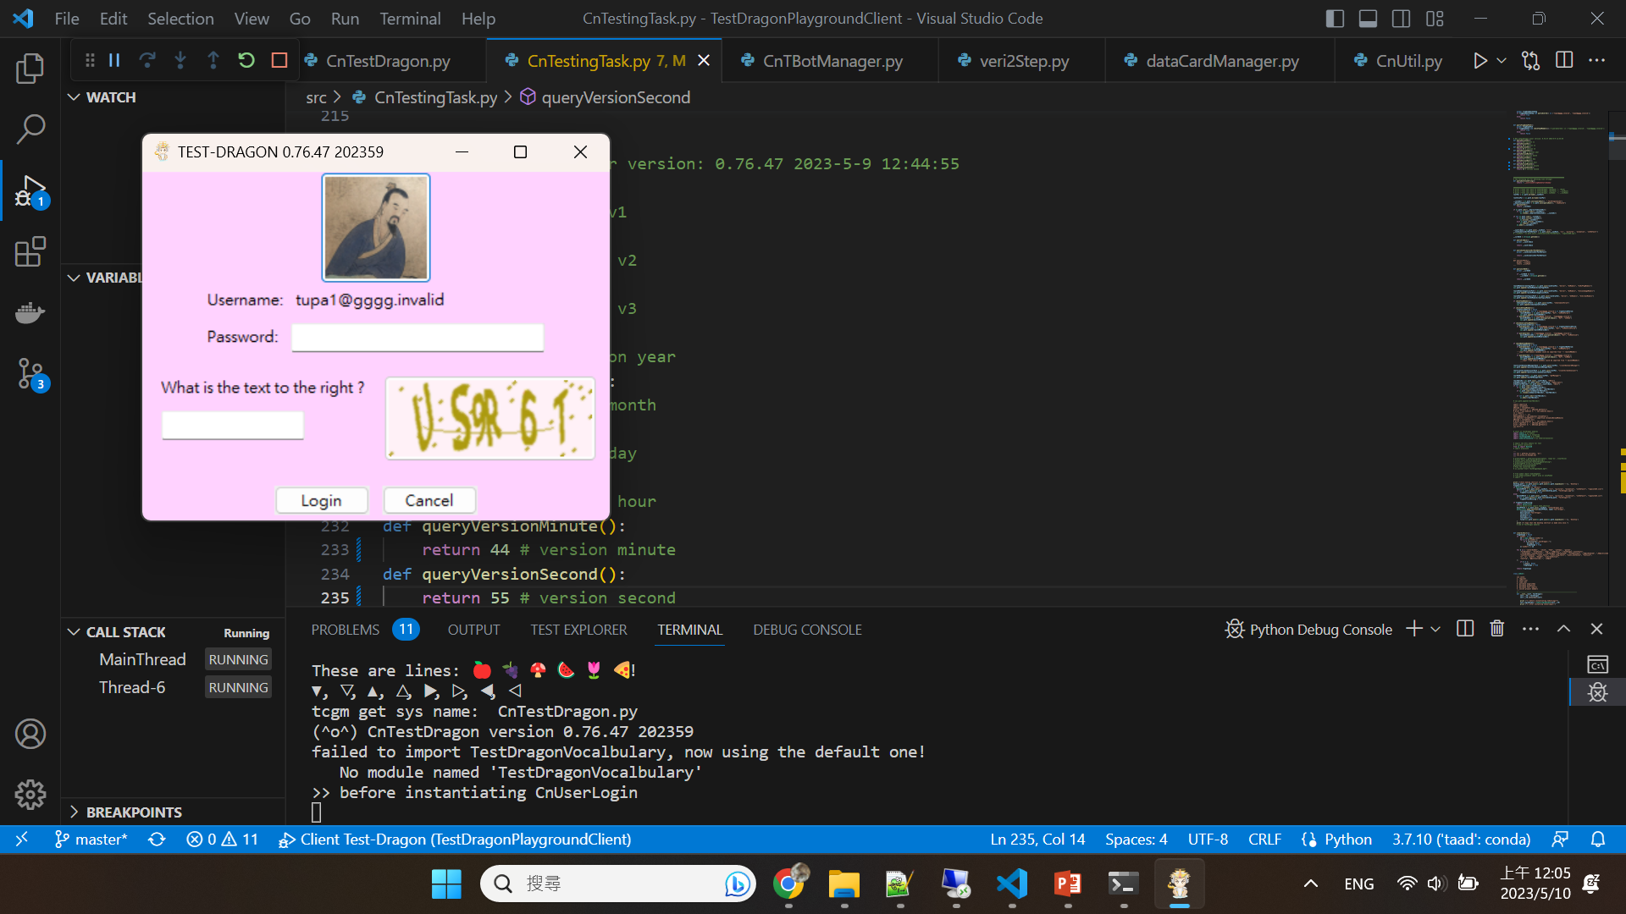
Test Dragon
- After invocation, please fill in the password and captcha!
The pyc cannot
be copied to
other users!
The pyc is encrypted only for you!

Slide 8
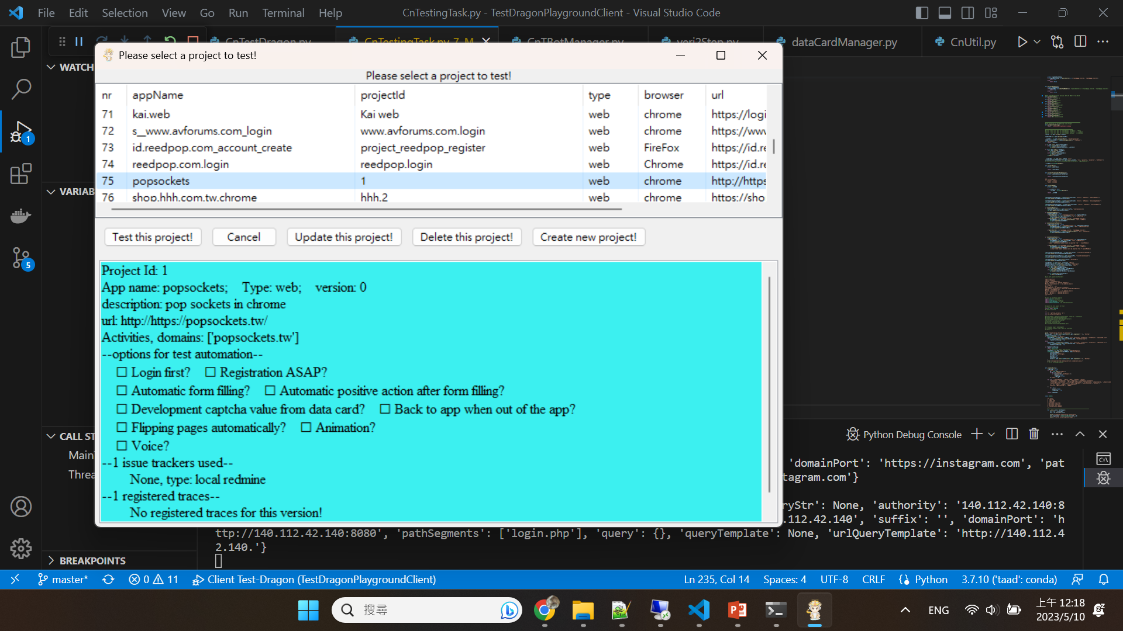
Test Dragon
- After logged in, select or create a project for testing!
Here is selection button for project testing.
The AuT of a project can be web, Android, or iOS.

Slide 9
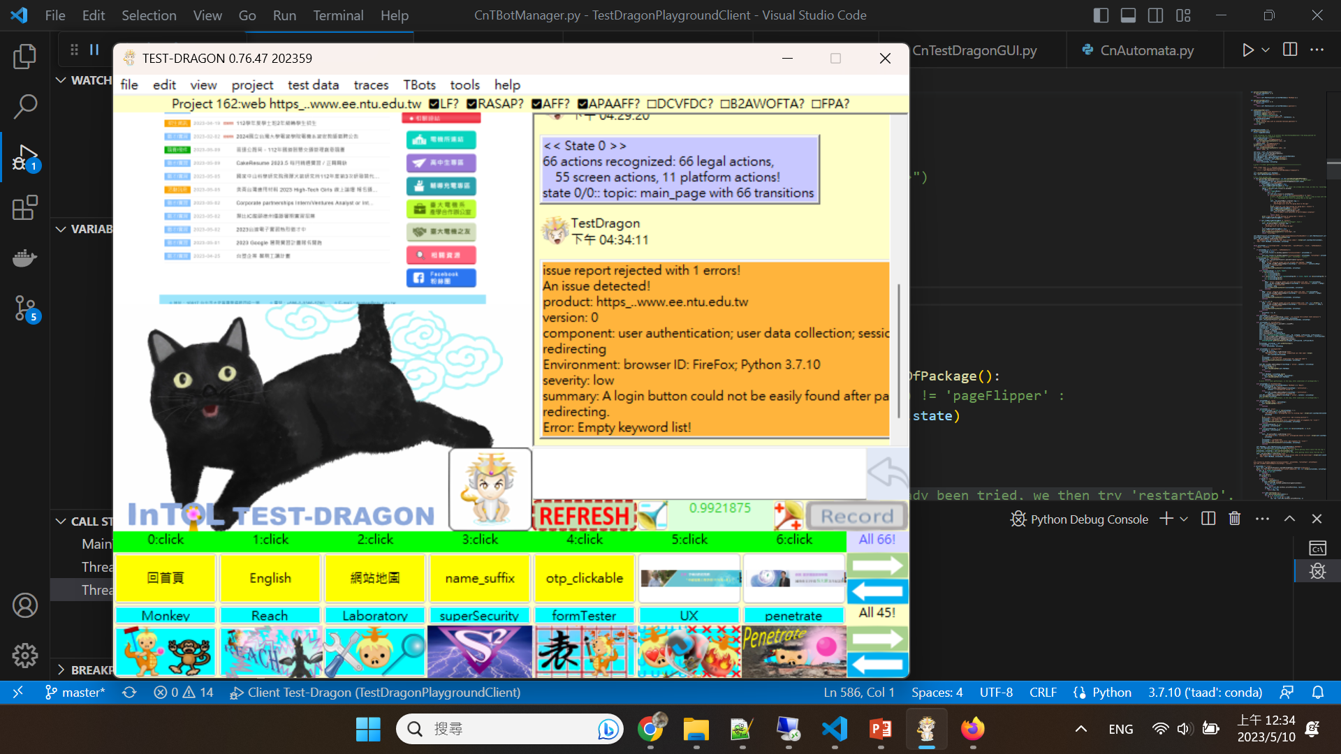
Test Dragon
- After selecting a project, now you see the full GUI of test-dragon!
All action elements
All tBot buttons

Slide 10
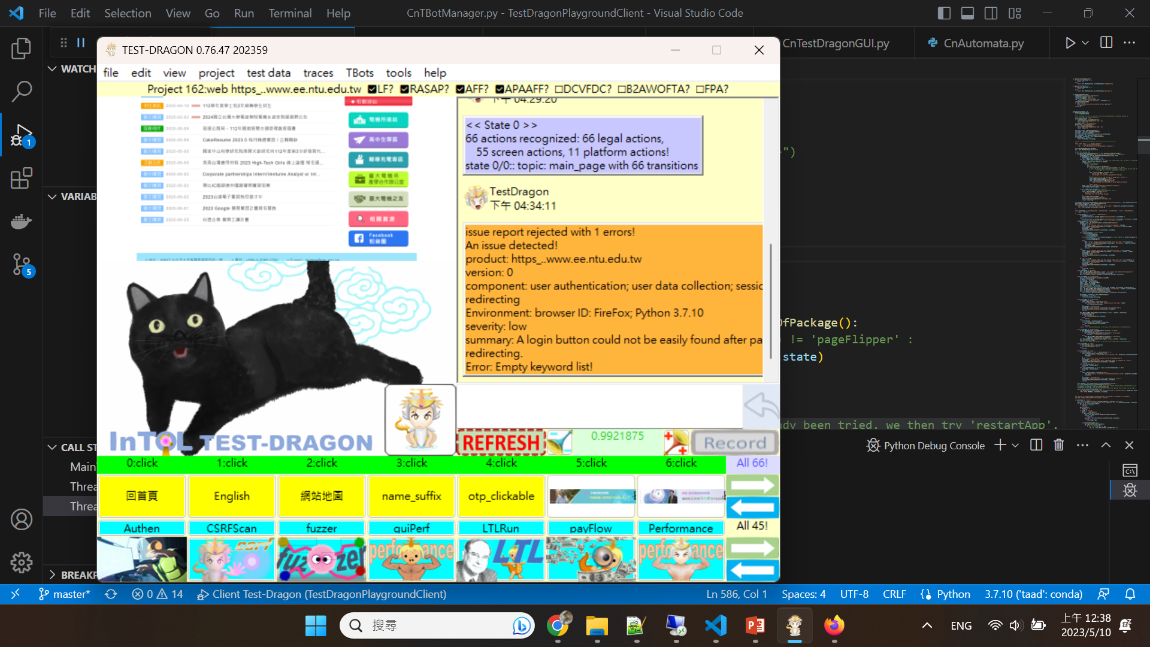
Test Dragon
- After selecting a project, now you see the full GUI of test-dragon!
But how can I make the fuzzer button appear?
Click here to execute you fuzzer Tbot.

Slide 11
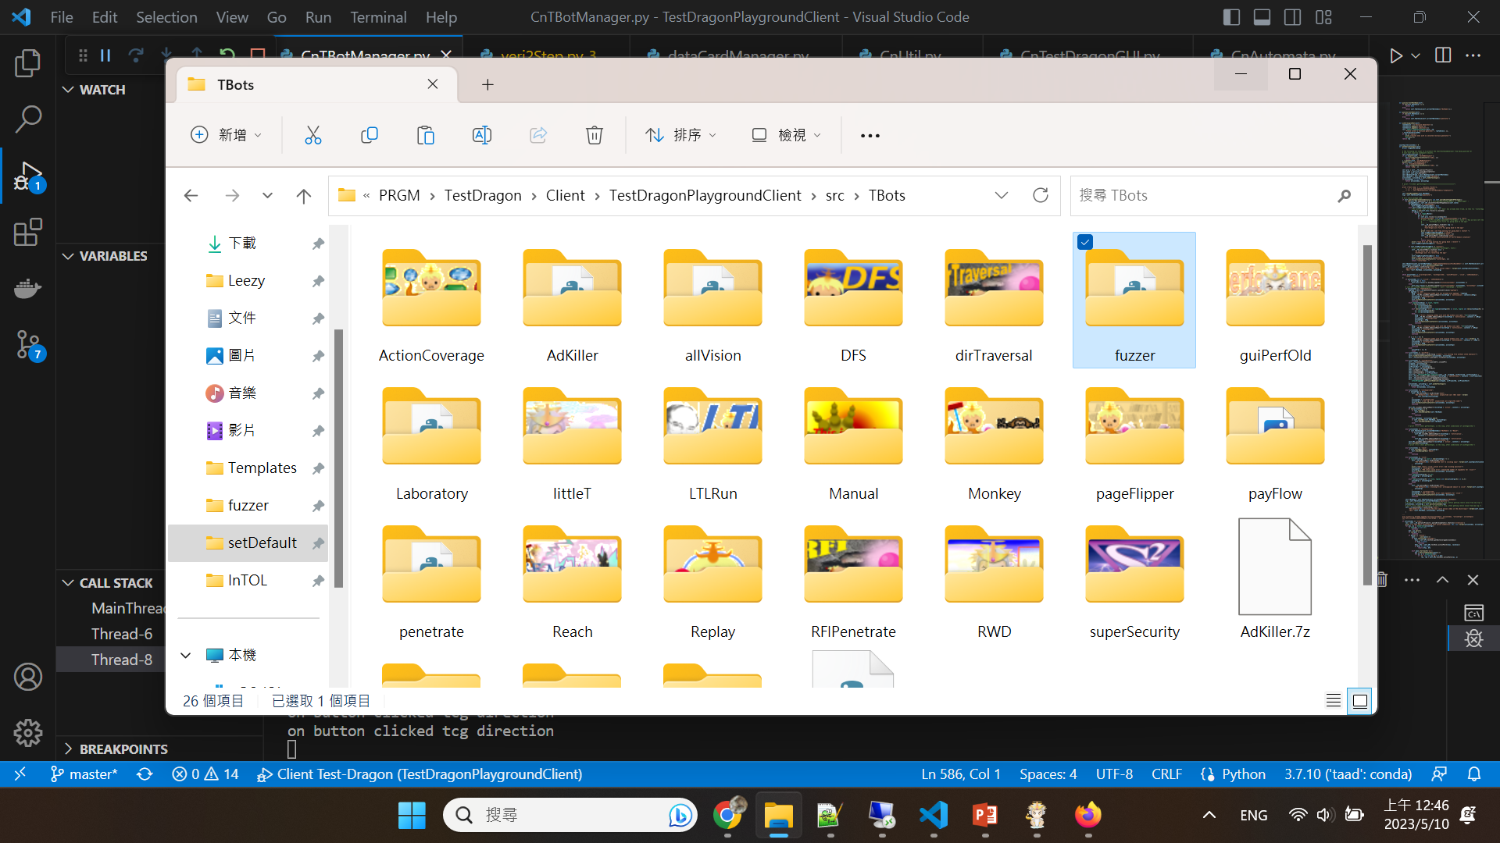
Test Dragon
- How can I make the fuzzer button appear in the GUI?
You need a fuzzer folder in src/Tbots.

Slide 12
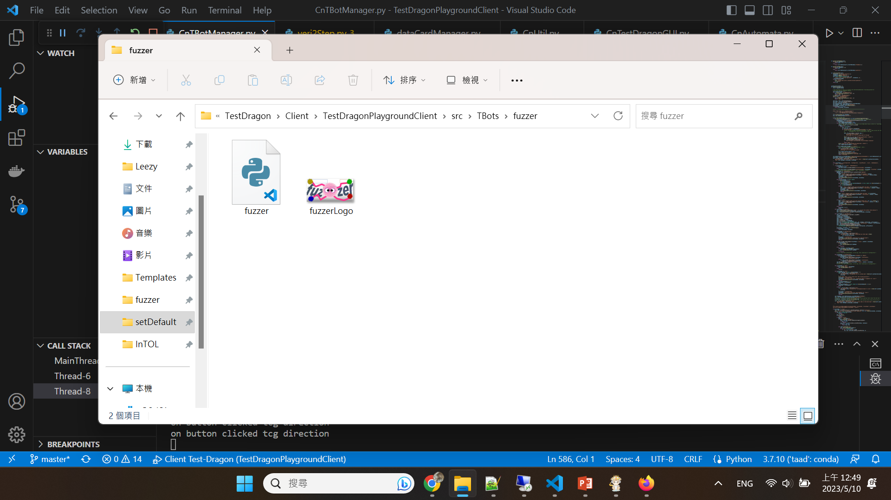
Test Dragon
- How can I make the fuzzer button appear in the GUI?
The two files can be found in https://github.com/farnking/fuzzer
You can also
add issues to
the github
repository.
You need a fuzzer.py and a fuzzerLogo.png in src/Tbots/fuzzer.

Slide 13
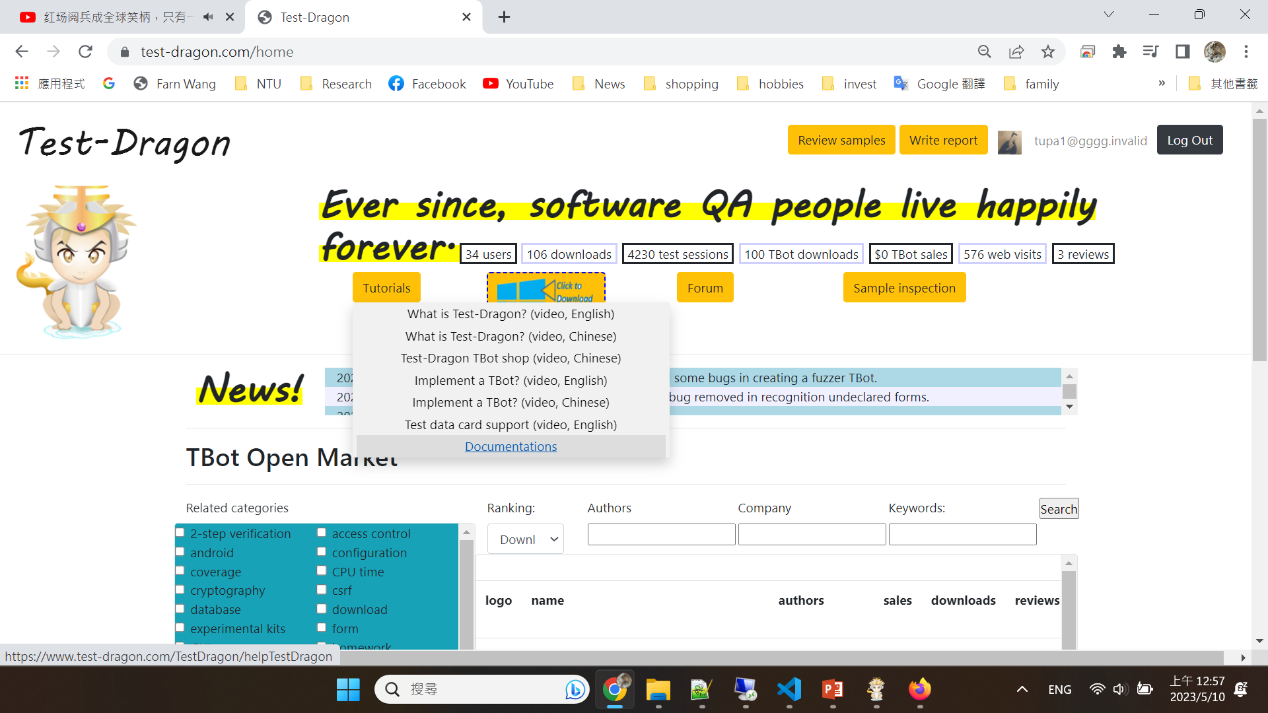
Test Dragon
- How can I the two files for the fuzzer tBot?
You can also find the source files in https://www.test-dragon.com
Click here to see the documents!

Slide 14
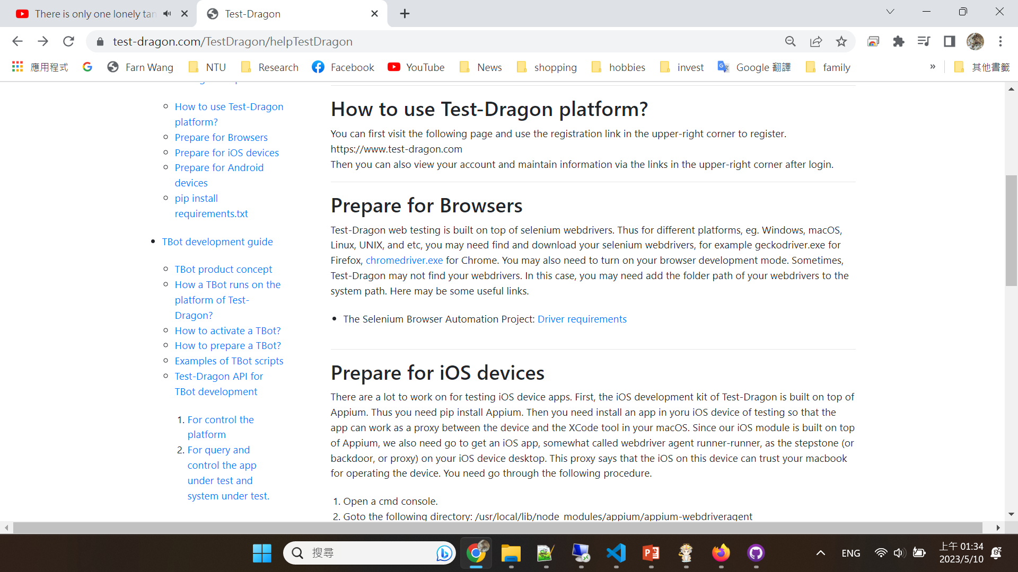
Test Dragon
- How can I the two files for the fuzzer tBot?
You can also find the source files in https://www.test-dragon.com
Click here to see fuzzer.py!

Slide 15
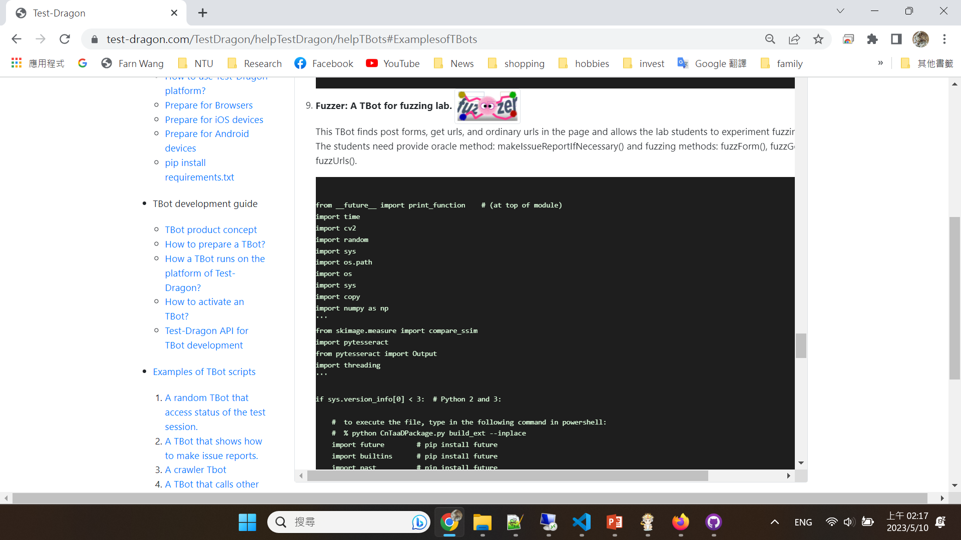
Test Dragon
- How can I the two files for the fuzzer tBot?
You can also find the source files in https://www.test-dragon.com
Scroll to see fuzzer.py!

