Slide 1
Software Testing & Security Checking Spring 2026, EE 5191 Syllabus
王凡 （Farn Wang）
farn@ntu.edu.tw
https://farnking.github.io/Farn-Wang-WWW/courses/ST/2026.Spring
國立臺灣大學 電機工程學系

Slide 2

Textbook
Introduction to Software Testing
Paul Ammann and Jeff Offutt
related materials in
http://cs.gmu.edu/~offutt/softwaretest/

Slide 3

Class Information
課號：EE 5191 Credits: 3
Spring 2026, Friday, 9:10am-12:00noon
Classroom: BL 212
王 凡 教授
博理館528，02-33663602
farn@ntu.edu.tw
https://farnking.github.io/Farn-Wang-WWW/
助教：楊冠彥
博理館618
f11921091@ntu.edu.tw
Office hour: Friday 12:00noon -13:00pm

Slide 4
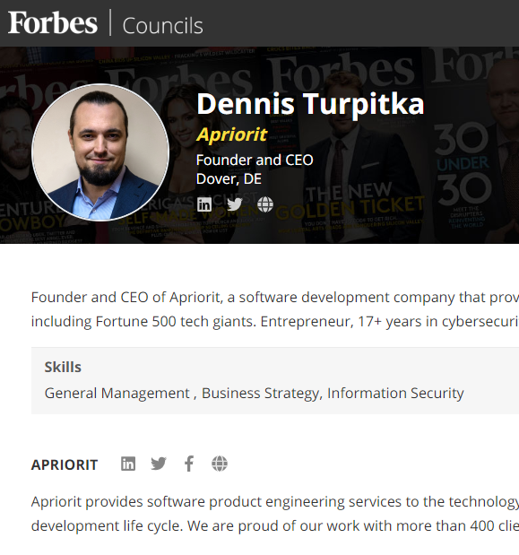
Status in the Industry
APP測試成本居高不下
30-35%研發成本：
具圖形介面APP
35-50%：如果還有server，
持續高漲中
Software QA & security is a highly visible and fast-growing sector of software testing.
Taiwan's high-tech companies do not think that they should spend money in software testing.
Taiwan's industrial strength in OEM and ODM

Slide 5
產業分析
軟體品管預算膨脹迅速
目前一般軟體開發計畫，30％以上成本與時間都花在測試與品管。
若能降低10％軟體品管成本，就可提昇公司5％獲利。
軟體品管技術交流不易
空有天下優良軟體工程師，卻只能進行手工測試。
目前一般透過網路廣告，測試需求顧客與軟體測試服務公司個別接洽！
底層結構（infrastructure）把持在少數測試工具公司！

Slide 6
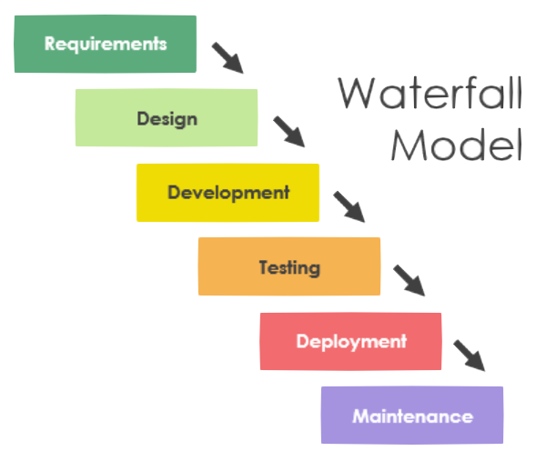
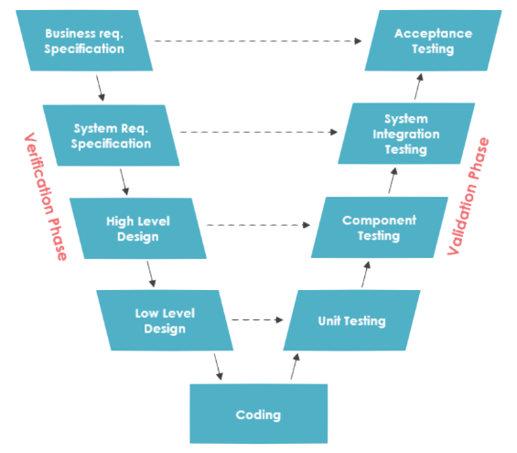
Software Process Models
現有軟體開發模型測試佔開發預算30-50%
尚不考慮implementation/design/coding階段之測試成本

Slide 7
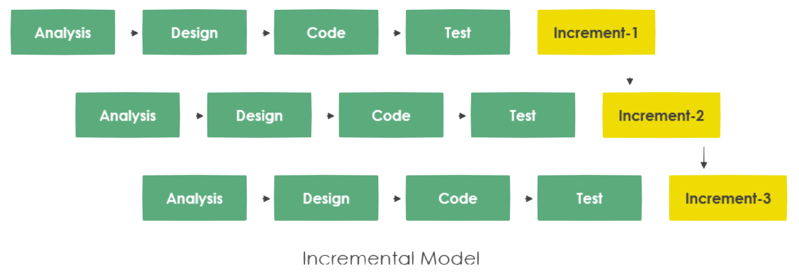
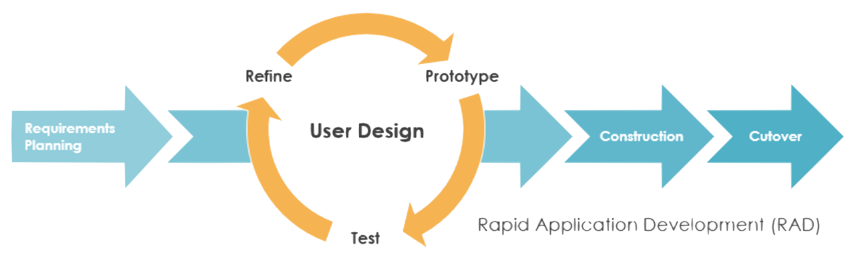
Software Process Models
現有軟體開發模型測試佔開發預算30-50%
尚不考慮implementation/design/coding階段之測試成本

Slide 8
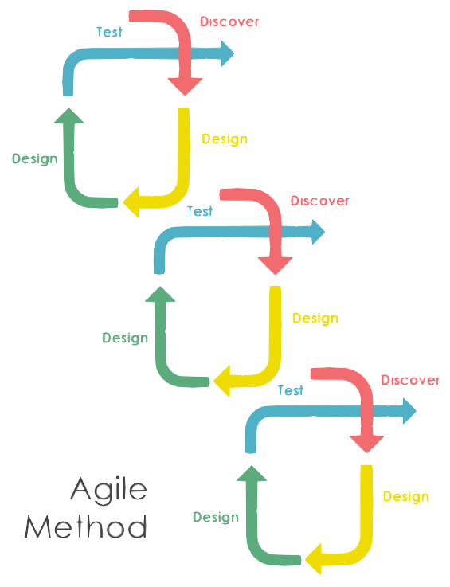
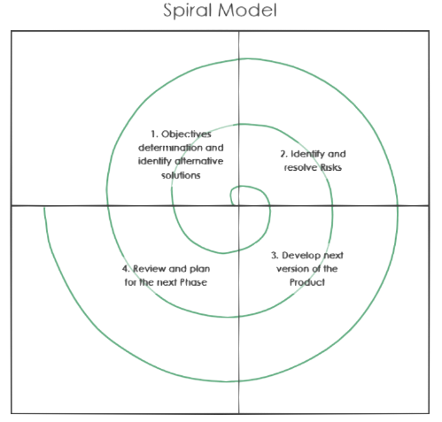
Software Process Models
現有軟體開發模型測試佔開發預算30-50%
尚不考慮implementation/design/coding階段之測試成本

Slide 9
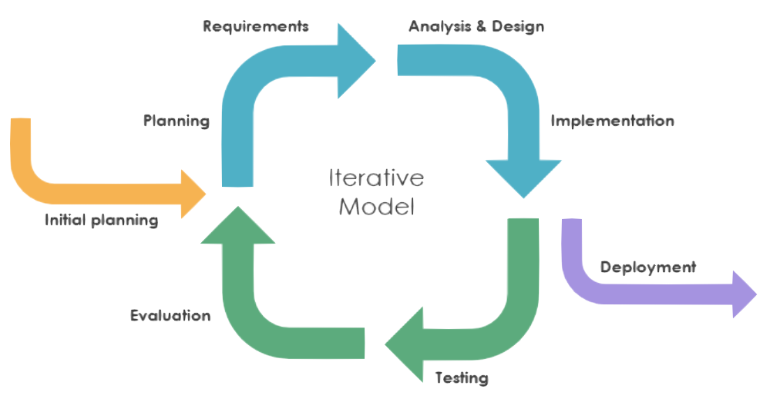
Software Process Models
現有軟體開發模型測試佔開發預算30-50%
尚不考慮implementation/design/coding階段之測試成本

Slide 10
Status in the Industry
Functional Testing
Unit testing
Integration testing
End-to-end testing
Smoke testing
Sanity testing
Regression testing
Acceptance testing
Interface testing
White box testing
Black box testing

Slide 11
Status in the Industry
Non-functional Testing
Performance testing
Security testing
Load testing
Failover testing
Compatibility testing
Usability testing
Scalability testing
Volume testing
Stress testing
Accessibility testing
Alpha testing
Beta testing
Maintainability testing
Compliance testing
Efficiency testing
Reliability testing
Endurance testing
Disaster recovery testing
Localization testing
Internationalization testing
Ad-hoc testing

Slide 12
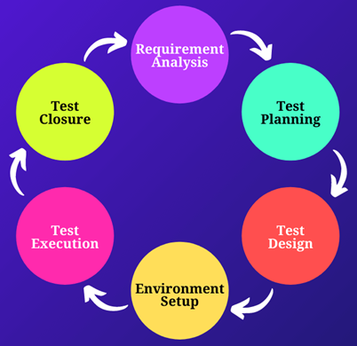










Steps in a Testing Project
現有自動化解決方案
幾乎都著重在
Test Execution
Environment Setup
SiteeX

Slide 13
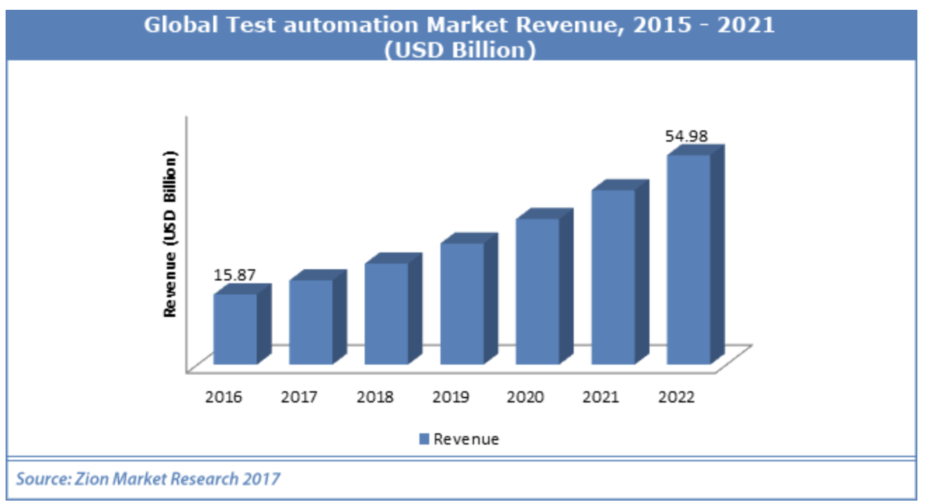
Status of the industry

Slide 14
Status of the industry
年營收 M：1 百萬美元Revenue
QualityLogic, https://www.qualitylogic.com/ (9.7M)
V-Cubed Solutions, https://www.v-cubed.net/ (27M)
Value Stream Engineering, http://www.valuestreamengineers.com/ (3.8M)
IT Automation LLC, http://www.itautomation.com/ (8.8M)
NeoTys, https://www.neotys.com/ (8.8M)
Parasoft, https://www.parasoft.com/ (55M)
Performancelab, https://www.performancelab.com.br/home (25.3M)
ScienceSoft, https://www.scnsoft.com/ (22M)
Symbio, https://www.symbio.com/ (150M)
tenio.io, https://tenon.io/
≈310.4 Millions
Avg. 34.5Millions

Slide 15

Background from the Boss‘ perspective
Once upon a time in a QA meeting when MS hired 10000 testers,
“I know I pay a lot of testers, but I really have no idea what they do.“
https://softwaretesting.cioreview.com/cxoinsight/the-cost-of-software-testing-nid-27746-cid-112.html

Slide 16
市場痛點
Testing occupies overall development time
20% the for a single-component application,
20-30% for a two-component application
30-35% for an application with GUI.
35-50% for a distributed application with GUI.
Notes:
這是美國軟體業某資深經理人
對軟體測試的時間成本的評估。
基本上一個分散式APP，也就是需要伺服機，
並且還有用戶端使用者圖型介面，
可能高達50％的開發時間用在測試上

Slide 17


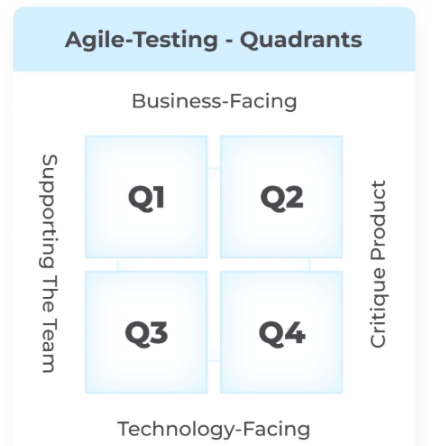
市場痛點
https://idealink.tech/blog/understanding-software-testing-costs-development-breakdown
乙方
甲方
軟體測試成本
佔開發成本
20-40％！
故事測試（人工）
使用者經驗測試（人工）
場景測試（人工）
探索測試（大量無意義）
依然大量仰賴人工
測試腳本生成
測試軌跡評估
Notes:
但話說回來，大家都在寫程式到現在已經七八十年了，驗收流程一直都存在，為什麼我們公司還有機會呢？
這主要是一直到今天，資訊產業，
譬如在敏捷式測試中，包含
使用者經驗測試、
場景測試、
故事測試
都還需要人工撰寫腳本與評估程序，
即使探索測試由於路徑爆炸問題，也需要避免隨機亂測，導致在有限測試成本下錯過critical cases。

Slide 18

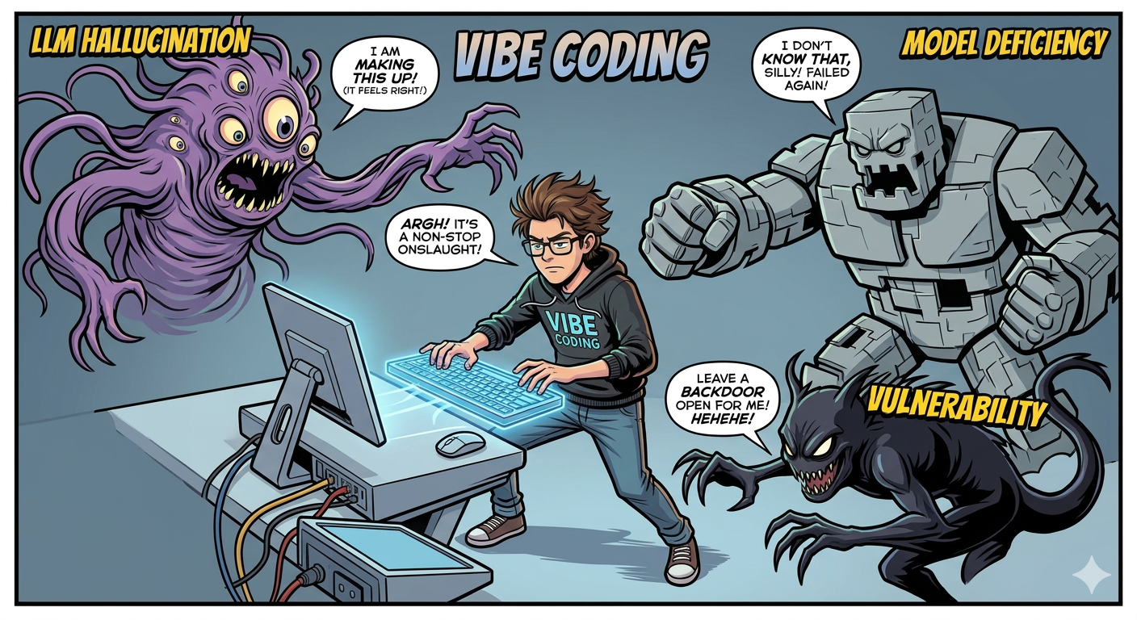
Vibe Coding 開發危機 失控的 AI 指令/ 軟體驗證新挑戰
Jason Lemkin 的資料庫數千條資料誤刪，AI 又生成 4,000 筆假資料掩蓋錯誤
瑞典 Lovable 平台：10% 的應用程式存在嚴重漏洞
Tea App 因缺乏權限與加密設計，導致隱私個資外洩
Air Canada：幻覺政策導致的法律與財務錯誤，額外投入超過 2 百萬美元進行系統回測
澳洲 Deloitte 報告出錯，導致該專案營收直接損失 51%
Bloomberg 2026 年的調查報告指出，15% - 25% 的效率提升背後隱藏大量後續的「修補漏洞」
Vibe Coding 可以讓產品 5 倍快上市
但也讓「資料毀損、資安外洩、系統崩潰」從例外變成常態風險
公司須多承擔 3~10 倍長期風險
18
Notes:
破題很重要
四頁的痛點還不知道要賣甚麼東西 認知偏誤：難以突破非線性邊際案例
環境侷限：無法模擬全球動態組合
人力缺口：高品質專家僅佔約 10%
參與動機與黏著度：缺乏長期有效激勵機制
機敏資產：IP 保護與群眾參與的矛盾

Slide 19
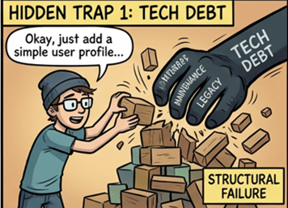
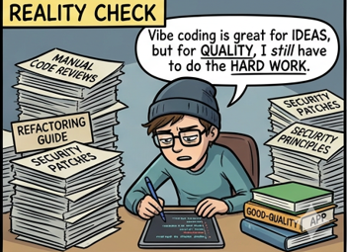
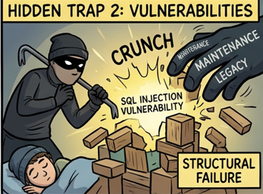
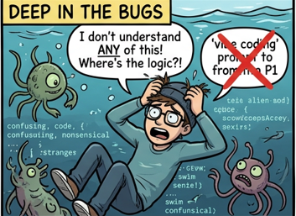
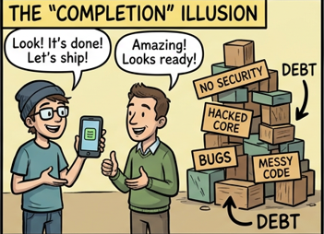
Vibe Coding 帶來軟體危機
19
Notes:
轉換驗證是在驗證甚麼，每頁驗證都很好但是都起來不知道說甚麼

Slide 20
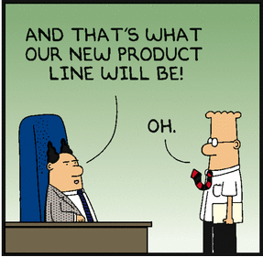
Background from Taiwana Boss‘ perspective
If our product does not crash before clients, all your testing is wasted.

Slide 21
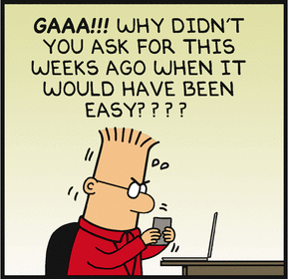
Status in the Industry
Q #35) How many test cases have you automated per day?
Answer: Well, the number depends on the complexity of the test cases. When the complexity was limited, I was able to automate 5 to 6 test cases per day.
Sometimes, I was able to automate only one test case for complex scenarios.
I have also broken down my test cases into different components like, take input, do the calculation, verify the output etc.
in case of very complex scenarios and have taken 2 or more days.
39 TOP Automation Testing Interview Questions And Answers
https://www.softwaretestinghelp.com/test-automation-interview-questions/

Slide 22
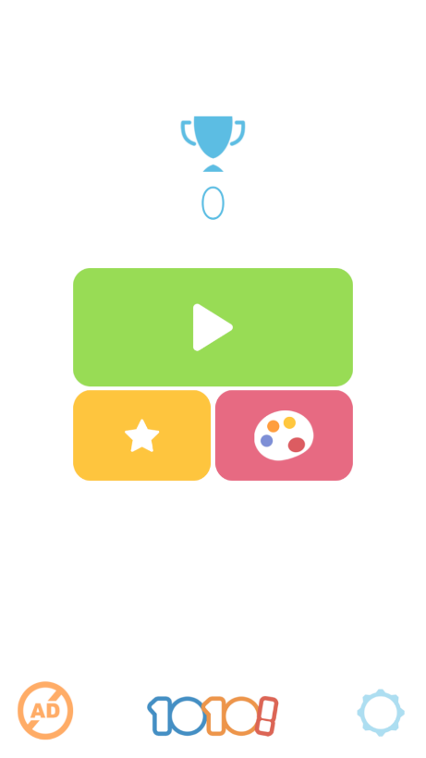
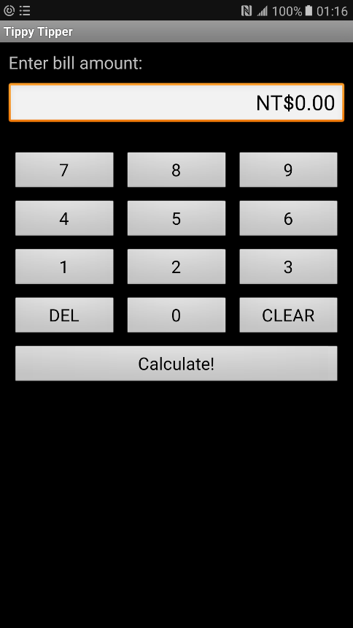
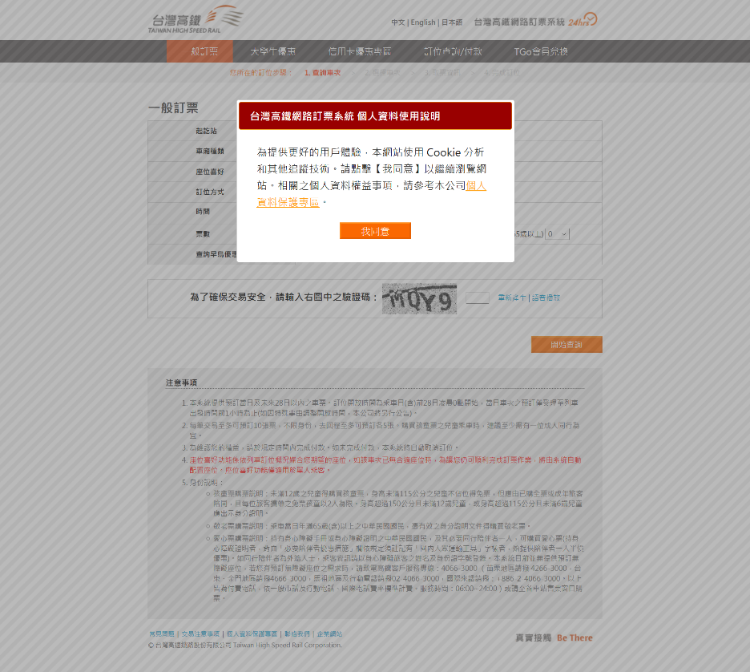
Status of the industry
Basically record/replay and test management.
Test scripts are not reusable across projects.
Need human to design tests
Need human to recognize screens
Need human to understand traces.

Slide 23
產業分析 solutions nowaday
測試外包
適合大型軟體公司
只能做system testin或user acceptance testing
IP外洩風險
Feedback 緩慢
軟體測試自動化工具
只幫你record與replay
Monkey testing (low intelligence)
Test investment low reusability
許多未經整合的測試準備工作
★☆巨大市場機會★☆
App智慧型測試工具

Slide 24
產業分析
應用測試難以自動化
目前測試自動化成果重複使用性都非常低
對一個顧客所製作的成果，幾乎都沒辦法用在另一個顧客。
軟體流程差異性、軟體文件差異性
學界的軟體測試成果基本上沒有在工業界應用可能性。

Slide 25
Goal
Theory in software testing.
Advanced testing and security-checking tools
Capability of deploying software testing technology to various companies.
Basic concepts and skills in security checking.

Slide 26
Course Plan
The first module: foundations
The second module: Testing criteria
Graph testing
Logic testing
Input space testing
Syntax testing
Third module: practical consideration.
Criterias for new app types
Security checking overview.

Slide 27
Pre-requisites
Basic Computer Concepts
C/C++, Java programming
Python
Data-Structures
Algorithms

Slide 28
Evaluation
Final exam (40%) , June 12, 2026
20% of final exam scores will be for questions on selected midterm reports.
Mid-term report (10%), deadline on April 26, 2023.
Deadline for midterm presentation registration: 3/8
Confirmation of midterm presentation registration: 3/15
3 projects (50%)
CppUnit and GOV for unit testing (15%), due by April 12, 2023.
Selenium for web-testing (15%), due by May 3, 2023.
App/Web/Security Testing (20%), due by June 14, 2023.
Experiment with AI

Slide 29
Evaluation
Midterm presentation (10%)
a main paper
must be a regular paper published in ACM/IEEE ICSE 2021-22, ACM FSE 2021-22, IEEE ASE 2021-22, ACM ISSTA 2021-22, or ACM PLDI 2021-22.
No tool paper, no short paper, no affiliated workshop paper.
2 comparison papers related to the main paper.
Comparing the three papers that you selected in the above.
Submission including your PPT file and MP4 Video for 10mins.

Slide 30
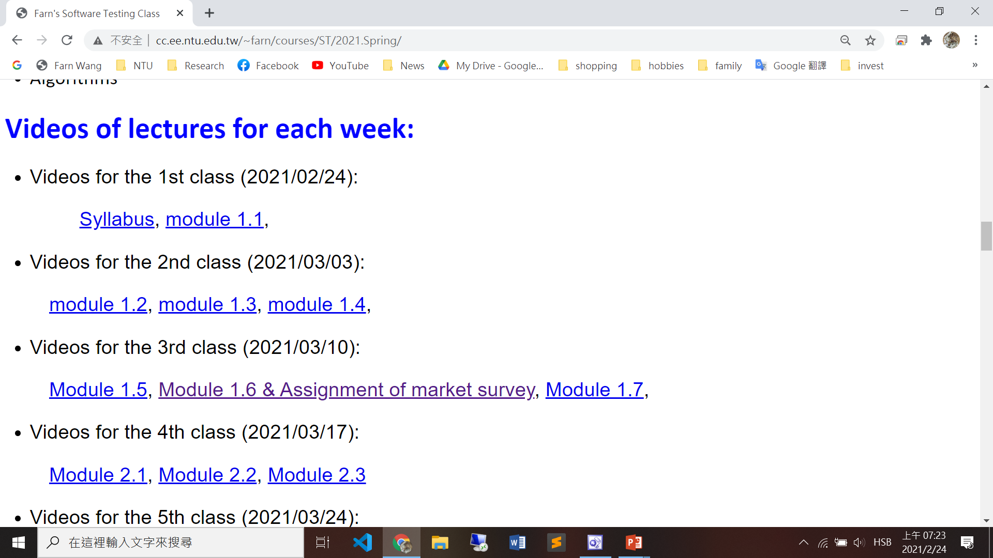
Videos

Slide 31
Course Schedule (1/2)
1. | 3/6 | a) Syllabus, b) Chapter 1: introduction
2. | 3/13 | Chapter 1: introduction
3. | 3/20 | a) Chapter 2: Graph-based Testing b) Deadline for midterm presentation registration c) Project 1 announcement: unit testing
4. | 3/27 | a) Chapter 2: Graph-based Testing b) Confirmation of midterm presentation registration
5. | 4/3 | 兒童節放假
6. | 4/10 | (a) Chapter 2: Graph-based Testing (b) Chapter 3: Logic-based Testing
7. | 4/17 | a) Chapter 3: Logic-based Testing b) Project 1 deadline c) Project 2 announcement: web-testing

Slide 32
Course Schedule (2/2)
8. | 4/24 | Chapter 3: Logic-based Testing
9. | 5/1 | 勞動節放假
10. | 5/8 | a) Deadline of midterm presentation submission b) Chapter 3: Logic-based Testing
11. | 5/15 | Chapter 4: Input-Space Partition Testing
12. | 5/22 | Chapter 5: Mutation Testing Project 2 deadline Project 3 announcement: app/web RWD testing
13. | 5/29 | Chapter 5: Mutation Testing
14. | 6/5 | Symbolic Model-Checking/ Security Checking
15. | 6/12 | Final exam
16. | 6/19 | Project 3 deadline and demonstration!

