Slide 1
Market Survey for Software Testing
王凡 R08921104 吳意凡 2019 Fall Week 6

Slide 2
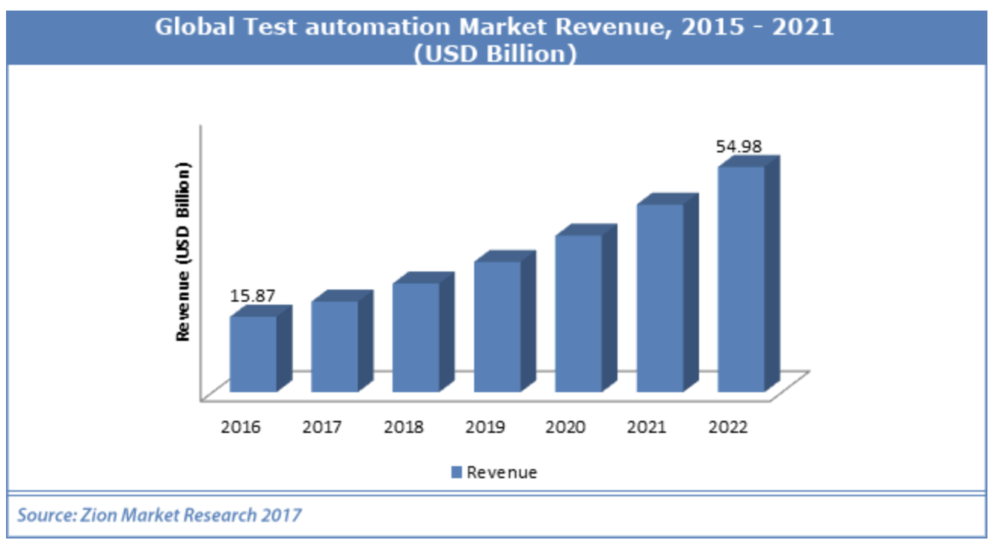
Revenue
Zion Market Research https://www.zionmarketresearch.com/report/test-automation-market
Global test automation market is expected to reach USD 54.98 billion by 2022, growing at a CAGR of 23.01% between 2017 and 2022.

Slide 3
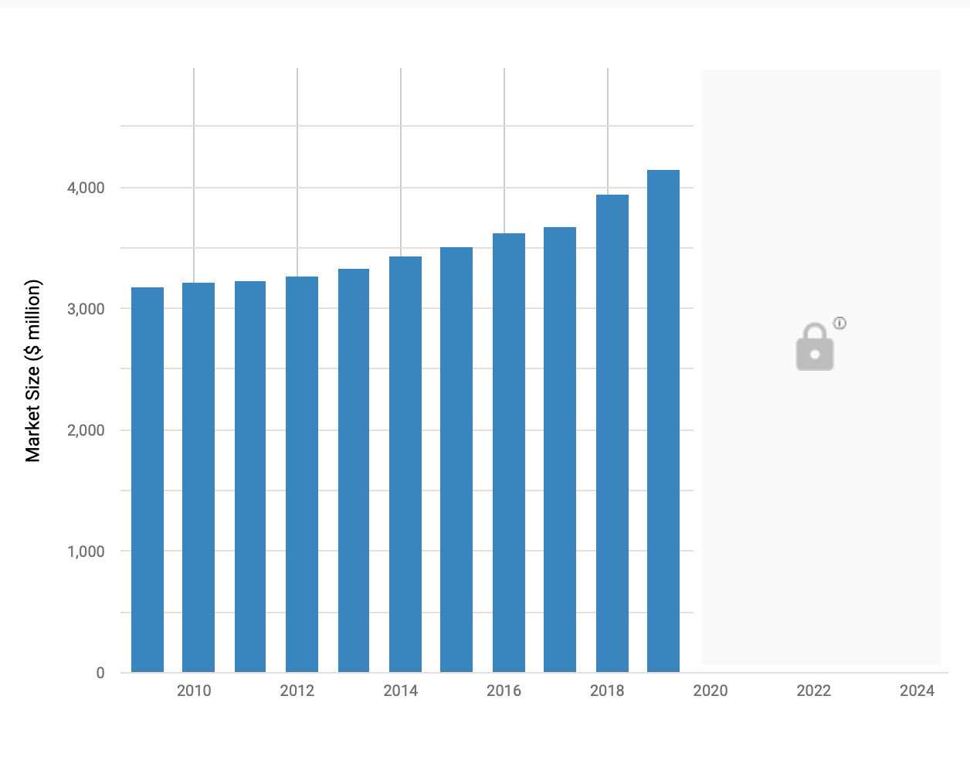
Software Testing Services in the US
(2003 - 2024)
The market size, measured by revenue, of the Software Testing Services industry is $4.1bn in 2019.
The market size of the Software Testing Services industry is expected to increase 4.9% in 2019.

Slide 4
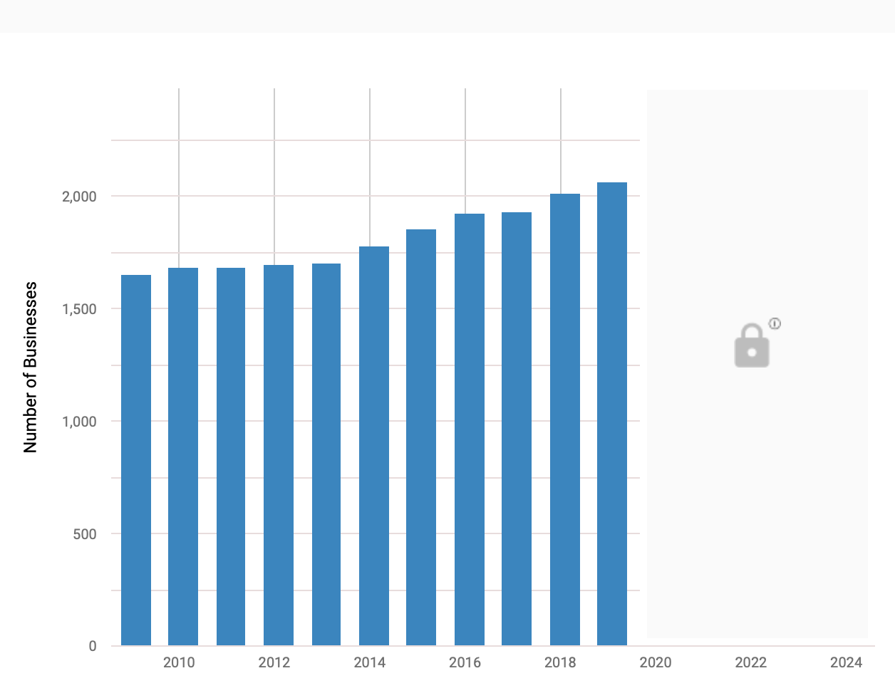
Software Testing Services in the US
Number of Businesses
There are 2,064 Software Testing Services businesses in the US as of 2019.
The number of businesses in the Software Testing Services industry is expected to grow 2.5% in 2019.

Slide 5
Software Testing Services in the US
Number of Businesses
The Software Testing Services industry has low market share concentration and there are no companies with more than 5% market share.

Slide 6
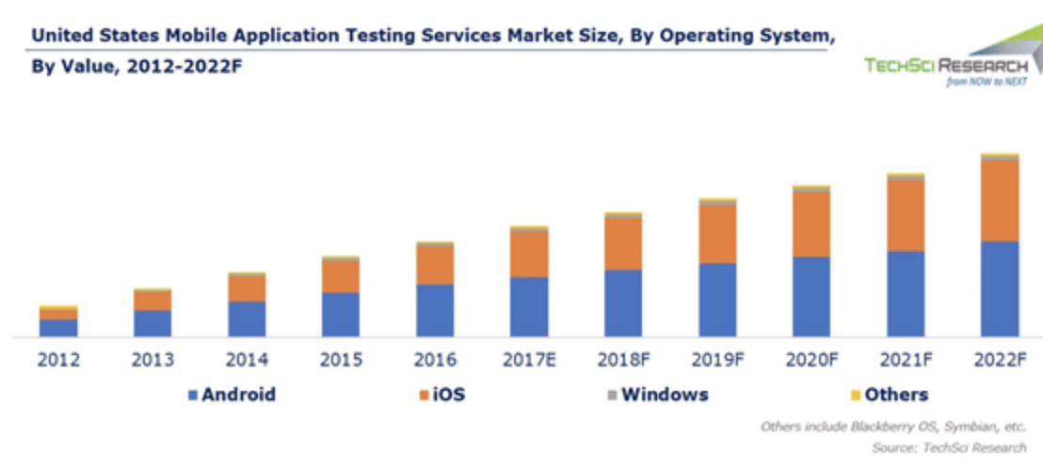
US Mobile Application Testing Services Market Size

Slide 7
Trends and Growth
https://www.qasymphony.com/blog/2019-software-testing-trends-top-predictions-year-ahead/
Software Quality Becomes a Cross-Functional Goal.
Quality Assurance Shifts to Quality Engineering
Organizations Democratize Load Testing
Levels of Test Automation Increase
Continuous Testing Goes Mainstream
Behavior-Driven Development Reaches a New Level of Maturity
AI and Machine Learning Continue to Come Into Focus
Adaptability Becomes Even More Important for Testers
Opportunities for Growth Abound

Slide 8
Software Quality Becomes a Cross-Functional Goal.
AI and Machine Learning Continue to Come Into Focus
Adaptability Becomes Even More Important for Testers
The level of private investment in computers and software is directly related to demand for software testing services. Private investment in computers and software is expected to increase in 2018, presenting a potential opportunity for the industry.

Slide 9
Top 50
https://www.guru99.com/testing-tools.html
High Competitive !

