Slide 1
Test Automation
With Model-based Testing
July 18, 2012
Yaxiong Lin
TestOptimal, LLC
© 2012 Testptimal LLC

Slide 2

Model-Based Testing (MBT) Introduction
Benefits of MBT
MBT Tool Demo

Slide 3
Model-Based Testing (MBT) Introduction
Benefits of MBT
MBT Tool Demo

Slide 4

Model-based testing is software testing in which test cases are derived in whole or in part from a model that describes some (usually functional) aspects of the system under test (SUT)
  http://en.wikipedia.org/wiki/Model-based_testing

Slide 5

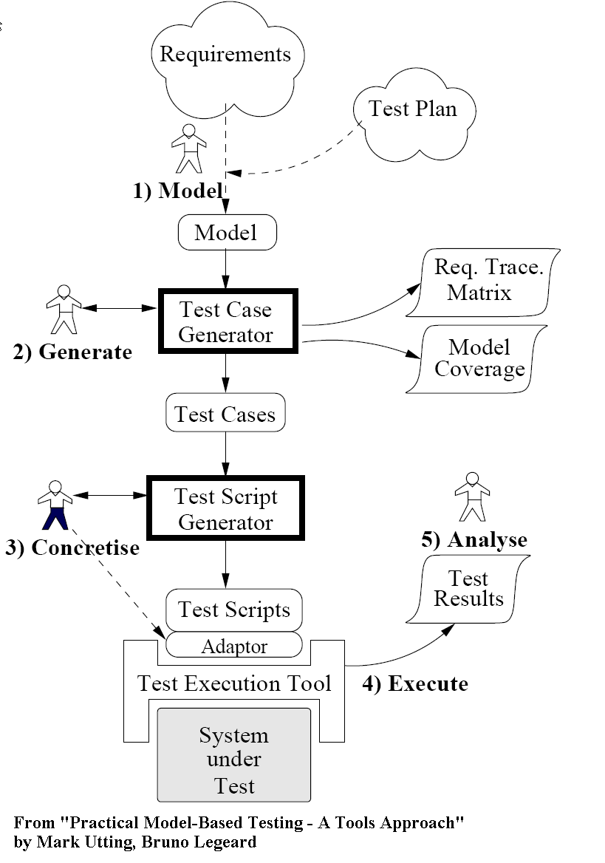

Slide 6

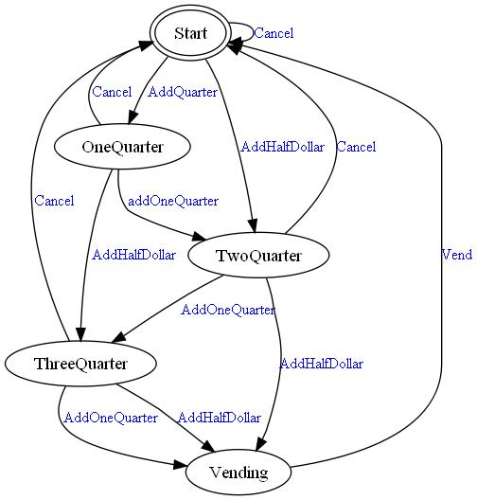

Slide 7

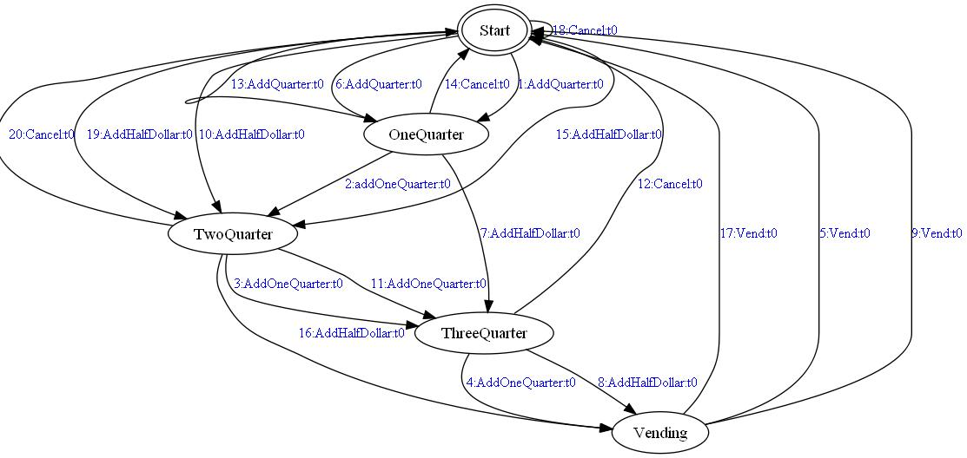

Slide 8

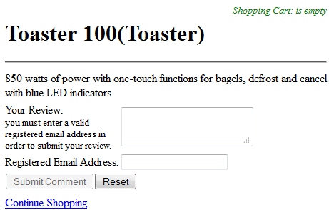
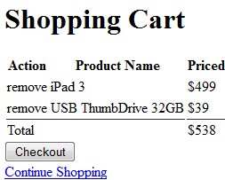
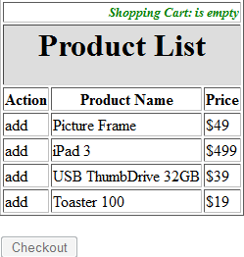
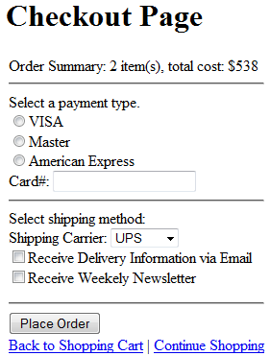


Slide 9

Demo_WebStore
  5 Web Pages
  Shopping cart
Test flow between pages
Verify content
Test different payment & shipping methods
Notes:
http://localhost:8888/DemoWebApp/ProductList.html

Slide 10

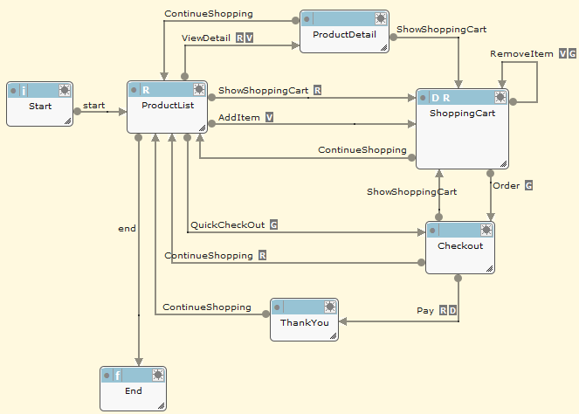

Slide 11

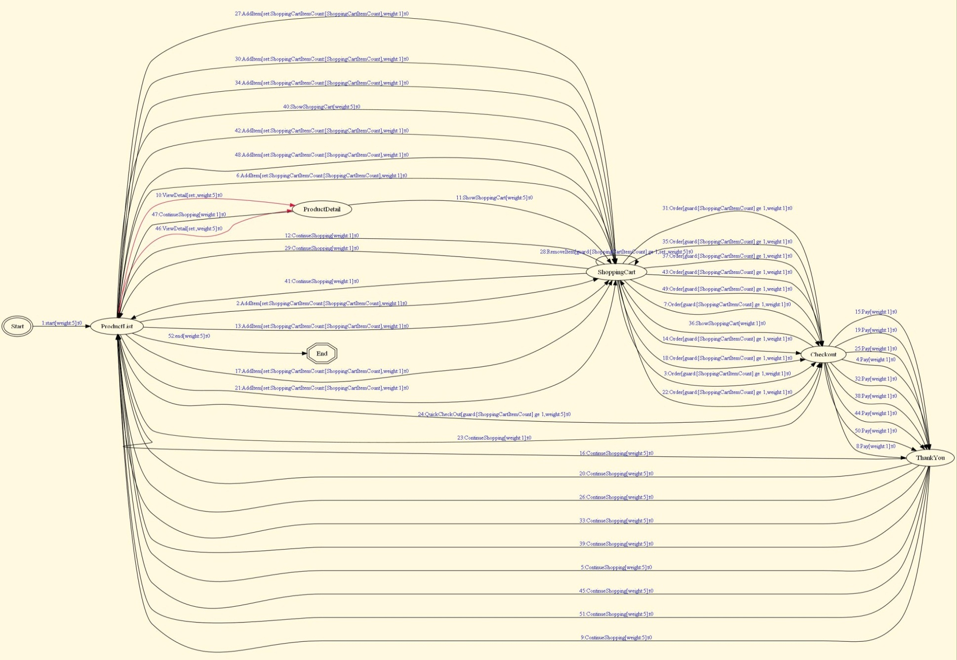

Slide 12

Conformance Testing
Functional Regression Testing
Functional Progression Testing
Performance / Load Testing
Exploratory Testing
Risk Based Testing
Security Vulnerability Testing
Notes:
Applications of MBT in various areas of software testing

Slide 13
Model-Based Testing (MBT) Introduction
Benefits of MBT
MBT Tool Demo

Slide 14

Improved fault detection
Reduction in cost and cycle time
Improved test quality and traceability
Requirements Defect Detection
Requirements evolution
Allows automation to be used for more than regression
From: Model Based Testing, Fabrizio Stortoni, Siemens Building Technologies
CQAA Lunch & Learn April 11, 2012
Notes:
Improved fault detection:
􀁺Studies compared Fault detection of manual vs. automatically generated tests (e.g. IBM, Microsoft, smart card industry)
􀁺Reported that the model based tests were equal or better at uncovering defects than the manual tests
􀁻Reduction in cost and cycle time:
􀁺Model Based Testing can lower the cost of creating manual tests and/or automated scripts.
􀁺Once the model and the execution framework are in place, the model can be used to generate unlimited test cases, freeing human testers for more challenging test tasks such as exploratory testing.
Improved test quality and traceability:
􀁺With model based testing the quality of the tests is uniform, the design process is systematic and repeatable, and linkage of tests and requirements is clear.
􀁺Testers can choose the desired level of coverage when starting the test generation, based on risk and other factors.
􀁺The level of coverage is clearly documented
Requirements Defect Detection:
􀁺Creation of the model requires a level of understanding of the requirements and specifications equal to or greater than is required for manual test design.
􀁺That can uncover inaccurate or incomplete requirements and foster cooperation between developers and testers. A Microsoft study showed that the modeling process uncovered twice as many design issues as implementation bugs
Requirements evolution:
􀁺Model Based Testing lowers the cost of updating test suites for changing requirements.
􀁺Since the test creation is automated, a requirements change can be accommodated by making the corresponding change to the model, and re-generating the tests.
Allows automation to be used for more than regression:
􀁺An MBT tool creates generic test cases that can be executed manually or tied to an automation framework for automated execution.
􀁺The need for manual test cases to precede automated test cases is removed or minimized

Slide 15

MBT reduced escaped bugs by 59%.
MBT reduced testing costs by 17%.
MBT reduced testing duration by 25%.
Notes:
Reduced escaped bugs – better coverage, better test case design
Reduced costs – efficient test case generation, ability to handle changes very efficiently, see demo
Reduced duration – no longer waiting for development to complete, modeling in tandem with the development, rapid response to changes

Slide 16

Over 90% requirements covered by model based/derived automated tests
Improving release turnaround times by over 60%
Load testing was achieved through repurposed models at minimal cost and minimal time
Innovate QA/Test Processes with Model-Based Testing, QUEST 2012, http://www.qaiquest.org/2012/publications/conference-papers/
Notes:
A team of 20 test engineers
90% req coverage – MBT can address majority of the testing needs, found requirement defects during modeling while development is occurring
60% reduction in release turnaround – TestOptmal enables them to build a lean development/testing process to handle changes very quickly and efficiently
Loading testing is a breeze – setting up on Friday to run over the weekend unattended simulating hundreds of concurrent users running AUT, found database deadlock issue and backend resource contention issue during testing

Slide 17
Model-Based Testing (MBT) Introduction
Benefits of MBT
MBT Tool Demo

Slide 18


Test Dev. Env’s
Runtime Servers
Win XP
ProMBT
IE
FireFox
Chrome
Opera
Safari
Win 7
ProMBT
SvrMgr
Vista
Safari
FireFox
Chrome
Opera
Enterprise
Mac
Model Repo
Enterprise
Cloud-based Testing Services
(e.g. SauseLabs.com)
VM

Slide 19

Modeling using Finite State Machine (FSM)
Test Case Generation
Test Automation – Automate Models
Data-Driven Testing
Combinatorial – Pairwise Testing
Test Execution Environment
Performance/Load
Notes:
FSM simple to create and easy to understand
Random/optimal to ad hoc test scenarios
Describe Online/offline testing, online is the most effective way to achieve benefits of MBT
Embedded DDT within model, supporting comb testing algorithms built-in
Believe it’s critical to ensure testing are executed on the controlled env., provide facilty to build a dedicated test execution QA environment as well as scalable for large scale load and stress testing

Slide 20

Interested to learn more or download 30-day trial: http://testoptimal.com/

Slide 21

Intelligent Test Automation http://www.harryrobinson.net/intelligent.pdf
A Quick Intro to Model-Based Testing http://testoptimal.com/ref/MBT%20A%20quick%20Intro.pdf
Model Based Testing of Web Applications http://testoptimal.com/ref/ModelBasedTestingOfWebApplications.pdf
TestOptimal LLC

Slide 22


Confidential, TestOptimal LLC

Slide 23

Single IDE support full MBT process
Full featured development platform
Browser based, accessed from anywhere
Flexibile & extensible architecture
  Custom plugins,
  Remote agent,
  Custom reports
Scaleable load/stress testing architecture
Power of visualization

Slide 24

Model-based Testing Process (online & offline testing)
FSM Modeling Notation with Graphical Model Editor
Model Animation & Test Case Visualization
Requirement Tagging
Web App Cross Browser Testing & Other App Types
Built-in Application Performance Stats
Extensive Test Result Statistics & Reports
Built-in Data-Driven Testing
Built-in Combinatorial / pairwise testing
Test Data Generation

Slide 25

Super States and Sub Models
Load / Stress Testing
Ad-hoc Test Case Generation
XML-based Scripting Language
Customer Extensible Architecture
Integration with Other Test Automation Tools (QTP, TestComplete, AutoIT, etc.)
Support Continuous Integration
Integration with Requirements Systems
© 2012 Testptimal LLC

Slide 26

BasicMBT*
ProMBT
Enterprise
Runtime
SvrMgr*
IE
Firefox
TestOptimal Server
Web Applications
Interfaces
Web Services
Windows Applications
Databases
Mobile devices*
internet
AUT
Chrome
Opera
Other Auto. Tools (QTP)
Safari
Agent

Slide 27


Runtime Servers
CI Server
(Jenkins, Hudson, etc.)
Win XP
IE
FireFox
Chrome
Opera
Safari
Win 7
Enterprise
MBT
SvrMgr
Vista
Safari
FireFox
Chrome
Opera
Mac
Model Repo
Cloud-based Testing Service
(e.g. SauseLabs.com)
VM

