Slide 1
Fuzz testing
Eerik Till

Slide 2
Agenda
Introduction
Methodology
Types
Techniques
Phases
Technologies
SQL fuzzing
Conclusions

Slide 3
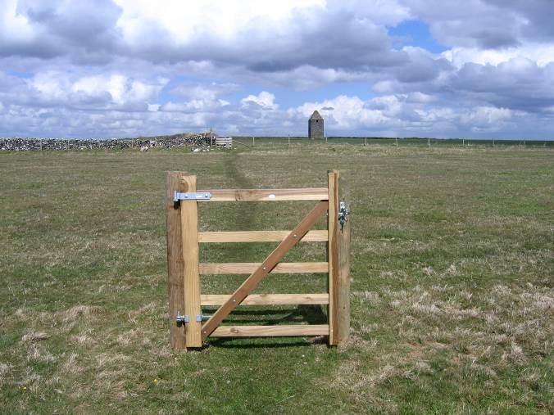
Intended use? Assumptions made?
Notes:
What is the intended use of this gate, defined by the designer? Are there any workarounds? Who does the designer expect to come through this gate? Has he built the construction based on the assumptions made at the beginning?
Lets consider an integer in a program, which stores the result of a user's choice between 3 questions. When the user picks one, the choice will be 0, 1 or 2. Which makes three practical cases. But what if we transmit 3, or 255 ? We can, because integers are stored in a static size variable. If the default switch case hasn't been implemented securely, the program may crash and lead to "classical" security issues: (un)exploitable buffer overflows, DoS, ...

Slide 4
Fuzz testing
Black box software testing technique.
Injects malformed or semi-malformed data in an automated way in order to find implementation bugs.
Purpose: send anomalous data to a system in order to crash it and reveal its reliability problems.
Developed at the University of Wisconsin Madison in 1989 by Professor Barton Miller and his students.
Notes:
The result of our testing is that we can crash (with core dump) or hang (infinite loop) over 40% (in the worst case) of the basic programs and over 25% of the X-Window applications. Errors in the use of pointers and array subscripts dominate the results of the tests. In all these cases, the programmer made implicit assumptions about the contents of the data being processed. These assumptions caused the programmer to use insufficient checks on their loop termination conditions.

Slide 5
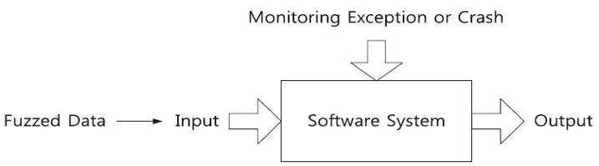
Fuzz testing methodology
Notes:
A fuzzer is a program that attempts to discover security vulnerabilities by sending random input to an application. If the program contains a vulnerability that can lead to an exception, crash or server error (in the case of web apps), it can be determined that a vulnerability has been discovered. Fuzzers are often called Fault Injectors for this reason, they generate faults and send them to an application. Generally fuzzers are good at finding buffer overflow, DoS, SQL Injection, XSS, and Format String bugs.

Slide 6
Fuzzer types
Static and random template-based:
  Test request-response protocols or file formats.
Block based:
  May contain some rudimentary dynamic functionality.
Dynamic generation or evolution based:
  Learn protocols based on feedback loop.
Model-based or simulation-based:
  Implement the tested interface either through a model or a simulation.
Notes:
Static and random template-based fuzzers: There is no dynamic functionality involved. Protocol awareness is close to zero.
Block-based fuzzers: implement basic structure for a simple request-response protocol and may contain some rudimentary dynamic functionality, such as calculation of checksums and length values.
Dynamic generation or evolution based fuzzers: do not necessarily understand the protocol or file format that is being fuzzed, but they will learn it based on a feedback loop from the target system. They may or may not break the message sequences.
Model-based or simulation-based fuzzers: implement the tested interface either through a model or a simulation, or they also can be full implementations of a protocol. Message structures are fuzzed and unexpected messages in sequences can be generated.

Slide 7
Types of fuzzing
Application fuzzing
  Attack vectors are within I/O.
Protocol fuzzing
  Sending forged packets to application.
File format fuzzing
  Generates multiple malformed samples, and opens them sequentially.
Notes:
Application fuzzing: For a desktop app: the UI, the command-line options, the import/export capabilities. For a web app: urls, forms, user-generated content, RPC requests
Protocol fuzzying: may eventually acts as a proxy, modifying requests on the fly and replaying them.
File format fuzzying: When the program crashes, debug information is kept for further investigation.

Slide 8
Fuzzing techniques
Session data fuzzing
  The simplest because it transforms legal data incrementally.
Specialised fuzzing
  Target specific protocols, such as SMTP, FTP, SSH and SIP.
Second generation fuzzing
  Allows the user to define the packet type, the protocol and the elements within it.
Notes:
Specialised fuzzers: They have now expanded to include file types such as documents, image files, video formats, and Flash animations.
The most flexible type is the second generation fuzzer: Its flexibility is balanced by the fact that users have to be aware of the vulnerabilities to be tested and may overlook some. It is crucial that every element in the protocol is tested, no matter how unimportant it may seem.

Slide 9
Session data fuzzing, SMTP
mail from: sender@testhost
This would then be sent in the following forms to see what effect they have:
mailmailmailmail from: sender@testhost
mail fromfromfromfrom: sender@testhost
mail from:::: sender@testhost
mail from: sendersendersendersender@testhost
mail from: sender@@@@testhost
mail from: sender@testhosttesthosttesthosttesthost
Notes:
It is crucial that every element in the protocol is tested, no matter how unimportant it may seem. In the above example, it may seem pointless to repeat the colon but this could be the flaw that the hacker is looking for. The lesson is that nothing should be taken for granted.

Slide 10
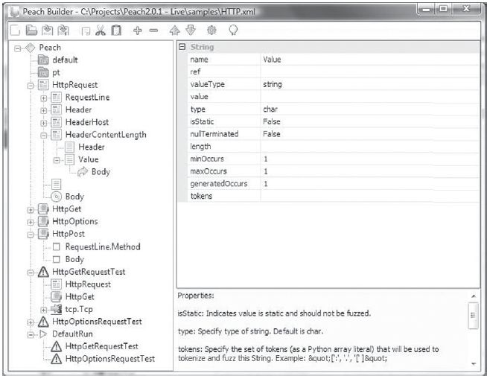
Peach is a Smart Fuzzer that is capable of generating a protocol from scratch or mutating
an existing protocol.
Notes:
Generational fuzzers are capable of building the data being sent based on a data model provided by the fuzzer creator (starts from a speciﬁcation or RFC, which describes the ﬁle format or network protocol and constructs test cases from these documents).
Mutation on the other hand starts out with a known good "template" which is then modified. However, nothing that is not present in the "template" or "seed" will be produced (known good data is collected (ﬁles, network trafﬁc, etc) and then modiﬁed; modiﬁcations may be random or heuristic, little or no knowledge of the protocol or application under study is required).

Slide 11
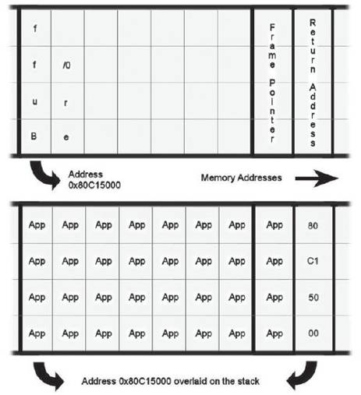
Buffer overflow
Notes:
A buffer overflow or memory corruption attack is a programming condition which allows overflowing of valid data beyond its prelocated storage limit in memory.
The buffer in the upper picture is filled with application code suffixed by a four byte address which overflows onto the stack to alter the return address.
The null marks the buffer’s edge, but would be overwritten by an apparently legal 32 character input. This means that the boundary between neighbouring buffers disappears and future accesses may treat the two strings as a larger single buffer and open up the possibility of a buffer overflow exploit where one may not have existed before.

Slide 12
General fuzzing phases
Identify target
  Relational database engine
Identify inputs
  SQL interface of the DBMS
Generate fuzzed data
Execute fuzzed data
  Send SQL statements to server
Monitor for exceptions
  Crashes, resource usage, etc.
Determine exploitability
Notes:
Microsoft adopted the Security Development Lifecycle (SDL) process, securing Microsoft's customers has been a top priority, and while there is no perfectly secure software application in the industry today, it is very important to significantly reduce and minimize the severity of any security vulnerability that may be found after a product ships.

Slide 13
Fuzzing tool for SQL
Automated test-case generators
  Simple tools that automatically generate tests.
SQL token fuzzer
  Used in the fuzzed data generation phase.
Fuzzer driver
  In charge of putting together the output of the other two modules and executing SQL statements.
Notes:
1.- Automated test-case generators. Simple tools that could automatically generate tests, either based on querying the database for information, parsing source code, etc.
2.- SQL token fuzzer. The "core" of our fuzzing infrastructure. This particular module was used in the fuzzed data generation phase.
3.- Fuzzer Driver. This is the module in charge of the execution phase. Typically this module will be in charge of putting together the output of the other two modules and then executing the SQL statements by connecting to the DBMS and executing the query.

Slide 14
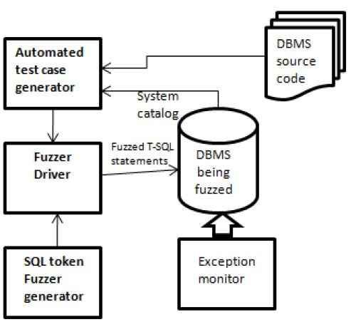
SQL fuzzing modules
Notes:
MODULAR DESIGN – easy to replace one module in the future!
1.- Automated test-case generators. Simple tools that could automatically generate tests, either based on querying the database for information, parsing source code, etc.
2.- SQL token fuzzer. The "core" of our fuzzing infrastructure. This particular module was used in the fuzzed data generation phase.
3.- Fuzzer Driver. This is the module in charge of the execution phase. Typically this module will be in charge of putting together the output of the other two modules and then executing the SQL statements by connecting to the DBMS and executing the query.

Slide 15
Resulting iterations
SELECT * FROM [C96t@s?Ir;}Cz}:bi}8J6d[pDm]
WHERE user_name = N'Bob'
EXEC sp_demo N'Bob', '06/29/2009 11:45AM'
SELECT * FROM [MyTable]
WHERE user_name = N'OSA‰§j'
EXEC sp_demo N'OSA‰§j',
'06/29/2009 11:45AM'
SELECT * FROM [w0ehI9B£n7TD‹6ED5b.I‚9IIEUf]
WHERE user_name = N'Alice'
EXEC sp_demo 'Alice', '7461-IV-15 8:49:3 '

Slide 16
Interesting technologies for fuzzers
Next Generation Networks (NGN), such as VoIP and IPTV
IPv6 and related protocols
Wireless protocols
Industrial SCADA networks
Vehicle Area Networks (VAN)
Notes:
The hottest trends in fuzzing seem to be related to communication interfaces that have just recently been developed. One reason for that could be that those technologies are mostly immature, and therefore security flaws are easy to find within them.
SCADA (supervisory control and data acquisition) generally refers to industrial control systems: computer systems that monitor and control industrial, infrastructure, or facility-based processes.
A vehicle bus is a specialized internal communications network that interconnects components inside a vehicle (e.g. automobile, bus, train, industrial or agricultural vehicle, ship, or aircraft). Special requirements for vehicle control such as assurance of message delivery, assured non-conflicting messages, assured time of delivery as well as low cost.

Slide 17
Conclusion
From the QA perspective it offers a very effective way to discover flaws early.
For attackers it presents a way to penetrate black box servers that would otherwise be difficult to penetrate.
Trade-off between increasing the security and financial considerations may start to affect the reliability of software.
Post-release bug fixes are 10-100x more expensive.
Notes:
The cost of fixing bugs increases drastically in each phase of the SDLC; there is a 10x-100x cost increase for fixing bugs post-release that were introduced in earlier phases.
Spending the proper amount of time on design for functionality and security will greatly reduce development, ongoing maintenance, and support costs.

Slide 18
More information
Something to begin with:
  https://www.owasp.org/index.php/Fuzzing
  http://www.infosecinstitute.com/blog/2005/12/fuzzers-ultimate-list.html
  http://pages.cs.wisc.edu/~bart/fuzz/

Slide 19
References
Chickowski, E. “Built-in security”. 2008.
Garcia, R. “Case Study: Experiences on SQL Language Fuzz Testing”. 2009.
Jenik, A. “Fuzzing tools: making sense out of nonsense”. 2009.
Kim, H. C. Choi, Y. H. Lee, D. H. “Efficient file fuzz testing using automated analysis of binary file format”. 2010.
Naraine, R. “Microsoft Office under siege”. 2006.
Takanen, A. “Fuzzing for the masses”. 2008.
https://www.owasp.org/index.php/Fuzzing

Slide 20
Thank you for your attention!
Questions?

