Slide 1
(semi)Automatic Methods for Security Bug
Detection
Tal Garfinkel
Stanford/VMware

Slide 2

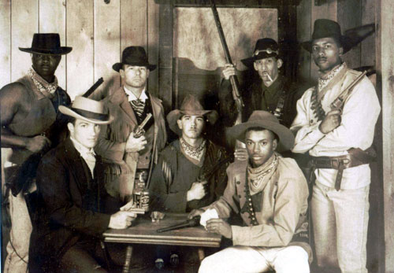
Vulnerability Finding Today
Security bugs can bring $500-$100,000 on the open market
Good bug finders make $180-$250/hr consulting
Few companies can find good people, many don’t even realize this is possible.
Still largely a black art

Slide 3
Security Vulnerabilities
What can Security bugs an attacker do?
  avoid authentication
  privilege escalation
  bypass security check
  deny service (crash/hose configuration)
  run code remotely

Slide 4
Why not eliminate bugs all together?
Impractical in general
  Formal verification is hard in general, impossible for big things.
Why don’t you just program in Java, Haskell, <your favorite safe language>
  Doesn’t eliminate all problems
  Performance, existing code base, flexibility, programmer competence, etc.
Not cost effective
  Only really need to catch same bugs as bad guys
Incremental solutions beget incremental solutions
  Better bug finding tools and mitigations make radical but complete solutions less economical

Slide 5
Bug Patterns
Most bugs fit into just a few classes
  See Mike Howards “19 Deadly Sins”
  Some lend themselves to automatic detection, others don’t
Which classes varies primarily by language and application domain.
  (C/C++) - Memory safety: Buffer overflows/integer overflow/double free()/format strings.
  Web Apps - Cross-Site Scripting

Slide 6
More Bug Patterns
Programmers repeat bugs
  Copy/paste
  Confusion over API
    e.g. linux kernel drivers, Vista exploit, unsafe string functions
  Individuals repeat bugs
Bugs come from broken assumptions
  Trusted inputs become untrusted
Others bugs are often yours
  Open source, third party code

Slide 7
Bug Finding Arsenal
Threat Modeling: Look at design, write out/diagram what could go wrong.
Manual code auditing
  Code reviews
Automated Tools
Techniques are complementary
  Few turn key solutions, no silver bullets

Slide 8
What this talk is about
Using tools to find bugs
  Major techniques
  Some tips on how to use them
Static Analysis
  Compile time/source code level
  Compare code with abstract model
Dynamic Analysis
  Run Program/Feed it inputs/See what happens

Slide 9
Static Analysis

Slide 10
Two Types of Static Analysis
The type you write in 100 lines of python.
  Look for known unsafe string functions strncpy(), sprintf(), gets()
  Look for unsafe functions in your source base
  Look for recurring problem code (problematic interfaces, copy/paste of bad code, etc.)
The type you get a PhD for
  Buy this from coverity, fortify, etc.
  Built into visual studio
  Roll your own on top of LLVM or Pheonix if your hardcore

Slide 12
Static Analysis Basics
Model program properties abstractly, look for problems
Tools come from program analysis
  Type inference, data flow analysis, theorem proving
Usually on source code, can be on byte code or disassembly
Strengths
  Complete code coverage (in theory)
  Potentially verify absence/report all instances of whole class of bugs
  Catches different bugs than dynamic analysis
Weaknesses
  High false positive rates
  Many properties cannot be easily modeled
  Difficult to build
  Almost never have all source code in real systems (operating system, shared libraries, dynamic loading, etc.)

Slide 13
Example: Where is the bug?
int read_packet(int fd)
{
char header[50];
char body[100];
size_t bound_a = 50;
size_t bound_b = 100;
read(fd, header, bound_b);
read(fd, body, bound_b);
return 0;
}

Slide 14
Example: Where is the bug?
int read_packet(int fd)
{
char header[50]; //model (header, 50)
char body[100]; //model (body, 100)
size_t bound_a = 50;
size_t bound_b = 100;
read(fd, header, 100);
read(fd, body, 100);
return 0;
}

Slide 15
Example: Where is the bug?
int read_packet(int fd)
{
char header[50]; //model (header, 50)
char body[100]; //model (body, 100)
size_t bound_a = 50;
size_t bound_b = 100;
read(fd, header, 100); //constant propagation
read(fd, body, 100); //constant propagation
return 0;
}

Slide 16
Example: Where is the bug?
int read_packet(int fd)
{
char header[50]; //model (header, 50)
char body[100]; //model (body, 100)
size_t bound_a = 50;
size_t bound_b = 100;
//check read(fd, dest.size >= len)
read(fd, header, 100); //constant propagation
read(fd, body, 100); //constant propagation
return 0;
}

Slide 17
Example: Where is the bug?
int read_packet(int fd)
{
char header[50]; //model (header, 50)
char body[100]; //model (body, 100)
size_t bound_a = 50;
size_t bound_b = 100;
//check read(fd, 50 >= 100) => SIZE MISMATCH!!
read(fd, header, 100); //constant propagation
read(fd, body, 100); //constant propagation
return 0;
}

Slide 18
Rarely are Things This Clean
Need information across functions
Ambiguity due to pointers
Lack of association between size and data type…
Lack of information about program inputs/runtime state…

Slide 19
Rarely are Things This Clean
Need information across functions
Ambiguity due to pointers
Lack of association between size and data type…
Lack of information about program inputs/runtime state…
Static Analysis is not a panacea, still its very helpful especially when used properly.

Slide 20
Care and Feeding of Static Analysis Tools
Run and Fix Errors Early and Often
  otherwise false positives can be overwhelming.
Use Annotations
  Will catch more bugs with few false positives e.g. SAL
Write custom rules!
  Static analysis tools provide institutional memory
Take advantage of what your compiler provides
  gcc -Wall, /analyze in visual studio
Bake it into your build or source control

Slide 21
Dynamic Analysis

Slide 22
Normal Dynamic Analysis
Run program in instrumented execution environment
  Binary translator, Static instrumentation, emulator
Look for bad stuff
  Use of invalid memory, race conditions, null pointer deref, etc.
Examples: Purify, Valgrind, Normal OS exception handlers (crashes)

Slide 23
Regression vs. Fuzzing
Regression: Run program on many normal inputs, look for badness.
  Goal: Prevent normal users from encountering errors (e.g. assertions bad).
Fuzzing: Run program on many abnormal inputs, look for badness.
  Goal: Prevent attackers from encountering exploitable errors (e.g. assertions often ok)

Slide 24

Fuzzing Basics
Automaticly generate test cases
Many slightly anomalous test cases are input into a target interface
Application is monitored for errors
Inputs are generally either file based (.pdf, .png, .wav, .mpg)
Or network based…
  http, SNMP, SOAP
Or other…
  e.g. crashme()

Slide 25
Trivial Example
Standard HTTP GET request
  GET /index.html HTTP/1.1
Anomalous requests
  AAAAAA...AAAA /index.html HTTP/1.1
  GET ///////index.html HTTP/1.1
  GET %n%n%n%n%n%n.html HTTP/1.1
  GET /AAAAAAAAAAAAA.html HTTP/1.1
  GET /index.html HTTTTTTTTTTTTTP/1.1
  GET /index.html HTTP/1.1.1.1.1.1.1.1

Slide 26
Different Ways To Generate Inputs
Mutation Based - “Dumb Fuzzing”
Generation Based - “Smart Fuzzing”

Slide 27

Mutation Based Fuzzing
Little or no knowledge of the structure of the inputs is assumed
Anomalies are added to existing valid inputs
Anomalies may be completely random or follow some heuristics (e.g. remove NUL, shift character forward)
Examples:
  Taof, GPF, ProxyFuzz, FileFuzz, Filep, etc.

Slide 28
Example: fuzzing a pdf viewer
Google for .pdf (about 1 billion results)
Crawl pages to build a corpus
Use fuzzing tool (or script to)
  Grab a file
  Mutate that file
  Feed it to the program
  Record if it crashed (and input that crashed it)

Slide 29
Dumb Fuzzing In Short
Strengths
  Super easy to setup and automate
  Little to no protocol knowledge required
Weaknesses
  Limited by initial corpus
  May fail for protocols with checksums, those which depend on challenge response, etc.

Slide 30

Generation Based Fuzzing
Test cases are generated from some description of the format: RFC, documentation, etc.
Anomalies are added to each possible spot in the inputs
Knowledge of protocol should give better results than random fuzzing

Slide 31
Example: Protocol Description
//png.spk
//author: Charlie Miller
// Header - fixed.
s_binary("89504E470D0A1A0A");
// IHDRChunk
s_binary_block_size_word_bigendian("IHDR"); //size of data field
s_block_start("IHDRcrc");
s_string("IHDR"); // type
s_block_start("IHDR");
// The following becomes s_int_variable for variable stuff
// 1=BINARYBIGENDIAN, 3=ONEBYE
s_push_int(0x1a, 1); // Width
s_push_int(0x14, 1); // Height
s_push_int(0x8, 3); // Bit Depth - should be 1,2,4,8,16, based on colortype
s_push_int(0x3, 3); // ColorType - should be 0,2,3,4,6
s_binary("00 00"); // Compression || Filter - shall be 00 00
s_push_int(0x0, 3); // Interlace - should be 0,1
s_block_end("IHDR");
s_binary_block_crc_word_littleendian("IHDRcrc"); // crc of type and data
s_block_end("IHDRcrc");
...

Slide 32
Generation Based Fuzzing In Short
Strengths
  completeness
  Can deal with complex dependencies e.g. checksums
Weaknesses
  Have to have spec of protocol
    Often can find good tools for existing protocols e.g. http, SNMP
  Writing generator can be labor intensive for complex protocols
  The spec is not the code

Slide 33

Fuzzing Tools

Slide 34
Input Generation
Existing generational fuzzers for common protocols (ftp, http, SNMP, etc.)
  Mu-4000, Codenomicon, PROTOS, FTPFuzz
Fuzzing Frameworks: You provide a spec, they provide a fuzz set
  SPIKE, Peach, Sulley
Dumb Fuzzing automated: you provide the files or packet traces, they provide the fuzz sets
  Filep, Taof, GPF, ProxyFuzz, PeachShark
Many special purpose fuzzers already exist as well
  ActiveX (AxMan), regular expressions, etc.

Slide 35
Input Inject
Simplest
  Run program on fuzzed file
  Replay fuzzed packet trace
Modify existing program/client
  Invoke fuzzer at appropriate point
Use fuzzing framework
  e.g. Peach automates generating COM interface fuzzers

Slide 36
Problem Detection
See if program crashed
  Type of crash can tell a lot (SEGV vs. assert fail)
Run program under dynamic memory error detector (valgrind/purify)
  Catch more bugs, but more expensive per run.
See if program locks up
Roll your own checker e.g. valgrind skins

Slide 37
Workflow Automation
Sulley, Peach, Mu-4000 all provide tools to aid setup, running, recording, etc.
Virtual machines can help create reproducable workload
Some assembly still required

Slide 38
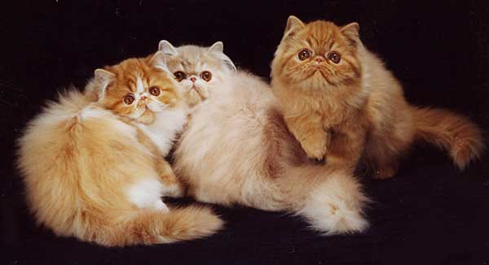
How Much Fuzz Is Enough?
Mutation based fuzzers can generate an infinite number of test cases... When has the fuzzer run long enough?
Generation based fuzzers generate a finite number of test cases. What happens when they’re all run and no bugs are found?

Slide 39
Example: PDF
I have a PDF file with 248,000 bytes
There is one byte that, if changed to particular values, causes a crash
  This byte is 94% of the way through the file
Any single random mutation to the file has a probability of .00000392 of finding the crash
On average, need 127,512 test cases to find it
At 2 seconds a test case, thats just under 3 days...
It could take a week or more...

Slide 40
Code Coverage
Some of the answers to these questions lie in code coverage
Code coverage is a metric which can be used to determine how much code has been executed.
Data can be obtained using a variety of profiling tools. e.g. gcov

Slide 41
Types of Code Coverage
Line coverage
  Measures how many lines of source code have been executed.
Branch coverage
  Measures how many branches in code have been taken (conditional jmps)
Path coverage
  Measures how many paths have been taken

Slide 42
Example
Requires
  1 test case for line coverage
  2 test cases for branch coverage
  4 test cases for path coverage
    i.e. (a,b) = {(0,0), (3,0), (0,3), (3,3)}
if( a > 2 )
a = 2;
if( b > 2 )
b = 2;

Slide 43
Problems with Code Coverage
Code can be covered without revealing bugs
Error checking code mostly missed (and we don’t particularly care about it)
Only “attack surface” reachable
  i.e. the code processing user controlled data
  No easy way to measure the attack surface
    Interesting use of static analysis?
mySafeCpy(char *dst, char* src){
if(dst && src)
strcpy(dst, src);
}
ptr = malloc(sizeof(blah));
if(!ptr)
ran_out_of_memory();

Slide 44
Code Coverage Good For Lots of Things
How good is this initial file?
Am I getting stuck somewhere?
if(packet[0x10] < 7) { //hot path
} else { //cold path
}
How good is fuzzer X vs. fuzzer Y
Am I getting benefits from running a different fuzzer?
See Charlie Miller’s work for more!

Slide 45
Fuzzing Rules of Thumb
Protocol specific knowledge very helpful
  Generational tends to beat random, better spec’s make better fuzzers
More fuzzers is better
  Each implementation will vary, different fuzzers find different bugs
The longer you run, the more bugs you find
Best results come from guiding the process
  Notice where your getting stuck, use profiling!
Code coverage can be very useful for guiding the process

Slide 46

The Future of Fuzz

Slide 47
Outstanding Problems
What if we don’t have a spec for our protocol/How can we avoid writing a spec.
How do we select which possible test cases to generate

Slide 48

Whitebox Fuzzing
Infer protocol spec from observing program execution,then do generational fuzzing
Potentially best of both worlds
Bleeding edge

Slide 49
How do we generate constraints?
Observe running program
  Instrument source code (EXE)
  Binary Translation (SAGE, Catchconv)
Treat inputs as symbolic
Infer contraints

Slide 50
Example:
int test(x)
{
if (x < 10) {
//X < 10 and X <= 0 gets us this path
if (x > 0) {
//0 < X < 10 gets us this path
return 1;
}
}
//X >= 10 gets us this path
return 0;
}
Constraints:
X >= 10
0 < X < 10
X <= 0
Solve Constraints -- we get test cases: {12,0,4}
Provides maximal code coverage

Slide 51
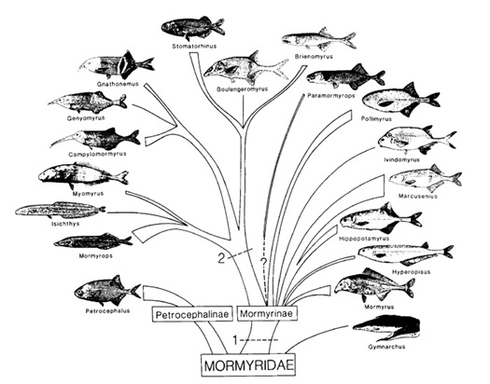
Greybox Techniques
Evolutionary Fuzzing
Guided mutations based on fitness metrics
Prefer mutations that give
  Better code coverage
  Modify inputs to potentially dangerous
  functions (e.g. memcpy)
EFS, autodafe

Slide 52
Summary
To find bugs, use the tools and tactics of an attacker
Fuzzing and static analysis belong in every developers toolbox
Field is rapidly evolving
If you don’t apply these tools to your code, someone else will

