Slide 1

A Quick Intro to
Model-Based Testing
45,000 tests in 45 minutes or less!
Harry Robinson, harryr@microsoft.com
Test Architect
Microsoft Engineering Excellence Group

Slide 2
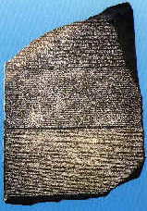
The Villain of this Piece
CurrentWindow = WFndWndC("Calculator", "SciCalc")
WSetWndPosSiz(CurrentWindow, 88, 116, 260, 260)
WMenuSelect("@2\@2")
CurrentWindow = WFndWndC("Calculator", "SciCalc")
WSetWndPosSiz(CurrentWindow, 88, 116, 480, 317)
WButtonClick("@32")
WButtonClick("@27")
WButtonClick("@38")
WButtonClick("@58")
WMenuSelect("@2\@1")
CurrentWindow = WFndWndC("Calculator", "SciCalc")
WSetWndPosSiz(CurrentWindow, 88, 116, 260, 260)
WMenuSelect("@2\@1")
Play "{Click 330, 131, Left}"
WToolbarButtonClk("@2", "@6")
WToolbarButtonClk("@2", "@7")
WToolbarButtonClk("@1", "@1")
Awe-inspiring
Unchanging
Indecipherable

Slide 3
Traditional Automated Testing
Imagine that this projector is the software you are testing.

Slide 4
Traditional Automated Testing
Typically, testers automate by creating static scripts.

Slide 5
Traditional Automated Testing
Given enough time, these scripts will cover the behavior.

Slide 6
Traditional Automated Testing
But what happens when the software’s behavior changes?

Slide 7
So What’s a Model?
A model is a description of a system’s behavior.
Models are simpler than the systems they describe.
Models help us understand and predict the system’s behavior.

Slide 8
Model-Based Testing
Now, imagine that the top projector is your model.

Slide 9
Model-Based Testing
The model generates tests to cover the behavior.

Slide 10
Model-Based Testing
… and when the behavior changes…

Slide 11
Model-Based Testing
… so do the tests.

Slide 12
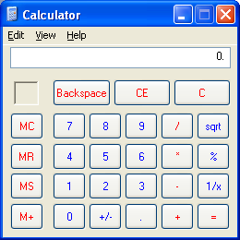
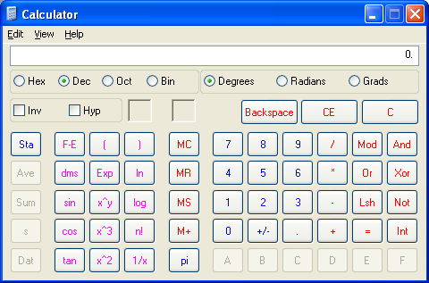
Calculator
Familiar enough
Simple enough
Complex enough
Hard to test well

Slide 13
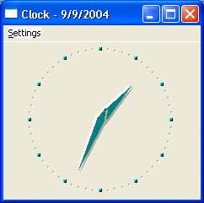
Exploratory Testing the Calculator
Start
Scientific
Enter a Number
Standard
…
hmm … let’s see …
I Start the calculator, and the calculator starts running
- OK.
I select Scientific, and the calculator goes to Scientific mode.
- Good.
I Enter a Number, and the number appears in the display
– Yup.
I select Standard, and the calculator goes back to Standard mode
- OK.
…

Slide 14
Scripting the Calculator Testing
Step Action Result
1 Start Calculator should be Running
2 Scientific Calculator in Scientific mode
3 Enter Number Number in the display
4 Standard Calculator in Standard mode
…
How did you think
to try these actions
in this order?
And how did you know
you’d end up with
these results?

Slide 15
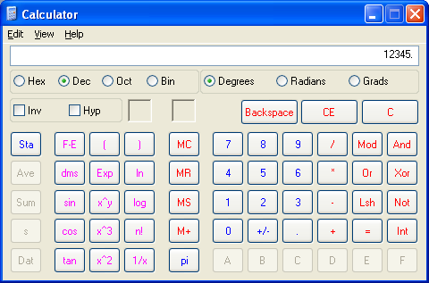
You Have a Model in your Head
NotRunning
Start
?
Scientific
Standard
Enter Number

Slide 16
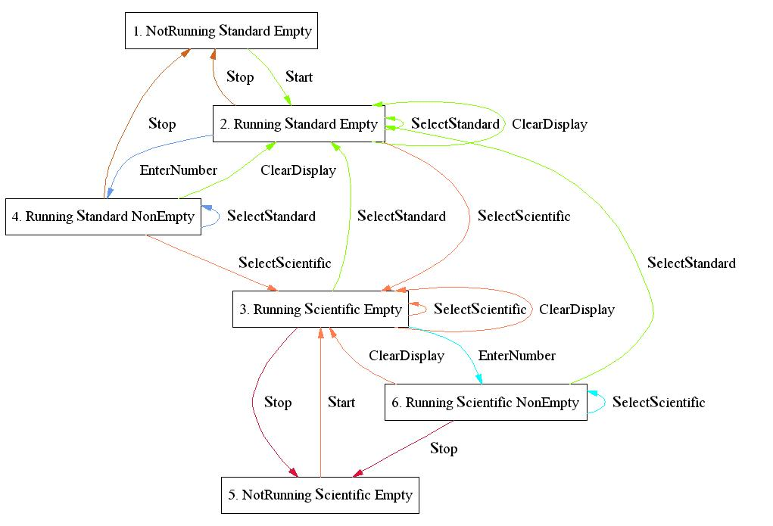
You Could Hand-Draw Your Model
But you wouldn’t want to do that.

Slide 17
You Could Hand-Trace Test Sequences
1 Start
Scientific
Enter Number
Standard
…
But you wouldn’t want to do that either.

Slide 18
Let the Machine Do It for You
!

Slide 19


But first …
… let’s talk about calculator’s behavior.

Slide 20
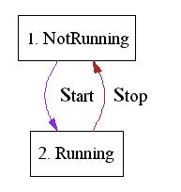
Let’s Start Simply

Slide 21
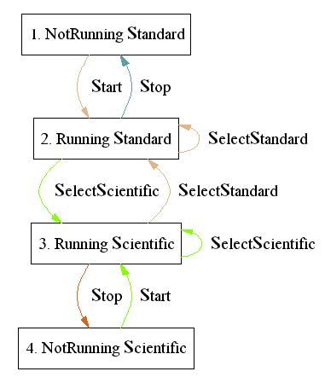
And Get a Bit More Complex

Slide 22
And Even More Complex

Slide 23
What Does This Model Care About?
Application status:
  Running
  Not Running
Mode status:
  Standard
  Scientific?
Display status:
  Empty
  Not Empty

Slide 24
Find the Rules of your Model
(Start)
Natural Language
If the Calculator is Not Running
then the user can execute ‘Start’.
When the user executes ‘Start’,
the Calculator goes to
‘Running’ mode
C#
if (AppStatus == AppStatusValues.NotRunning)
a.Add("start")
AppStatus = AppStatusValues.Running;

Slide 25
Find the Rules of your Model
(Standard)
interesting
Natural Language
If the Calculator is Running
then the user can execute ‘Standard’.
When the user executes ‘Standard’, the Calculator goes to ‘Standard’ mode and the display is cleared.
C#
if (AppStatus == AppStatusValues.Running)
a.Add("standard");
if (ModeStatus == ModeStatusValues.Scientific)
DisplayStatus = DisplayStatusValues.Empty;
ModeStatus = ModeStatusValues.Standard;

Slide 26
Let the Machine Do It for You
1 Start
Scientific
Stop
Start
Standard
Stop
Clear
Stop
Start
Scientific
Clear
Enter Number
Standard
Clear
…
!

Slide 27
So let’s generate a few thousand tests …
demo

Slide 28
Executing the Test Actions, pt 1
while ( (strRecord = StreamToRead.ReadLine()) != null)
{
string[] individualWords = strRecord.Trim().Split(whitespace.ToCharArray(),strRecord.Length);
switch( individualWords[1])
{
<perform the actions>
}
}

Slide 29
Executing the Test Actions, pt 2
switch( individualWords[1])
{
case "start":
Process.Start("calc");
break;
case "stop":
SendKeys.SendWait("%{f4}");
break;
case "standard":
SendKeys.SendWait("%vt");
SetForegroundWindow(FindWindow(null, "Calculator"));
break;
…
<process the actions>

Slide 30
A Brief Filk on Test Oracling
If you wish to succeed
As a tester you need
To consider all matters oracular.
Verifying is tough;
Monkey tests aren’t enough;
(Though the crashes are often spectacular!)

Slide 31
Executing the Test Actions, pt 3
// copy display contents to the clipboard
SendKeys.SendWait("^c");
if ((individualWords[4] == "Empty")
&& (GetClipboardContent() != "0"))
{
Console.WriteLine(" mismatch");
}
if ((individualWords[4] == "NotEmpty")
&& (GetClipboardContent() == "0"))
{
Console.WriteLine(" mismatch");
}
<oracle the result>

Slide 32
So let’s run a few dozen tests …
demo

Slide 33
Doing Cool Stuff with Models

Slide 34
Beeline
Choose any 2 nodes in the path
Find the shortest path between them
Execute the spliced ‘shortcut’ path
Evaluate the results and repeat

Slide 35
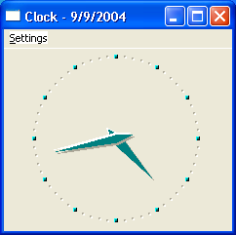
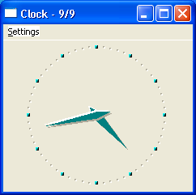
That Was The Year That Wasn’t
bug
Start, Minimize, Stop, Start, Restore, Date

Slide 36

An 84-step bug repro sequence
start about ok_about no_title doubleclick seconds restore seconds doubleclick doubleclick date about ok_about restore gmt maximize doubleclick doubleclick date seconds date stop start stop start stop start seconds date restore about ok_about no_title doubleclick digital doubleclick doubleclick no_title doubleclick no_title doubleclick seconds restore restore doubleclick doubleclick gmt analog maximize date digital minimize restore minimize stop start restore digital date minimize stop start maximize gmt digital restore doubleclick doubleclick about ok_about maximize digital digital digital seconds analog about ok_about about ok_about minimize stop start restore date

Slide 37
Reducing the Sequence:
Initial path length: 84 steps
Shortcut attempt 2 : repro sequence: 83 steps
Shortcut attempt 3 : repro sequence: 64 steps
Shortcut attempt 4 : repro sequence: 37 steps
Shortcut attempt 5 : repro sequence: 11 steps
Shortcut attempt 7 : repro sequence: 9 steps
Shortcut attempt 20 : repro sequence: 8 steps
Shortcut attempt 29 : repro sequence: 6 steps

Slide 38
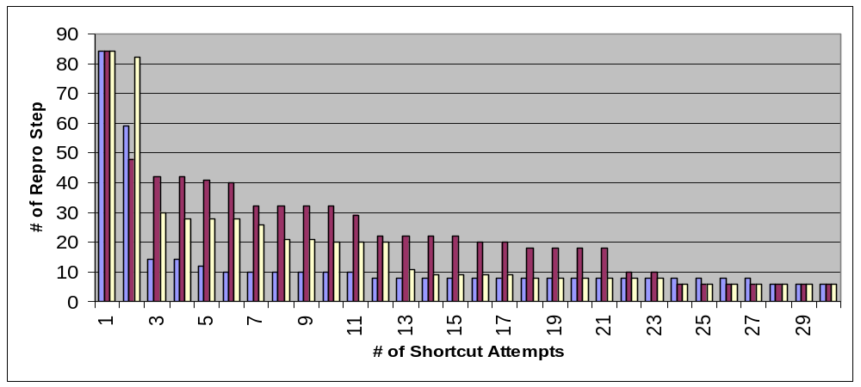
# Repro Steps Over Time

Slide 39
Why Does Model-Based Testing Work?
system under test
complexity
model
speed
“… I think that less than 10 percent of most programs’ code is specific
to the application. Furthermore, that 10 percent is often the easiest 10 percent.
Therefore, it is not unreasonable to build a model program to use as an oracle.”
–Boris Beizer, Black Box Testing, p.63

Slide 40
Benefits of Model-Based Testing
Easy test case maintenance
Reduced costs/more tests
Can run different tests on 1000s of machines
Early bug detection
Increased bug count
Time savings
Time to address bigger test issues
Improved tester job satisfaction
Start automated testing from Version 0.1

Slide 41
Obstacles to Model-Based Testing
Comfort factor
  This is not your parents’ test automation
Skill sets
  Need testers who can design
Expectations
  Models can be a significant upfront investment
  Will never catch all the bugs
Metrics
  Bad metrics: bug counts, number of test cases
  Better metrics: spec coverage, code coverage

Slide 42
Tools
Used in this talk:
  C# (is free)
  Notepad (is just about free)
  WinSTDtoDOT (was written by a friend)

Slide 43
Acknowledgments
Michael Corning
Rory Clark
Wolfram Schulte
Mike Barnett
Margus Veanes
Wolfgang Grieskamp

Slide 44
To Learn More
Model-based testing website:
www.model-based-testing.org
Books:
  “Black-Box Testing : Techniques for Functional Testing of Software and Systems” by Boris Beizer
  “Testing Object-Oriented Systems: Models, Patterns, and Tools” by Robert Binder
A real model-based testing tool:
  Spec#

Slide 45
thanks!

