Slide 1

A GUI Testing Framework
22 Aug 2008
The University of Queensland

Slide 2
PhD Research:
  Duc Hoai Nguyen (PhD Candidate)
  Paul Strooper (advisor)
  Jorn Guy Suess (associate advisor)

Slide 3
Content
Problems in GUI Testing
Current approaches in GUI Testing
Proposed framework
Mapping language
Coverage criteria

Slide 4
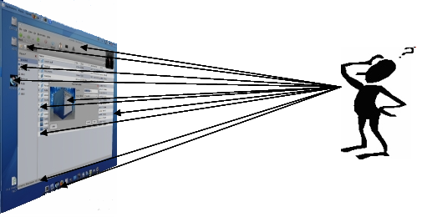
Problems in GUI Testing
So many permutations of events to test !

Slide 5
Problems in GUI Testing
  Generation 1: Manual Testing
  Generation 2: Capture/Playback
    Generation 3: Model-based Testing

Slide 6
Current approaches in
Model-based GUI Testing
Generate test cases from a model of GUI events:
  Event Flow Graph (Atif Memon)
  UML state diagram (Ana C.R. Paiva)

Slide 7
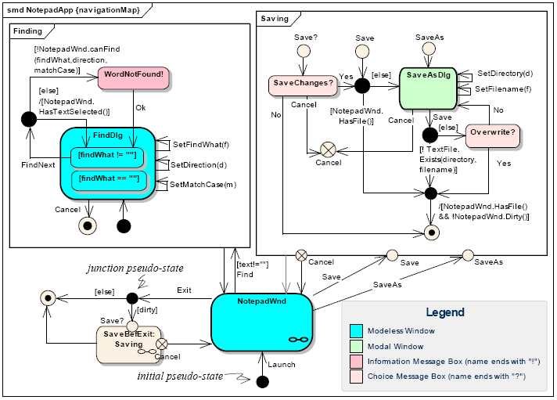
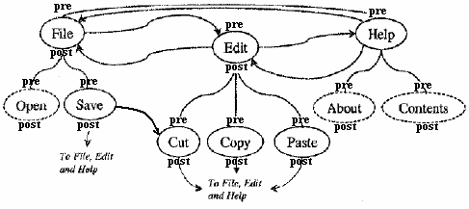
Current approaches in
Model-based GUI Testing
Modeling GUI events by
an Event-Flow Graph
Modeling GUI events by
an UML state diagram

Slide 8
Current approaches in
Model-based GUI Testing
Drawbacks:
Lack of abstraction
Dependencies on the GUI implementation
High effort for defining test oracles (expected outputs and the methods to check)

Slide 9
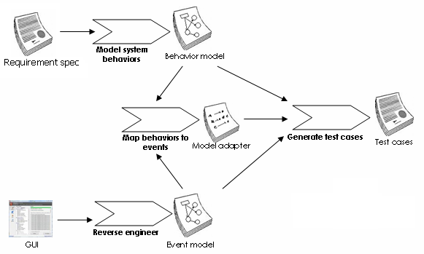
The proposed framework

Slide 10
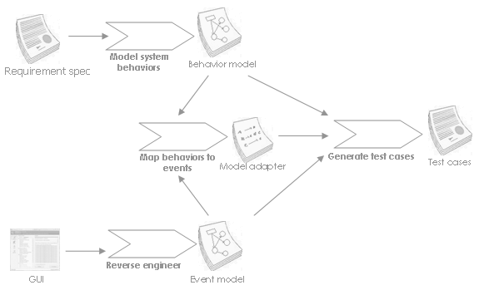
The proposed framework
Spec# notation
Behaviour-Event
mapping language
Event-Flow-Graph

Slide 11
The proposed framework
[Action]Task edittask(string name, Priority priority, Progress progress)
requires currenttask!=null;
{
currenttask.name=name;
currenttask.priority=priority;
currenttask.progress=progress;
return new Task(name, priority,progress);
}
int openlist(string filename) {
Serialize {
Execute(GUI.MainWindow.menuFILEOPEN_click);
Execute(GUI.FileWindow.textboxName_type, filename);
Execute(GUI.FileWindow.bottonOK_click);
}
return GUI.MainWindow.tree.Nodes.Count;
}
E2
E1
E5
E4
E3

Slide 12
The mapping language
Single-event execution:
  Execute/ExecuteOp
Event-Sequence execution:
  Serialize: requires events or groups of events to be executed serially
  Permute: requires events or groups of events to be executed in all possible orders
  Select: requires one of the events or groups of events to be executed

Slide 13
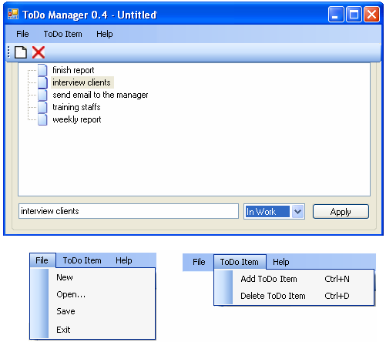
The mapping language

Slide 14
The mapping language
string deletetask() {
Select{
Execute(GUI.MainWindow.menuTODODELETE_click);
Execute(GUI.MainWindow.toolbarDELETE_click);
}
return GUI.MainWindow.tree.SelectedNode.Text;
}
menuTODODELETE_click
Deletetask
toolbarDELETE_click

Slide 15
  Task edittask(string name,Priority priority,Progress progress){
  Serialize{
  Permute{
  ExecuteOp(GUI.MainWindow.textboxNAME_type);
  ExecuteOp(GUI.MainWindow.comboboxSTATUS_select,status);
  }
  Execute(GUI.MainWindow.buttonALLOW_click);
  }
  return new Task(GUI.MainWindow.tree.SelectedNode.Text,
  GUI.MainWindow.comboboxSTATUS.SelectedIndex,
  GUI.MainWindow.comboboxPRIORITY.SelectedIndex);
  }

Slide 16
  Task edittask(string name,Priority priority,Progress progress){
  Serialize{
  Permute{
  ExecuteOp(GUI.MainWindow.textboxNAME_type);
  ExecuteOp(GUI.MainWindow.comboboxSTATUS_select,status);
  }
  Execute(GUI.MainWindow.buttonALLOW_click);
  }
  return new Task(GUI.MainWindow.tree.SelectedNode.Text,
  GUI.MainWindow.comboboxSTATUS.SelectedIndex,
  GUI.MainWindow.comboboxPRIORITY.SelectedIndex);
  }
Behaviour → GUI events mapping
Test oracles → GUI attributes mapping

Slide 17
  Task edittask(string name,Priority priority,Progress progress){
  Serialize{
  Permute{
  ExecuteOp(GUI.MainWindow.textboxNAME_type);
  ExecuteOp(GUI.MainWindow.comboboxSTATUS_select,status);
  }
  Execute(GUI.MainWindow.buttonALLOW_click);
  }
  return new Task(GUI.MainWindow.tree.SelectedNode.Text,
  GUI.MainWindow.comboboxSTATUS.SelectedIndex,
  GUI.MainWindow.comboboxPRIORITY.SelectedIndex);
  }
textboxNAME_type → comboboxSTATUS_select → buttonALLOW_click
comboboxSTATUS_select → textboxNAME_type → buttonALLOW_click
Edittask
comboboxSTATUS_select → buttonALLOW_click
textboxNAME_type → buttonALLOW_click
buttonALLOW_click

Slide 18
Coverage Criteria
Behaviour-based criteria
Link-based criteria
Event-based criteria

Slide 19
Coverage Criteria
Behaviour-based criteria
  State coverage
  Transition coverage
Event-based criteria
  Event coverage
  Event-transition coverage
Link-based criteria
  One-link coverage
  All-link coverage
  All-combination coverage

Slide 20
Conclusion
Finished: introduce a framework for model-based GUI testing
In progress: evaluate the proposed approach.
Industrial case studies are welcomed !

Slide 21
Thank you !!!

